Slide 1
High-Q and high-gradient research updates from Cornell University
Dr. Mingqi Ge
On behalf of the SRF group of Cornell University
ALCW2018
May 31, 2018

Slide 2
Outline
Vertical electropolishing (VEP) updates
Bipolar electropolishing (BEP) updates
Low-temperature doping updates

Slide 3
Outline
Vertical electropolishing (VEP) updates
Bipolar electropolishing (BEP) updates
Low-temperature doping updates

Slide 4
Motivation of Vertical Electropolishing
VEP has lower cost compared to horizontal EP;
VEP requires smaller space for the system set-up;
VEP’d SRF cavities have similar performance compared with HEP’d cavities.

Slide 5
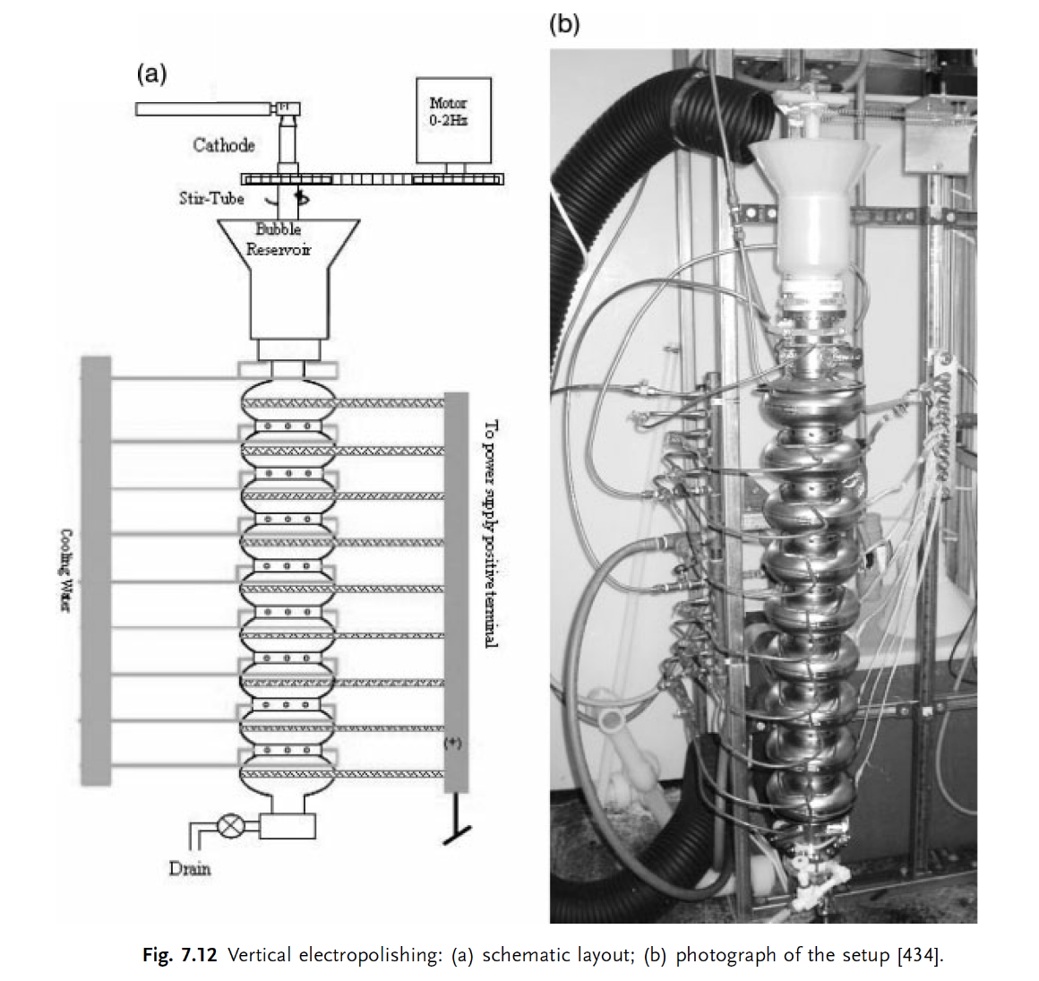
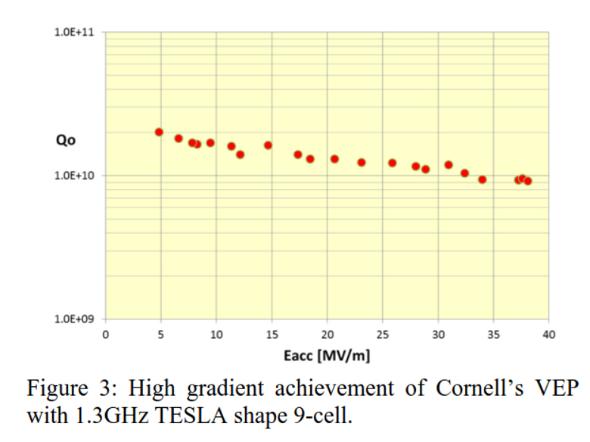
Cornell VEP system for the ILC R&D project
(high-gradient research)
ILC spec. @ 2K
@ 2K
Cornell VEP for 9-cell set-up
Cornell Vertical electropolished 9-cell and single-cell SRF cavities achieved the ILC specification at 2K (Eacc >35MV/m with Q0>0.8e10)

Slide 6
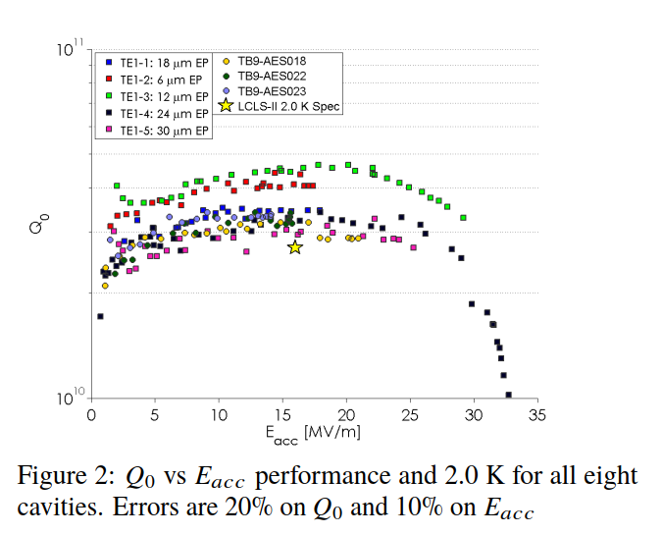
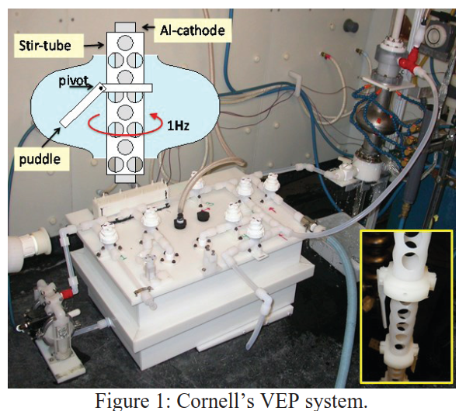
Cornell VEP system for the LCLS-II R&D project
(high-Q0 research)
LCLS-II spec. @ 2K
The nitrogen-doped 9-cell and single-cell SRF cavities after VEP all achieved the LCLS-II specification (Eacc>16MV/m , Q0>2.7e10 at 2K)

Slide 7
Motivation of Ninja cathode development
(collaborated with KEK and Marui)
Iris ave.;
Gravity effect causes VEP removal un-uniform;
Cavity has to be flipped in a VEP;
Ninja Cathode has been designed to compensate the removal un-uniform;
Eq. ave.;
Upper half cell
Eq. ave.;
lower half cell
Iris ave.;
Removal (um)
Upper
Removal (um)
Lower
top
Equator : 104±14um
Cell number
Cell number

Slide 8
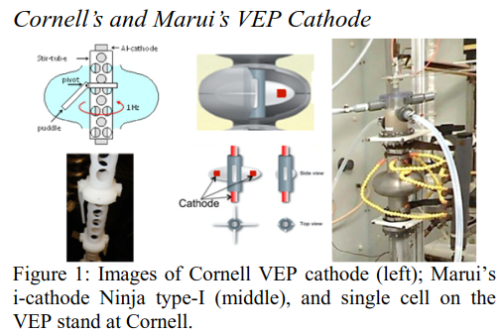
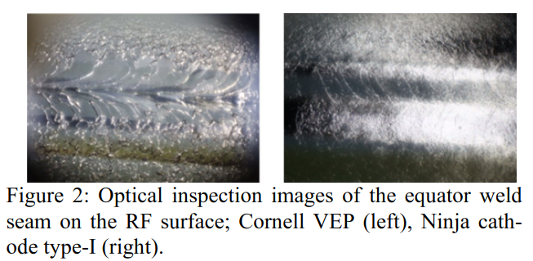
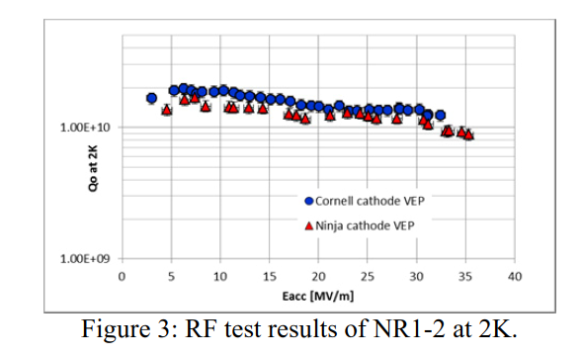
Ninja cathode development in collaboration with KEK and Marui
ILC spec. @ 2K
Surface preparation of NR1-2:
NR1-2: CBP (30μm)+BCP (60μm)+800C baking (2hrs),
Two VEPs (20μm each) using the Ninja cathodes of type-I & II,
120C baking (48hrs) and RF test,
NR1-2 treated by the Ninja cathode achieved the ILC spec.

Slide 9
Outline
Vertical electropolishing (VEP) updates
Bipolar electropolishing (BEP) updates
Low-temperature doping updates

Slide 10
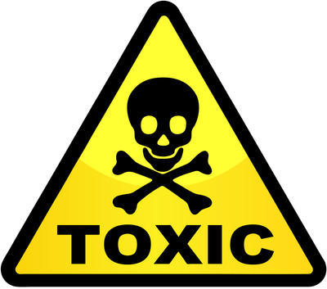
Motivation of Bipolar-EP
Regular EP contains HF.
HF is toxic !
Regular EP will require >10,000 liters HF acid for ILC project (~8000 1.3GHz 9-cell SRF cavities).

Slide 11
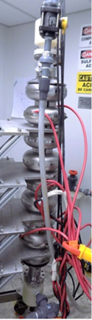
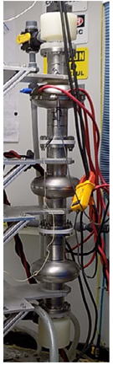
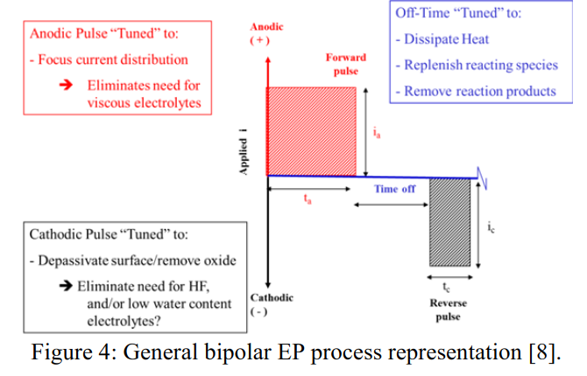
Bipolar-EP development collaborated with Faraday Inc.
(HF-free EP technique using H2SO4 acid)
an anodic forward pulse to grow an oxide layer on niobium surface,
voltage time off to dissipate the heat, remove reaction products, and replenishes reacting species;
a cathodic pulse with reversed voltage to remove the oxide layer on the niobium surface, thus eliminating the need for HF.
BEP setup of 9-cell and single-cell SRF cavities

Slide 12
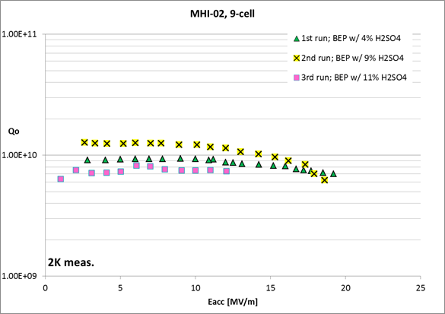
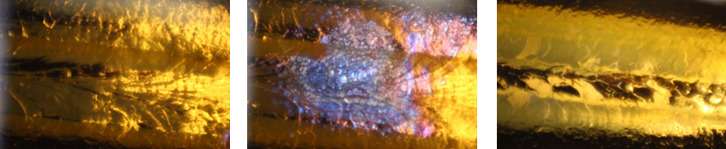
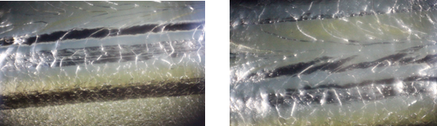
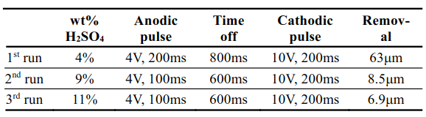
9-cell cavity BEP results
Optical inspection images:
1st Run:
No 800C and 120C baking after BEP
Max Eacc in baseline test
Surface coated with thick and golden oxide layer after 63um BEP of the 9-cell cavity.
2nd Run: BEP 8.5um, surface looks similar to the conventional EP surface;
3rd Run: BEP 7um, surface has light yellow layer.
FE
Quench
Baseline test: cavity quenched at 22MV/m,
BEP degraded gradient ~ 4MV/m,
Gradient was limited by quench and FE,
Low Q0 due to the oxide layer on surface.

Slide 13
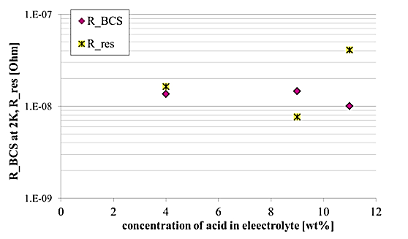
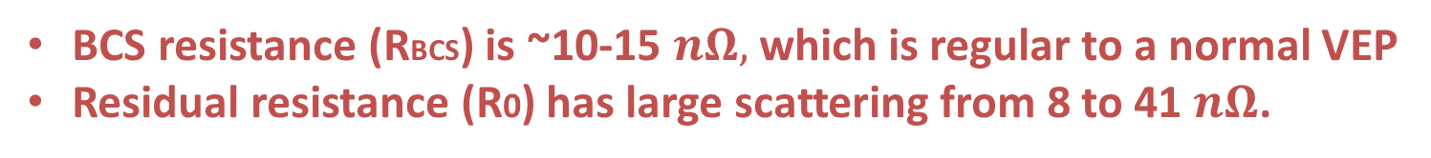
Surface resistance analysis of the 9-cell cavity results
BCS resistance (RBCS) is ~10-15 $nΩ,$ which is regular to a normal VEP
Residual resistance (R0) has large scattering from 8 to 41 $nΩ$.

Slide 14
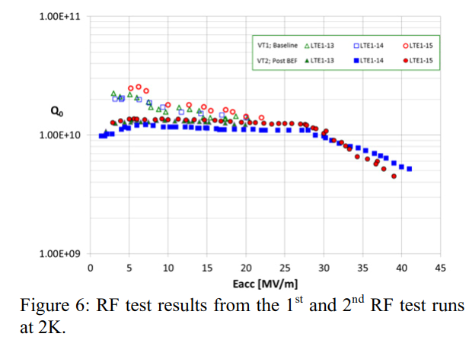
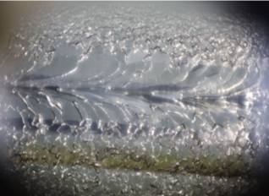
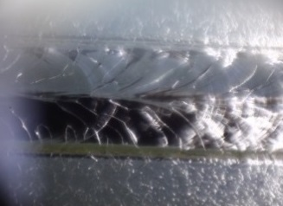
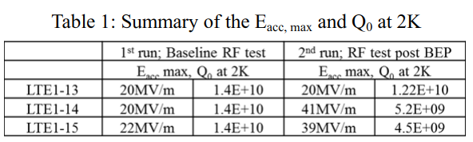
Single-cell cavity-string BEP results
Optical Inspection comparison
ILC spec. @ 2K
Max Eacc in baseline test
Cornell VEP
(BEP 64um; no 800C and 120C baking)
BEP
Baseline test: Eacc ~20MV/m limited by quench,
BEP improved two single-cell Eacc up to ~40MV/m,
Q0 is flat when Eacc is between 5-30MV/m,
high-field Q-slope started after 30MV/m.

Slide 15
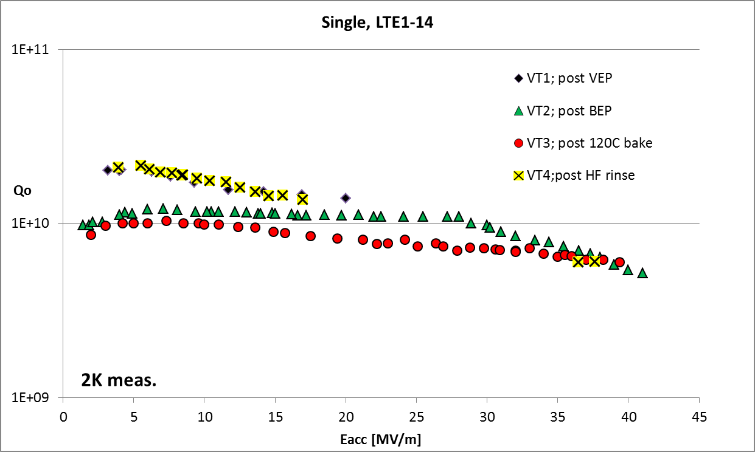
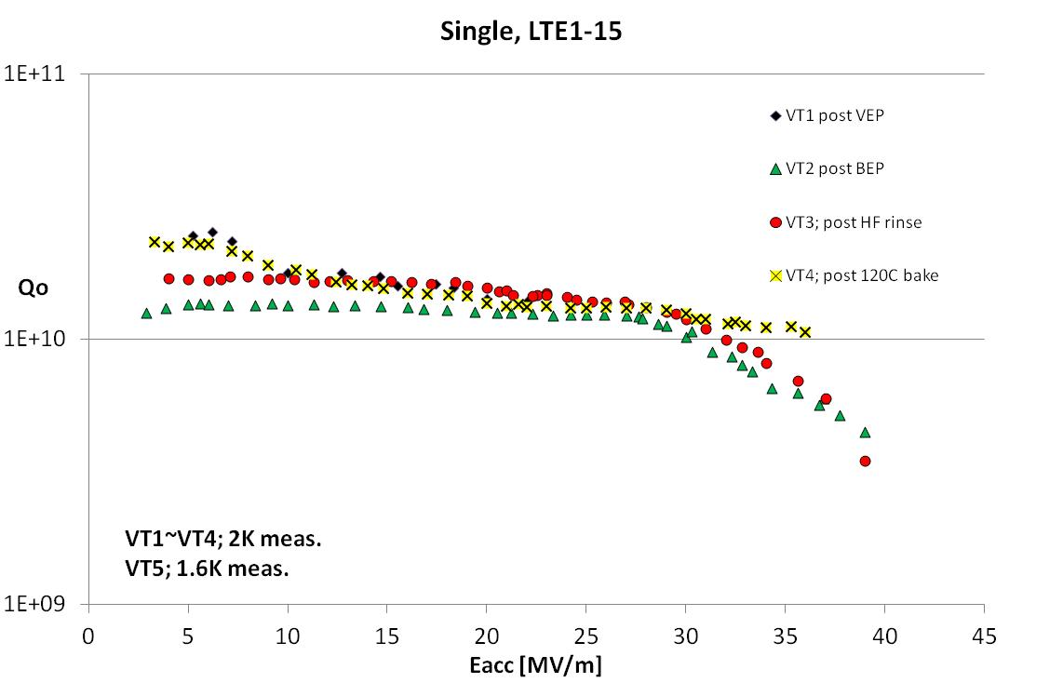
Post treatment study after BEP
HF rinsing to remove bad oxide layer;
120C baking to improve Q
ILC spec. @ 2K
ILC spec. @ 2K
LET1-14:
120C baking: Q0 degraded at low, medium fields; no change at high fields. Eacc~ 40MV/m.
HF rinsing: Q0 was improve at low fields; no change at high fields. Eacc~ 40MV/m.
LET1-15:
HF rinsing: Q0 was improved at low, medium fields; no change at high fields. Eacc~ 40MV/m.
120C baking : Q0 was improve at low fields; no high-field Q-slope. Eacc quenched at 38MV/m.

Slide 16
Conclusions of BEP study
Gradient of the BEP’d cavities can achieve ~40MV/m,
Q0 varies from ~8e9 to 1.2e10 based on BEP parameters,
The post treatments can reduce surface resistance of BEP’d cavity down to conventional VEP level.

Slide 17
Outline
Vertical electropolishing (VEP) updates
Bipolar electropolishing (BEP) updates
Low-temperature doping updates

Slide 18
Motivation of Low-temperature doping
Average quench field: ~20MV/m
ILC spec. @ 2K
High-temperature (800C) doping cavity has high-Q, but gradient of most cavities does not achieve the ILC specification;
Low-temperature (120-160C) doping might be a solution for producing high-Q and high-gradient cavities.

Slide 19
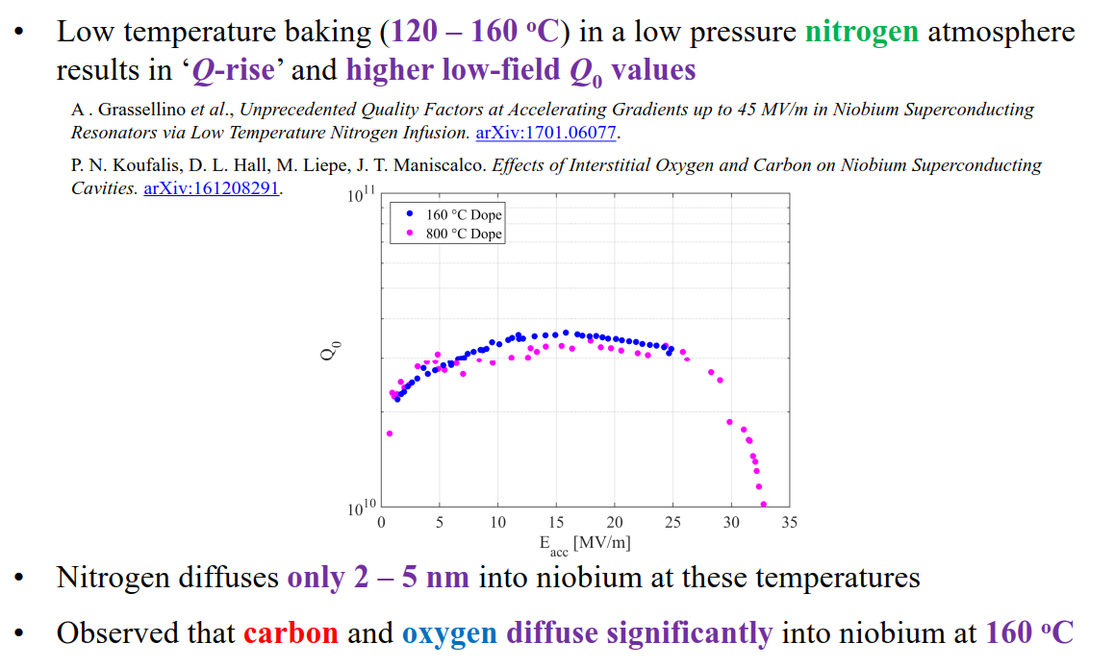
Low-temperature doping at Cornell

Slide 20
One more thing…

Slide 21
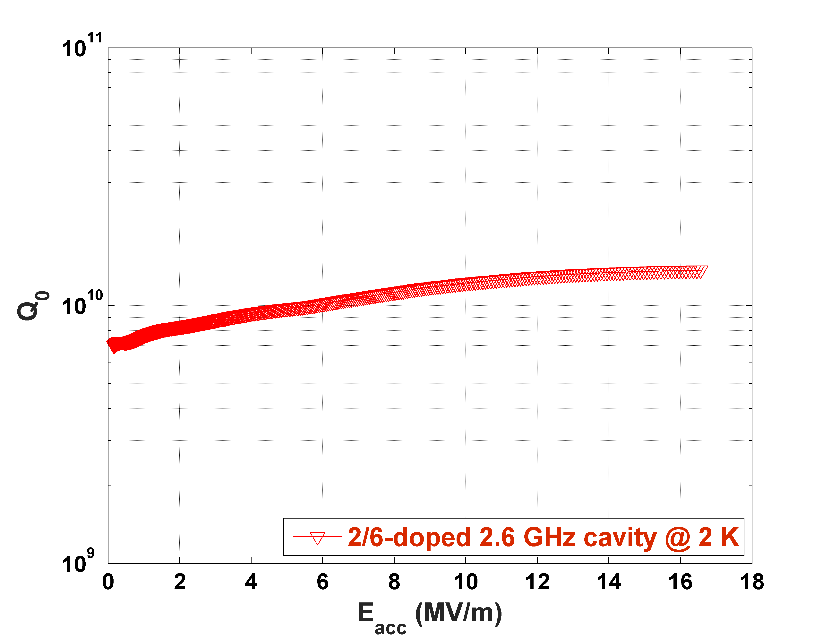
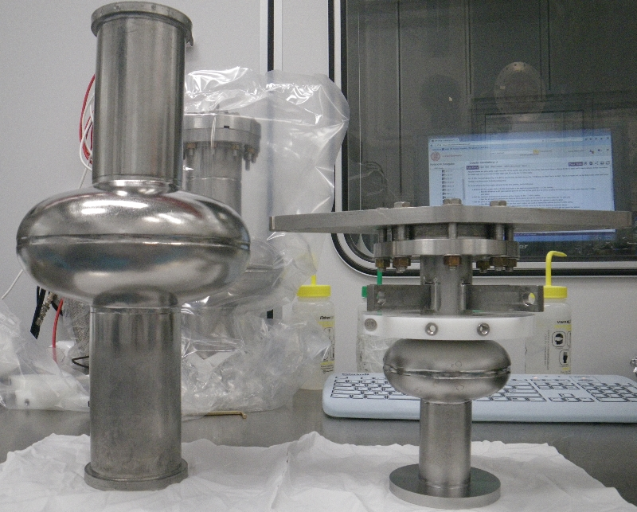
Latest results of 2.6GHz Nitrogen-doped single-cell SRF cavity
@ 2K, Q0 > 1e10 at 16MV/m
1.3GHz
Q0=1.5e10
2.6 GHz
1.3 GHz cavity need Q0> 3e10 at 2K to obtain same cryogenic loss per length.
2/6 Doping recipe;
Q-value is comparable with a 1.3GHz EP’d cavity (non-doped);
RBCS ~11 nΩ at 16MV/m;
R0 ~ 8 nΩ
Epk/Eacc = 1.86
Bpk/Eacc = 4.25 mT/ (MV/m)
M. Martinello et al., SRF2017, Lanzhou, China, 2017.

Slide 22
Cornell SRF group:
P. Bishop, H. Conklin, F. Furuta, T. Gruber, A. Holic, J. Kaufman, P. Koufalis, G. Kulina, M. Liepe, J. Maniscalco, T. Oseroff, R. Porter, J. Sears, S. Zeryck.
Acknowledgement
Thanks for your attention!

Slide 23
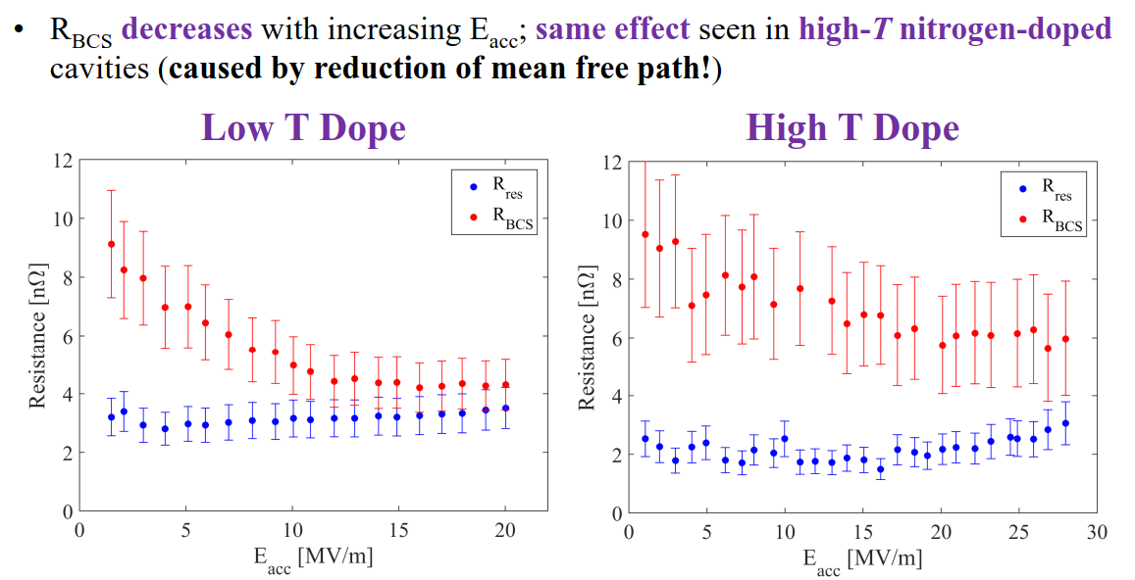
Surface resistance analysis of low T doping results

