Slide 1
Efforts concerning the manufacture
of Cryomodule Abutment
IWATE IRON Co., Ltd. Toshiyuki Okubo
Notes:
声のトーンは低めに！
ご紹介、ありがとうございます。
Thank you / for introduction.
岩手製鉄株式会社の大久保利之と申します。
I‘m Toshiyuki Okubo / from Iwate Iron(ｱｨｧﾝ) Corporation.
「クライオモジュールを支える架台の製造に関する取組み」についてプレゼンします。
I will make a presentation on / about / "Efforts concerning the manufacture of / a abutment supporting a Cryomodule".

Slide 2
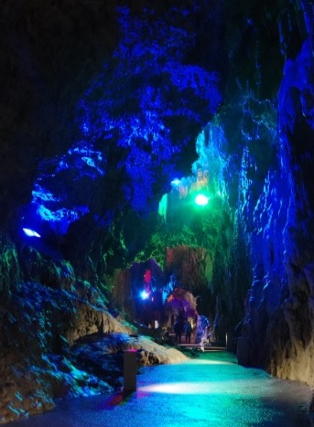
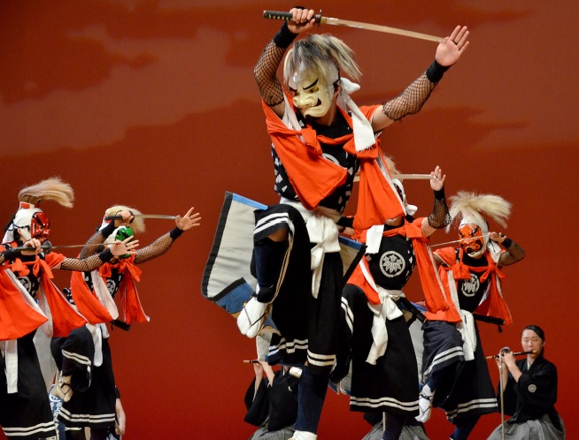
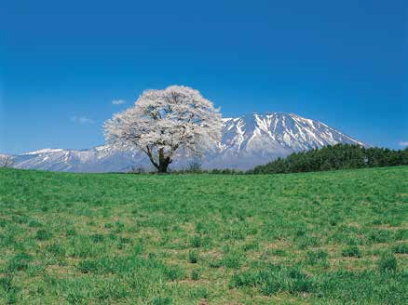
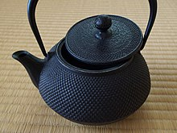
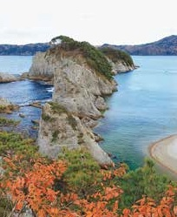
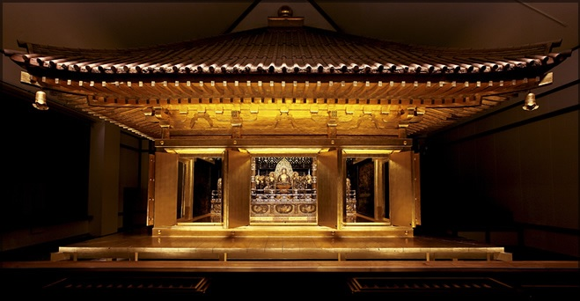
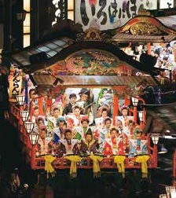
■ Company Profile
Address … 18-14 Waga, Kitakami, Iwate
Established … 14th June 1949
Capital … \ 80 million
Number of employees … 64 people
Site area … 65,000 ㎡
Extra-high voltage receiving facility
… 66,000 V
Notes:
我が社はＩＬＣ予定地である岩手県の北上市にあります。
Our company is / located / in Kitakami city of / Iwate prefecture / which is the ILC planned place.
設立から約70年経つ中小企業です。
It is / a medium-sized company / which is / about 70 years / since its establishment.

Slide 3
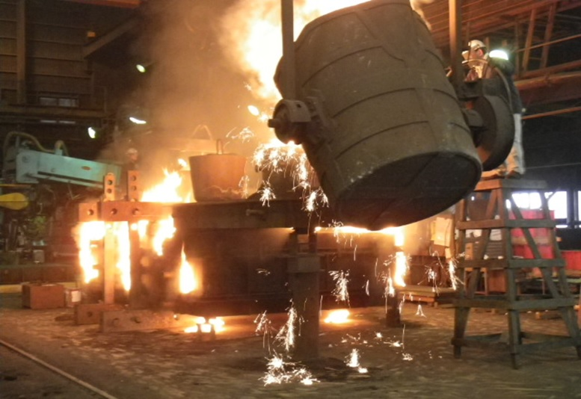
Business contents
● Castings Operations Department
・ Iron castings ( Gray cast iron ; Ductile cast iron )
・ Steel castings
・ Aluminum castings
・ Stainless steel castings
etc.
Notes:
事業内容は、鋳物事業とエンジニアリング事業です。
The contents of / business operations are / casting business / and engineering business.
鋳物事業部では、鉄鋳物、鋳鋼、アルミ鋳物、ステンレス鋳物等を製造しています。
The castings operations department / manufactures / iron(ｱｨｧﾝ) castings, / steel castings, / aluminum castings, / stainless steel castings, / etc.(ｴﾄｾﾄﾗ)

Slide 4
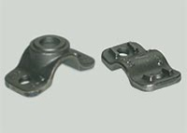
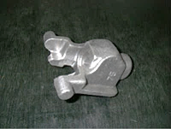
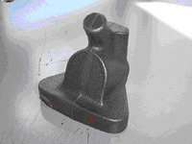
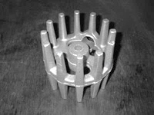
Small casting example
Water pipe parts
Material:FCD450
Weight:1kg
Dimension:
200mm×80mm×60mm
Sewer pipe parts
Material:FCD600
Weight:1kg
Dimension:
100mm×80mm×70mm
Mass production in units of hundred units, thousand units
Vehicle parts
Material:FCD500
Weight:1.5kg
Dimension:
70mm×70mm×80mm
Electrical parts
Material:FCD450
Weight:2.5kg
Dimension:
Φ150mm×200mm
Notes:
数百グラムから20kgまでの小型鋳物の大量生産を行ったり、
We mass-produce / miniature(ﾐﾆｱﾁｬ) castings / ranging(ﾚﾝｼﾞﾝｸﾞ) from several hundred grams(z) / to 20 kilograms(z),

Slide 5
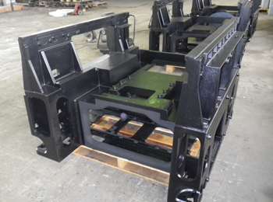
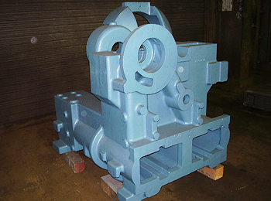
Large casting example
Base parts of semiconductor
manufacturing equipment
Material:FC250
Weight:800kg
Length:1500mm
Width:1300mm
Height:1300mm
Initially, it was a canned product,
but it was changed to
an iron cast for the reason
that it has excellent
vibration absorption properties.
Compressor parts
Material:FCD450
Weight:2,000kg
Length:1300mm
Width:1200mm
Height:1500mm
It is made of casting
because it is large
and complicated shape.
It is an integrated product.
Notes:
3０ｋｇから１０ｔまでの大型鋳物を数多く製造しています。
and we are producing(ﾌﾟﾛﾃﾞｭｰｼﾝｸﾞ) / many large castings / ranging(ﾚﾝｼﾞﾝｸﾞ) from 30 kilograms(z) / to 10 tons(z).

Slide 6
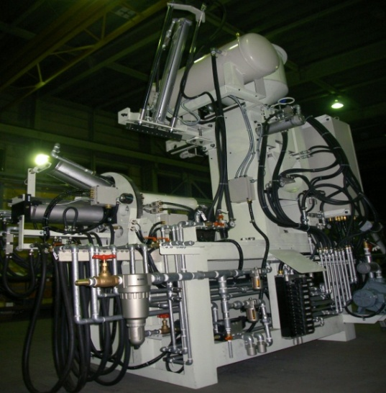
● Engineering Operations Department
・ Design and Manufacturing of
Mechatronics Equipment
and FA Equipment
・ Contract Manufacturing and Assembly
of Equipment 【OEM Production】
・ Modification and Repair
of Mechanical Equipment
・ Periodical Maintenance
of Facility and Device
Notes:
そして、エンジニアリング事業部では、
メカトロニクス装置やファクトリーオートメーション装置の設計、製造、改造、修理を行っています。
In the engineering operations department, / we / design, / manufacture, / remodel and repair mechatronics equipment / and factory automation equipment.
また、工場施設の各種装置、制御盤の不具合対応や定期点検など、メンテナンスサービスもしています。
We also provide / maintenance services / such as troubleshooting of / various equipment / and control panels / at factory facilities / and periodic inspections.
電気、機械、ソフトウェア、各エンジニアが全ているのが強みです。
It is the advantage / that we have all the electric, / mechanical / and software engineers.

Slide 7
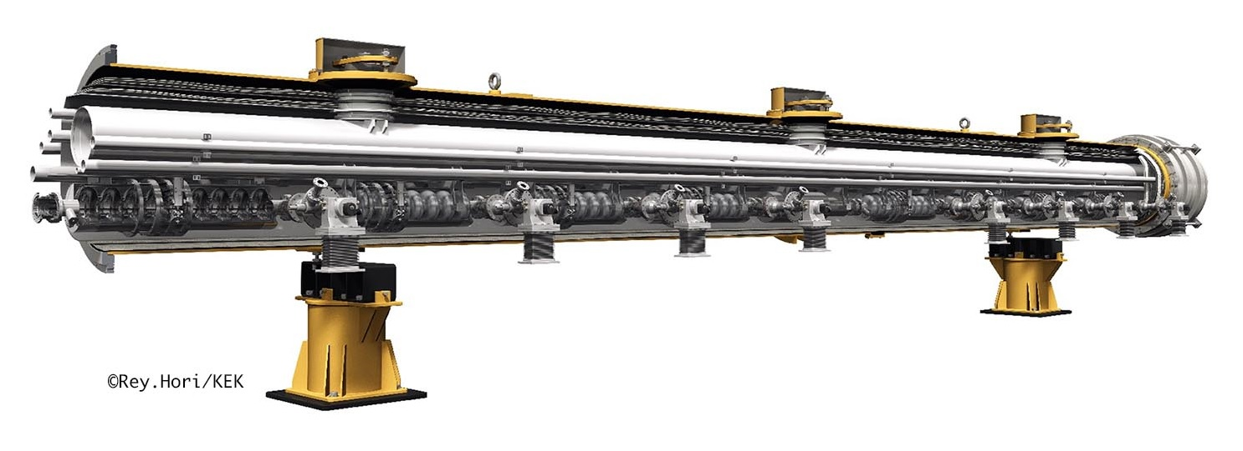
Consideration of precision adjustment abutment of ILC Cryomodule
Cryomodule
Active Mover Section
Abutment
Notes:
さて、クライオモジュールは２つの架台により支えられる構成となっています。
Now,/ The Cryomodule is configured / to be supported / by two abutment.
さらに、バンチコンプレッサー部のクライオモジュールは位置微調整のためのアクティブムーバー装置を必要とします。
Additionally, / the Cryomodule of the bunch compressor section / needs / an active mover device / for fine adjustment.
我々は研究会を結成し、アクティブムーバー装置のスケールダウンモデルを作成し、精密位置制御の基本検討を行ってきました。
We have formed / a research group, / created a scale down model of / active mover devices, / and carried out / a basic examination of / precise(ﾌﾟﾘｻｲｽ) position control.

Slide 8
◇ Specification
１）Required number of Abutment
・ 2 units per 1 Cryomodule
２）Withstand load
・ 6t per 1 abutment
（ Cryomodule body size … Diameter 1m, Length 12m, Weight 10t ）
３）Mechanical section
・ Range of movement … … … … X-axis：10 mm
Z-axis：10 mm
・ Final positioning accuracy … X-axis：0.010 mm
Y-axis：0.001 mm
・ Movable velocity … … … … X-axis：1 mm/sec
Z-axis：1 mm/sec
Notes:
構成仕様はこの通りです。
The specification is / as it is.
据え付け時は従来通りボルトで調整し、その後、微調整を行います。
When installing(ｲﾝｽﾄｰﾘﾝｸﾞ), / adjust / with bolts as before, / and then / make fine adjustments.

Slide 9
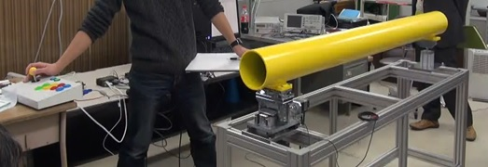
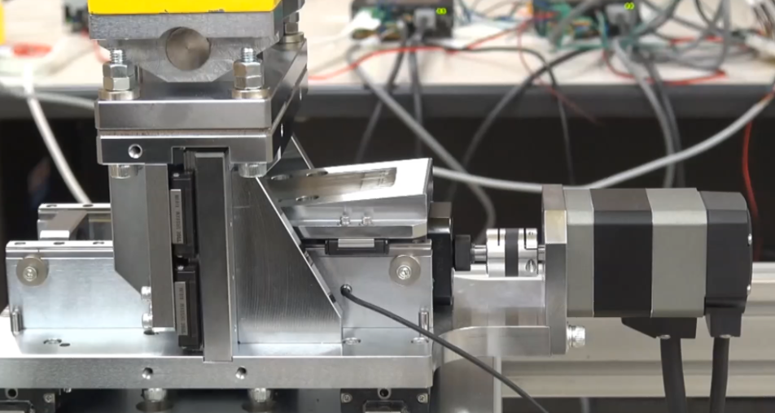
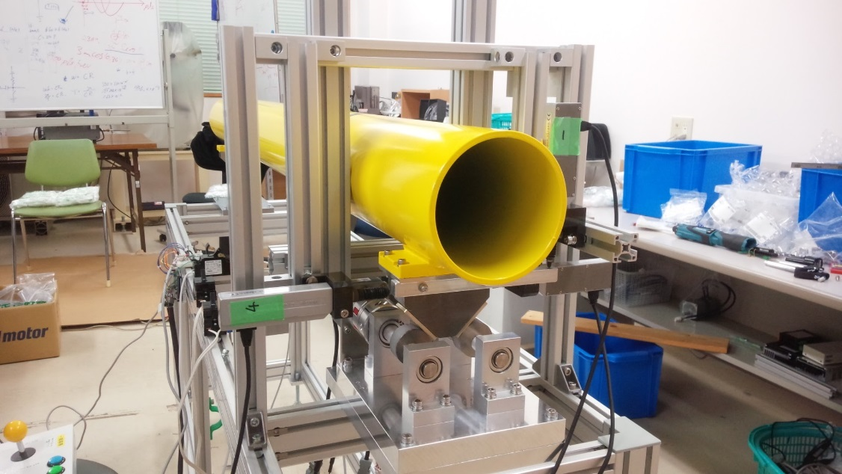
◇ Evaluation status in scale down model
Mechanism section draft①:
Structure to displaces Z-axis with taper cam
Mechanism section draft②:
Structure to displaces Z-axis with eccentric cam
Notes:
Z軸の変位について、2種類のスケールダウンモデルを作って評価をしました。
Regarding the displacement of / the Z-axis, / we made two types of / scale down models / and evaluated(ｲｳﾞｧﾘｭｴｲﾃｯﾄﾞ) them.
第1案はZ軸をテーパカムで変位させる構造です。
The first draft is / a structure / that displaces the Z axis / with a taper cam.
第2案はZ軸を偏心カムで変位させる構造です。
The second draft is / a structure / that displaces the Z axis / with an eccentric(ｲｸｾﾝﾄﾘｯｸ) cam.
テーパカム構造では、位置精度に関して要求仕様を概ね満たす結果が得られました。
As / for the tapered cam structure, / the result satisfying / the required specifications / about position accuracy(ｱｷｭﾚｽｨ) was / obtained.
偏心カム構造については、評価継続中です。
The eccentric(ｲｸｾﾝﾄﾘｯｸ) cam structure is / under evaluation.
そして、今後はフルスケールモデルで評価を行っていきます。
And / in the future / we will continue / to evaluate / with full scale model.

Slide 10
About manufacturing method
of Cryomodule Abutment
Notes:
さて、本プレゼンテーションの本題となる、
クライオモジュールの架台を鋳物で製造するという提案をさせて頂きたいと思います。
Well, / I would like to propose / to manufacture the Cryomodule abutment, / which is the main subject of / this presentation, / by casting.

Slide 11
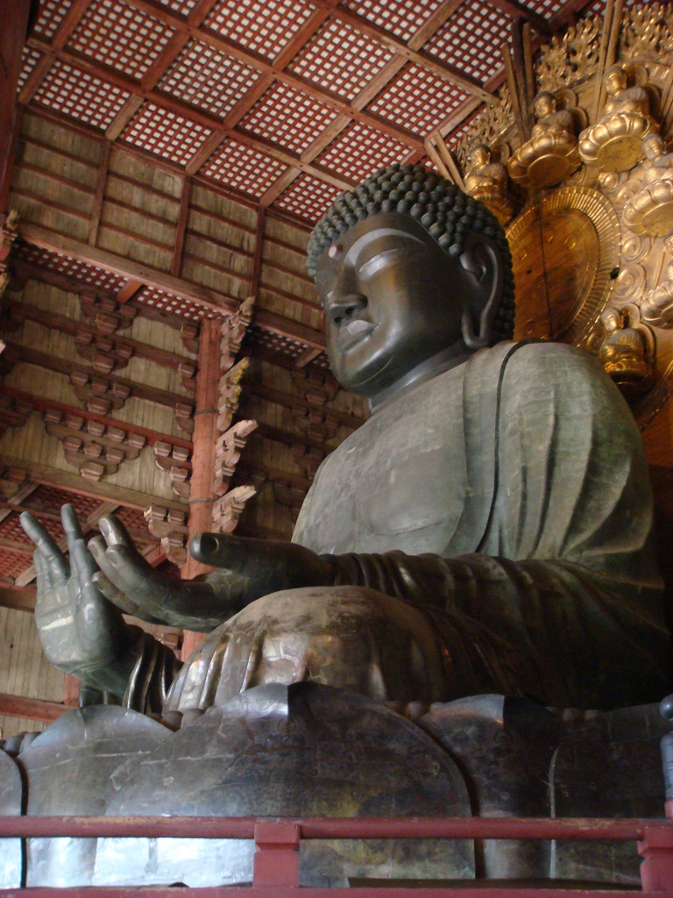
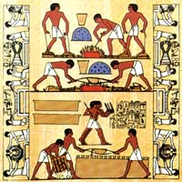
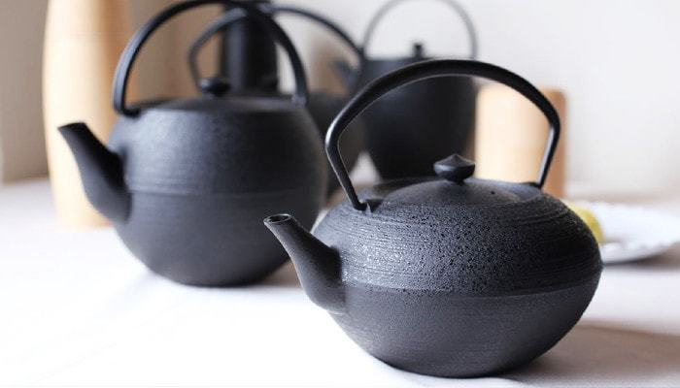
History of Casting
Nanbu ironware for export
Mural painting the casting work
in the Mesopotamian civilization
Great statue of Buddha in Nara
Notes:
＝ このスライドは飛ばす？ ＝
鋳造は今から約6000千年前、紀元前4000年頃に始まる最も古い金属加工技術の一つです。
Casting is one of / the oldest metal processing technologies / that begins / about 6 thousand years ago now, / around 4 thousand BC.
日本の奈良にある大仏は世界最大の鋳造物であり、
The Great statue(ｽﾃｨﾁｭｳ) of Buddha in Nara in Japan is / the world's largest casting.
現在、世界で人気の出ている岩手の南部鉄器も鋳物です。
Currently(ｶﾚﾝﾄﾘ), / the Nanbu ironware / in Iwate Prefecture, / which is popular all over the world, / is also a casting.

Slide 12
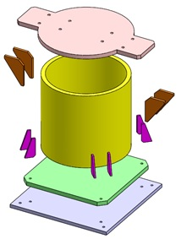
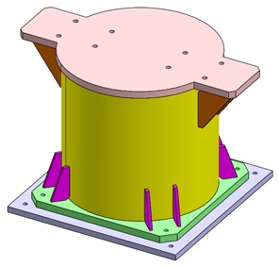
Case of making an abutment
with Canning
① Cut each part from
steel sheet or steel pipe
② Weld each joint
③ Repeat the above operations
as many as necessary
Canning :
(Not to make cans)
Welding the steel frame or steel plate
to make the structure.
Notes:
現在、クライオモジュールの架台は製缶で造られています。
At present, / the abutment of / the Cryomodule is / made of canning.
ここで、製缶とは、缶を作ることではなく、鉄骨や鉄板を溶接して構造品を作る事です。
Here, / Canning is not to make cans, / but to weld steel frames / and steel plates / to make structures.
架台を製缶で作る場合、まず各パーツを鋼の板材やパイプ材から成型します。
When making an abutment / with canning, / firstly cut each part / from steel plate material / or pipe material.
そして各パーツの接合部をそれぞれ溶接していきます。
Then / weld the joints of / each part respectively(ﾚｽﾍﾟｸﾃｨｳﾞﾘｰ).
その作業を必要台数分繰り返すこととなります。
We will repeat / that work / as many as necessary.
この工法の場合、溶接作業を人が行う時は、１個１個の形状に差が出てしまいます。
In this construction method, / if a person conducts welding work, / there will be a difference / in the shape of / each piece.
形状品質を一定にするためにはロボット溶接が適当ですが、
Robot(ﾗﾊﾞｯﾄ) welding is / suitable(ｽｨﾀﾎﾞ) / for keeping shape quality constant,
それを行うためには、さらに費用をかけてロボット溶接での製造設備を作らなければなりません。
In order to do that, / we have / to make manufacturing equipment / for robot(ﾗﾊﾞｯﾄ) welding / at even more expense.

Slide 13
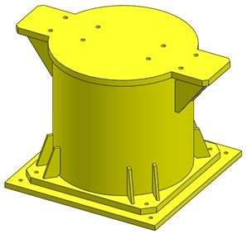
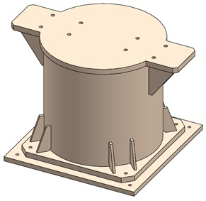
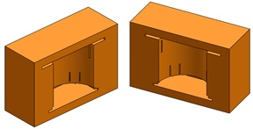
Case of making an abutment with Casting
Origin Model
3D-CAD Data
Mold
Notes:
一方、鋳物で作る場合、
On the other hand, / when making / with a casting,
まず、３ＤーＣＡＤデータからOrigin Modelを作ります。
First, / I will make an Origin Model / from 3D-CAD data.
そしてそのOrigin Modelを使って凹型を作り、そこに溶融金属を流し込みます。
And using / that Origin Model, / make a concave mold /and pour(ﾎﾟｧ) molten metal / into it.

Slide 14
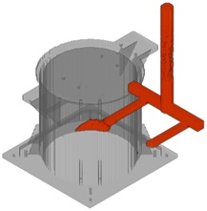
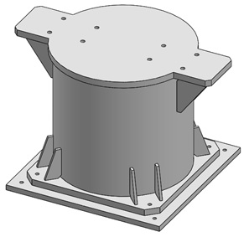
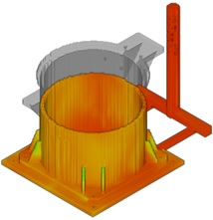
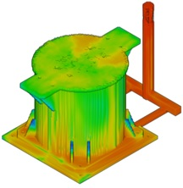
Completion of Casting
Casting image
Notes:
ここに鋳造シミュレーションによる鋳造のイメージの絵を示します。
Here is a picture of / casting image / by casting simulation.
このように一気に形が出来上がります。
In this way / the shape is completed / at once.
そして数千個作っても形状が均一で、金属特性も一定となります。
And even / when making thousands, / the shape is uniform / and the metal properties(ﾌﾟﾛﾊﾟﾃｨｰｽﾞ) are / constant.

Slide 15
Manufacturing Cost
Casting ＜ Canning
３０％ＯＦＦ
Notes:
製造コストの比較をすると、鋳物の場合、製缶より約３０％ＯＦＦとなります。
When comparing(ｺﾝﾍﾟｱﾘﾝｸﾞ) the manufacturing cost, / in case of Casting, / it is / about 30(thirty)% off / from Canning.
ー 以下、省略？ ー
さらに我が社では、クリーンな製造環境で、夜間電力を使ってコスト低減を図っています。
In addition, / we are trying / to reduce costs / by using nighttime electricity / in a clean manufacturing environment.
また、引け等の鋳造欠陥が発生しないような制御技術を有しているため、不良発生率も低いです。
Moreover, / because we have a control technology / that prevents casting defects / such as shrinkage, / the defect occurrence(ｵｺｰﾚﾝｽ) rate is / also low.

Slide 16
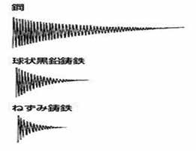
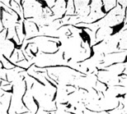
Physical merit when Abutment is changed from Canning to Casting
Steel
Displacement
→ time
Carbon
Ductile Cast Iron
Displacement
→ time
Gray Cast Iron
Displacement
→ time
Damped vibration waveform
Notes:
次に、物理的特性を見てみます。
Next, / let’s look / at the physical characteristics.
ねずみ鋳鉄の減衰振動時間は、鋼のそれに比べて１／３以下となっています。
The damped vibration time of / gray cast iron is / less than one-third of / that of steel.
これは、ねずみ鋳鉄組織内の炭素が振動エネルギーを熱エネルギーに変換するためと言われています。
It is said / that carbon / in the gray cast iron structure / converts / vibration energy / into thermal energy.

Slide 17
Comparison of other physical characteristics
 | Coefficient of thermal expansion (10⁻⁶/K) | Compressive strength (N/mm²)
Gray cast iron | 10.5 | 580～1050
General steel | 11.5 | 400～700
Granite | 7.0 | 135～150
Notes:
その他、熱膨張率や圧縮強度の比較を見てみます。
In addition, / let‘s look / at the comparison(ｶﾝﾊﾟﾘｽﾝ) of / the coefficient(ｺｪﾌｨｼｪﾝﾄ) of / thermal expansion / and compressive strength.
参考に定盤等に用いられる花崗岩の数値も併記します。
For reference, / numerical values of / granite(ｸﾞﾗﾆｯﾄ) used / for surface plate are / also shown.
これらの数値を見ても、ねずみ鋳鉄は製缶に用いられる鋼材よりも優秀な数値となっています。
Even / with these numbers, / the gray cast iron(ｱｨｧﾝ) is / superior / to the steel used / for canning.

Slide 18
Example of switching from Canning to Casting
Material:FC250
Weight:800kg
Length:1500mm
Width:1300mm
Height:1300mm
Base parts of semiconductor manufacturing equipment
Notes:
このように鋳鉄が架台素材として優れているのに、ナゼ今まで用いられてこなかったのでしょうか？
As mentioned above, / why has not it been used / until now, / although cast iron(ｱｨｧﾝ) is / excellent / as an abutment material?
おそらく、架台を作ろうと考える時、
Probably, / when we think / to make abutment,
モノづくりの基本として、金属パーツを組み合せるか金属材から削り出すイメージを持つと思います。
as a basis of manufacturing, / I think / that we have / an image to combine metal parts / or to scrape / from metal material.
空間部分の多い形状を金属材から削り出すことは無駄が多いので、金属板を溶接して作り上げればよいと考えます。
It is wasteful / to scrape out shapes / with many spaces / from metal materials,/ so we think / that it is better / to weld metal plates.
鋳物で造ろうという事が念頭に無い限り、鋳造は思いつきません。
As long as / we don‘t mind / to build it / as a casting, / we don’t conceive(ｶﾝｼｰｳﾞ) making it / by casting.
それがずっと受け継がれてきたのだと思います。
I think / that it has been passed on.
同様の考えから、この部品も最初は製缶で造られていましたが、
From the same idea, / this part was / originally made / with canning,
減衰特性、生産性、コストの面で鋳鉄製に変更され、現在も生産され続けています。
It has been changed to cast iron(ｱｨｧﾝ) / in terms of / damping characteristics, / productivity(ﾌﾟﾛﾀﾞｸﾃｨｳﾞｨﾃｨ) and cost, / and it is / still being produced(ﾌﾟﾛﾃﾞｭｰｽﾄ) now.

Slide 19
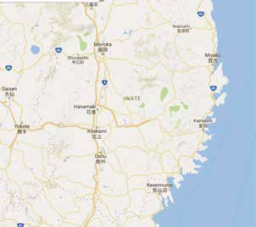
Distance merit that Iwate Iron Co., Ltd. is in charge of manufacturing Abutment
・ ILC is within 60 km
２０㎞
４０㎞
６０㎞
Notes:
物の輸送には運賃がかかりますが、
Fare is charged / for transporting objects.
岩手製鉄は、ILCまで60キロメートル圏内にあるため、輸送費が安いです。
Iwate Iron(ｱｨｧﾝ) Corporation is / within 60 kilometers(z) of / ILC, / so the shipping cost is cheap.
メンテナンス等ですぐ駆けつける事ができます。
And / we can quickly rush over maintenance / and so on.
Co., Ltd. :Company Limited

Slide 20
Summary
・ Gray cast iron is proposed for Abutment material.
→ Excellent in terms of productivity, vibration damping performance, and cost.
・ Iwate Iron Co., Ltd. is located close distance from ILC.
→ Transportation costs of many heavy objects are reduced.
・ Iwate Iron Co., Ltd. has a vast site.
→ Massive goods can be stored.
・ Iwate Iron Co., Ltd. has Extra-high voltage receiving facility.
→ Evaluation and inspection of various devices are possible.
・ Iwate Iron Co., Ltd. has an engineering department.
→ Respond quickly to various maintenance.
Notes:
最後に、岩手製鉄のＰＲを兼ねて、まとめを申し上げます。
Finally, / I will summarize(ｻﾏﾗｲｽﾞ) as a PR of / Iwate Iron(ｱｨｧﾝ) Corporation.
架台素材には、ねずみ鋳鉄を提案します。
We propose gray cast iron(ｱｨｧﾝ) / for the material of / abutment.
これは生産性、振動減衰性能、コスト面で優れているからです。
Because / it is excellent / in terms of / productivity(ﾌﾟﾛﾀﾞｸﾃｨｳﾞｨﾃｨ), / vibration damping performance / and cost.
岩手製鉄はＩＬＣから近距離にあるため多数の重量物の輸送コストが安くなります。
Since our company is / located close / to ILC, / transport costs of / many heavy objects are / reduced.
弊社は、広大な敷地を有するので大量の物品保管ができます。
Since our company has / a vast site, / it can store large quantities(ｸｧﾝﾃｨﾃｨｽﾞ) of / goods.
弊社には特高受電設備があるので各種装置の評価や検査に対応できます。
Since our company has / Extra-high voltage receiving(ﾘｼｰｳﾞｨﾝｸﾞ) facility(ﾌｧｼﾘﾃｨ), / we can deal / with evaluation / and inspection of / various equipment.
岩手製鉄にはエンジニアリング部門があるので色々と迅速にメンテナンス対応できます。
Since our company has / an engineering department, / we can respond / to various kinds of / maintenance quickly.
PR : Public Relations

Slide 21
Thank you for your attention.
After this, it will be a question-and-answer time,
but I am not good at English,
so I would like to ask for interpretation by someone.
Notes:
ご清聴、ありがとうございました。
Thank you / for your attention.

