Slide 1
Physics with e-beams (SPS)
Overview of the project
Y. Dutheil (TE-ABT-BTP), T. Åkesson, L. Evans, S. Stapnes
on behalf of the working group PBC-acc-e-beams (electron beam in SPS) <PBC-acc-e-beams@cern.ch>

Slide 2
Electrons at CERN
Accelerator implementation at CERN of LDMX type of beam (Physics Beyond Colliders)
X-band based 70m LINAC to ~3.5 GeV in TT4-5:
Fill the SPS in 1-2s (bunches 5ns apart) via TT60
Accelerate to ~16 GeV in the SPS
Slow extraction to experiment in 10s as part of the SPS super-cycle
Experiment(s) considered by bringing beam back on Meyrin site using TT10
Beyond LDMX type of beam, other physics experiments considered (for example heavy photon searches)
Acc. R&D interests: Overlaps with CLIC next phase (klystron based), FEL linac modules, e-beams for plasma, medical/irradiation/detector-tests/training, impedance measurements, instrumentation. positrons and damping ring R&D

Slide 3
Outline
Physics case and detector specifics
Linac design and parameters
SPS : injection, acceleration and extraction
Transfer to the target and civil engineering

Slide 4
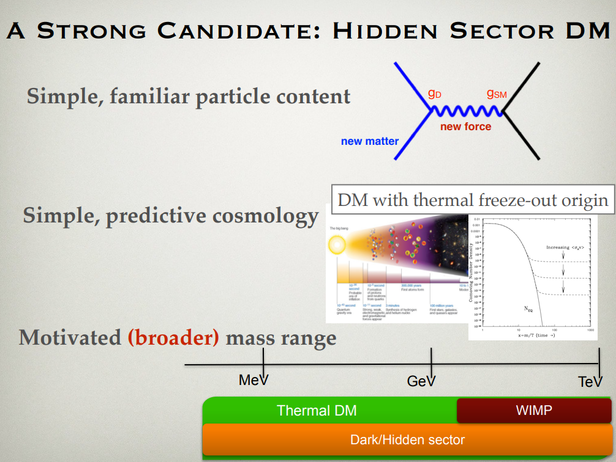
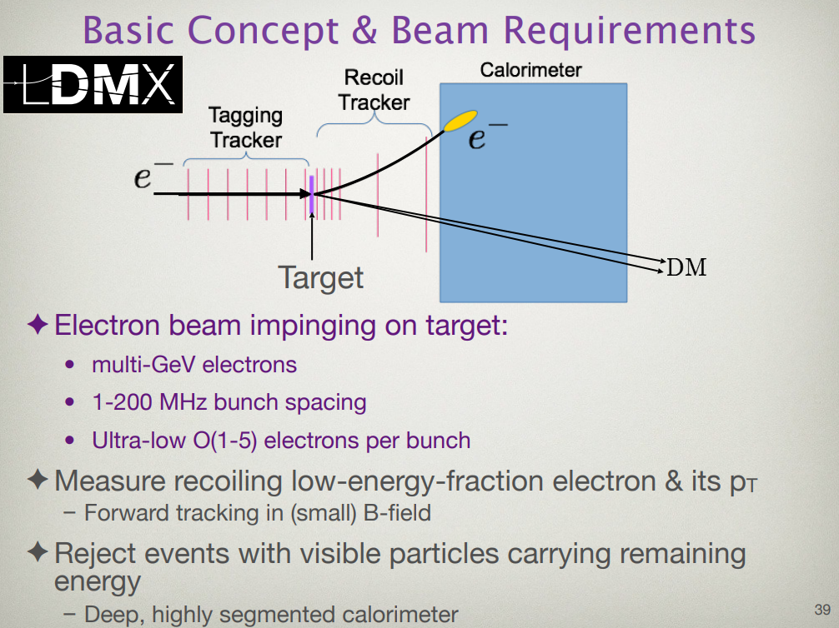
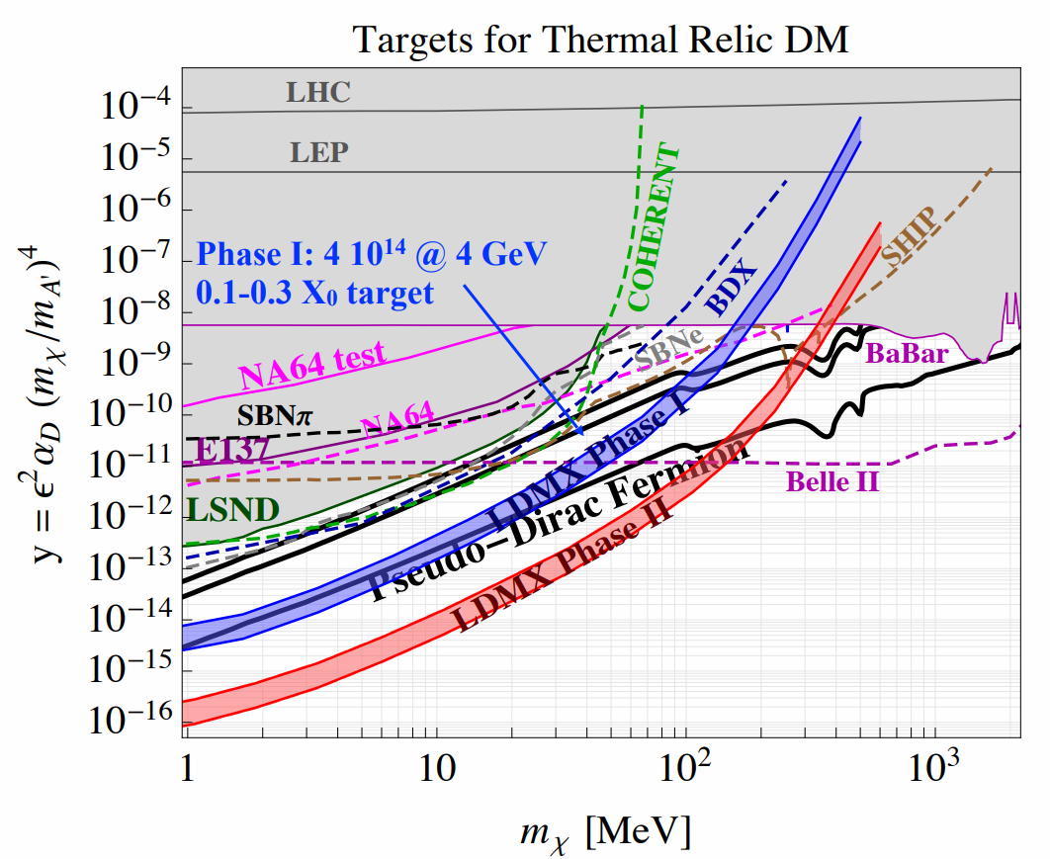
Physics with e-beams, example of LDMX
[1]Talk by P. Schuster
Exploring Hidden Sector Physics with an electron beam facility
Physics beyond collider annual workshop
November 21 2017, CERN
indico.cern.ch/event/644287/contributions/2762531/
Notes:
Existing LDMX collaboration produced a white paper and worked on the detector design for LCLS2 beam, but somewhat location agnostic
Torsten Åkesson
- An energy of around 16GeV would be optimal for background rejection, sweet spot
Blue 4GeV E14 electrons
Red 8 GeV E16 electrons

Slide 5
Linac parameters
modulator
0.1GeV S-band injector
3.4GeV X-band linac
  13 RF units to get 3.4 GeV in ~70 m [1]
kl
kl
2 x 50MW
p
c
e⁻
Possible parameters consistent with what is achieved in CLEAR (to be checked)
Energy spread (uncorrelated*) | <1MeV
Bunch charge | 52 pC
Bunch length | ~5ps
Norm. trans emittance | ~10um
N bunches in one train | 40
Train length | 200 ns
Rep. rate | 50/100 Hz
~5.3m
Certainly, some parameters can be improved if needed
* Correlated energy spread along the bunch (1st and 2nd order) may appear due to RF voltage and/or wakes. Should be discussed in detail and specified what is acceptable
[1] Talk by A. Grudiev, Linac layout and cost, March 20th 2018, CERN
indico.cern.ch/event/715324/
[2] Talk by A. Grudiev, Linac parameters, February 2nd 2018, CERN
indico.cern.ch/event/701603/
[2]

Slide 6
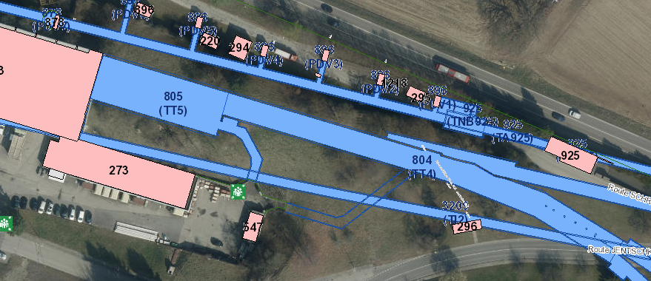
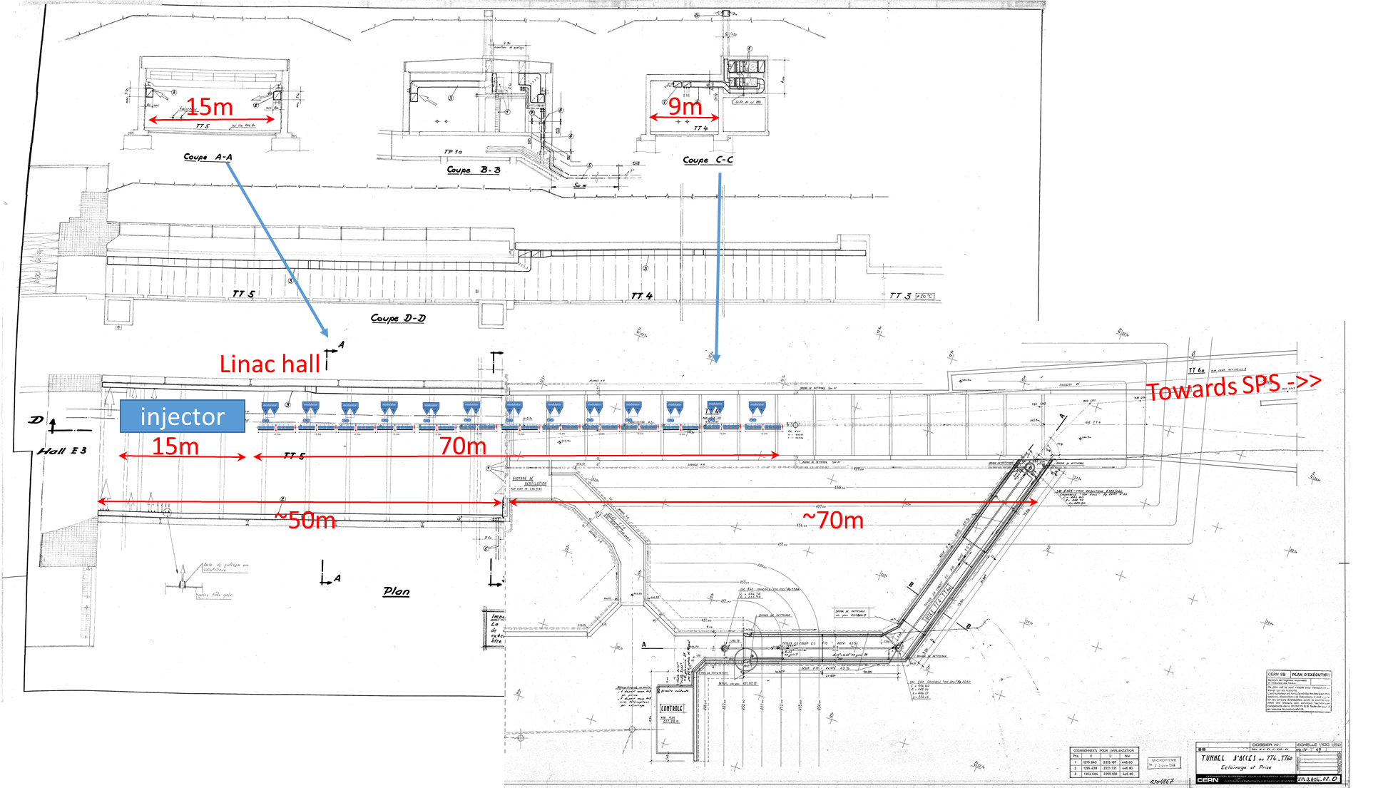
Linac layout
Beam instrumentation [2]:
Position : CTF3 inductive pick-ups or simple button BPMs
Beam size : OTR screens
Intensity : CTF3 inductive pick-ups or standard current transformer
[1]
[1] Talk by A. Grudiev, Linac layout and cost, March 20th 2018, CERN indico.cern.ch/event/715324/
[2] R. Jones, Instrumentation challenges, March 1st 2018, indico.cern.ch/event/703049/

Slide 7
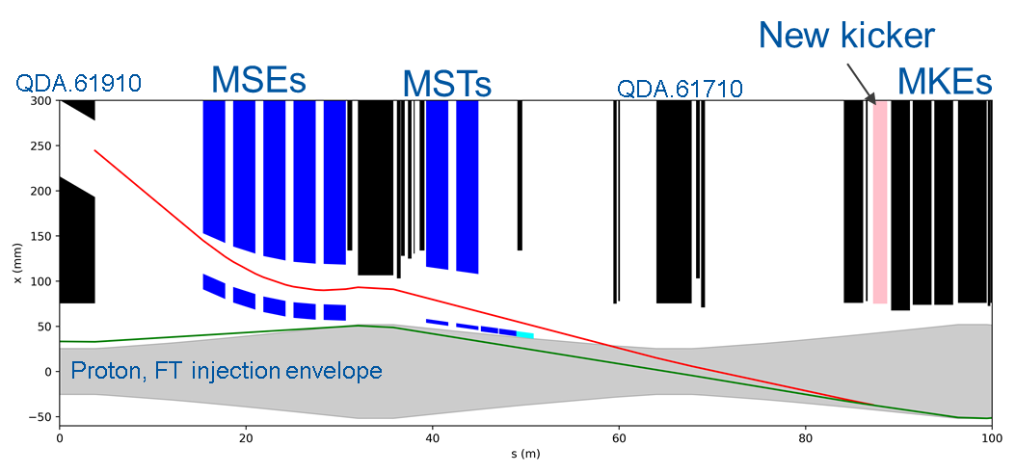
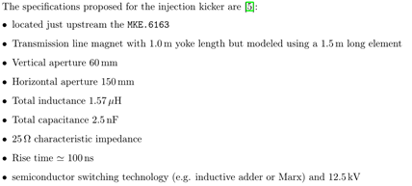
SPS injection in LSS6
Fast injection of 200ns trains into SPS 200MHz buckets
  40 bunches per train and 75 trains for 3000 bunches
Fast kicker with 50 to 100Hz repetition rate and 100ns rise time
Realistic kicker specifications using conventional technologies
Reference trajectory only
[1] Y. Dutheil , SPS electron slow extraction, March 1st 2018, CERN
indico.cern.ch/event/703049/
Notes:
Flexible patter, all guided by photo injector
Design very similar to e injection from LEP time
We can use the studies and experience learned from the LEP era, particularly in term of realistic field and powering of the septa for the 3.5GeV beam
Rebuild TT60..

Slide 8
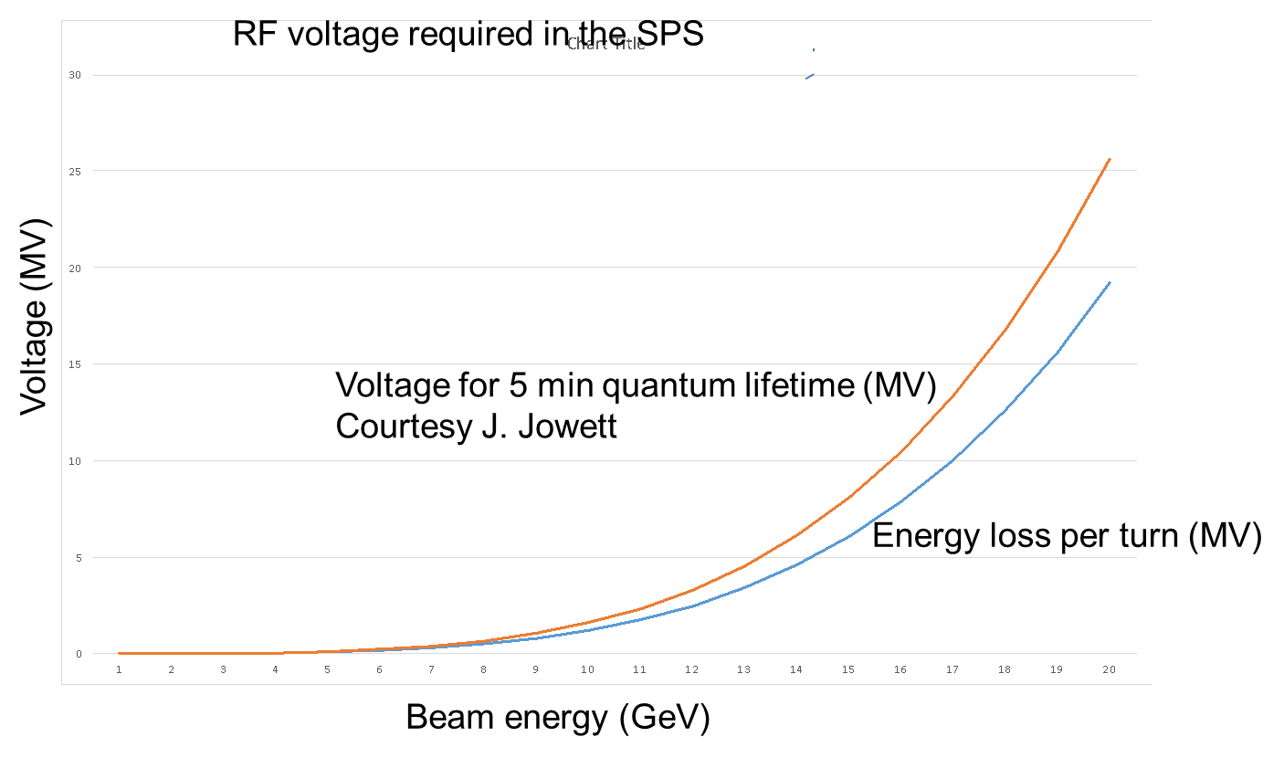
SPS RF system
200 MHz cavities from LEP era
  Need 10MV for 16GeV electrons
  We have kept (12 + 1) * 200 MHz Standing
  Wave Cavities [1 MV per cavity] in storage
  area, in very good condition.
  We only have few of the peripherals
  (amplifiers + HOM couplers + FPC + Tuners),
  but these can be rebuilt within 2-3 years if needed
Preliminary estimate of longitudinal broadband impedance
  It is based on the numbers from SL-note-96-49 by Linnecar and Shaposhnikova
  12 cavities will increase Z/n of SPS by about 10% (with fundamental mode dampers/plungers in)
[1] Talk by A. Grudiev and E. Montesinos, SPS RF for eupdate, March 1st 2018, CERN
indico.cern.ch/event/703049/
Notes:
For quantum lifetime need 12MV to bring to 16GeV

Slide 9
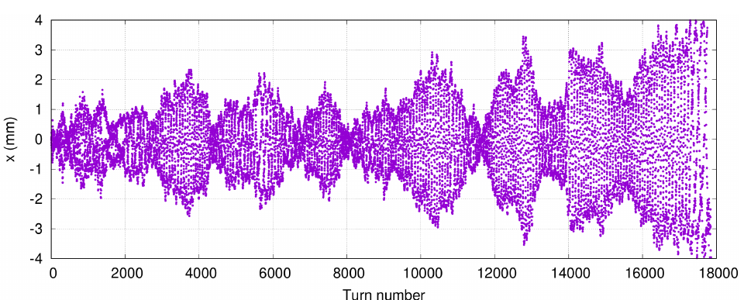
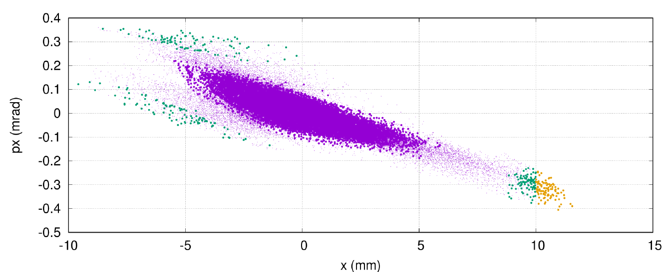
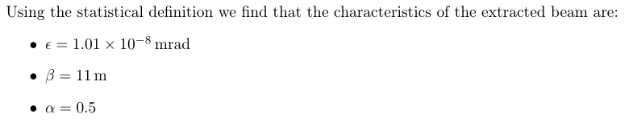
SPS slow extraction driven by quantum diffusion
Stochastic motion of a single particle in presence of synchrotron damping and quantum excitation.
Particles in orange are kicked by the septum and extracted while their position on the 3 previous turns are showed in green.
In purple is the position of the particles during the 1000 turns before extraction.
Quantum excitation provides the stochastic process for extraction. Control of extraction rate through the distance to resonance in tune space.
Analytical model being developed for extraction rate and power supply ripple effect (J. Prieto, TE-ABT-BTP).
Very low emittance and flat beam extracted
[1]Talk by P. Schuster
Exploring Hidden Sector Physics with an electron beam facility Physics beyond collider annual workshop November 21 2017, CERN indico.cern.ch/event/644287/contributions/2762531/
[2] Y. Dutheil , SPS electron slow extraction, March 1st 2018, CERN
indico.cern.ch/event/703049/

Slide 10
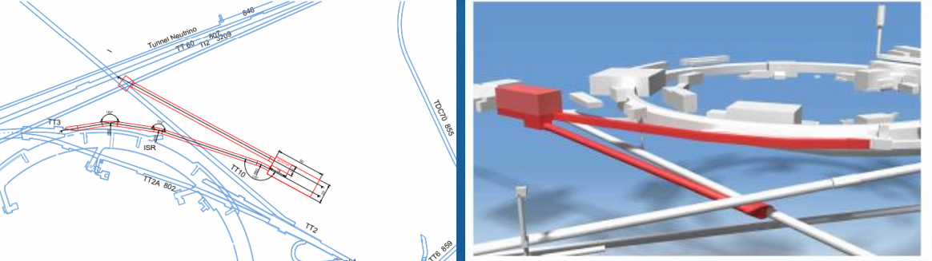
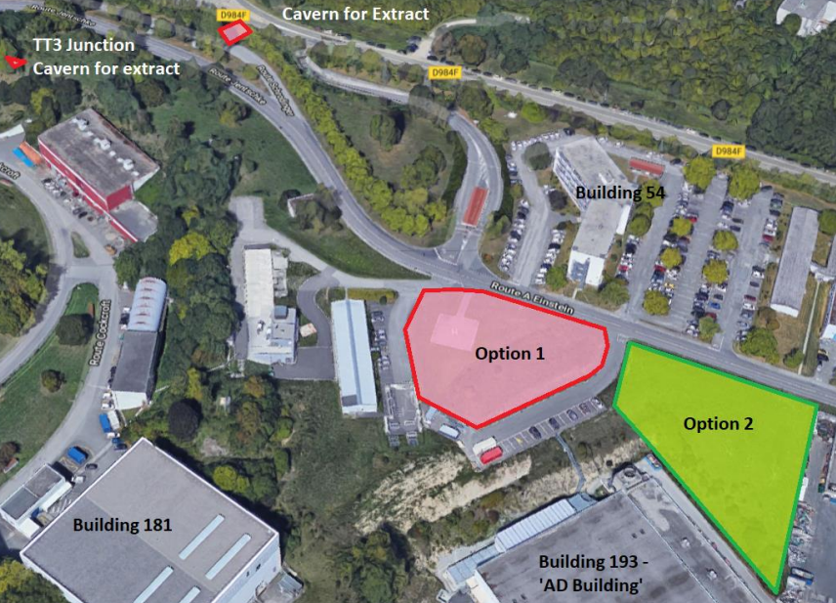
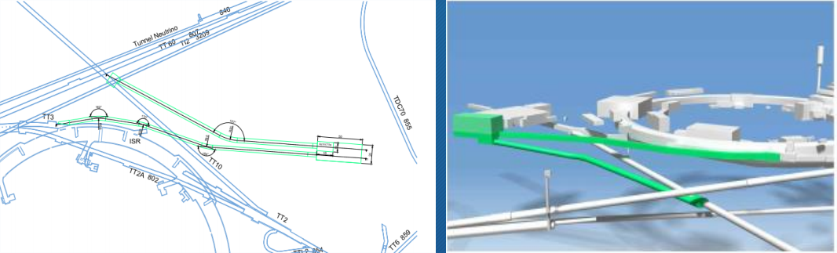
Civil engineering for target and transfer
2 options considered
  Option 1 – ‘Helipad Option’
  Option 2 – ‘AD building Option’
[1] J.A. Osborne and J. Gall, Civil engineering – experimental hall, March 20th 2018, CERN, indico.cern.ch/event/715324/

Slide 11
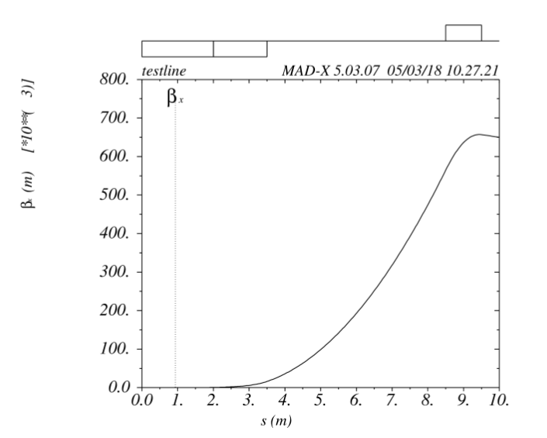
SPS to target transfer line
Uses TT10 line, specifics remain to be studied
Extracted beam would be small and very flat
Collimation in the line for control of beam size and intensity
Instrumentation:
  Very low intensity for operation could be measured in intensity and position using fiber monitors[1]
  Setup could be done at higher intensity using higher
  extraction rate
Beam size could be increased at the target to
increase maximum rate per bunch.
For instance a 20cm wide beam is feasible
[1] R. Jones, Instrumentation challenges, March 1st 2018, indico.cern.ch/event/703049/
Notes:
TT10 was designed for 10 to 20 GeV

Slide 12
User groups and communities
Physics (main driver)
  LDMX
  Other experiments, incl. dump-type experiments using available higher intensity
Plasma studies with electrons
  Use rlectron (3.5GeV) beam as driver and/or probe – AWAKE WG (P. Muggli)
CLIC : Linac goes a long way towards a TDR verification of a klystron based CLIC
Plasma community in general and Linear Colliders: Positron production and studies (talk in next WG meeting 26.4)
Linear Collider related studies
  e-SPS as damping ring (also relevant for FCC-ee) and extracted beam for final focus studies (beyond ATF2)
General acc. R&D as in CLEAR today (plasma-lenses, impedance, high grad, medical, training, instrumentation, THz, ESA irrad.) ..
….. in all cases we have representatives in e-SPS WG ….

Slide 13
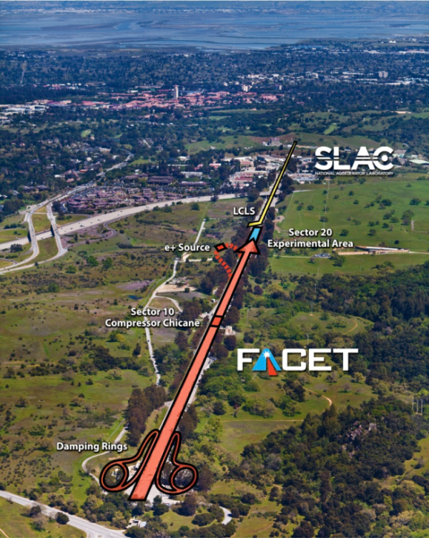

Positron PWFA Research Facilities
10GeV, 100 kA, e⁺/e⁻
2019
  There are only been two facilities that have provided positron beams for PWFA experiments: FFTB and FACET, both at SLAC.
  FACET-II is under construction at SLAC and will also provide positron beams for PWFA experiments.
  There have been no laser-driven positron acceleration experiments to date.
LCLS
FACET-II
LCLS-II
Presentation by Spencer Gessner

Slide 14
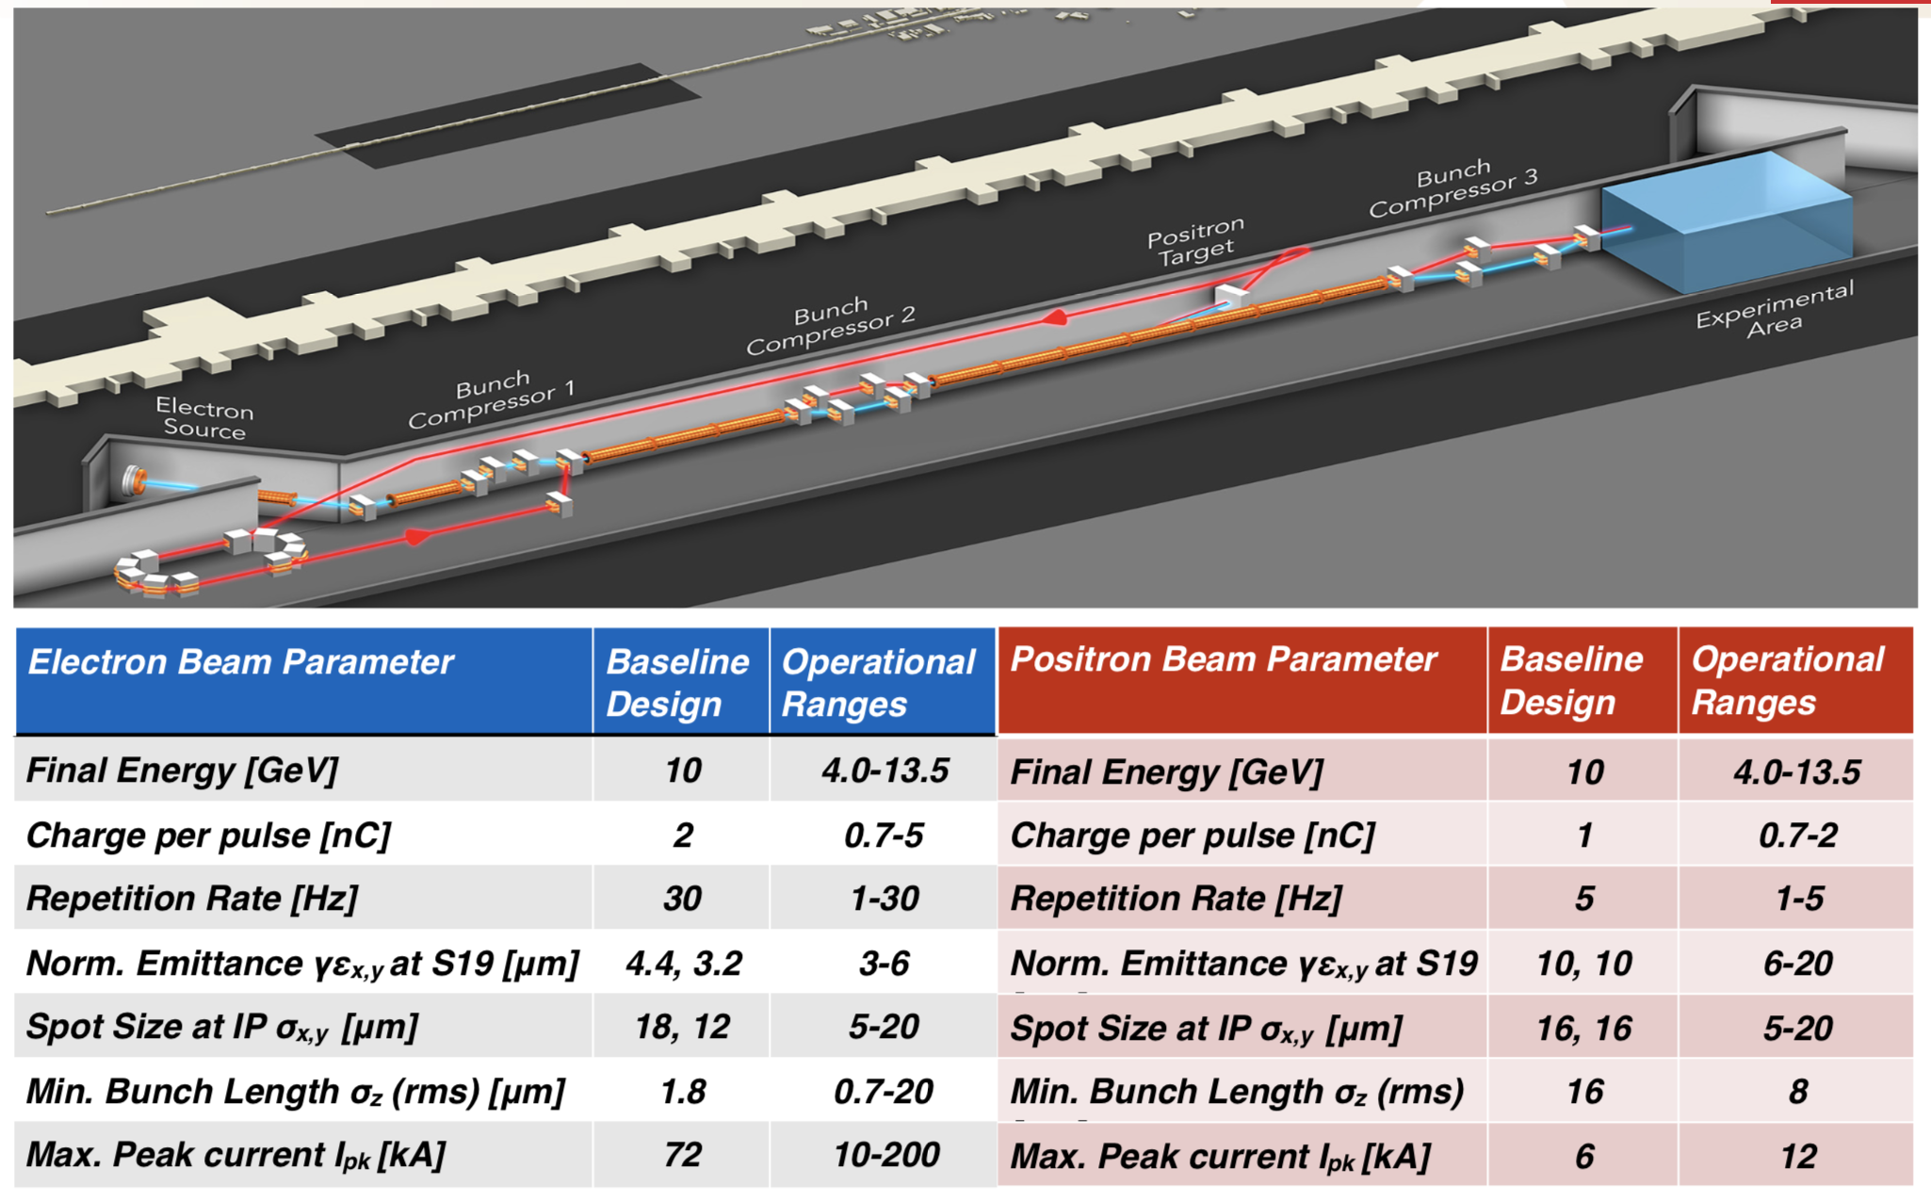
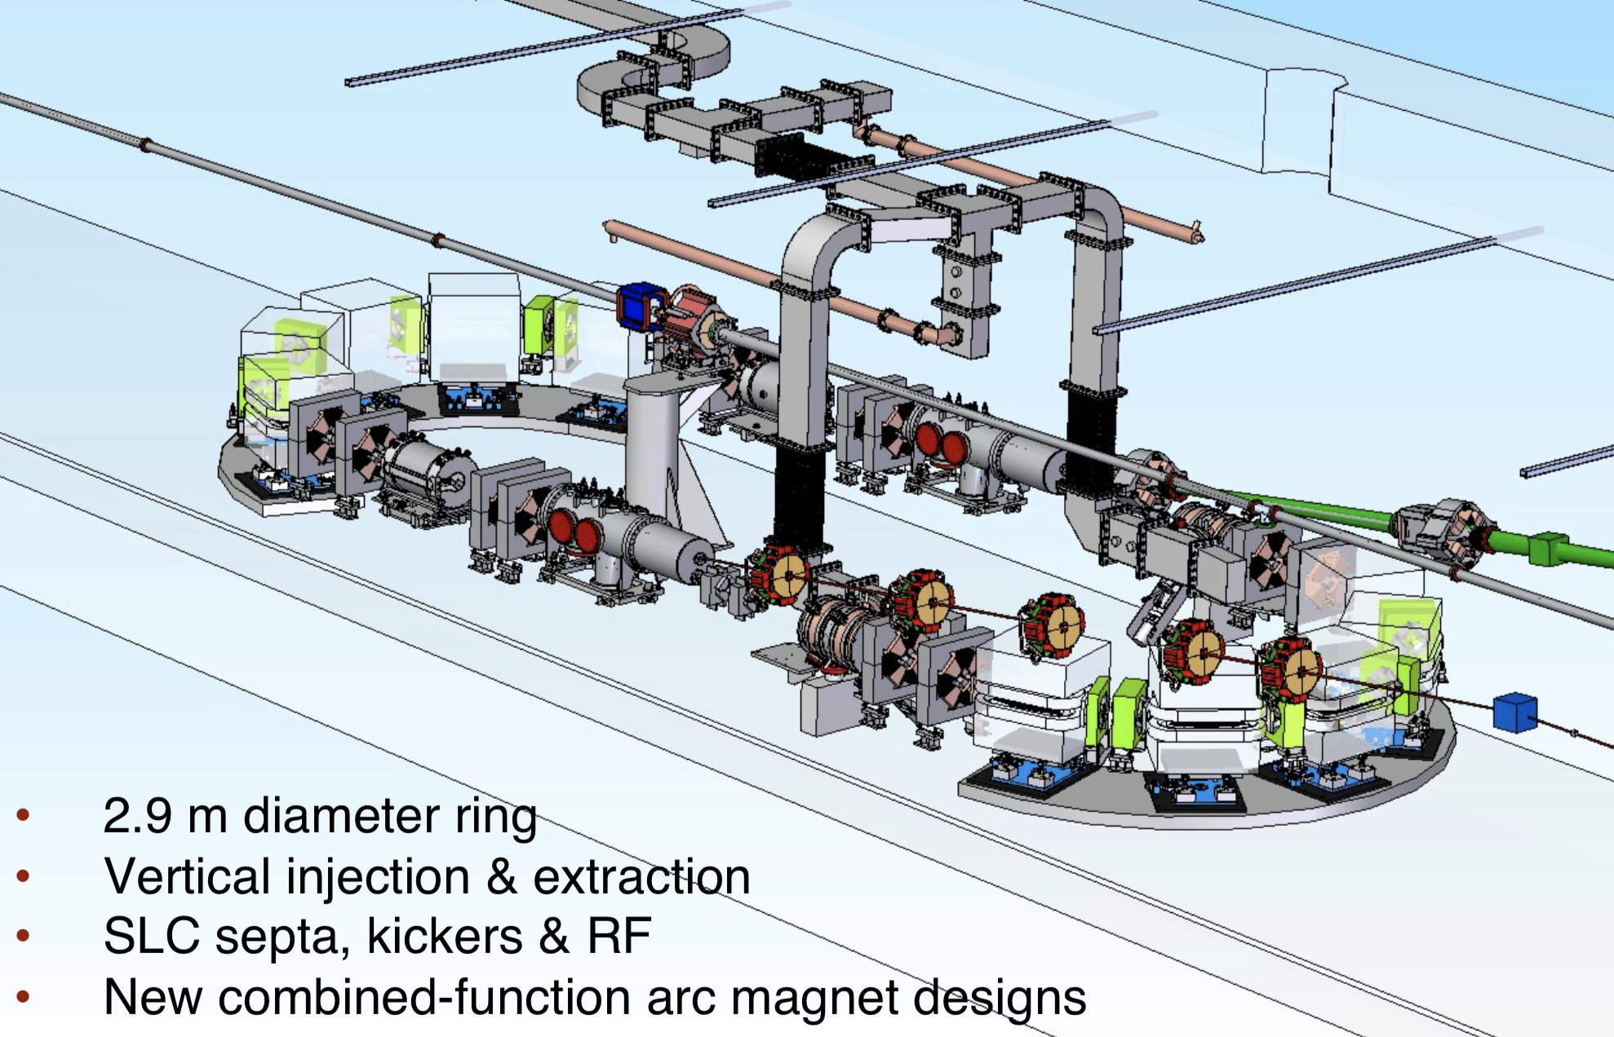
Positrons at FACET-II
FACET-II uses existing infrastructure to generate positrons from a high-Z target. The beam is captured and returned to a damping ring before being reaccelerated in the linac.
The compact damping ring is a new feature. It is 2.9 meters in diameter and hangs from the ceiling of the tunnel.
Spencer Gessner

Slide 15
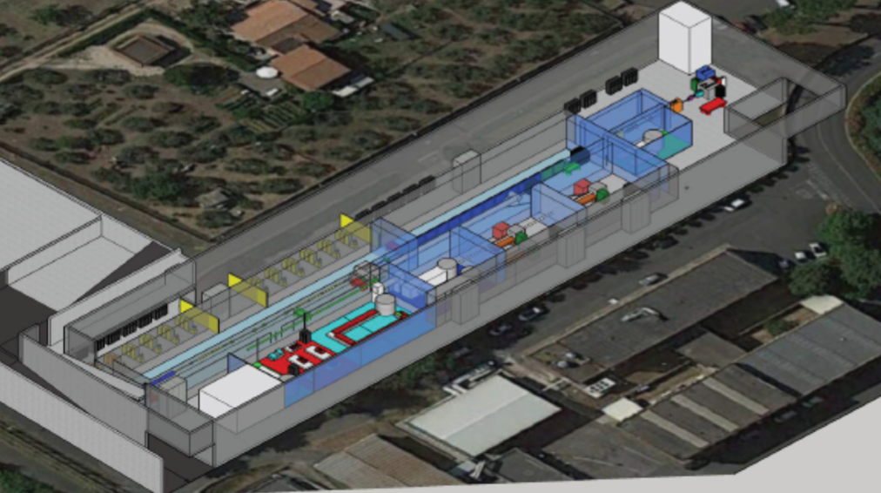
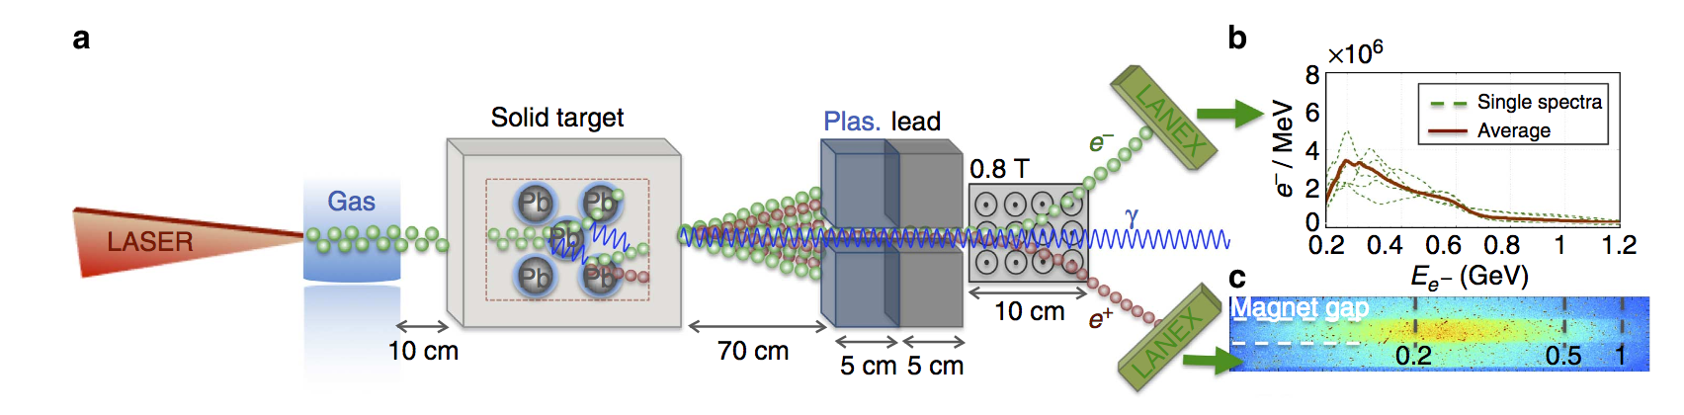
Positrons at EUPRAXIA
EUPRAXIA combines high-power laser technology with an x-band accelerator.
There is interest in generating positrons by using a laser to accelerate electrons in plasma, and collide the accelerated electrons into a high-Z target.
The positrons produced this way have a spectra that extends to the GeV-level and beyond depending on the laser parameters.
EUPRAXIA @ LNF
G. Sarri, Nat. Comm., 6747, 2015
Spencer Gessner

Slide 16
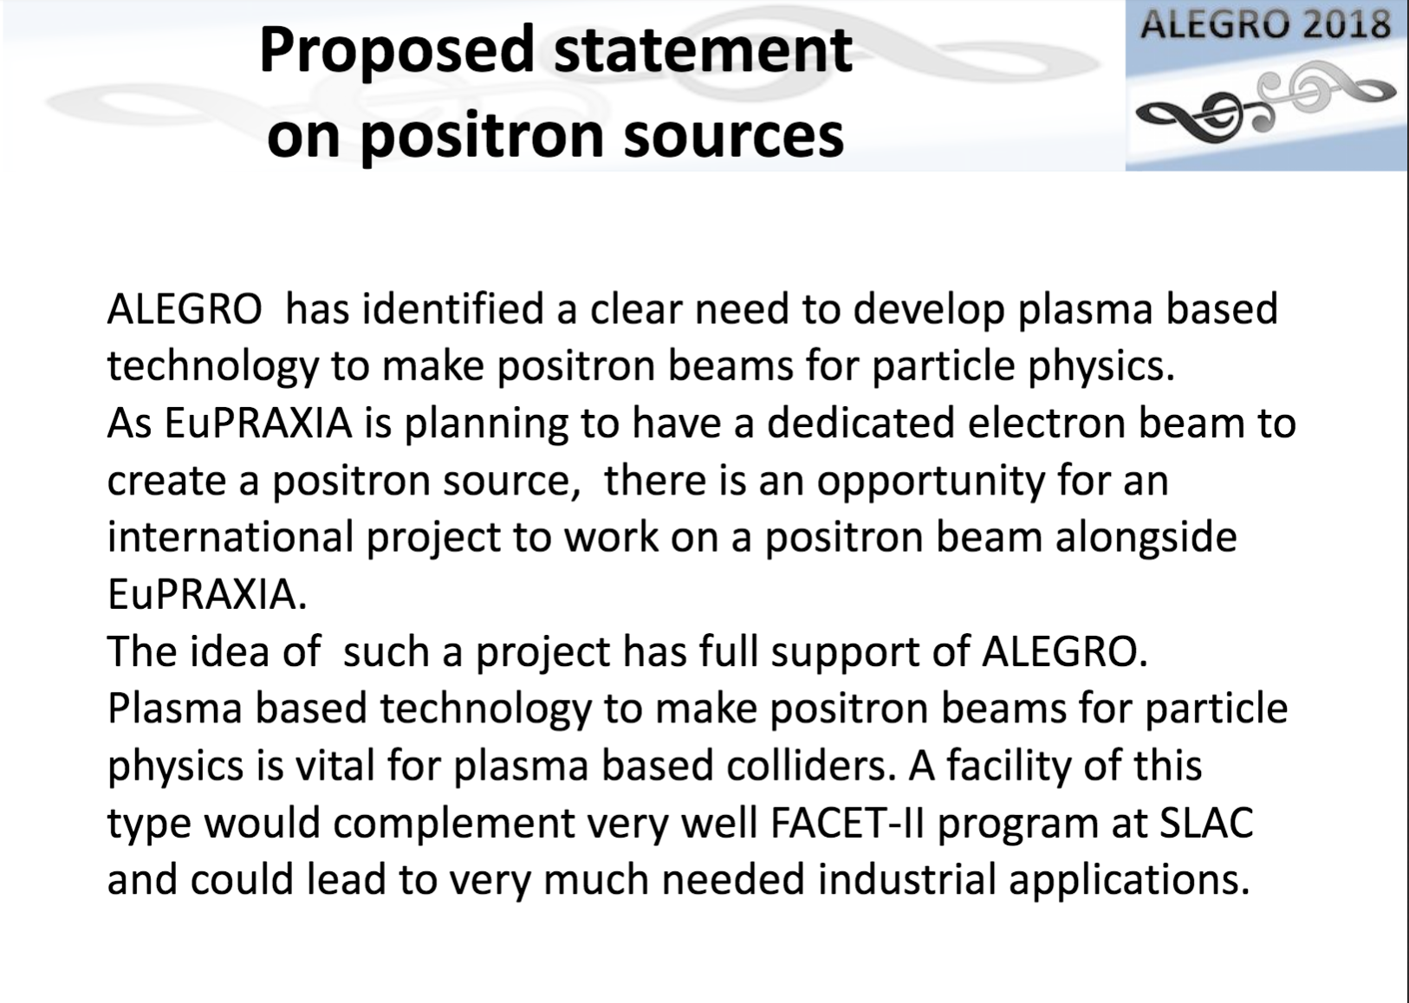
A Dedicated Positron PWFA/LWFA Research Facility
ALEGRO will provide input to the European Strategy Group.
A facility that can provide positrons for PWFA/LWFA research is a top priority!
B. Cros, ALEGRO Summary
Spencer Gessner

Slide 17
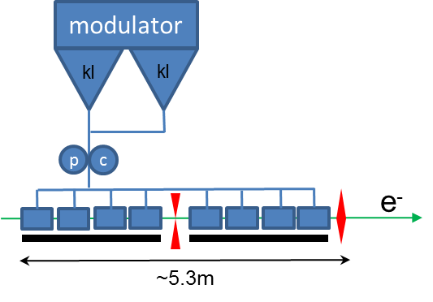
CERN Concept
Positron
Damping
Ring
Positron Return Line
Positron Capture
e⁺ ,e⁻, laser, to plasma
RTML
High-Z Target
e⁻ chicane
Electrons to target
injector
15m
70m
e⁺ ,e⁻ to chicanes
e⁺ chicane
Plasma cell, spectrometer, dump
A. Grudiev
PW-Class Ti:Sapph System
Spencer Gessner

Slide 18
Why CERN?
  There are already many “customers” for novel, compact, electron accelerators:
    X-Ray diagnostics
    Medical physics
    FEL science
  Groups throughout Europe are racing to develop PWFA/LWFA technologies with these applications in mind.
  The only reason to generate high-energy positrons is for high-energy physics.
  CERN is the only laboratory in Europe (the world?) dedicated to energy frontier physics. If CERN supports novel acceleration research in general, CERN should support positron acceleration research in plasma.
Spencer Gessner

Slide 19
Conclusion
Prospects of LDMX-type experiments at CERN was particularly well received by the physics and LDMX community
  Many interesting accelerator R&D prospects
Studies so far show no major issues to provide 16GeV electrons at CERN
Studies encounter large resonance in many groups and interest might well increase as investigations continue
  In particular other experiments such as dump-type high intensity at 16GeV or at 3.5GeV will be investigated
Notes:
Pbc 50/60 pages for the end of the year

Slide 20
An opportunity for ILC R&D
A 3.5 GeV electron beam would be a great opportunity
for R&D towards a ILC positron source.
Target experiments could be envisaged
What else ?
Notes:
Pbc 50/60 pages for the end of the year

Slide 21
CLIC news
Mainly busy with preparing the project implementation plan (PIP)
Focusing on optimized 380 GeV first stage of the machine
Cost and Power update
Input for the European strategy update
Continue to work on positron source optimization (see Yanliang’s talk)
Notes:
Pbc 50/60 pages for the end of the year

Slide 22
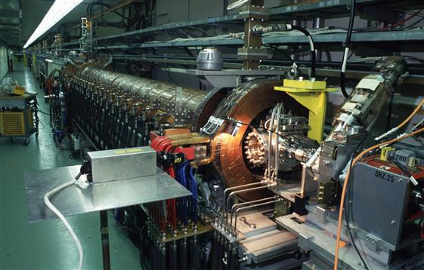

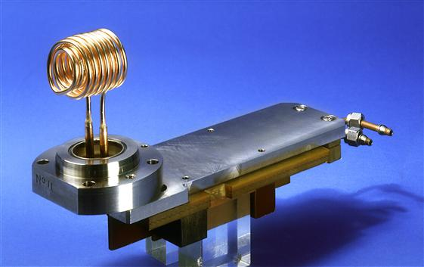
POSIPOL 2018 at CERN
September 3rd – 5th
Back to the roots / rocks !

Slide 23
POSIPOL 2018 at CERN
New topics to enlarge scope of the meeting
Other projects needing positrons: LHeC, FCC-ee, GBAR at CERN
Positrons for Plasma acceleration, Alegro
Target testing and simulations as well for non positron applications
Muon-collider, high energy positrons to produce good quality Muons
Othere related facilities, ThomX, …
Notes:
Pbc 50/60 pages for the end of the year

Slide 24
POSIPOL 2018 at CERN
September 3rd – 5th
Save the date
Registration will open soon :
https://indico.cern.ch/event/727621/
Notes:
Pbc 50/60 pages for the end of the year

Slide 25
Thank you
Asian Linear Collider workshop, Fukuoka

Slide 26
SPS considerations
Preliminary results predict no stability issues for the intensities considered[1]
  TMCI threshold is one order of magnitude away
Total supercycle of 40s possible [2]
  <1s injection with 100Hz linac repetition rate
  1s for acceleration and deceleration
  10s slow extraction
Possible Beam Instrumentation for Circulating Beam [3]
  Position : standard system down to 1e9 (limit ~5e8)
  Beam Size : Wire scanner and possibly SR
  Intensity : DC Transformer for total current
[1] Talk by Y. Papaphilippou, SPS beam stability, March 20th 2018, CERN indico.cern.ch/event/715324/
[2] L. Evans, Parameter overview, March 1st 2018, indico.cern.ch/event/703049/
[3] R. Jones, Instrumentation challenges, March 1st 2018, indico.cern.ch/event/703049/
Notes:
What intensity is considered

Slide 27
SPS extraction requirements
The detector requires very low intensity, in the order of a few electrons per bunch per turn[1]
Slow extraction is investigated. In general low and regular extraction rates are achieved by use of diffusion processes[2]
  Bunched extraction is mandatory. SR losses are too important and the beam would be lost immediately
  Chromatic extraction and RF noise to diffuse particles out of the bucket can be investigated
  Particle dynamic undergo stochastic motion due to the equilibrium between synchrotron damping and quantum excitation. The synchrotron radiation acts as a diffusion mechanism of particle actions. This was studied
[1]Talk by P. Schuster
Exploring Hidden Sector Physics with an electron beam facility Physics beyond collider annual workshop, November 21 2017, CERN indico.cern.ch/event/644287/contributions/2762531/
[2] Y. Dutheil , SPS electron slow extraction, March 1st 2018, CERN
indico.cern.ch/event/703049/
Notes:
Diffusion processes, for instance by using RF noise to difuse particles out of the bucker

Slide 28
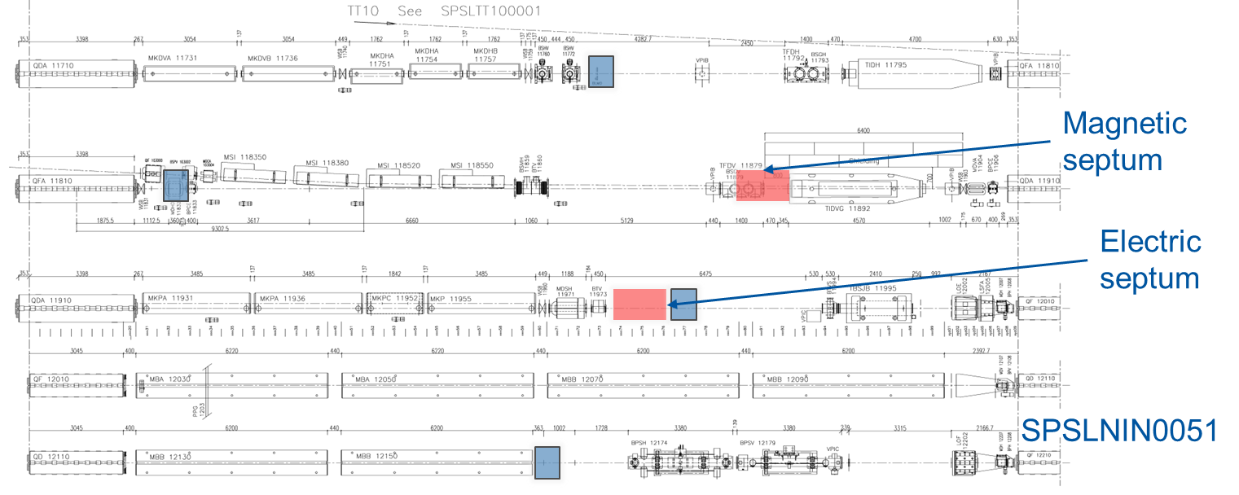
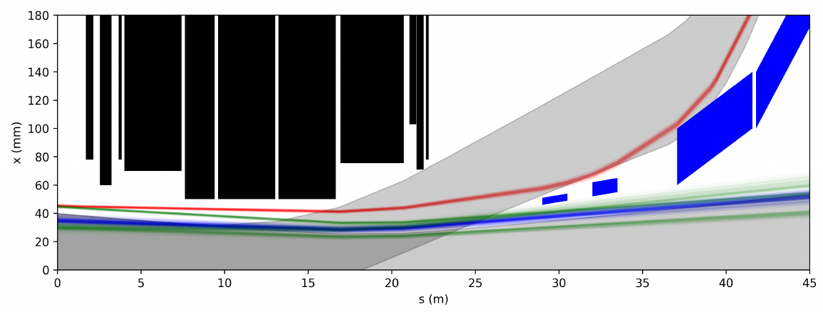
SPS slow extraction in LSS1
Extracted trajectories are in red while the 3 turns leading to extraction are showed in green. Blue trajectories correspond to circulating beam.
Electric septum is at s=0m.
Injected and circulating FT proton beam at 14GeV with margins is showed in grey.
MKPs
QDA.11910
New magnetic septa
New elements
Electrostatic septum 1.5m long and 5.0MV/m to provide 0.46875mrad kick at 16GeV
2 magnetic septa with realistic characteristics
MSIs
Proton, FT injection envelope
Notes:
Into TT10

Slide 29

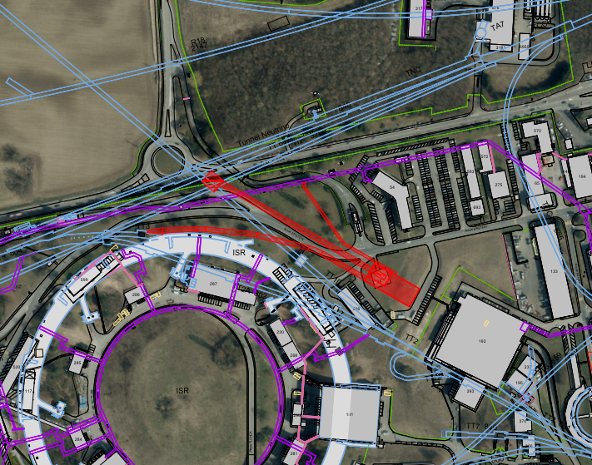
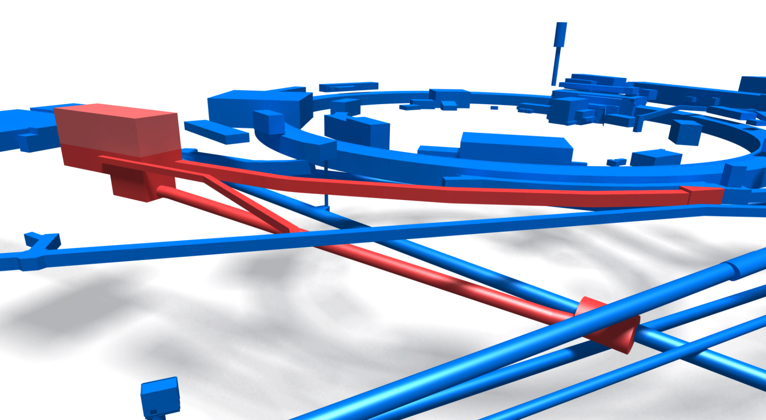
Chosen option – Option 1 - ‘Helipad Option’
Next iteration details:
  Junction caverns estimated
  Tunnels in molasse and moraines
  Building lowered to achieve required depth for TT10 tunnelling
  Technical gallery added for service supply
TT10 Junction Cavern
TT10 Extract Tunnel
Technical Gallery
TT3 Junction Cavern
TT3 Extract Tunnel
Detector/ Target Building

Slide 30
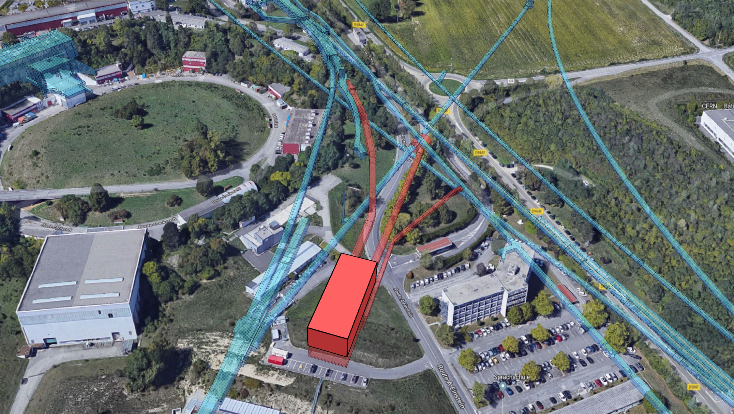
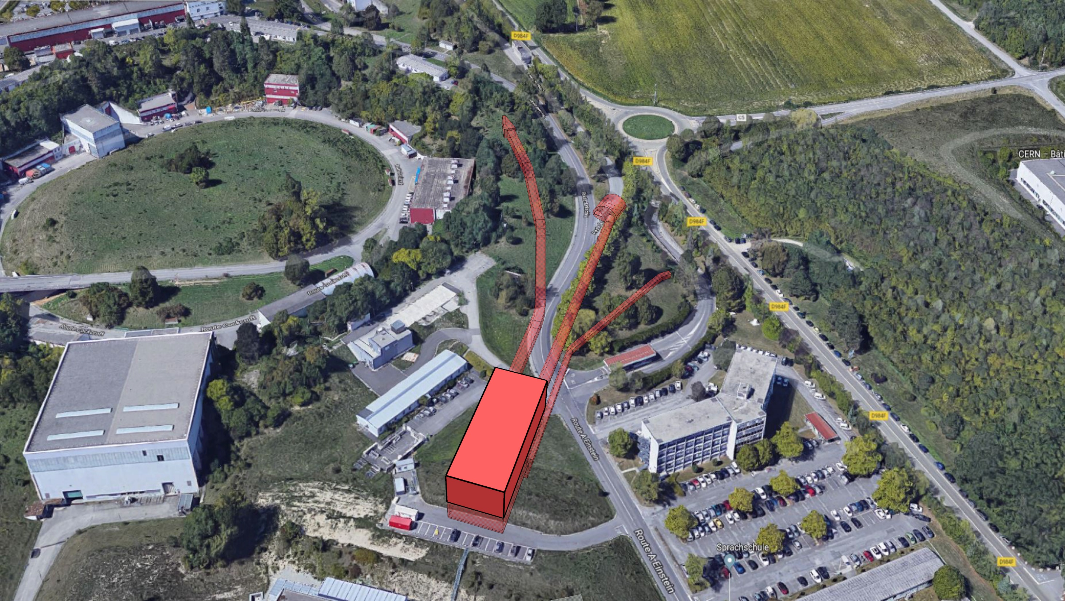
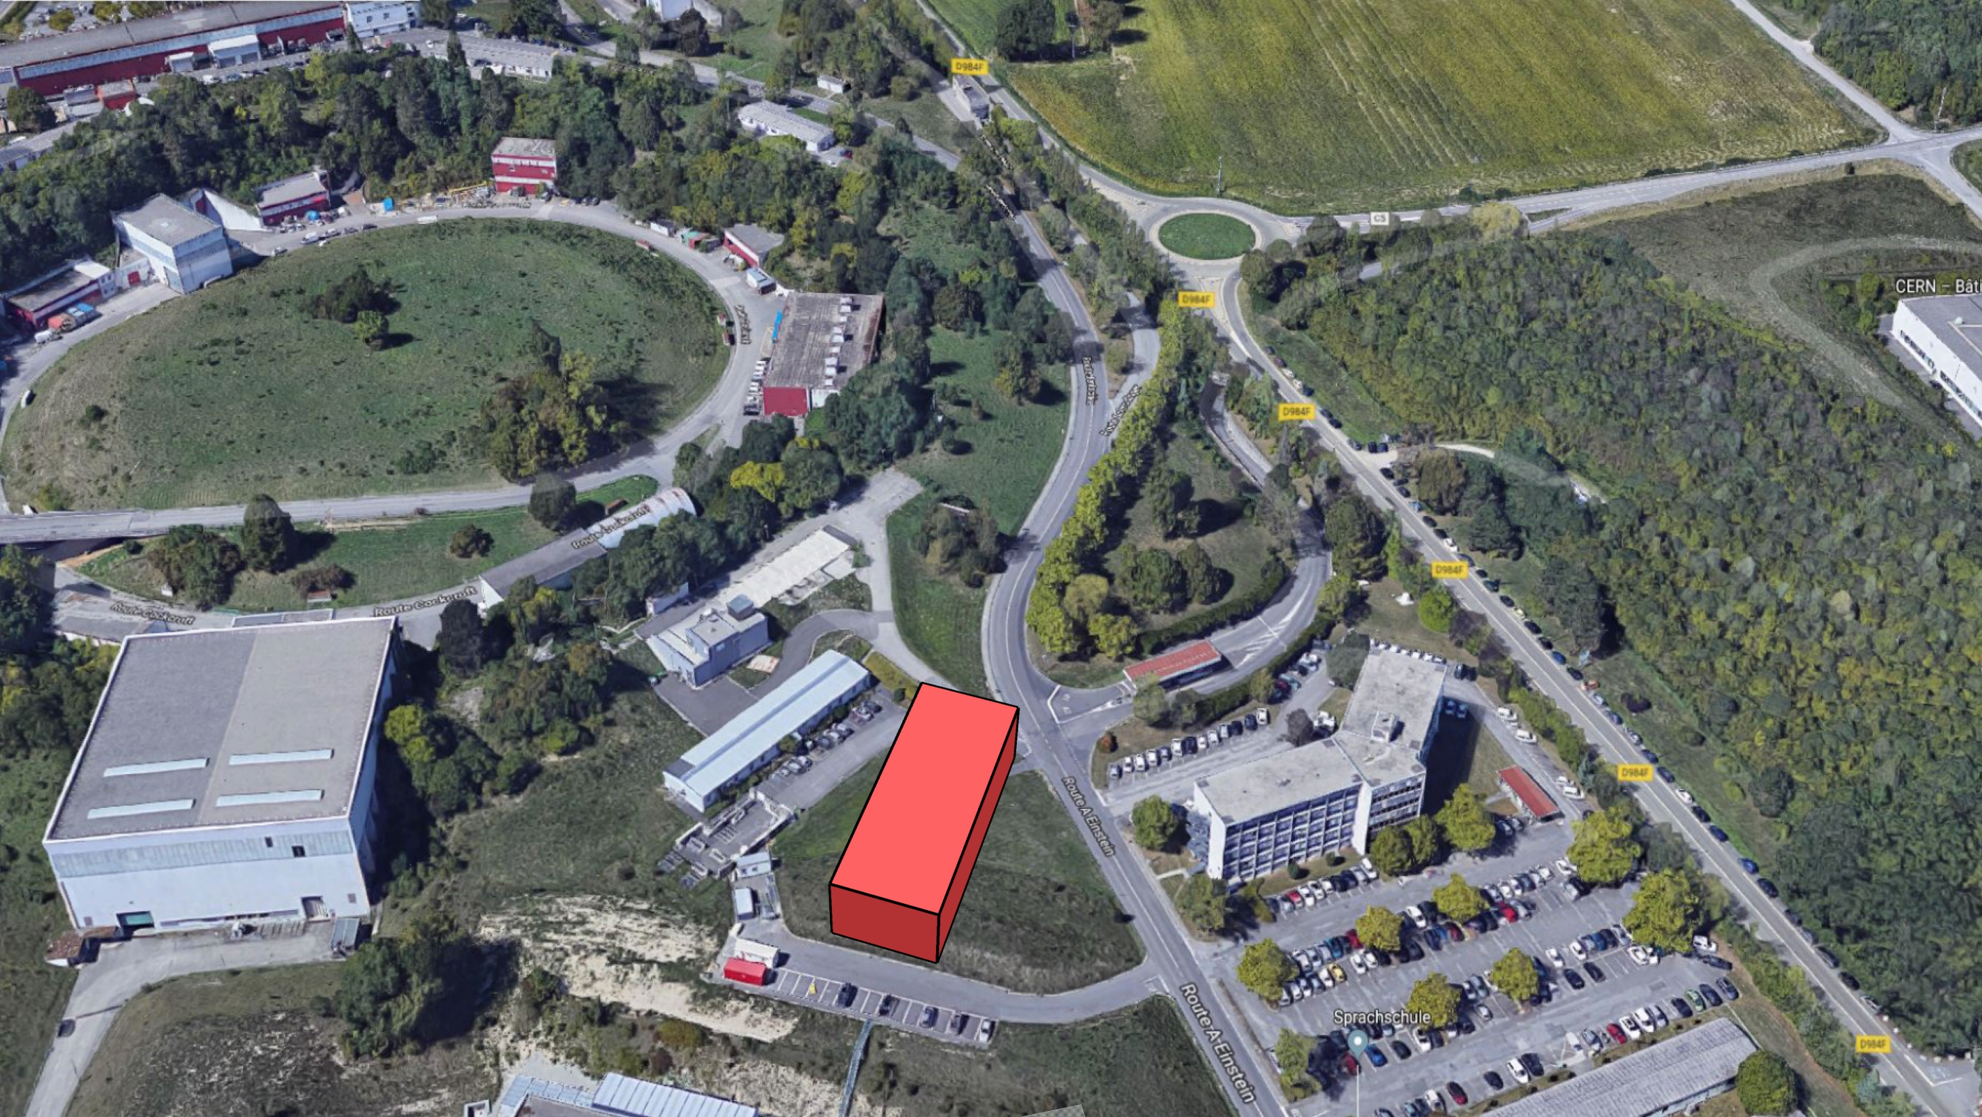
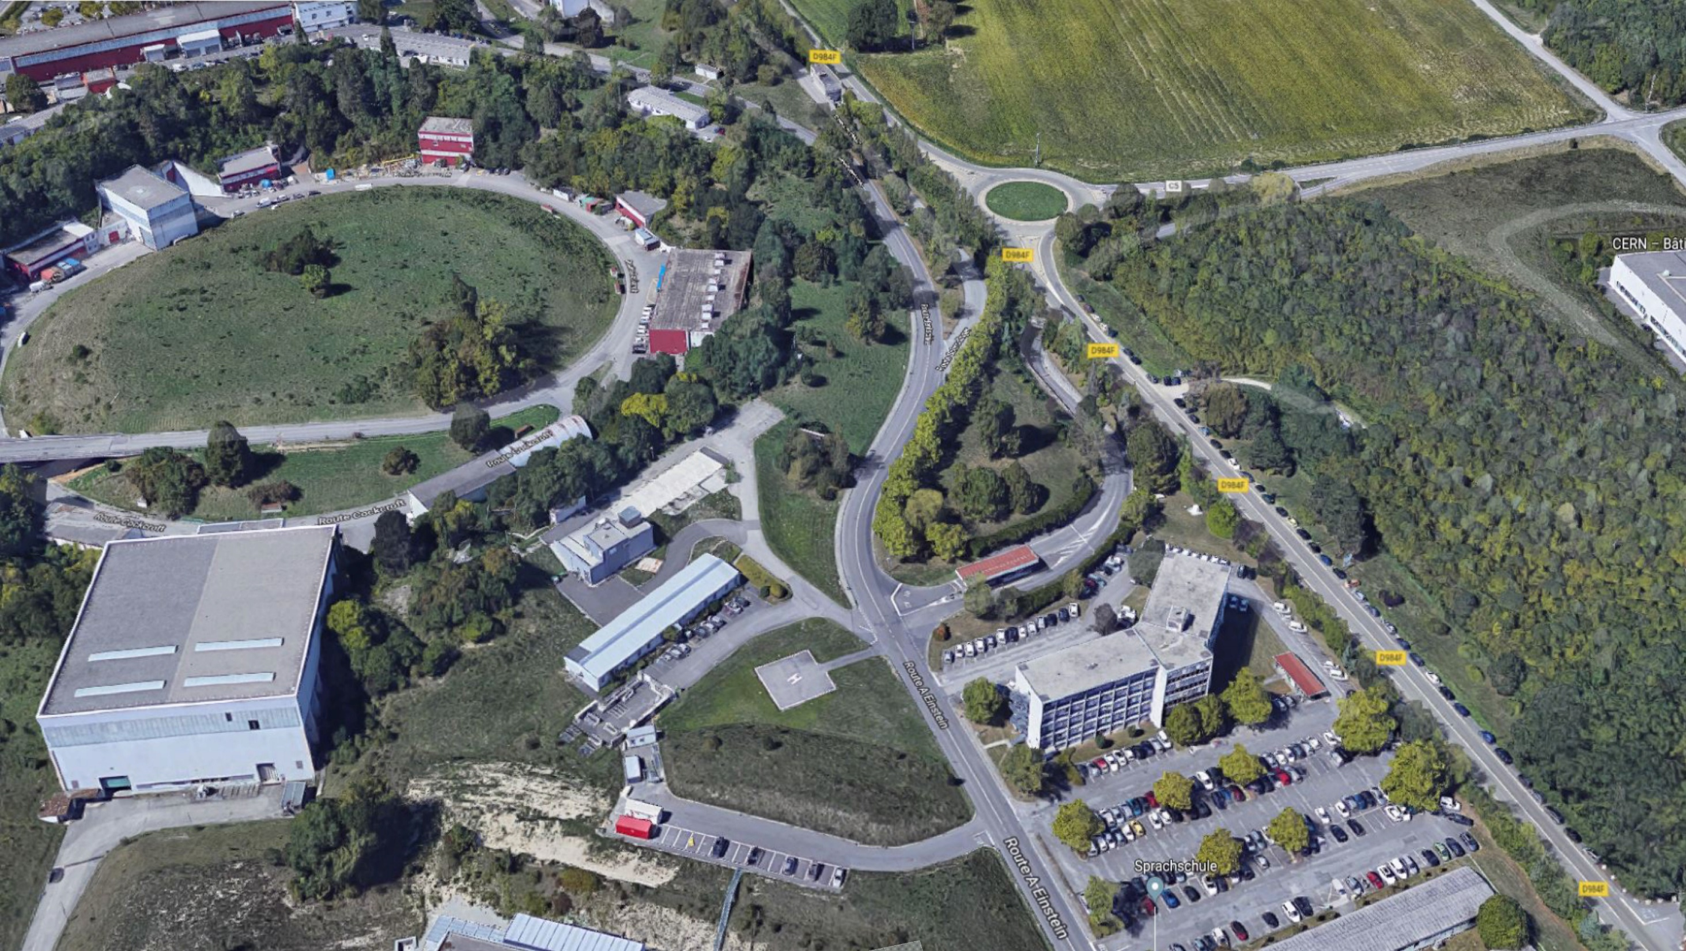
Next Steps – Civil Engineering
Any further requirement from civil engineering for European Particle Physics Strategy submission?
Conceptual design report
  Further design refinement
  Construction sequence feasibility
  Route Einstein Diversion and phasing to consider
  Service diversions to cost in some detail
  Discussion with adjacent building users to understand constraints
  Feedback to consider from all study group members

Slide 31
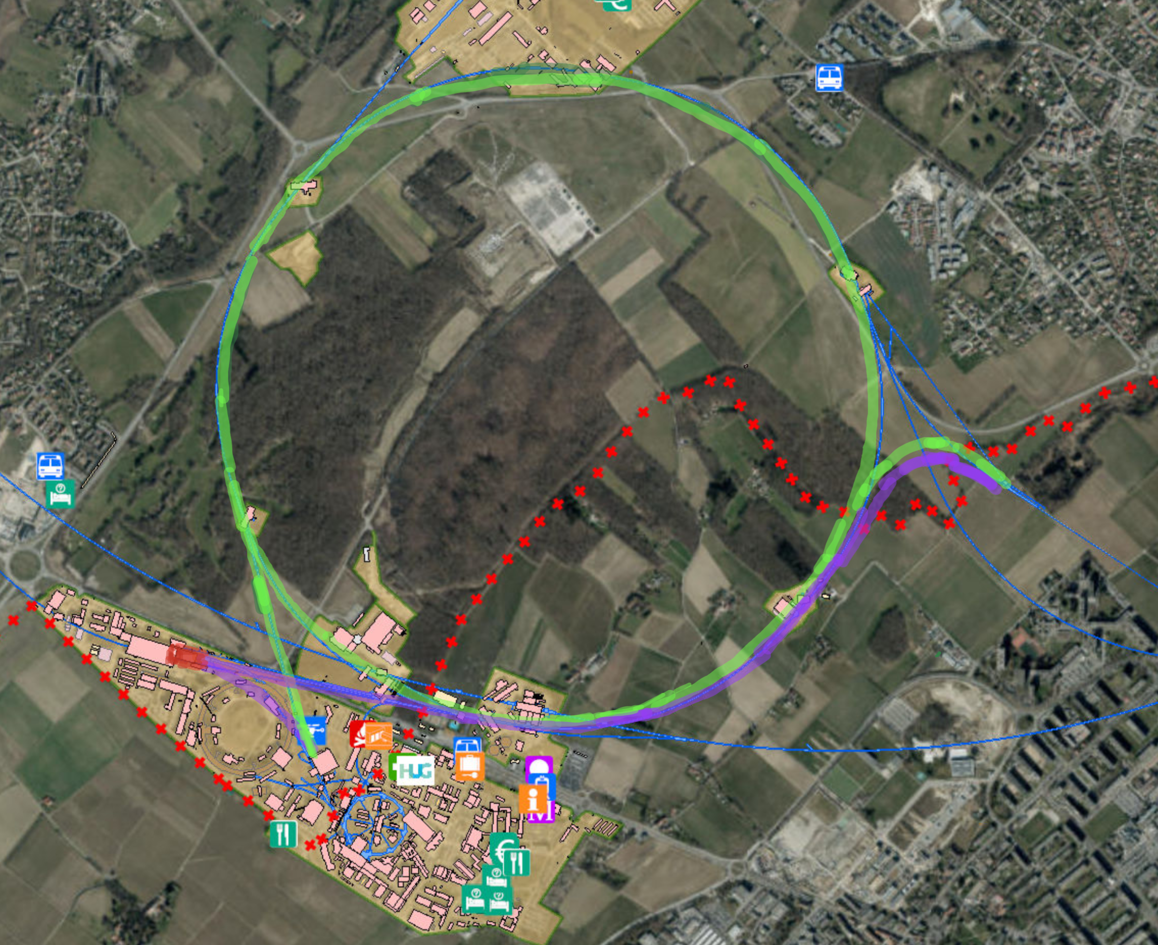
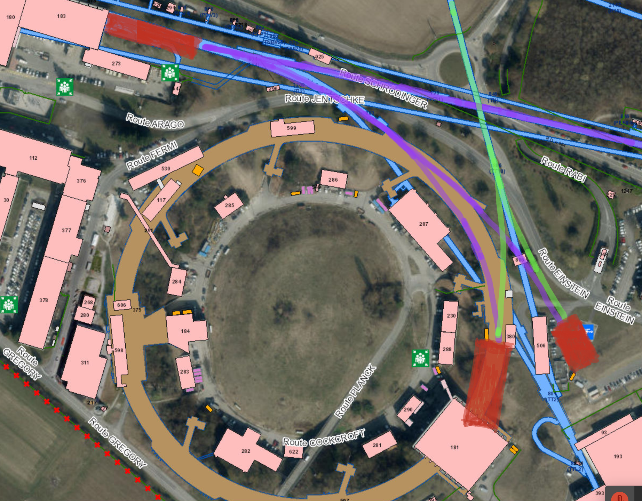
Four/five users groups:
Physics
CLIC TDR overlap large
e-AWAKE
CLEAR(er)
DR, positrons and ATF-like studies (possible)
GREEN: ~16 GeV electron beam in SPS
Acc. in SPS, can also be a damped small emittance beam. Long bunches.
Extracted to Meyrin side for LDMX like experiment.
Can also – possibly – be guided to AWAKE.
Other uses, either extracted or circulating to be worked out.
PURPLE: 3.5 GeV x-band linac with excellent beam quality
Short bunch electrons from X-band linac, only used 5% for filling the SPS. Can be used right after linac (TT4), in new experimental area, and/or possibly directed to the current AWAKE area.
CLEAR type of research progamme.
Electrons for drive and/or probe beam exploring novel accelerating techniques, including second gun (drive and probe bunches with variable distances and charges).
Longer term possibilities for positrons if deemed crucial

