Slide 1
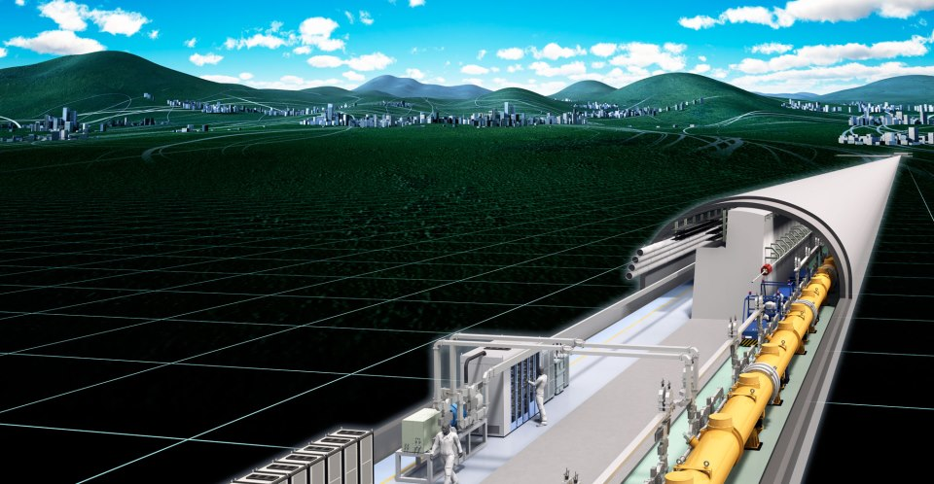
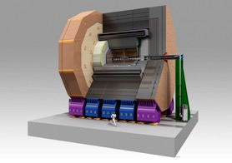



ILD status and plans
Annual ILC physics and detector meeting
2018.03.19-20
K. Kawagoe (Kyushu)

Slide 2
Now 72 groups including Iwate-U
T. Behnke@LCWS2017

Slide 3
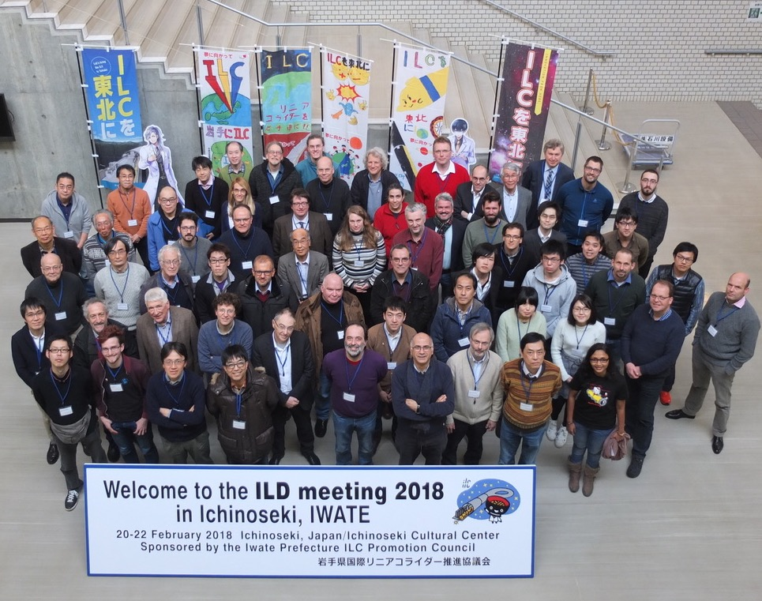
ILD is very active.
We had 64 participants at the ILD meeting in Ichinoseki (Feb 2018).

Slide 4
T. Behnke@LCWS2017

Slide 5
T. Behnke@LCWS2017

Slide 6
The Deliverable
Document ILD in a comprehensive way
Describe the ILD philosophy
Describe ILD subdetectors and options
Describe the ILD optimization process
This document should replace the LOI and the DBD
by a new, “complete” document.
ILD
Report
(tbd)
End 2018: a short version as input to the European Strategy
Early 2019: the full report
T. Behnke@Ichinoseki

Slide 7
Halina Abramowicz

Slide 8
EPPSU and ILC/ ILD
Physics/ detector group will provide a general document to make the
case for the ILC
  Physics, at different energies
Accelerator: LCC will provide input
ILD:
  Strongest role will be to demonstrate the community
  Affirm the science case
  Strongly point to the R&D done for ILD/ ILC
T. Behnke@Ichinoseki

Slide 9
Tentative structure of the document
The science case for the ILC
ILC environment
The ILD concept
ILD subdetector technologies
ILC global integration
Detector modelling for optimization
Detector performance on various levels for the two models
Updated cost model
Science with ILD
The ILD organisation
T. Behnke@Ichinoseki

Slide 10
The Science Case
Short summary of the ILC physics case, at the different center of mass energies. This is based on the recent papers published by the LCC physics group.
T. Behnke@Ichinoseki

Slide 11
ILC environment
Overall ILC constraints
Could be adapted from LoI intro
Updated beam conditions since DBD: new L*, backgrounds, energy profile …
plots from machine study group
Initial focus on 250 GeV with future upgrades to higher energies
250 GeV specific machine performance,
Performance aspects to be anticipated for higher energies
T. Behnke@Ichinoseki

Slide 12
The ILD Concept
The ILD overall concept: low tracker material, high granularity, particle flow, triggerless …
main arguments from the LoI reference for sizes, B, depth, etc…
Further optimization: the 2 global size options and their rationale
1 DBD-like as reference and 1 smaller radius/same length
Michael’s aspect/ratio performance plot
T. Behnke@Ichinoseki

Slide 13
ILD Subdetector Technologies
Overall detector structure
Subdetector layouts including updates (VFS, calo layers, silicon trackers…)
Open options for non-resolved issues: TESLA/Videau, anti-DID, calo and vertex sensors, TPC readout technology
Subdetector prototypes and beam test results
Structure of latest technological prototypes, performance plots from beam tests
Possible future options: where do we see major new opportunities,
or developments, for an ILD detector on 5 / 10 years timescale
T. Behnke@Ichinoseki

Slide 14
ILD Global Integration
Internal integration:
Subdetector interfaces (based on interface documents) and integration scheme incl. Services
External integration:
Ancillary services in the cavern and on surface
Expected data throughput per subdetector and DAQ farm
Mechanical structure studies:
deformations, stability, calo integration issues …
Coil studies:
updated field maps, technological options for anti-DID
Beam background studies: beam-beam w and w/o anti-DID, backscattered neutrons …
Alignment/calibration procedures
Could be adapted from LoI/DBD, but would profit from additional work
T. Behnke@Ichinoseki

Slide 15
Detector Modelling for Optimization
New DD4HEP framework
GEANT4 level of details
hybrid options for calorimeters
Digitisation implementation
Method for BG overlap and anti-DID inclusion
Validation of the detector models
T. Behnke@Ichinoseki

Slide 16
Detector Performance
Updated reconstruction and analysis methods
Response to individual particles
Global tracking and vertexing performance
Global response including particle flow
ideally using both Pandora and Arbor for mutual cross-checks
Performance on a few physics benchmarks
T. Behnke@Ichinoseki

Slide 17
ILD Cost
Costing methodology
Cost model for each subdetector
  Work Breakdown Tables
Scaling of Costs with main detector parameters
T. Behnke@Ichinoseki

Slide 18
Science with ILD
Ideally: report on the braod set of physics channels which have been studied
within ILD
This should be the ultimate place to find how ILD does on a particular analysis
Challenge: consistency, as we will not have a full set of analyses ready
in the new framework etc
T. Behnke@Ichinoseki

Slide 19
Science with ILD
Higgs physics
  Higgs mass, width
  Branching Ratios
  CP properties
  ttH
  Higgs Self Coupling
  …
Top physics
Standard Model physics
BSM at different energies
Rare processes
…
A rather complete list of results
would be highly desirable, even
if they are not all obtianed with the
exact same detector.
T. Behnke@Ichinoseki

Slide 20
ILD as an organisation
ILD rules and by-laws
The ILD collaboration
Statistics on ILD: where, what, etc.
T. Behnke@Ichinoseki

Slide 21
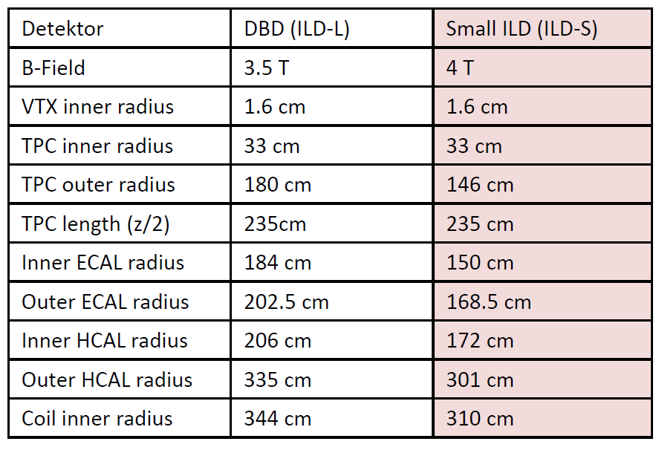
A Reminder
ILD_L
ILD_S
Have converged on
two geometric ILD
models (ILD-S and ILD-L)
as “boundaries” for the
optimization
Both models now are
available in simulation
ILD-S
Same length as ILD-L
Size similar to CLIC for
maximum synergies
Concept same as ILD-L
Decided on ILD meeting in Santander, 2016
T. Behnke@Ichinoseki

Slide 22
Optimize the ILD detector
Single particle Studies
Response studies focussed on one sub-detector
“easy”, low resource needs, fast
High Level performance studies
Tracking, vertexing, particle flow
Based on dedicated, maybe even unphysical samples
Based on multiple subdetectors
Physics Performance
Selected physics channels to study performance for
key measurements
Need full samples, including backgrounds
Increasing complexity
Increasing demands on samples
Do the optimization with a clear view on the physics we want to do!
T. Behnke@Ichinoseki

Slide 23
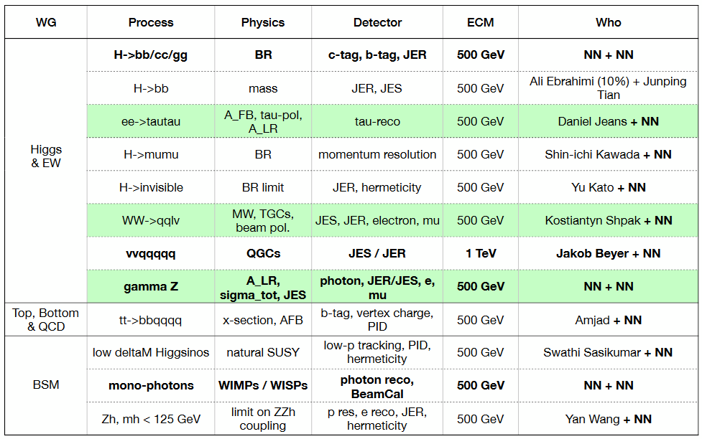
Benchmarks
T. Behnke@Ichinoseki

Slide 24
Time Schedule (tbc)
1
2 | ILD workshop
3 |  |  | Determine editors for ILDD
4 |  | Start Production | Setup infrastructure for contribution
5 | Fukuoka WS
6
7 |  | End Production ???
8 |  |  | First versions available
9 |  |  | First draft ESUP ready
10 | Arlington WS
11 |  |  | Final version ESUP | First complete version ILDD
12 |  |  | ESUP delivery: 18.12.2018
T. Behnke@Ichinoseki

Slide 25
Discussion
Our resource is limited.
Short term: How can we efficiently contribute to the ILD group, especially to the ILD document ?
Long term: How can we increase our resources, especially in case of “Green signal”.
  Man power
  Funding

