Slide 1


ATF2 December Shifts
R. Ramjiawan, D. Bett
Monday, 18th December 2017

Slide 2
Shift Outline
1-BPM feedback (Tuesday owl)
  Nominal optics
  0dB,
  1-BPM feedback stabilising at IPC,
  C-band BPFs in place,
  Noise floor removal.
2-BPM feedback (Friday day and swing)
  High beta optics,
  10dB,
  2-BPM feedback at IPB,
  Noise floor removal.

Slide 3
1-BPM Feedback
ipfbRun18
Calibration file: AQD0FFyScan1

Slide 4
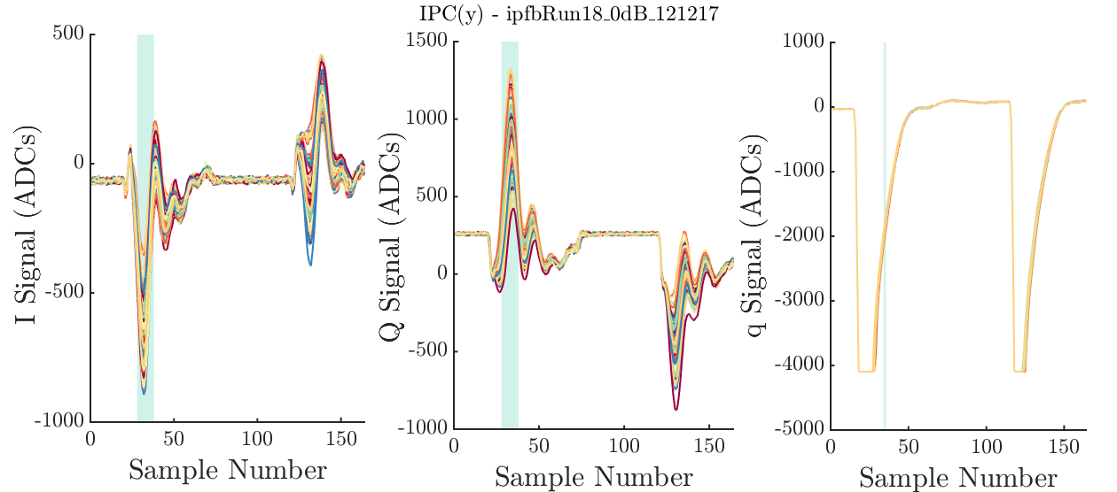
Waveforms
Effect of noise floor removal channel offset

Slide 5
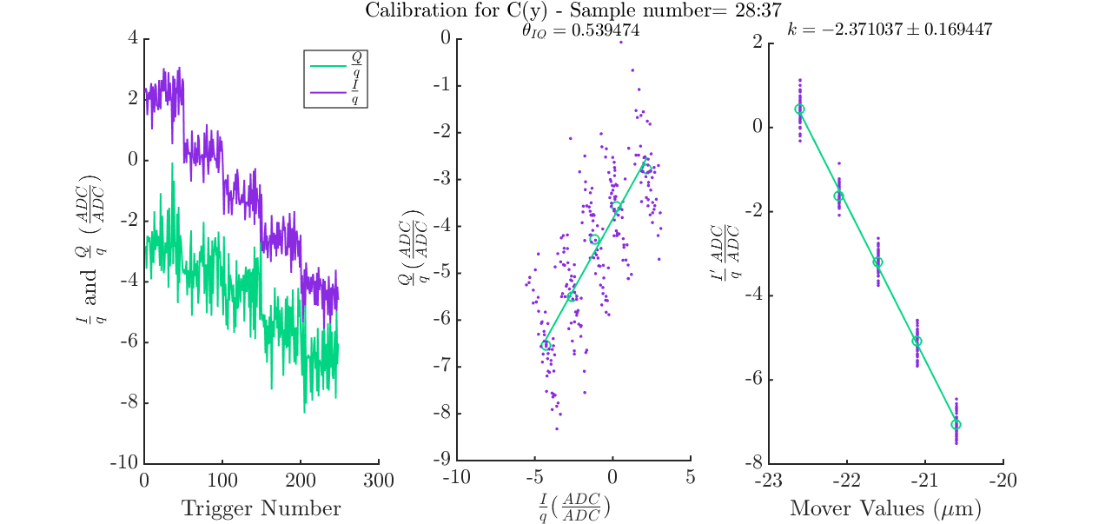
Calibration IPC
Scaled calibration constant:
k=-0.237
We tried to reduce Q’ to reduce the effect of the phase jitter on the position measurement.
Phase jitter

Slide 6
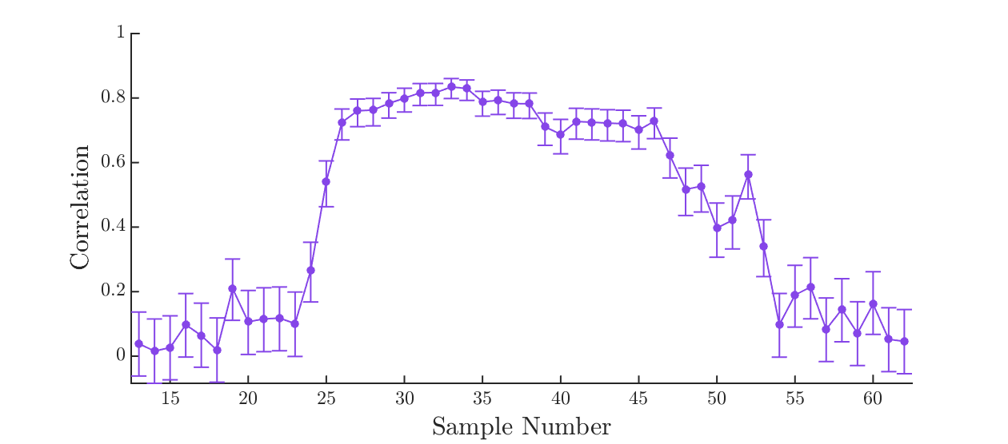
IPC Single Sample Correlation
Sample range used for feedback

Slide 7
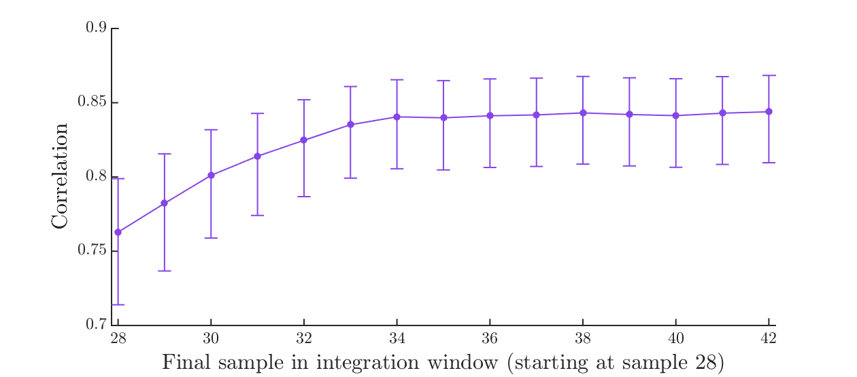
Integrated Sample Correlation
Sample range used for feedback

Slide 8
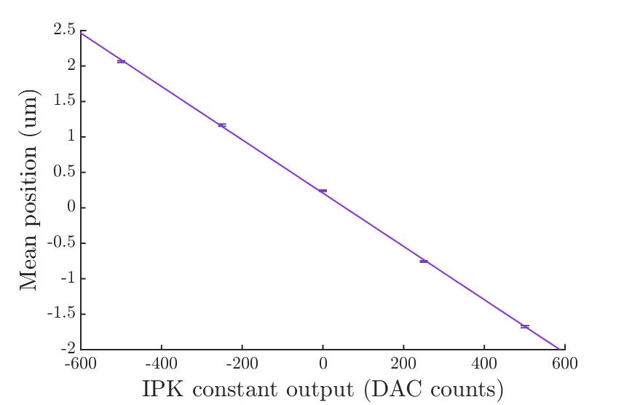
Kicker Calibration IPC
Gradient -0.0038 (um/DACs)
R²=0.99968
Standard errors given.

Slide 9
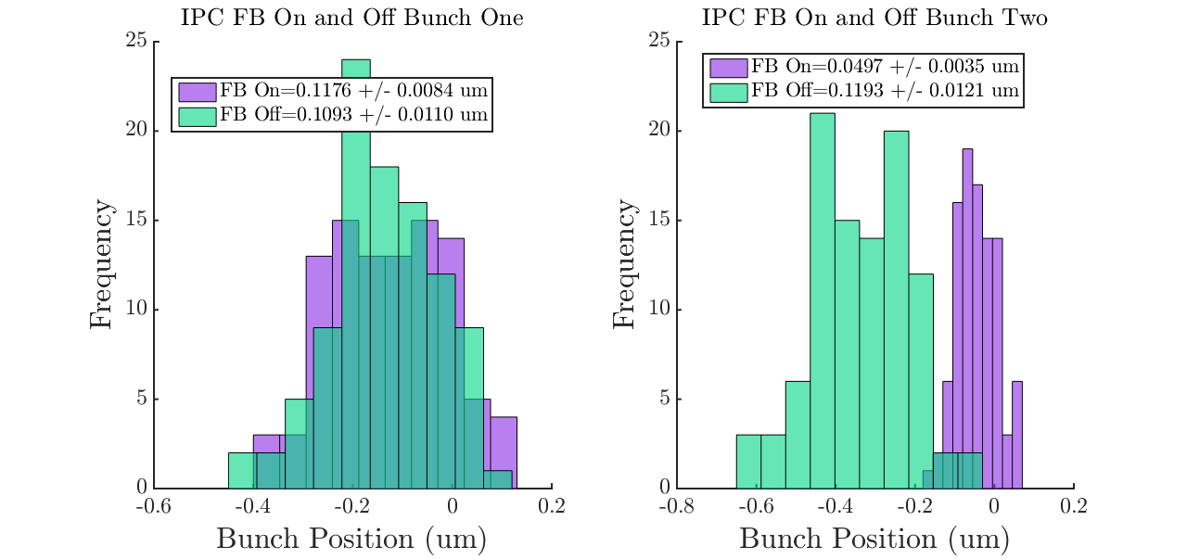
1-BPM Feedback Performance
Feedback integration window: 28:37
Analysis integration window: 28:37
Triggers cut:
290 372
Feedback on jitter: 49.7 nm

Slide 10
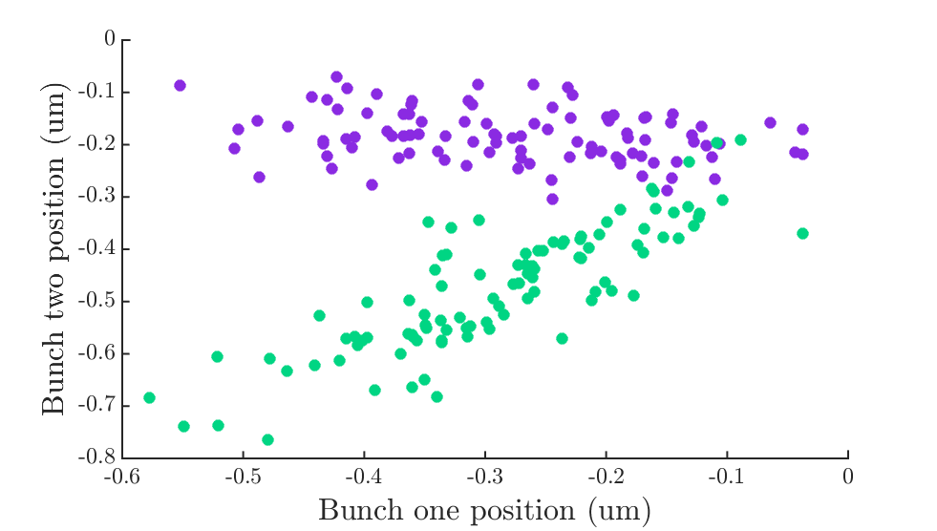
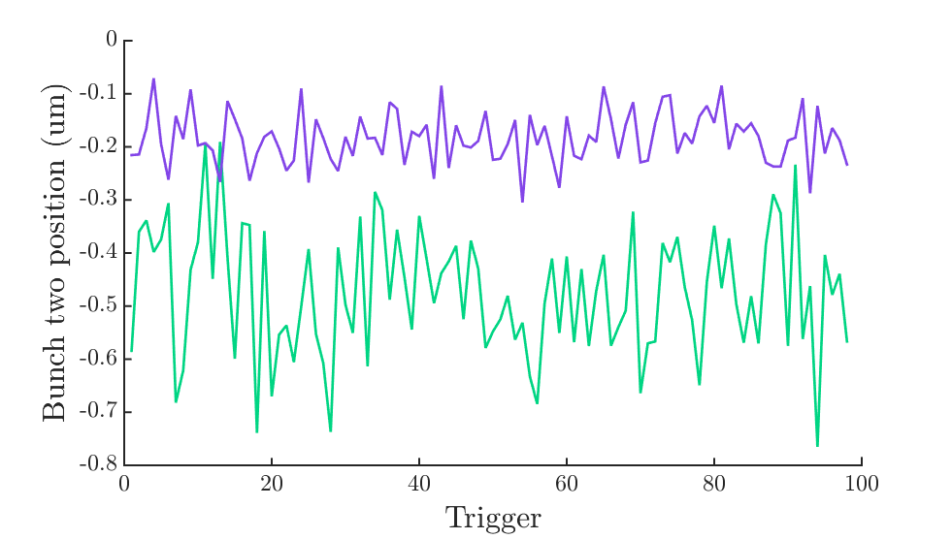
Feedback Performance
Correlation feedback on: -26%
Correlation feedback off: 84%
Purple: FB on
Green: FB off

Slide 11
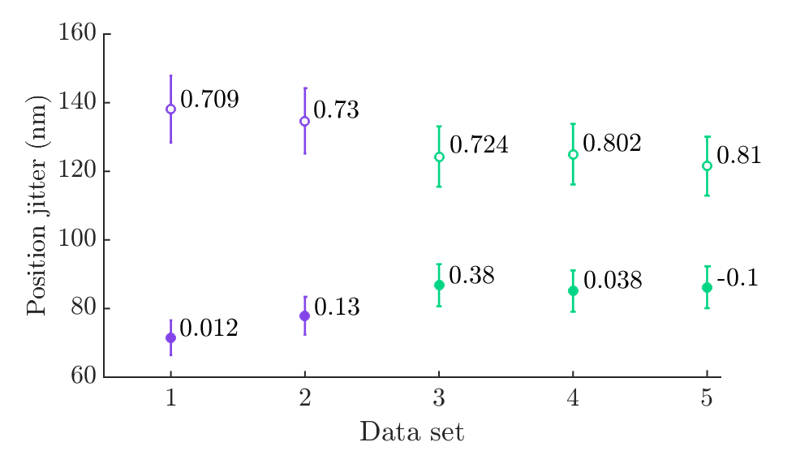
Noise Floor Removal (Channel Offset)
Purple: feedback performed with noise floor removal.
Green: feedback performed without noise floor removal.
Filled data points: feedback on.
Unfilled data points:
feedback off.
Position correlations shown as data labels.
(Data sets ipfbRun24:28)

Slide 12
2-BPM Feedback
gainScan2_10dB_0.8
Calibration file: AQD0FFyScan7

Slide 13
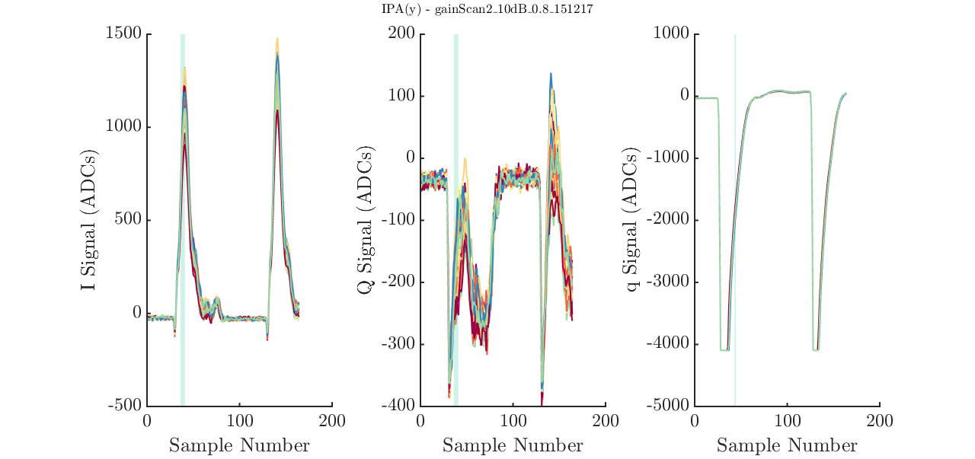
IPA Waveforms

Slide 14
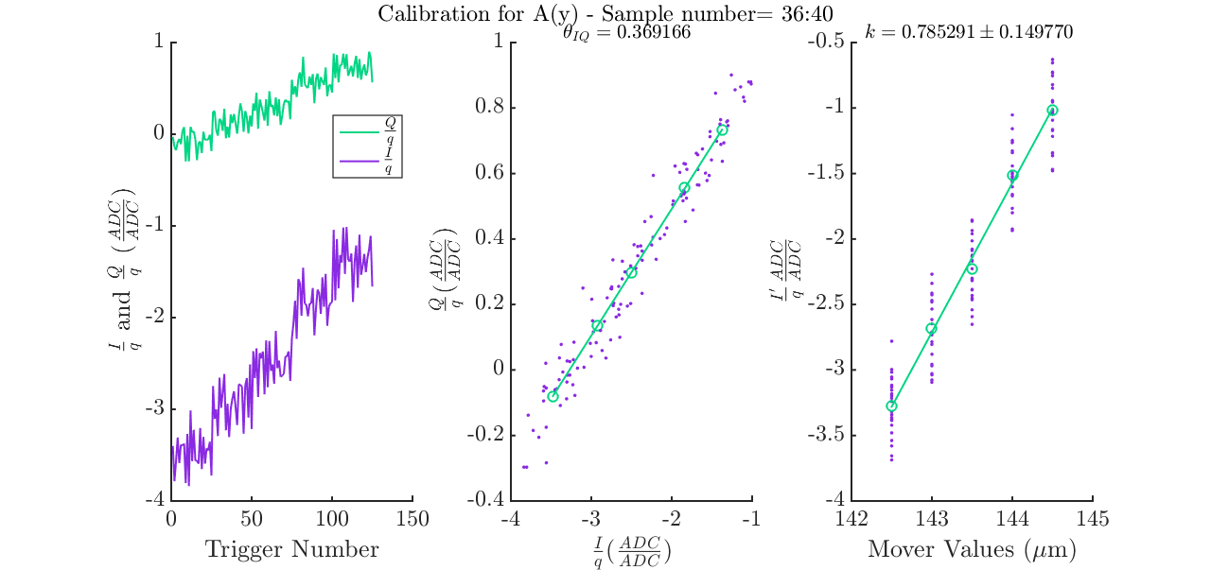
IPA Calibration
k=0.15706,
Theta=0.369
Samples 36:40

Slide 15
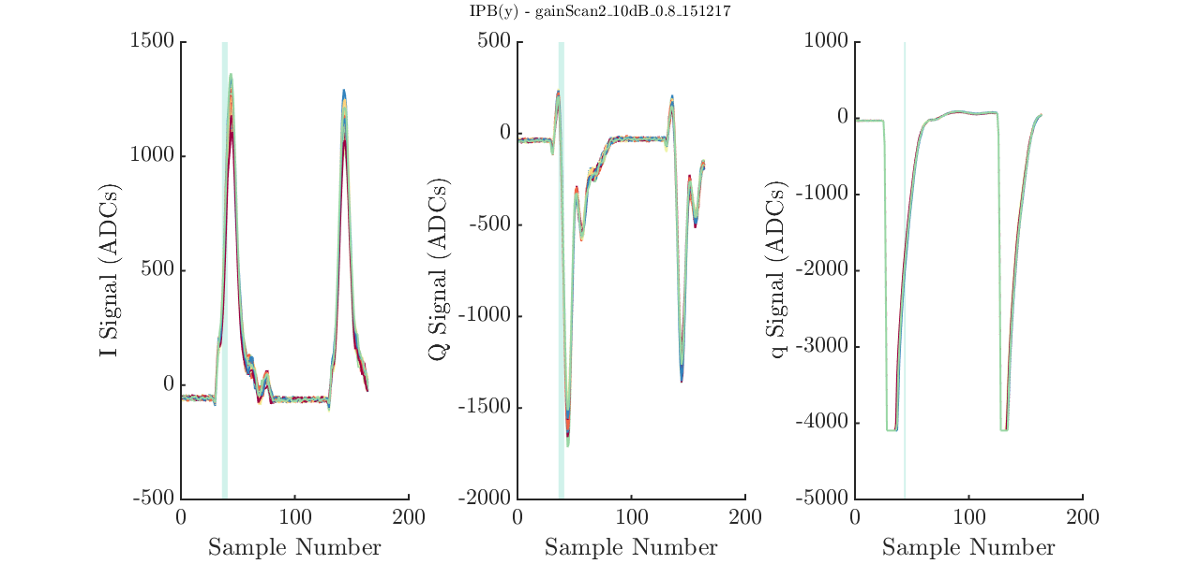
IPB Waveforms

Slide 16
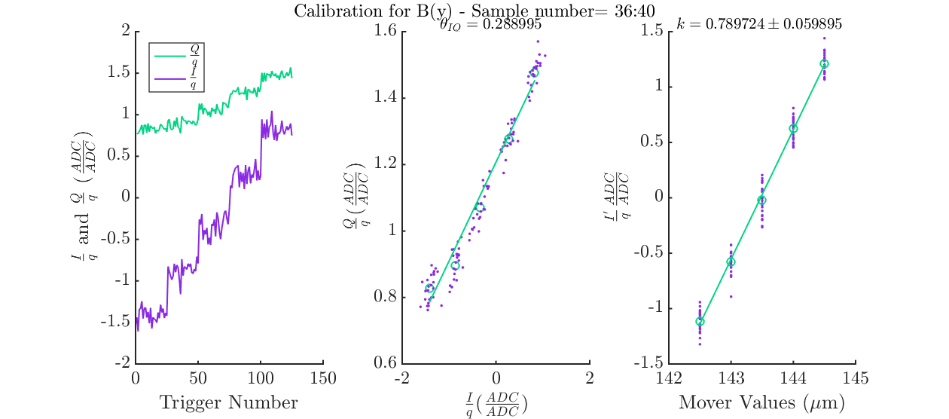
IPB Calibration
k=0.15794,
Theta=0.289
Samples 36:40

Slide 17
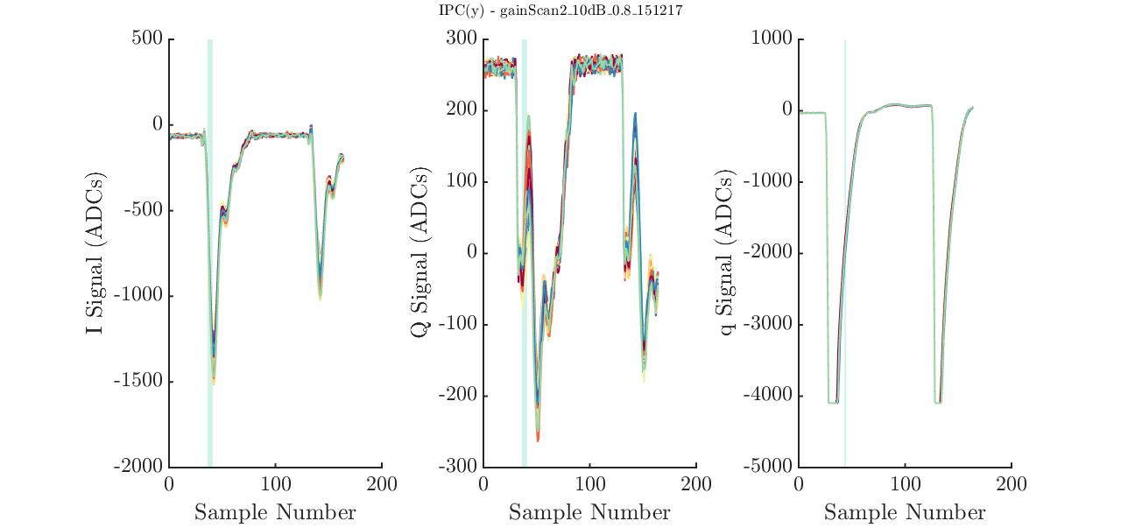
IPC Waveforms

Slide 18
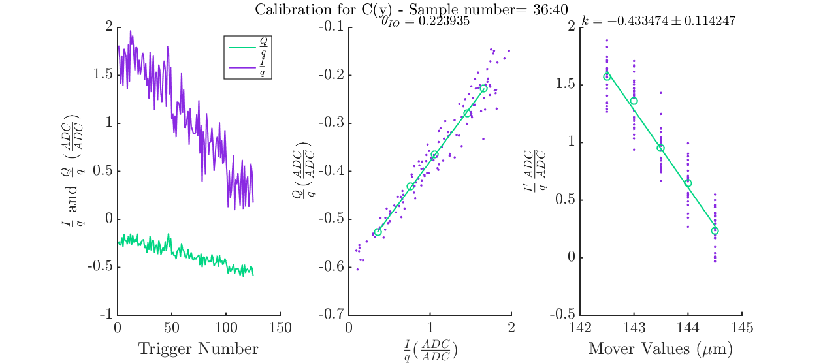
IPC Calibration
k=-0.086695,
Theta=0.2239
Samples 36:40

Slide 19
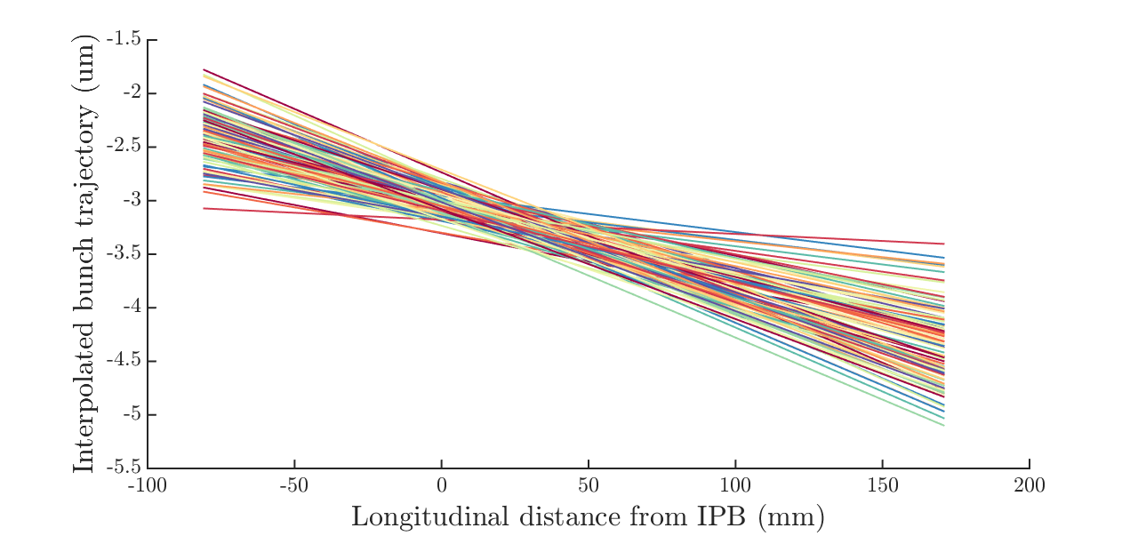
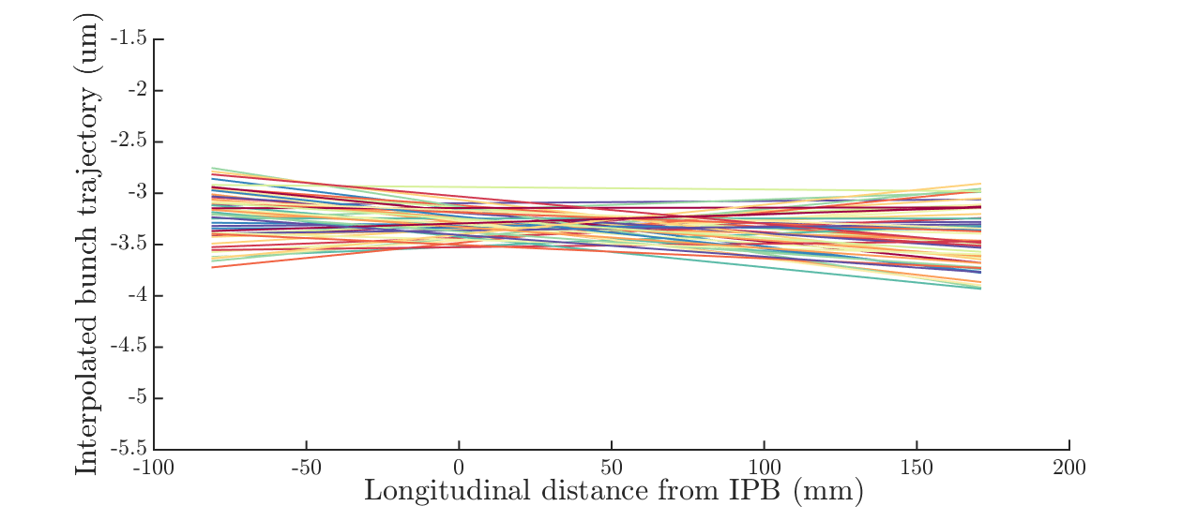
High beta optics
Bunch trajectory interpolated between IPA and IPC.
Feedback off bunch jitters shown as data labels.
Bunch One
Bunch Two
270 nm
220 nm
290nm
120 nm
110 nm
360 nm

Slide 20
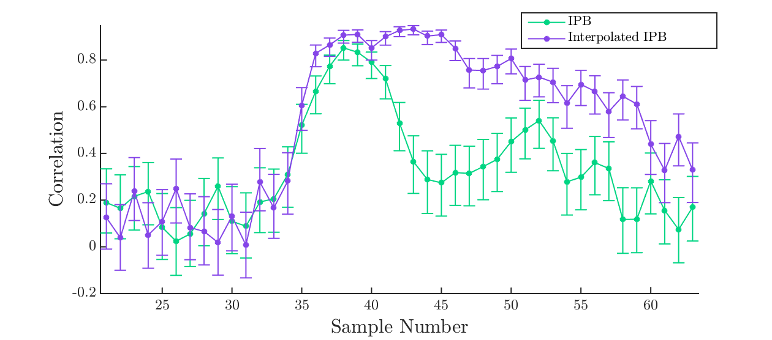
IPB Single Sample Correlation
Highest single sample interpolated IPB correlation: 93.3%.
Highest IPB correlation: 85.2%.
Sample range used for feedback

Slide 21
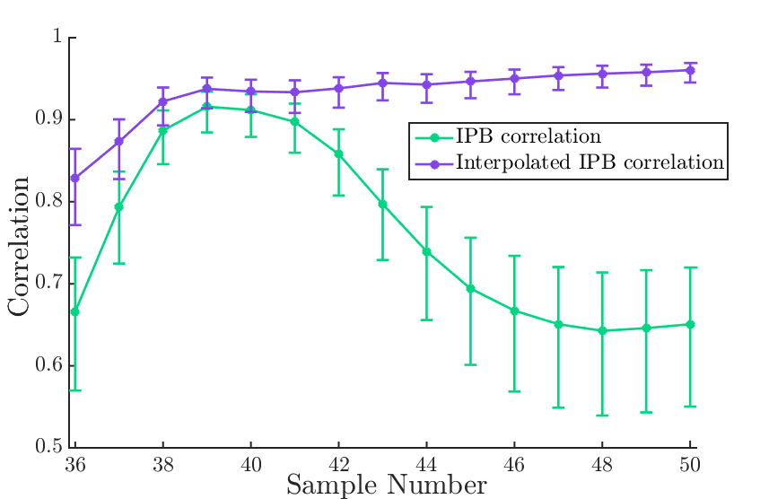
IPB Integrated Sample Correlation
Sample range used for feedback
Highest single sample interpolated IPB correlation: 96.1%.
Highest IPB correlation: 91.6%.

Slide 22
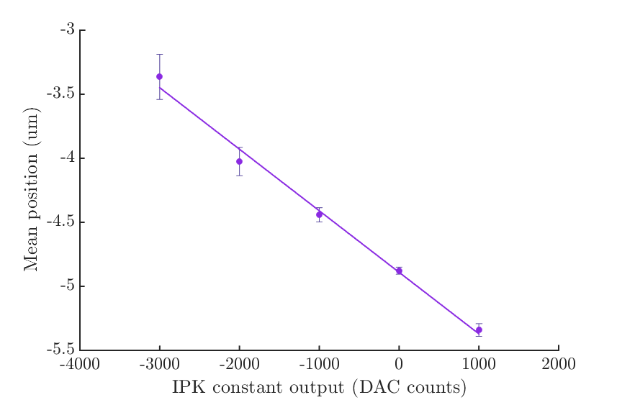
Kicker Calibration
Interpolated kicker scan.
Gradient = -0.00048 (um/DAC).
R² value = 0.99206.
Propagated standard errors given.

Slide 23
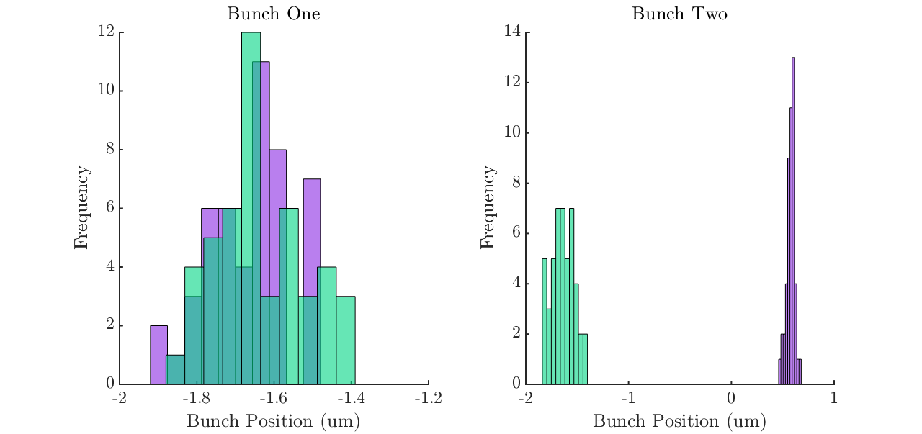
Filename: gainScan2_10dB_0.8
Purple: FB on
Green: FB off
Bunch One:
FB Off: 115.1 nm
FB On: 104.5 nm
Bunch Two:
FB Off: 107.9 nm
FB On: 40.9 nm

Slide 24
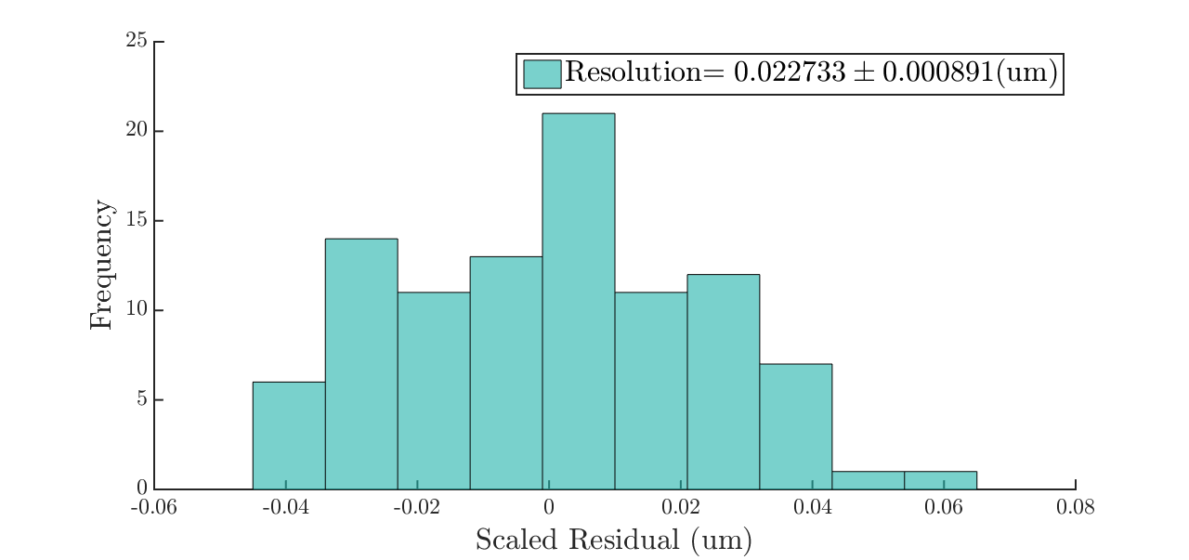
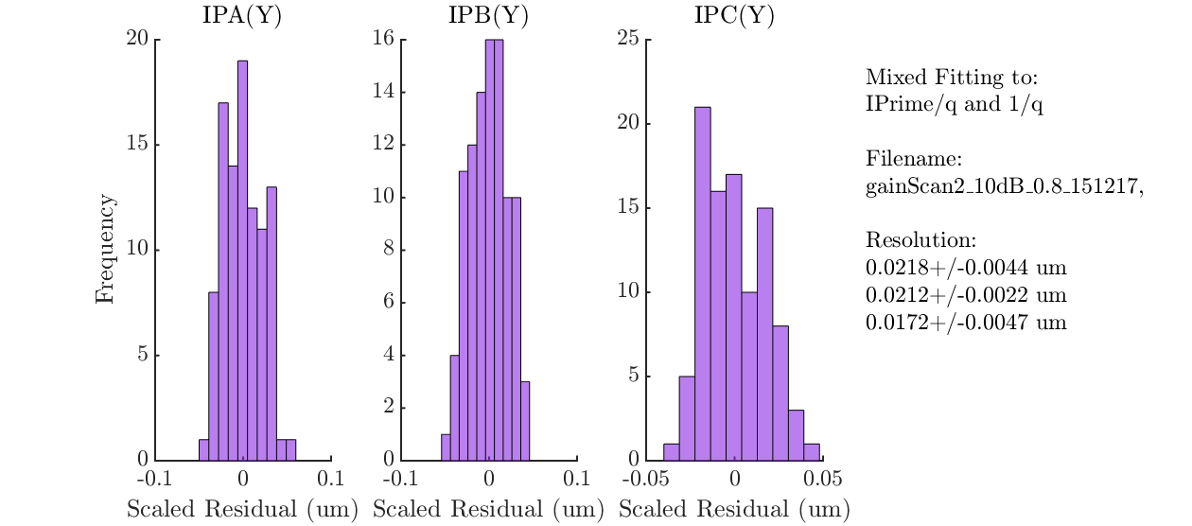
Resolution
Resolution results for 41 nm feedback run (gainScan2_10dB)
22.7 nm
21.8 nm
21.2 nm
17.2 nm

Slide 25
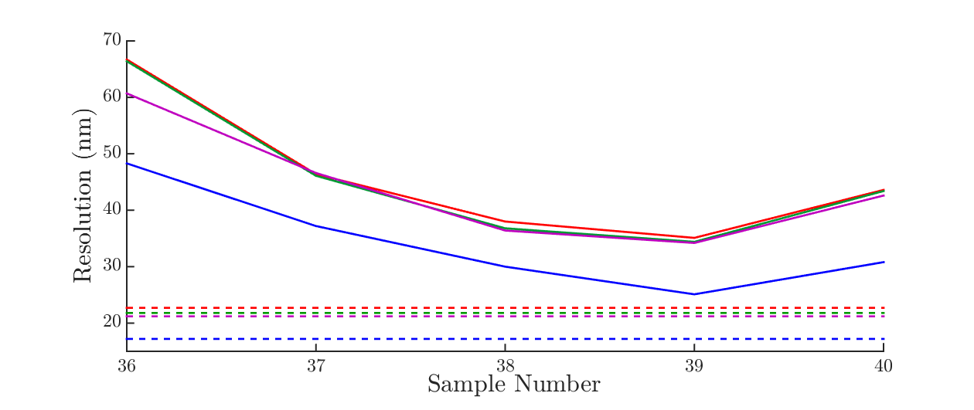
Single Sample vs. Integrated Resolution
Solid line: single sample
Dashed line: integrated sample (36:40)
Geometric resolution
IPA fitting resolution
IPB fitting resolution
IPC fitting resolution

Slide 26
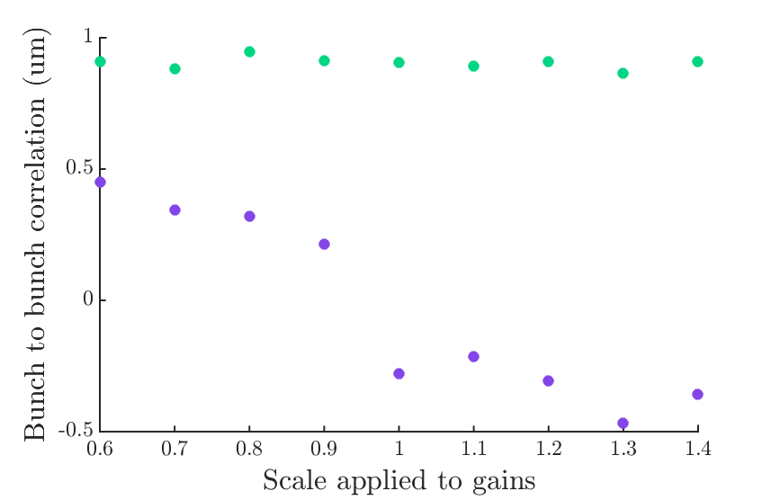
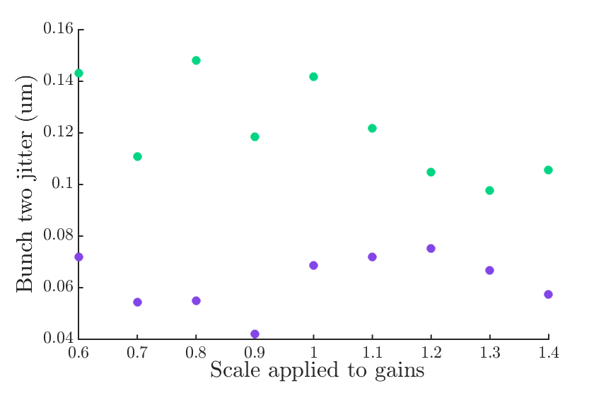
Gain Scan
gainScan4_10dB: scaling magnitude of all four gains.
Gain scans of ratio of pairs of gains still to be analysed.

Slide 27
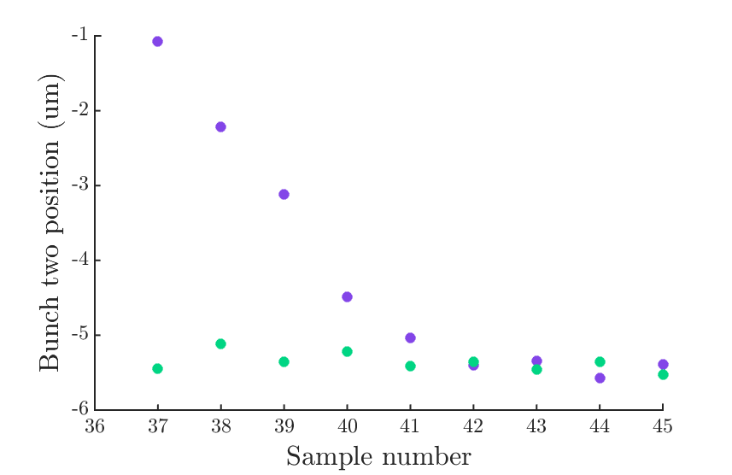
Latency Scan
We should have gone to earlier sample numbers.
Feedback has 22 samples latency, excluding the kicker rise time.

Slide 28
Shift Outline
1-BPM feedback (Tuesday owl)
  50 nm stabilisation at IPC.
  21 nm resolution.
  Noise floor removal appears to offer some improvement to feedback performance.
2-BPM feedback (Friday day and swing)
  41 nm stabilisation at IPB.
  Better resolution through integration.

