Slide 1
FONT Meeting
Friday 12th December 2017
Waist scan and IQ rotation
Douglas BETT

Slide 2
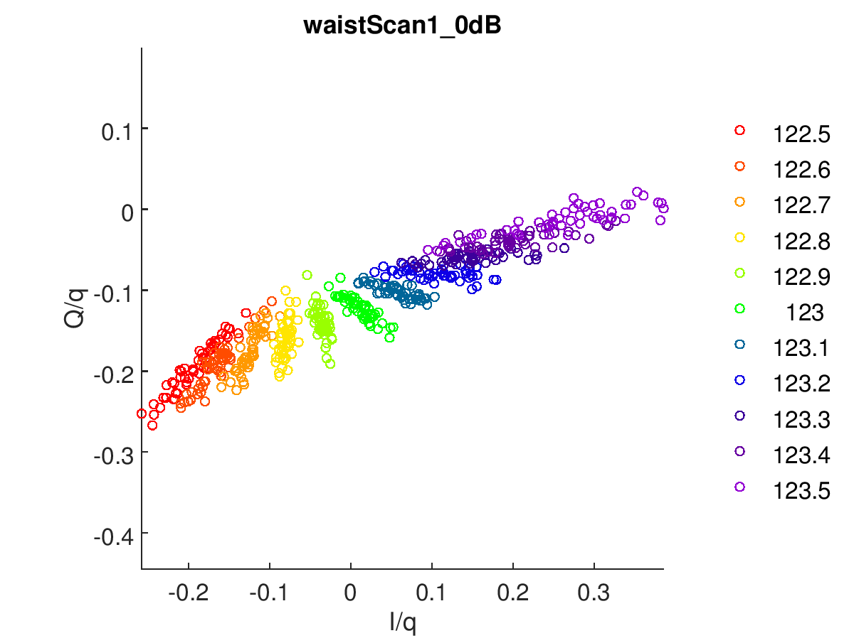
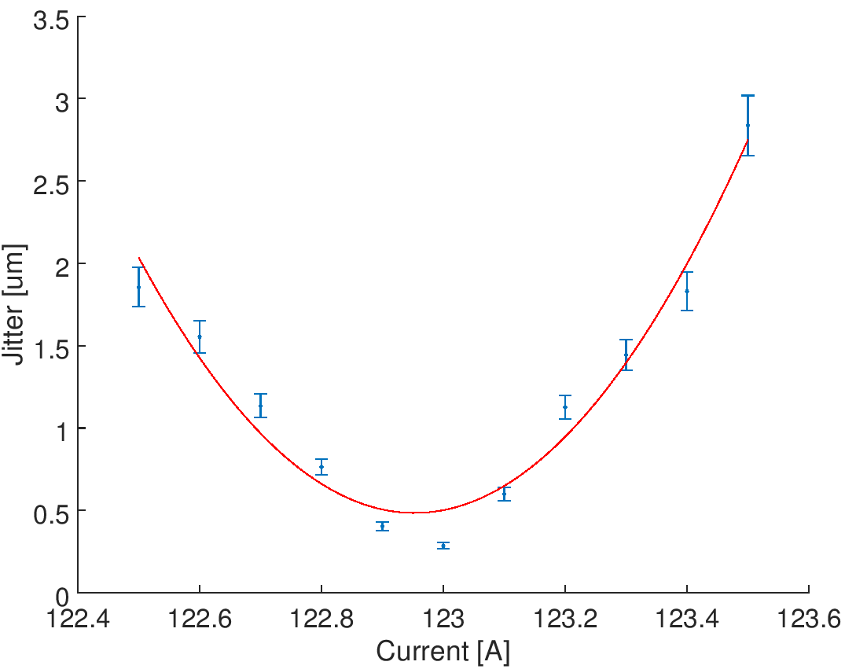
Waist scan 1
Fit minimum = 122.95

Slide 3
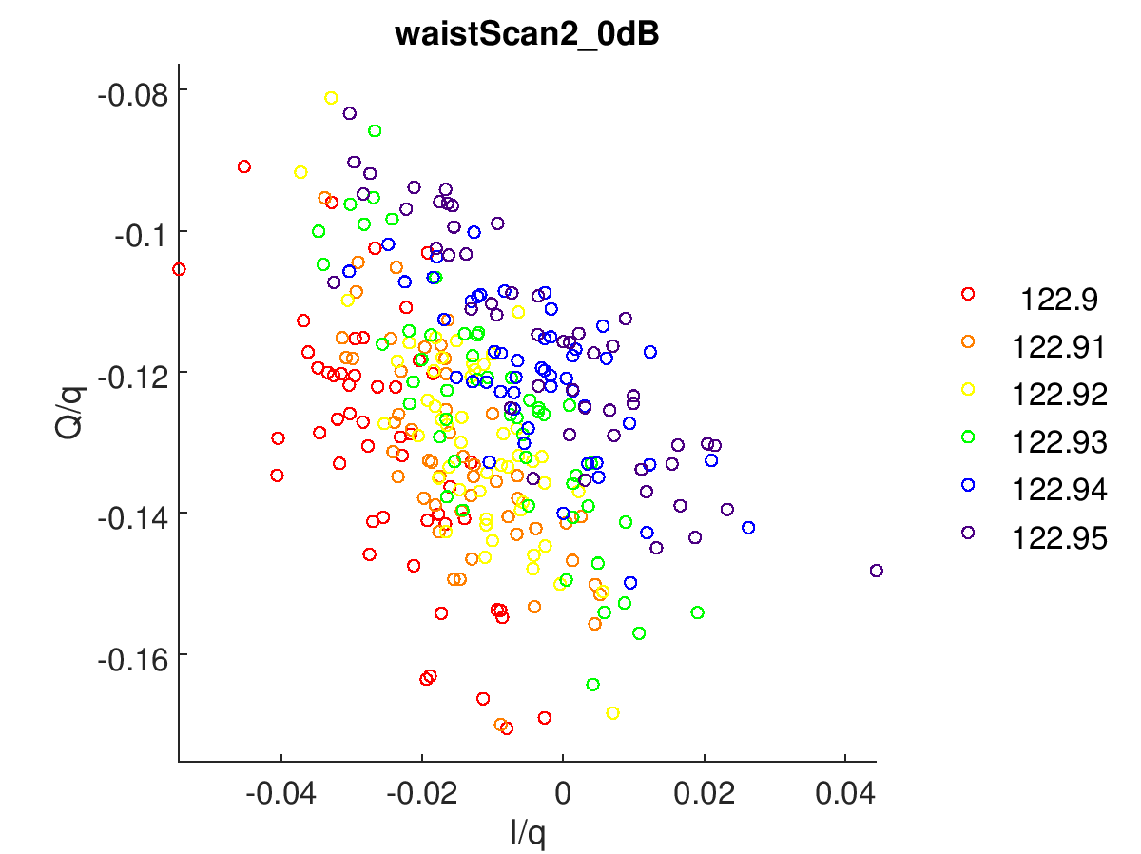
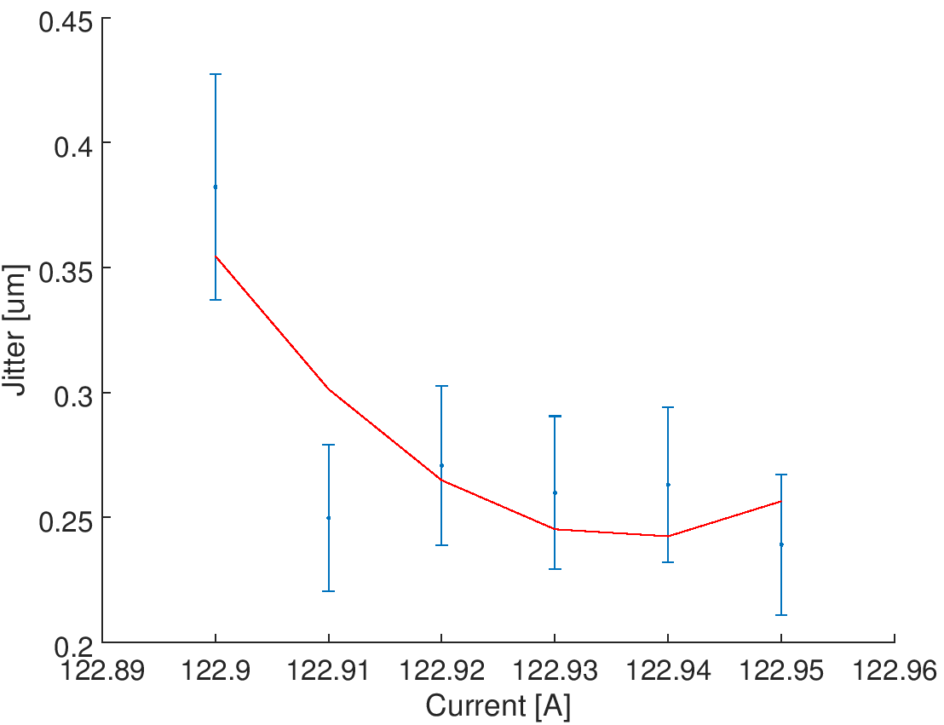
Waist scan 2
AQF1FF at -10 um

Slide 4
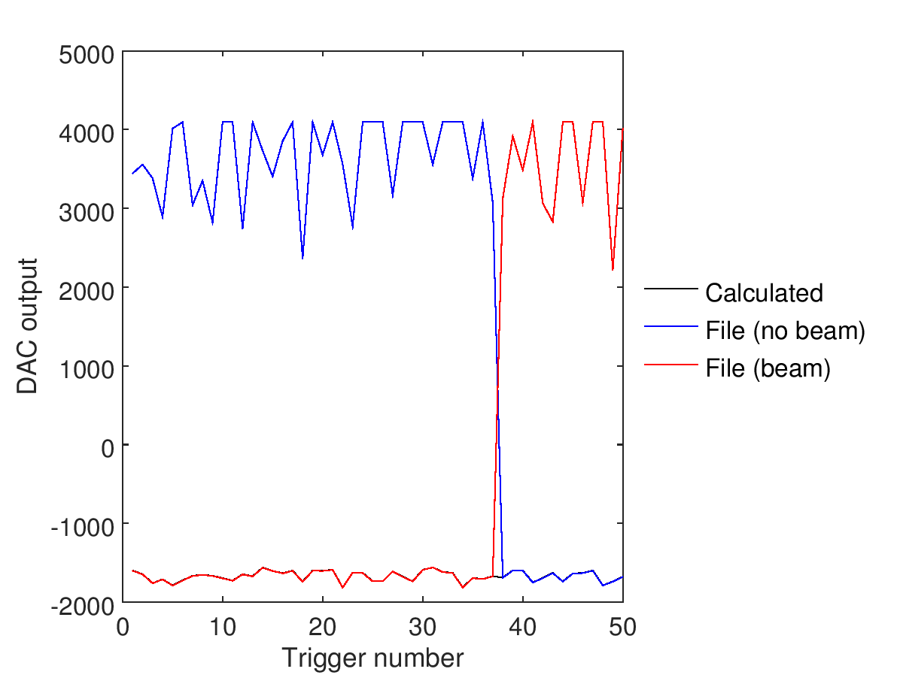
Bonus: DAC issues revisited
Bunches present, feedback off
Bunches present, feedback on
Beam
extraction
1 – 0 – 1 – 0 – 1 – 0 – 1 – 0 – 1 – 0
Feedback
0 – 0 – 1 – 1 – 0 – 0 – 1 – 1 – 0 – 0
Bunches absent, feedback off
Bunches absent, feedback on
missed
trigger
1 – 0 – 1 – 0 – 1 – 0 – 1 – 0 – 1 – 0 – 1 – 0 – 1 – 0 – 1 – 0 – 1 – 0 – 1 – 0 – 1 – 0
0 – 0 – 1 – 1 – 0 – 0 – 1 – 1 – 0 – 0 – 1 – 1 – 1 – 0 – 0 – 1 – 1 – 0 – 0 – 1 – 1 – 0
NB – the fact that the feedback on/off pattern looks normal suggests that the trigger was missed by the board itself rather than being dropped by the network or the DAQ

Slide 5
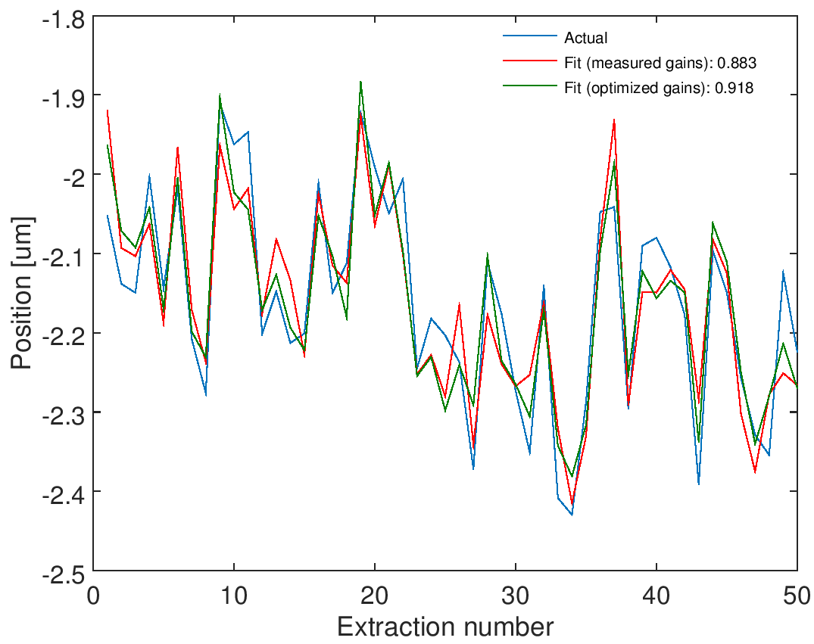
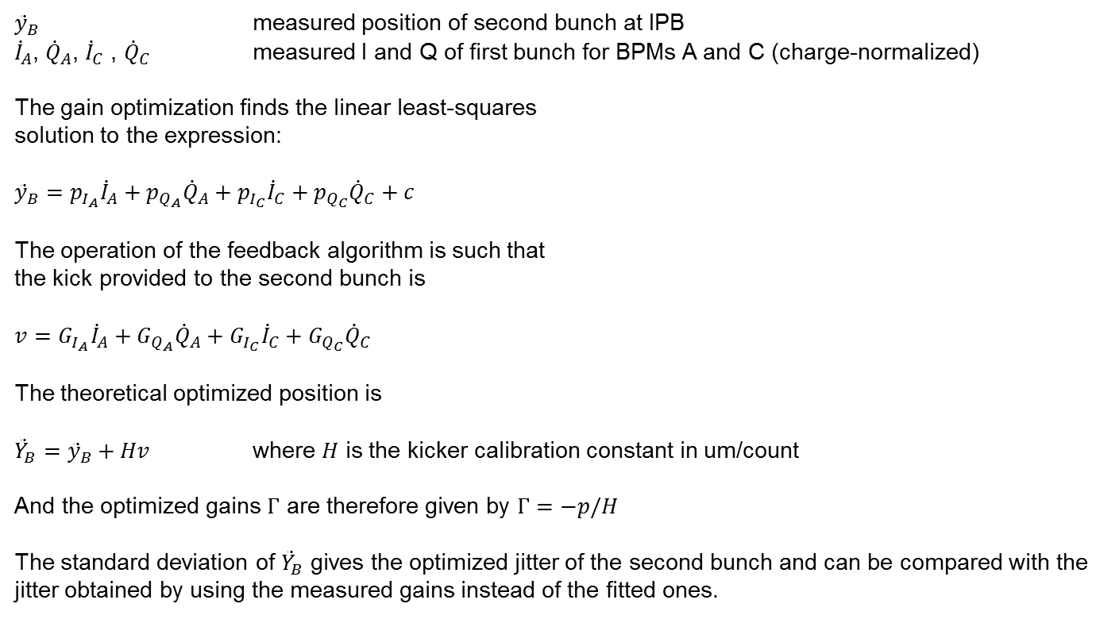
Extra bonus: Gain optimization
(clarification of the “gain optimization” method presented last week)
${\ddot{y}}_{B}$ measured position of second bunch at IPB
${\dot{I}}_{A}$, ${\dot{Q}}_{A}$, ${\dot{I}}_{C}$ , ${\dot{Q}}_{C}$ measured I and Q of first bunch for BPMs A and C (charge-normalized)
The gain optimization finds the linear least-squares
solution to the expression:
$${\ddot{y}}_{B}=p_{I_{A}}{\dot{I}}_{A}+p_{Q_{A}}{\dot{Q}}_{A}+p_{I_{C}}{\dot{I}}_{C}+p_{Q_{C}}{\dot{Q}}_{C}+c$$
The operation of the feedback algorithm is such that
the kick provided to the second bunch is
$$v=G_{I_{A}}{\dot{I}}_{A}+G_{Q_{A}}{\dot{Q}}_{A}+G_{I_{C}}{\dot{I}}_{C}+G_{Q_{C}}{\dot{Q}}_{C}$$
The theoretical optimized position is
${\ddot{Y}}_{B}={\ddot{y}}_{B}+Hv$ where $H$ is the kicker calibration constant in um/count
And the optimized gains $Γ$ are therefore given by $Γ=−p/H$
The standard deviation of ${\ddot{Y}}_{B}$ gives the optimized jitter of the second bunch and can be compared with the jitter obtained by using the measured gains instead of the fitted ones.
ipfbRun6
Bunch 2, IPB, feedback off

Slide 6
Summary
IQ rotation may be more reliable method of determining when the waist is on the BPM than the jitter
Issue with DAC values brought up last week found to be due to missing trigger

