Slide 1
The 21th ATF2 Project Meeting and the ATF Technical Board meeting supported by TYL-FJPPL program
Welcome and status
Nobuhiro Terunuma, KEK
March 21, 2018, LAL, Orsay

Slide 2
ATF2 Project Meetings

Slide 3
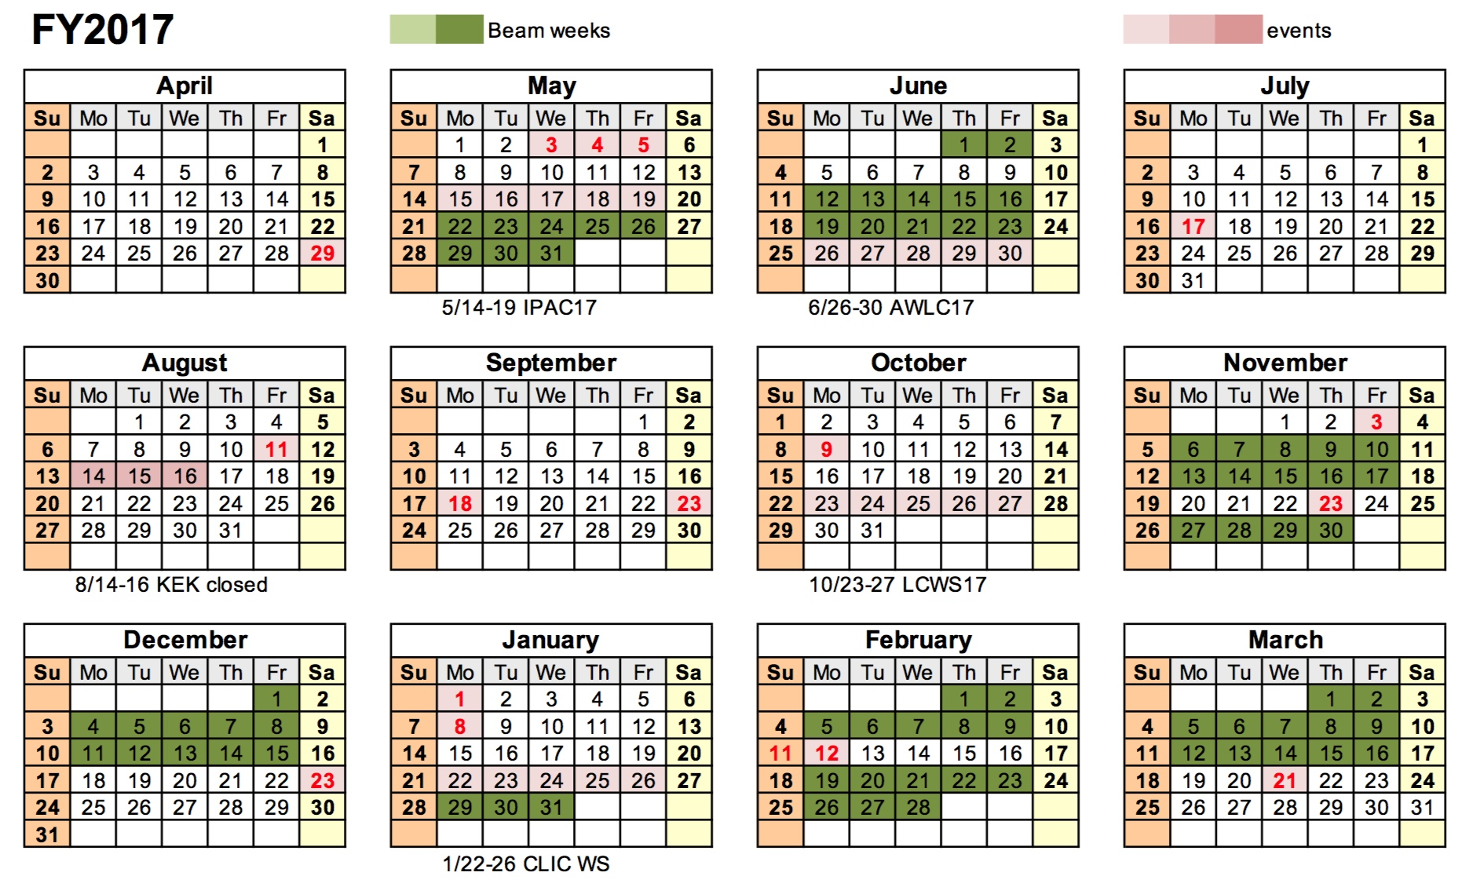
FY2017 ATF Beam : 15 weeks

Slide 4
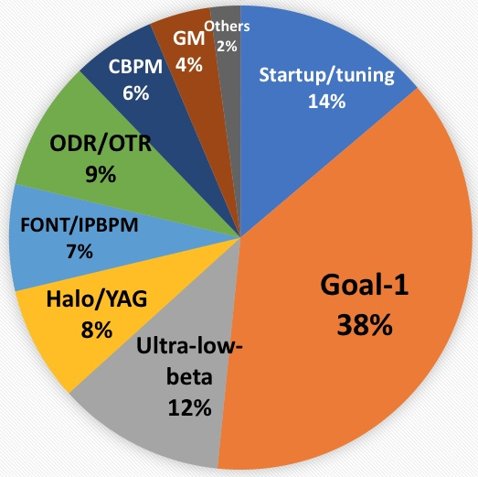
FY2017
15 weeks
188 shifts

Slide 5
Maintenance status of ATF in FY2017
We have a lot of maintenance works; repairs, exchanges, cleaning, etc.,…
Here, I would like to notice some of major status for beam studies.
Accelerator and beam monitors
Electron source: RF Gun
  Laser for photocathode: One of the mirror control on the laser oscillator (178.5MHz) was lost in November 2017.
  Temporary replaced by an old laser system (357MHz) which had been used by 2010. This laser needs manual retuning in a few days to keep mode-locking.
  Now 178.5MHz laser was repaired and will be back in operation in next week.

Slide 6
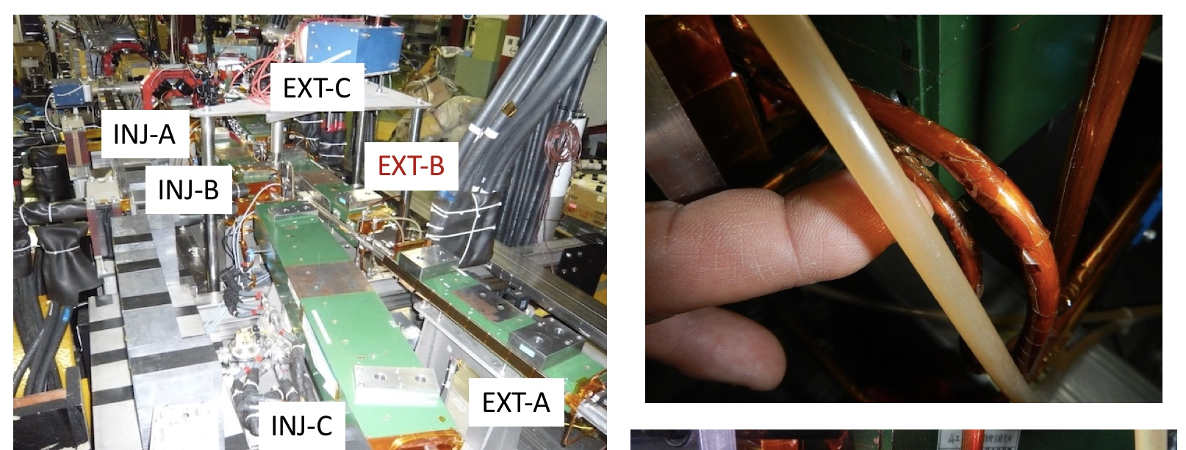
Septum magnet
  A pin-hole water leak from a cooling pipe for the EXT-B Septum magnet was happen just before starting the beam on January 2018. This trouble on Septum system was repeated by several years.
  Repaired but No fundamental redesigning is expected. Repair it when happen.

Slide 7
Multi-OTR at ATF2
  Controller (box-PC): One of the mover controller was dead-locked sometimes, and frequently in spring runs 2018. It was caused by the malfunction of CPU board.
  New CPU board is delivered and will be set up by the next beam runs.
  Camera: one camera was replaced in January 2018.

Slide 8
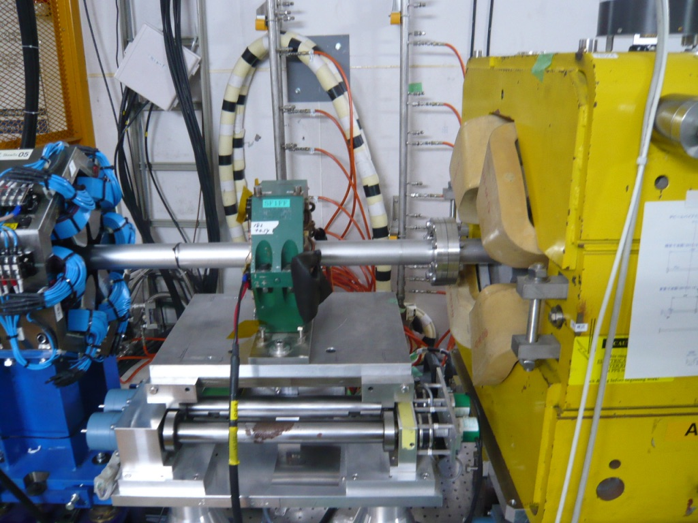
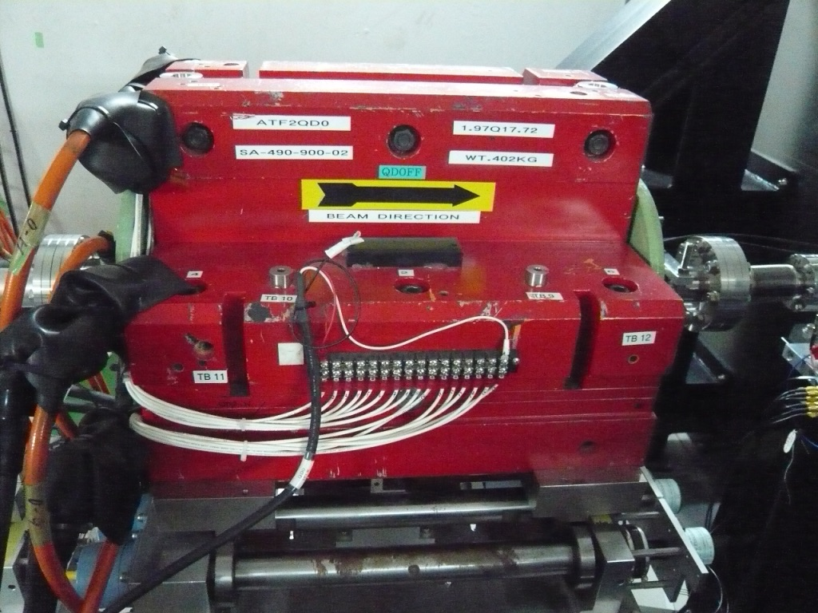
Multi-OTR at ATF2 –continued -
  The broken controller (XPS) was also control the mover for SD4FF and QD0FF which were used for a small beam tuning. When the XPS was dead-locked, we had to reboot XPS and recover these magnet positions every time.
  Investigation of the control circuit and software was done then moved connections of SD4FF and QD0FF to another XPS.
  It worked successfully and small beam tuning was recovered by the end of March operation.

Slide 9
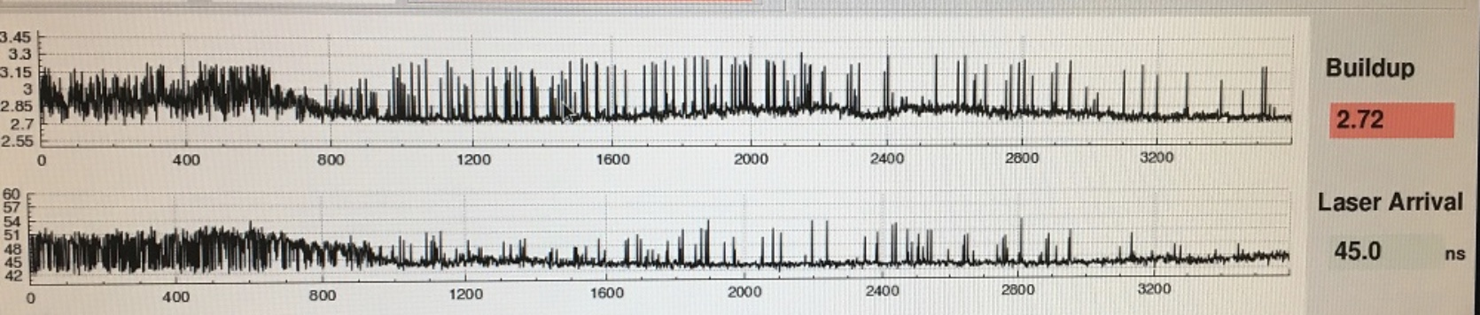
IPBSM laser
  The IPBSM (Shintake monitor) uses a high power pulse laser based on the Q-switching YAG flash lamps.
  The stability of positions and arrival timing at IP is an issue on the small beam measurement.
  It is very sensitive to not only for the environment (air and cooling water) but also aging of the lamps. The drift caused by the transport mirrors in the transport line is an additional difficulty.
  Monitoring of the laser pulse at near IP was installed in DAQ. It can be effective to reject off timing collisions.

Slide 10
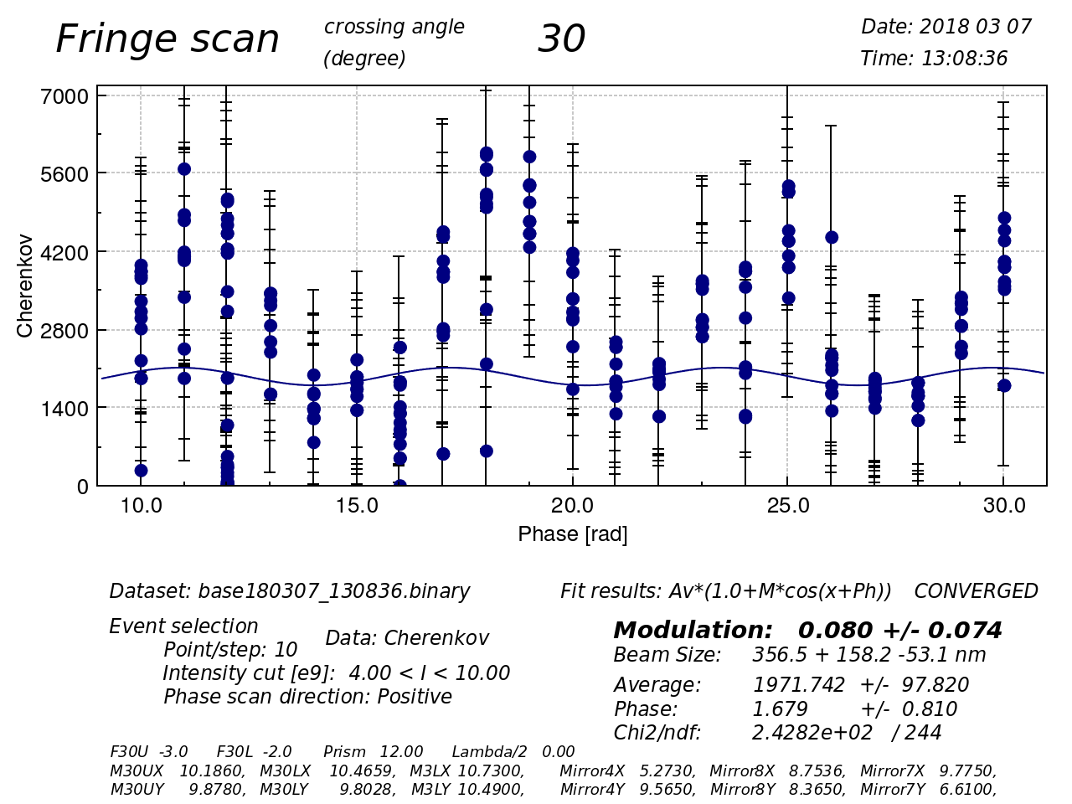
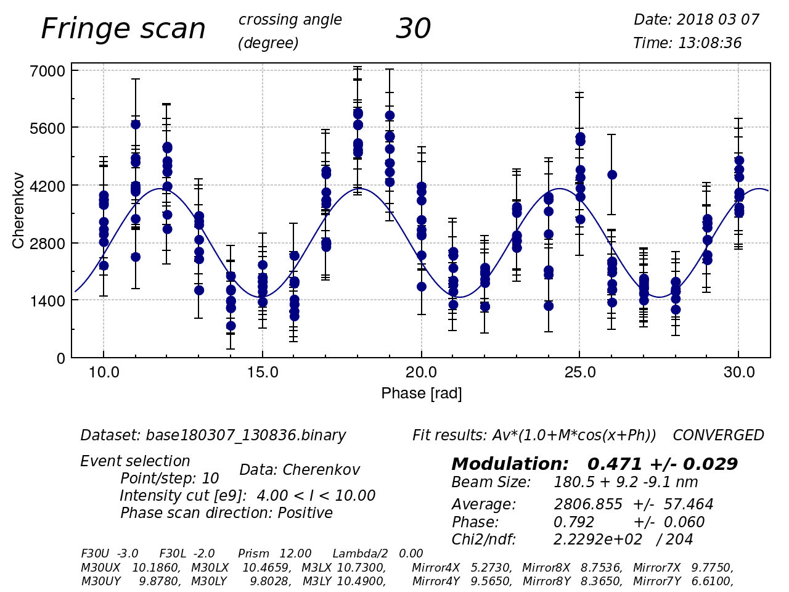
Example of new IPBSM DAQ
Apply the laser-arrival-timing cut on Collision timing events.
  (unlimitted → +/- 3nsec)
Reject off collision events
The difference on a fringe scan is as follows.
Forced Off-Collision Timing
In Fringe scan
Collision
Timing
events

Slide 11
Utilities
Power station for DR main dipoles/quads
  The 20-years aged vacuum breakers were lost their function after the KEK summer maintenance of power.
  Recovery took 2 months (mostly delivering them) by October so we had no delay on beam schedule.

Slide 12
Utilities
LINAC cooling water system
  A lot of repairs were done on the cooling facility.
  Repairs were scheduled in the maintenance weeks.
  No severe beam-stop was done in FY2017, fortunately.
Water leak on the cooling pump for LINAC; repaired.

Slide 13
Utilities
DR cooling water system
    A heat exchanger of the auxiliary unit on the DR magnet cooling system was broken in January 2018.
    We had to bypass it then a water flow was down from 1400 L/min to 1330 L/min.
    Repair is not easy and very expensive.
    We decided to operate under this flow condition by changing a water temperature.
    We need to watch and retune the beam condition in DR especially for warmer seasons; i.e., May and June operation.
End of slides

