Slide 1






Cherenkov Diffraction Radiation as a potential Beam size measurement technique
M. Bergamaschi¹, V.V. Bleko², M. Billing³, L. Bobb⁴, J. Conway³, R. Kieffer¹, A.S. Konkov² P. Karataev⁵, R.O. Jones¹, T. Lefevre¹, J.S. Markova², S. Mazzoni¹, Y. Padilla Fuentes³, A.P. Potylitsyn², J. Shanks³
1. CERN, Geneva, Switzerland
2. Tomsk Polytechnic University, Tomsk, Russia
3. Cornell University, Ithaca, New York, USA
4. Diamond Light Source, Oxfordshire, United Kingdom
5. John Adams Institute at Royal Holloway, University of London, Egham, United Kingdom

Slide 2
Outline
Development of non-invasive beam size monitor for CLIC
  From the emission of Diffraction radiation in Slits to Cherenkov Diffraction Radiation in longer dielectric
Experimental set-up on CESR
Experimental results obtained in 2017
Possible studies at ATF2
M. Bergamaschi, ATF2 Project Meeting 2018, LAL

Slide 3
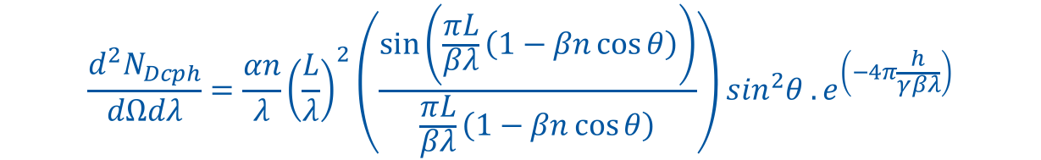
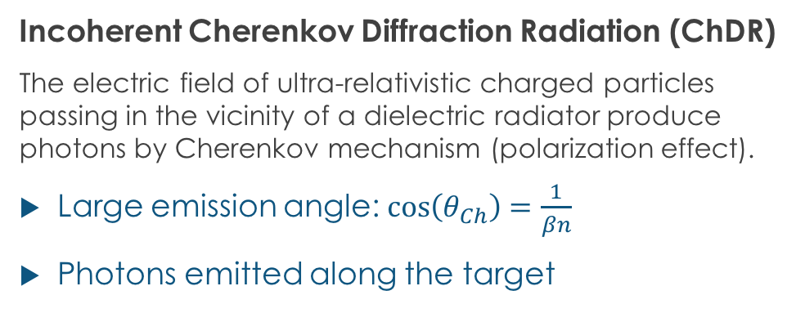

Incoherent Cherenkov Diffraction Radiation
Dielectric
Incoherent Cherenkov Diffraction Radiation (ChDR)
The electric field of ultra-relativistic charged particles passing in the vicinity of a dielectric radiator produce photons by Cherenkov mechanism (polarization effect).
Large emission angle: $\cos\left(θ_{Ch}\right)=\frac{1}{βn}$
Photons emitted along the target
Cherenkov DR
photons
E Field
h
Vacuum
$$θ_{Ch}$$
For a cylindrical geometry
L
Cherenkov emission
Exponential decay
of the particle field
$$\frac{d^{2}N_{Dcph}}{dΩdλ}=\frac{αn}{λ}{\left(\frac{L}{λ}\right)}^{2}\left(\frac{\sin\left(\frac{πL}{βλ}\left(1−βn\cos{θ}\right)\right)}{\frac{πL}{βλ}\left(1−βn\cos{θ}\right)}\right)\sin^{2}θ .e^{\left(−4π\frac{h}{γβλ}\right)}$$
α, fine structure constant
β, normalised beam velocity
γ, beam relativistic factor
θ, angle of observation
M. Bergamaschi, ATF2 Project Meeting 2018, LAL
Ref: A.P. Potylitsyn et al, Diffraction radiation from charged particles, STMP 29 (Springer Berlin Hedeilberg 2010)

Slide 4
Motivation to develop Incoherent Cherenkov Diffraction Radiation
Suppress Synchrotron radiation → cleaner signal
  DR and SR are emitted at similar angles
  Looking for a physical process emitted at larger angles
Larger aperture slits (>500 um)
  Difficult as DR will provide less photons
  Looking for a physical process providing more photons
‘Generating Cherenkov diffraction radiation in longer dielectric’
M. Bergamaschi, ATF2 Project Meeting 2018, LAL
Ref: A.P. Potylitsyn et al, Diffraction radiation from charged particles, STMP 29 (Springer Berlin Hedeilberg 2010)

Slide 5
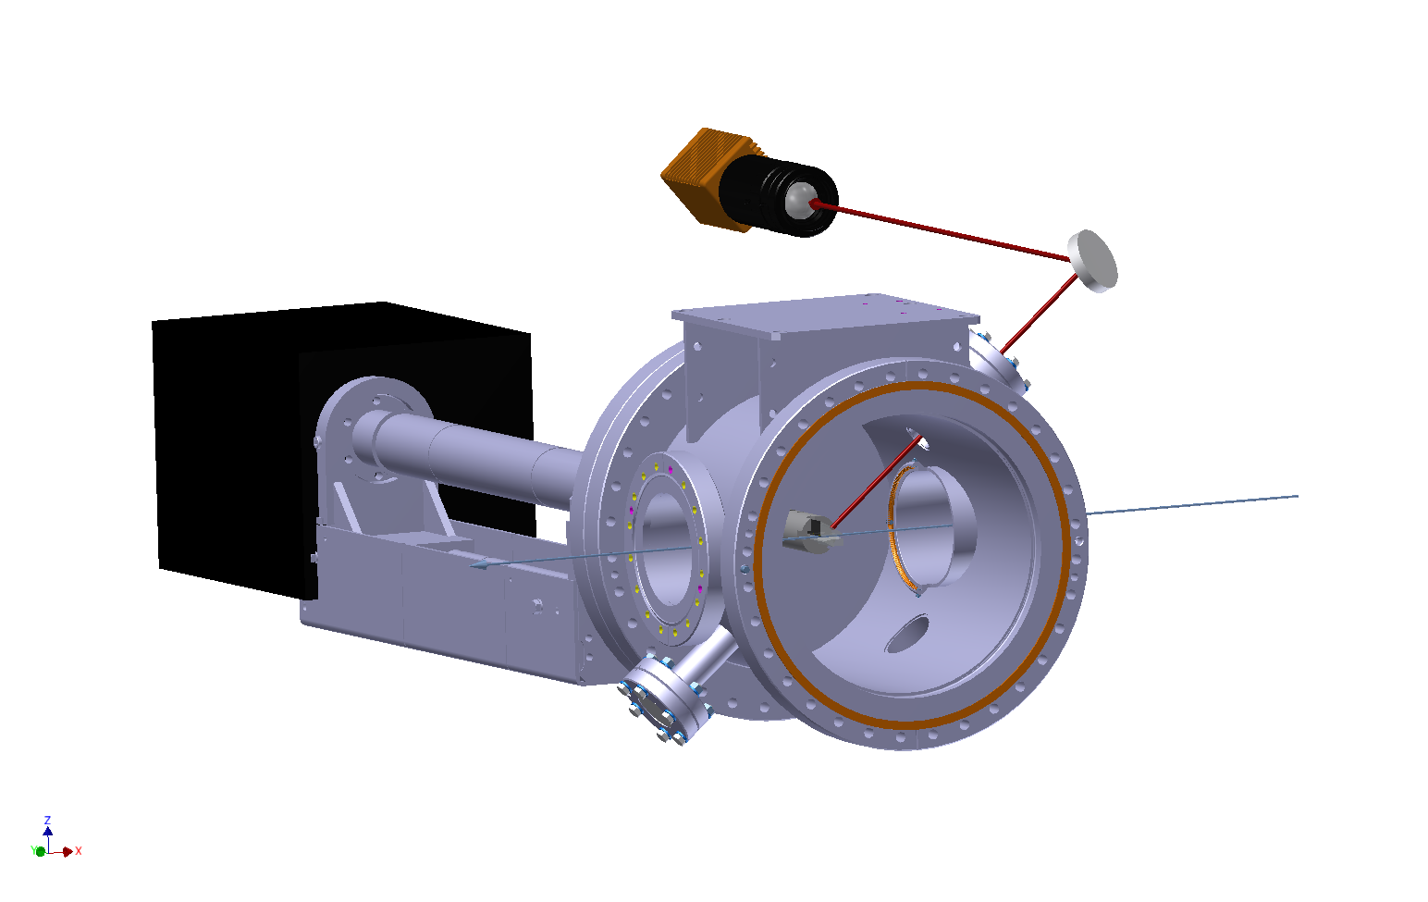
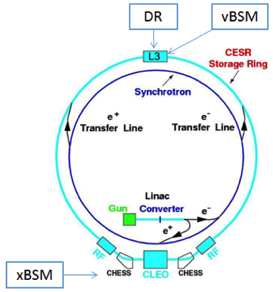
Experimental set-up on CESR (1/2)
Re-using the DR vacuum chamber and optical system
ChDR
Camera
ChDR
One bunch
2.5nC
Target
M. Bergamaschi, ATF2 Project Meeting 2018, LAL

Slide 6
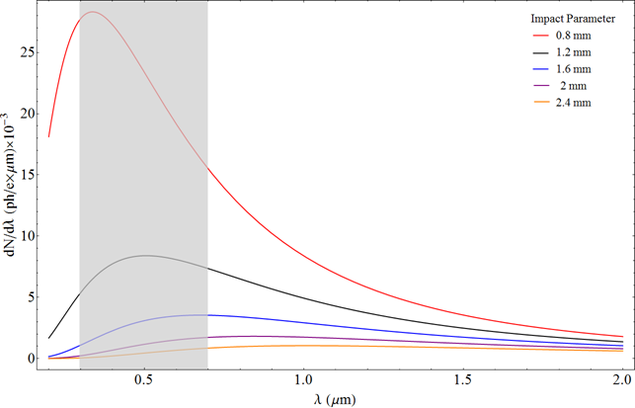
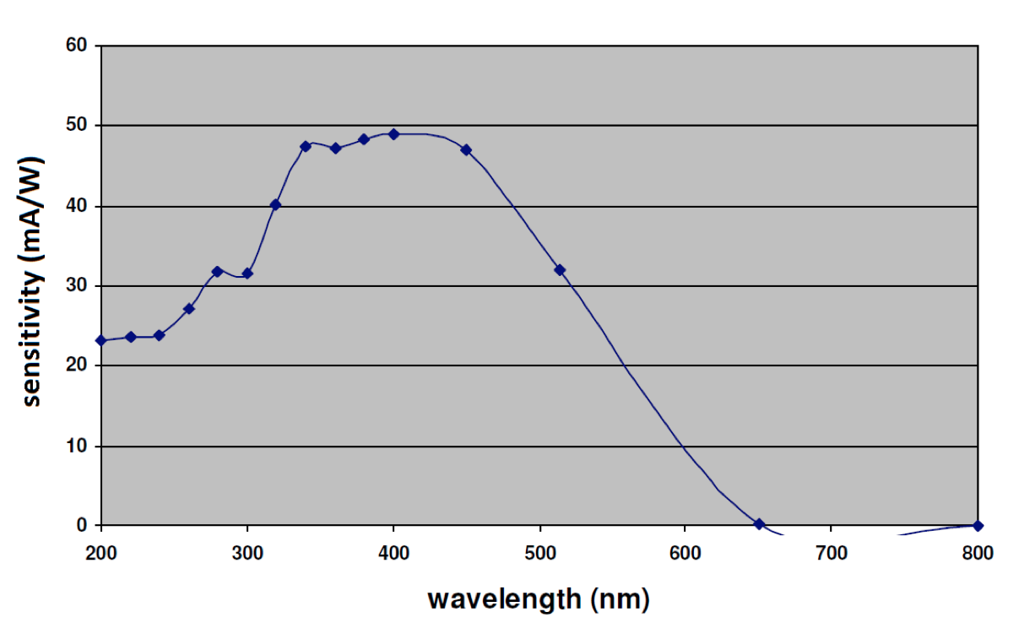
Experimental set-up on CESR (2/2)
Design a 2cm long SiO2 (n=1.46) Cherenkov Diffraction Radiation target
  Testing with 5.3GeV e⁻ / e⁺ and measuring in visible (0.3-0.7um) – October 2017
λ= 400±10nm
λ= 600±10nm
Gated and intensified camera
    M.V. Shevelev and A.S. Konkov, JETP 118, 501 (2014)
M. Bergamaschi, ATF2 Project Meeting 2018, LAL

Slide 7
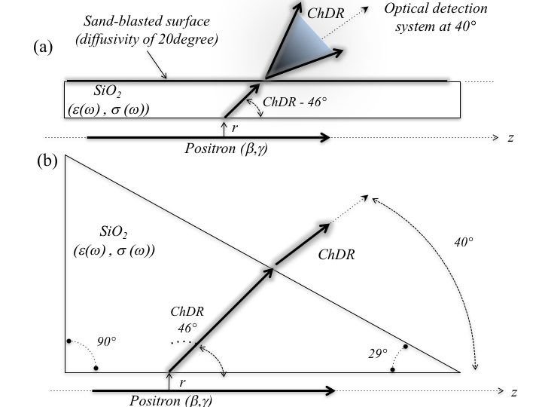
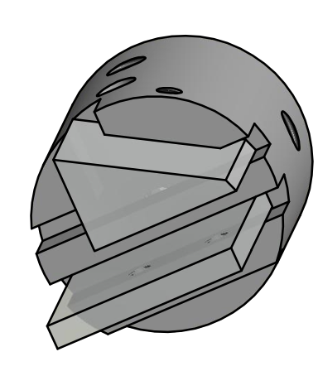
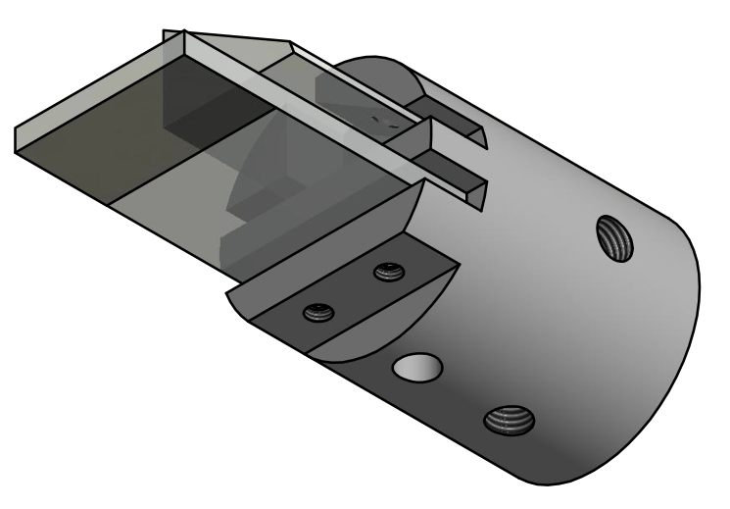
Cherenkov radiators
Two different geometries have been tested
  Prismatic radiator
  Flat radiator (simpler and cheaper)
Prismatic target for polarization studies
M. Bergamaschi, ATF2 Project Meeting 2018, LAL

Slide 8
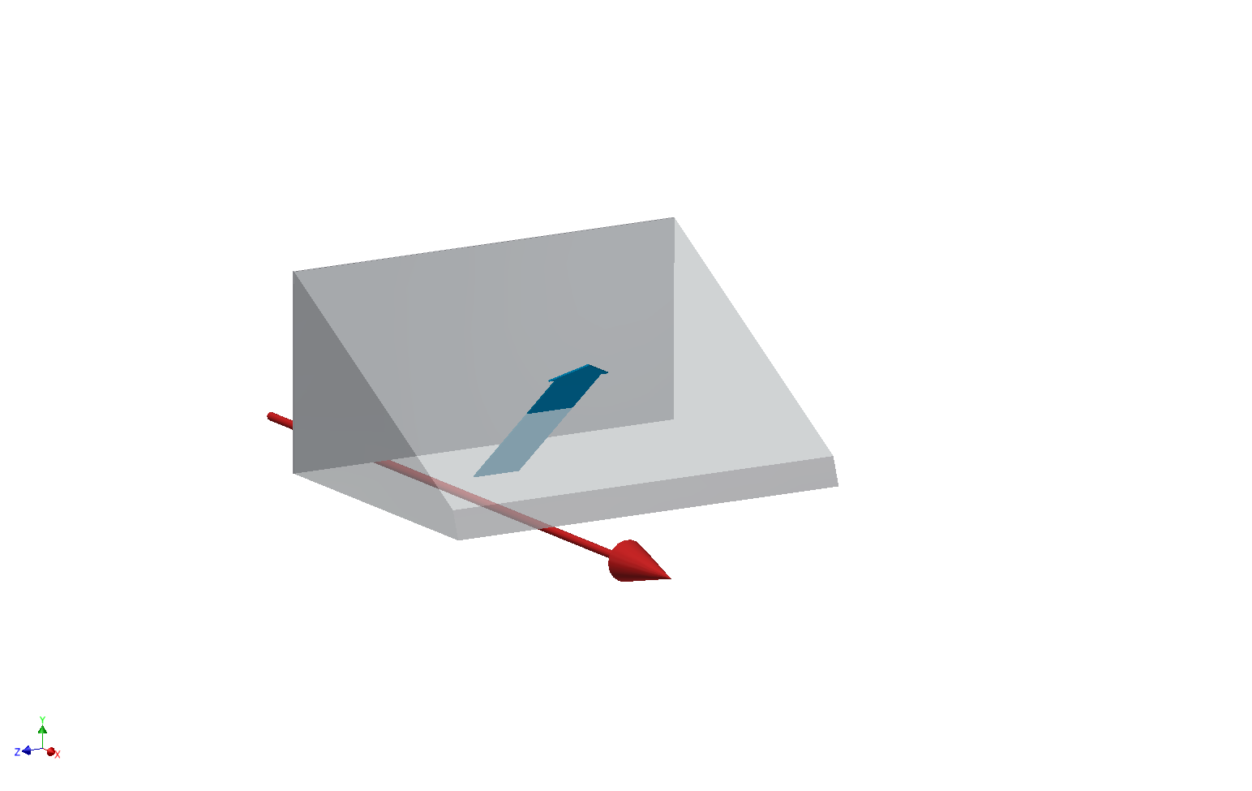
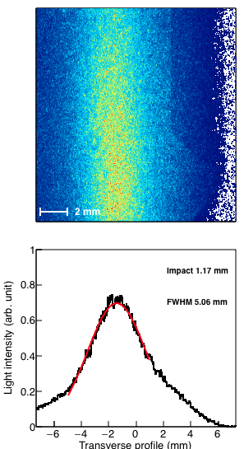
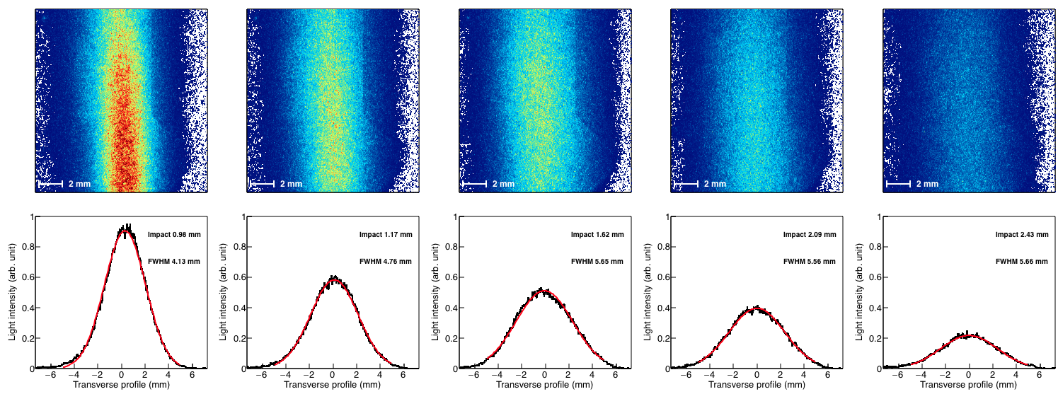
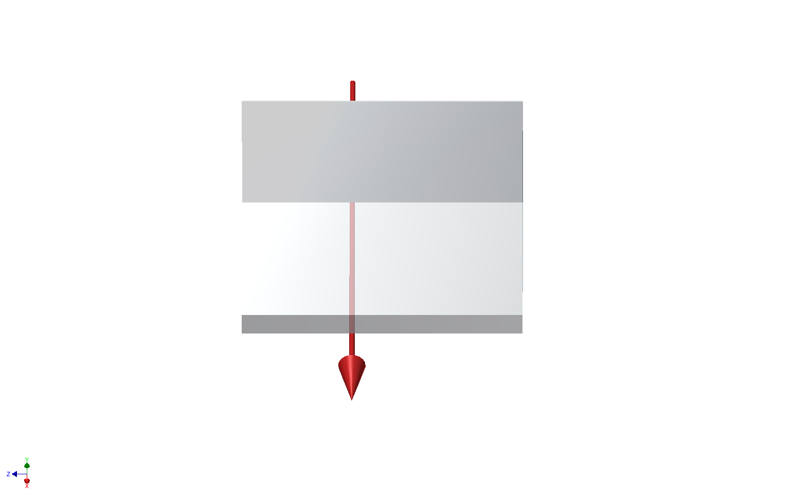
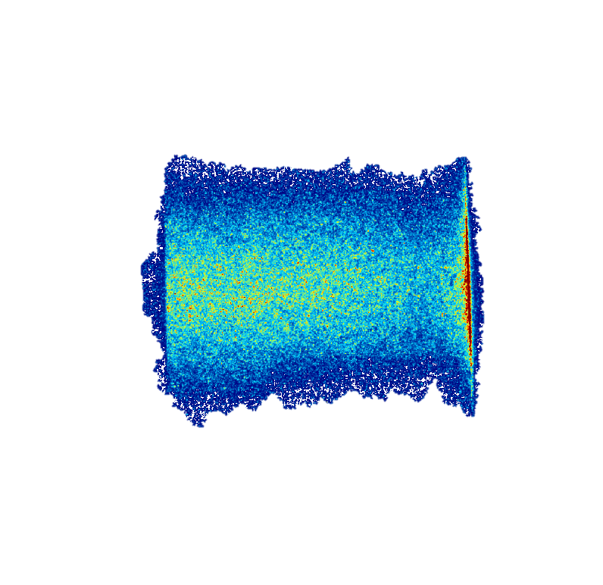
Experimental data : Positron at 5.3GeV
Measuring the horizontal Beam size :
Horizontal polarization
Vertical polarization
Cherenkov
Diffraction
Radiation
Positron Beam
Positron Beam
‘Vertically polarized photons give the best spatial resolution (σ_{y}=2mm)’
M. Bergamaschi, ATF2 Project Meeting 2018, LAL

Slide 9
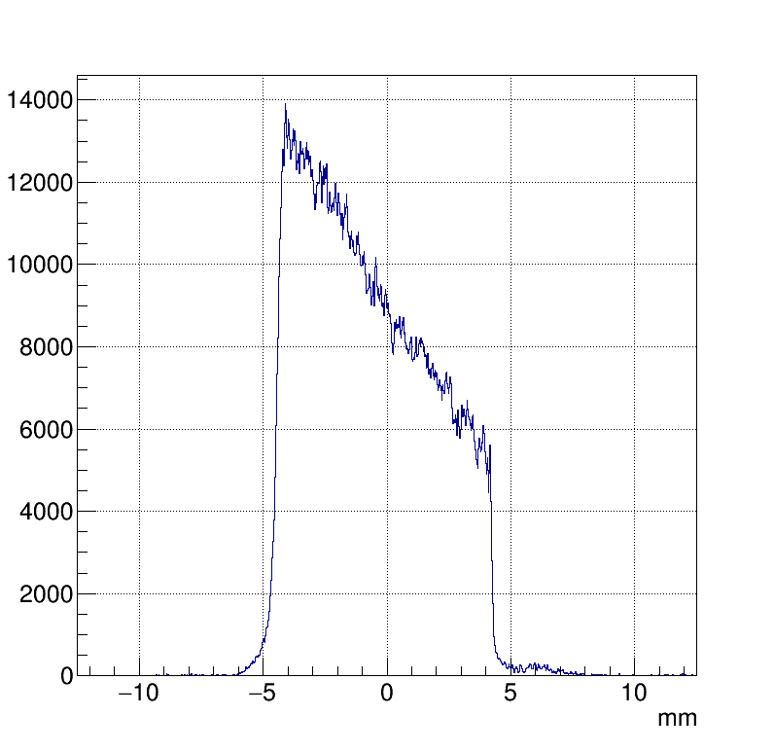
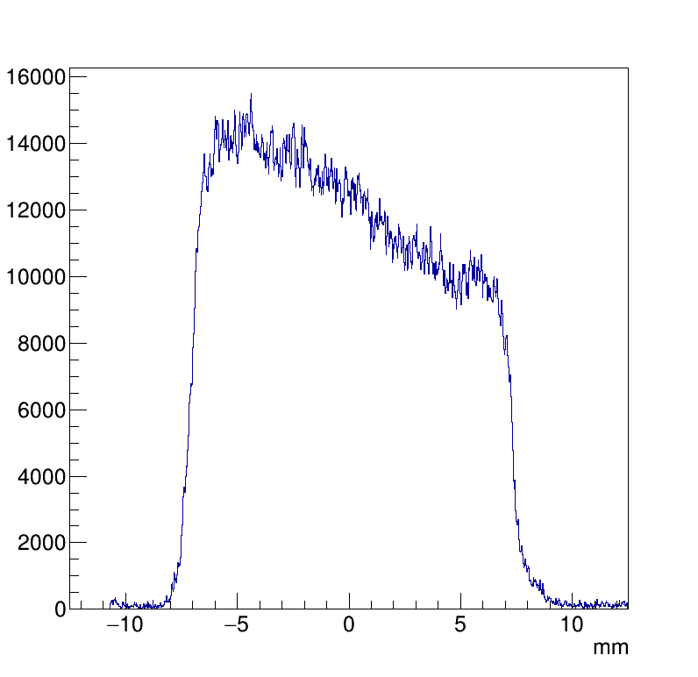
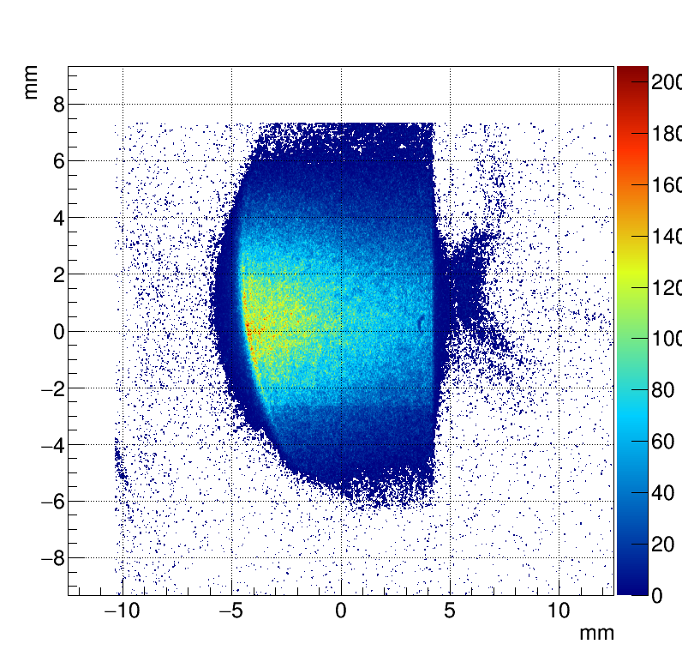
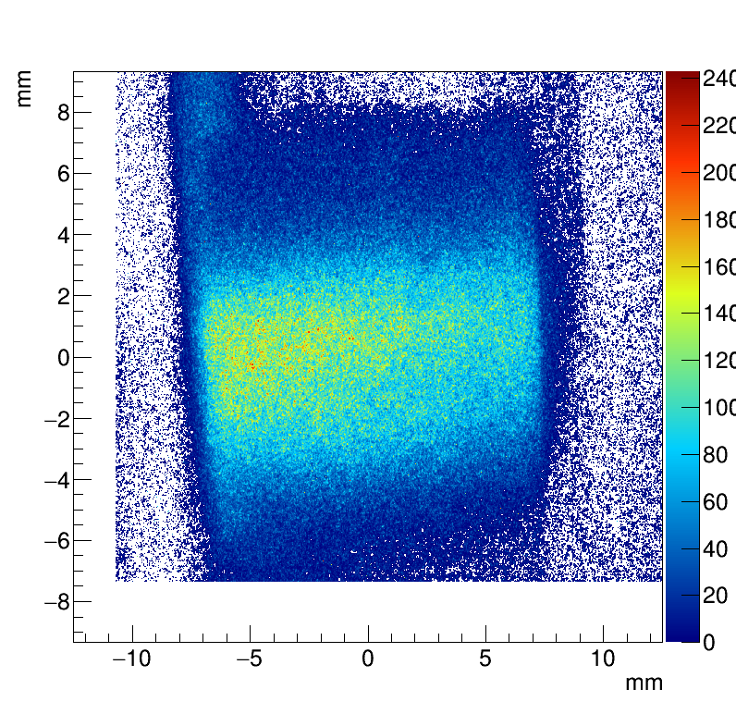
Experimental data : Positron at 5.3GeV
Rotating the target :
ChDR @600±10nm ; h_{mean} = 1.5mm
α = 4.28 deg (74mrad)
α = 0.98 deg (17mrad)
1.5mm
350um
Target angle, α
Positrons
λ= 600nm
‘Measuring the Beam tilt angle with respect to the surface of dielectric
as the light intensity strongly depends on the impact parameter’
M. Bergamaschi, ATF2 Project Meeting 2018, LAL

Slide 10
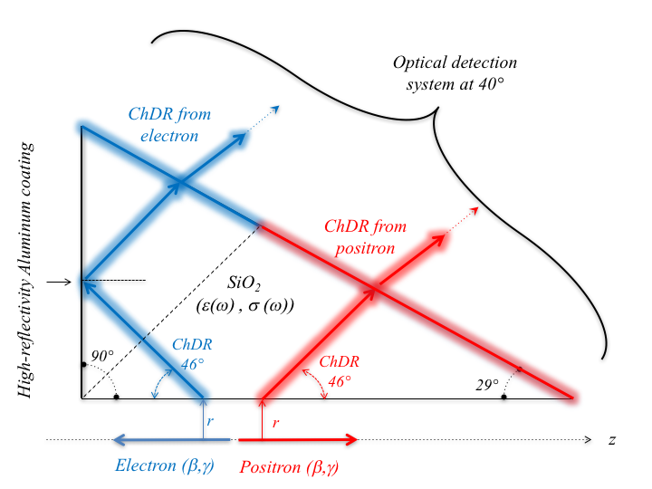
Experimental data : Measuring counter-propagating beams
(a)
Measuring counter-propagating beams using the prismatic target
M. Bergamaschi, TWEMLSF, ALBA

Slide 11
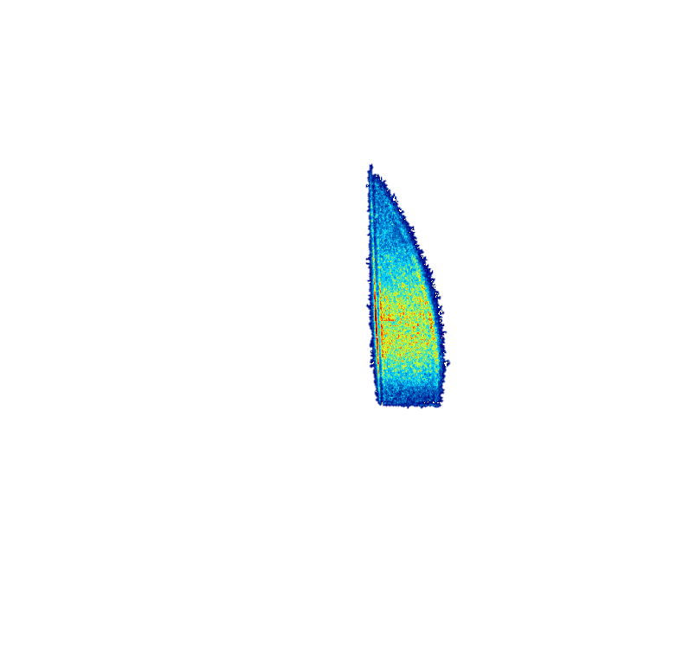
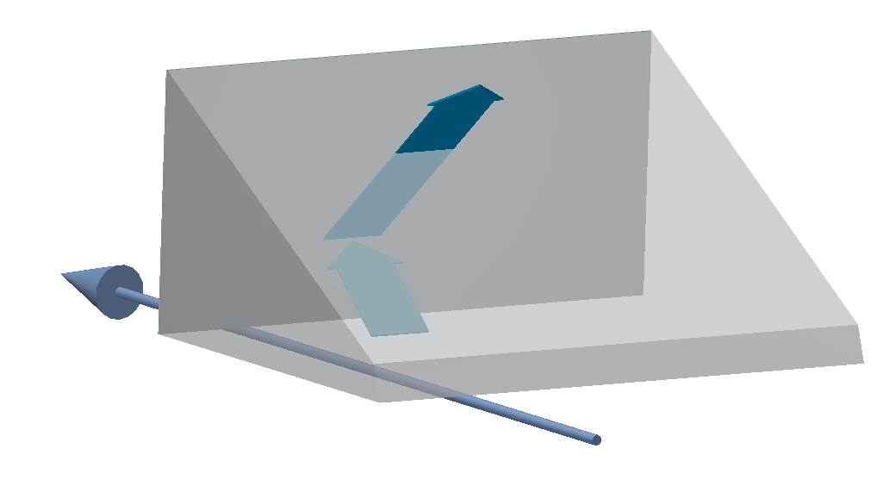
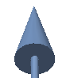
Experimental data : Measuring counter-propagating beams
(a)
Imaging both beams with the prismatic target
Cherenkov
Diffraction
Radiation
Electron Beam
Images from e⁻ is truncated due to the limited aperture of the current detection system
Electron Beam
Cherenkov
Diffraction
Radiation
Positron Beam
Positron Beam
The photons produced by electrons and positrons appear on a different part of the target and give the possibility to high directivity beam measurements (measured more than 60dB)
M. Bergamaschi, ATF2 Project Meeting 2018, LAL

Slide 12
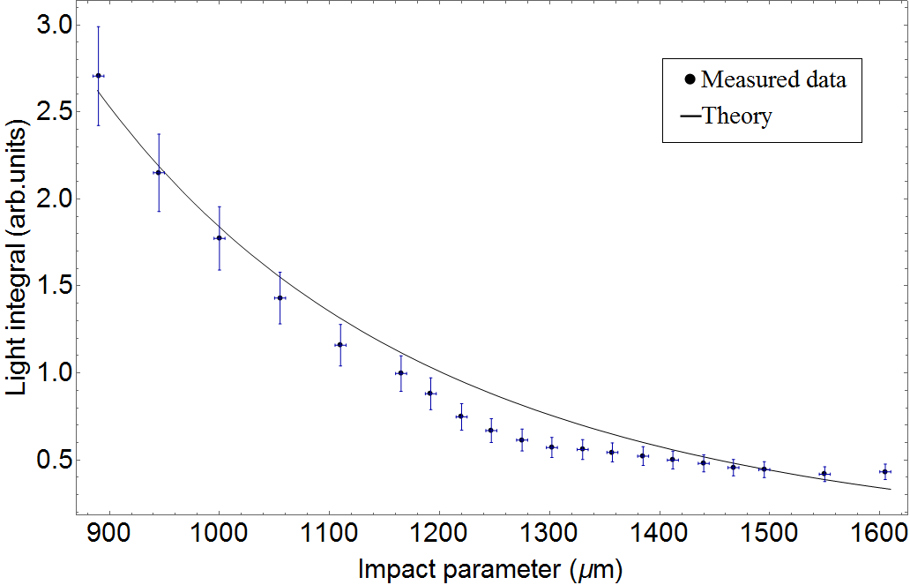
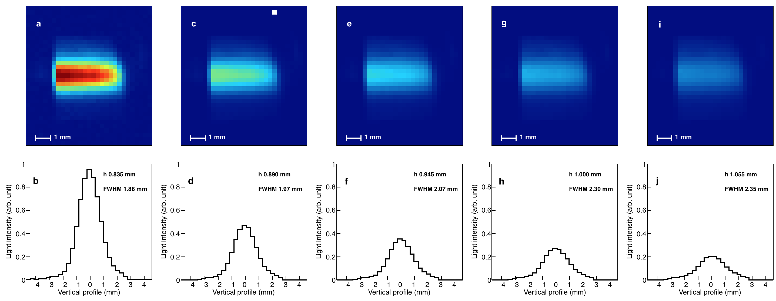
Experimental data : Electron at 2.1GeV
Steering the beam vertically
  No wavelength filter – no polarizer
‘Cherenkov photons yield increasing strongly for smaller impact parameter’
M. Bergamaschi, ATF2 Project Meeting 2018, LAL

Slide 13
Summary of measurements
Incoherent ChDR has been studied in IR and visible range for beams propagating at a distance of 1-3mm from the edge of the dielectric
The light is polarized and emitted in a narrow cone angle, different from SR angle providing excellent S/N ratio
The number of photons scales linearly with the length of the radiator and exponentially with the impact parameter
  e.g. for 5.3GeV and h=1.5mm, measured 10⁻³ photons/turn/particle
Qualitative concept proved for mm beam size
M. Bergamaschi, ATF2 Project Meeting 2018, LAL

Slide 14
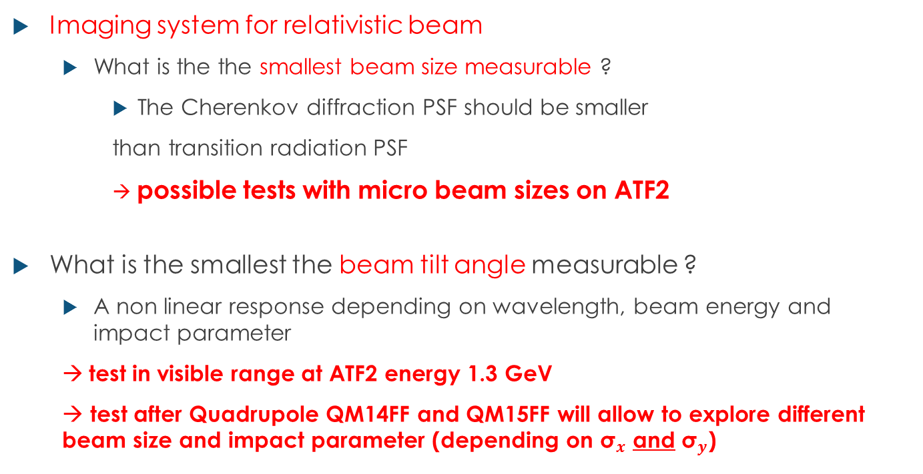
Possible studies at ATF2
Imaging system for relativistic beam
  What is the the smallest beam size measurable ?
    The Cherenkov diffraction PSF should be smaller
    than transition radiation PSF
  → possible tests with micro beam sizes on ATF2
What is the smallest the beam tilt angle measurable ?
  A non linear response depending on wavelength, beam energy and impact parameter
  → test in visible range at ATF2 energy 1.3 GeV
  → test after Quadrupole QM14FF and QM15FF will allow to explore different beam size and impact parameter (depending on ${\text{σ}}_{x}$ and ${\text{σ}}_{y}$)
M. Bergamaschi, ATF2 Project Meeting 2018, LAL

Slide 15
Possible studies at ATF2
Re-use of fused silica developed target for electron beam
Cherenkov
Diffraction
Radiation
M. Bergamaschi, ATF2 Project Meeting 2018, LAL

Slide 16
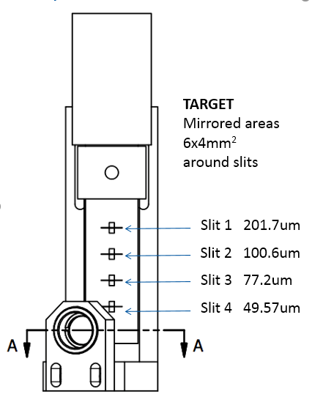
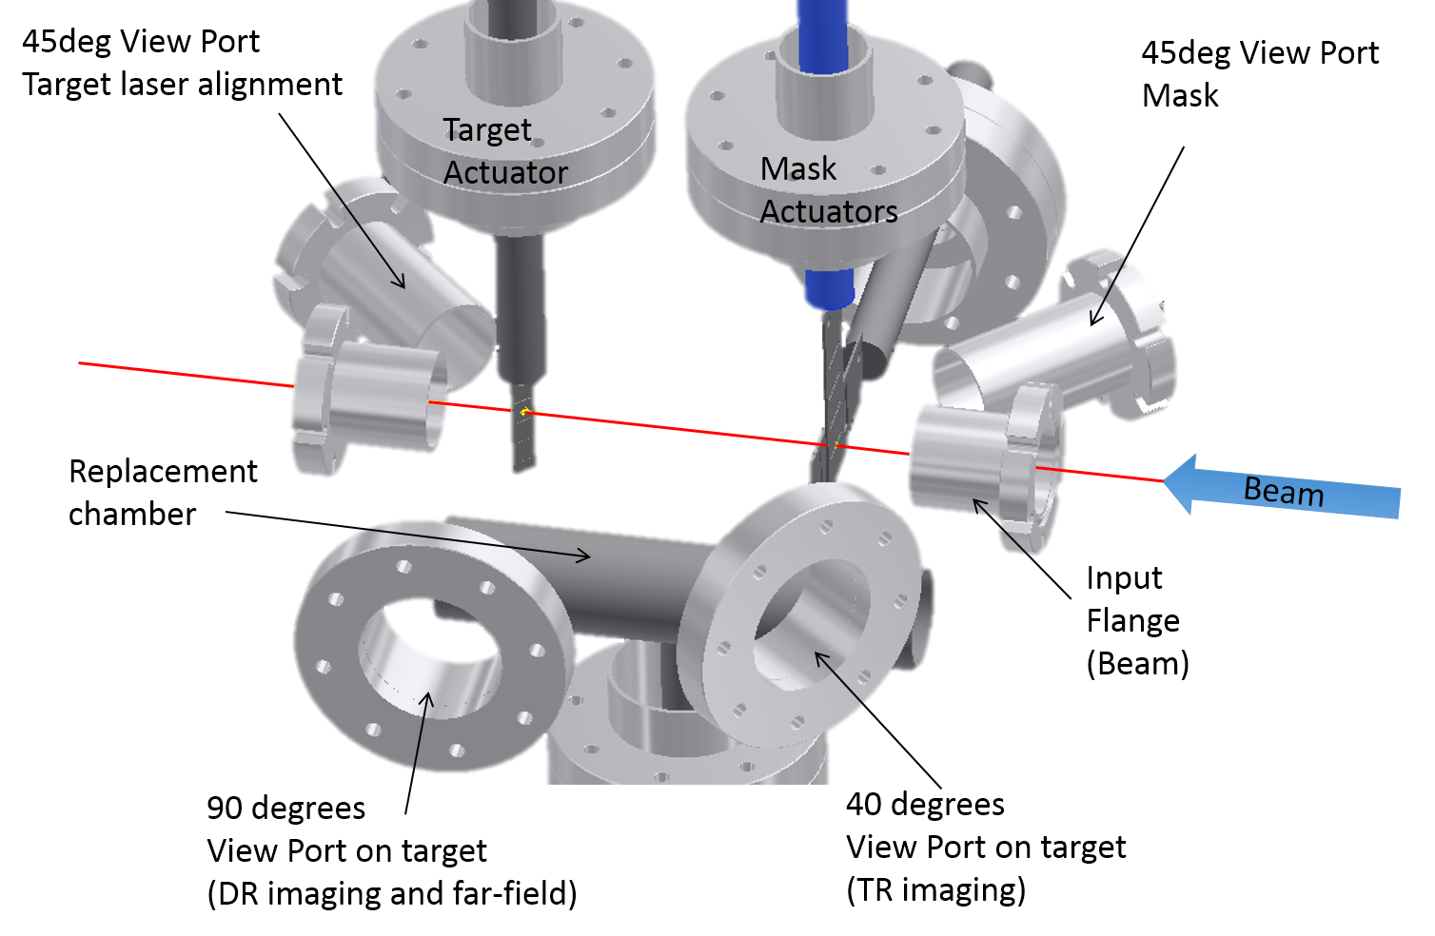
Possible studies at ATF2
Simple integration in the present ODR tank: replace old in-vacuum lens. Installation in few days, support already prepared at CERN.
Use in parallel OTR to monitor beam size and position
M. Bergamaschi, ATF2 Project Meeting 2018, LAL

Slide 17
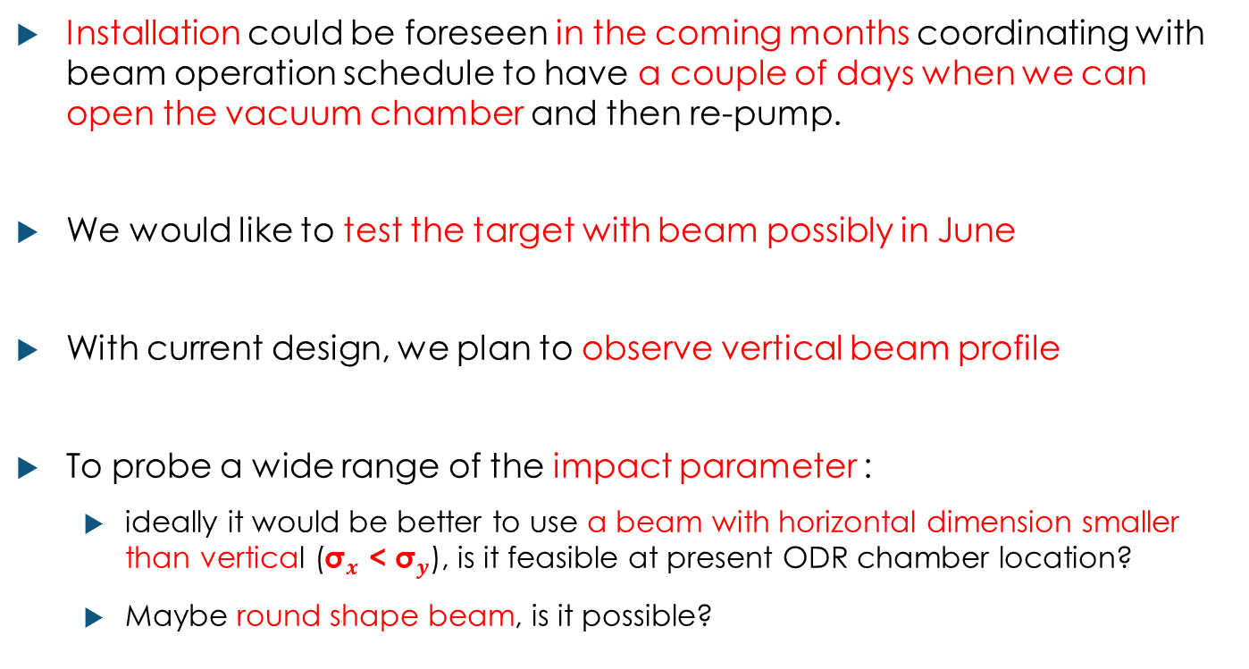
Conclusions
Installation could be foreseen in the coming months coordinating with beam operation schedule to have a couple of days when we can open the vacuum chamber and then re-pump.
We would like to test the target with beam possibly in June
With current design, we plan to observe vertical beam profile
To probe a wide range of the impact parameter :
  ideally it would be better to use a beam with horizontal dimension smaller than vertical (${\text{σ}}_{x}$ < ${\text{σ}}_{y}$), is it feasible at present ODR chamber location?
  Maybe round shape beam, is it possible?

Slide 18
Thanks for your attention
M. Bergamaschi¹, V.V. Bleko², M. Billing³, L. Bobb⁴, J. Conway³, R. Kieffer¹, A.S. Konkov² P. Karataev⁵, R.O. Jones¹, T. Lefevre¹, J.S. Markova², S. Mazzoni¹, Y. Padilla Fuentes³, A.P. Potylitsyn², J. Shanks³
1. CERN, Geneva, Switzerland
2. Tomsk Polytechnic University, Tomsk, Russia
3. Cornell University, Ithaca, New York, USA
4. Diamond Light Source, Oxfordshire, United Kingdom
5. John Adams Institute at Royal Holloway, University of London, Egham, United Kingdom

Slide 19
Back-up slides

Slide 20
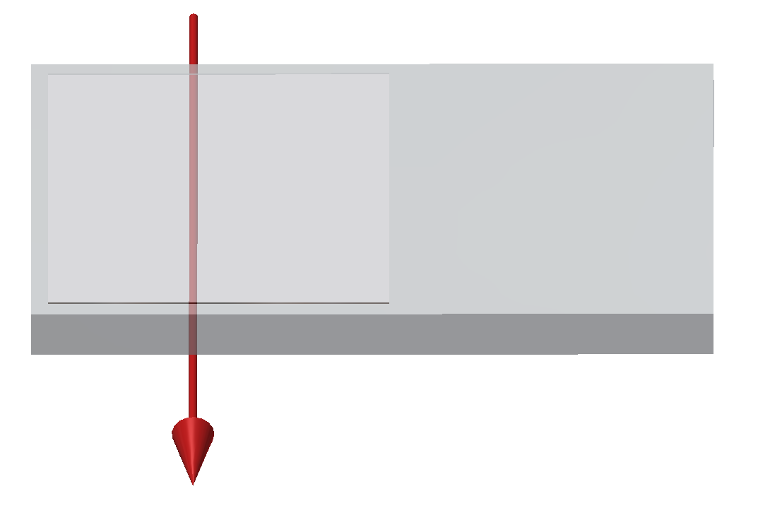
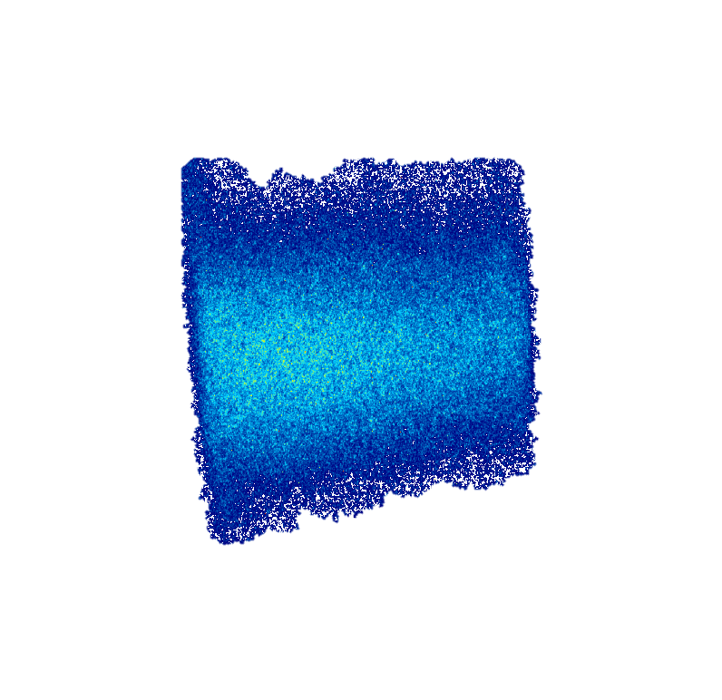
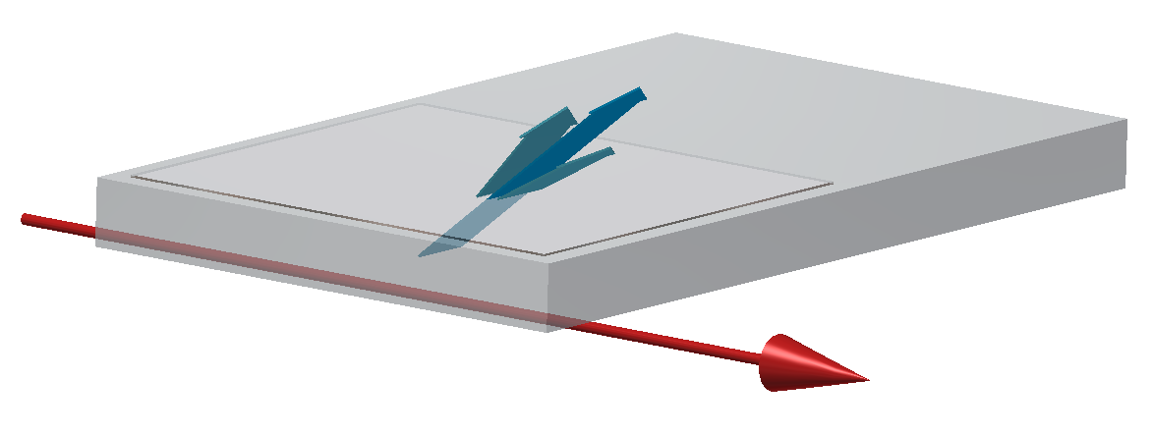
Experimental data : Positron at 5.3GeV
Imaging the Flat radiator (diffusive coating to extract the photons out of the target)
Cherenkov
Diffraction
Radiation
Cherenkov
Diffraction
Radiation
Positron
Beam
Positron
Beam
‘Cherenkov photons emitted all along the target surface’
M. Bergamaschi, ATF2 Project Meeting 2018, LAL

Slide 21
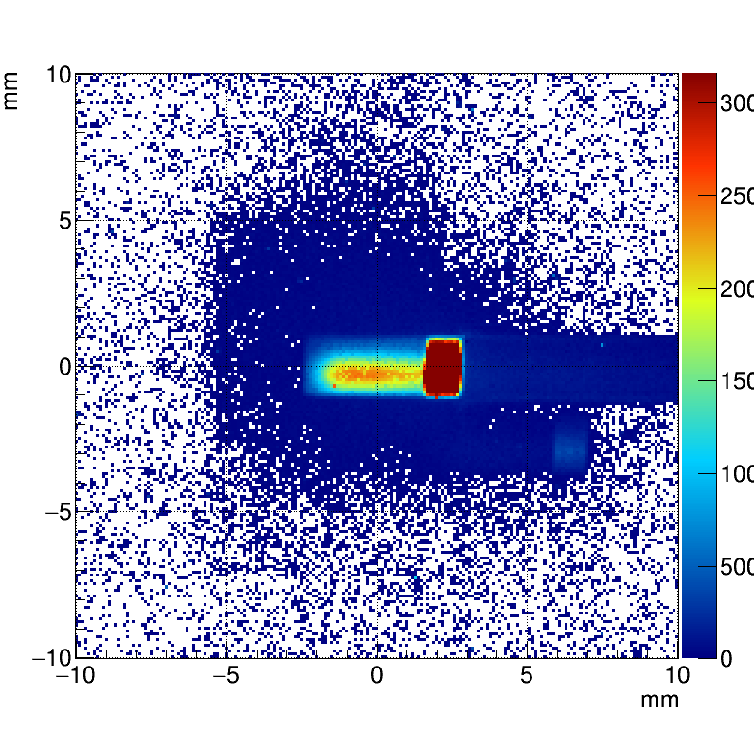
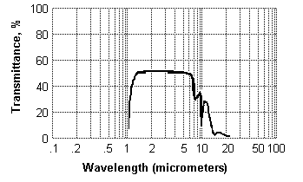
Perspectives on radiator’s shapes and material
Prismatic or flat targets ? Something else ?
  BPM using flat target – possibly using long(er) target
  Imaging system requiring to select the appropriate polarization
How thick should a target be ? cm/mm/um ?
  ChDR is mainly emitted within the first atomic layer of the dielectric since the beam field decreases as it penetrates inside the material
Testing different materials for different applications / wavelength
ChDR
Beam
Silicon
Diamond
M. Bergamaschi, ATF2 Project Meeting 2018, LAL

Slide 22
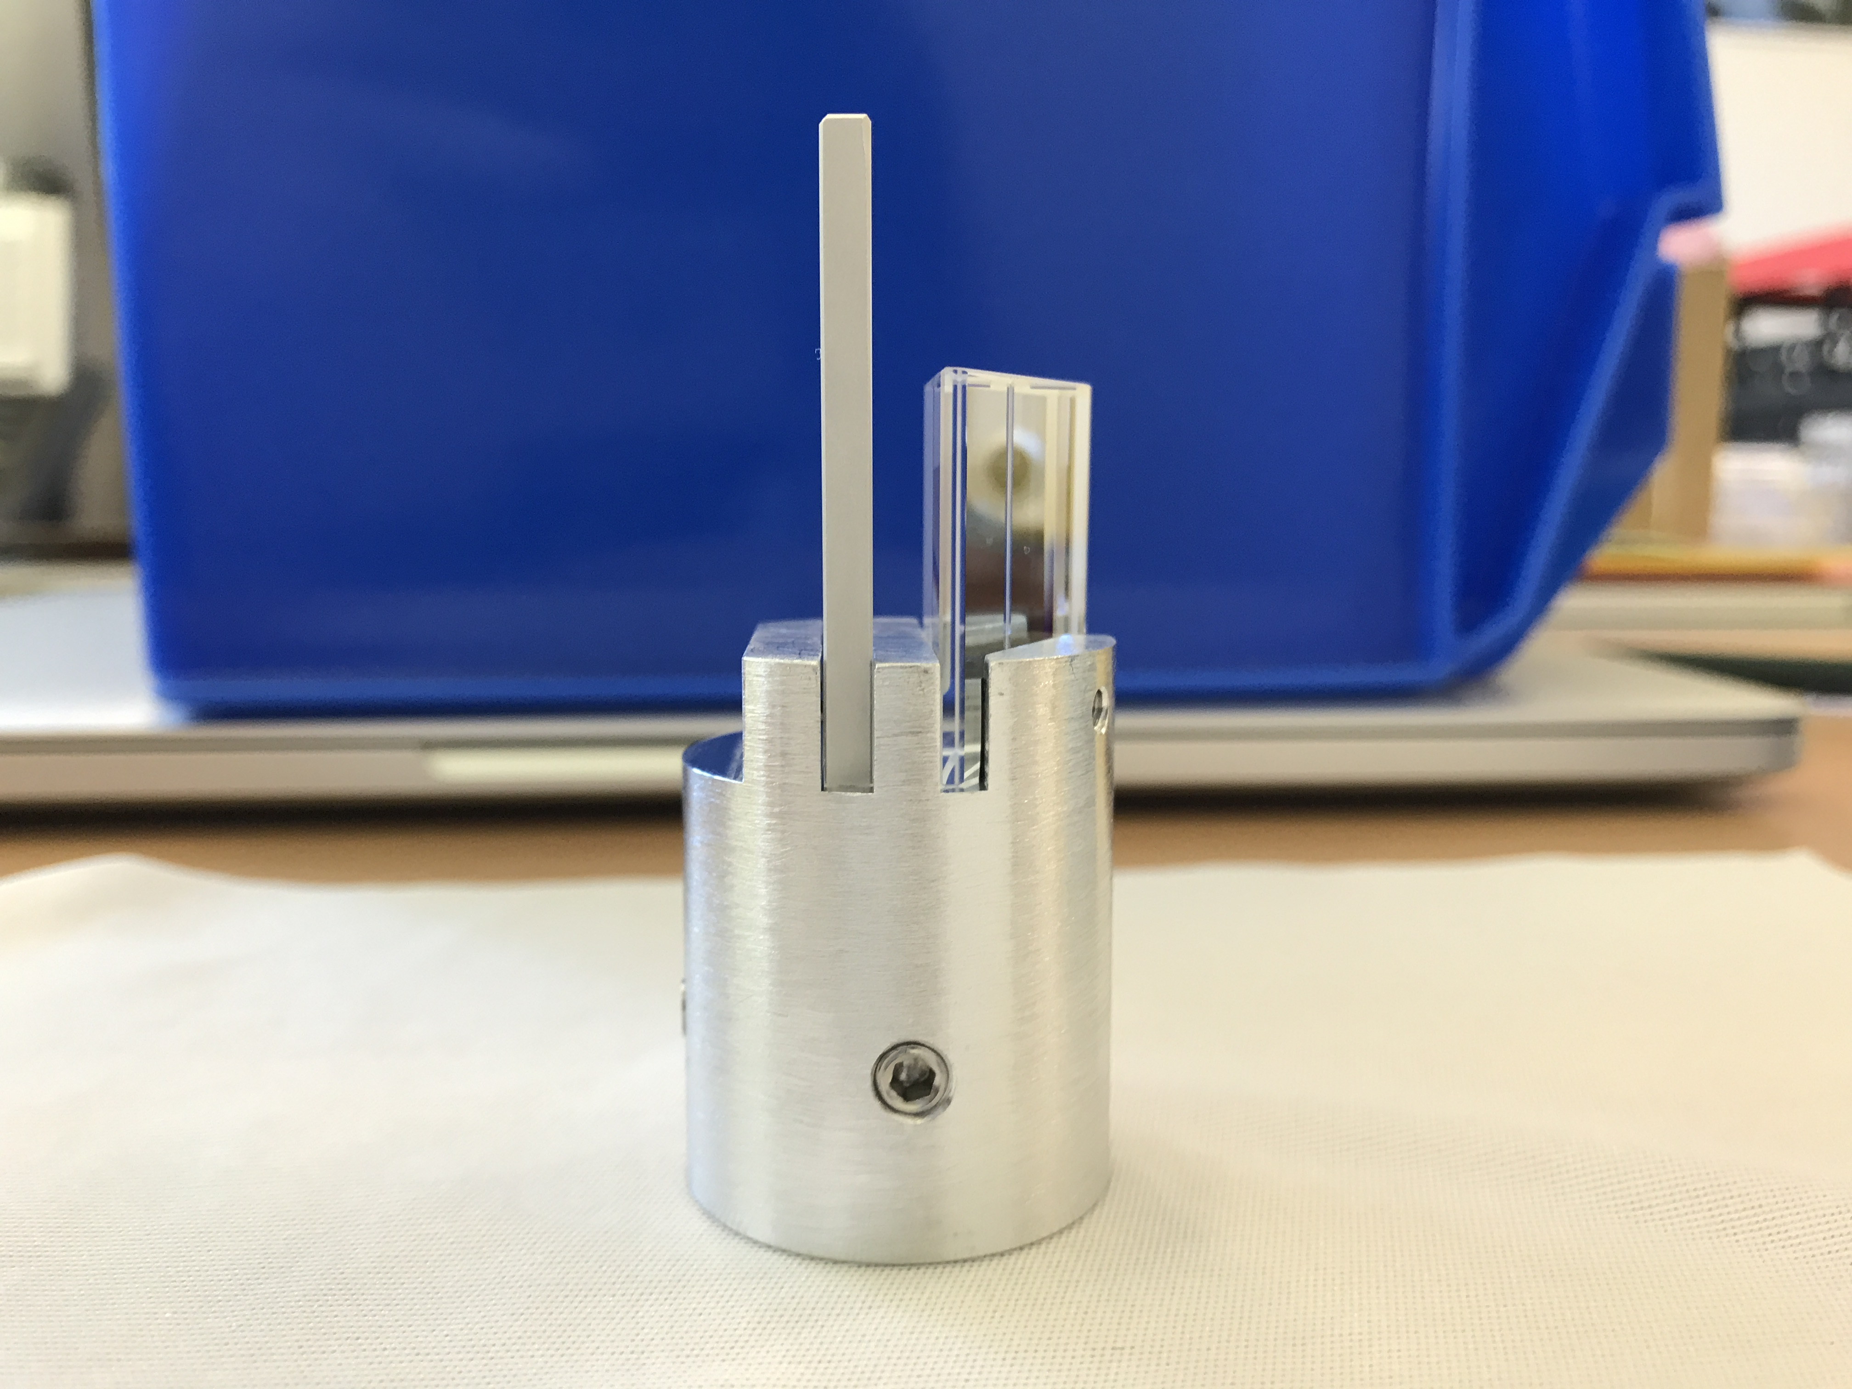
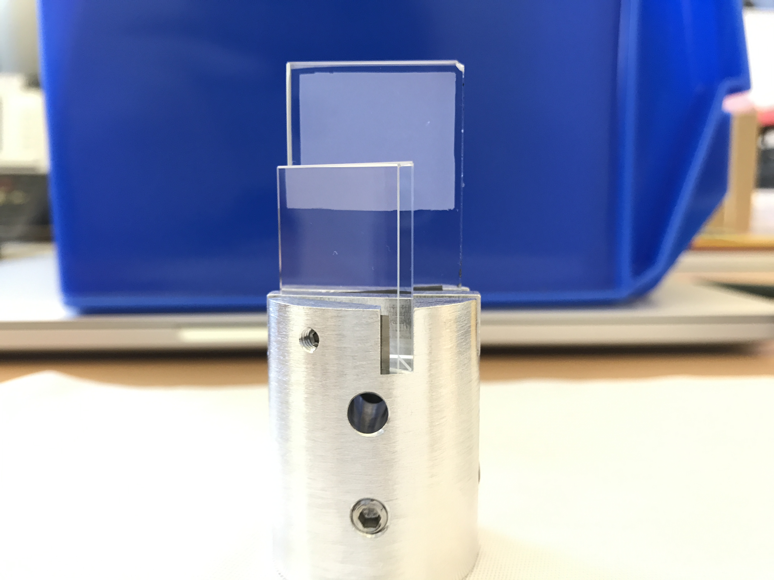
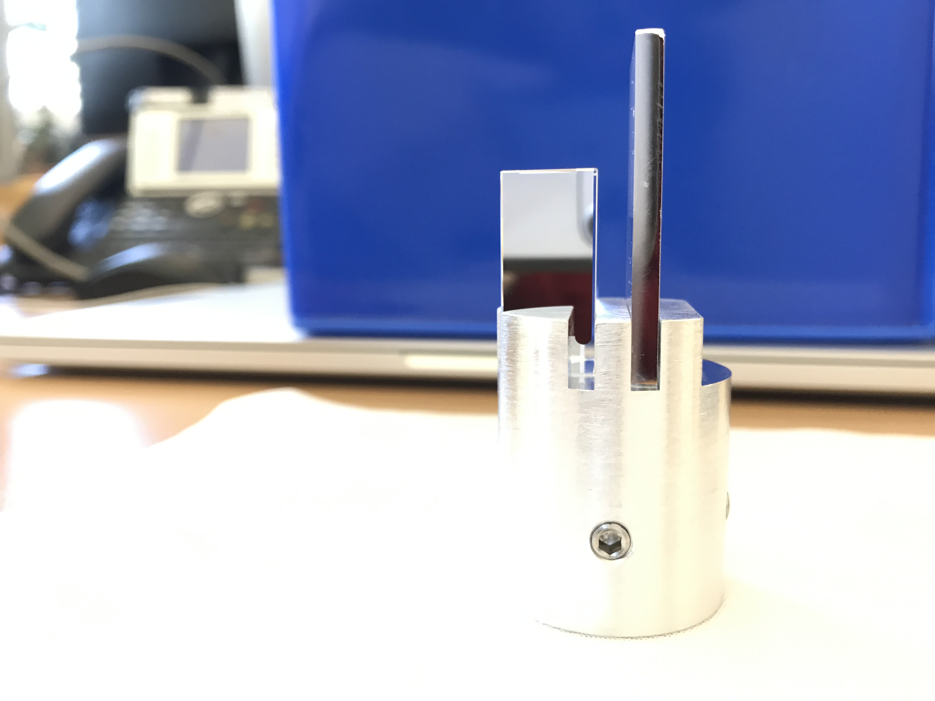
Cherenkov radiators (2/2)
Pictures of the radiators
Depolished
& Coated
Depolished
Area - no coating
Polished
& Coated
M. Bergamaschi, ATF2 Project Meeting 2018, LAL

Slide 23
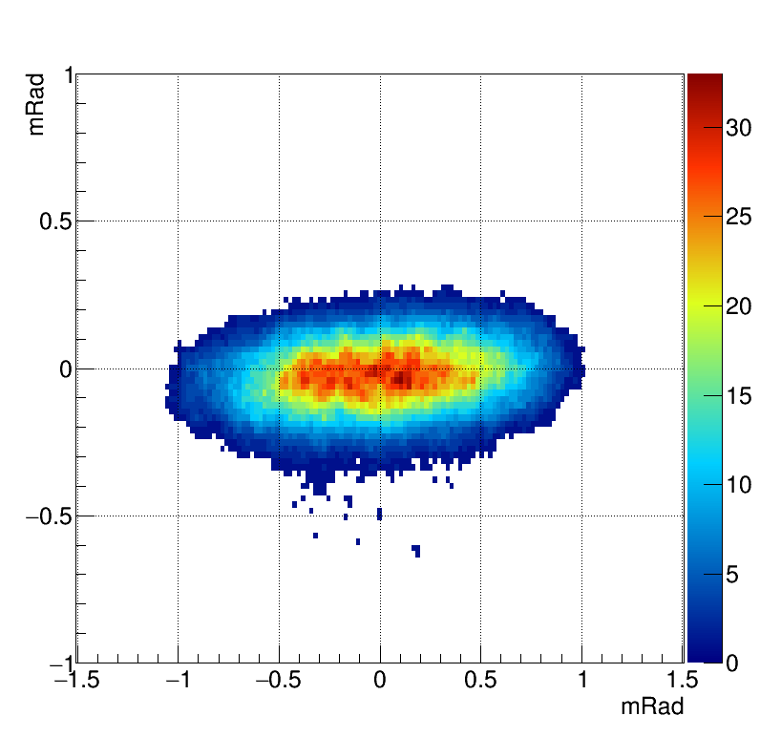
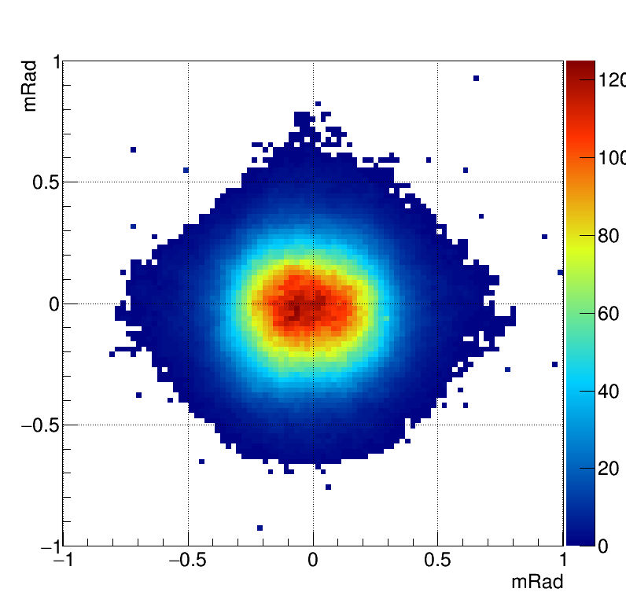
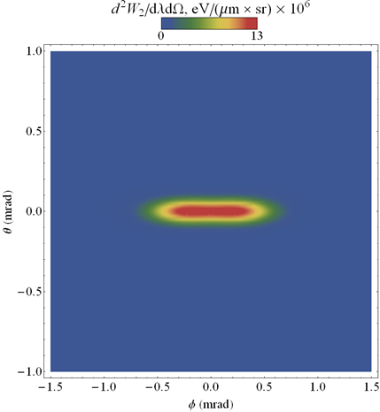
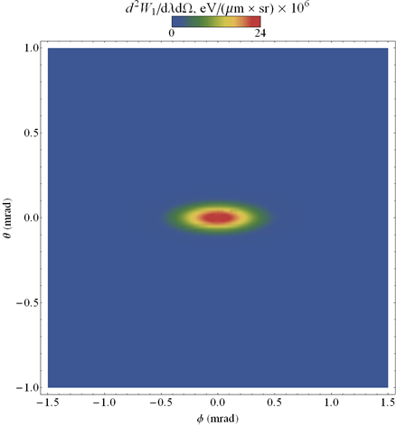
Experimental data : Positron at 5.3GeV
Angular distributions with Prismatic radiator : Comparison with simulations
Horizontal polarization
Vertical polarization
Measurements
Simulations
M. Bergamaschi, ATF2 Project Meeting 2018, LAL

Slide 24
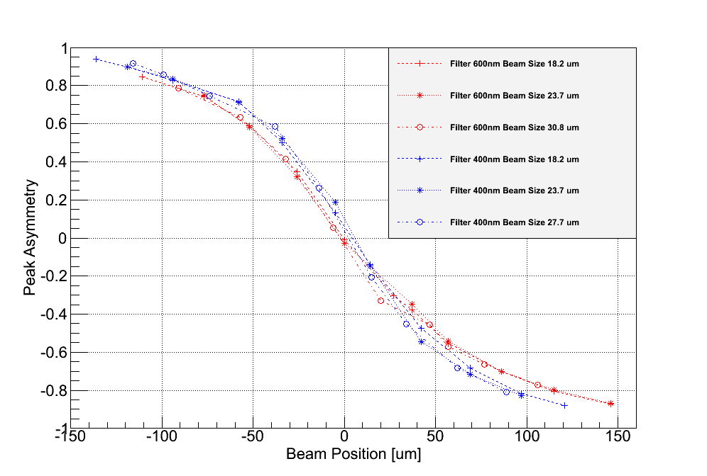
Incoherent Diffraction Radiation on CESR (4/6)
Steering the beam through the slit
Conditions: wavelength 400/600 nm, beam size: 16.2/23.7 um, slit width 0.5mm
Offset
Different sensitivity depending on the wavelength
M. Bergamaschi, ATF2 Project Meeting 2018, LAL

Slide 25
Cherenkov radiators (2/2)
Pictures of the radiators
Depolished
& Coated
Depolished
Area - no coating
Polished
& Coated
M. Bergamaschi, ATF2 Project Meeting 2018, LAL

Slide 26
Experimental data : Positron at 5.3GeV
Imaging the prismatic target at wavelength of 600±10nm
Cherenkov
Diffraction
Radiation
Cherenkov
Diffraction
Radiation
Positron Beam
Positron Beam
M. Bergamaschi, ATF2 Project Meeting 2018, LAL

Slide 27
Experimental data : Positron at 5.3GeV
Steering the beam vertically
  Wavelength 600±10nm
  Vertical Polarization component
h= 0.96mm 1.17mm 1.52mm 2.09mm 2.43mm
Cherenkov photons yield increasing strongly for smaller impact parameter
M. Bergamaschi, ATF2 Project Meeting 2018, LAL

Slide 28
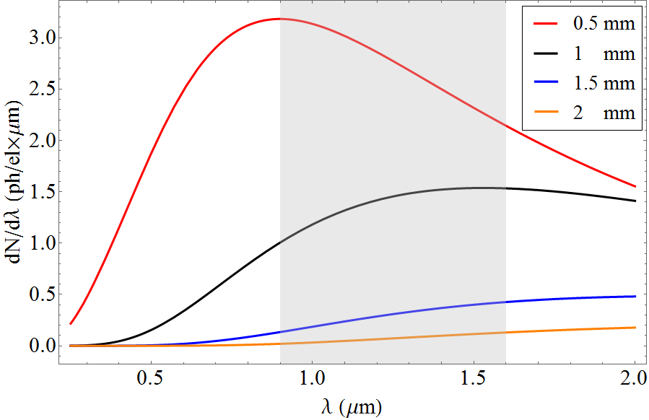
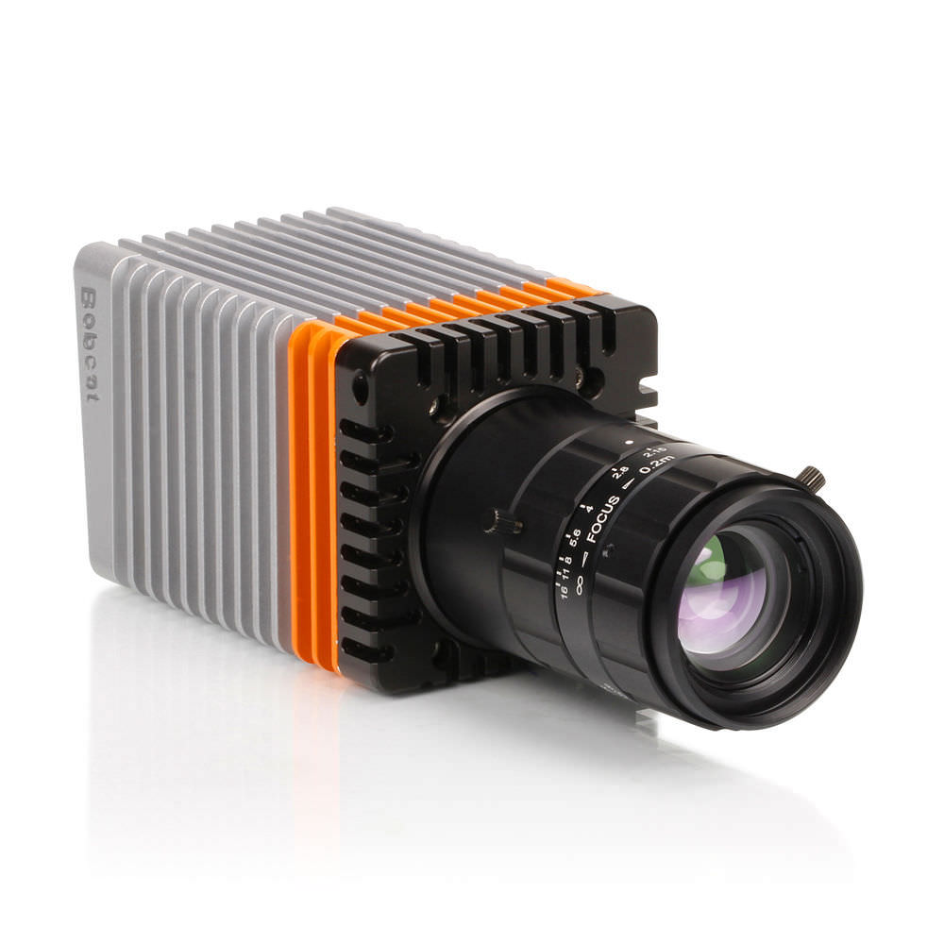
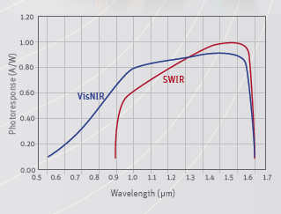
Experimental set-up on CESR (2/3)
Design a 2cm long SiO2 (n=1.46) Cherenkov Diffraction Radiation target
  Testing with 2.1GeV e⁻ and measuring in IR (0.9-1.7um) – April 2017
Xenics Bobcat 640 GigE
Cooled InGaAs 640x512 pixels : 20um pixel pitch
QE up to 80% at 1.6um
14bit ADC
1us-40ms integration window
‘The red curve as been scaled down by 1/3 for better presentation
    M.V. Shevelev and A.S. Konkov, JETP 118, 501 (2014)
M. Bergamaschi, ATF2 Project Meeting 2018, LAL

Slide 29
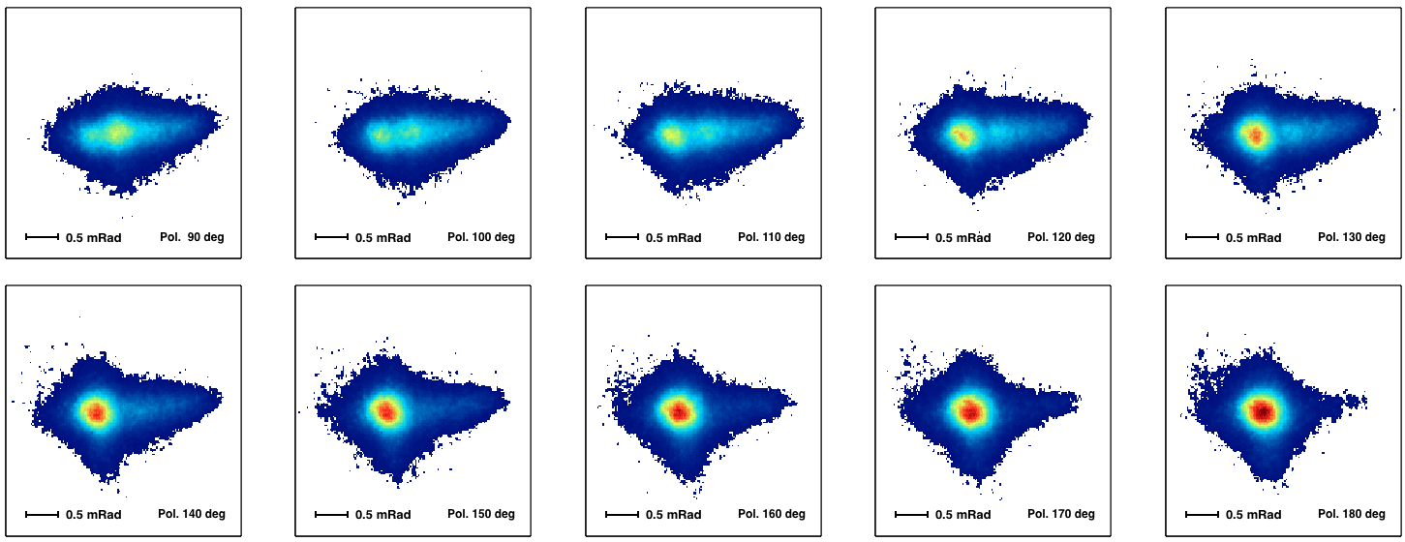
Experimental data : Positron at 5.3GeV
Prismatic target : Angular distribution and polarization study
Impact parameter fixed , 600±10nm wavelength, Polarization Scan
M. Bergamaschi, ATF2 Project Meeting 2018, LAL

Slide 30
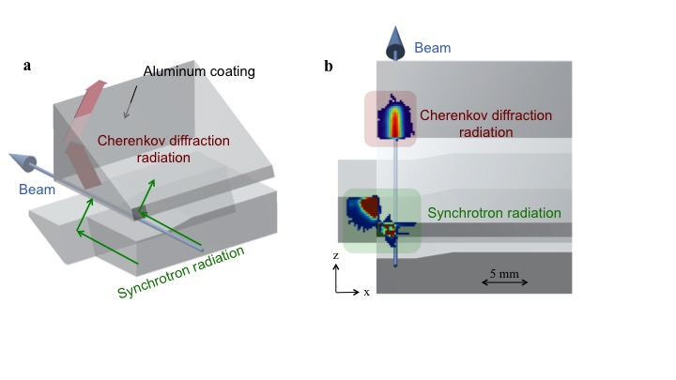
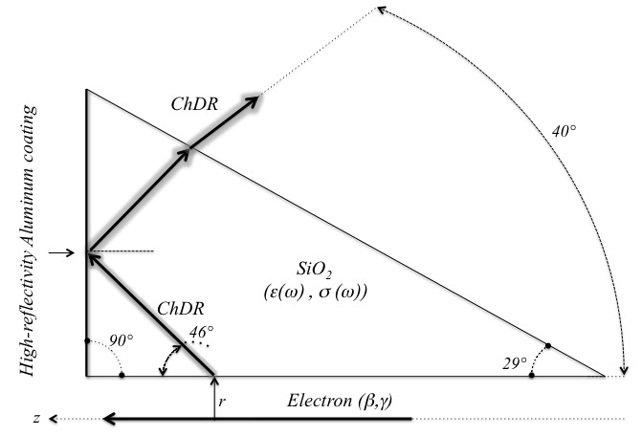
Experimental data : electron at 2.1GeV
Prismatic target for the detection of electrons
M. Bergamaschi, ATF2 Project Meeting 2018, LAL

Slide 31
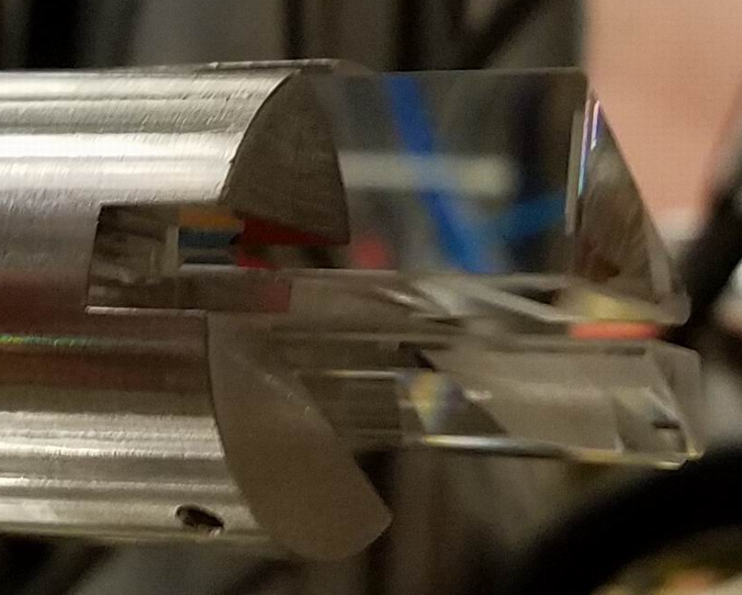
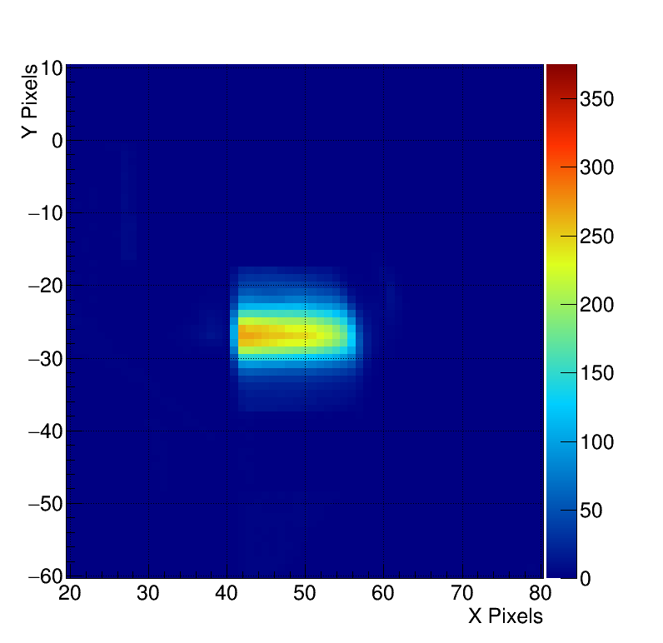
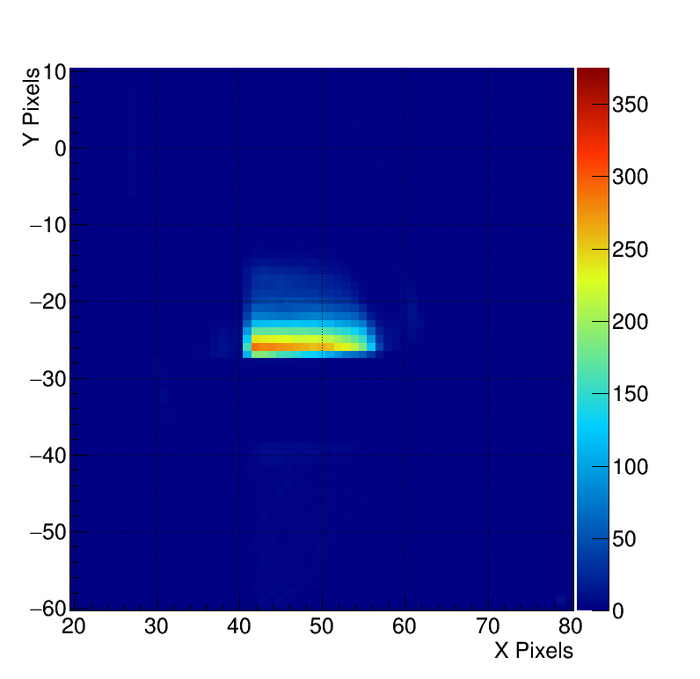



Experimental data : electron at 2.1GeV
Optically polished ChDR target insertion passing over a 3mm de-polished strip on the surface.
Diffusive surface =>We loose the highly directional ChDR emission.
3mm Strip
Target Movement
3mm Strip
M. Bergamaschi, ATF2 Project Meeting 2018, LAL

Slide 32


Cherenkov radiation (1/2)
‘Equivalent to the supersonic boom but for photons’
Threshold process: Particles go faster than light β > 1/n
n is the index of refraction
β is the relative particle velocity
θ_{c} is the Cherenkov light emission angle
d the length of the cherenkov radiator
The total number of photons proportional to the thickness of the Cherenkov radiator
Almost no dependency on beam energy
M. Bergamaschi, ATF2 Project Meeting 2018, LAL

Slide 33


Cherenkov radiation (2/2)
Emitted (measurable) power spectrum depends on the materiel transparency (Tr(λ))
Silicon
Diamond
SiO2
Al2O3
CVD SiC
M. Bergamaschi, ATF2 Project Meeting 2018, LAL

Slide 34
e.g. Cherenkov Diffraction Radiation
ChDR Photons spectrum in Silicon for LHC (7TeV protons) and different impact parameters
h=1mm
h=2mm
h=3mm
Photon
Spectrum (a.u)
Peaking @1-3um
Silicon – n=3.45
Photon spectrum only calculated over the transmission bandwidth of
corresponding material
Wavelength (m)
M. Bergamaschi, ATF2 Project Meeting 2018, LAL

Slide 35
e.g. Cherenkov Diffraction Radiation
Number of ChDR photons and ChDR power spectrum as function of beam Energy (LHC-FCC)
  1m Si crystal and impact parameter h = 2mm
LHC 7TeV
Photon
Spectrum (a.u)
Better to Detect
in the FIR
FCC
N_{ph}
per proton
450GeV
7TeV
50TeV
Nph=300
Nph=11500
Nph=39000
LHC 450GeV
Wavelength (m)
Proton Beam Energy (MeV)
M. Bergamaschi, ATF2 Project Meeting 2018, LAL

