Slide 1
FONT Meeting
Friday 16th February 2018
Diode processor, sample jumps and IQ phase
Douglas BETT

Slide 2
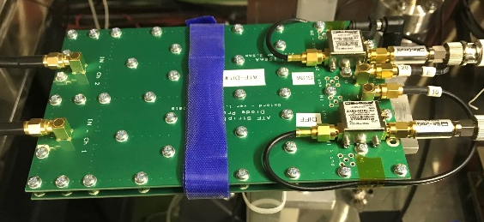
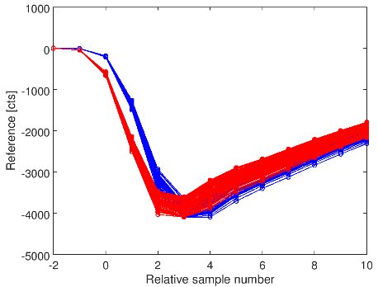
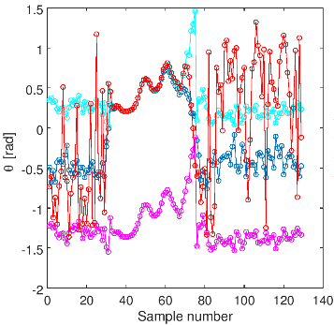
Contents
Diode processor
  setup and commissioning
  stability, dynamic range measurements
Sample jumps
  review and timing signal study
  amplitude and frequency analysis
Bonus: IQ phase
  historically random before signal arrived

Slide 3
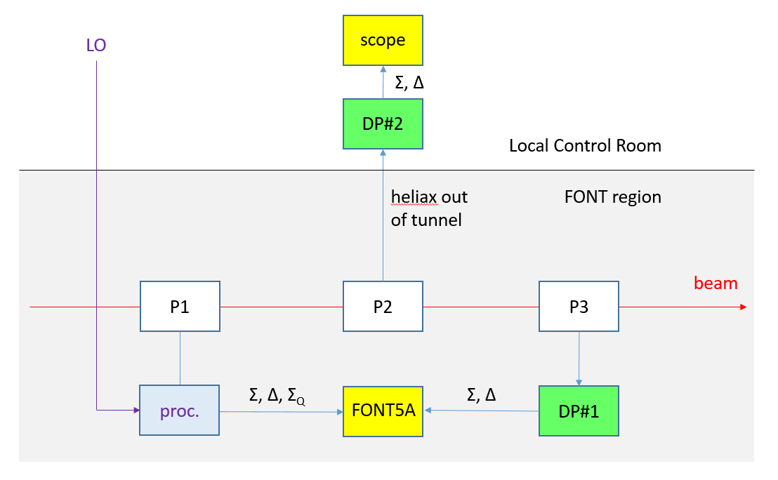
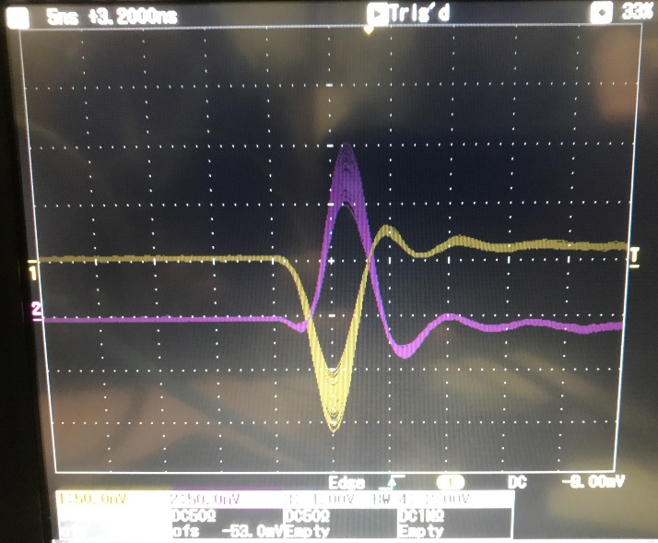
Diode processor commissioning
Matched pair of heliax required to transport raw stripline signals;
B1, B2 available in P2 region
Heliax 4 replaced B1 as fast clock input of upstream FONT5A board
6 dB attenuators installed on P3 and DP1 instrumented in situ (phase shifter removed from signal path due to cabling issues)
Initial processor tests performed in Local Control Room using scope
Δ
Σ
DP2 instrumented with P2 signals with 6 dB attenuation on inputs and no filters on outputs
Δ signal responded as expected to changes in P2 BPM mover setting but beam orbit sufficiently offset that Δ could not be reduced to zero
From crude calibration estimated jitter to be tens of microns
With attenuation removed |Σ| = 350 mV

Slide 4
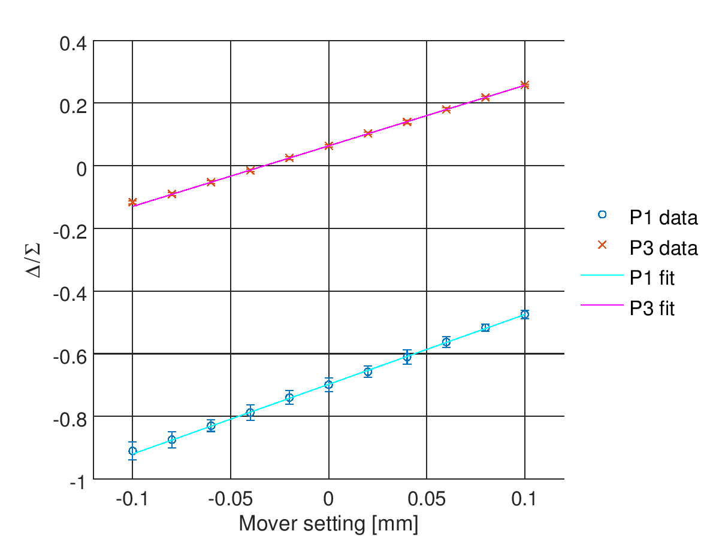
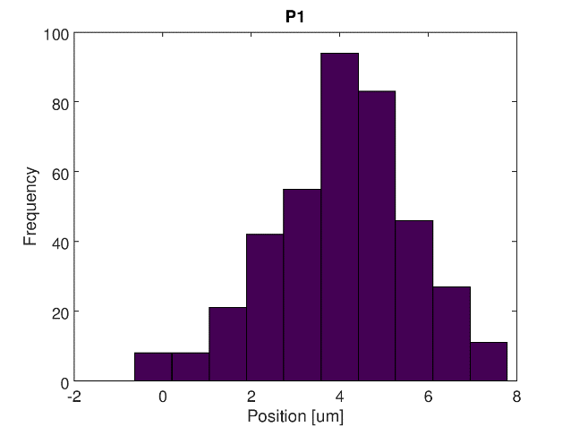
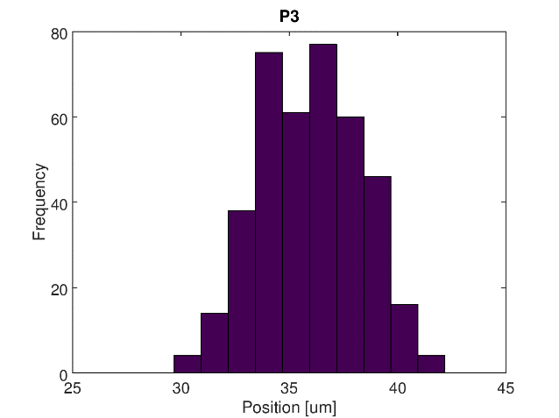
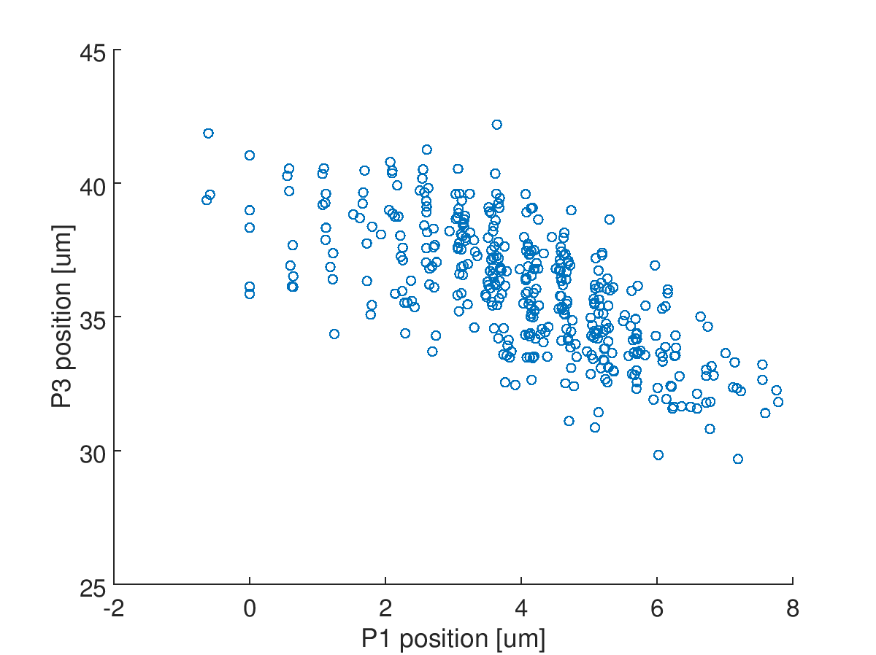

Initial in situ measurements
mCal1
180206_owl
Calibration using BPM movers
449.4 (P1)
517.3 (P3)
LATENCY
P3 sum signal peak occurs three samples after that of P1
(formerly 5 samples)
→ can infer a reduction in latency of > 5 ns compared to conventional processor
$$k=y/\left(Δ/Σ\right)$$
jitRun2
Measured beam jitter
1.59 um (P1)
2.37 um (P3)
caveats
- significant P3 offset
- couldn’t change LO phase;
Σ_{Q} used instead of Σ for P1
- charge unstable: σ(Σ) doubled during latter half of jitter run
- no phase compensation for P1
- no drift removal
P1-P3 correlation = -0.70

Slide 5
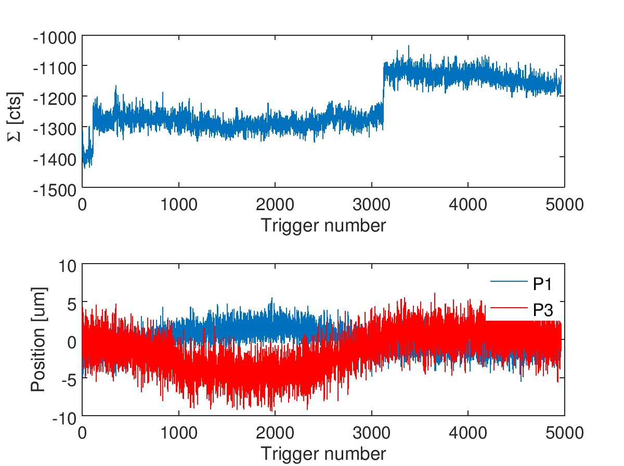
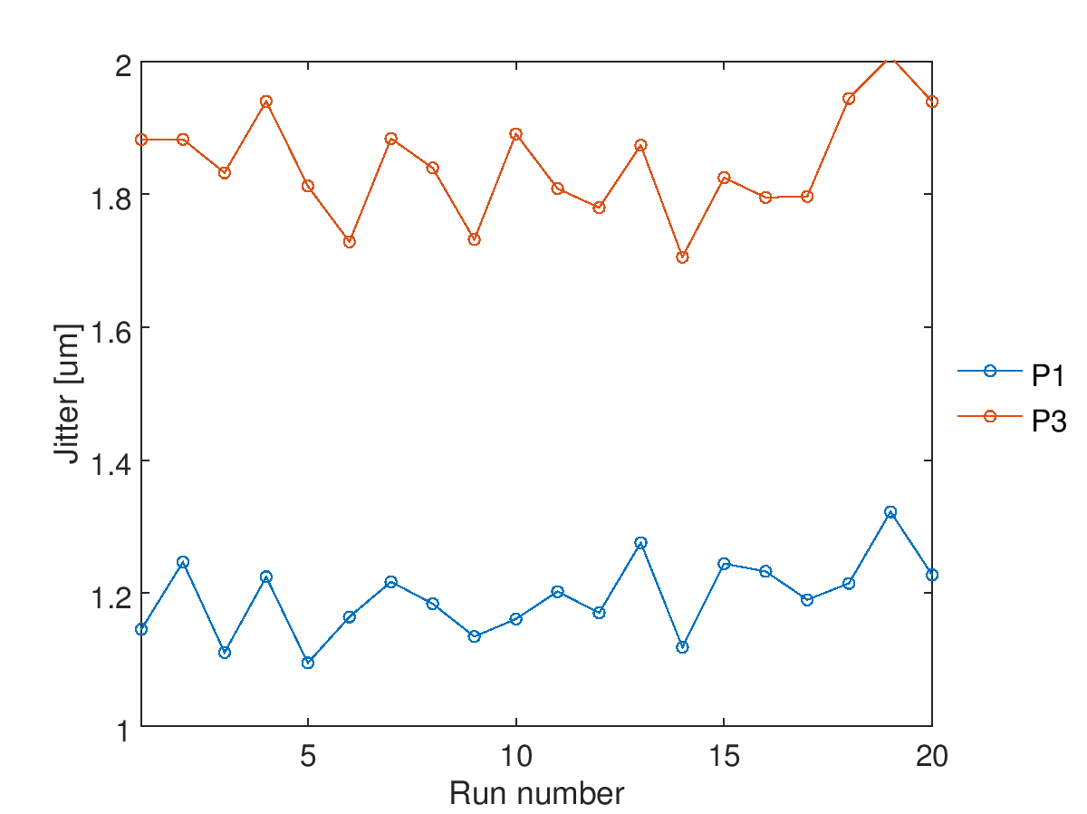
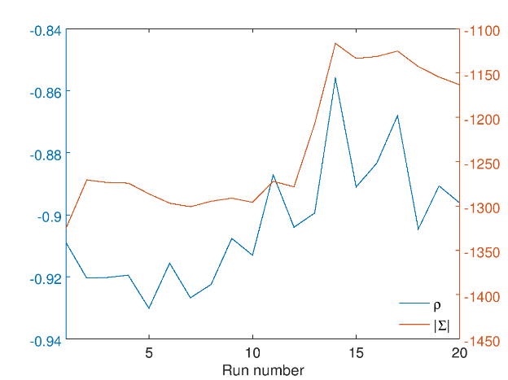
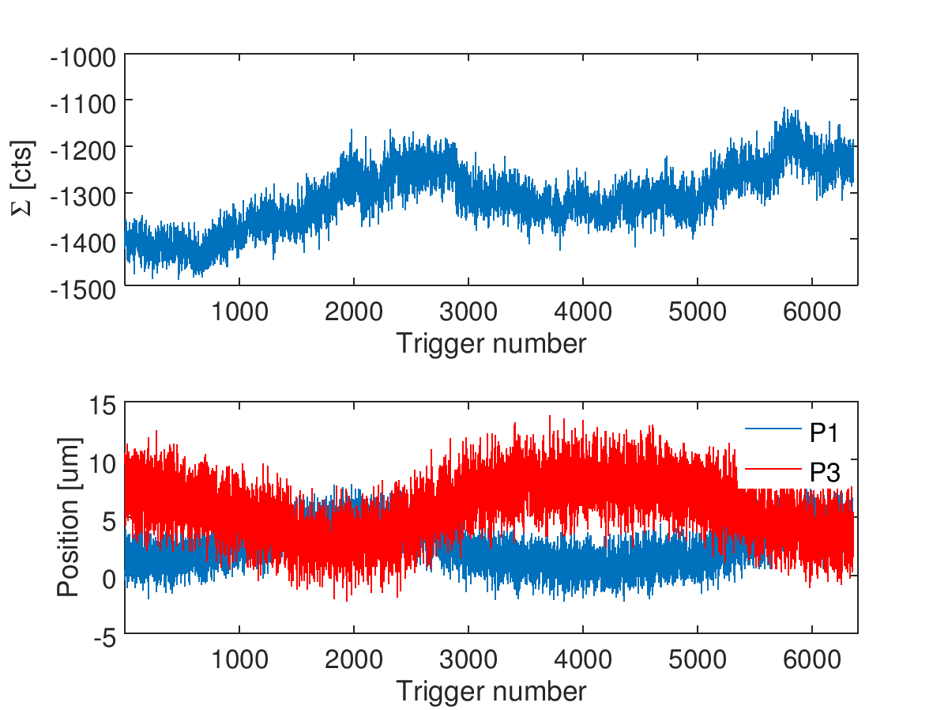
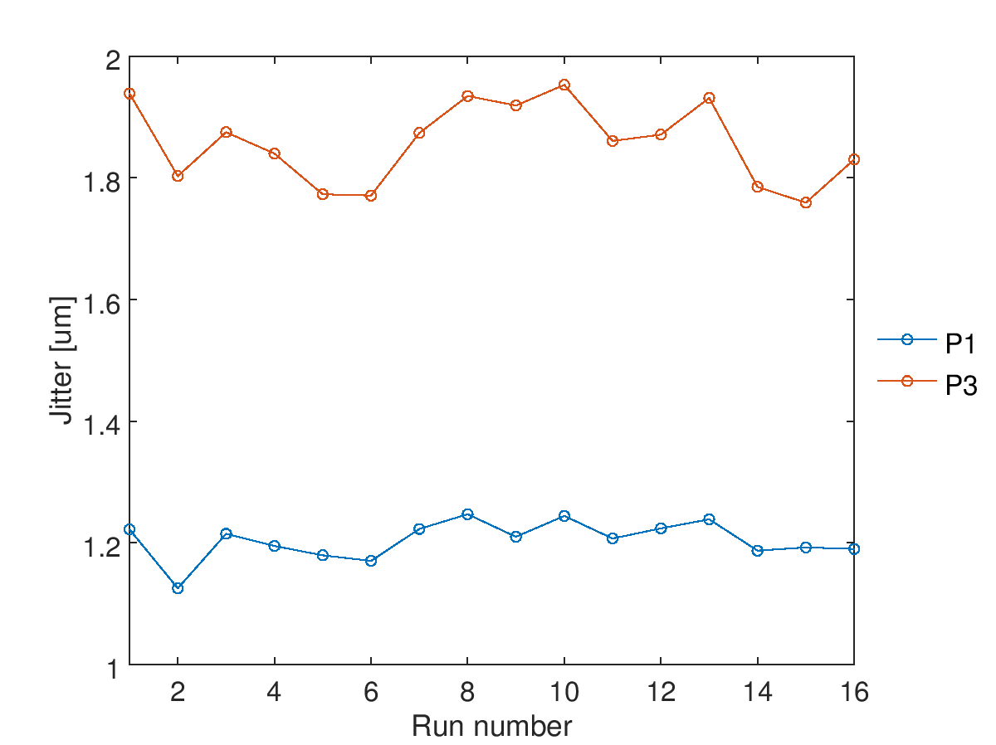
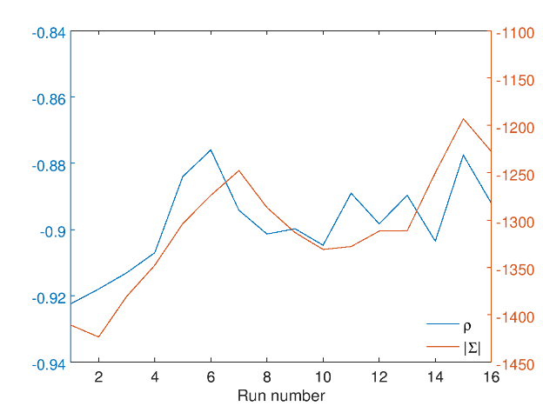
Stability
[14:07:29] diodeProcessor: 5,000 trigger data run. Charge modified twice during run.
P1-P3 correlation
Σ(P1) [cts]
[15:40:21] jitRun: 16 × 400 trigger data runs. Charge varied by itself.
P1-P3 correlation
Σ(P1) [cts]

Slide 6
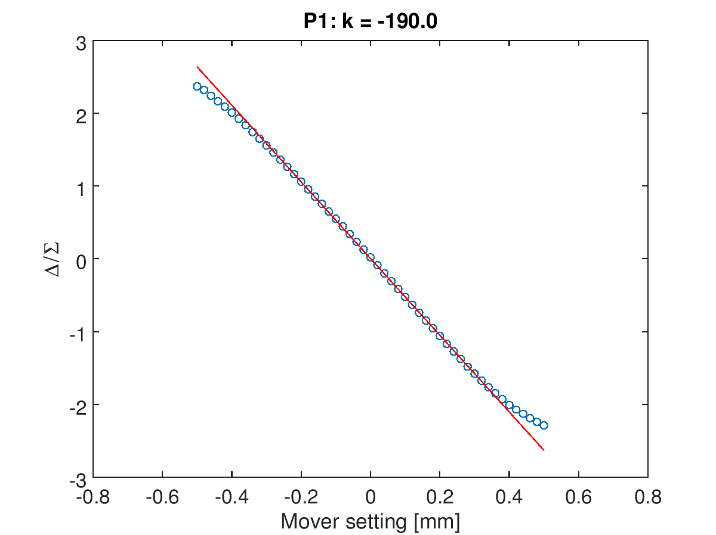
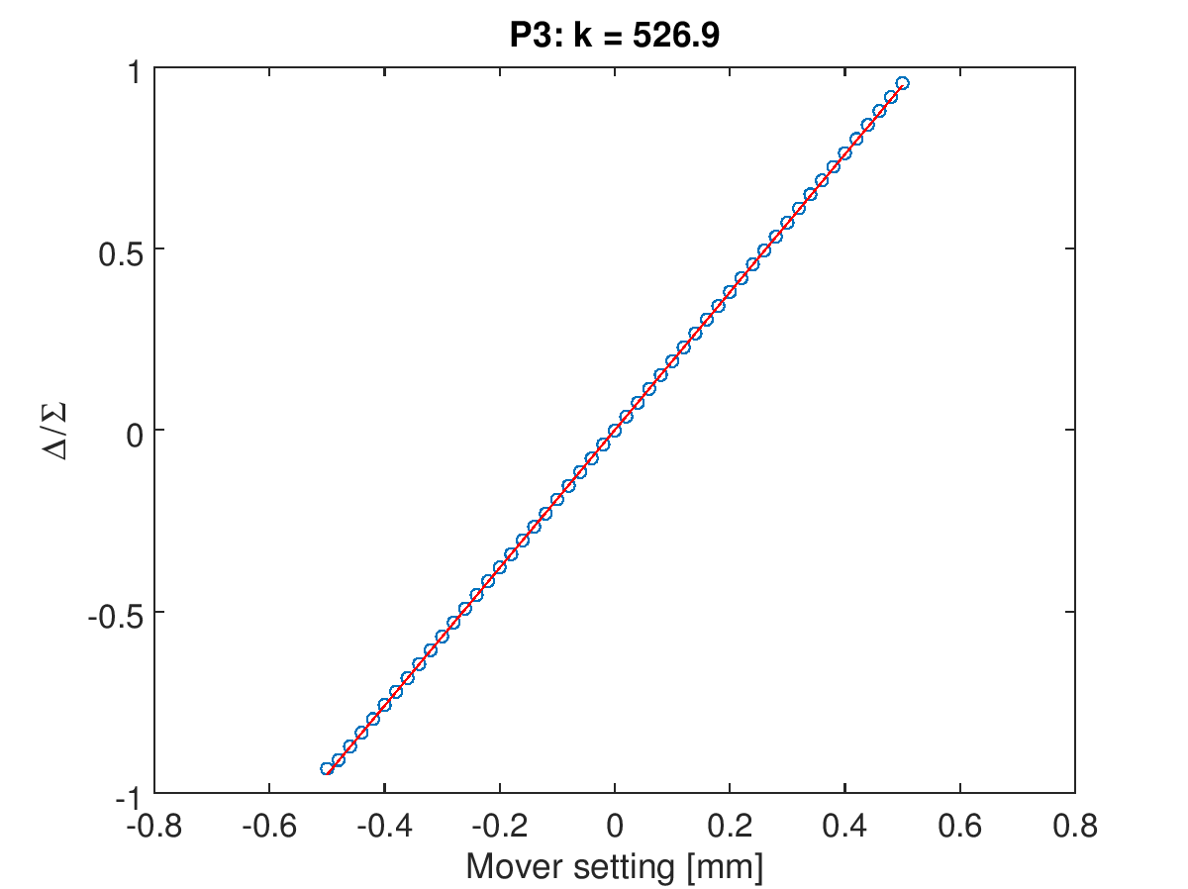
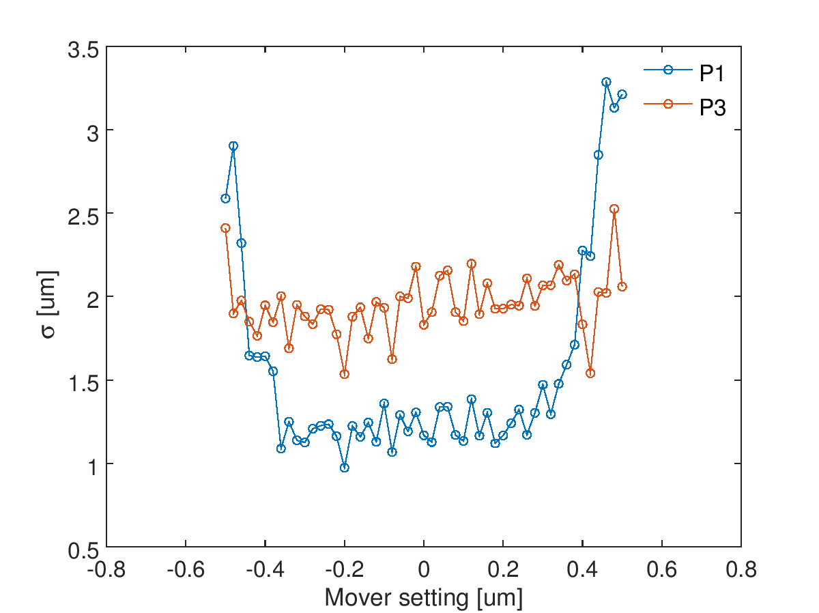
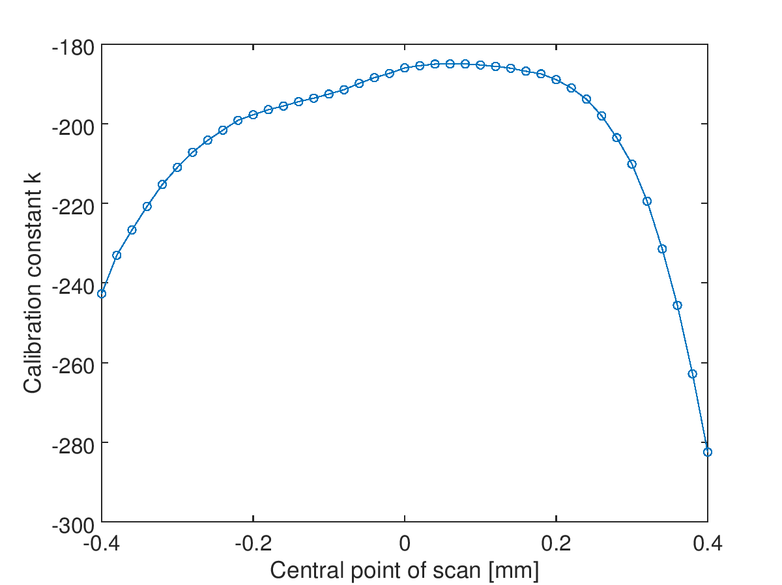
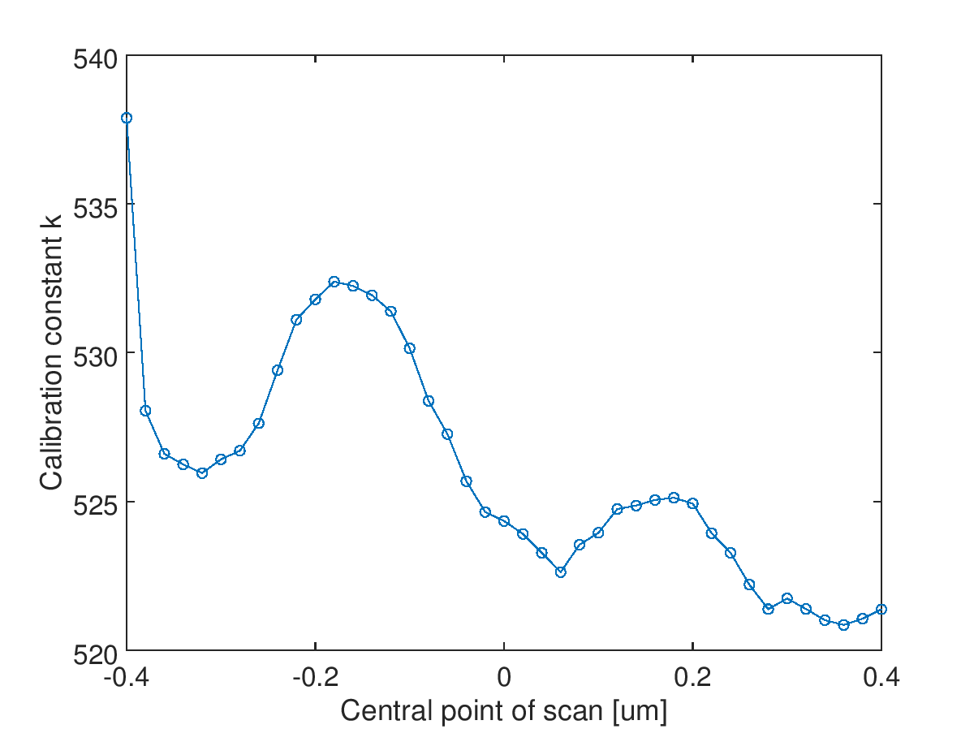
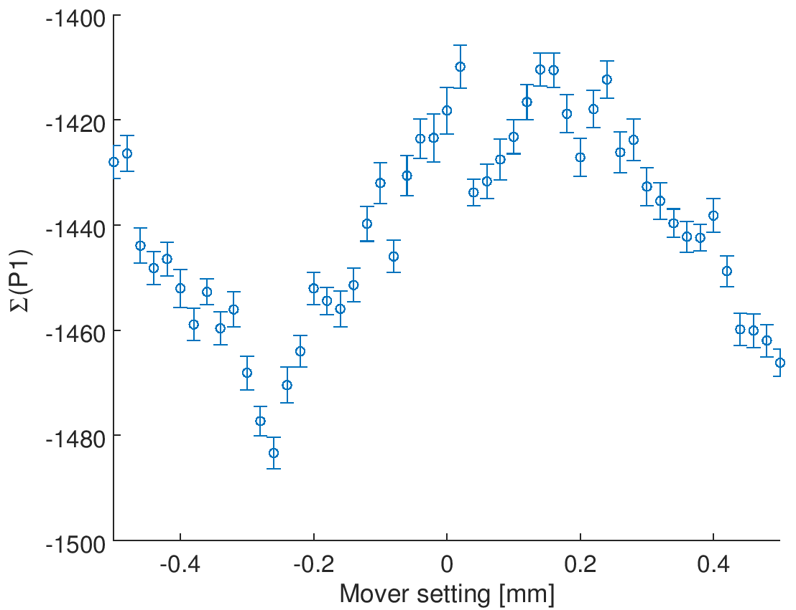
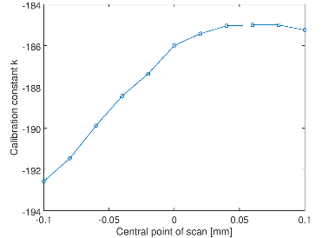

Dynamic range
Mover scan over range ± 500 μm with a 20 μm step size.
P1 mean position
P3 mean position
Position jitter
Calibration constant for each BPM as a function of central point of scan.
charge
$$\frac{k_{max}−k_{min}}{\left\langle k\right\rangle }<0.015$$

Slide 7
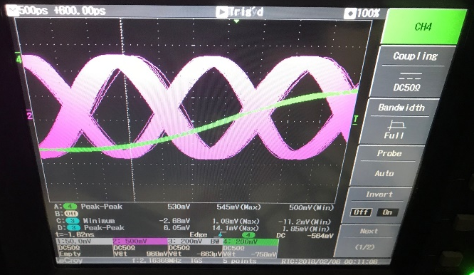
Sample jumps: a review
Refers to recently observed spontaneous shifts in the sample window of the FONT5A board
  Internal ring clock generated from fast clock
  Board starts counting ring clock cycles after trigger rising edge detected
  Input trigger delay defines number of ring clock cycles to wait before sampling
  Sample hold-off allows sample window to be further delayed by up to 127 fast clock cycles
Problem intermittent: possible to go an entire shift without observing it once but if it does happen, the board sample timing will tend to jump repeatedly
Frequently the sample window shifts by such a large amount that it no longer includes both bunches
For feedback and analysis purposes the signals should remain stationary; depending on the size of the jump and initial value of sample hold-off, it may not be possible to trivially recover the initial state
sample window
trigger input delay: count ring clock cycles
trigger
sample hold-off
count fast clock cycles
TIMING SIGNAL STABILITY STUDY
Trigger, ring clock and beam (represented by sum output of diode processor) all found to be stable with respect to each other
Fast clock and ring clock left on scope. After sample jump,
fast clock phase found to have flipped
Fast clocks are outputs of Mikey’s LO distribution box
i.e. generated from the DR 714 MHz

Slide 8
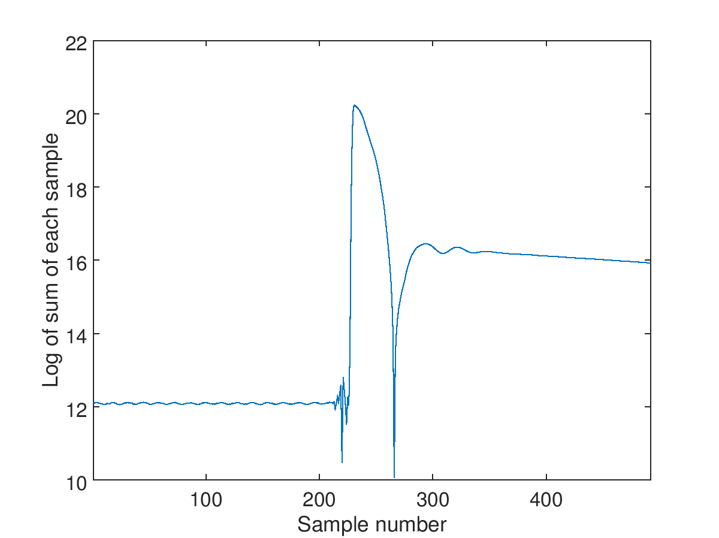
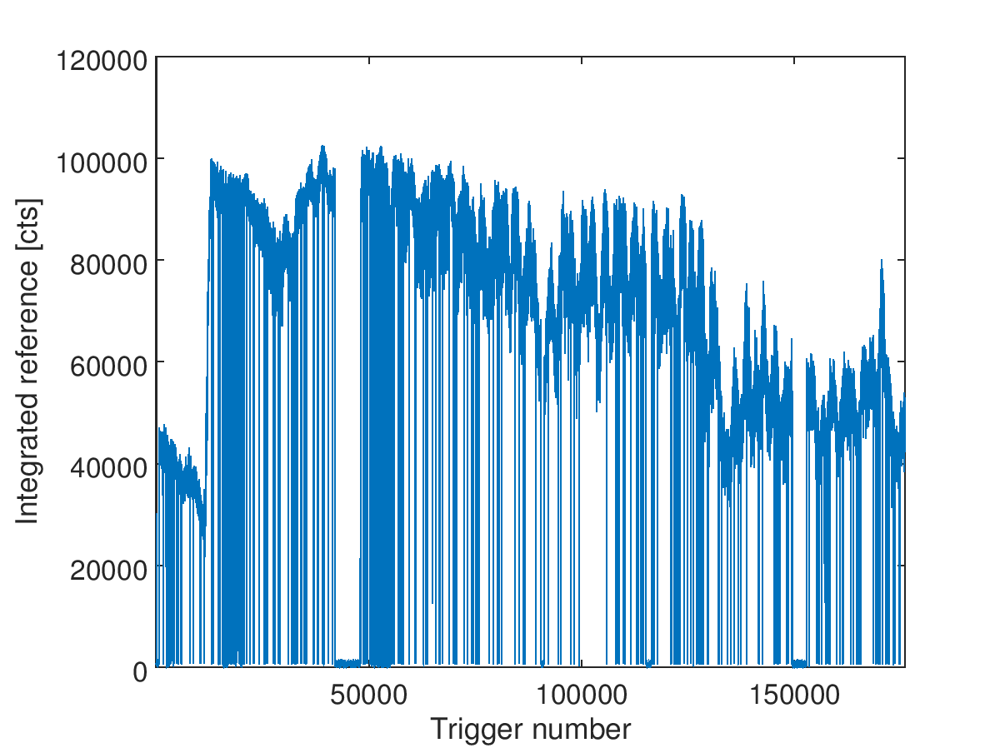
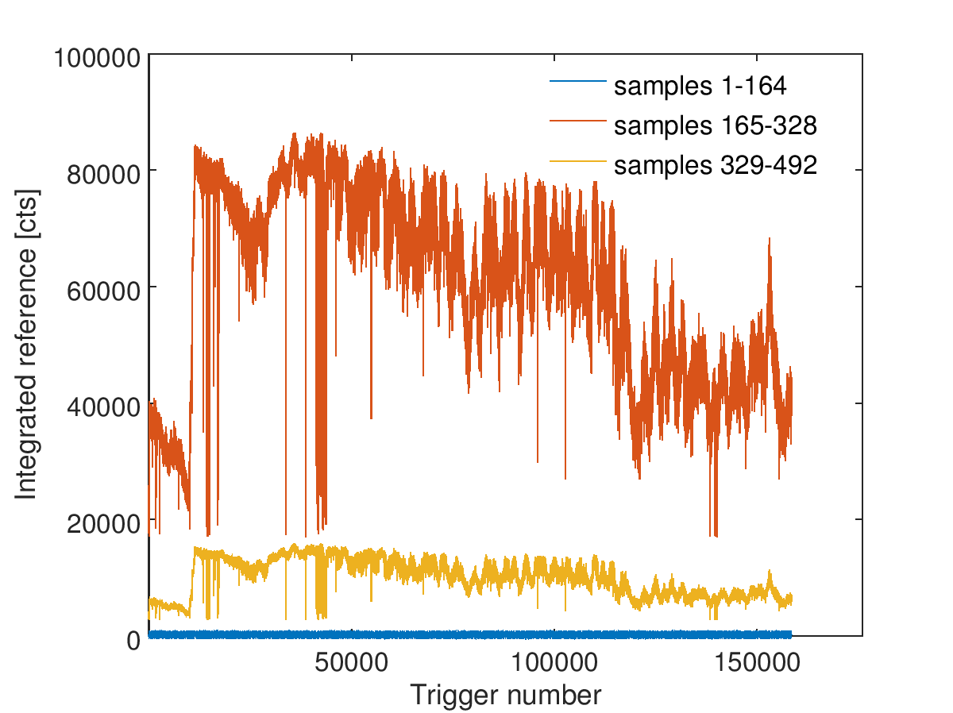
Sample jumps: overnight
In an attempt to gather some data about this phenomenon, at the end of Wednesday day shift the sample window was increased to 492 samples (three ring clock cycles) and the board left to repeatedly take data runs until deactivated next morning
440 runs × 400 triggers / run = 176,000 triggers ~ 15h40m
Not a single sample jump
Hard to demonstrate due to large size of data set, but came up with a few metrics
Sum of waveforms on a sample-by-sample basis.
Sum of waveforms on a trigger-by-trigger basis.
Same as previous but separated by ring clock cycle.
cycle 1
cycle 2
cycle 3

Slide 9

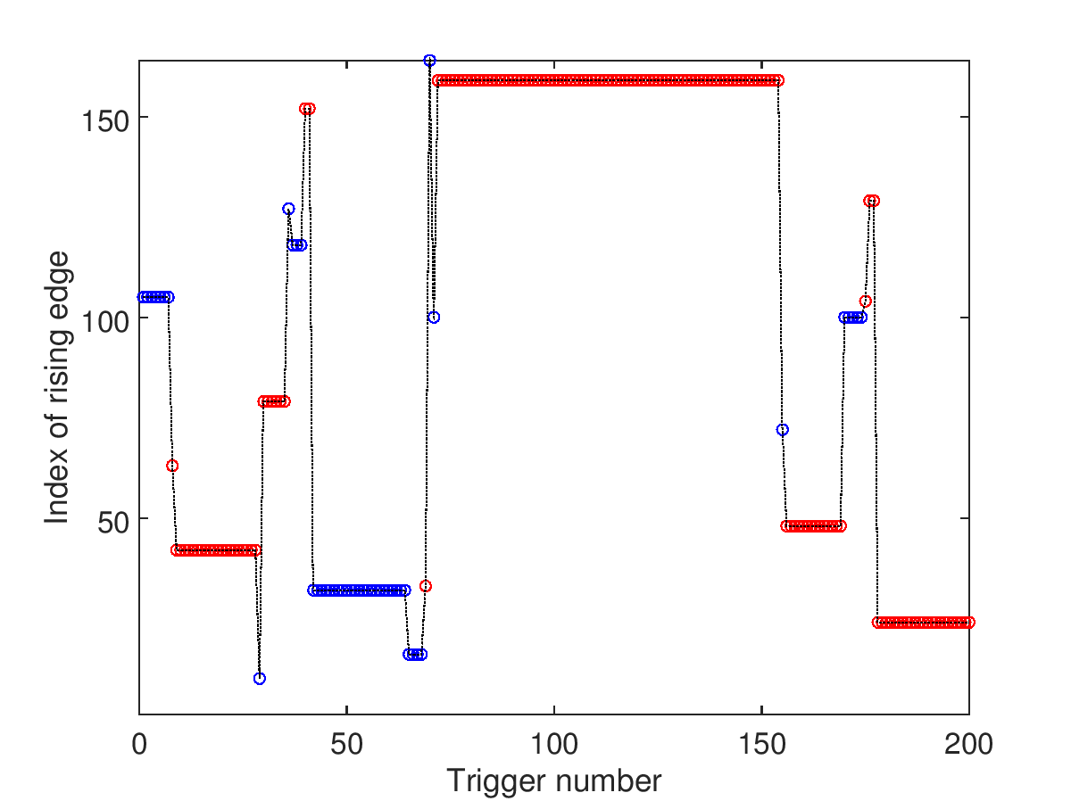
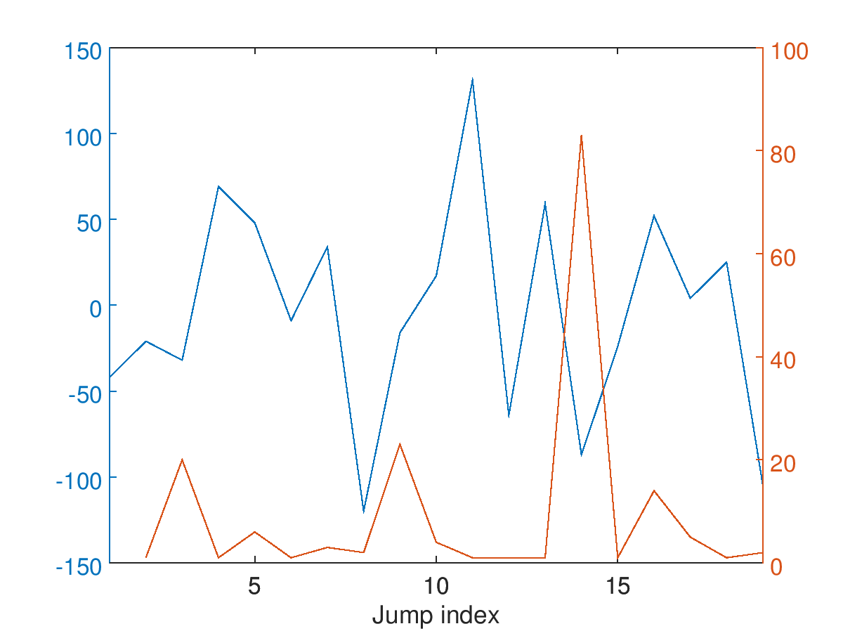
Sample jumps: jump3
Fortunately plenty of jumping during the Friday day shift – took data (downstream board only) as soon as it happened, but noted that the upstream board was affected too
Sample window can jump by a non-integer number of fast clock cycles
  Particularly obvious upstream: as the scan delays are typically used to shift the ADC clocks in order to catch the peaks of the Σ signals, a 1.4 ns shift completely changes the shape of the sampled signal
  Also visible in the shape of the reference diode
    For each trigger, locate the rising edge of the reference signal
    By superimposing the rising edges, it is immediately evident
    that there are two distinct populations
    The red lines correspond to a sample clock lagging by 1.4 ns
    relative to the blue lines
optimal sampling
offset 1.4 ns
Index of rising edge
Size and frequency of jumps
Size of jump [samples]
Time since last jump [triggers]
Too small a data set to make any definitive conclusions about the size and frequency of sample jumps

Slide 10
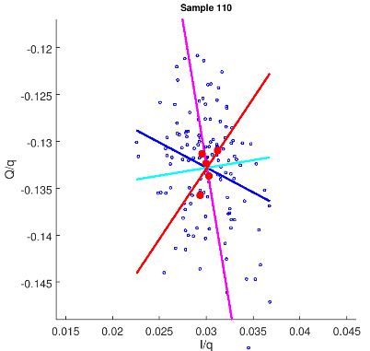
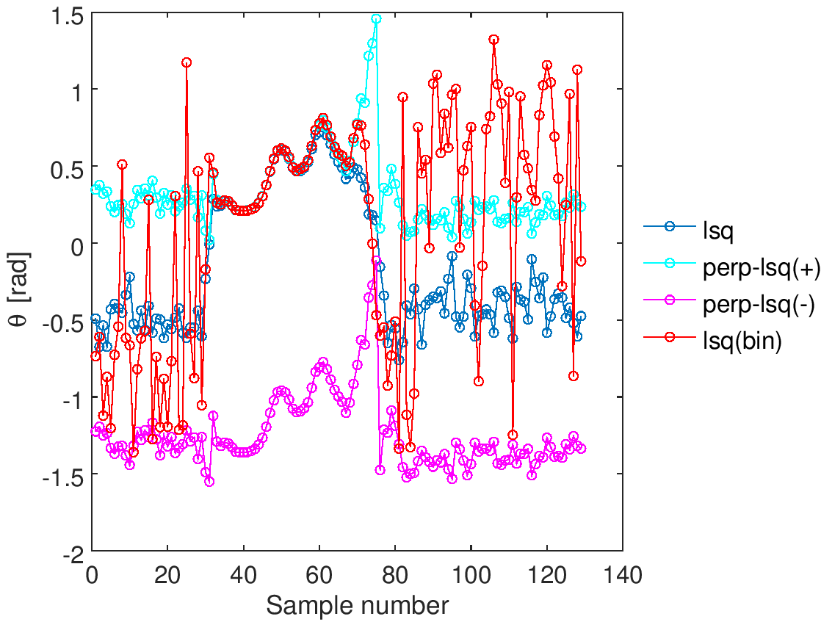
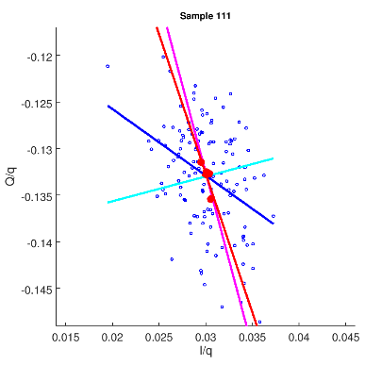
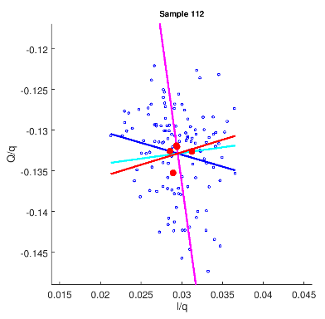
Bonus: IQ phase
Single-sample IQ phase rotation angle as a function of waveform sample index.
lsq =
least squares
perp-lsq =
perpendicular
least squares
Random phase found in absence of signal only when fit performed to the data once binned by quad mover setting.
This amounts to fitting to just 5 data points and accounts for the loss of consistency compared to fitting to all data points.

Slide 11
Conclusions
Diode processor successfully commissioned. Not able to demonstrate performance limit but have shown that it exceeds requirement.
Based on the available evidence, the most likely cause of the sample jumping is the fast clock.
Apparent random IQ phase before arrival of signal simply a consequence of performing a fit with a very small number of data points.

