Slide 1
  ALCW Preparation
  Benno List, DESY
  TCMB Meeting
  20.2.2018

Slide 2
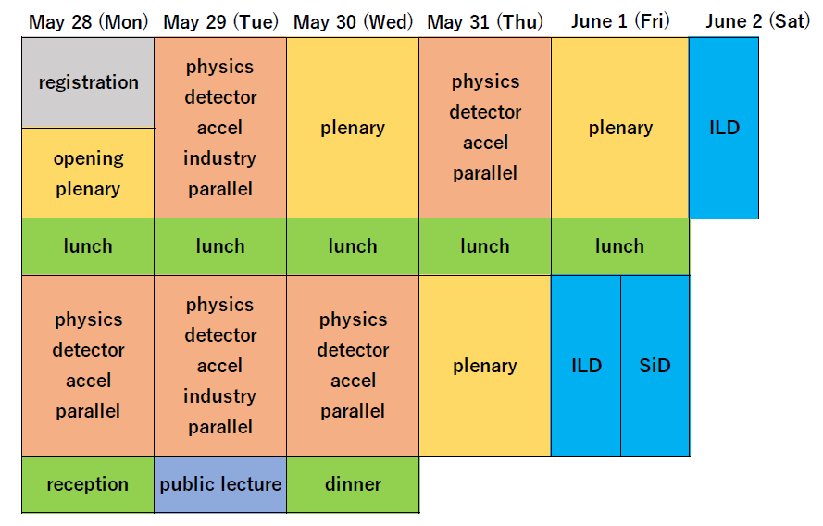
Structure, preliminary
https://agenda.linearcollider.org/event/7826/attachments/32573/49714/LCWS2018Plan.pdf

Slide 3
Conveners: Start from LCWS2017
ATF2 and Damping Rings
  Nobuhiro Terunuma
  Phil Burrows
Beamdynamic and RTML
  Andrea Latina
  Kaoru Yokoya
  Nikolay Solyak
Beam delivery system
  Toshiyuki Okugi
  Edu Marin
  Rogelio Tomas
  Glen White
Sources
  Masao Kuriki
  Sabine Riemann
  Steffen Doebert
LC Central Region Working Group
  Kaoru Yokoya -> No CRWG at AWLC2018
ILC: Civil Engineering and Siting
  Hitoshi Hayano
  John Osborne
ILC: Super Conducting RF
  Yasuchika Yamamoto
  Jiyuan Zhai?(IHEP)
  Denis Kostin
  Anna Grassellino
ILC Technical and Change Management Board
  Benno List
Accelerator Plenary
  Jie Gao? (IHEP)
  Benno List(DESY),
  Steinar Stapnes(CERN)

Slide 4
Next Steps
This Week: Phone Call with Steinar Stapnes for Coordination with CERN
Discuss: Re-introduce Accelerator Plenary ?
Then: Ask conveners
Plan number of session blocks for each track

