Slide 1

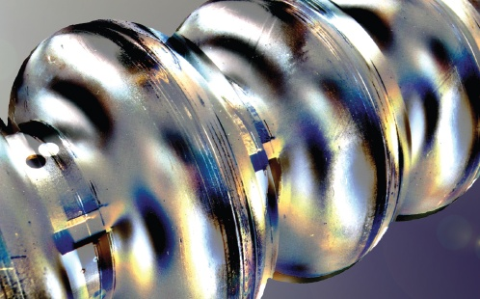

Status Update on the Nitrogen Infusion R&D at DESY
Marc Wenskat on behalf of the SRF team at DESY
LCWS 2018, Arlington, Texas – 25.10.2018

Slide 2
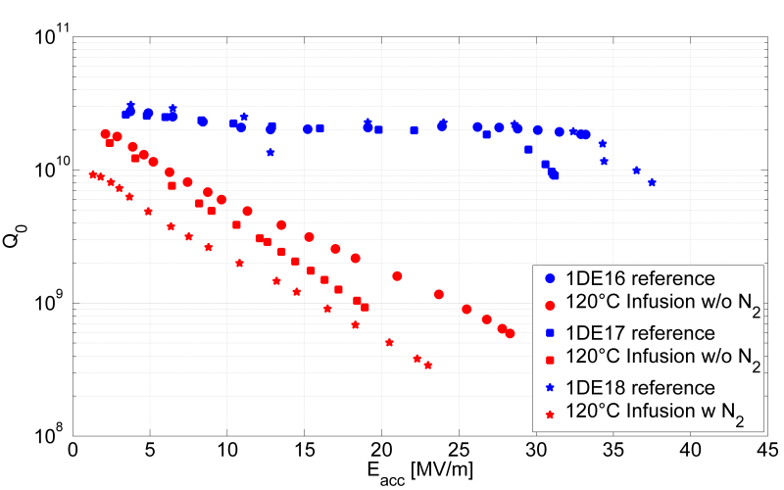
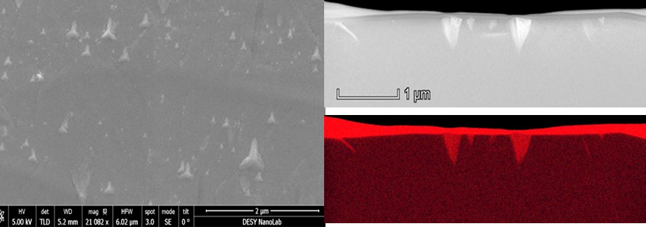
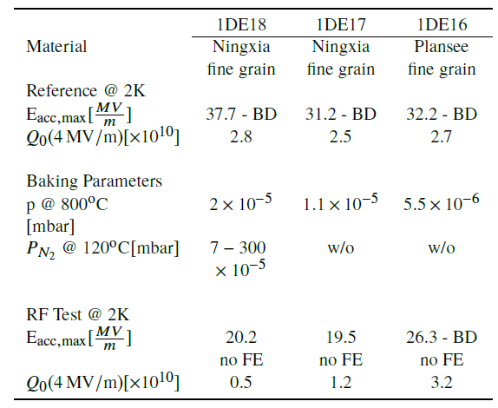
Whats going on?
RGA during 800°C bake showed high mass contributions (Hydrocarbons)
Samples within a standard 800°C bake showed precipitates as well

Slide 3
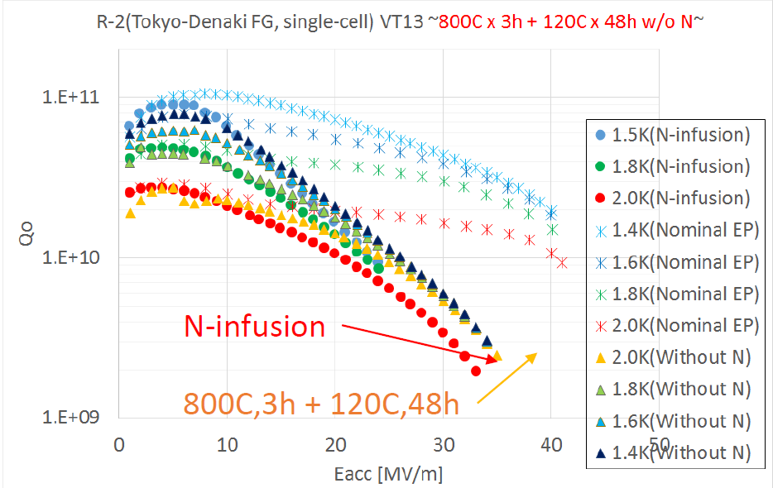
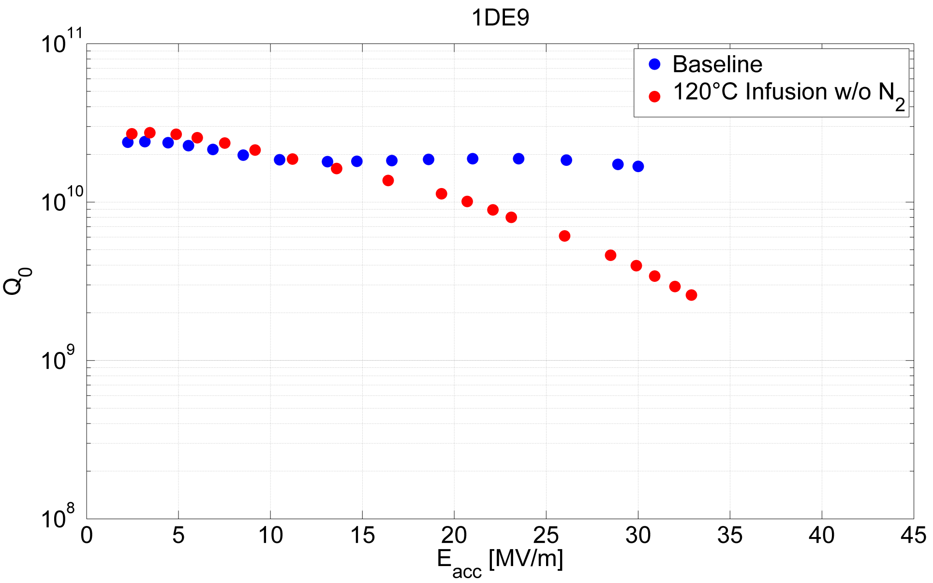
Fifth Infusion Run
w/o Nitrogen – just temperature cycle
No precipitates on samples!
[K. Umemori et al., „Trial of Nitrogen Infusion and Nitrogen Doping by using JPARC Furnace“, THPB021@SRF2017]
KEK identified 120°C part of bake as origin of deterioation.
Did we solve our 800°C problem and moved on to another?

Slide 4
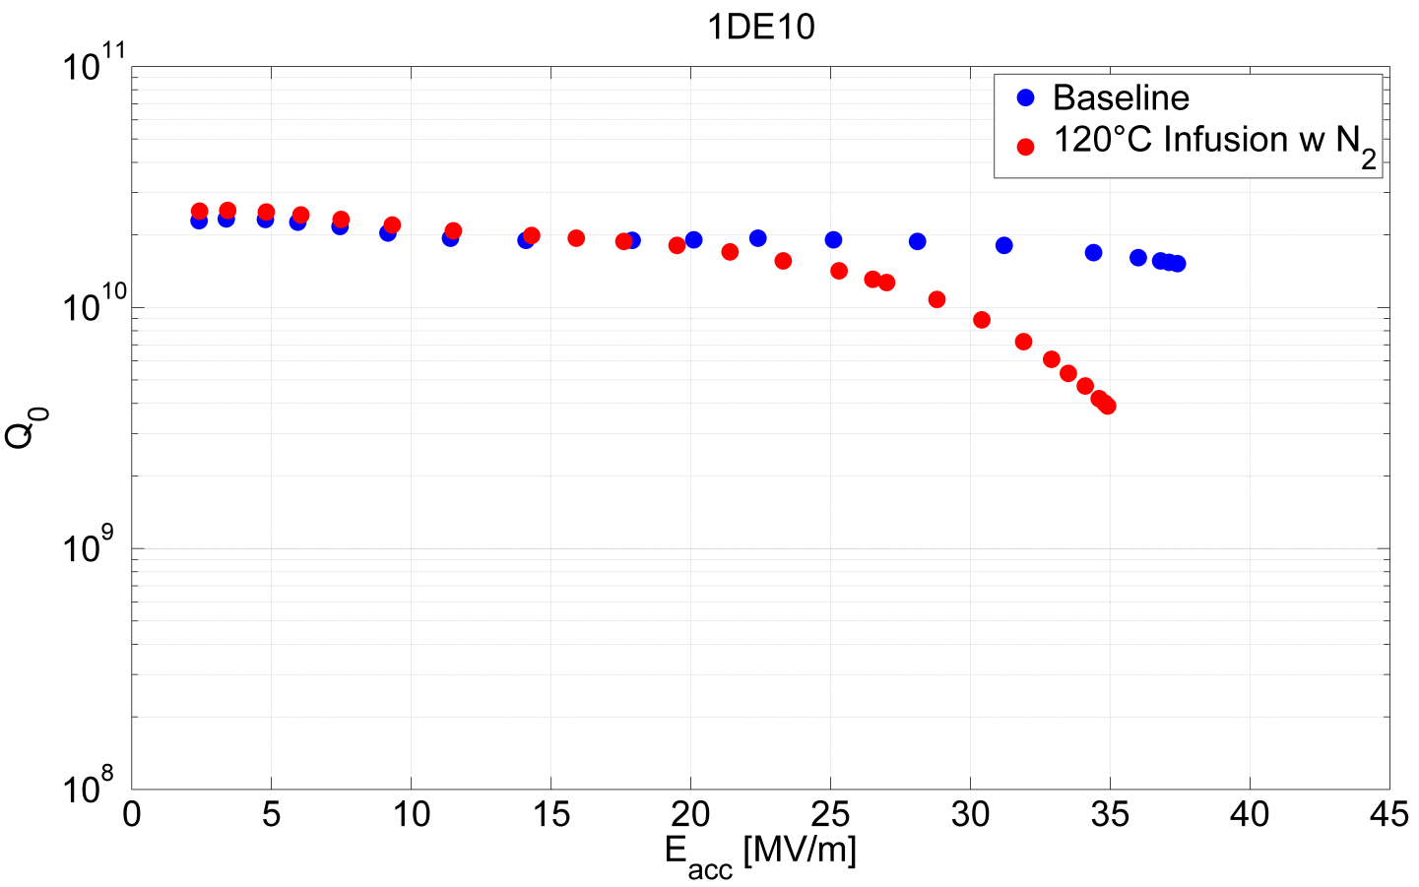
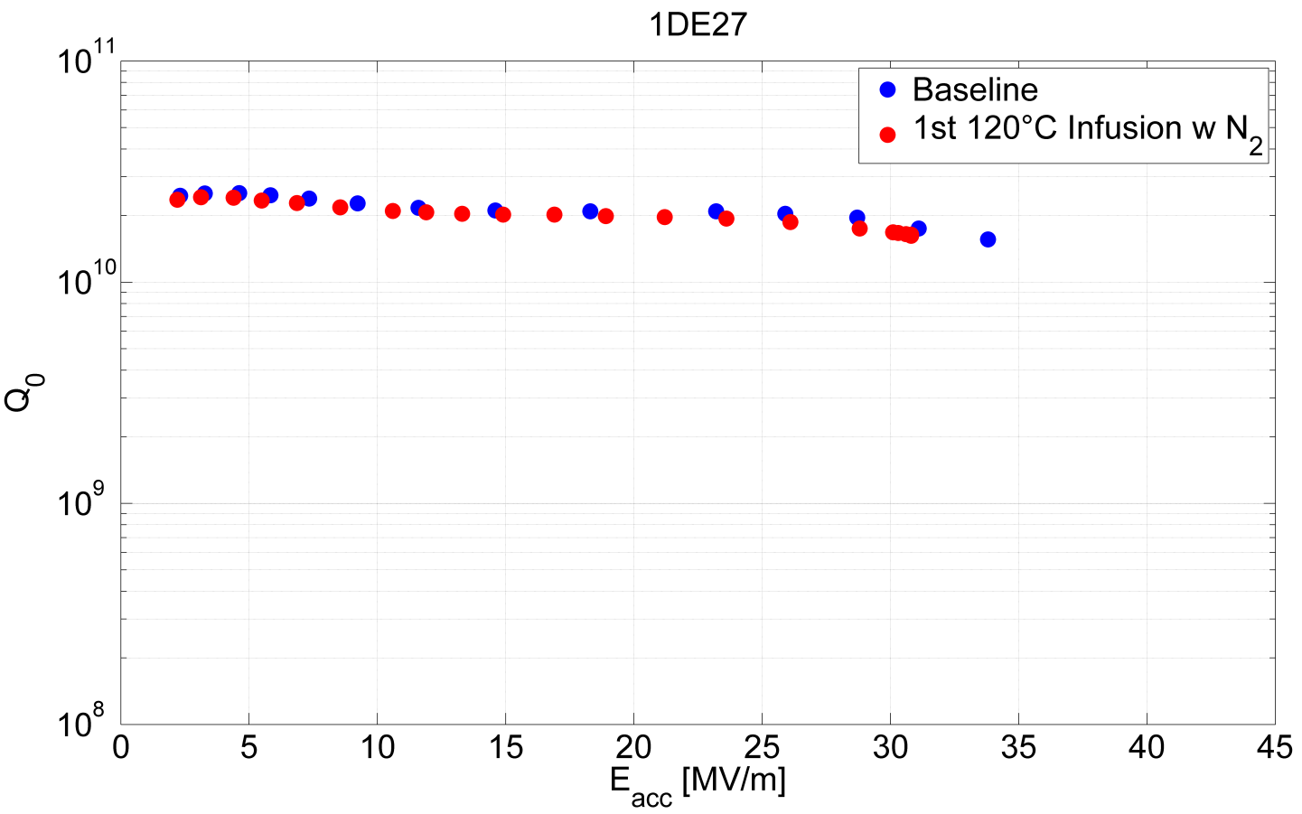
Sixth and Seventh Infusion Run
With Nitrogen!
Again precipitates on samples! ☹
BUT…

Slide 5
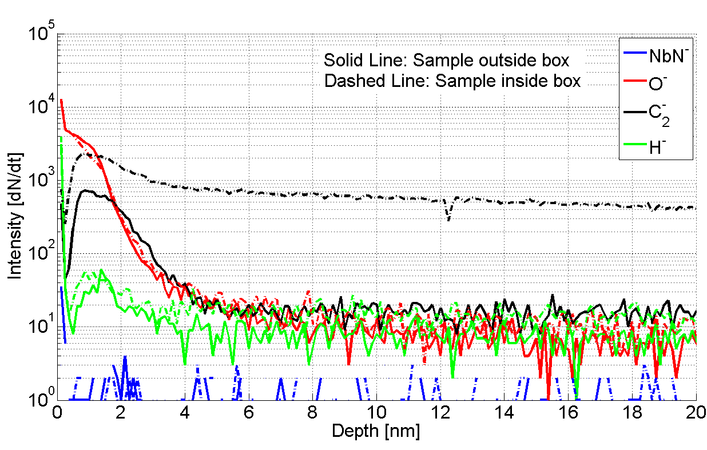
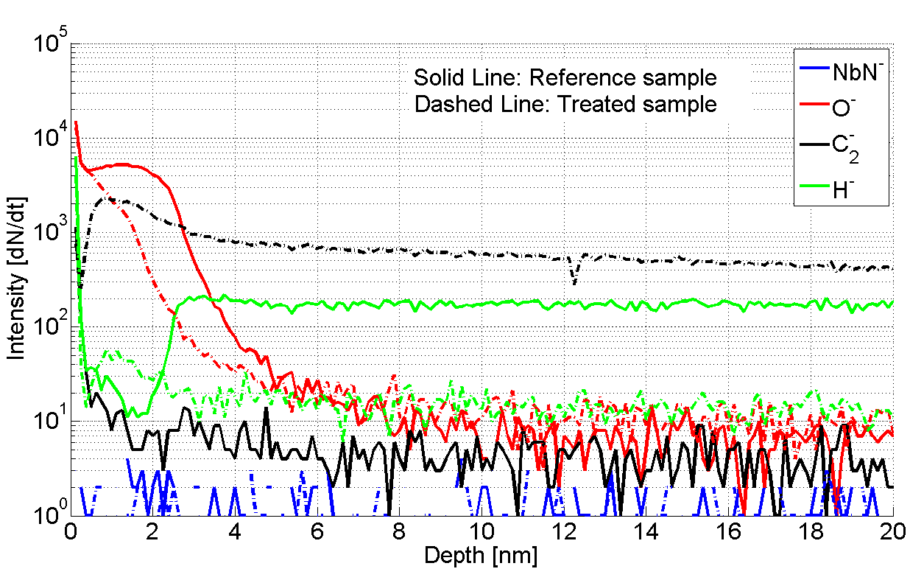
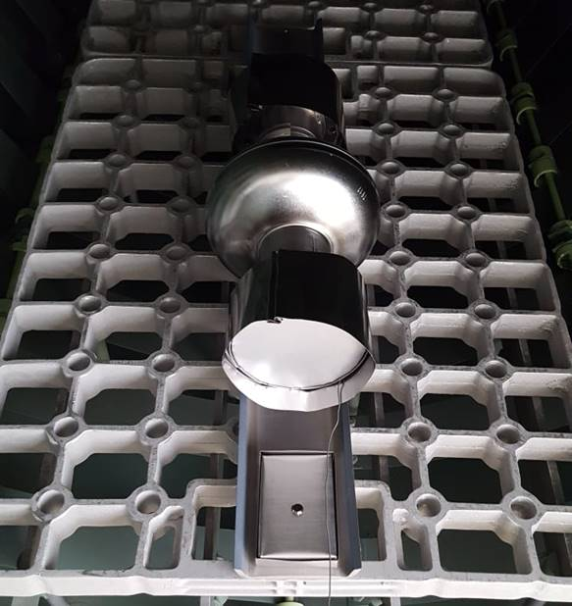
TOF-SIMS Analysis
Treated vs. Reference and „Inner vs. Outside Atmosphere“
No precipitates on outside samples
Precipitates on inside samples

Slide 6
Current Situation
Repeated infusion on 1DE27 w/o resetting
  Decision to do infusion at 160°C
  VT took place two weeks ago – cold leak at 16MV/m ☹
  TOF-SIMS showed no NbN⁻ signal in samples…
Infused a new cavity 1DE7
  Again 160° C
  Disassembled on Monday – preparation for VT ongoing
Assess recipe after 1DE7 VT and sample analysis

Slide 7
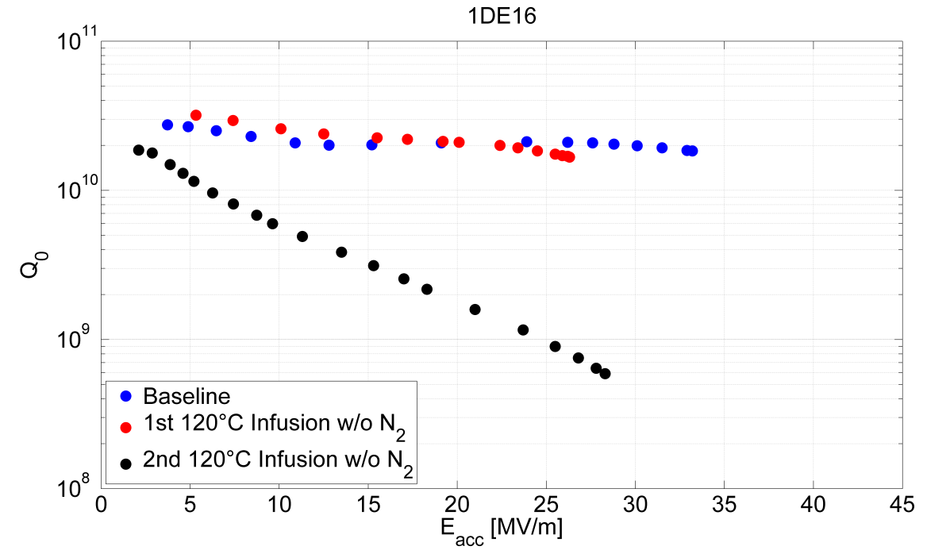
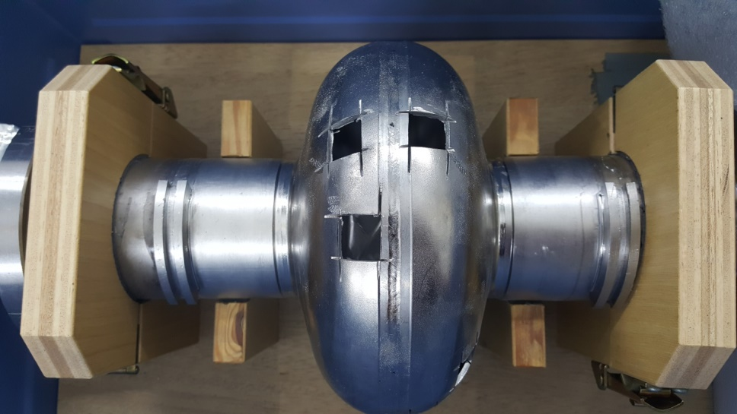
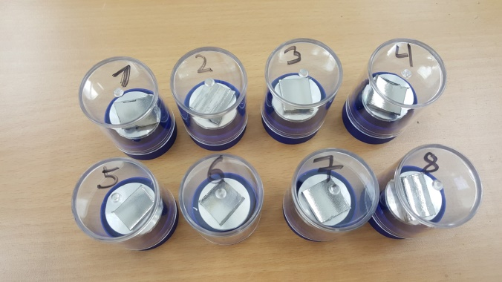
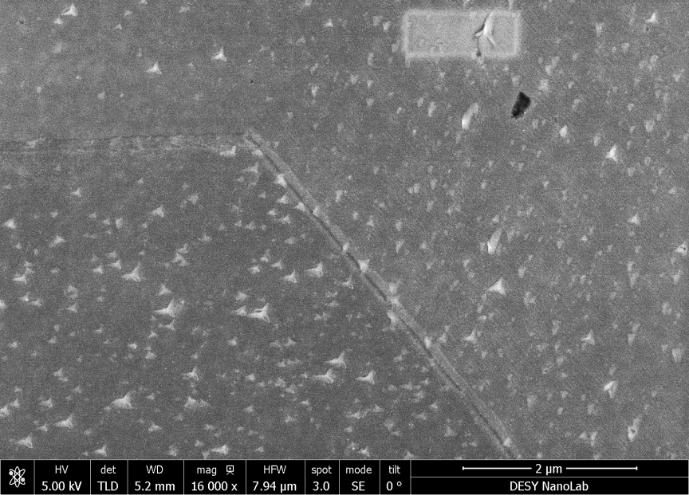
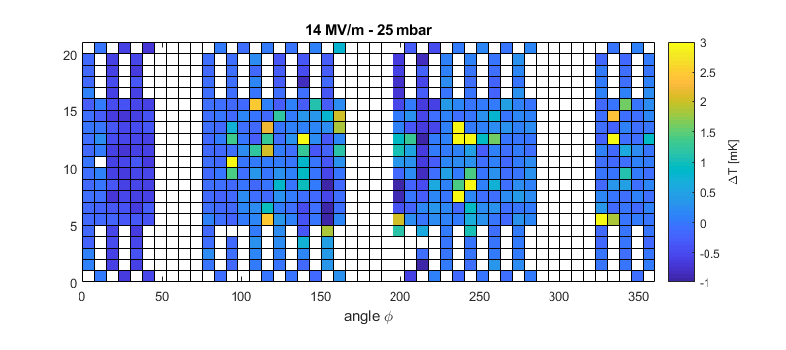
Sample Surface = Cavity Surface?
Origin of deterioration?

Slide 8
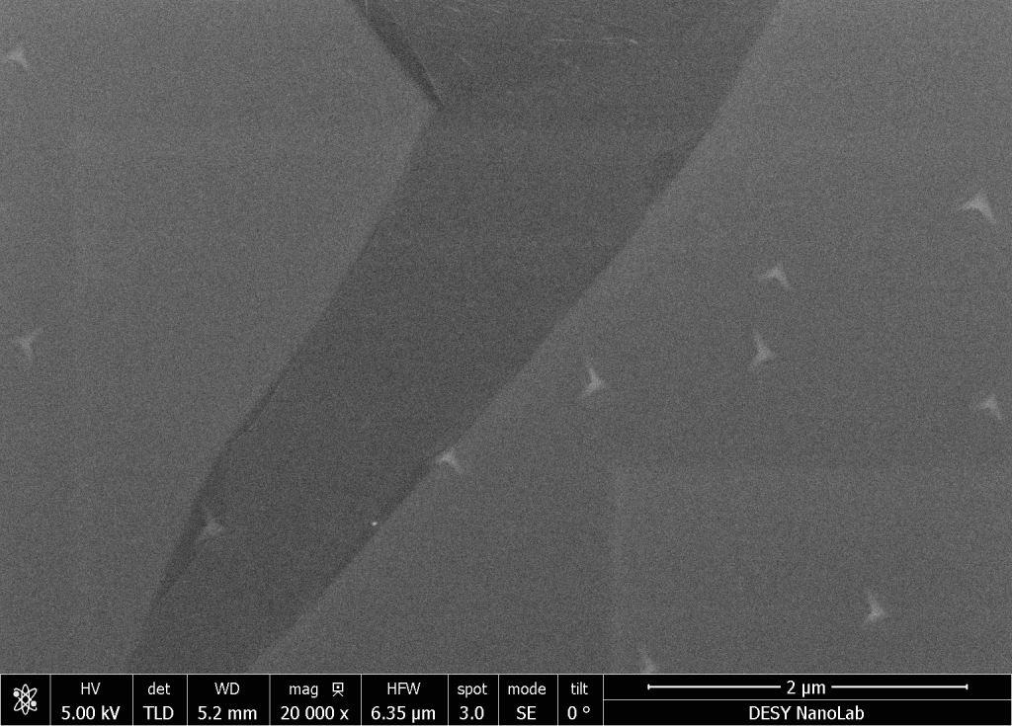
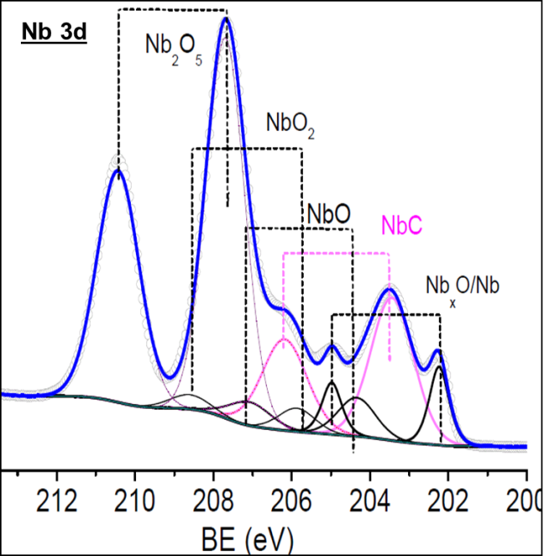
One more puzzle…
In-situ sample R&D
UHV-mobile chamber with in-situ surface characterization
Two samples, both single crystals [100]:
  Purified by degassing at 2000°C in UHV
  „Cavity grade“ material from large grain disc
Both baked at 800°C in UHV for 2h & 120°C for 48h with 0.03 mbar N₂
Cavity grade material showed precipitates - purified sample did not!
  SEM
  XPS confirmed Nb-C phase, no Nb-N

Slide 9

Conclusions
„Atmosphere“ inside cavity and niobium box different than furnace – no data!
Need of caps will be investigated
New set of caps with defined „leak“ will be fabricated
Lack of nitrogen in samples is puzzling
Origin of Nb-C precipitates
And relation to rf performance not obvious

