Slide 1


Higgs Trilinear coupling at Linear Colliders
Zhen Liu
University of Maryland
Linear Collider Workshop 2018
10/25/2018
mainly based upon 1711.03978
S. Di Vita, G. Durieux, C. Grojean, J. Gu, ZL, G. Panico, M. Riembau, T. Vantalon
and contributions to various reports

Slide 2
Outline
Motivation and probes for Higgs trilinear at linear colliders:
Double Higgs observables
Singlet Higgs observables
EFT global fit
Results and implications:
  Are we limited by knowledge on other operators entering the 2H process?
  Are we limited by knowledge on other operators entering the 1H process?
  How complimentary are the HL-LHC and LCs with different energy runs?

Slide 3
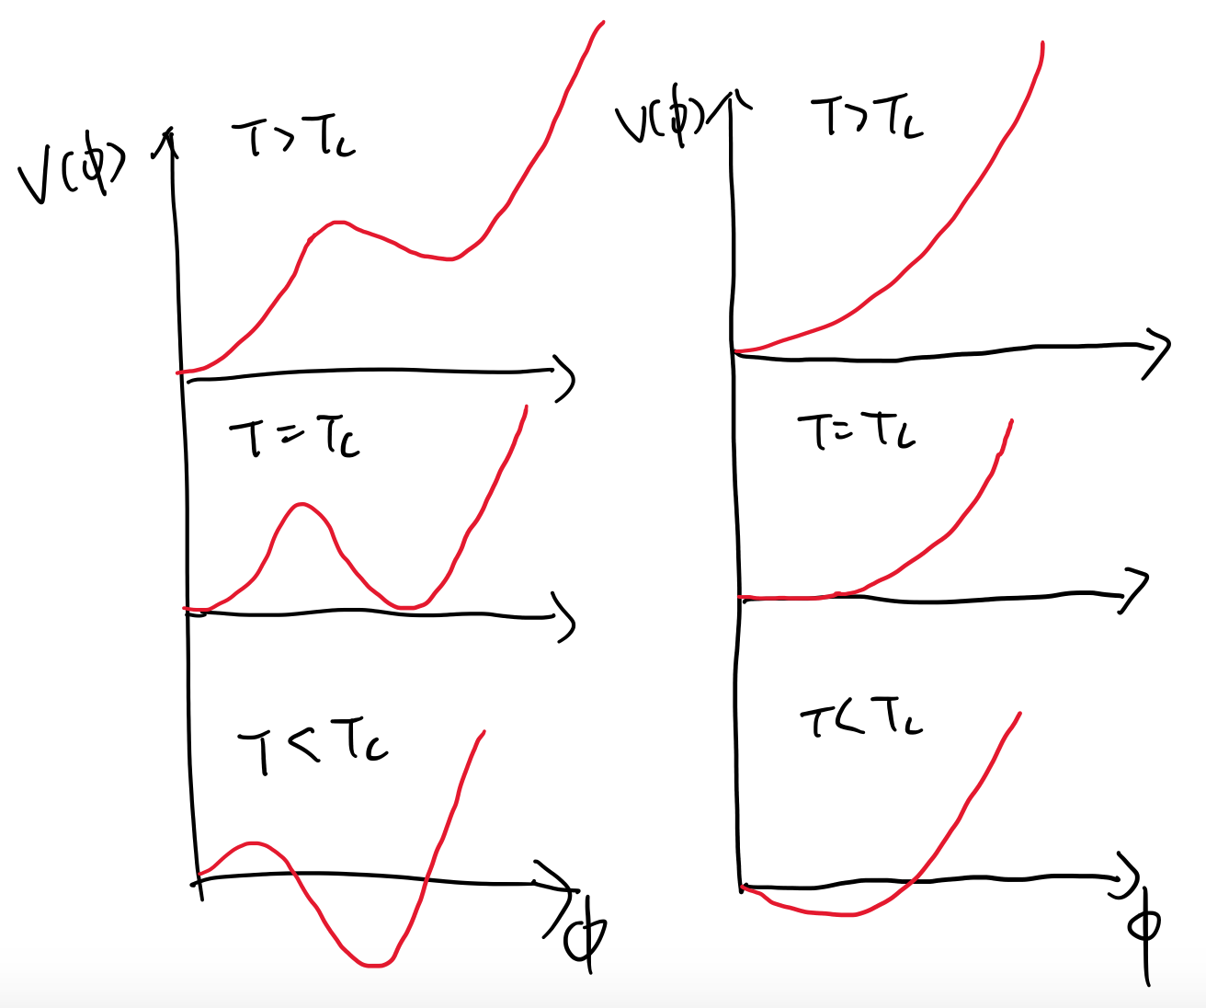
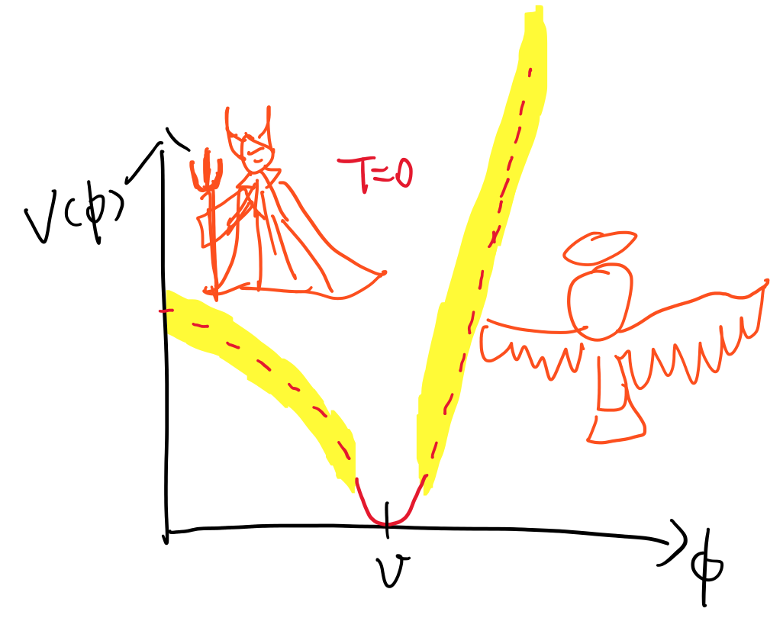

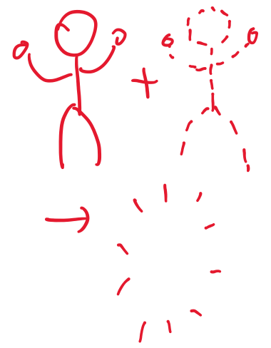
Higgs Precision and Electroweak Phase-Transition
1st order PT
2nd order PT
How does the potential look like?
Is EWPT strong enough?
Higgs self-couplings determinations shed lights.
Both the self-coupling determination and the strength of EWPT convolutes with other Higgs property measurements.

Slide 4
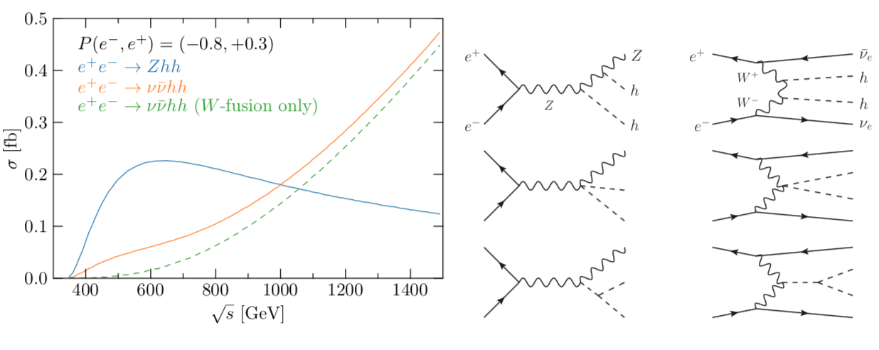
Finding probes: 2H processes
``direct’’ tree-level dependence on the Higgs trilinear;
Many other 2H processes not originated from Higgs trilinear
➔Need to evaluate the impact of trilinear extraction in a EFT framework

Slide 5
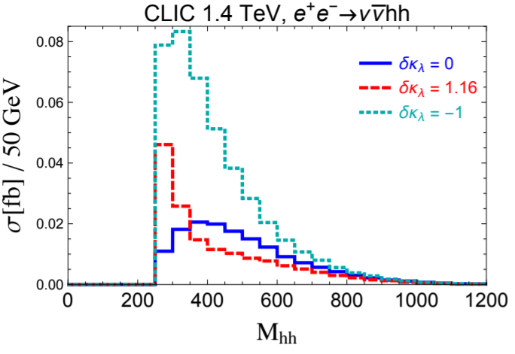
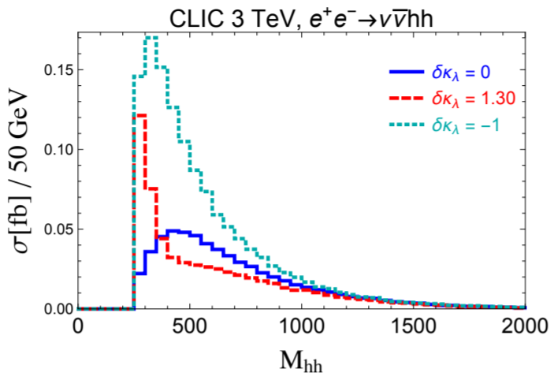
More observables in 2h
Differential observables help resolve interplays between different diagrams.

Slide 6
Finding probes: 2H processes
Tree-level probes for the Higgs self-couplings are *NOT* kinematically accessible at their baseline running (250 GeV for ILC and 350 GeV for CLIC), we need to think about alternative probes.
Help understanding the staging and complementarity between different running energies.

Slide 7
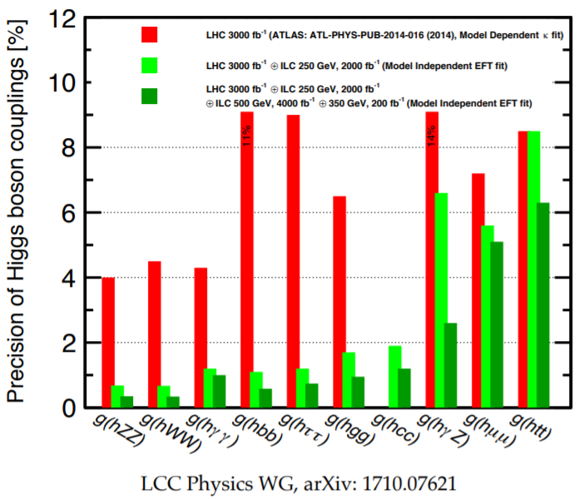

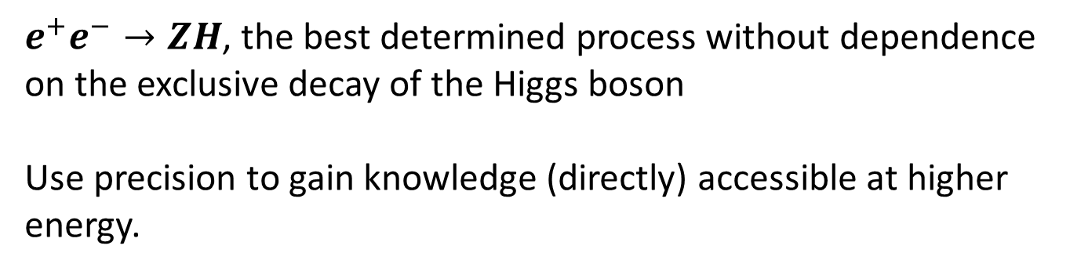
Finding probes for Higgs trilinear at Linear Colliders
$e^{+}e^{−}→ZH$, the best determined process without dependence on the exclusive decay of the Higgs boson
Use precision to gain knowledge (directly) accessible at higher energy.
*here I choose the fit result on hZZ coupling in $κ$-framework instead the direct measurement, just to visualize the precision.

Slide 8
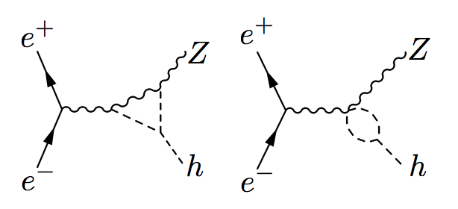
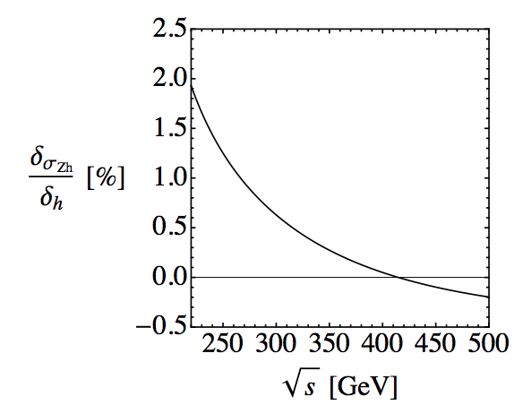
Constraints from $e^{+}e^{−}→ZH$
M. McCullough 1312.3322
A natural/free threshold enhancement helps enhancing the sensitivity;
O(30%) precision achievable, at 5 ab^-1 for an unpolarized e+e- machine, with some assumptions that we will break down in the next few slides;

Slide 9
Constraints from $e^{+}e^{−}→ZH$ : discussion
Hard to achieve single O₆ operator from UV point of view;
To gain knowledge about the O₆ in presence of other operators one needs to include more observables;

Slide 10
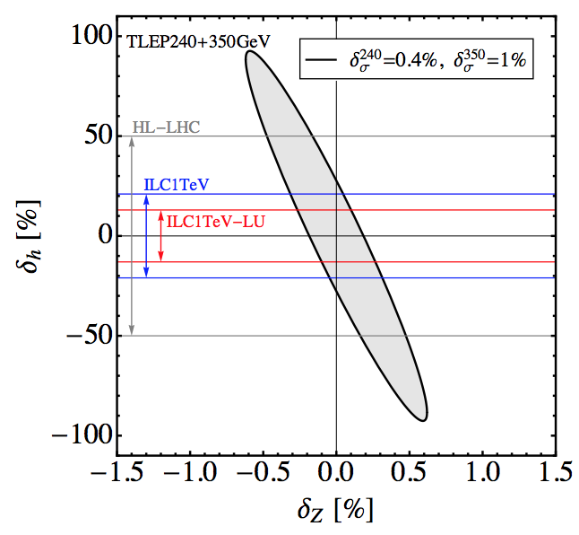
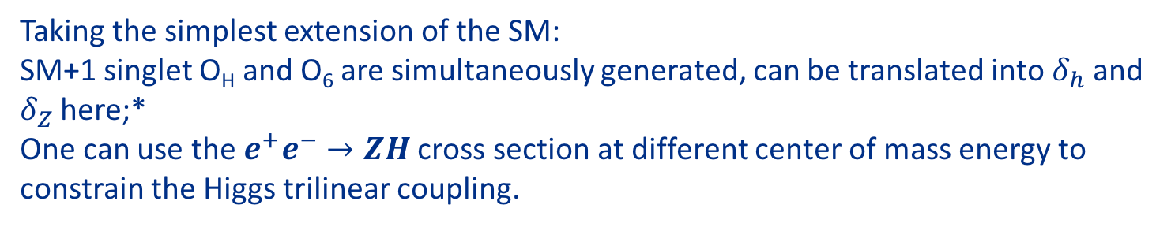
Constraints from $e^{+}e^{−}→ZH$ : discussion
Hard to achieve single O₆ operator from UV point of view;
To gain knowledge about the O₆ in presence of other operators one needs to include more observables;
M. McCullough 1312.3322
Taking the simplest extension of the SM:
SM+1 singlet O_{H} and O₆ are simultaneously generated, can be translated into $δ_{h}$ and $δ_{Z}$ here;*
One can use the $e^{+}e^{−}→ZH$ cross section at different center of mass energy to constrain the Higgs trilinear coupling.
*for more detailed discussion using fuller set of observables, see next talk by S. Su, on work J. Gu, H. Li, ZL, S. Su, W. Su 1709.06103;

Slide 11
Constraints from $e^{+}e^{−}→ZH$ : discussion
Hard to achieve single O₆ operator from UV point of view;
To gain knowledge about the O₆ in presence of other operators one needs to include more observables;
How many more do we need to include to robustly extract trilinear Higgs couplings from this process?
In particular, we are extracting loop-level corrections from SM corrections on a tree-level process; any in precise determination of other BSM contributions could spoil this.
M. McCullough 1312.3322
Taking the simplest extension of the SM:
SM+1 singlet O_{H} and O₆ are simultaneously generated, can be translated into $δ_{h}$ and $δ_{Z}$ here;*
One can use the $e^{+}e^{−}→ZH$ cross section at different center of mass energy to constrain the Higgs trilinear coupling.
*for more detailed discussion using fuller set of observables, see next talk by S. Su, on work J. Gu, H. Li, ZL, S. Su, W. Su 1709.06103;

Slide 12
more operators
How many more do we need to include to robustly extract trilinear Higgs couplings from this process?
EFT is a nice framework to address this issue:
a) ``model blind’’;
b) Can relate different measurements at different scales and observables, allowing a more consistent/transparent treatment beyond Higgs observables; (see M. Trott’s talk earlier in the Higgs session)

Slide 13
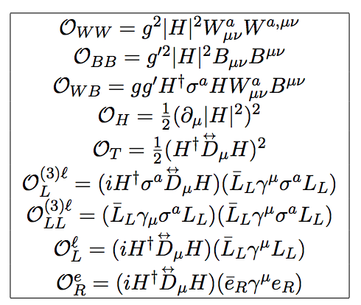
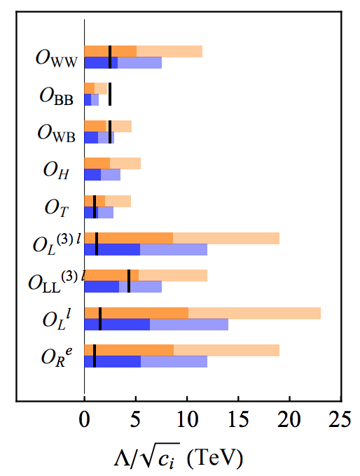
more operators
How many more do we need to include to robustly extract trilinear Higgs couplings from this process?
N. Craig, M. Farina, M. McCullough, M. Perelstein, 1411.0676
EFT is a nice framework to address this issue:
a) ``model blind’’;
b) Can relate different measurements at different scales and observables, allowing a more consistent/transparent treatment beyond Higgs observables; (see M. Trott’s talk earlier in the Higgs session)
9 tree-level CP even dimension-6 operators contributing at linear level;
and more if we include some of the SM input parameter uncertainties;
Angular asymmetries help probe these operators, see N. Craig, J. Gu, ZL, K. Wang, 1512.06877

Slide 14
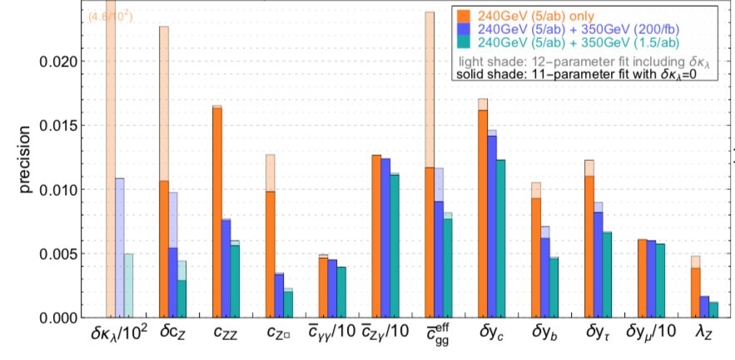
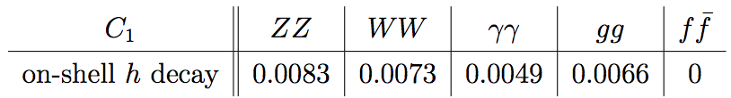
more operators
Higgs fit *without* trilinear, see Durieux, Grojean, Gu, Wang, 1704.02333 , with trilinear + more observables,+ZL et al, 1711.03978
The impact of adding the new d.o.f. of Higgs trilinear modifications is quite sizable;
Strong correlations between the trilinear modification and the parameter (hZZ shifting); already seen in the simplest example for the singlet extension;
Sizable reduction in other ``coupled’’ coefficients;
C₁ linear dependence on trilinear modifications
G. Degrassi, P. Giardino, F. Maltoni, D. Pagani, 1607.04251

Slide 15
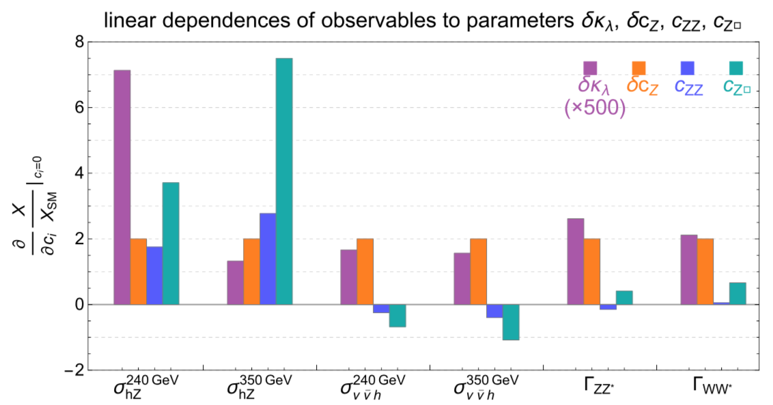
More observables (that are sensitive to Higgs trilinear)
New probes:
Cross sections at different c.o.m. energies, 240 GeV & 350 GeV ;
Different production processes, ZH & WW-fusion;
Decay processes, WW* and ZZ*;
C₁ linear dependence on trilinear modifications
G. Degrassi, P. Giardino, F. Maltoni, D. Pagani, 1607.04251

Slide 16
More observables (that are sensitive to Higgs trilinear)
Threshold enhancement
New probes:
Cross sections at different c.o.m. energies, 240 GeV & 350 GeV ;
Different production processes, ZH & WW-fusion;
Decay processes, WW* and ZZ*;
C₁ linear dependence on trilinear modifications
G. Degrassi, P. Giardino, F. Maltoni, D. Pagani, 1607.04251

Slide 17
Results and implications
ILC results
CLIC results
  Are we limited by knowledge on other operators entering the 2H process?
  Are we limited by knowledge on other operators entering the 1H process?
  How complimentary are the HL-LHC and LCs with different energy runs?

Slide 18
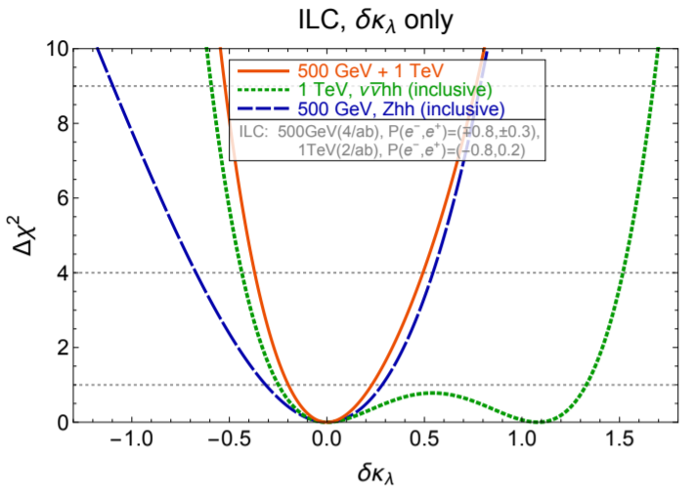
ILC Results (one parameter fit)
ILC 500 GeV Zhh
ILC 1000 GeV vvhh
ILC 500 GeV + 1000 GeV
Zhh and vvhh complementary in removing second minimum from vvhh searches

Slide 19
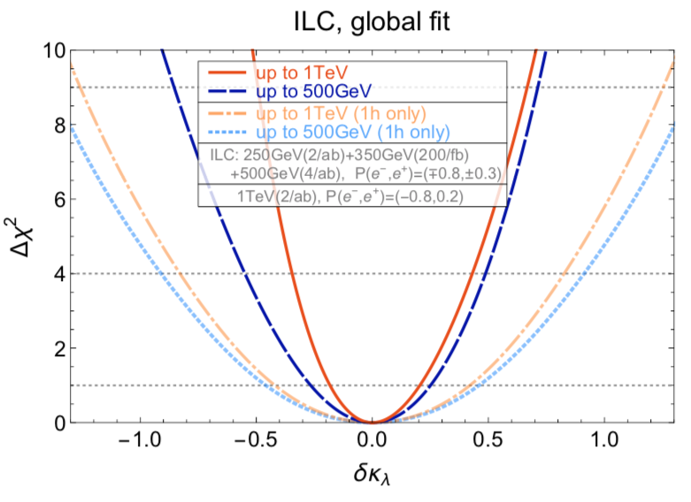
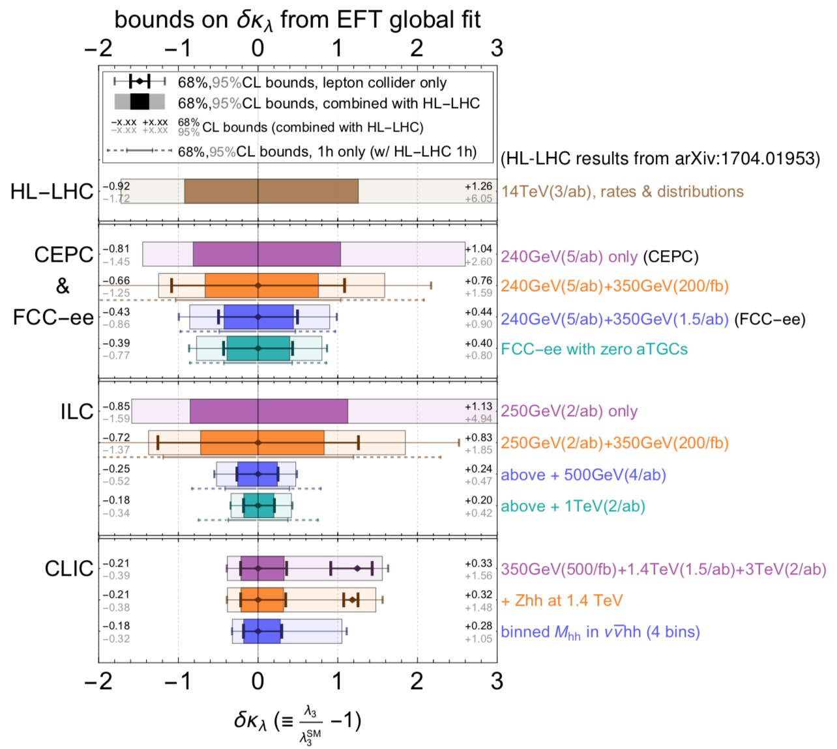
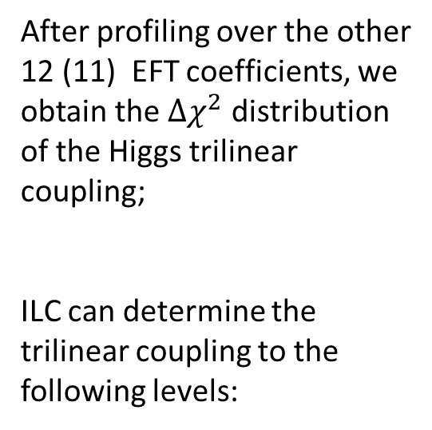
ILC Results (global fit)
After profiling over the other 12 (11) EFT coefficients, we obtain the $Δχ^{2}$ distribution of the Higgs trilinear coupling;
ILC can determine the trilinear coupling to the following levels:

Slide 20
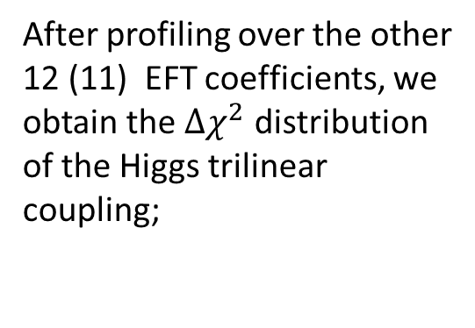
ILC Results (global fit)
After profiling over the other 12 (11) EFT coefficients, we obtain the $Δχ^{2}$ distribution of the Higgs trilinear coupling;
1h observables only
Comparable precision gained through 1h processes

Slide 21
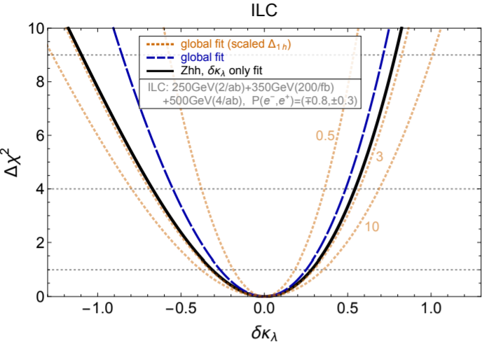
ILC Results (implication)
Single parameter fit using 2H observable only
Global fit with much enlarged parameter space
Clearly, the ILC 500 GeV trilinear extrapolation:
Not limited by Higgs coupling uncertainties;
1H trilinear observable even improves the sensitivity;
If Higgs properties worsen by a factor of 3, start limiting the trilinear extrapolation;
improving 1h will continue to improve the trilinear extrapolation (other precision Higgs machines help!)

Slide 22
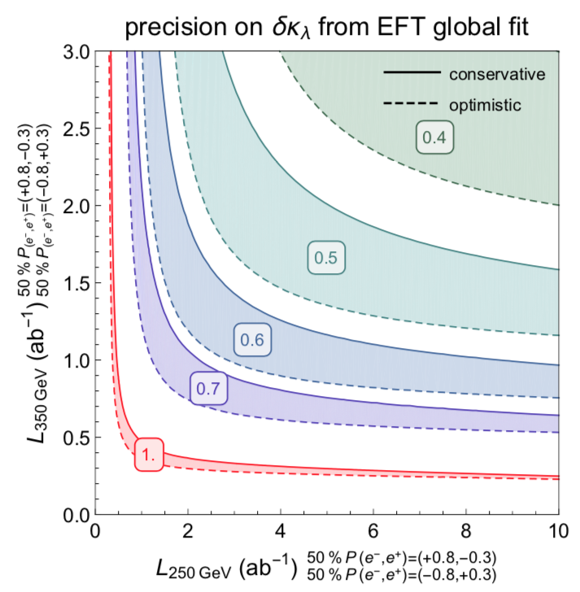
ILC Results: 240 GeV and 350 GeV interplay (1h)
Optimization of relative size of data sets (run scenarios) remain interesting practice;
Result depend on physics goals; need to be chosen carefully.
Maybe we can consider some other running scenarios? Trilinear would be a nice measure as it requires balanced information about Higgs and EW.

Slide 23
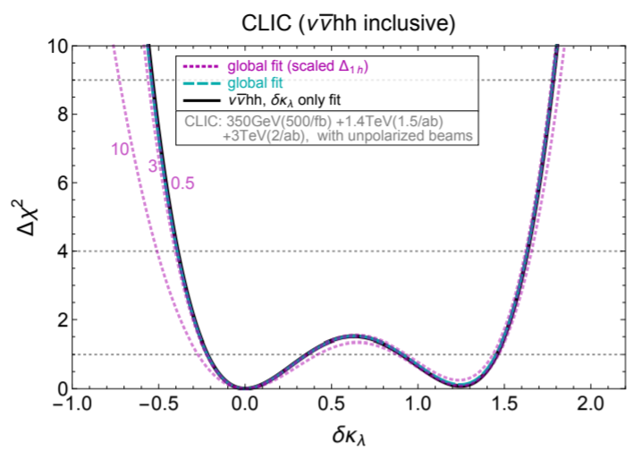
CLIC results
Single parameter fit and global fit doesn’t diff visibly so only show global here.
Varying 1H inputs between 0.5~3 do not change the result much: implying at CLIC 1H is not yet sensitive to trilinear but good enough to not affect the trilinear extrapolation from 2H processes

Slide 24
CLIC results
Single parameter fit and global fit doesn’t diff visibly so only show global here.
Double solution to be resolved by differential observables

Slide 25
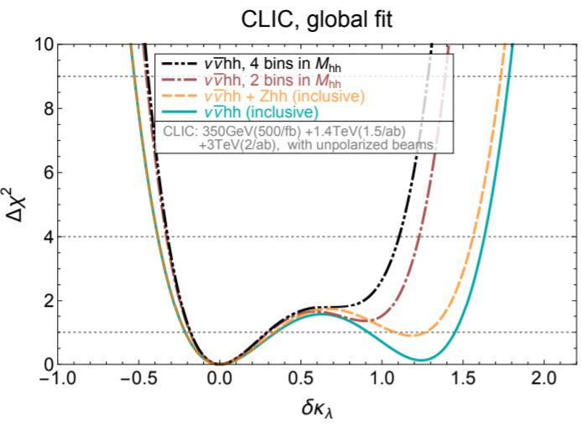
CLIC results
1H not good enough to derive trilinear limits, but also not limiting;
More modes helps;
Differential helps;

Slide 26
Results: complementarities
Higgs precision enhances LHC trilinear extrapolation;
HL-LHC also enhances LC trilinear determinations.

Slide 27
Summary
Higgs self-couplings are the keys to reveal nature of EWPT and EWBG;
LCs could use precision Higgs measures to constrain Higgs trilinear couplings in a robust way in the general EFT framework; we setup the framework and include more observables;
The observable set and operator set can be further expanded for a fuller treatment, so far we dropped a few of them constrained by EWPO;*
Interplay between Higgs precision and EWPO, 240 GeV and 350 GeV, LCs and other future collider programs, can be studied in this framework and provide useful information; This direction needs support from simulation groups for various channels and programs;
Independent probes are always useful, even if we can achieve 5% precision at FCC-hh;
*Studies by Peskin et al (1708.09079), and Lian-Tao Wang et al (1711.04046), indicate a larger EFT set analysis will not affect the trilinear determination, consistent with our treatment;

Slide 28
Summary
Thank you!

Slide 29
Backup

Slide 30
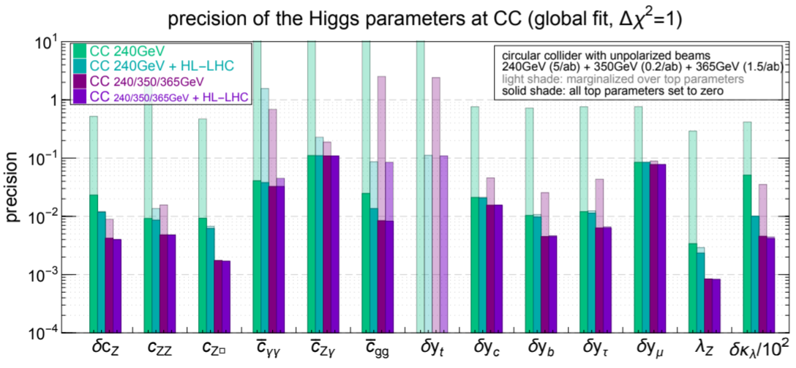
Durieux, Gu, Vryonidou, Zhang, 1809.03520

Slide 31

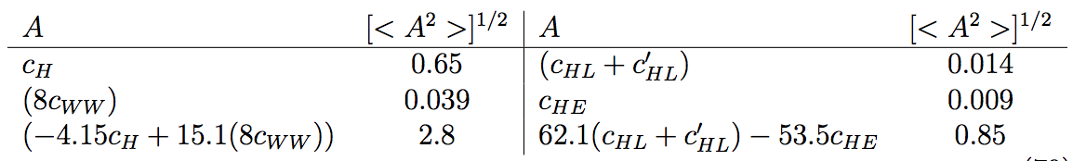
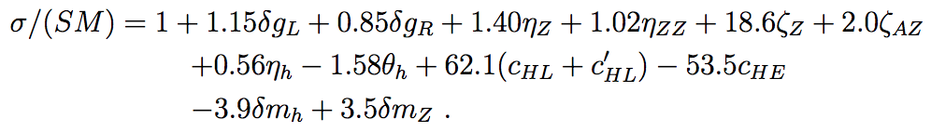
Fuller consideration: input uncertainties

Slide 32
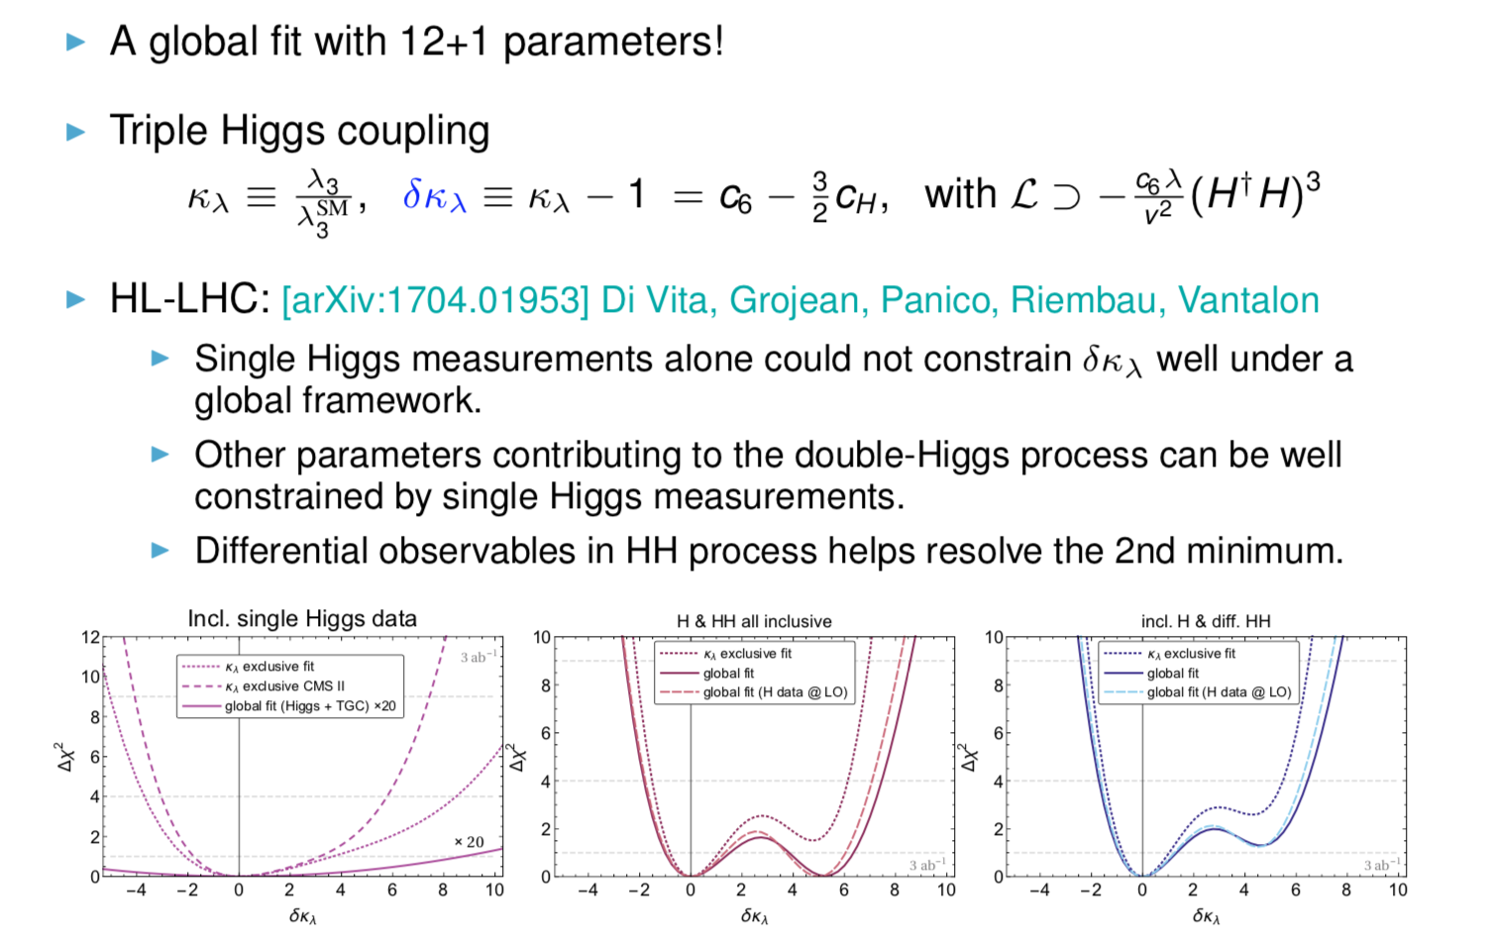

Slide 33
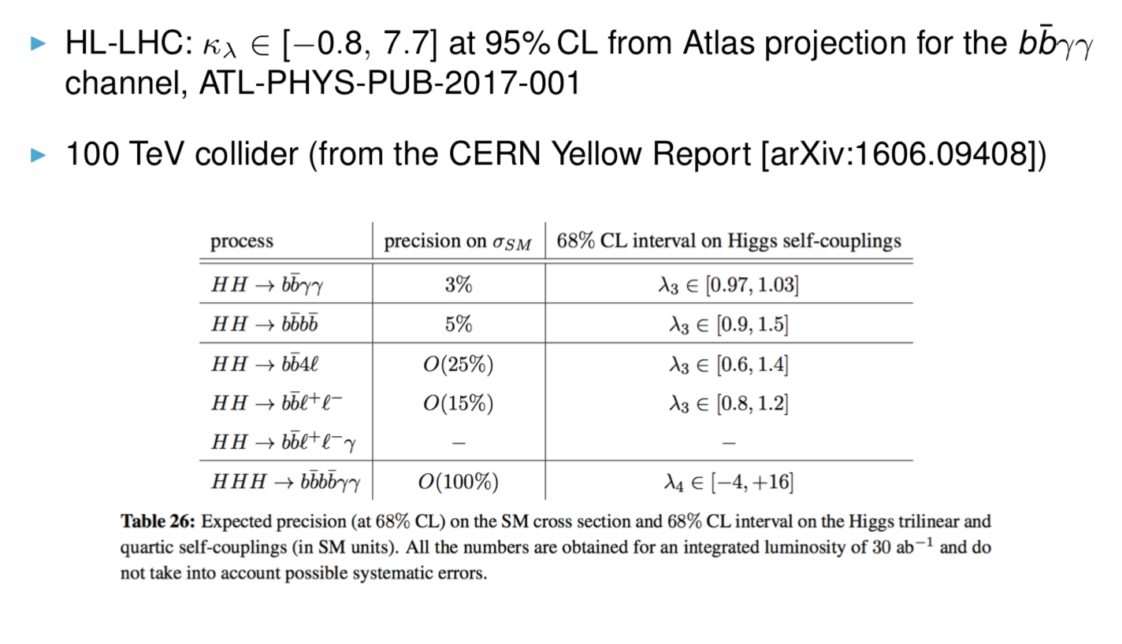

Slide 34
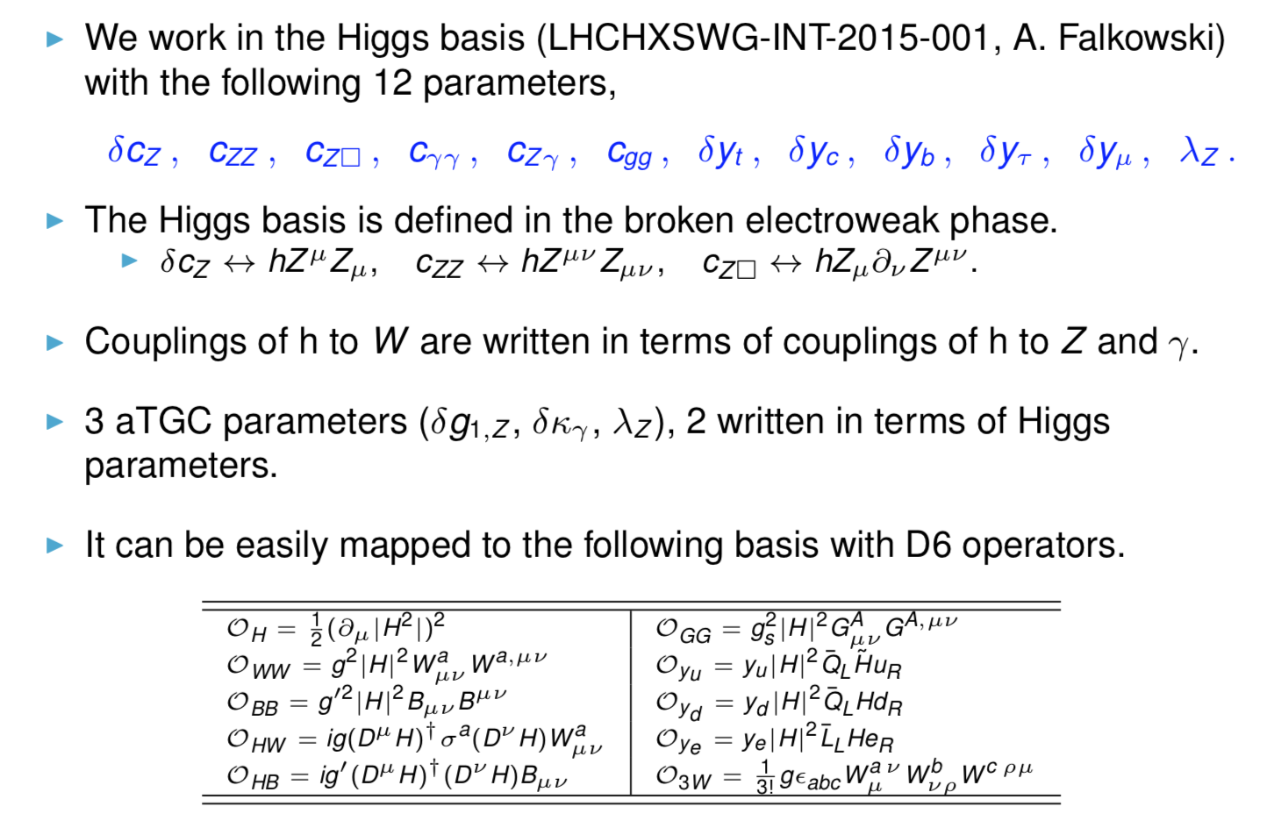

Slide 35
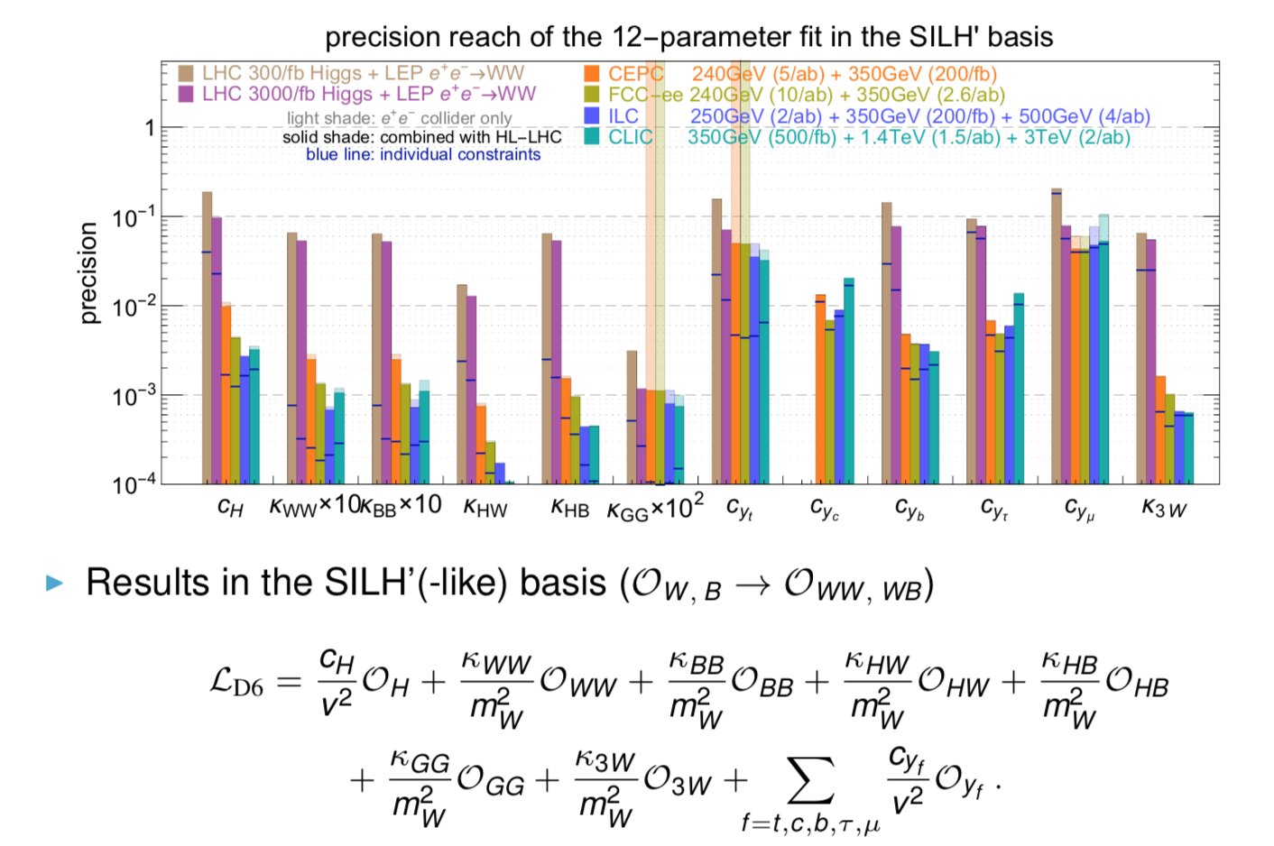

Slide 36
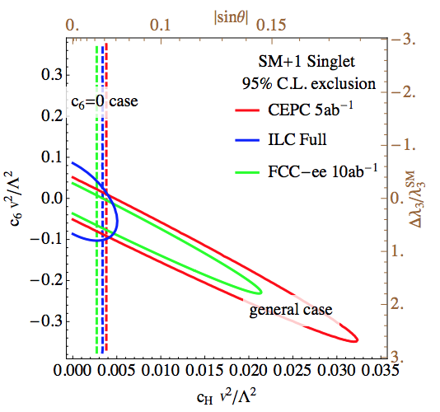
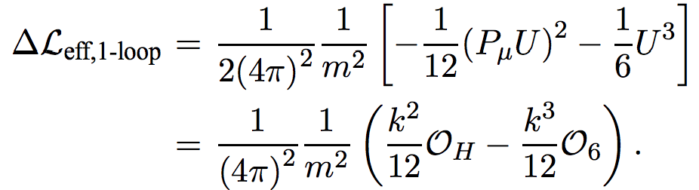
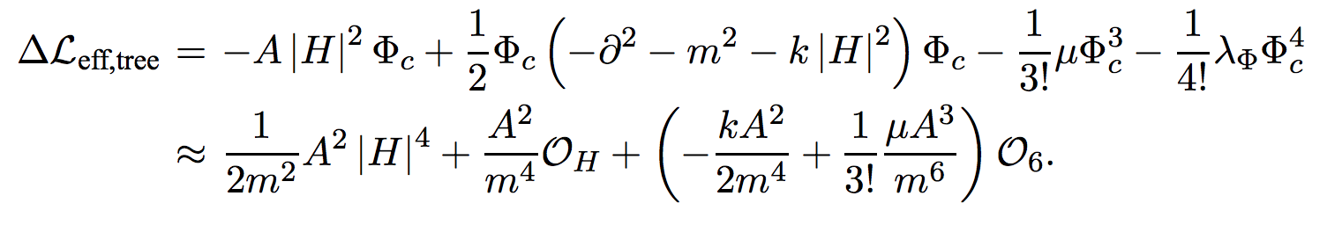
Murayama et al, 1412.1837

Slide 37
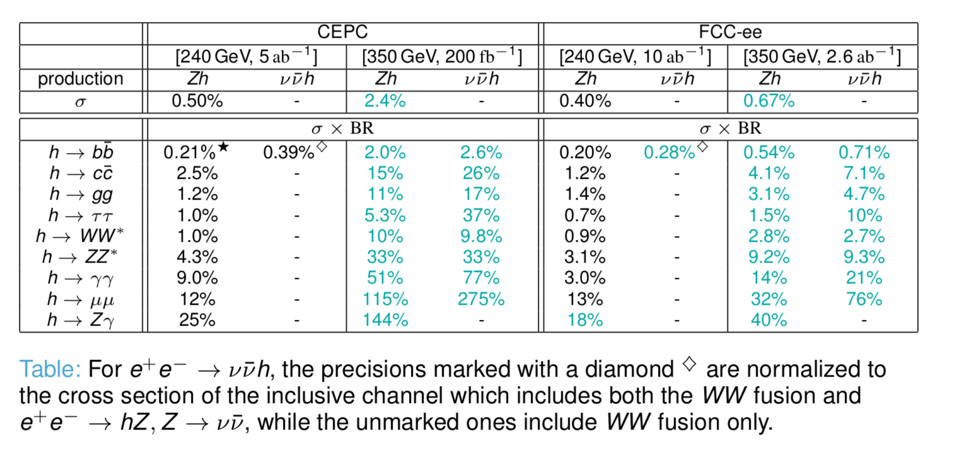

Slide 38
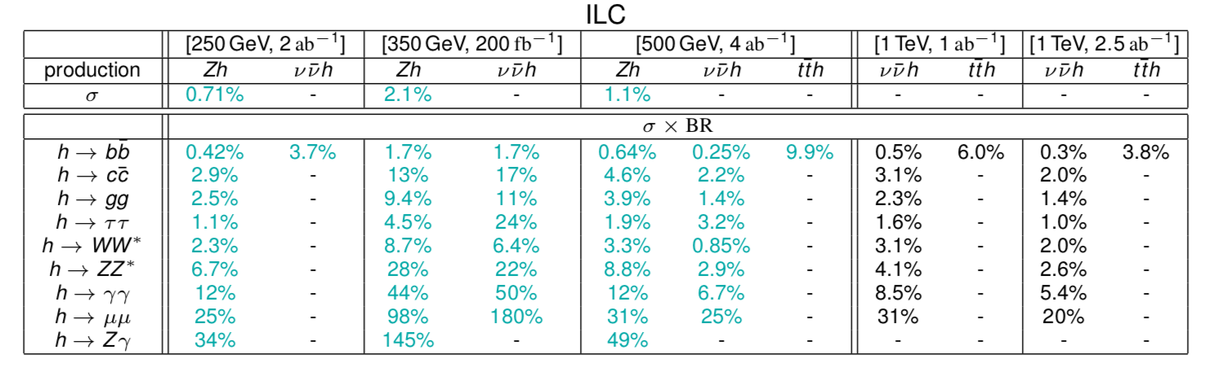

Slide 39
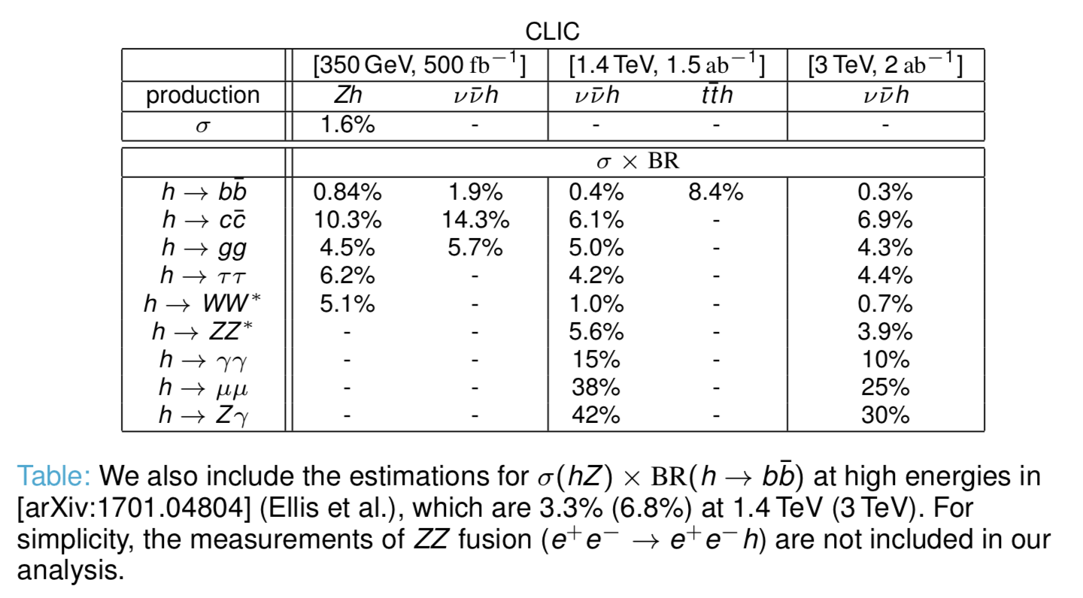

Slide 40
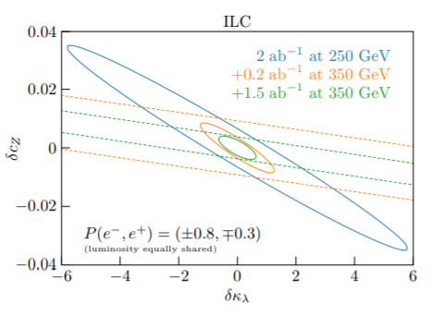
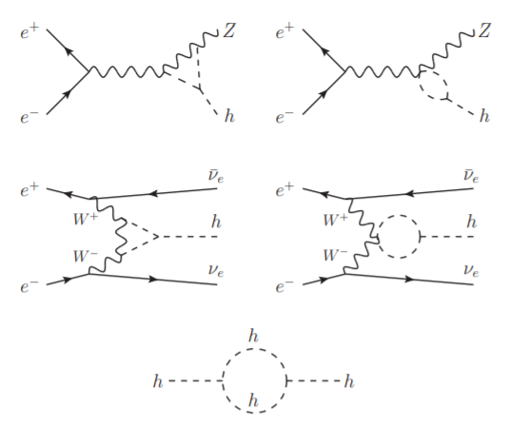

Slide 41
