Slide 1
ILC tunnel lengths & Commissioning
with
E-driven e+ source
and, a Proposal of the separate tunnel
for the e+ source
T. Omori, 23-Oct-2018
LCWS 2018, Oct 22nd - 26th, 2018
University of Texas at Arlington, USA

Slide 2
ILC tunnel lengths
E-driven e+ source

Slide 3
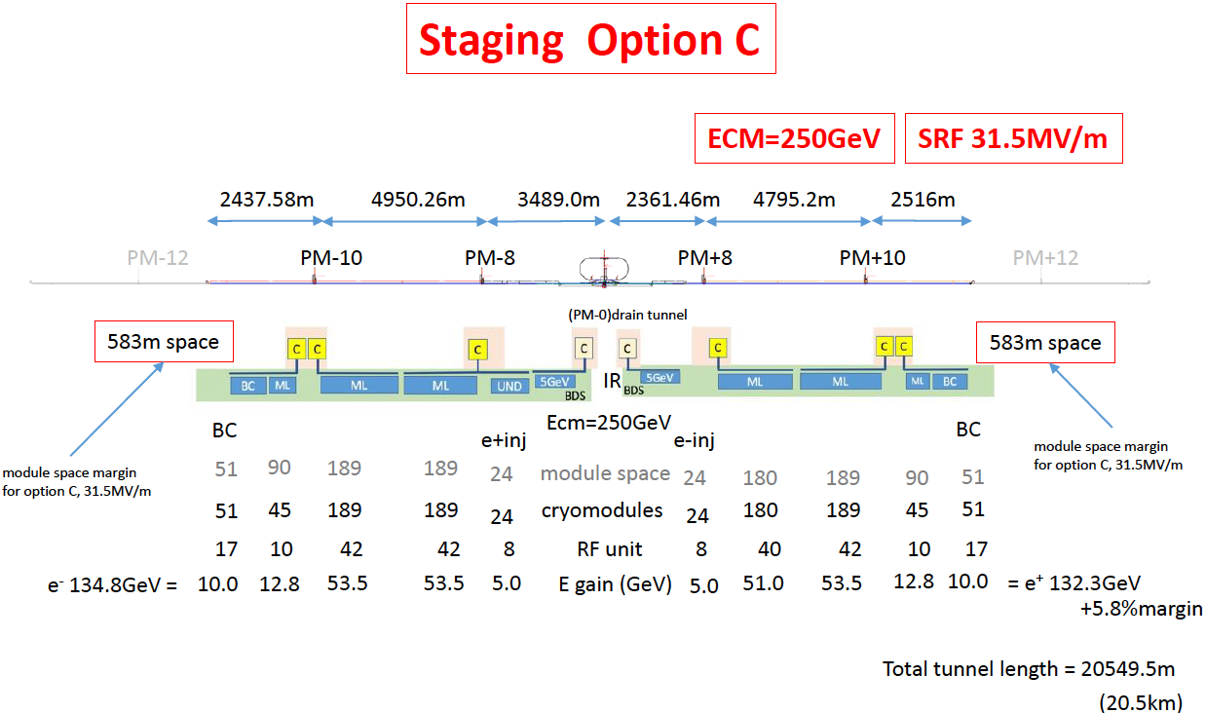
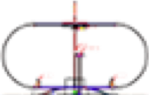
Option A
Note:
This was called "Option C" by the end of the last year
A
BDS tunnel
BDS tunnel
geoid
geoid
laser straight
laser straight
geoid
geoid

Slide 4
with
E-driven e+ source
Option A
Note:
This was called "Option C" by the end of the last year
A
with E-driven e+ source
2361m
BDS tunnel
BDS tunnel
geoid
geoid
laser straight
laser straight
geoid
geoid
with E-driven e+ source 150 m
with E-driven e+
remove 3 GeV ML
(130m)
with E-driven e+ source 150 m
With E-driven e+ source, length of electron-BDS becomes significantly shorter (3489m -> 2361 m).
with E-driven e+ source
Total tunnel length 18.5 km

Slide 5
Tunnel Length Comparison
ILC with undulator positron source
Option A 31.5 MV/m
e⁻ BDS
tunnel
e⁺ BDS
tunnel
e⁻ linac tunnel
e⁺ linac tunnel
geoid
laser
straight
IP
laser
straight
geoid
7.39km
3.49km
2.36km
7.31km
total : 20.55 km
ILC with E-driven positron source
Option A 31.5 MV/m
e⁻ BDS
tunnel
e⁺ BDS
tunnel
e⁻ linac tunnel
e⁺ linac tunnel
geoid
laser
straight
IP
laser
straight
geoid
6.88km
2.36km
2.36km
6.88km
total : 18.48 km

Slide 6

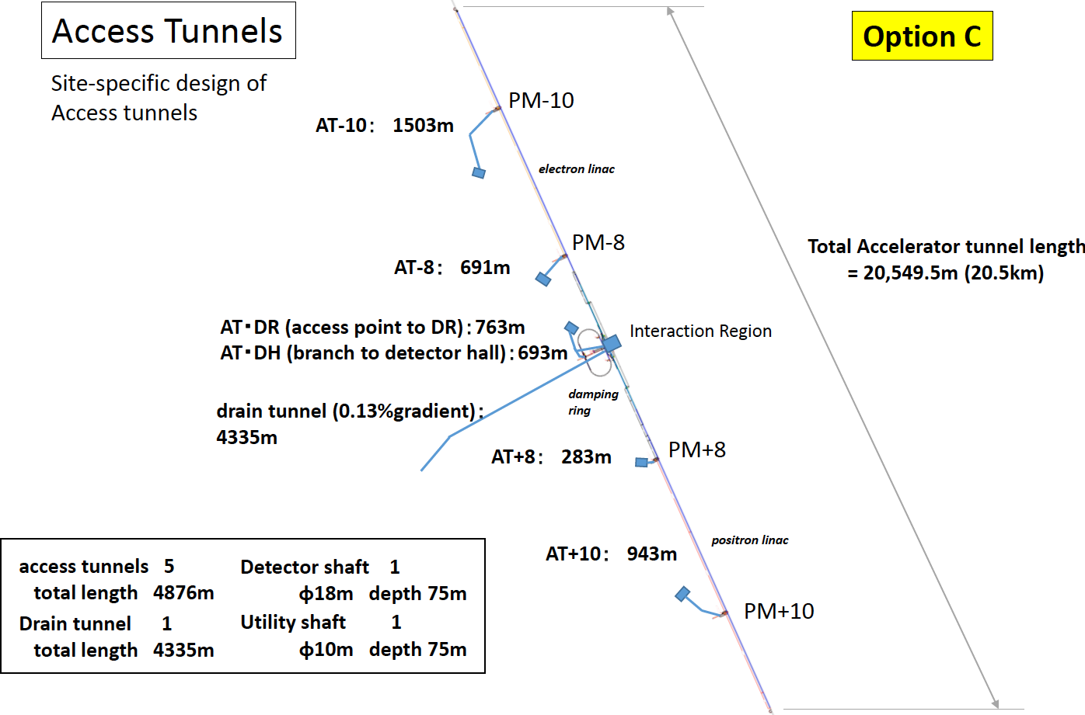
Option A
Note:
This was called "Option C" by the end of the last year
3489m
2361m

Slide 7
Option A
Note:
This was called "Option C" by the end of the last year
with
E-driven e+ source
with E-driven
e+ source
1500 m
with E-driven e+ source
2361m
3489m
with E-driven e+ source 490m
with E-driven e+ source
Total Accelerator tunnel length
18.5 km
2361m
With E-driven e+ source, length of electron-BDS becomes significantly shorter (3489m -> 2361 m).
Access tunnel to the electron-BDS becomes shorter too (690m -> 490 m).

Slide 8
Summary of Tunnel Length
(1) With E-driven e+ source, length of several tunnels can be shorter.
(2) Total footprint length becomes shorter, 20.5 km -> 18.5 km.
(3) Especially length of electron-BDS (where e+ source is located) becomes
significantly shorter (3489m -> 2361 m).
(4) The access tunnel to the electron-BDS becomes shorter too
(690m -> 490 m).
(5) Both (3) and (4) mean tunnel construction period of electron-BDS
can be shorter than that of the baseline design.
-> possibility of early commissioning of the central part (source and DR).
See next page.

Slide 9
Commissioning strategy
with E-driven e+ source

Slide 10
Commissioning Strategy
My Proposal
(1) E-driven e+ source is independent of the e- main linac.
(2) Make use of the short construction period of e-BDS tunnel and
the independence, maybe we can start the commissioning of the
e+ source earlier than that of main linacs.
(3) We would like to make an integrated commissioning strategy of ILC
with an integrated tunnel construction plan, in order to start physic
run as early as possible.

Slide 11
Construction and Commissioning
of e+/e- sources and DR
Optimistic plan or materials to trigger discussions
year
1
2
3
4
5
6
7
8
9
10
e+ Source Construction
preparation
production
Making Parts
Acc. tubues, Magnets
Klystrons, Modulators
Target, FC, etc.
1.5ys
5ys
preparation
construction
Tunnel construction
tunneling, access holes,
finishing, water, electricity
1.5ys
5ys
Installation
1y
Central Part Commissioning
sources and DRs
1.5y
ML construction
MLs and ML tunnels
9ys (ML tunnel const. + ML const.)
Global Commissioning
with ML
1y
year
1
2
3
4
5
6
7
8
9
10

Slide 12
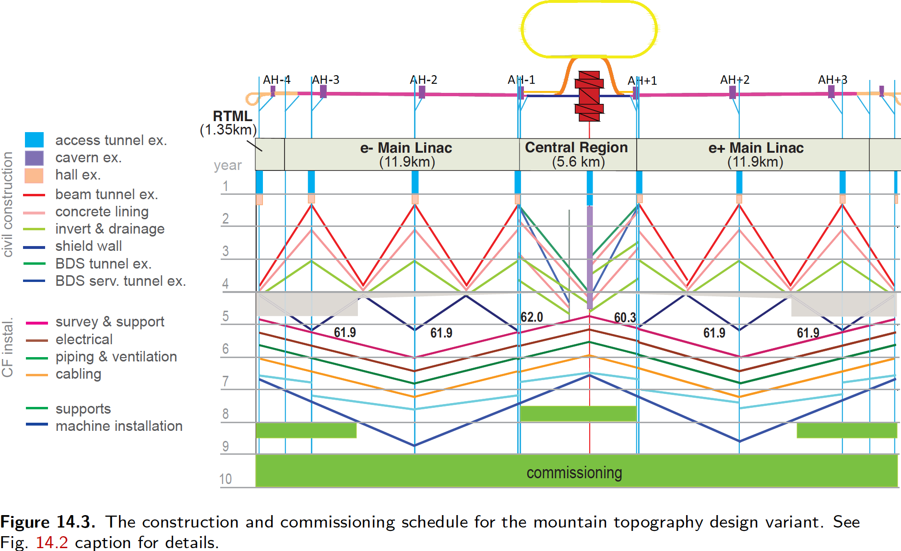
reference: Construction and Commissioning in TDR

Slide 13
Summary of Commissioning Strategy
My Proposal
(1) What I showed today is just to trigger discussions.
(2) We would like to make an integrated commissioning strategy
of ILC with an integrated tunnel construction plan, in order to
start physic run as early as possible.

Slide 14
E-driven e+ source in
a Separate tunnel
Thanks to Hayano-san and Miyahara-san

Slide 15
Option A
Note:
This was called "Option C" by the end of the last year
with
E-driven e+ source
with E-driven
e+ source
1500 m
with E-driven e+ source
2361m
3489m
with E-driven e+ source 490m
with E-driven e+ source
Total Accelerator tunnel length
18.5 km
2361m
With E-driven e+ source, length of electron-BDS becomes significantly shorter (3489m -> 2361 m).
Access tunnel to the electron-BDS becomes shorter too (690m -> 490 m).

Slide 16
Option A
Note:
This was called "Option C" by the end of the last year
with
E-driven e+ source
with E-driven
e+ source
1500 m
with E-driven e+ source
2361m
3489m
with E-driven e+ source 490m
with E-driven e+ source
Total Accelerator tunnel length
18.5 km
2361m
Close up -> next page
With E-driven e+ source, length of electron-BDS becomes significantly shorter (3489m -> 2361 m).
Access tunnel to the electron-BDS becomes shorter too (690m -> 490 m).

Slide 17
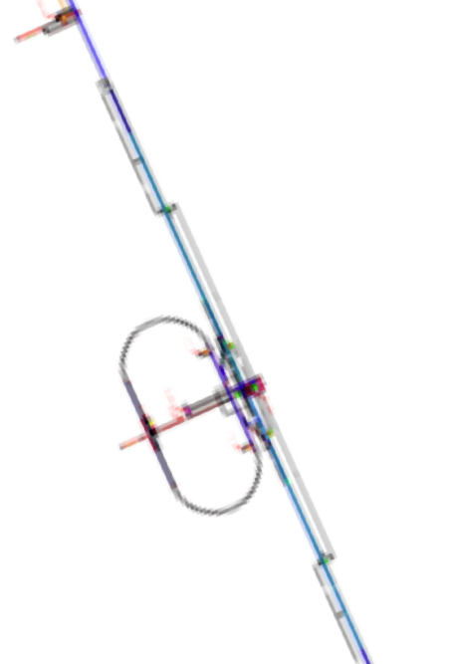
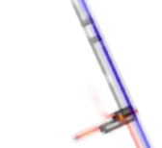
PM-8
Close up view of the central part
AT-8：490m
2361m
AT・DR (access point to DR)：763m
AT・DH (branch to detector hall)：693m
Interaction Region
2361m
PM+8
AT+8：283m

Slide 18
up
Slope of
the surface
down
PM-8
AT-8：490m
2361m
the triangular prism shows
the slope of the surface
2361m
PM+8
AT+8：283m

Slide 19
up
Slope of
the surface
down
E-Driven e+ source
2361m
1081 m
2361m

Slide 20
up
Shared tunnel plan
Slope of
the surface
down
E-Driven e+ source
2361m
1081 m
Put it into
the BDS tunnel
Shared tunnel plan
(current plan)
2361m

Slide 21
up
Separate tunnel plan
with additional access tunnel
Slope of
the surface
cost of access tunnel needed
down
E-Driven e+ source
2361m
1081 m
additional access
to the surface
Put it into a separate
tunnel and
make access
to the surface
cost of access tunnel needed
2361m

Slide 22
up
Separate tunnel plan
parallel to e- BDS tunnel
Slope of
the surface
We choose this a working assumption today.
down
E-Driven e+ source
1081 m
Put it into a
Separate tunnel
parallel to the BDS
and make connections
between them.
The separate tunnel
at DR side
looks reasonable
-> working assumption

Slide 23
Shared tunnel plan and Separate tunnel plan
• Shared tunnel plan
e- BDS tunnel (L=2.3 km, w =14 m)
put e-Driven e+ source in the BDS tunnel
• Separate tunnel plan
e- BDS tunnel (L=2.3 km, w =7.5 m)
e-Driven e+ source tunnel (L=1.1 km, w =9 m)

Slide 24
Shared tunnel plan and Separate tunnel plan
• Shared tunnel plan
e- BDS tunnel (L=2.3 km, w =14 m)
put e-Driven e+ source in the BDS tunnel
• e-Driven e+ soure, RTML, BDS are located.
• undulator e+ source will be added later.
• RTML and BDS are located.
• later, tunnel will be widen and
undulator e+ source will be added
• Separate tunnel plan
e- BDS tunnel (L=2.3 km, w =7.5 m)
e-Driven e+ source tunnel (L=1.1 km, w =9 m)

Slide 25
Shared tunnel plan and Separate tunnel plan
• Shared tunnel plan
e- BDS tunnel (L=2.3 km, w =14 m)
put e-Driven e+ source in the BDS tunnel
• e-Driven e+ soure, RTML, BDS are located.
• undulator e+ source will be added later.
(a) cost down
• RTML and BDS are located.
• later, tunnel will be widen and
undulator e+ source will be added
• Separate tunnel plan
e- BDS tunnel (L=2.3 km, w =7.5 m)
e-Driven e+ source tunnel (L=1.1 km, w =9 m)
(b) cost up
very rough estimation: (a) + (b) ~ 0

Slide 26
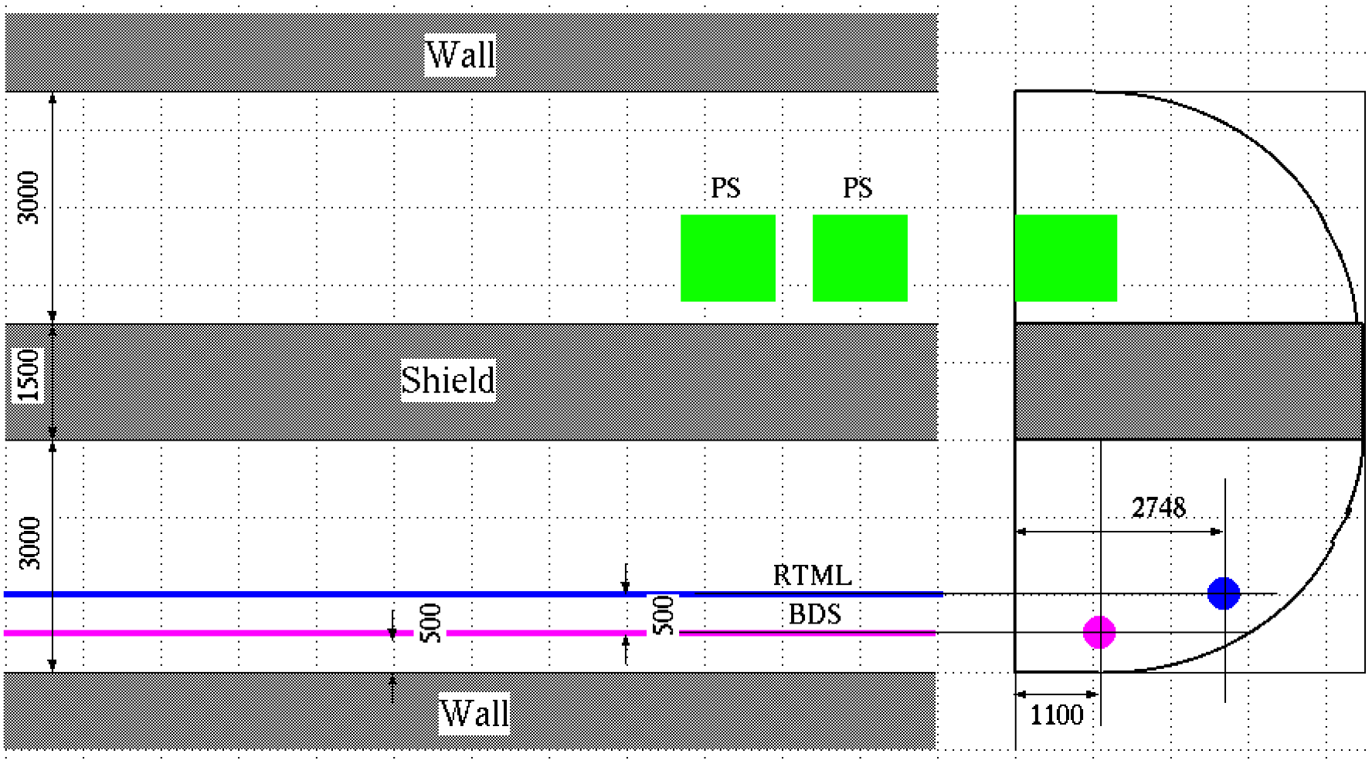
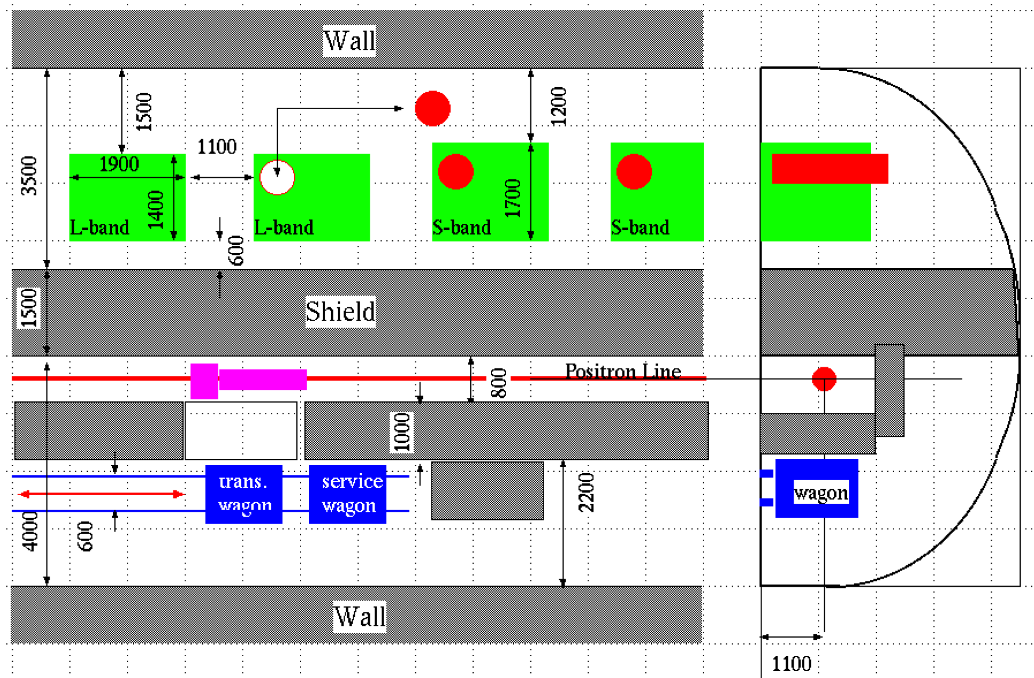
Separate tunnel plan
e- BDS tunnel
(L=2.3 km, w =7.5 m)
Service
Tunnel
3 m
Shield
7.5 m
1.5 m
BDS
RTML
3 m
e-Driven e+ source tunnel
(L=1.1 km, w =9 m)
Service
Tunnel
3.5 m
Shield
1.5 m
9 m
e+ Source
Tunnel
4 m

Slide 27
Summary of Separate tunnel
My Proposal
(1) What I showed today is just to trigger discussions.
(2) Separate tunnel for e-Driven e+ source has potential to make
early commissioning easier.
(3) We can make BDS tunnel (L=2.3 km) narrower (w= 14 m -> 7.5m).
The cost down by the narrow BDS tunnel probably compensate
the cost up by making a separate tunnel (L=1.1 km, w=9 m) for
the e+ source. (we need detailed study)

Slide 28
Polarization Upgrade
If we start with the E-driven e+ source, we need an upgrade path to the undulator source.
The question is "Can we have it?"
Especially, can we have it when we start with shorten BDS tunnel?

Slide 29
Polarization Upgrade
If we start with the E-driven e+ source, we need an upgrade path to the undulator source.
The question is "Can we have it?"
Especially, can we have it when we start with shorten BDS tunnel?
Yes we can. We can put undulator and photon drift in the geoid tunnel. --> Yokoya-san's symmetric laser straight scheme

Slide 30
Polarization Upgrade
Yokoya-san's symmetric laser straight scheme
• Only BDS tunnels are laser straight.
• Straight part is symmetric wrt the IP
• Undulator and photon drift (and, of course ML) are in the geoid tunnel.

Slide 31
The END
Thank you for your attention.

Slide 32
Option A
Note:
This was called "Option C" by the end of the last year
A

Slide 33
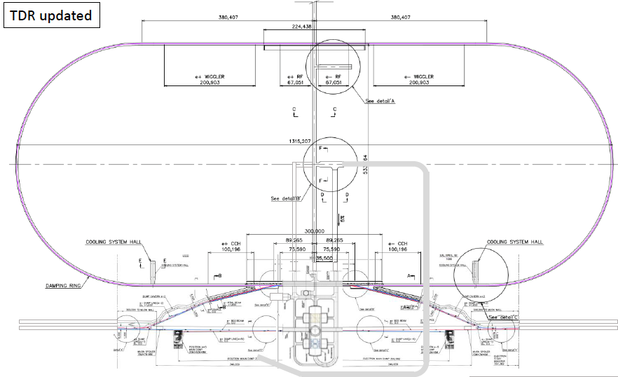
My Proposal and Assumption
with E-driven e+ source
Make use of the shorter tunnel length and make effort to optimize tunnel construction schedule of near DR (*), we may try to make it possible to start commissioning of e+/e- sources and DR earlier than global commissioning.
direction of tunnel construction
* Length of DR access tunnel is 763 m.
It is half of the longest access tunnel at ML.
* Length of ½ DR tunnel is 1500 m.
It is shorter than a half section of
ML tunnel
* Length of DR connecting
tunnel is 530 m.
* Length of RTML
tunnel is 250 m.

Slide 34

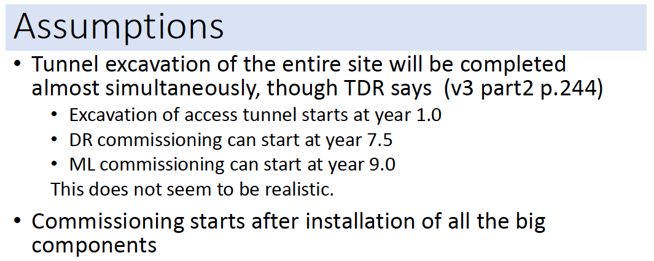
K. Yokoya, LCWS2017, 26/Oct., Strasbourg
What TDR says
• In TDR, it is assumed that central region tunnels is finished 1.5 years
earlier than main linac tunnels. Then it is assumed that central region
commissioning starts 1.5 years earlier than global commissioning.
• Today, people say that earlier start of central region commissioning is
NOT realistic.

Slide 35
Commissioning of the e+ injector system
Target
E-gun
Driver e- Linac
(3GeV)
Capture Linac
(250MeV)
e+ Booster Linac
(5GeV)
e+ DR
(5GeV)
The Tuning Dump
at 100 MeV
The Tuning Dump
at the end of
Driver e- Linac?
(very low current)
Necessary?
Permanent?
Temporally?
The Tuning Dump
at theend of Capture? (at 250 MeV)
(very low current)
Necessary?
Permanent?
Temporally?
• Basic strategy: Commissioning of the entire e+ injector system will be
done through e+ source and the e+ DR at once (一つの放射線申請).
• No partial commissioning will be performed in the injector system.
If we make the commissioning step-by-step for each part (個々別々
の申請), it will rather take long time.
• However the tuning of very low radiation operation at some part may
be useful. Tuning at 100MeV point of the driver e- linac will be useful.
How about at the end of the Driver e- Linac? Maybe NOT necessary?
How about at the end of the Capture? Maybe NOT necessary?

