Slide 1
Studies for the SiD Hadron Calorimeter
Dr. Andrew White
Andrew Myers
Sakshi Nag – Speaker
Divyanshu Sharma
Ross McCoy

Slide 2
Introduction
The University of Texas at Arlington joined the SiD optimization in plans to design and calibrate the AHCAL
Initial calibration using single particle studies
Studying the energy deposits in HCal & ECal Barrel
Notes:
What’s AHCAL and should we talk about it? A stands for Analog. Don’t need to talk about this.
-At this point, mention that Sakshi and Div have been focusing on the calibration using single particles.
-Insert a photo here. What kinda photo should we have here? Skip the pic here.

Slide 3
Data File Specifics
Detector Version: SiD_o2_v03
Physics list: FTFP_BERT
Particles: Muons, Pions, K0Long
Sample Size: 10,000 events (max.)
All events were run with full simulation and reconstruction process
Analysis performed using C++, Python, and Modular Analysis and Reconstruction for the Linear Collider (MARLIN)
Notes:
We will be focusing on pions In this presentation

Slide 4
SiD AHCAL Calibration
Results from the simulation are lower than the test beam data. This is expected.
These were performed using the SiDReconstruction_o2_v03_calib1ct1.xml file.
Notes:
Ask Dr. white If he can send us the latest calice plot again so that we can put it in the slide – cant find it in our emails.
Use the one from Andrew’s ppt. that’s latest.

Slide 5
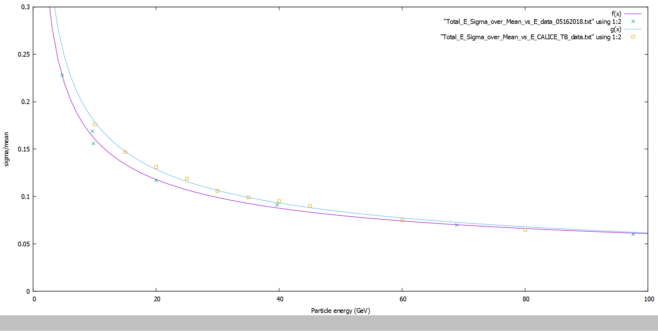
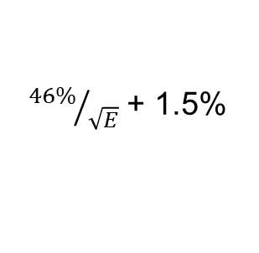
5-100 GeV charged pions:
SiD simulation and CALICE 1m3 test beam results
CALICE AHCAL
Test Beam
θ = 90º
SiD HCal
simulation
${46\%}/{\sqrt{E}}$ + 1.5%
Notes:
CALICE plot

Slide 6
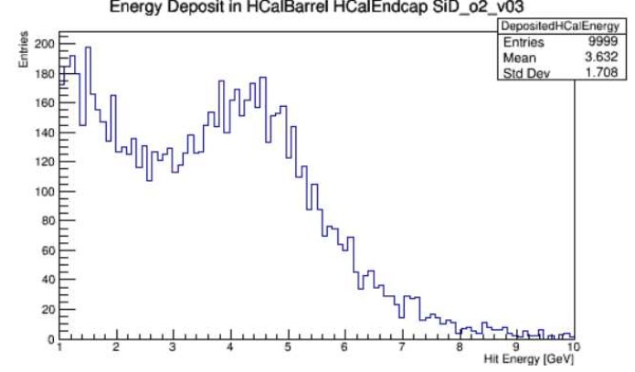
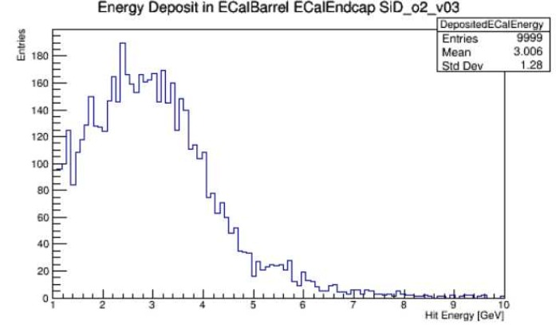
5 GeV Pions, 10,000 events
Notes:
HCAL Barrel and Endcap vs. ECAL Barrel and Endcap
should we include graphs for other energies as well Since there were a lot of them?
Have a slide comparing diff energy ranges. Wouldn’t hurt. 4 comparison slides.

Slide 7
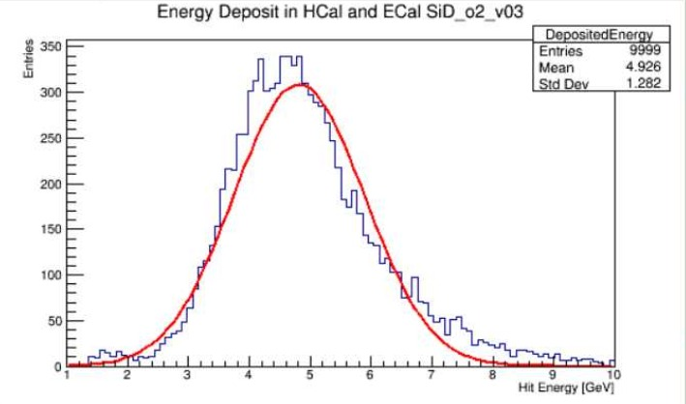
5 GeV Pions, 10,000 events
Notes:
HCAL Barrel and Endcap vs. ECAL Barrel and Endcap
should we include graphs for other energies as well Since there were a lot of them?
Have a slide comparing diff energy ranges. Wouldn’t hurt. 4 comparison slides.

Slide 8
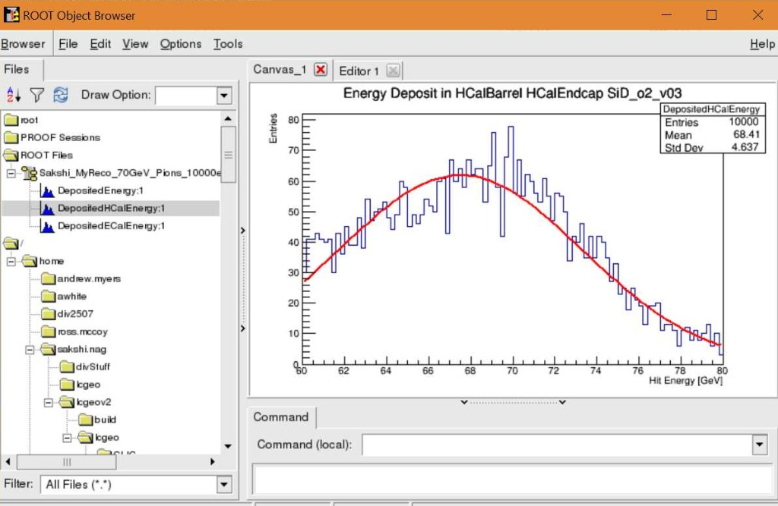
70 GeV Pions, 10,000 events
Notes:
HCAL Barrel
should we include graphs for other energies as well Since there were a lot of them?
Have a slide comparing diff energy ranges. Wouldn’t hurt. 4 comparison slides.

Slide 9
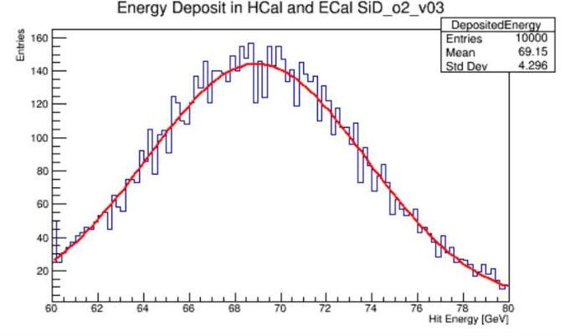
70 GeV Pions, 10,000 events
Notes:
Mention somewhere that all the angles that we use Were 89 degrees unless otherwise mentioned

Slide 10
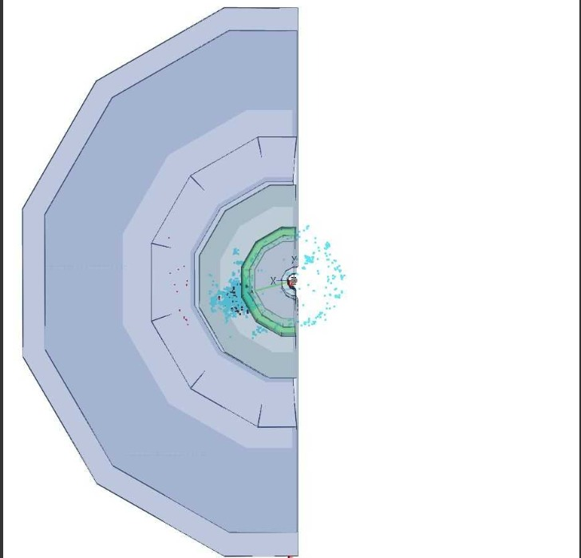
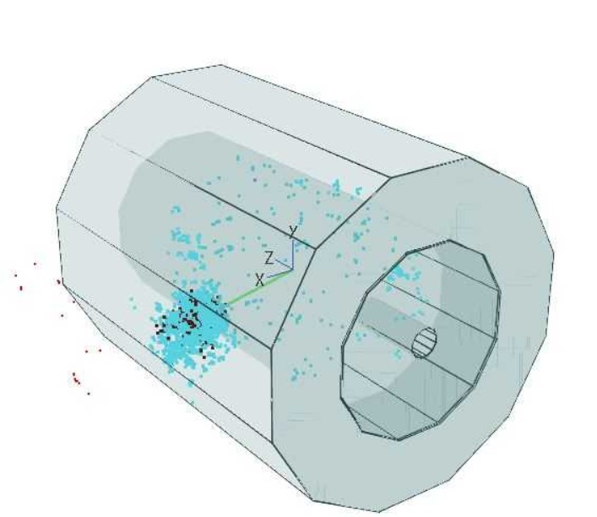
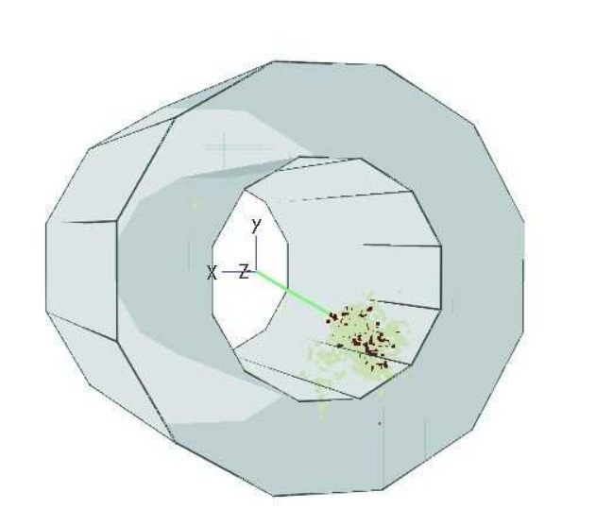
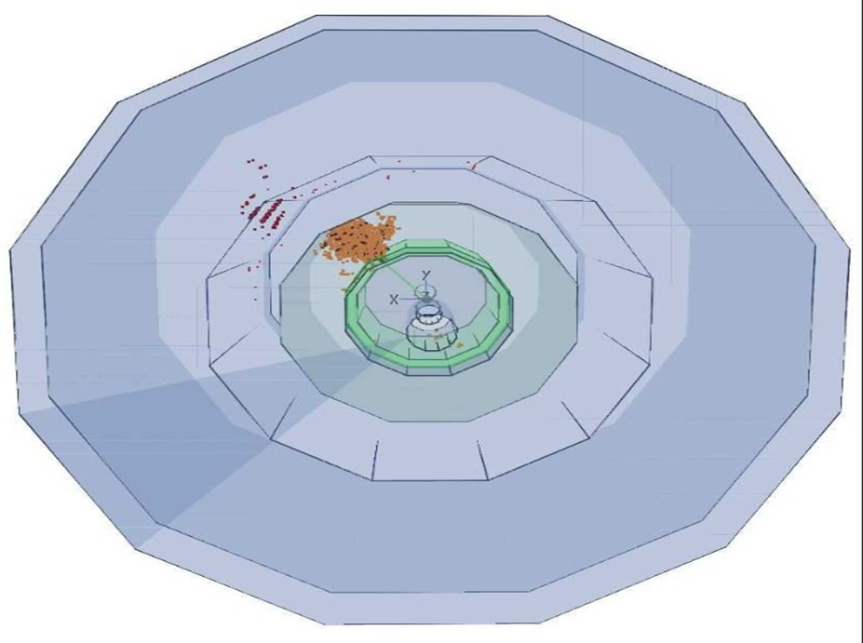
HCal Barrel
Notes:
HCAL Barrel

Slide 11
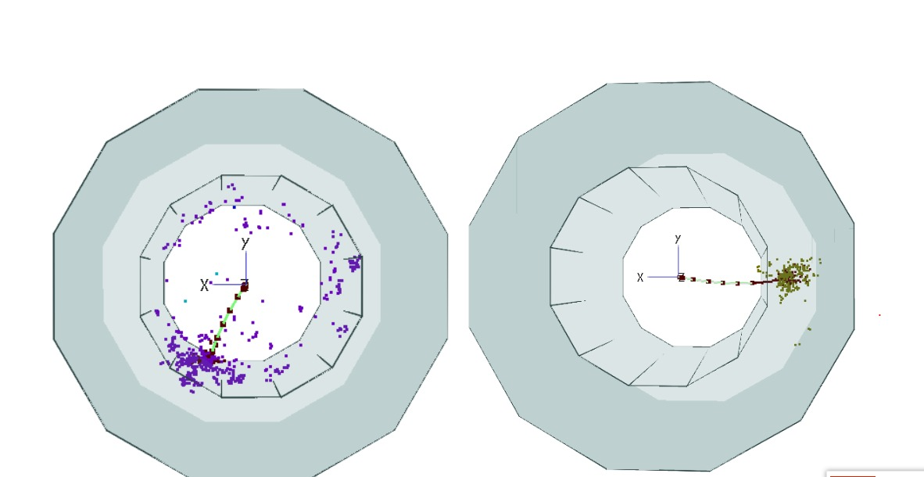
Hcal Barrel

Slide 12
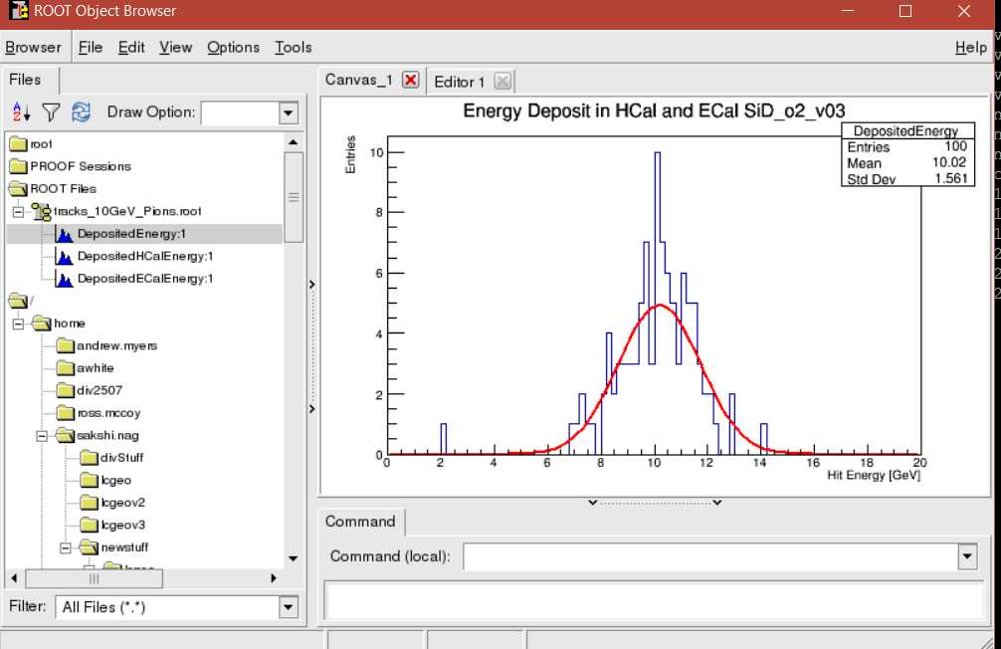
New plots: 10GeV, 100 events

Slide 13
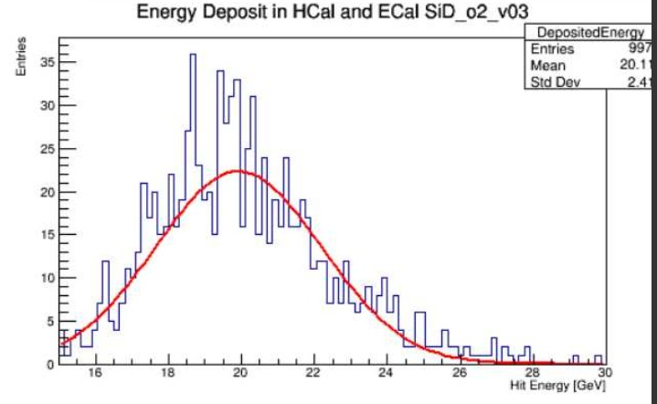
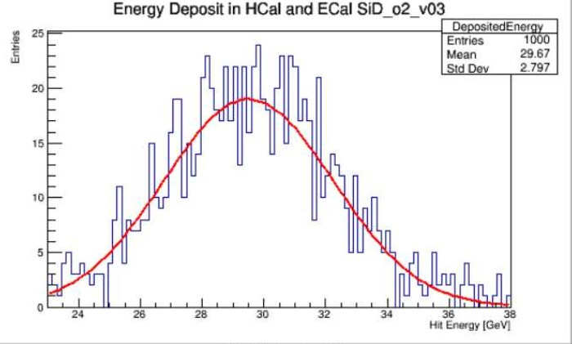
New Comparisons: 20GeV vs. 30 GeV

Slide 14
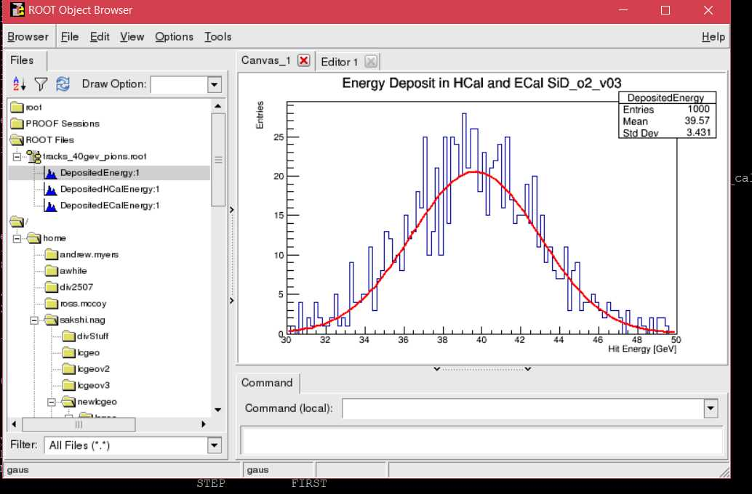
New Comparisons: 30GeV vs. 40 GeV

Slide 15
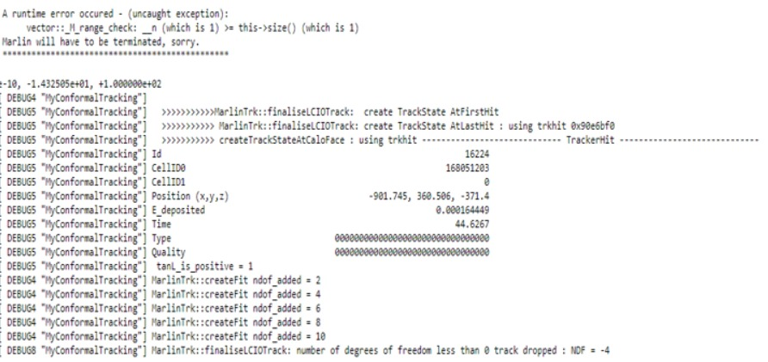
Errors Encountered
Marlin crashed for 10 GeV Pions at 1000 events, endcap.
Notes:
In the old calibration Marlin used to crush for 21 degree simulations.

Slide 16
Errors Encountered
After facing this error, we rebuilt LCGEO and used the most updated version of SiDReconstruction_o2_v03_calib1ct3.xml file.
Events which ran successfully:
- 10 GeV, 100 events, 89 Degrees (Pions)
- 20 GeV 996 on 1000 events, 89 Degrees (Pions)
- 30 GeV 1000 events, 89 Degrees (Pions)
Events which errored out:
- 40 GeV 1000 events, 20 Degrees
-10 GeV 1000 events, 89 Degrees
Notes:
Should we include the graphs for the results that worked correctly?
Yeah. More graphs the better. Ask Dr. white just in case.
89 degrees is barrel and 20 or 21 degrees is end cap

Slide 17
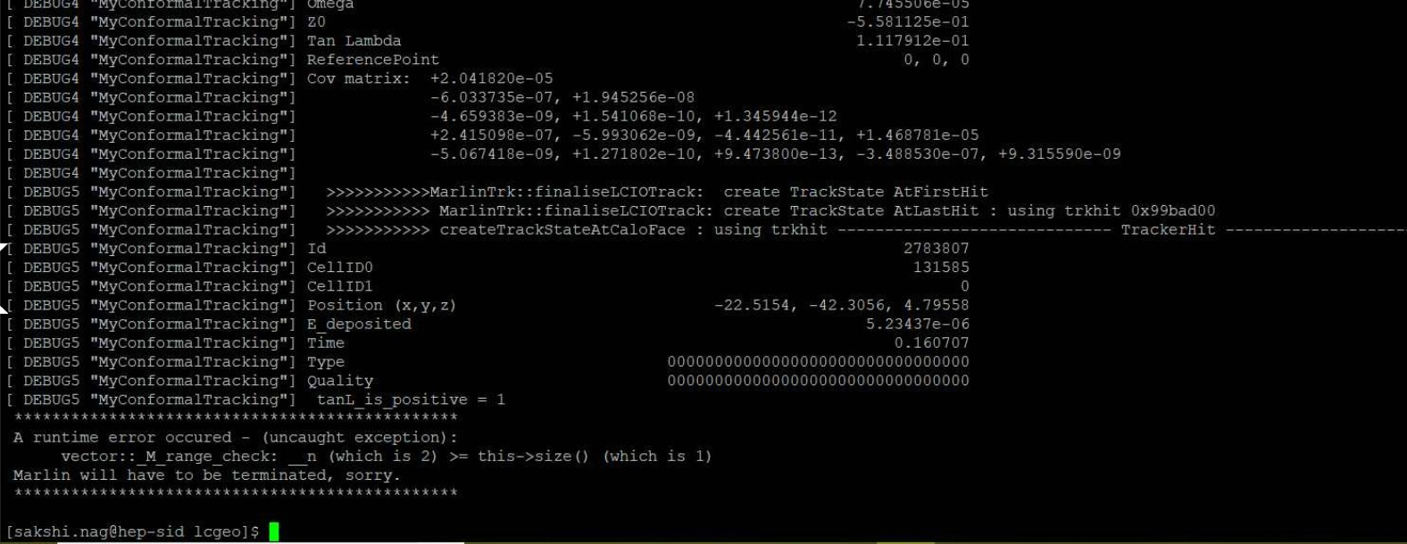
New Error
Notes:
Should we include a slide with the steps that we ran to get to this solution? No. that’s probably too much.
Should we include the k0 long result that we got? – that was interesting because we could only run about 45 events on that out of 100? Throw it in. Ask Dr. white just in case.
Should we include screenshots of the part of the SiD Reco code where we made the changes? If you changed source files, don’t worry about it. If you changed constants, show that. Get more clarification from Sakshi.

Slide 18
Future Plans
Try to get past the Marlin Error in tracking.
Compare energy resolution in endcaps with CALICE results.
Move onto actual physics studies with jets.

