Slide 1
Status and expected progress on SRF cavities
| Réunion d'information ILC -9avril 2018
C. Z. Antoine

Slide 2
INTRoduction
SRF limits

Slide 3
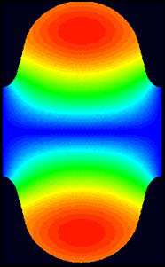


Ultimate limits in SRF-1
Niobium cavities
  Performances
    E_{acc} α H_{RF}
    Q₀ (α 1/R_{S}) α T_{C} => Nb₃Sn, MgB₂, NbN…
    Limit = magnetic transition of the SC material @ H_{peak}
  Superconductivity only needed inside :
    Thickness ~ < 1 µm => thin films
    (onto a thermally conductive, mechanically resistant material, e.g. Cu)
  Today :
    Thin films exhibit too many defects
    Only Bulk Nb has high SRF performances
  Issues : getting “defect free” superconductors (yes but not all defects are detrimental…)
H_{Peak}
H_{Max}.
0
H field mapping in an elliptical cavity

Slide 4
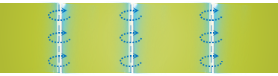

Ultimate limits in SRF-2
Mixed state w.Vortex
(i.e. N. cond. flux line + screening currents)
  SC phase diagram
    All SC applications except SRF: mixed state w. vortex
    Vortices dissipate in RF !
    SRF => Meissner state mandatory !
    H_{C1} = limit Meissner/mixed state
    Nb: highest H_{C1} (180 mT)
    “Superheating field”(?) :
  Metastable state favored by H // to surface
    Difficult to get in real life !
H
H_{C2}
H_{C1}
Meissner state
T_{C}
T
Screening current over λ, no magnetic field deeper

Slide 5
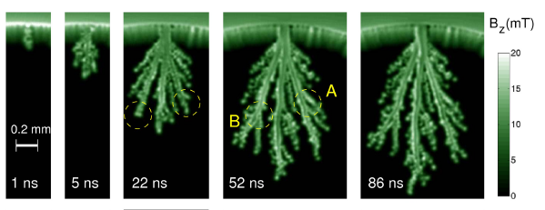



What is the limit (H_{p}/H_{C1}/H_{SH}) ?
  Real world cavities behavior is dominated by a few number of defects
  It is very important to measure the penetration field of samples in realistic conditions
H
$$\vec{HRF}$$
$$\vec{HRF}$$
H
H_{SH}
H//
H//
H_{SH}
H_{C1}
H_{C1}
H⊥
H⊥
T²_{C}
T²
T²_{C}
T²
$$\vec{Happl}$$
  ~100 µm in 1 ns (~RF period)
  Compare with λ (field penetration depth)
    Nb : ~ 40 nm
    MgB₂ ~ 200 nm
  Avalanche : high RF dissipation
MgB_{2:} http://www.nature.com/srep/2012/121126/srep00886/full/srep00886.html?message-global=remove&WT.ec_id=SREP-20121127

Slide 6
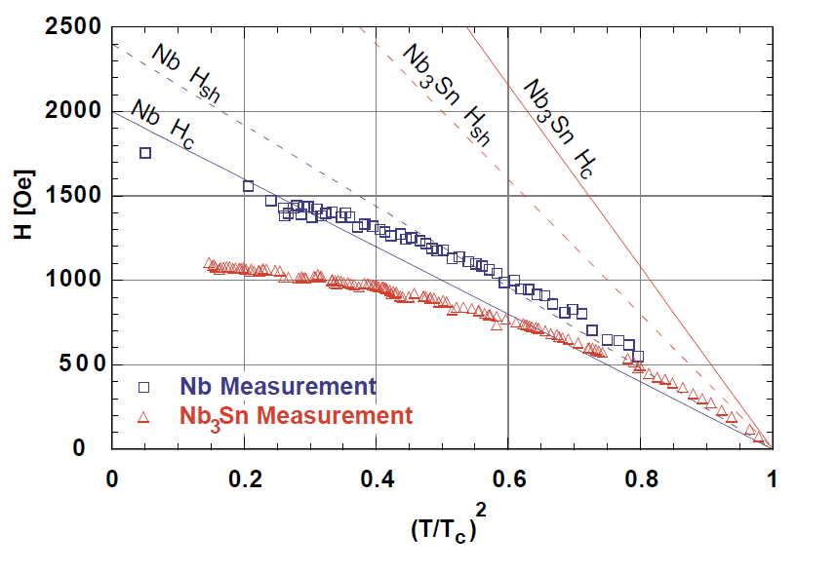
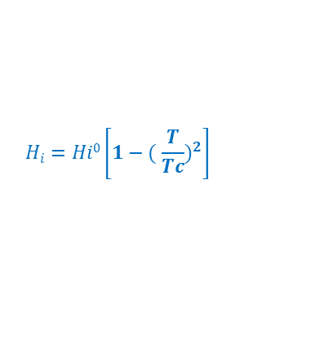
EFFECTs of local defects
H_{SH}^{Nb3Sn}
(~ 400 mT @ 0 K)
Hays. "Measuring the RF critical field of Pb, Nb, NbSn". in SRF 97. 1997.
Nb H_{C1}
(170 à 200 mT)
Nb₃Sn
Cornell, 1997
pulsed
Recent results from Cornell CW (Posen, 2015 (17 MV/m))
$$Hi=Hi0\left.\left[1−( \frac{T}{Tc}\right.)^{2}\right]$$
H_{C1}^{Nb3Sn} (~27mT)
(50 mT pour le bulk)
Dissipations :
~ 2K
  Vortices enter more easily at lower temperature (counter intuitive !)?
    @ T~T_{C} : H is low => low dissipations => easy to thermally stabilize
    @ T<<T_{C} : H is high=> even if small defect => high dissipations => Favors flux jumps
=> We have to reduce defect density (yes but which ones?)

Slide 7
Bulk Niobium
Present status

Slide 8
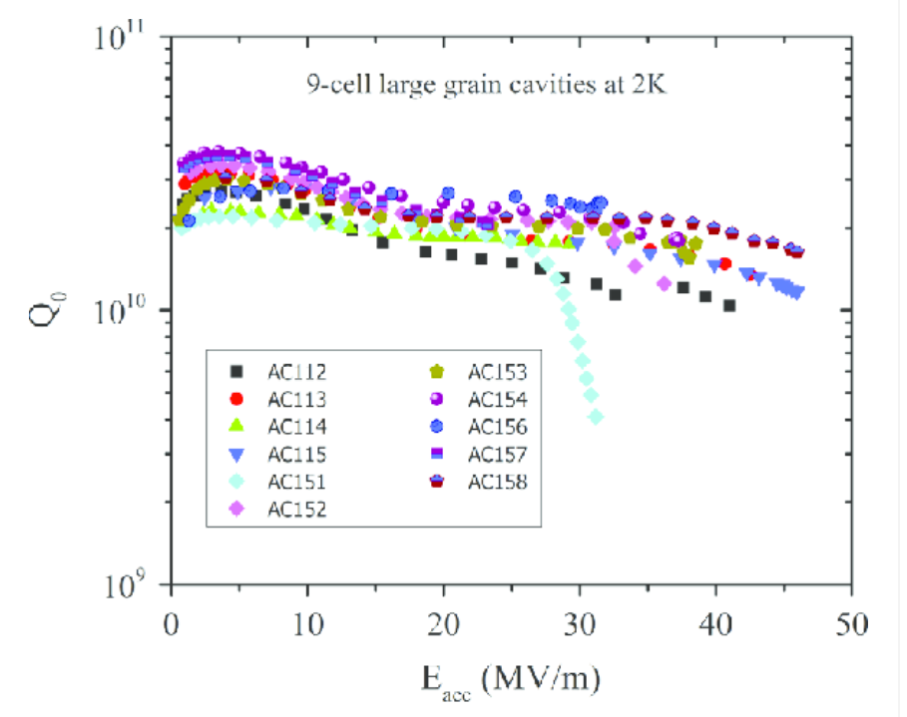
Typical production scores for 9-cells
Polycrystalline bulk Nb
https://agenda.linearcollider.org/event/7645/contributions/40185/attachments/32340/49084/Pekeler_XFEL-CavityProduction_ResearchInstruments.pdf
Large graine bulk Nb
https://www.google.fr/url?sa=t&rct=j&q=&esrc=s&source=web&cd=1&cad=rja&uact=8&ved=0ahUKEwjH57Di8qzaAhULuRQKHbUeBh4QFggsMAA&url=https%3A%2F%2Fwww.sciencedirect.com%2Fscience%2Farticle%2Fpii%2FS0168900214013977&usg=AOvVaw2_X7xJ6spZFAA0bhvMpfxf

Slide 9
Reducing cost
Many trails explored…
  Large grain material
    Economy in Nb Weigth
  Nitrogen (Oxygen ?) doping/infusion
    Today Nb is optimized for thermal conduction (stabilization), not for superconductivity
    Modification of the surface without loosing the bulk properties
  Multilayer :
    Route to realistic material with higher Q₀ and E_{acc} (and even defects)
    Protection against vortex avalanche
  Getting rid of the damage layer
    Only explored at lab level

Slide 10
Large grain material

Slide 11
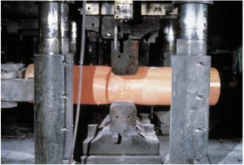
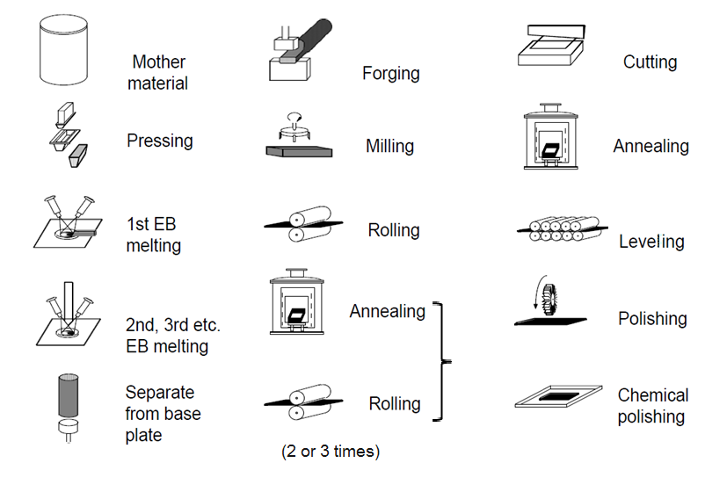
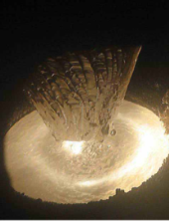
Typical sheet preparation
15-20 steps

Slide 12
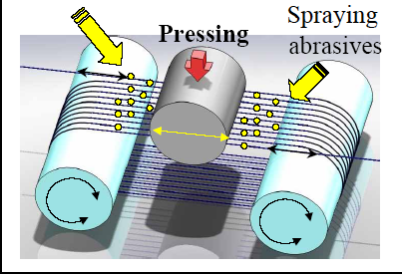
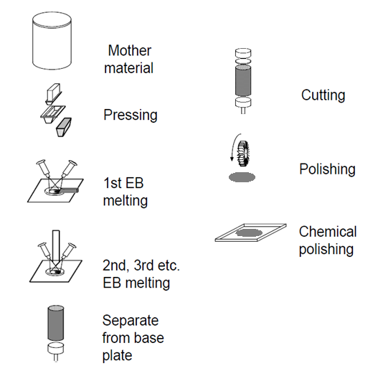
large grain disk preparation
8 steps
[Saito, 2007]
  Economy in weigth:
  ≠ ~ 6 Kg/ 9-cell
  ~ 3 k€ / 9-cell (compare w. 20 k€)
  ~ 15% of the cost

Slide 13
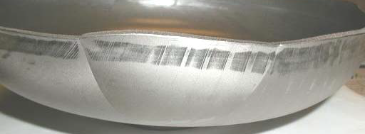
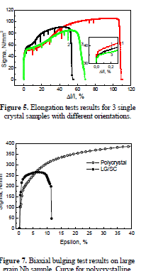
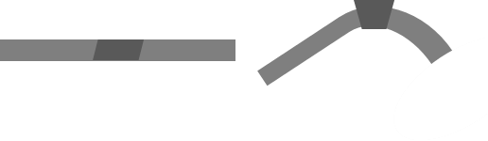
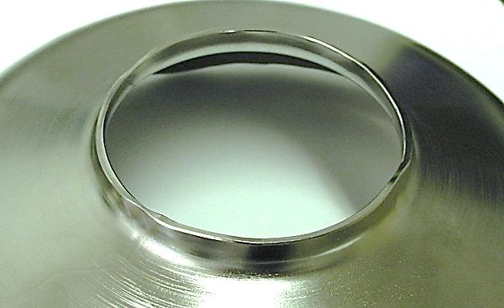
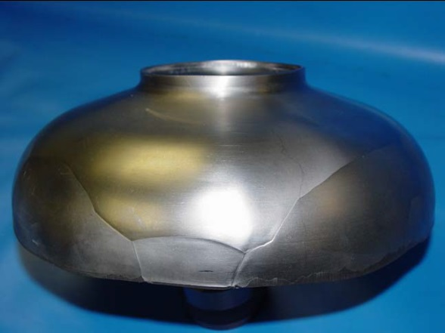
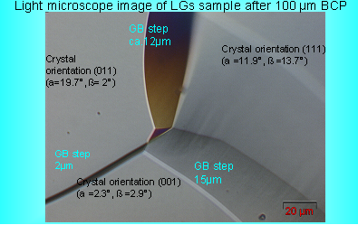
Large grain forming
But….
  Non uniform forming
  asymmetric deformation
  risk of tearing (irises)
  risk of holes during welding
  larges steps @ GB
[Singer, 2008]
=> a lot of forming failure
=> a whole new industrial process need to be developed

Slide 14
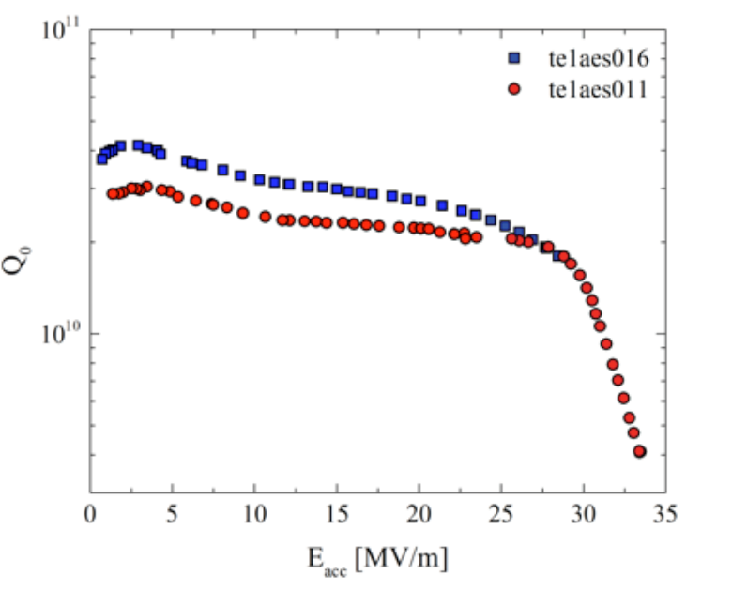
Large grain conclusion
  RF performances : ~ same as smaller grain cavities
      Medium Q ~ a little better for EP cavities
  Savings for (very) large Nb sheet production (small elliptical cavities only)
      Less fabrication steps
      Ingot => disks : no losses of material in the corners
      High purity material with intrinsically good crystalline quality
      But not fitted for ∅ > 30 cm (typical ingot ∅)
  Increased costs and delay for Cavity forming
      More fabrication steps, higher failure risks
      Large cost savings on material, …might be lost on fabrication

Slide 15
Nitrogen (Oxygen ?) doping/infusion

Slide 16
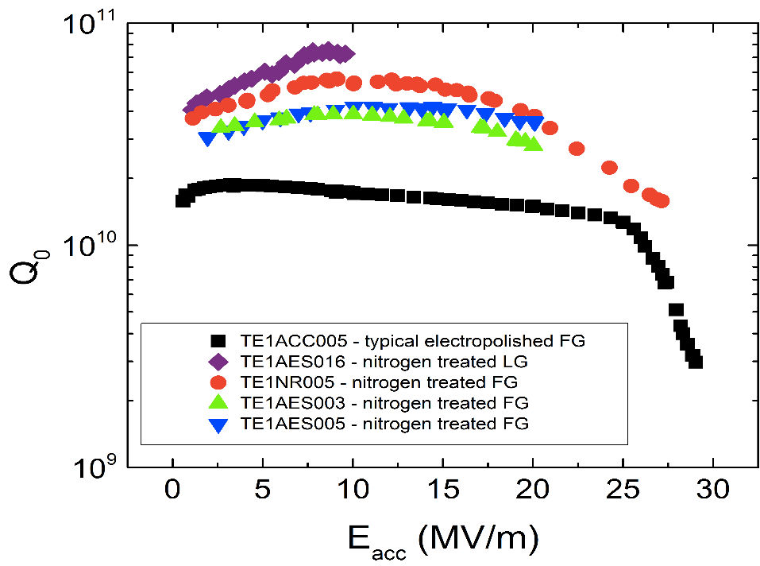
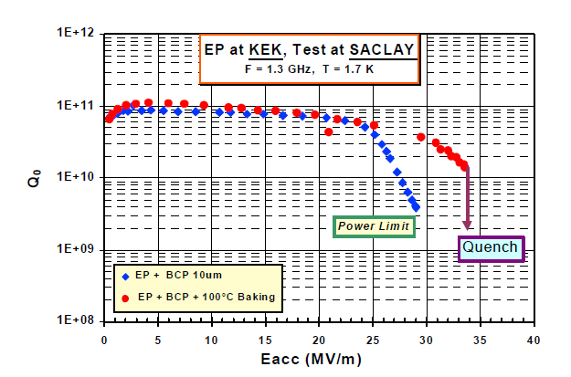
Baking/doping/infusion what is the difference?
  N doping
  high temperature annealing (oxide disappears)
  high temperature N₂ => degradation
  EP (~80 µm) => very high Q₀, but E_{acc} ↓↓
  At 1^{rst} order : modification of m.f.p. l
  Not For ILC !!!
  Not necessarily related to N
  Very well recrystallized material @ Saclay in 2001
T~ 2K ?
≡ 5-6 x10¹⁰ @ 2 K
4,5 K
Nb/Cu
Bulk Nb
(l ∝ RRR)

Slide 17
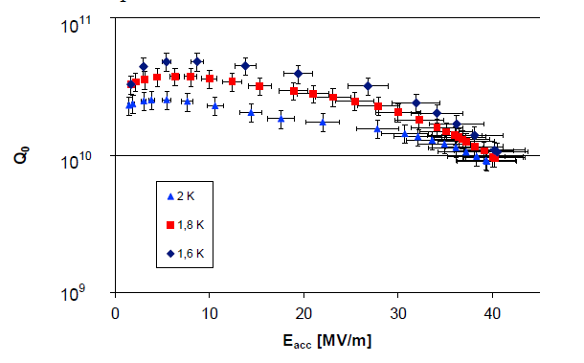
Effect of temp on
https://arxiv.org/pdf/physics/0401141.pdf

Slide 18
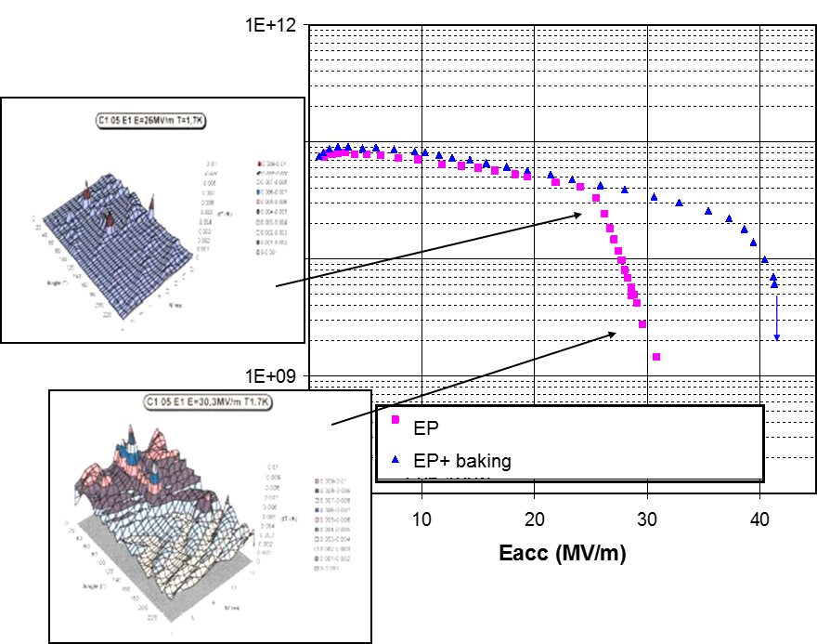
Baking/doping/infusion what is the difference?
  Baking
  120 °C, 48 h => oxide degrades, O_{i} diffuses ~100 nm
  Change in mean free path => better R_{S}
  prevents hydride precipitation ?
  N infusion
  800°C annealing (oxide disappears)
  120 °C, 48 h in presence of N₂ => N_{i} diffuses ~10 nm
  Change in mean free path => better R_{S}
  prevents hydride precipitation ?

Slide 19
Issues
  Variability lab to lab
  Same recipe, but not same results,
  Needs adaptation : high temperature treatment ≠
  Higher sensitivity to trap flux
  Upon cooldown if ⱻ defects, magnetic remnant flux gets trapped
  very high surf resistance in RF !
~100 nm => dislocation cells
~10 nm => interstitials
Martinello et al, FNAL
Gonella et al, CORNELL U.
      Related to crystalline sub-structure, not specified/monitored yet

Slide 20
Multilayers

Slide 21
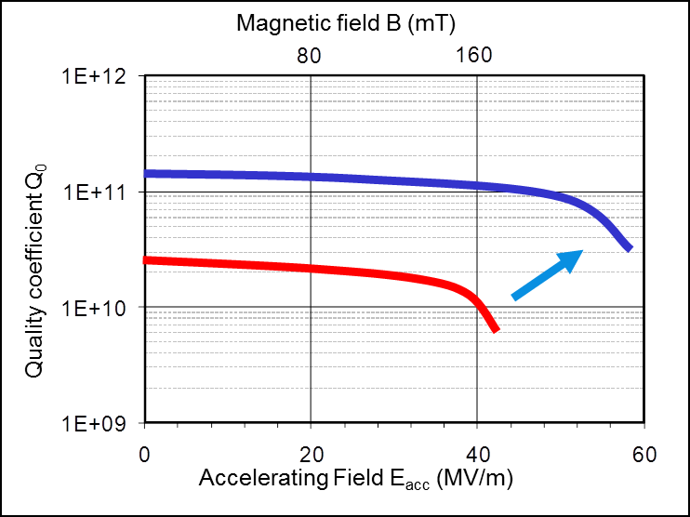


After niobium : nanocomposites multilayers
$$\vec{HRF}$$
$$\vec{HRF}$$
Structures proposed by A. Gurevich in 2006, SRF tailored
  Dielectric layer
    Small ⊥ vortex (short -> low dissipation)
    Quickly coalesce (w. RF)
    Blocks avalanche penetration
    => Multilayer concept for RF application
  Nanometric I/S/I/ layers deposited on Nb
    SC nanometric layers (≤ 100 nm) => H_{C1}↑ => Vortex enter at higher field
    Nb surface screening => allows high magnetic field inside the cavity => higher E_{acc}
    SC w. high T_{C} than Nb (e.g. NbN): => Q₀^{multi} >> Q₀^{Nb}
H_{Nb}
H_{applied //}
d_{sc}
Cavity's internal surface
→
S-I-S
Notes:
A. Gurevich, "Enhancement of RF breakdown field of SC by multilayer coating". Appl. Phys.Lett., 2006. 88: p. 12511.
Couche fine : pas favorable énergétiquement à la nucléation d’un vortex => augmentation artificielle du HC1.
Couches trop fines pour écranter totalement le champ, seulement atténuation : il en faut plusieurs => structures à optimiser

Slide 22
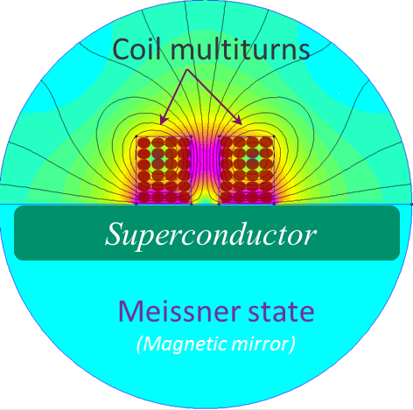
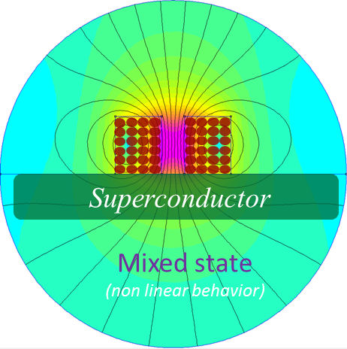

What is the limit (H_{p}/H_{C1}/H_{SH}) ?
  Real world cavities behavior is dominated by a few number of defects
  It is very important to measure the penetration field of samples in realistic conditions
H
$$\vec{HRF}$$
$$\vec{HRF}$$
H
H_{SH}
H//
H//
H_{SH}
H_{C1}
H_{C1}
H⊥
H⊥
T²_{C}
T²
T²_{C}
T²
  Local magnetometry
    ~ Same geometry as cavities
    No shape/edge effect (vs DC/ Squid magnetometry)
    No demagnetization effect
    Measures actual penetration field wherever it is H_{P}/H_{C1}/H_{SH}

Slide 23
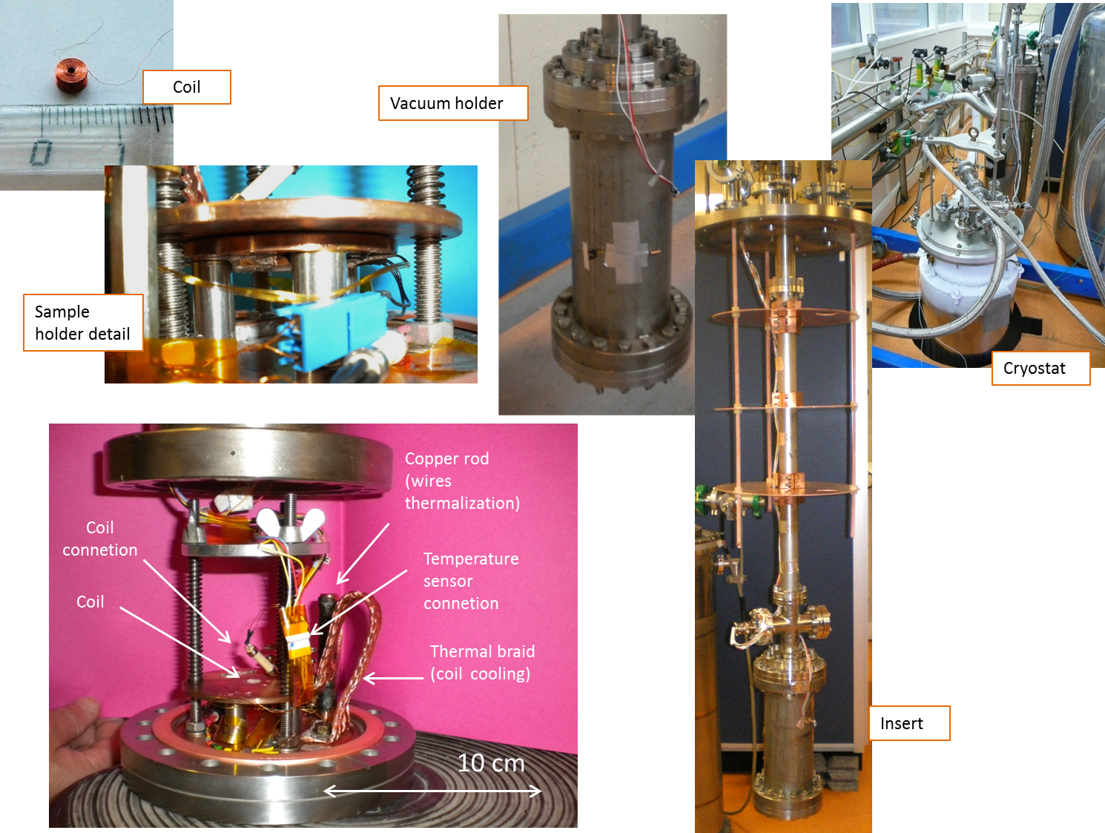
Experimental Details
H
H_{C2}
maximum field without Vx (max E_{acc})
maximum pinning
Vx ~ liquid
H_{Melting}
H_{C1}
Vx lattice
I_{a}/H_{a}
Meissner state
T_{C}
T
  Low frequency ≡ DC :
    0 < H_{a}< H_{C1} => R=O, Meissner state
    H_{C1}< H_{a}< H_{M} =>Vx are trapped, R=O, Campbell regime
    H_{M}< H_{a}< H_{C2} =>Vx are moving liquid like, R≠O, Flux flow regime
    Third harmonic signal arise from flux line tension (affects the e- inside the Cu coil),
    It does not depend on dissipation inside Nb, BUT depends on # of Vx trapped there (and length).
flux line moving in AC field
Vx pinned in the SC

Slide 24
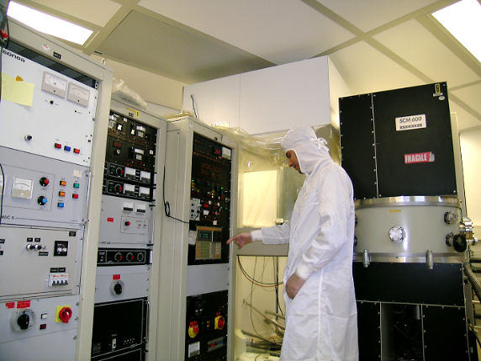
Nb – Insulator – NbN model
  NbN coating by Magnetron Sputtering
  NbN single layers series
    NbN SL / “thick” Nb layer
      Magnetron sputtered
      MgO as dielectric layer
    Far from perfect…
Nb (nm) | MgO (nm) Calc(actual) | NbN (nm) Calc(actual) | T_{C} (K)
250† | 14 | 0 | 8.9
250† | 14 | 25 | 15.5
500 | 10 (10.3) | 50 (65) | 15*
500 | 10 (8.4) | 75 (72) | 14.1*
500 | 10 (9.8) | 100 (94) | 14*
500 | 10 | 125 | 14.3*
500 | 10 (6.7) | 150 (132) | 15.9*
500 | 10 (10.4) | 200 (164) | 15*
† Not same batch, deposited on the same conditions, but substrate = sapphire
*As determined with magnetometry, see below.

Slide 25
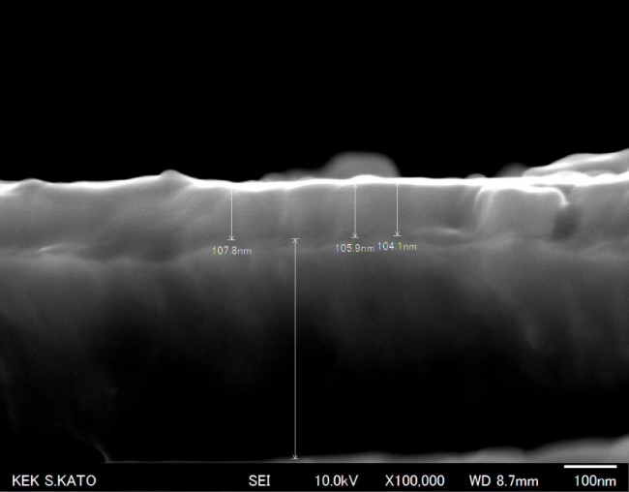
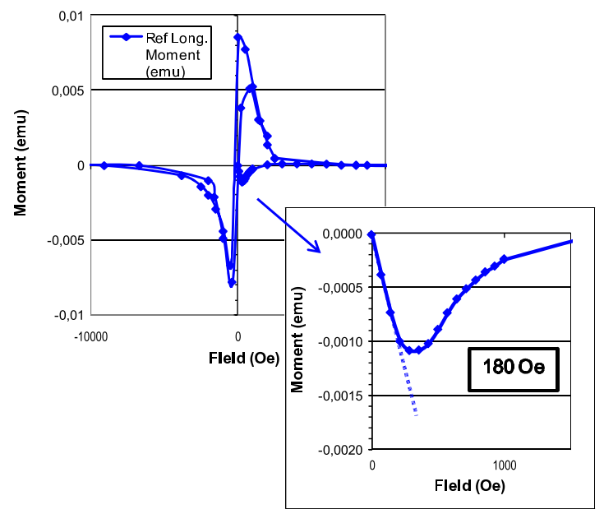
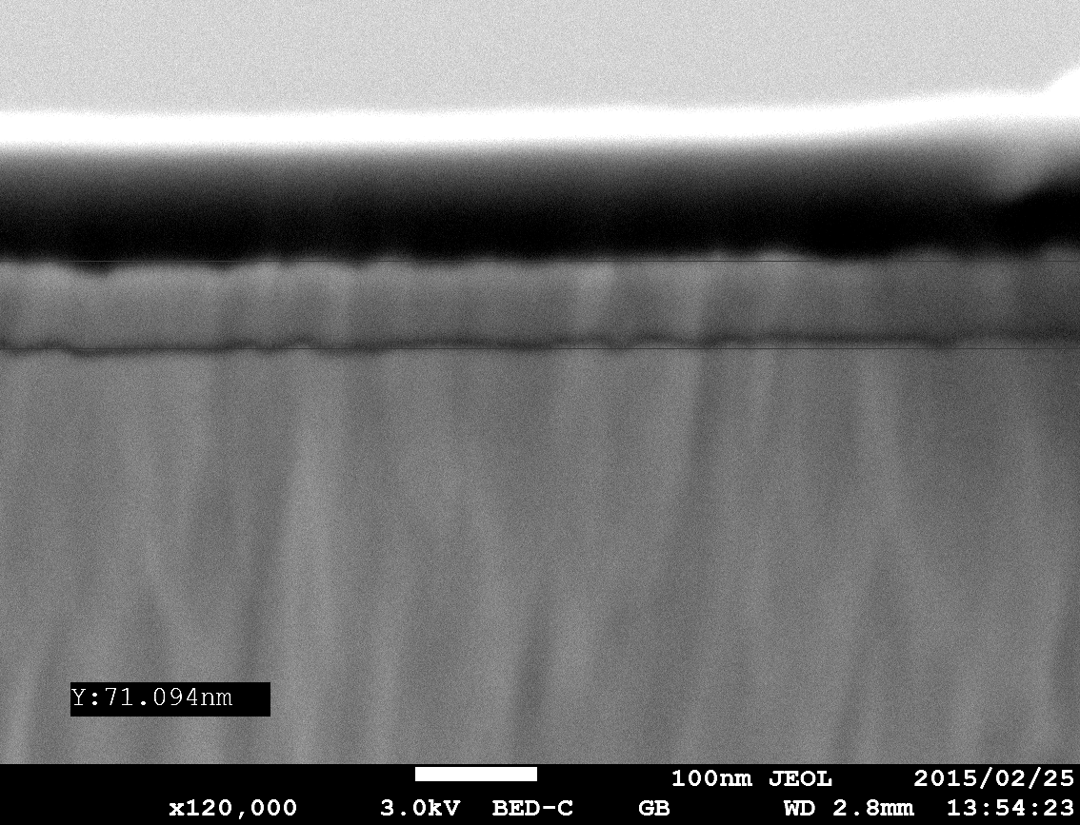
Sputtered (defective) materials…
  Typical defects…
    Low H_{C1}
    Thickness ≠ uniform
    …
    NbN 100nm
NbN Thickness ~ 105nm
250 nm Nb on saphire
DC Squid magnetometry @ 4.5 K
Nb Thickness ~ 425nm
Rippled interfaces
~ 18 mT
As expected for MS samples
    NbN 50nm
| PAGE 25

Slide 26
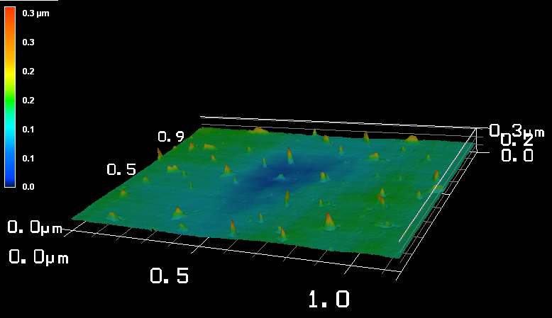
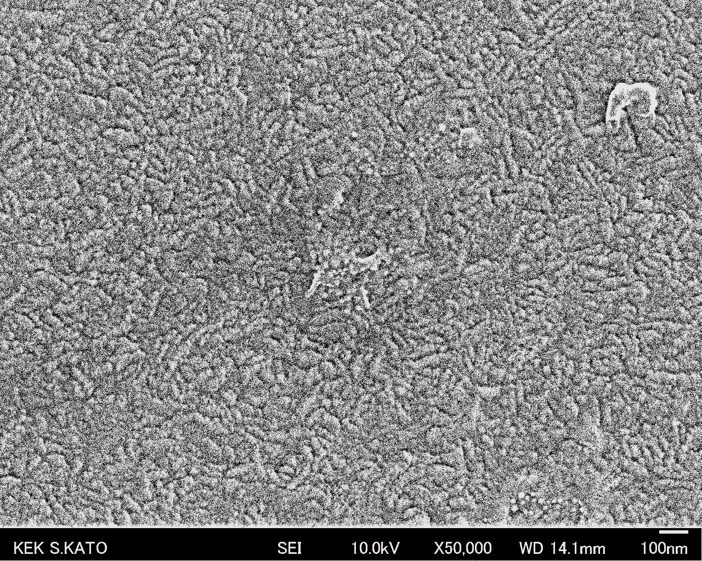
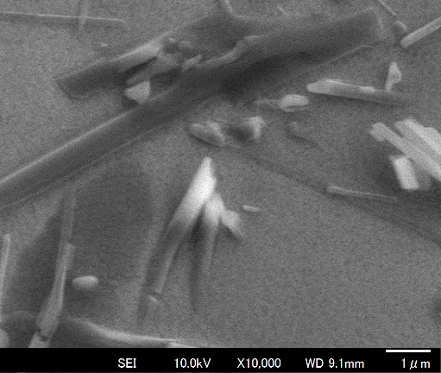
Far from perfect….
  Morphology
    Rough surface
    NbN 50 nm
    NbN 100 nm
    NbN 200 nm
    MgO needle ? (capping material)

Slide 27
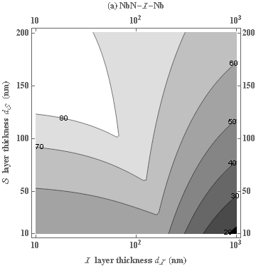
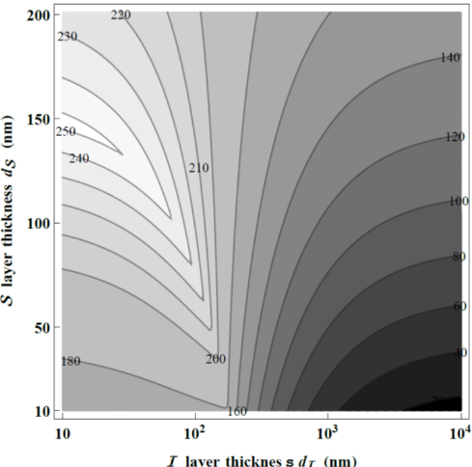
Comparaison with theory
  Theoritical predictions from T. Kubo (KEK)
x
x
Ideal Nb substrate with B_{C1}=170 mT
x
x
Nb with defects*, with B_{C1}=50 mT
* e.g. morphologic defects that allow earlier vortex penetration See SST paper cited earlier
x
x
x
x
x
x
x
x
  The enhancement of the field penetration increases with thickness of NbN
  It reaches a saturation at thicknesses > 100 nm

Slide 28
Comparaison with theory
  Theoritical predictions from T. Kubo (KEK)
x
x
Ideal Nb substrate with B_{C1}=170 mT
x
x
Nb with defects*, with B_{C1}=50 mT
* e.g. morphologic defects that allow earlier vortex penetration See SST paper cited earlier
x
x
x
x
x
x
x
x
  The enhancement of the field penetration increases with thickness of NbN
  It reaches a saturation at thicknesses > 100 nm

Slide 29
CLOSEUP OF 3rd HARMONIC SIGNAL
  For a given H_{appl}, we observe 3 ≠ transition temperatures
Phase signal
1
T~T
T >>T
3
    T~T: within noise level
    T >>T: dramatic transition
2
Voltage signal

Slide 30
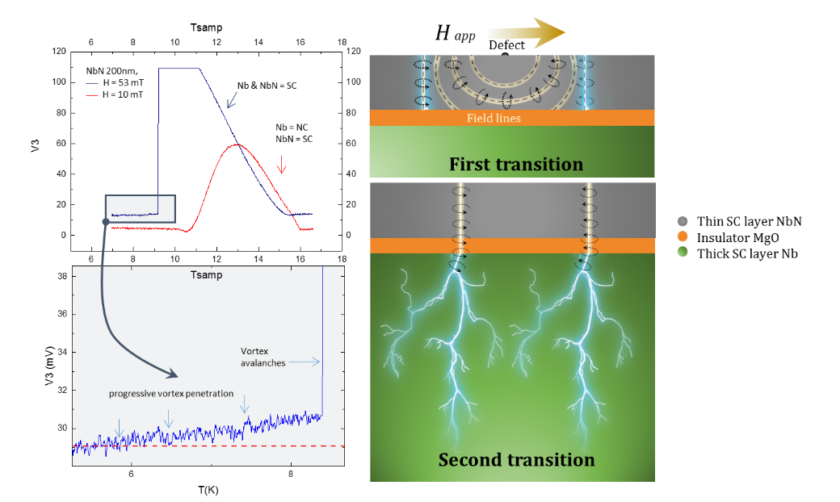
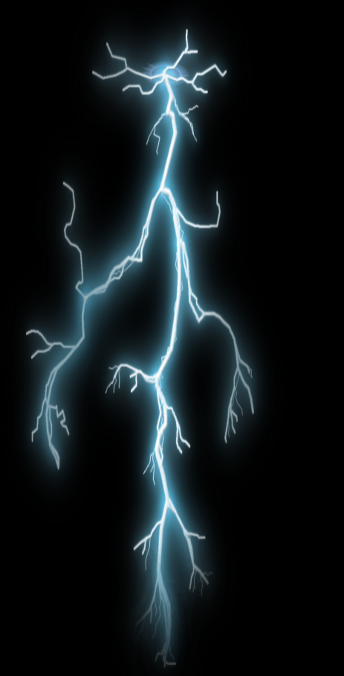
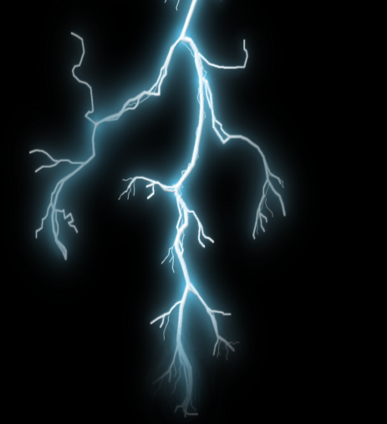
ROLE OF THE DIELECTRIC LAYER !
  Why do we have two transitions ?
H app
Defect
Thin SC layer NbN
Insulator MgO
Thick SC layer Nb
Field lines
First transition
      H // surface => surface barrier†
      A defect locally weakens the surface barrier
      1st transition, vortex blocked by the insulator ~100 nm => low dissipation.
      2nd transition, propagation of vortex avalanches (~100 µm) => high dissipation.
      Dielectric layer = efficient protection !!!
Second transition
†B. Bean and J. D. Livingston, Phys. Rev. Lett. 12, 14 (1964).

Slide 31
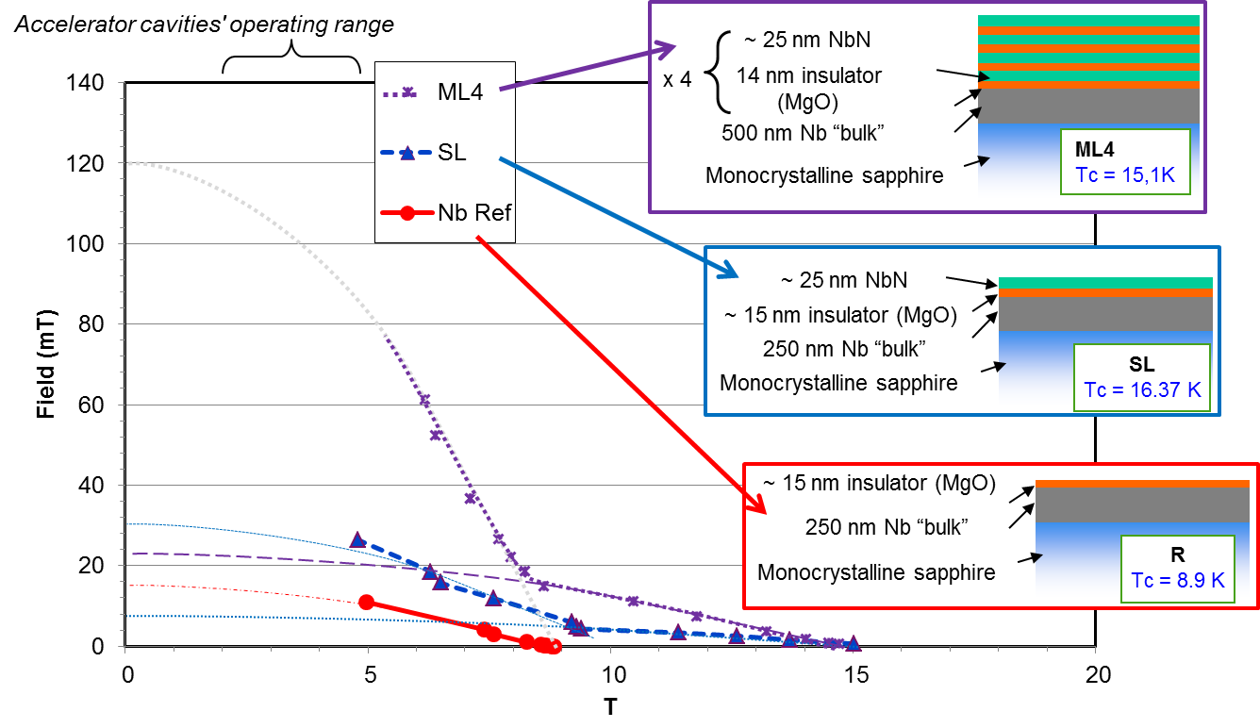
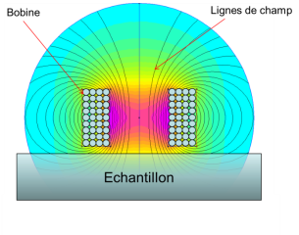
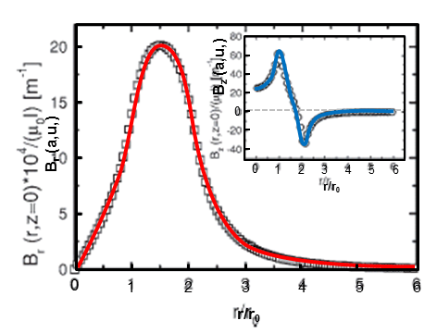
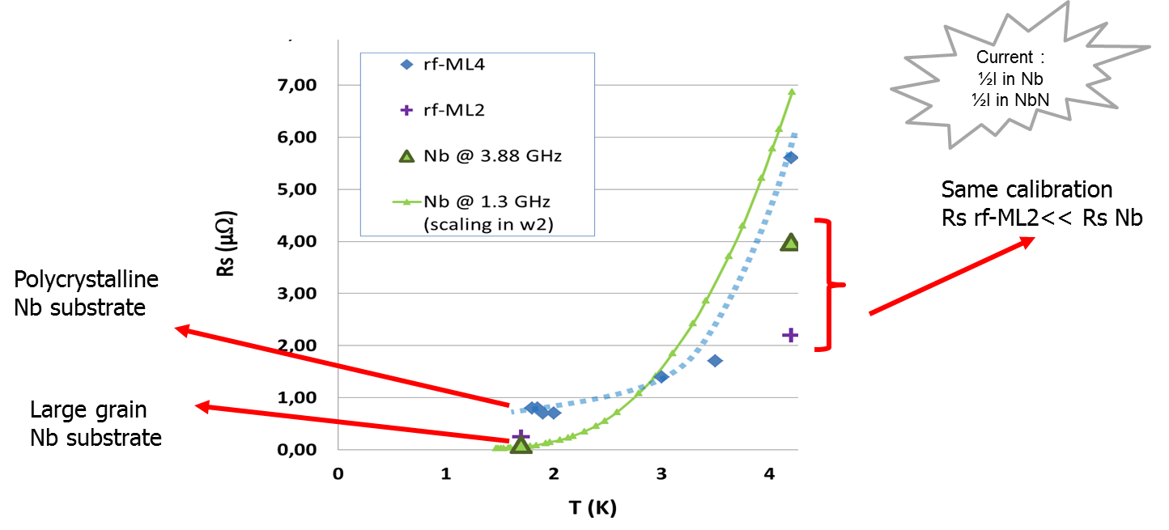
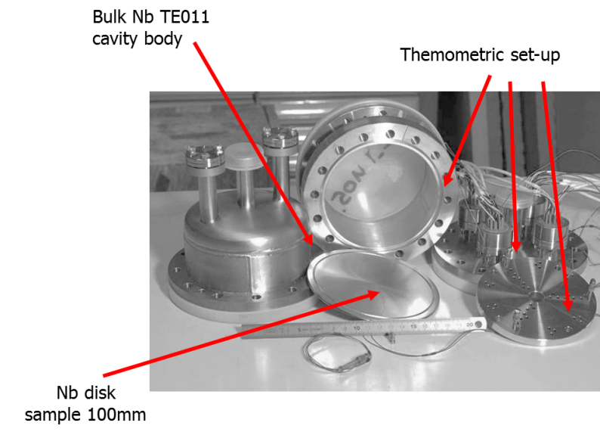
H_{C1} (E_{acc}^{max}) and R_{S} (Q₀^{max}) estimation
  Local magnetometry:
  RF test (collaboration IPNO)
Notes:
Pas possible de mesurer direct sur une cavité (on ne sait pas encore déposer de telles structures sur des formes complexes)
On mesure indirectement
Par magnétométrie : le champ de transition limite (donne une estimation du champ acc maximum)
Par cavité TE011 (5,88 GHz) : la Rs à bas champ (donne une estimation du Q0)
Magnétométrie : Les résultats au dessus de la ligne orange sont à prendre avec des précautions. On espère les confirmer avec les développements prévus cette année (bobine + petite ou échantillons plus grands)
RF La grande inconnue de ces multi couche c’était la résistance résiduelle qui aurait pu s’avérer monstrueuse et mettre tout par terre. Le premier échantillon, très rugueux présentait une résistance résiduelle seulement 5 fois plus grande que celle du Nb, le deuxième beaucoup + lisse est quasiment identique à celle du Nb . Dans ces échantillons la moitié du courant seulement passe dans les couches, l’autre moitié dans le Nb… on a donc bon espoir de faire beaucoup mieux

Slide 32
Dammage layer

Slide 33
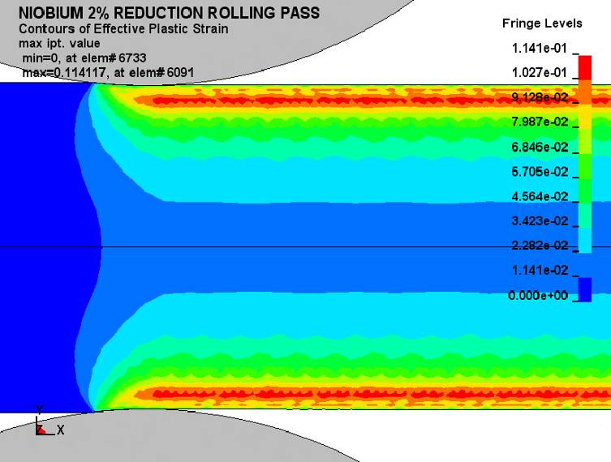
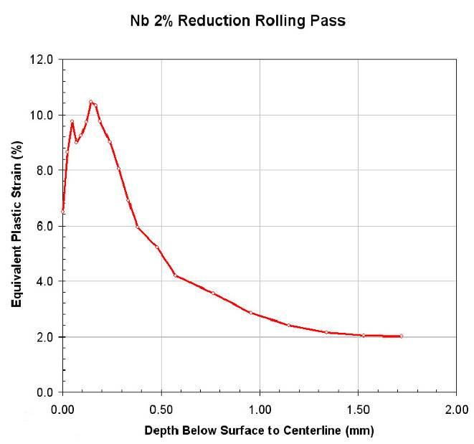
Damage layer / rolling
  High dislocation density (damage) incriminated in:
    Apparition of hot spots on operating cavities
    High density of hydride precipitates
    High sensitivity to trapped flux
  Damage layer seems to essentially originate from rolling
    Surface texture resistant to recrystallization
    Not fully eliminated after 150µm removal (patchy nature)
  Postulate :
    Strain left by forming and welding can be easily removed by recrystallization treatment
    => mechanical polishing of flat sheet easy and inexpensive !!!
NB : in case of billet slicing damage layer is ≠ and needs to be assessed
Finite element simulation of 2% reduction of 3.5 mm sheet with 1 cm diameter rolls (Courtesy Non-Linear Engineering, L.L.C.).
[R. Crook et al, Black Laboratory] &
http://accelconf.web.cern.ch/AccelConf/srf2009/posters/tuppo071_poster.pdf

Slide 34

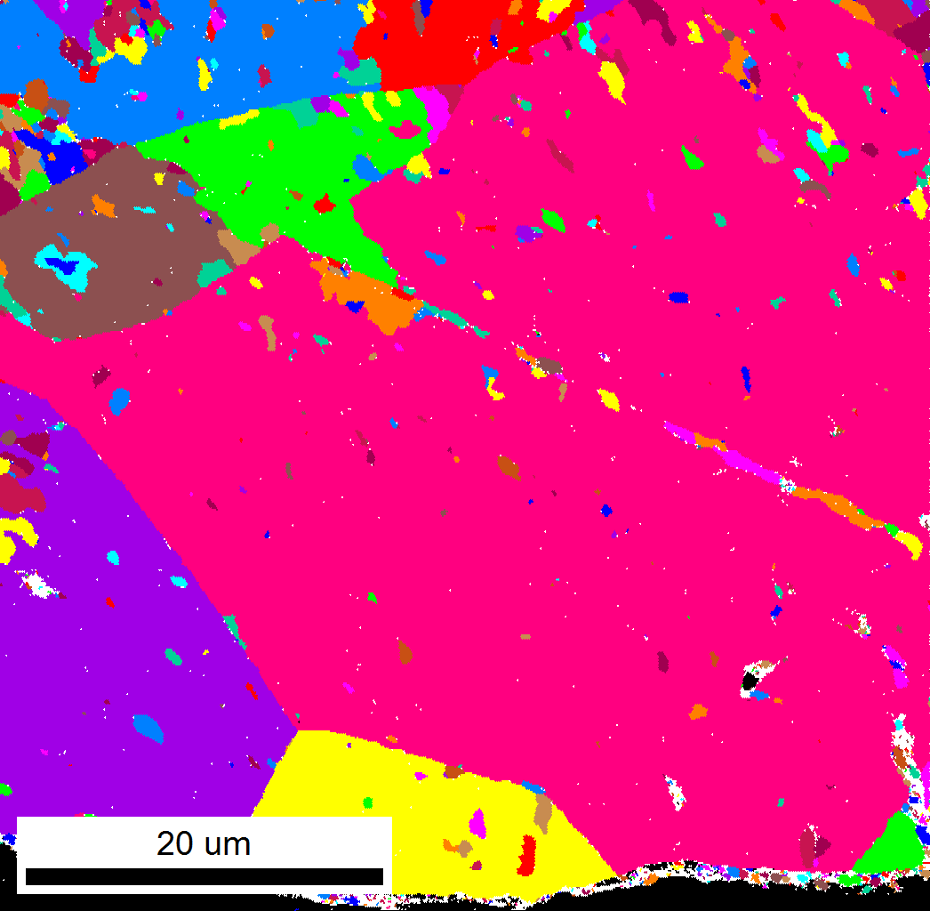
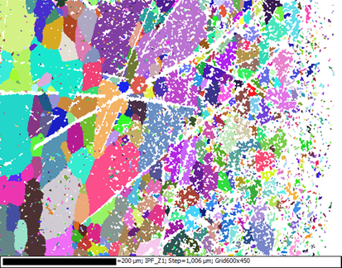
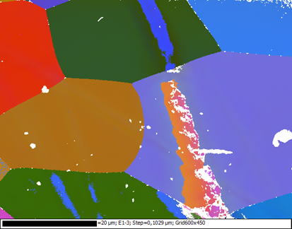

Damage as seen by electron diffraction
Surface of the sheet
New damage layer < 1µm
c) After forming
20 µm
200 µm
UGC
a) As received
b) After 2 steps polishing 20 + 25 min
(300 µm removed)
Core of the sheet
Polishing on flat surface is quick and easy.
Mechanical chemical preparation inspired from metallographic polishing can produce damage layer ≤100 nm
Notes:
Sheet cuts , prepared with metallographic polishing (5 steps, ⊥ damage <<100 nm)

Slide 35
Conclusion and outlook
  Production already asserted to produce specification
  Reducing cost R&D :
    Today limited to only 2 directions : large grain and N infusion
    Already promising
    Physics not fully understood => risks
  Longer term R&D
    Promising trails for improvement also exist
    better control of the material production is required

Slide 36
THANK YOU FOR YOUR ATTENTION

Slide 37
What do we measure ?
H = 7 mT
Determination of Hc1
  Low field => one transition
  High field => two transitions
    1st transition with low dissipation
    2nd transition very strong dissipation
Why do we have two transitions ?
H = 25 mT
1st transition
2nd transition
NbN 200nm

