Slide 1
The ILD detector: Design optimization and TPC R&D
Paul Colas

Slide 2
The ILD concept
Based on Particle Flow: reconstruct the event by matching calorimeter objects with charged tracks (use the most precise E-p determination, avoid double count between tracks and E objects
Continuous tracking (TPC) and highly segmented calorimeters
Optimize jet energy resolution .vs. B, R_{TPC} , ECAL cell size : 3.5T, 1.7 m or 1.4 m, 1cm or less (MIP subtraction)
Vertex detector for b and c hadron recon- struction (jet charge) : 4 µm resolution

Slide 3
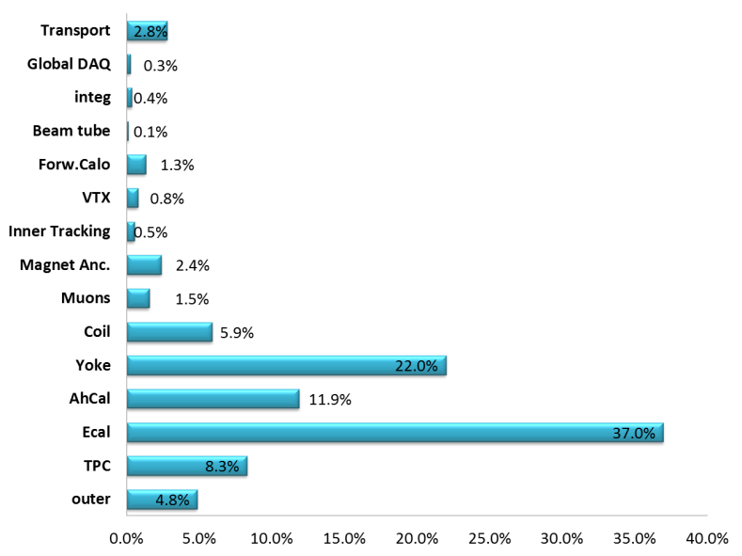
The ILD Group
Currently 68 groups signed up
Costing

Slide 4
The ILD Organization
Born from the fusion of GLD (mainly Asian) and LCD (mainly EU)
LOI in March 2009, ‘Detector Baseline Document’ in 2013
One spoke (Ties Behnke, elected in 2015)
One deputy spoke (Kiyotomo Kawagoe, nominated in 2016)
An Institute Assembly (68 members, one per institute)
An Executive Team
A Technical Board, chaired by the Technical Coordinator (Claude Vallée nominated in 2016)
A Physics Group (Physics Coordinator Keisuke Fujii)
A Software Group (Software Coordinator Frank Gaede)

Slide 5
The ILD Technical Organization

Slide 8
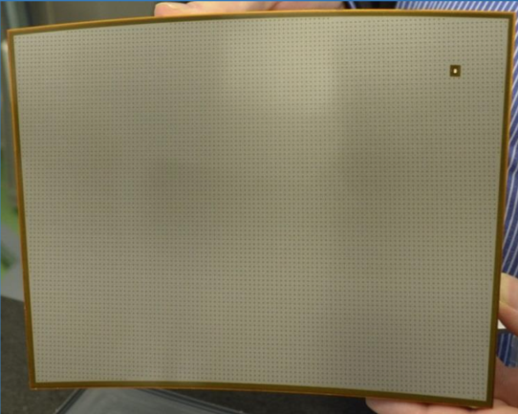
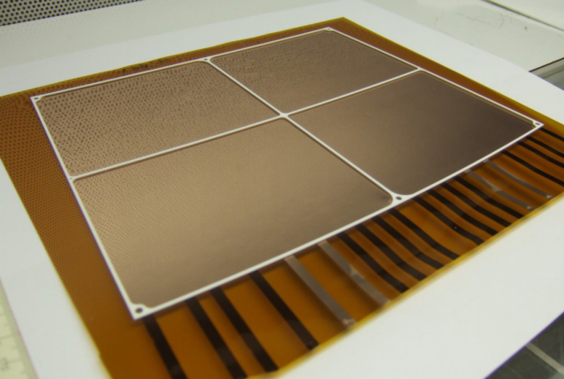
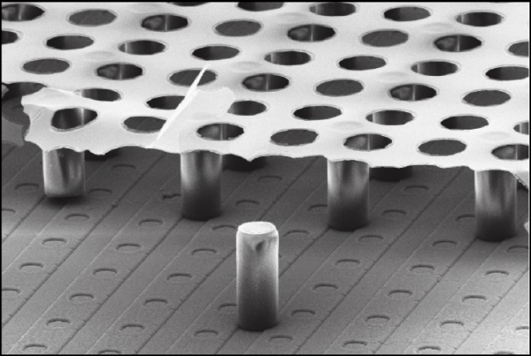
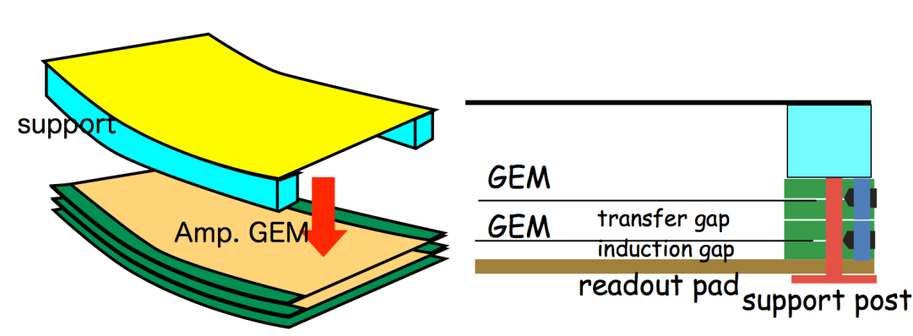
TPC Readout Technologies
MPGDs suffer less from ExB effects than MWPCs. They require less heavy mechanics. Panels with each technology have been made and tested.
Micromegas
European GEMs
Standard kapton triple GEM with ceramic spacers
Mesh on top of a
charge-dispersing resistive anode
GridPix
Asian GEMs
Integrated grid on 55 µ digital pixels

Slide 9
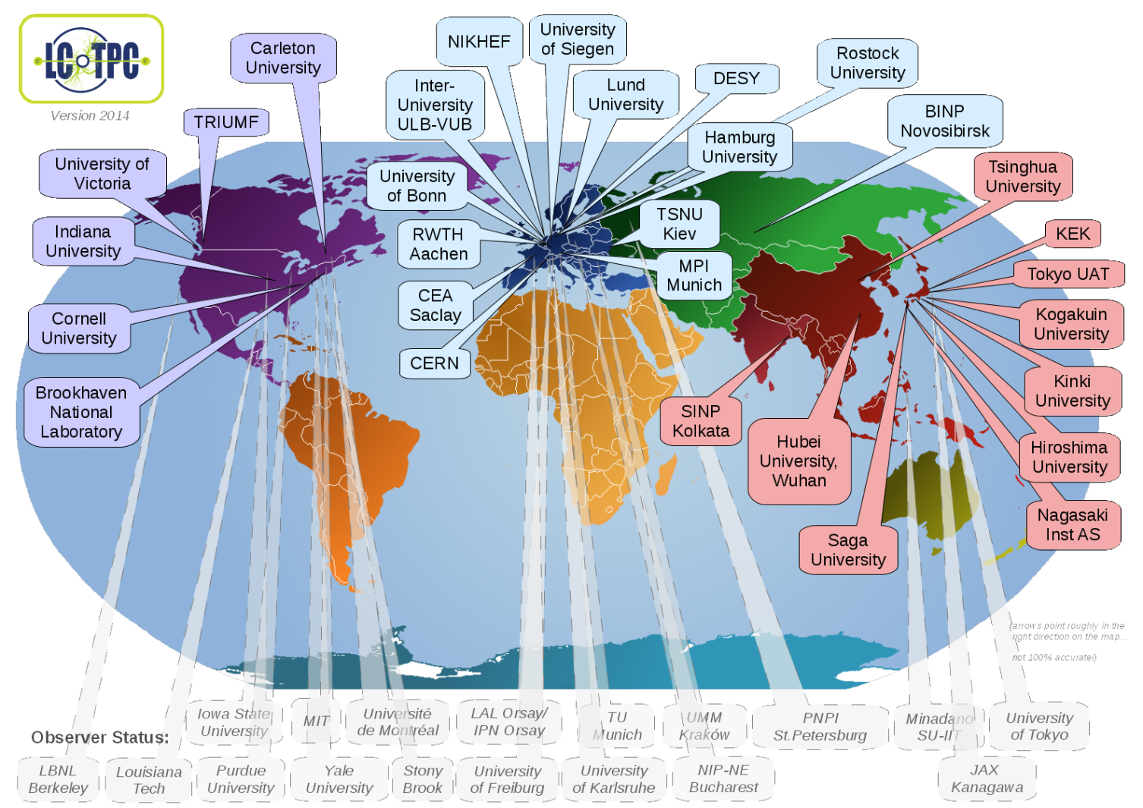
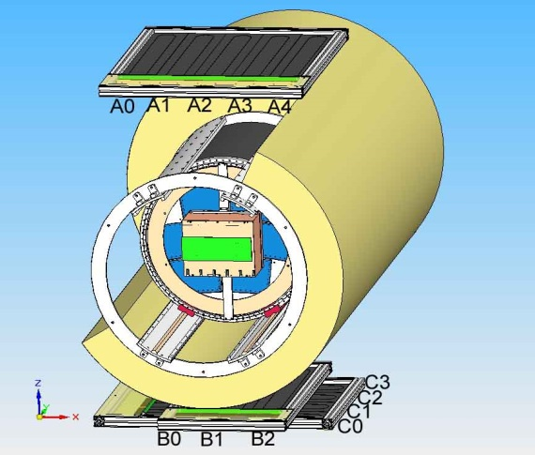
TPC R&D: The LCTPC collaboration and the DESY test setup
All the TPC R&D is gathered.
www.lctpc.org
The collaboration shares a test facility
(Field cage, magnet, endplate, cosmic-ray trigger, ancillaries)
Allows testing/comparing several technologies/ideas with cost-awareness

Slide 10
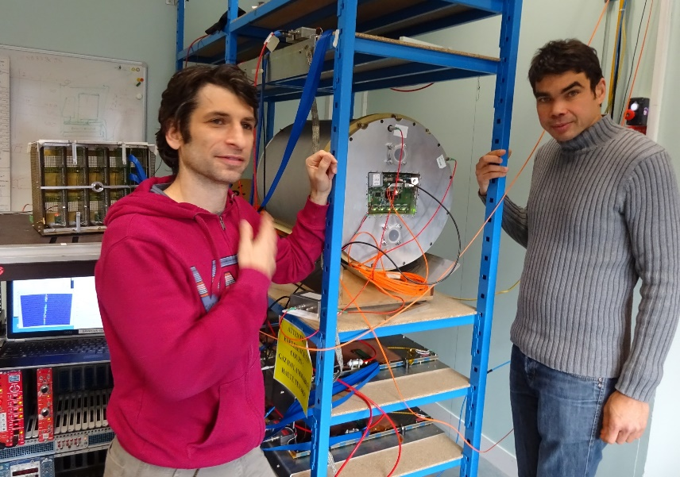
Beam and cosmic-ray tests
Beam test in DESY magnet
Cosmic-ray test at Saclay

Slide 11
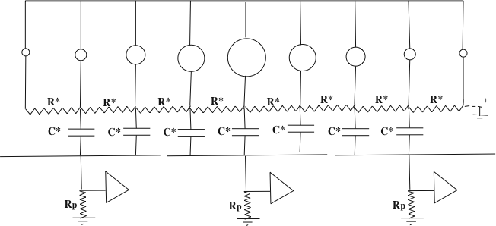
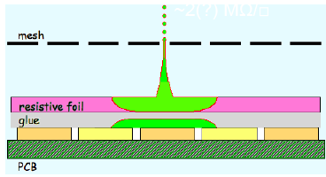
Charge spreading by resistive foil
Resistive coating on top of an insulator: Continuous RC network which spreads the charge: improves position sensitivity
M. Dixit, A. Rankin, NIM A 566 (2006) 28
Various resistive coatings have been tried: Carbon-loaded Kapton (CLK), Diamond-like Carbon (DLC) and resistive ink (3-5 MΩ/sq)
In addition the resistive foil suppresses sparks.

Slide 12
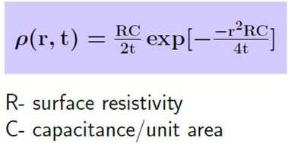
Charge spreading by resistive foil
Gaussian spreading as a function of time with σ_{r} = sqrt(2t/RC)
t~shaping~few 100 ns
RC = 180 R(MΩ) /(d/175µ) ns/mm²
For R= 2 Mohm/sq, shaping 200 ns, 200 µ insulation in addition to the 50 µm kapton, one obtains sigma = 1.3 mm
(For 0.2 Mohm/sq, we would have sigma= 3.16 mm)
M. Dixit, A. Rankin, NIM A 566 (2006) 28

Slide 13
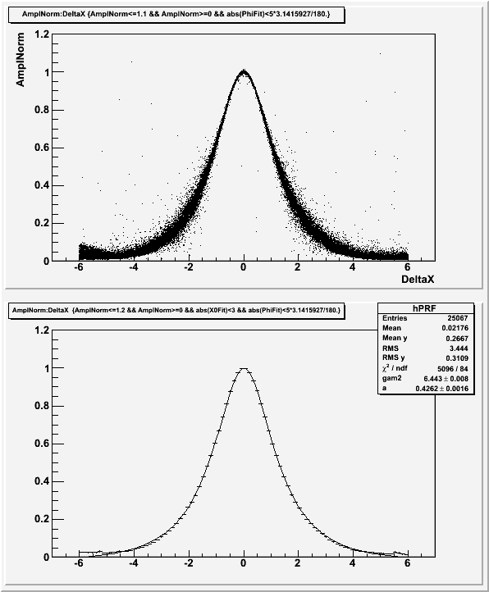
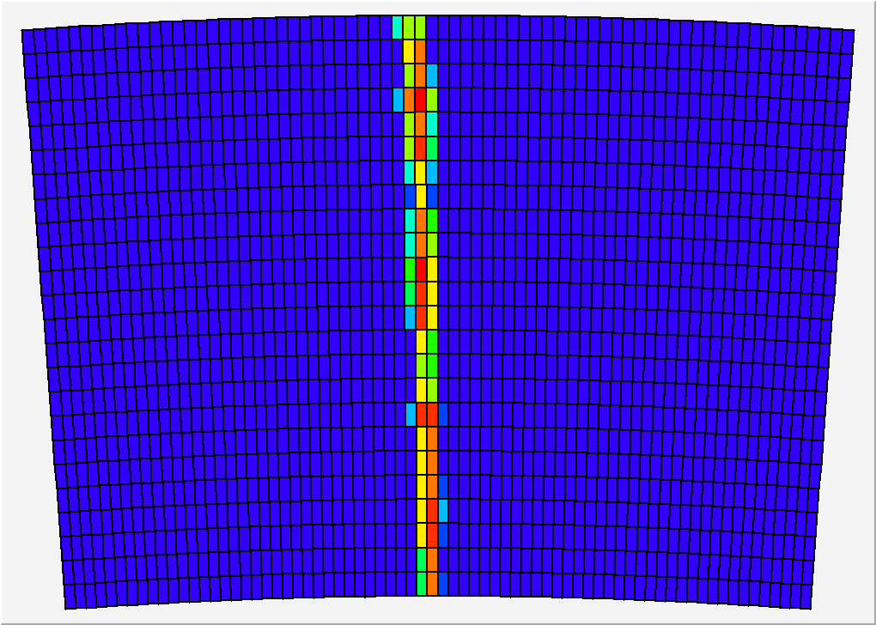
Pad response
Relative fraction of ‘charge’ seen by the pad, vs x(pad)-x(track)
Z=20cm, 200 ns shaping
24 rows x 72 columns of 3 x 6.8 mm² pads
x(pad) – x(track) (mm)

Slide 14
ENCAPSULATED RESISTIVE ANODE DESIGN
Spreading :
Resistive layer connected
to the guard ring with 28

Slide 15
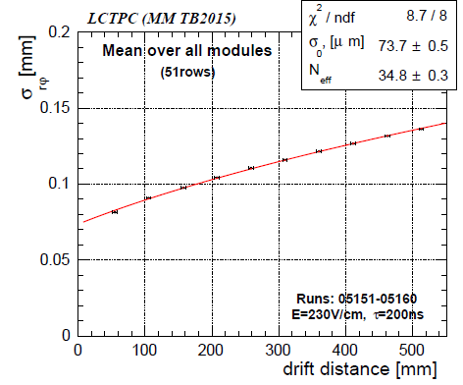
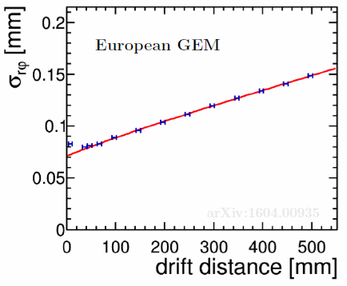
Results on resolution
All pad TPC technologies give similar results
(but with 3mm pads for MM and 1.2mm pads for GEMs)

Slide 16
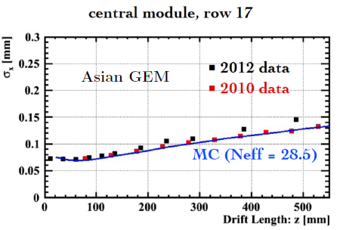
Results on resolution
All pad TPC technologies give similar results
(but with 3mm pads for MM and 1.2mm pads for GEMs)

Slide 17
S. Voronov, M. Zito, PC
dE/dx resolution of a resistive-anode TPC
OK for T2K2
OK for ILD TPC : 5.0%

Slide 18
TPC design and integration :electronics integration
D. Calvet et al., IEEE trans.

Slide 19
TPC design and integration : mechanical integration
Deformations under weight and inner pressure
M. Carty, P. Manil et al.
Resuming : Zhihong Sun et al.

Slide 20
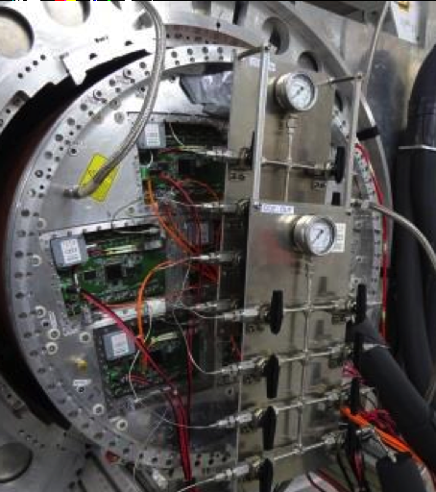
TPC design and integration : 2-phase CO₂ cooling
Advantages:
Specific heat 4 x water
Latent heat for evaporation : 80 x water
Boiling point at room temperature at 60 bar
Inexplosive, non-conductive, vapors instantly at 1 atm.
Tested in our test beam in 2014 and 2015

Slide 21
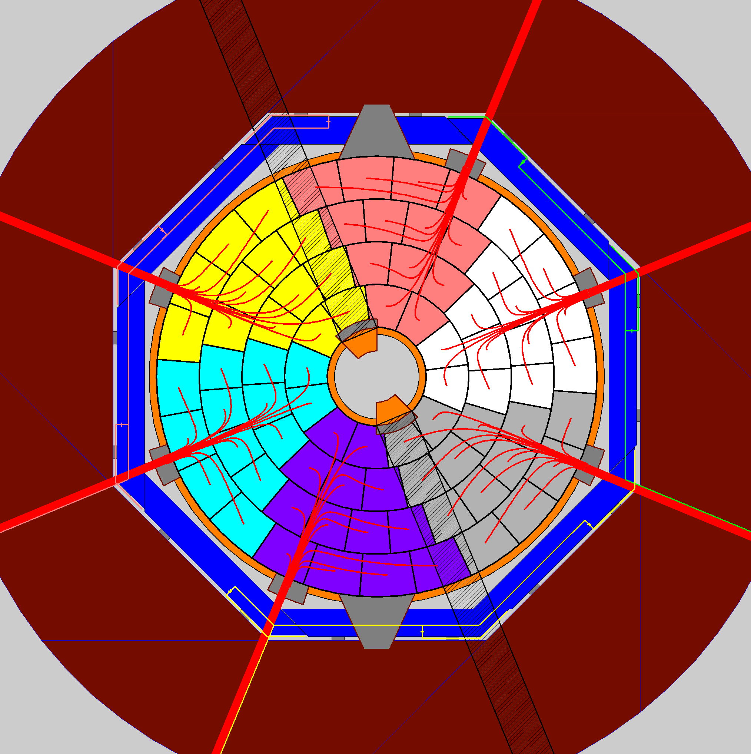
Cables, services, power consumption,…
All details are written in a TPC Interface Control Document.
Serious issues from push-pull operation.
Ion back-flow, Gating
IBF naturally suppressed in Micromegas. However a gating might be necessary, under study.
One possibility demonstrated: large opening GEM, could be integrated to the modules.

Slide 22
Conclusions
The ILD collaboration is coming to life
Proof-of-principle of a Micromegas TPC done (GEMs have similar performances, the difference will be in complexity/reliability)
Getting ready for the technology choice (S. Ganjour, K. Fujii et al., TYL)
Solutions for integration demonstrated, but still lots of studies in progress to make the detector a reality
ILD members from Irfu:
ATTIE David; BERRIAUD Christophe; Besancon Marc; COLAS Paul; FOURCHES Nicolas; GANJOUR Serguei; Giomataris Ioannis; NAPOLY Olivier; SHARYY Viatcheslav; TITOV Maksym; Tuchming Boris;

