Slide 1
dE/dx measurements with resistive Micromegas
P. Colas, S. Suvorov, M. Zito

Slide 2
In T2K (neutrino long baseline experiment), the dE/dx is used to tell e from µ.
But this is at a few 100 MeV and a non-resistive Micromegas
Investigate effect of charge sharing on dE/dx, using our DESY test beam data.
K. Abe et al., ‘Measurement of the intrinsic electron neutrino component in the T2K neutrino beam with the ND280 detector’, Phys.Rev. D89 (2014) 092003

Slide 3
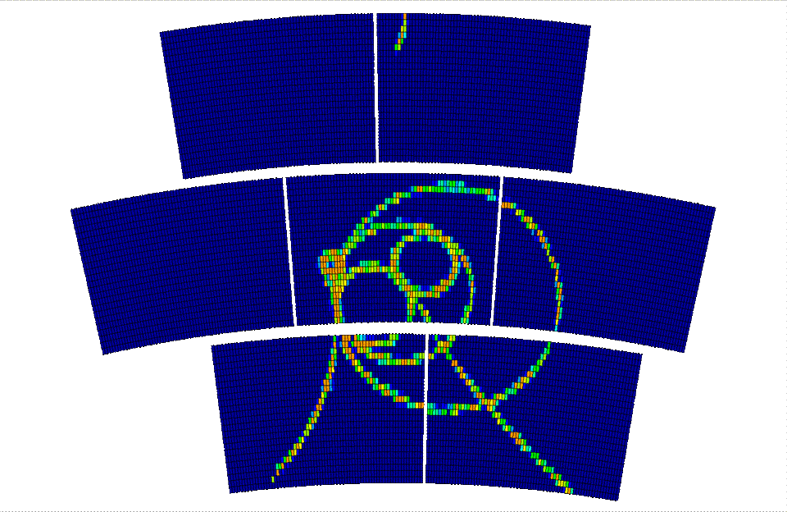
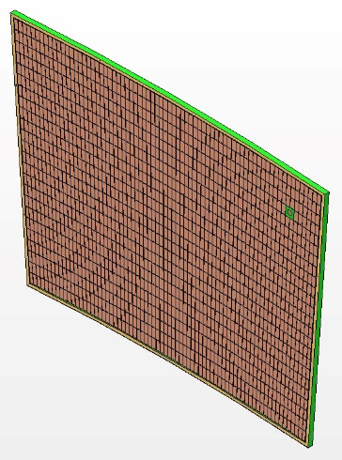
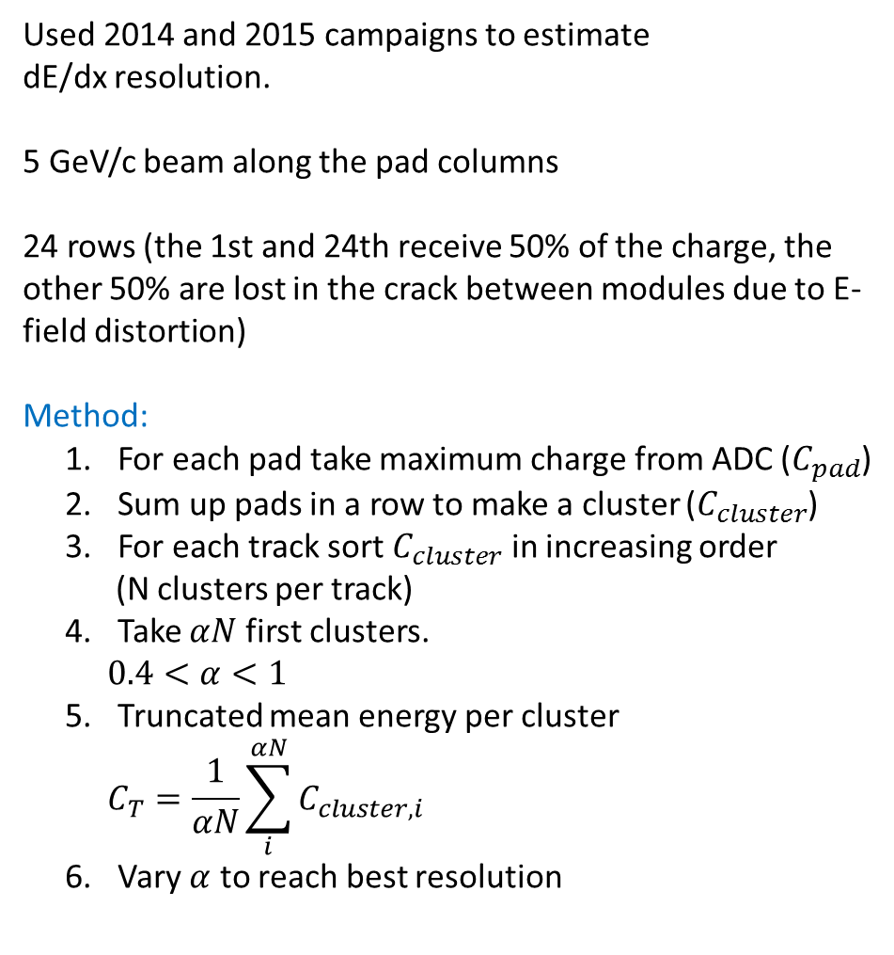
Used 2014 and 2015 campaigns to estimate
dE/dx resolution.
5 GeV/c beam along the pad columns
24 rows (the 1st and 24th receive 50% of the charge, the other 50% are lost in the crack between modules due to E-field distortion)
Method:
  For each pad take maximum charge from ADC ($C_{pad}$)
  Sum up pads in a row to make a cluster ($C_{cluster}$)
  For each track sort $C_{cluster}$ in increasing order
    (N clusters per track)
  Take $αN$ first clusters.
    $$0.4<α<1$$
  Truncated mean energy per cluster
    $$C_{T}=\frac{1}{αN}\sum_{i}^{αN}{C_{cluster, i}}$$
  Vary $α$ to reach best resolution
Data 2014
  middle module (mod 3) is extremely stable
  other modules show degradation in time
  strategy: make pseudo-long track from 8 different tracks crossing the middle module
Data 2015
  long tracks along all three modules can be used
  not all the pads can be used
  strategy: extract dead pads from the study

Slide 4
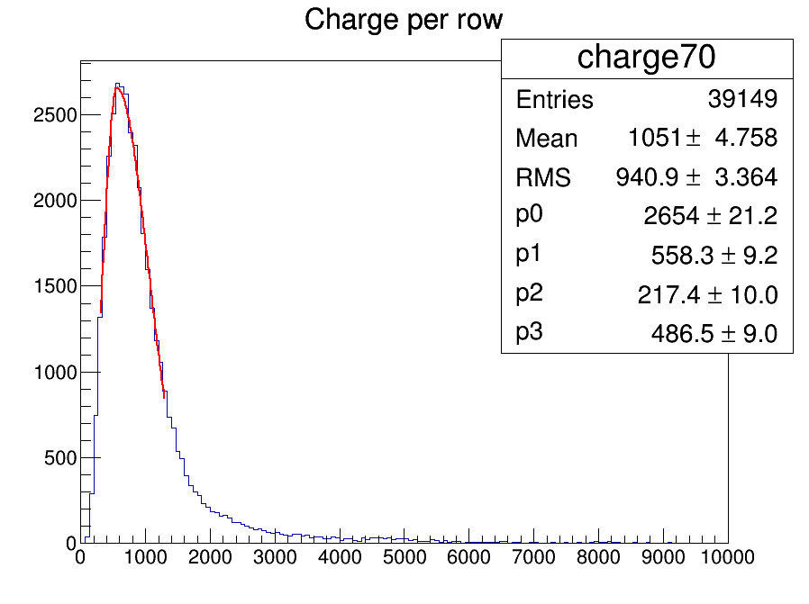
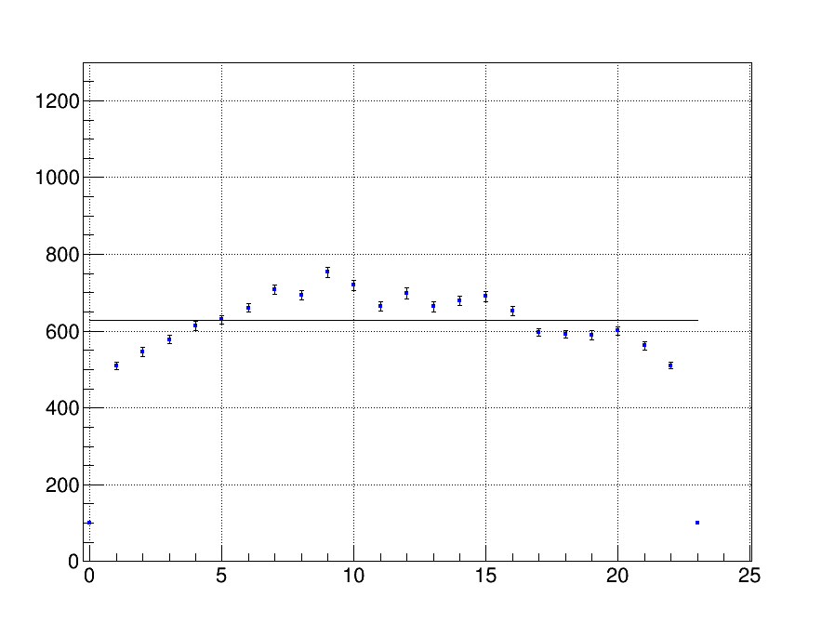
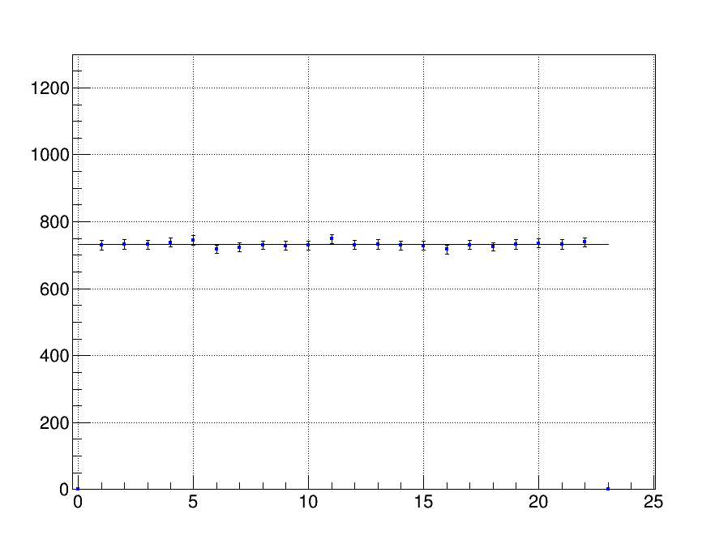
Calibration: equalize rows charge most probable value
Do not use 1st and 24th line (they receive only part of the charge), but count them as inefficient, to be conservative.
w/o calibration
w/ calibration
Most probable charge per row
row
row

Slide 5
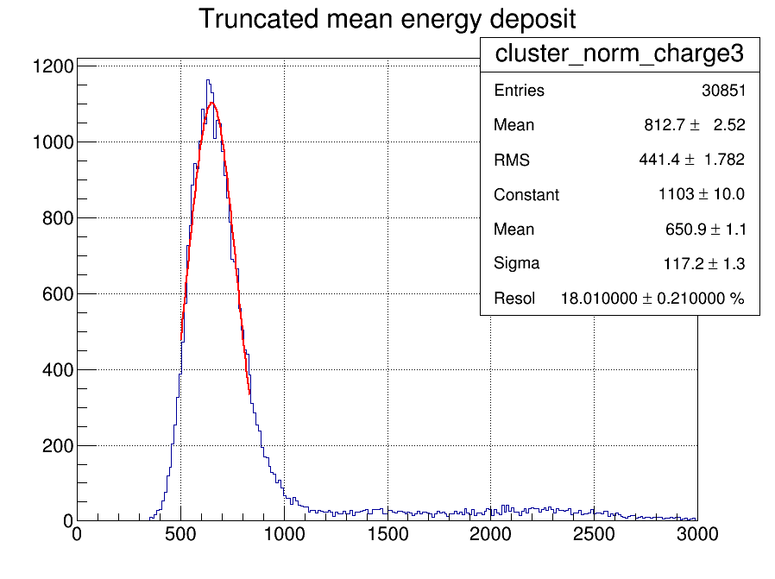
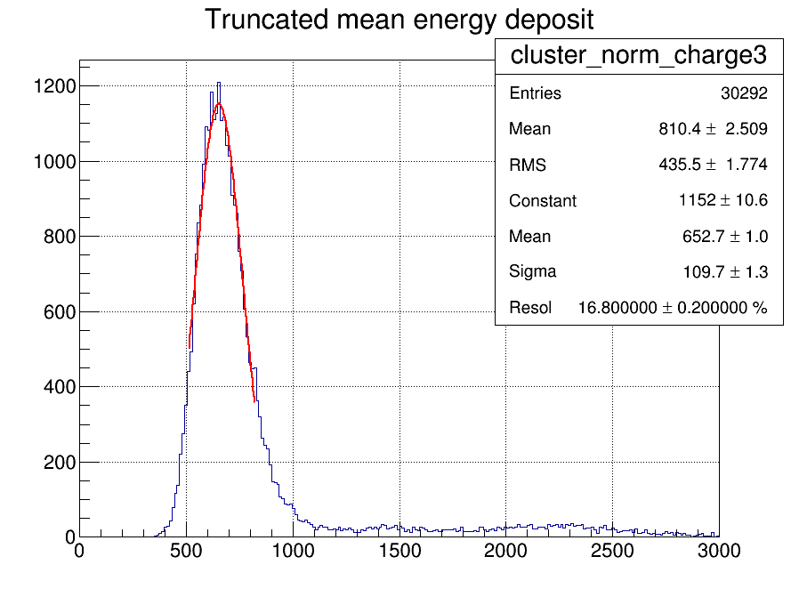
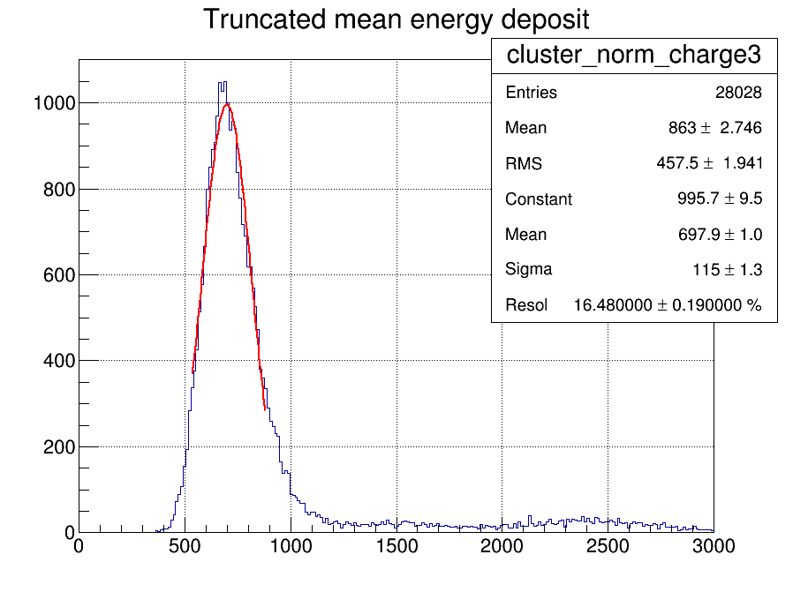
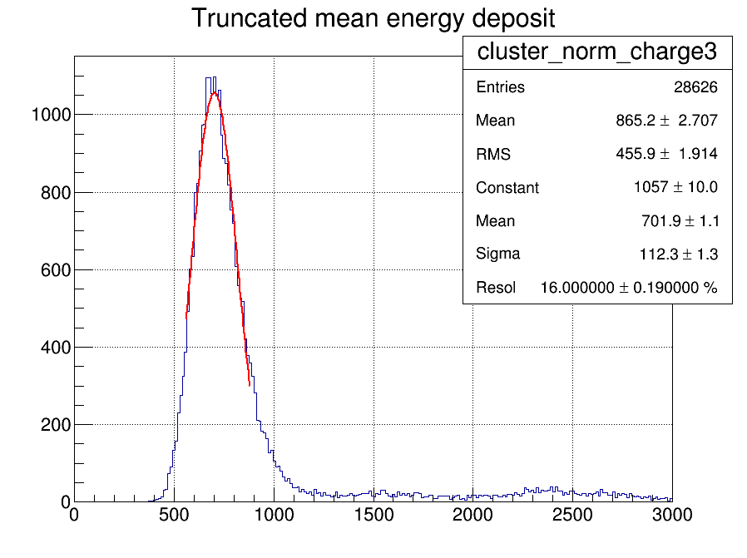
First check: 1 module 22 rows x 7 mm B = 0
w/o calibration
w/ calibration
E = 140 V/cm
E = 230 V/cm

Slide 6
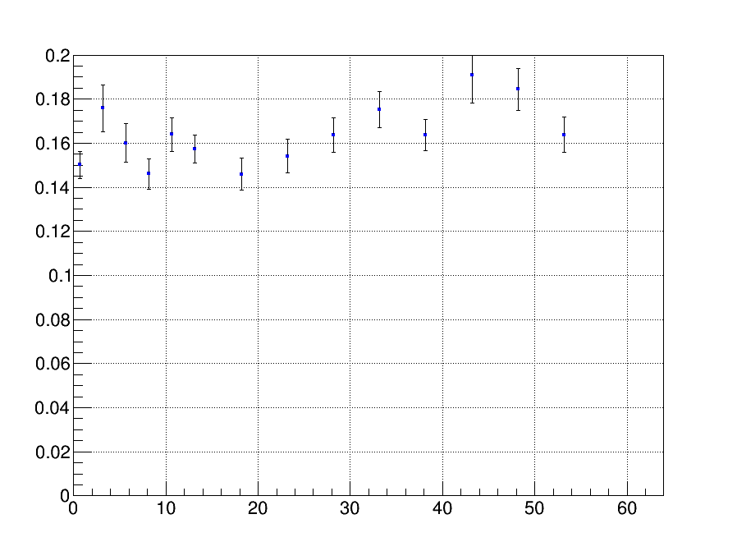
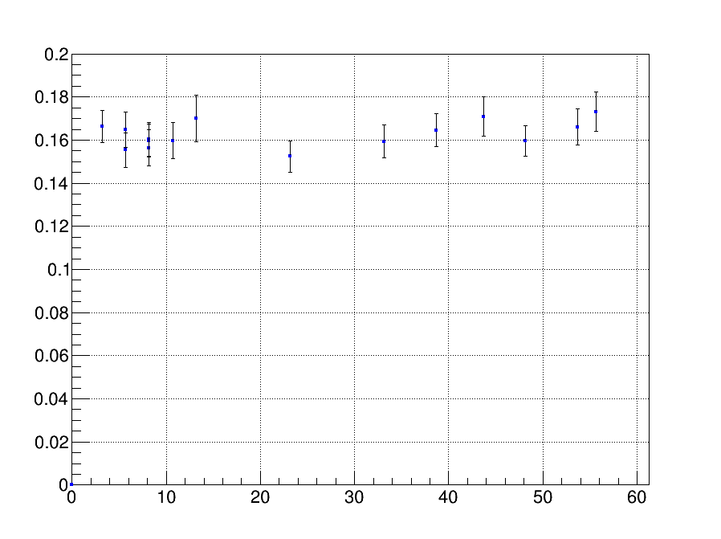
No significant dependence on drift distance observed (B=0 data)
Resolution
Drift, cm
Drift, cm

Slide 7
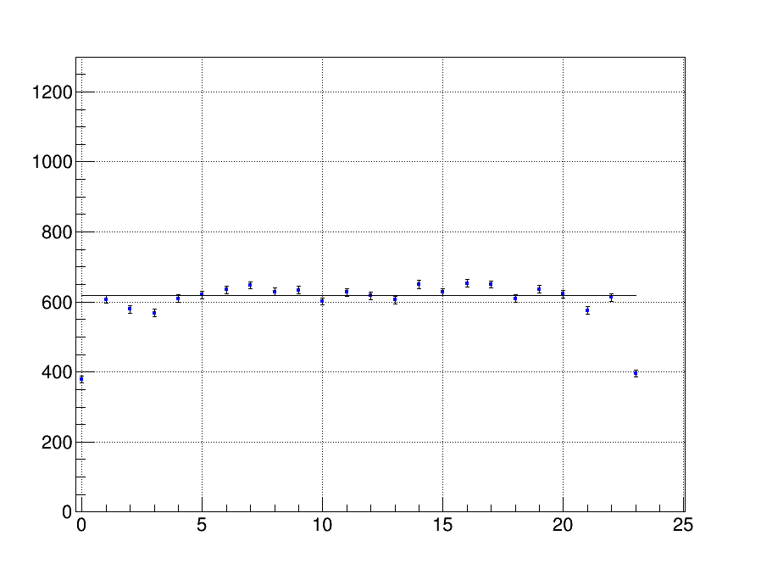
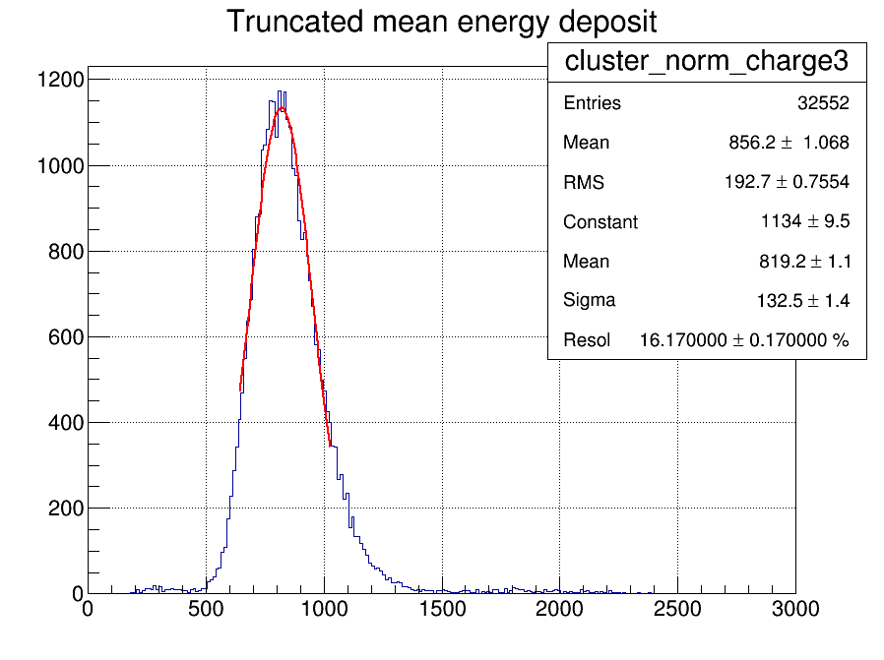
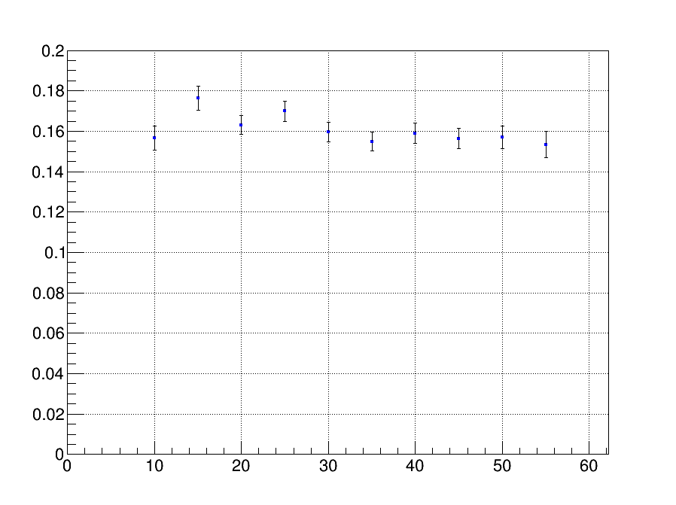
B= 1T Data
row
No dependence on drift distance observed
Drift (cm)

Slide 8
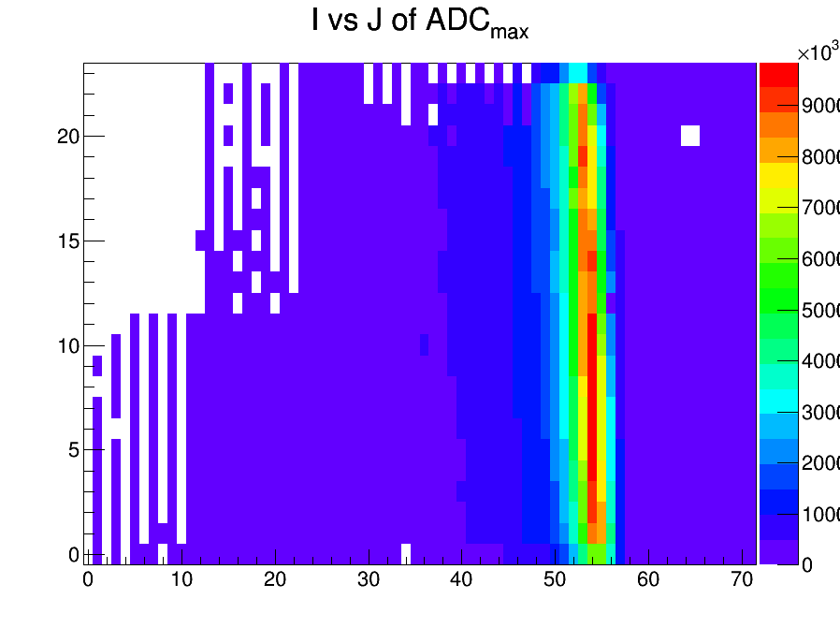
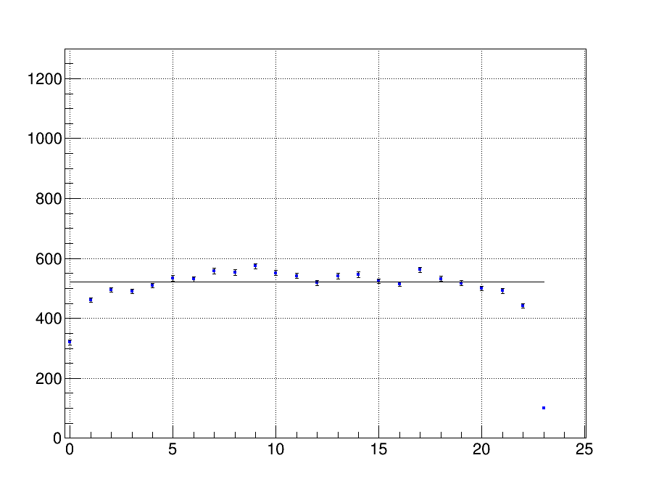
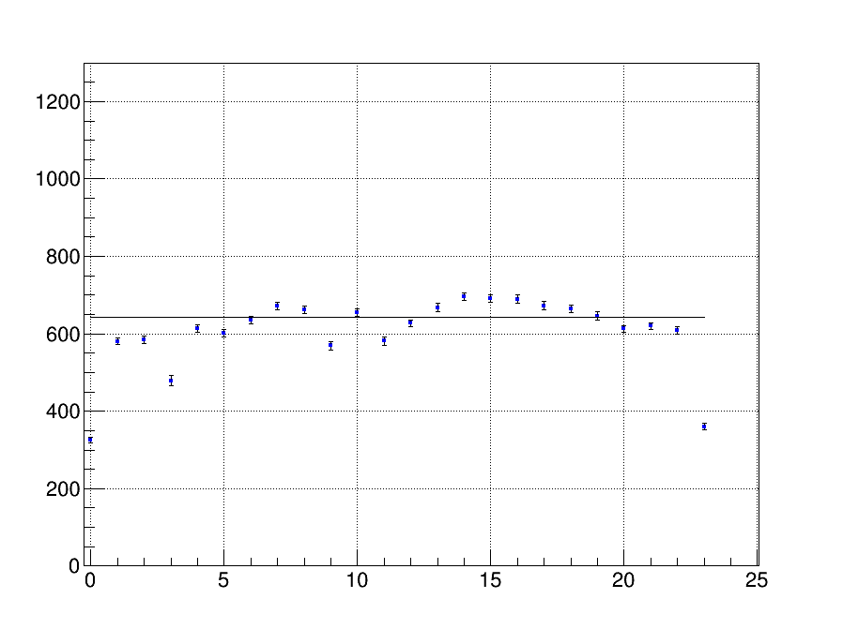
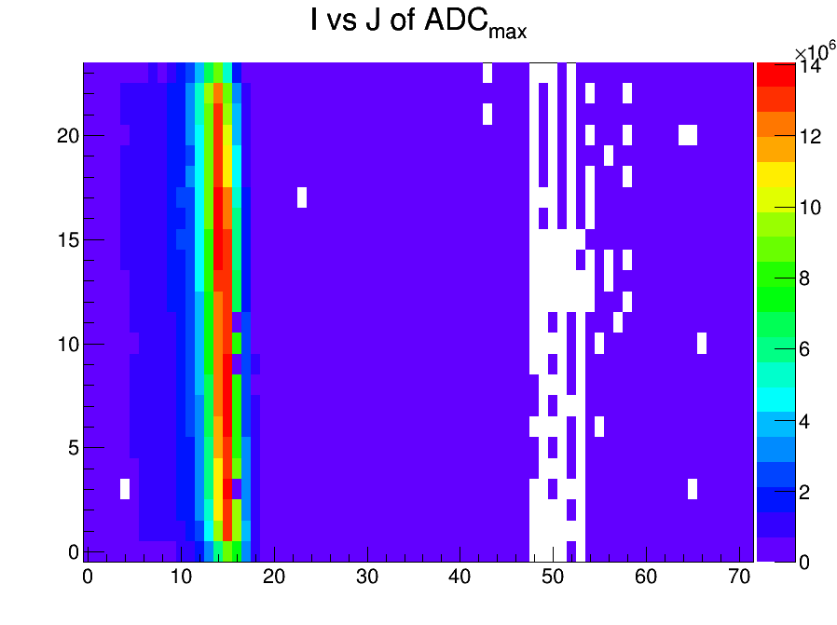
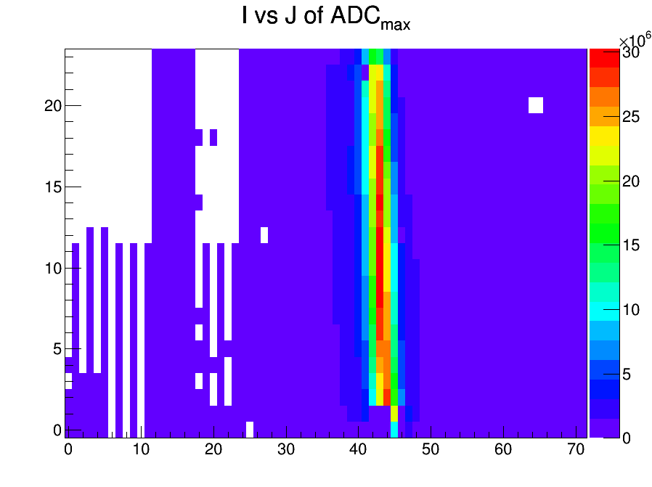
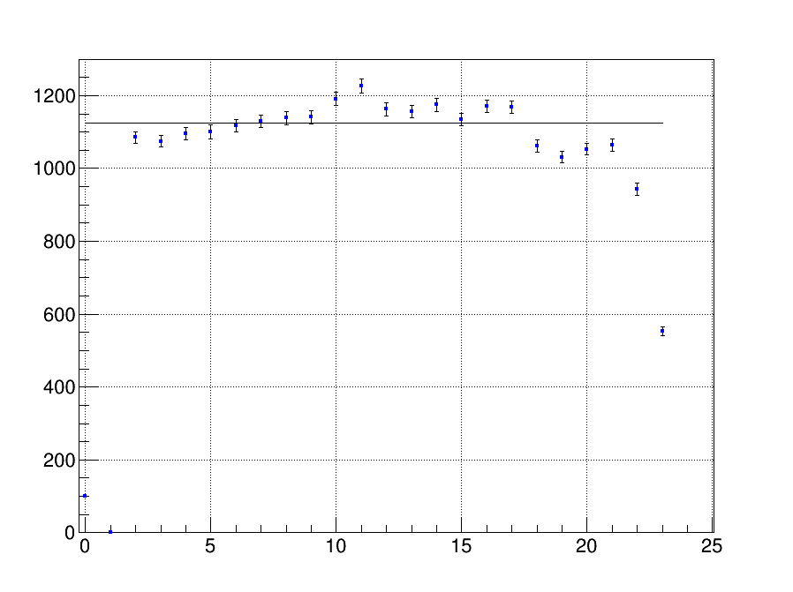
Charge per row
Data samples taken in 2015
Some pads were disconnected →
exclude them from PID study

Slide 9
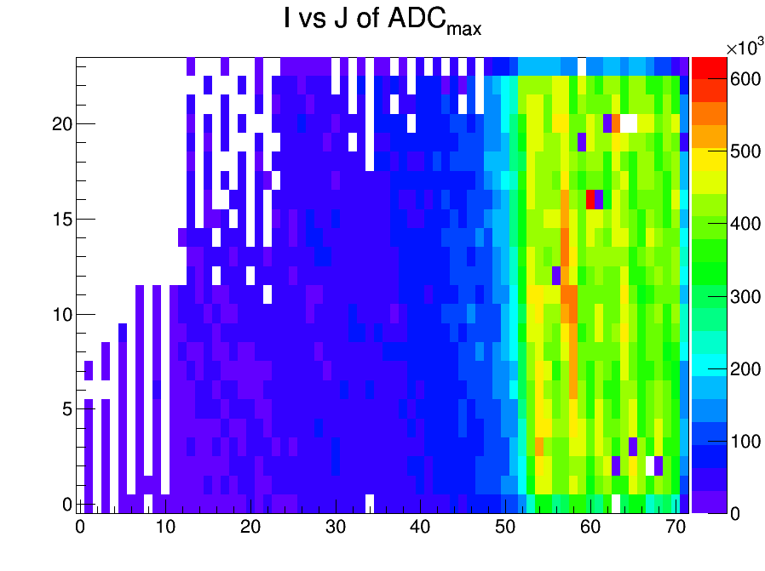
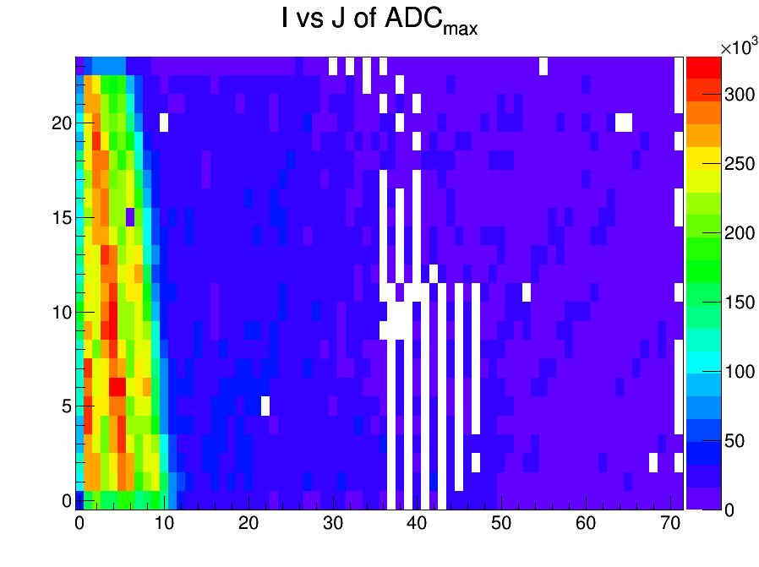
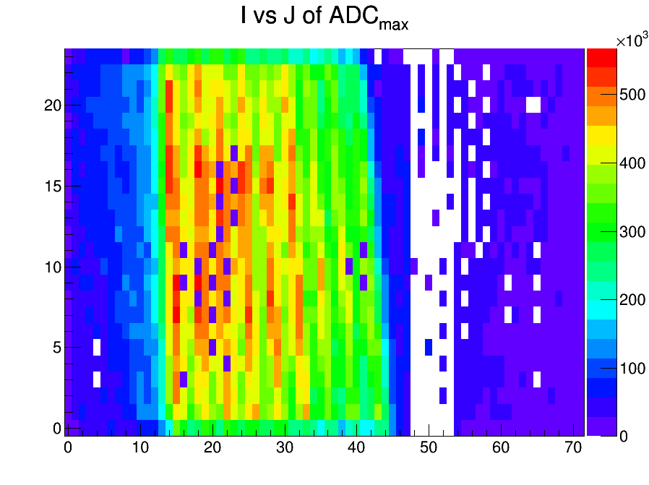
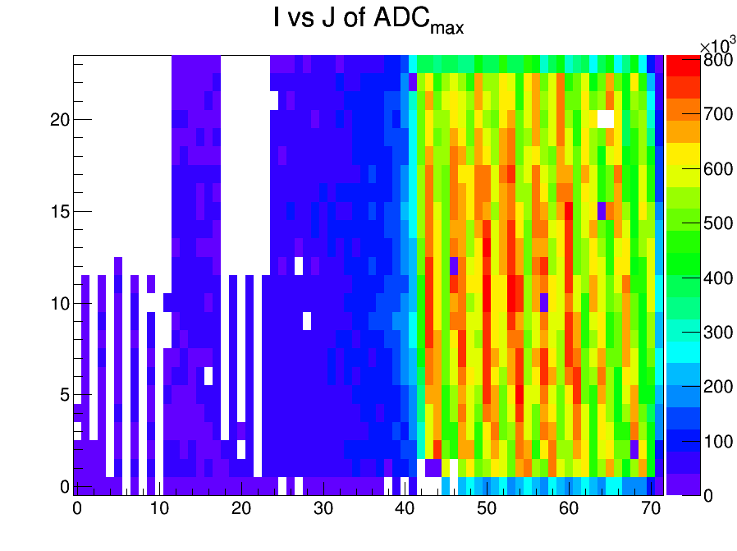
Cross check of the dead pads with the variation of the beam position
dead pads

Slide 10
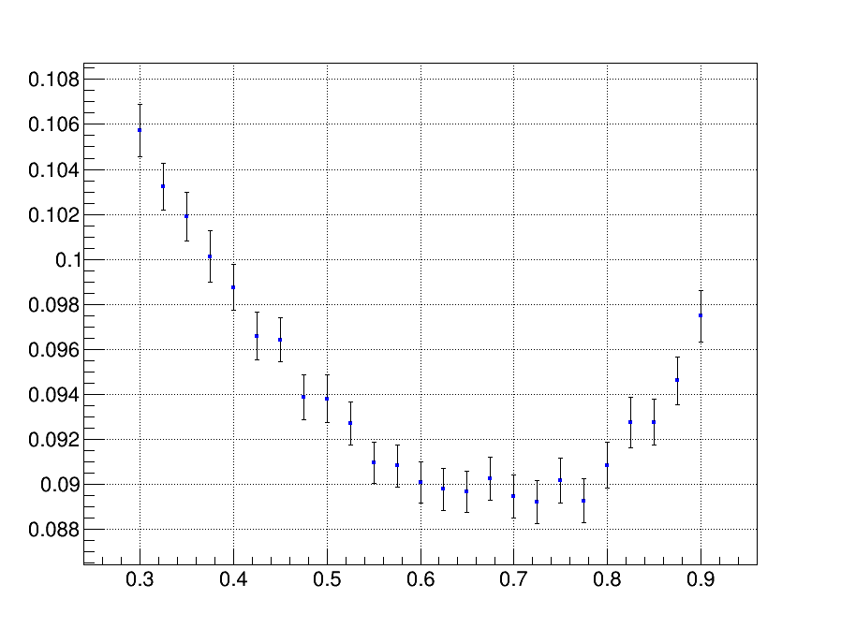
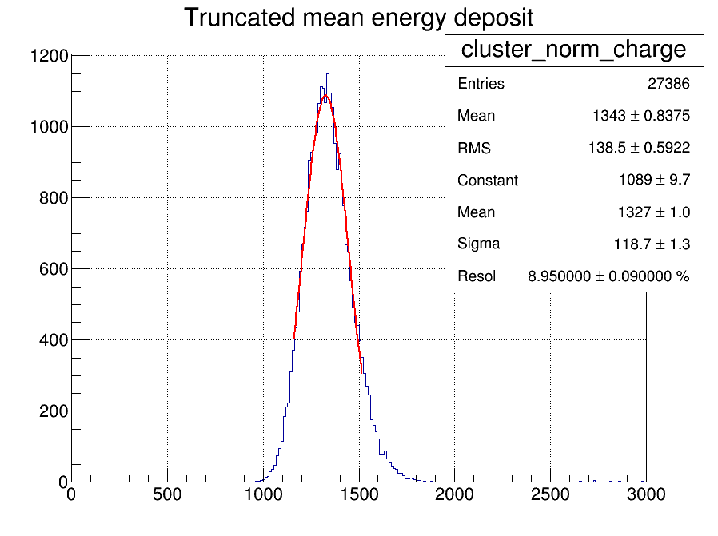


RESULTS
Apply multi-module selection (one long track across 3 modules)
Vary $α$ to reach the best resolution : $α$=0.7
Use 20+19+21=60 rows, 42.5 cm $8.95±0.09 \%$, which corresponds to $5.00±0.05 \%$,
dE/dx resolution
$$α$$

Slide 11
CONCLUSIONS
The dE/dx resolution for the ILD TPC track length (8 modules of 22 rows) is 5.0 %
-> no significant degradation by the resistive foil
Study the dependence of the resolution on the drift distance, energy, peaking time, was performed:
no dependence is observed
  230 V/cm field is slightly better than 140 V/cm
To be studied: correlation between rows (due to transverse diffusion or charge spreading) might increase the dE/dx uncertainty

