Slide 1




Measurement of ${\text{dE}}/{\text{dx}}$ Resolution with the DESY GridGEM Modules
Paul Malek
LCTPC Topical Analysis Meeting
Hamburg, 29.03.2018

Slide 2
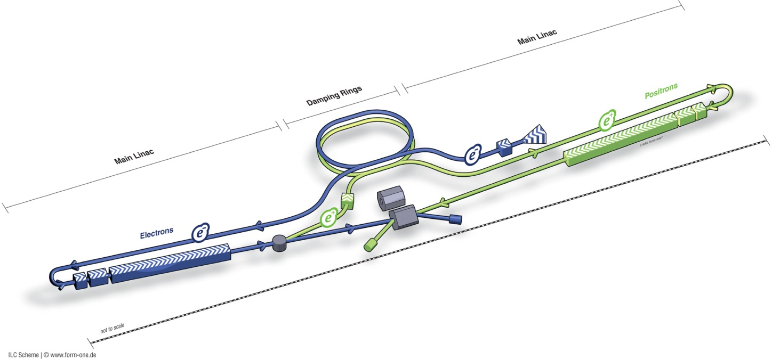
The International Linear Collider
ILC
Planned electron-positron collider
250 GeV center of mass energy first stage
Polarized electron & positron beams
Under political consideration in Japan

Slide 3
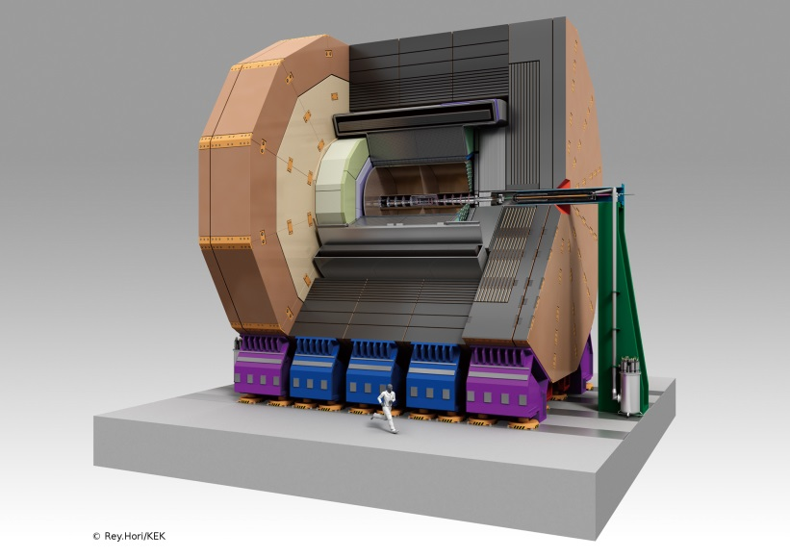
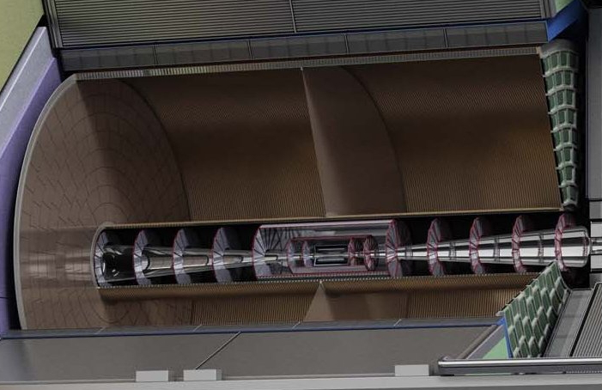

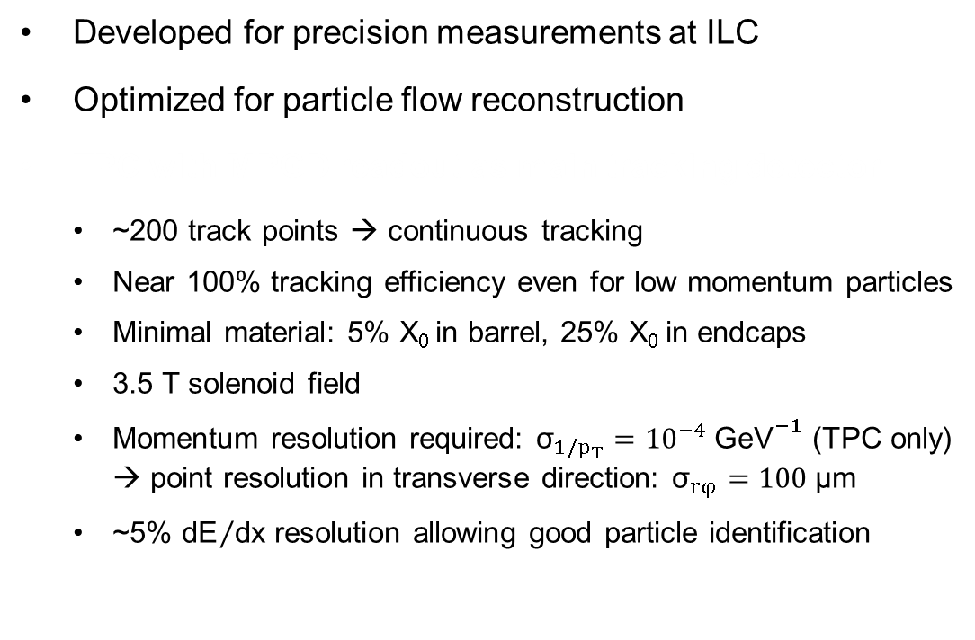
The International Large Detector
ILD
Developed for precision measurements at ILC
Optimized for particle flow reconstruction
TPC with MPGD readout as main tracking detector
  ~200 track points → continuous tracking
  Near 100% tracking efficiency even for low momentum particles
  Minimal material: 5% X₀ in barrel, 25% X₀ in endcaps
  3.5 T solenoid field
  Momentum resolution required: ${\text{σ}}_{1/p_{T}}={10}^{−4} {\text{GeV}}^{−1}$ (TPC only)
  → point resolution in transverse direction: ${\text{σ}}_{rφ}=100 \text{μm}$
  ~5% ${\text{dE}}/{\text{dx}}$ resolution allowing good particle identification

Slide 4
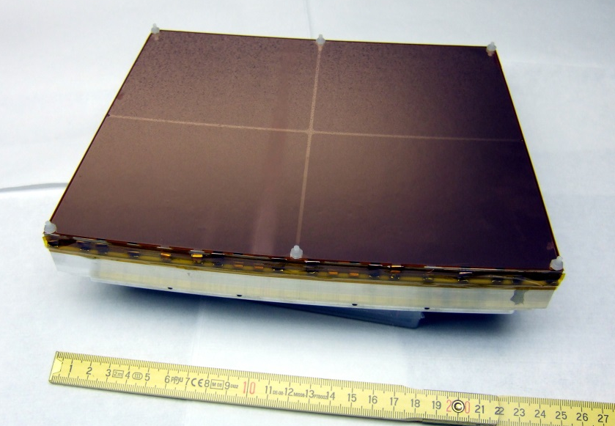
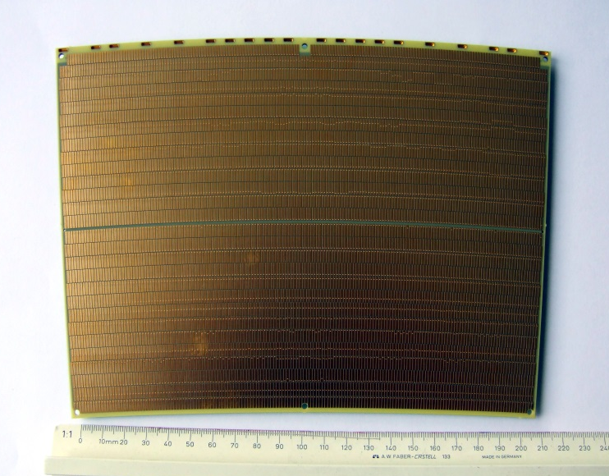
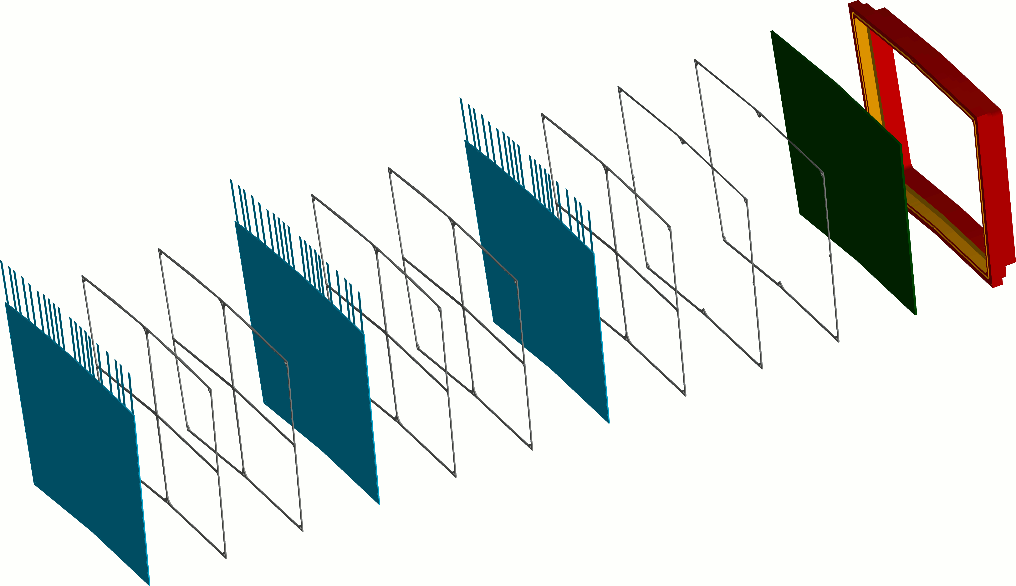
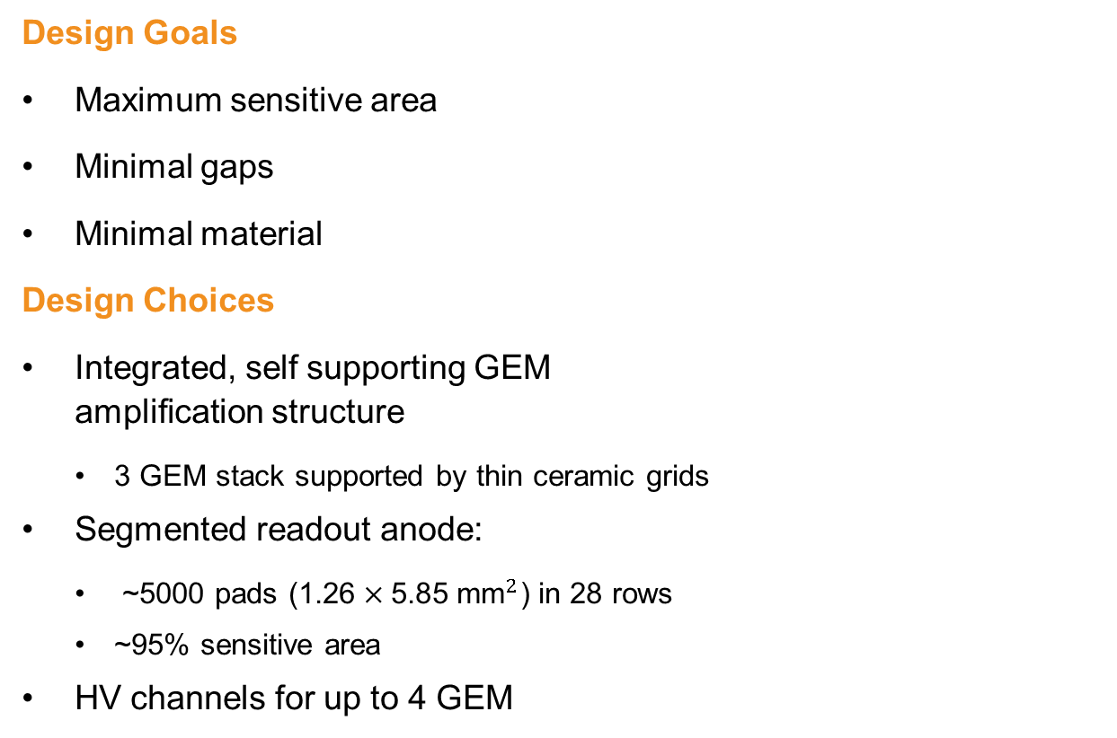
The DESY GridGEM Module
Design Goals
Maximum sensitive area
Minimal gaps
Minimal material
Design Choices
Integrated, self supporting GEM
amplification structure
  3 GEM stack supported by thin ceramic grids
Segmented readout anode:
  ~5000 pads $\text{(1.26}×\text{5.85} {\text{mm}}^{2}\text{)}$ in 28 rows
  ~95% sensitive area
HV channels for up to 4 GEM
164 – 182 pads
28 rows
ceramic
grids
aluminium
frame
anode
pad plane
GEM

Slide 5
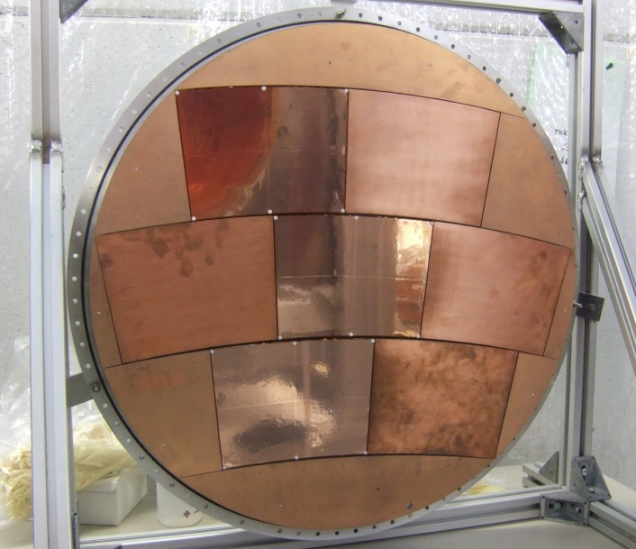
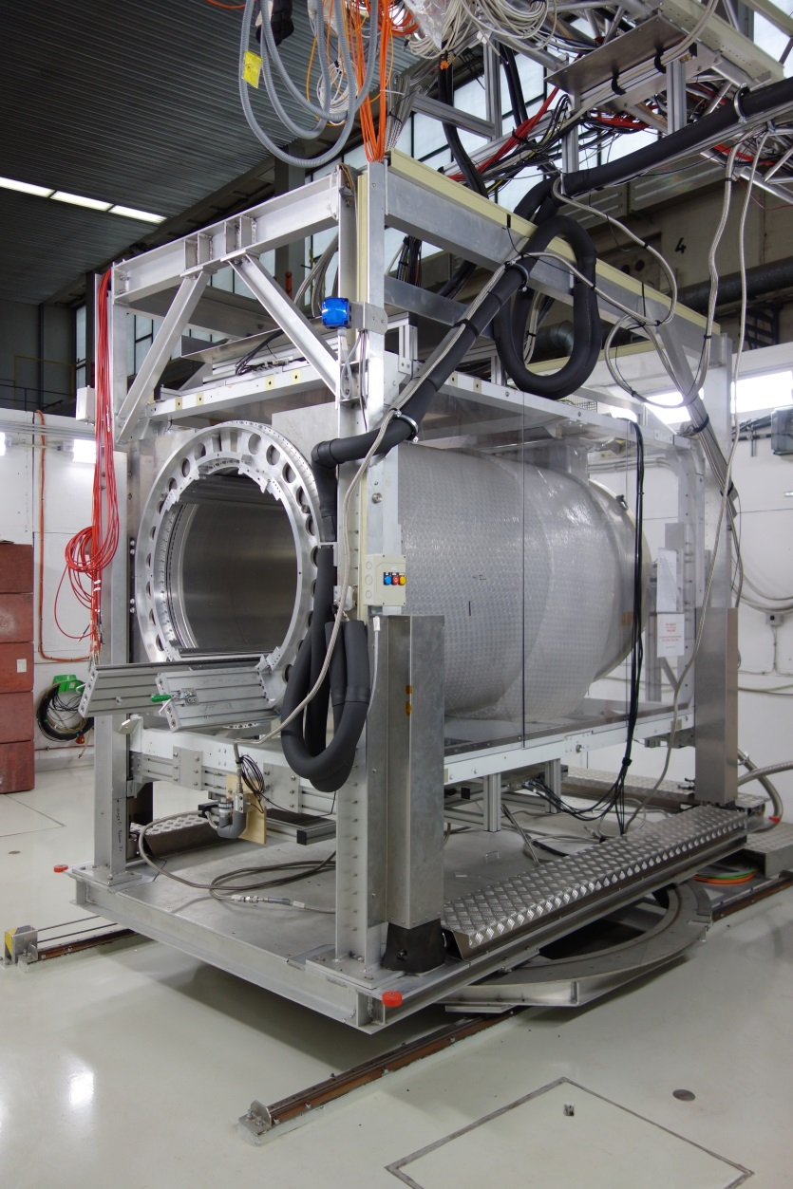
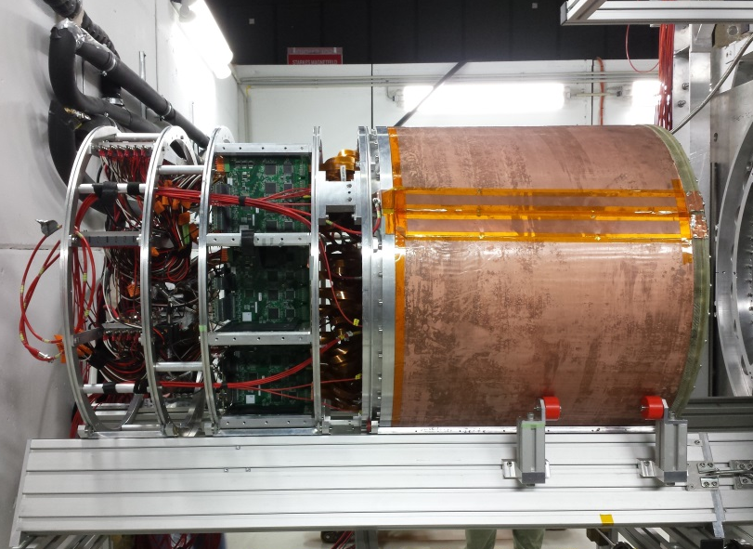
The LCTPC Setup at the DESY II Testbeam Facility
DESY II
1 GeV to 6 GeV electrons
PCMag
1 T superconducting solenoid
3-axis moveable stage
20% X₀ wall thickness
85 cm usable inner diameter
Large TPC prototype
75 cm diameter
57 cm maximum drift length
Endplate with space for 7 modules in 3 rows
e⁻
e⁻
3-axis movement

Slide 6
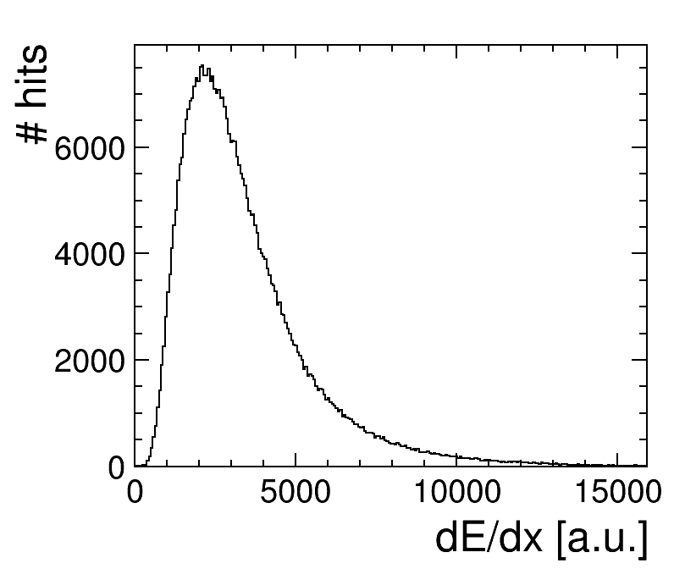
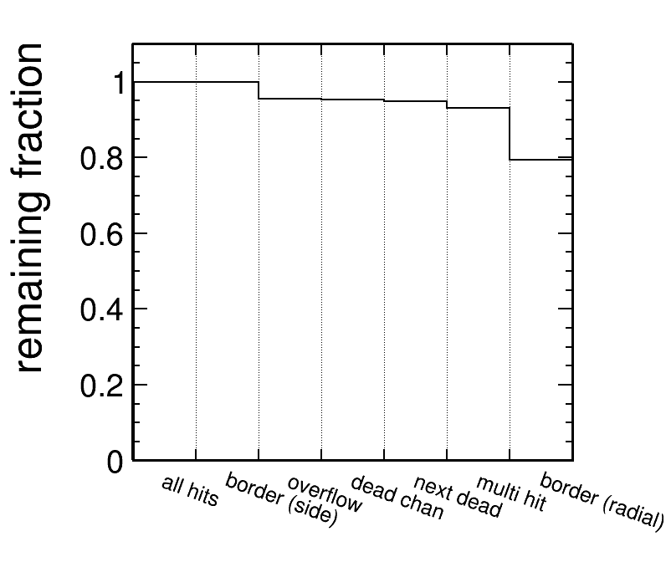
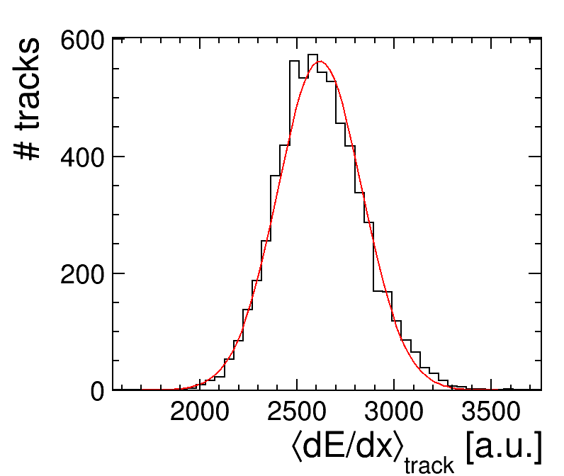
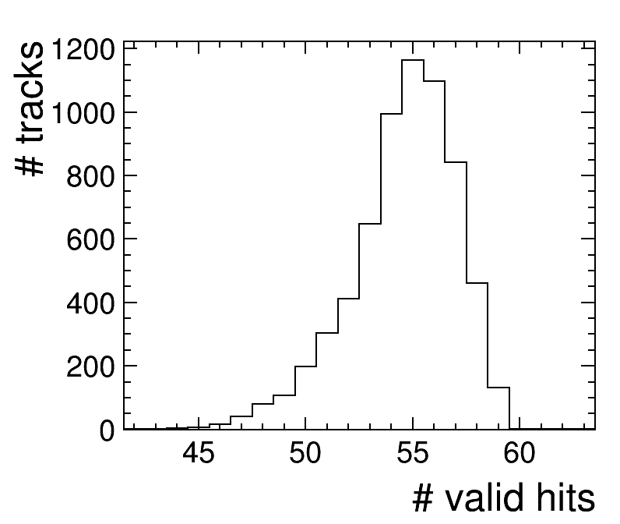
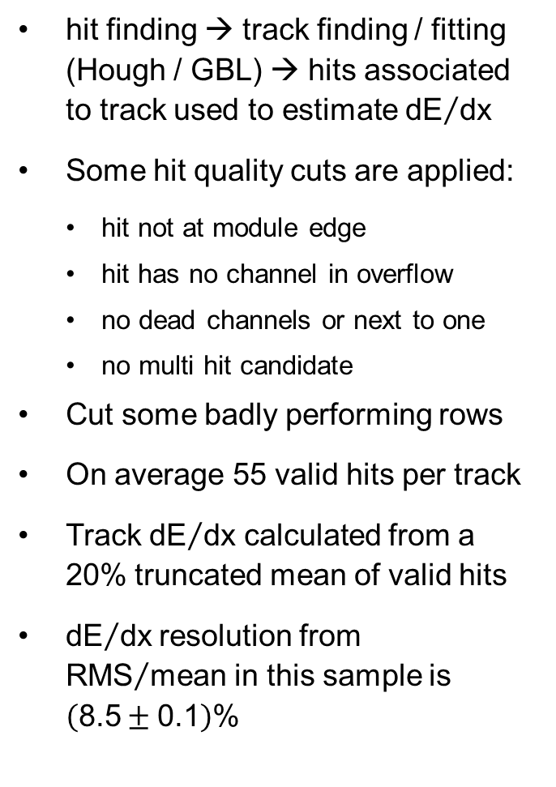
Measuring ${\text{dE}}/{\text{dx}}$ Resolution
hit finding → track finding / fitting (Hough / GBL) → hits associated to track used to estimate ${\text{dE}}/{\text{dx}}$
Some hit quality cuts are applied:
  hit not at module edge
  hit has no channel in overflow
  no dead channels or next to one
  no multi hit candidate
Cut some badly performing rows
On average 55 valid hits per track
Track ${\text{dE}}/{\text{dx}}$ calculated from a 20% truncated mean of valid hits
${\text{dE}}/{\text{dx}}$resolution from ${\text{RMS}}/{\text{mean}}$ in this sample is $\left(\text{8.5}±\text{0.1}\right)\text{\%}$

Slide 7
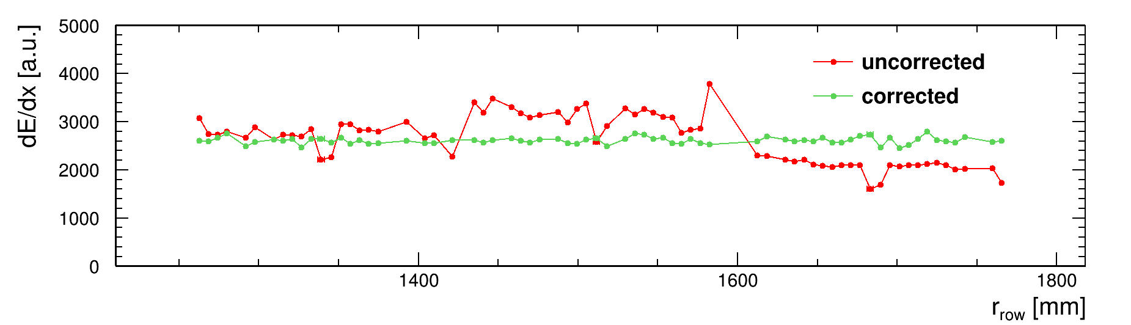
Recovering Module Edges
Radial border should be able to be recovered through calibration.
Might not even need recovery with good field shaping.
Not used at the moment to be comparable to uncorrected data.
Module 0
Module 3
Module 5

Slide 8
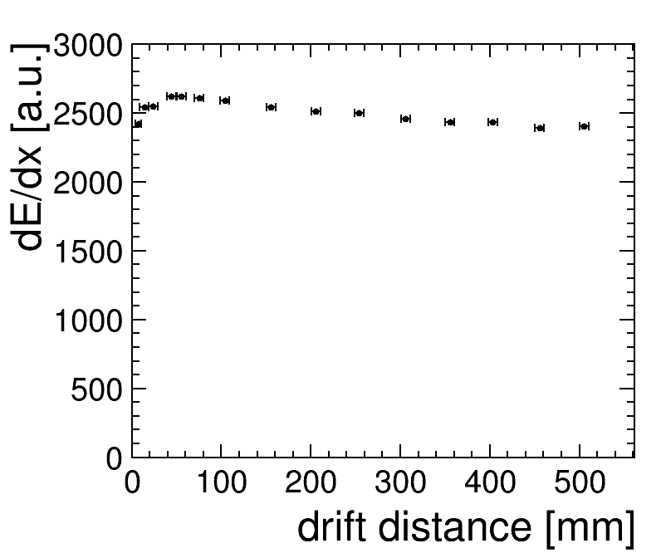
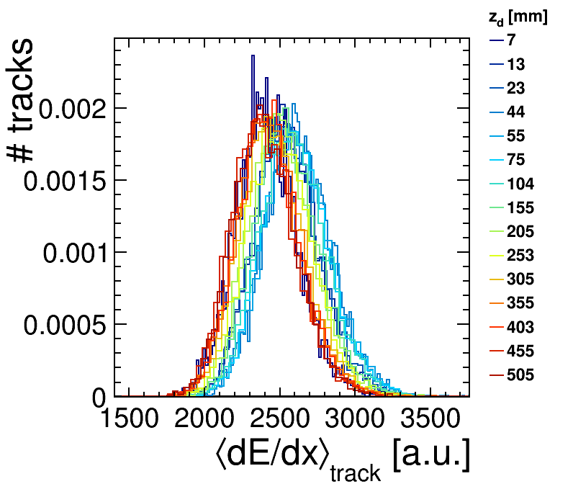
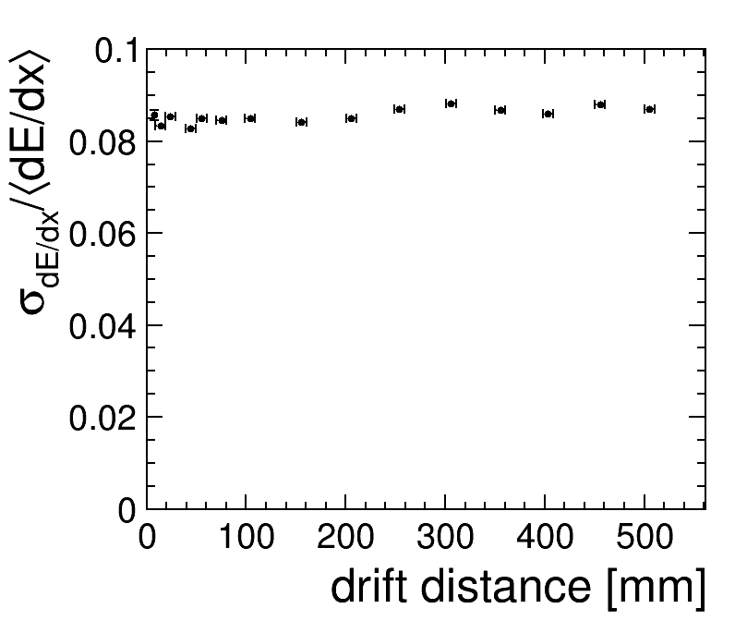
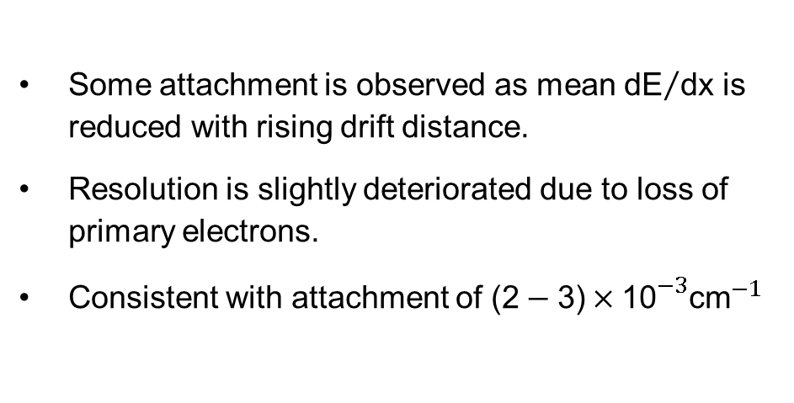
Influence of Attachment
Some attachment is observed as mean ${\text{dE}}/{\text{dx}}$ is reduced with rising drift distance.
Resolution is slightly deteriorated due to loss of primary electrons.
Consistent with attachment of ${\text{(2}−\text{3)}×\text{10}}^{−3}{\text{cm}}^{−1}$

Slide 9
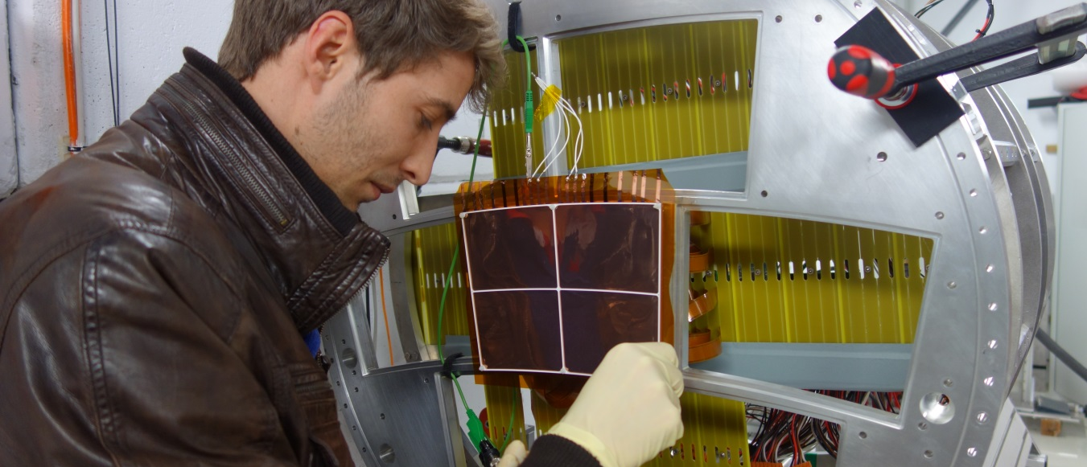
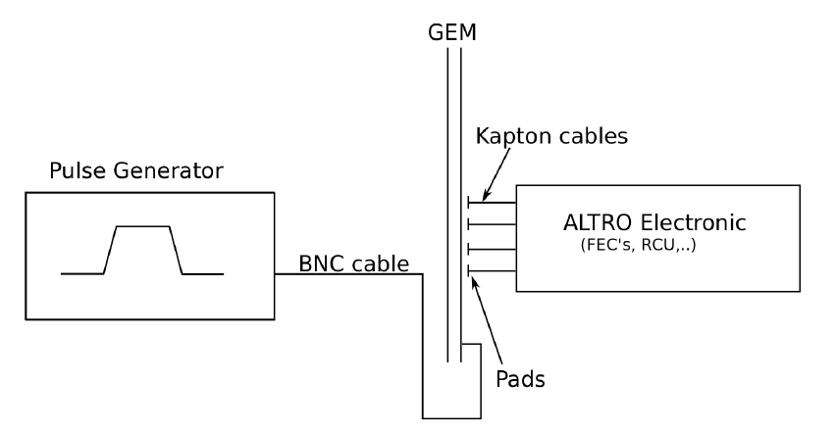
GEM Pulsing Calibration
Charge and time calibration by pulsing the common electrode of the bottom-most GEM
Tested before testbeam period with mock setup
Measurements with testbeam setup tricky (for 3rd module not possible)
  HV contacts had to be connected free-hand for pulsing the GEM
  ALTRO electronics and cables block easy access
Next module iteration should include easily accessible contact (over capacitor?) to bottom-most GEM layer

Slide 10
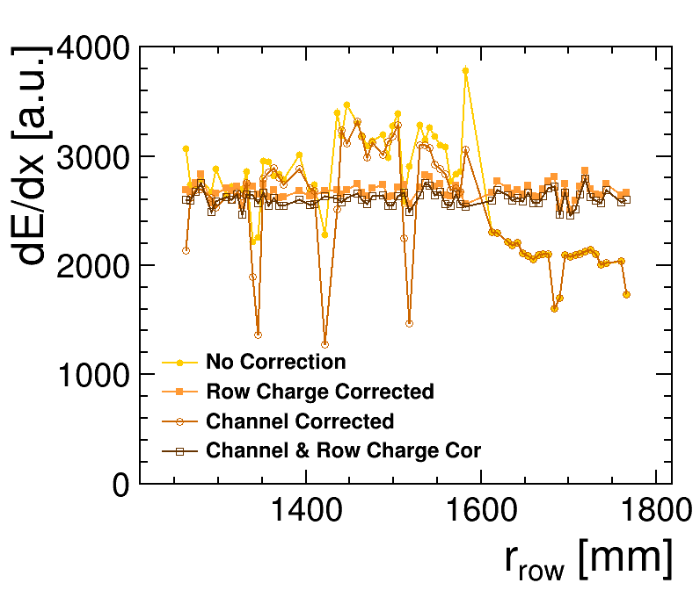
Charge Calibration
GEM
Pulsing
  Channel Calibration Factor
  Channel Offset
  Channel Time Offset
Calibration
  Pulse Finding
  Channel Correction
  Hit Finding
  Track Finding & Fitting
  Row Charge Calibration
Correction
  Row Charge Correction
  Track Finding & Fitting
Analysis

Slide 11
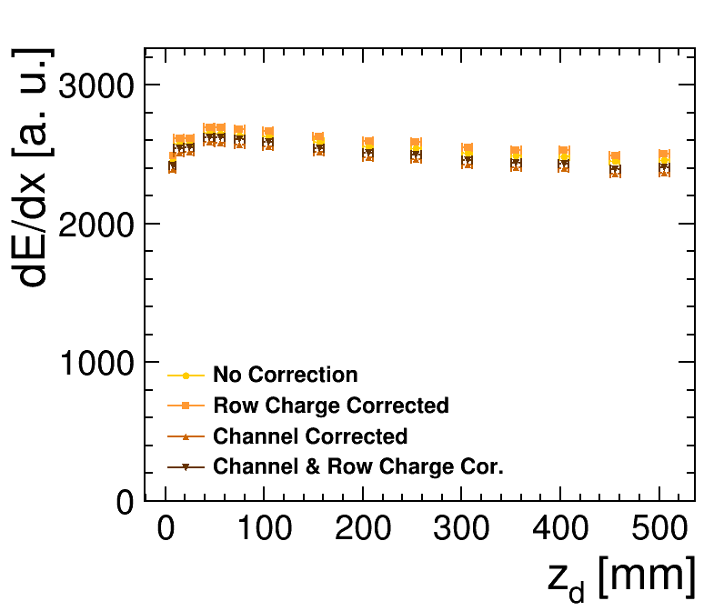
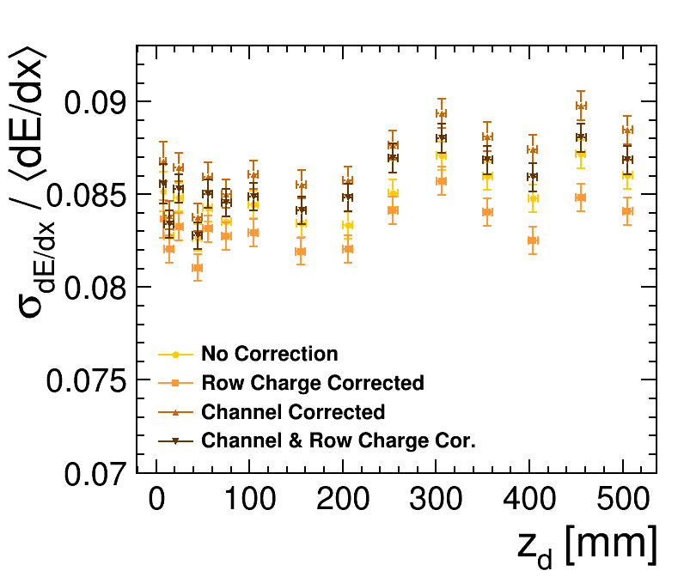
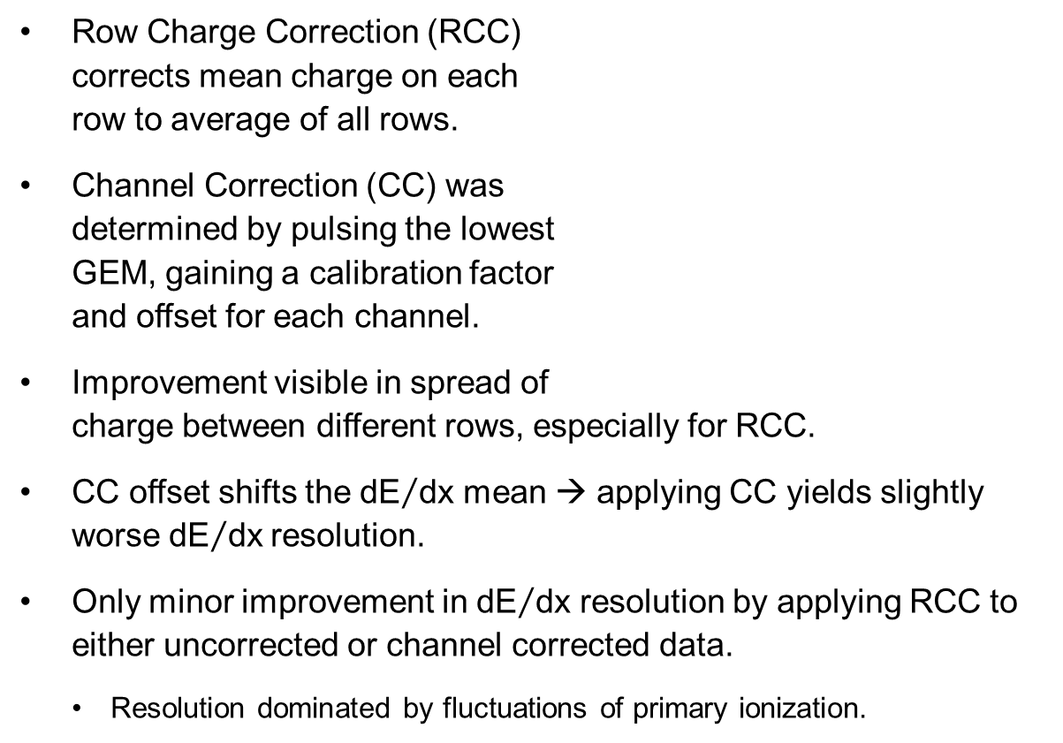
Charge Calibration
Row Charge Correction (RCC)
corrects mean charge on each
row to average of all rows.
Channel Correction (CC) was
determined by pulsing the lowest
GEM, gaining a calibration factor
and offset for each channel.
Improvement visible in spread of
charge between different rows, especially for RCC.
CC offset shifts the ${\text{dE}}/{\text{dx}}$ mean → applying CC yields slightly worse ${\text{dE}}/{\text{dx}}$resolution.
Only minor improvement in ${\text{dE}}/{\text{dx}}$ resolution by applying RCC to either uncorrected or channel corrected data.
  Resolution dominated by fluctuations of primary ionization.

Slide 12
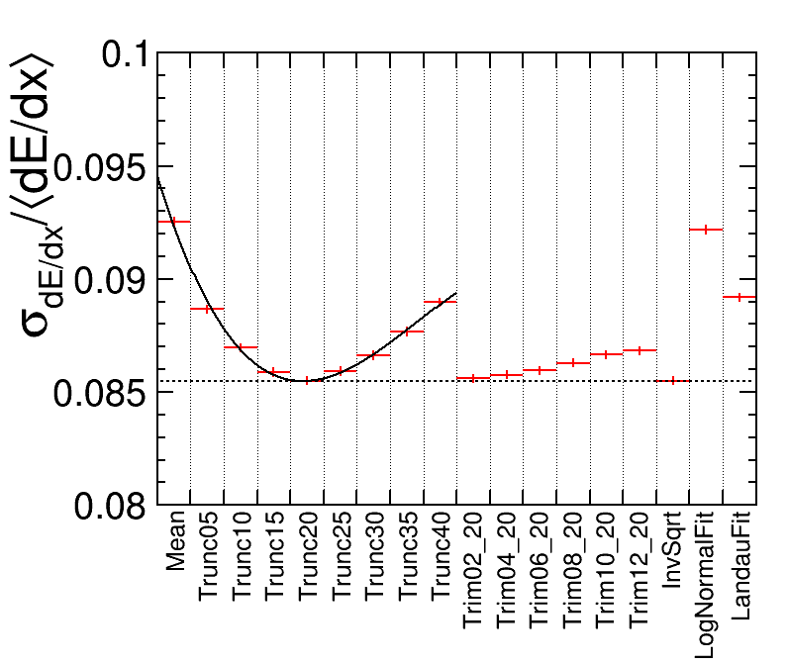
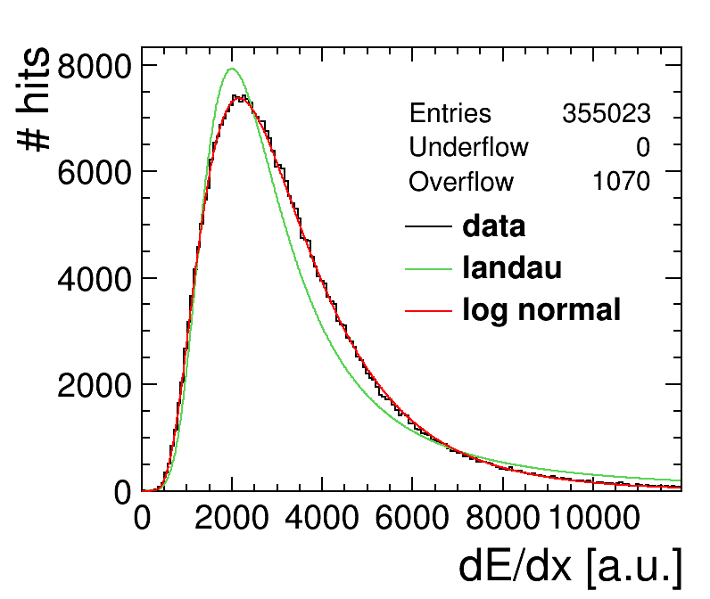
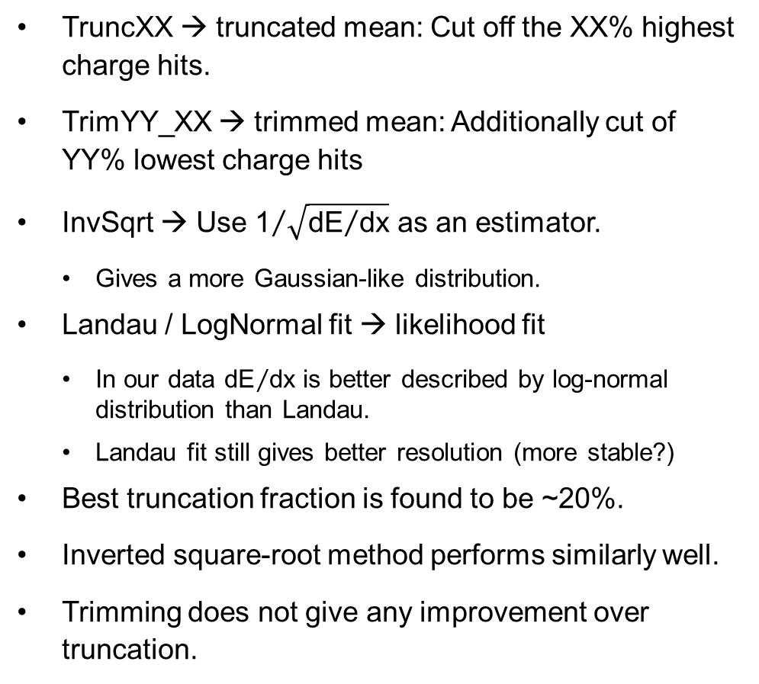
Comparing ${\text{dE}}/{\text{dx}}$ Estimators
TruncXX → truncated mean: Cut off the XX% highest charge hits.
TrimYY_XX → trimmed mean: Additionally cut of YY% lowest charge hits
InvSqrt → Use ${\text{1}}/{\sqrt{{\text{dE}}/{\text{dx}}}}$ as an estimator.
  Gives a more Gaussian-like distribution.
Landau / LogNormal fit → likelihood fit
  In our data ${\text{dE}}/{\text{dx}}$ is better described by log-normal distribution than Landau.
  Landau fit still gives better resolution (more stable?)
Best truncation fraction is found to be ~20%.
Inverted square-root method performs similarly well.
Trimming does not give any improvement over truncation.

Slide 13
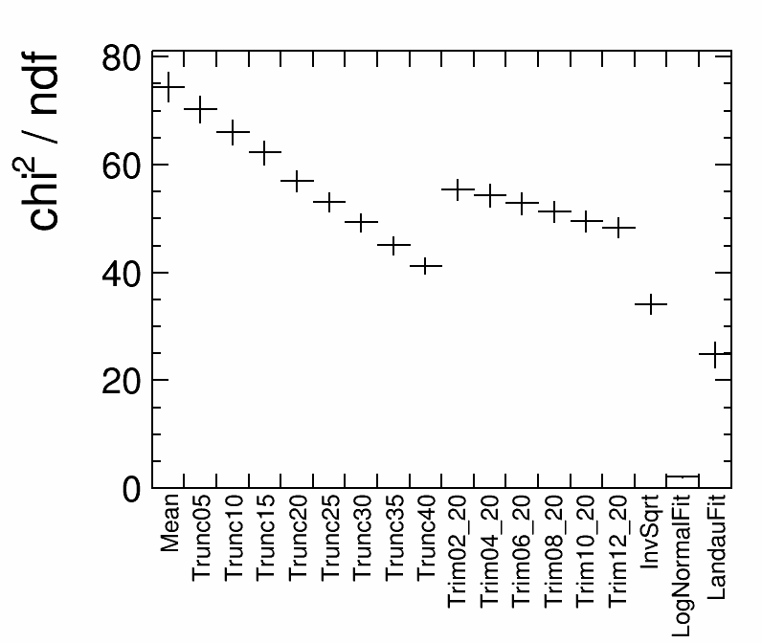
Comparing ${\text{dE}}/{\text{dx}}$ Estimators
TruncXX → truncated mean: Cut off the XX% highest charge hits.
TrimYY_XX → trimmed mean: Additionally cut of YY% lowest charge hits
InvSqrt → Use ${\text{1}}/{\sqrt{{\text{dE}}/{\text{dx}}}}$ as an estimator.
  Gives a more Gaussian-like distribution.
Landau / LogNormal fit → likelihood fit
  In our data ${\text{dE}}/{\text{dx}}$ is better described by log-normal distribution than Landau.
  Landau fit still gives better resolution (more stable?)
Best truncation fraction is found to be ~20%.
Inverted square-root method performs similarly well.
Trimming does not give any improvement over truncation.

Slide 14
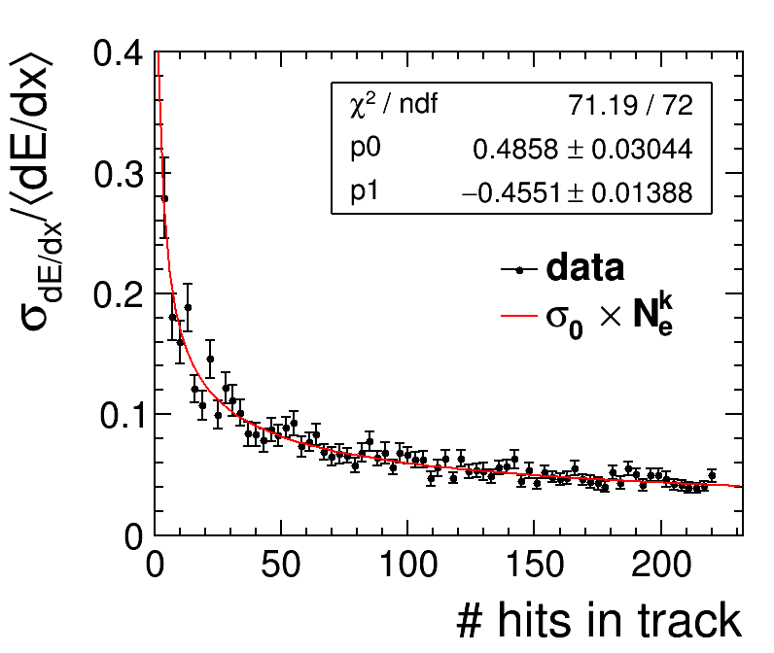
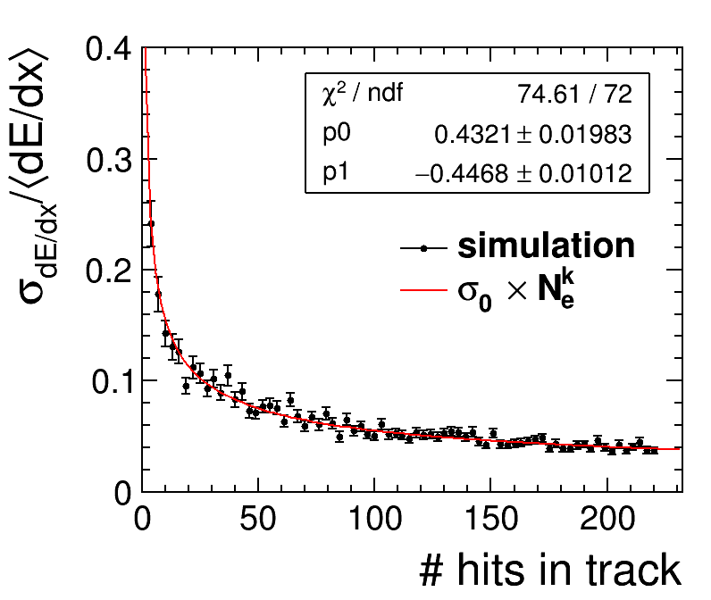
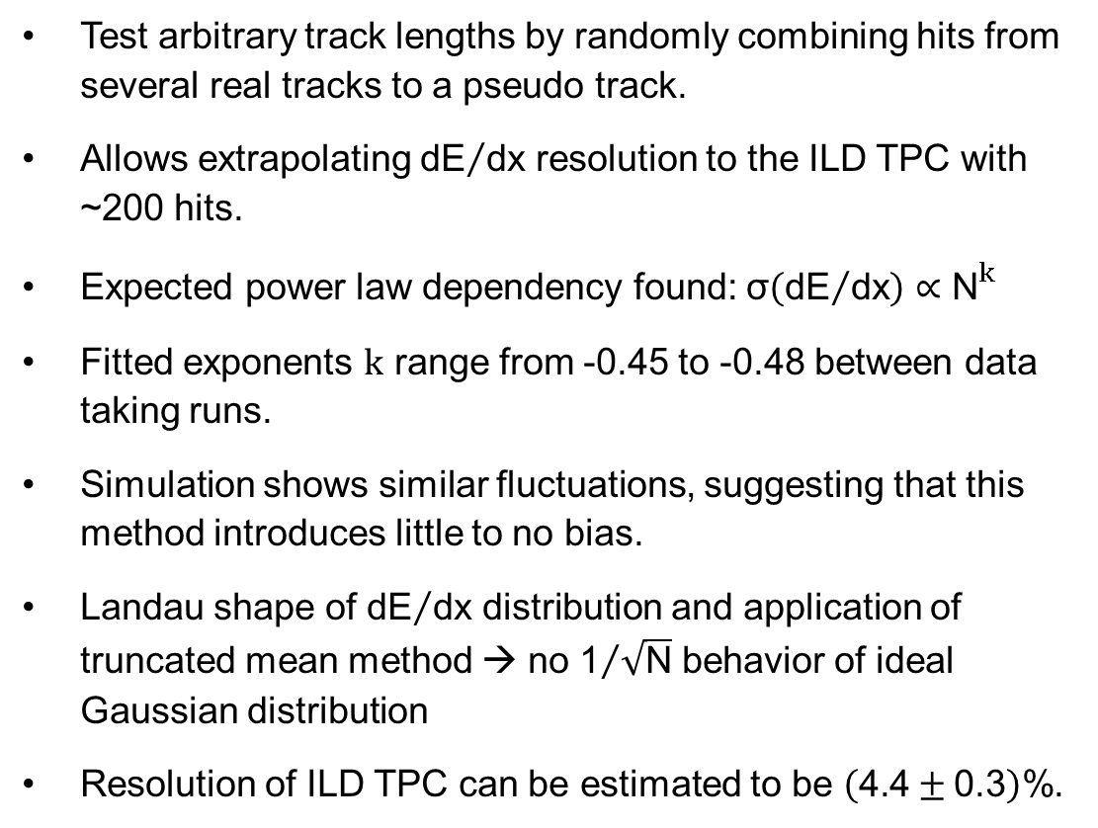


Extrapolating to ILD TPC
Test arbitrary track lengths by randomly combining hits from several real tracks to a pseudo track.
Allows extrapolating ${\text{dE}}/{\text{dx}}$ resolution to the ILD TPC with ~200 hits.
Expected power law dependency found:$\text{σ}\left({\text{dE}}/{\text{dx}}\right)∝{\text{N}}^{k}$
Fitted exponents k range from -0.45 to -0.48 between data taking runs.
Simulation shows similar fluctuations, suggesting that this method introduces little to no bias.
Landau shape of ${\text{dE}}/{\text{dx}}$ distribution and application of truncated mean method → no ${\text{1}}/{\sqrt{\text{N}}}$ behavior of ideal Gaussian distribution
Resolution of ILD TPC can be estimated to be $\left(\text{4.4}±\text{0.3}\right)\text{\%}$.
$${\text{σ}}_{0}$$
k
$${\text{σ}}_{0}$$
k

Slide 15
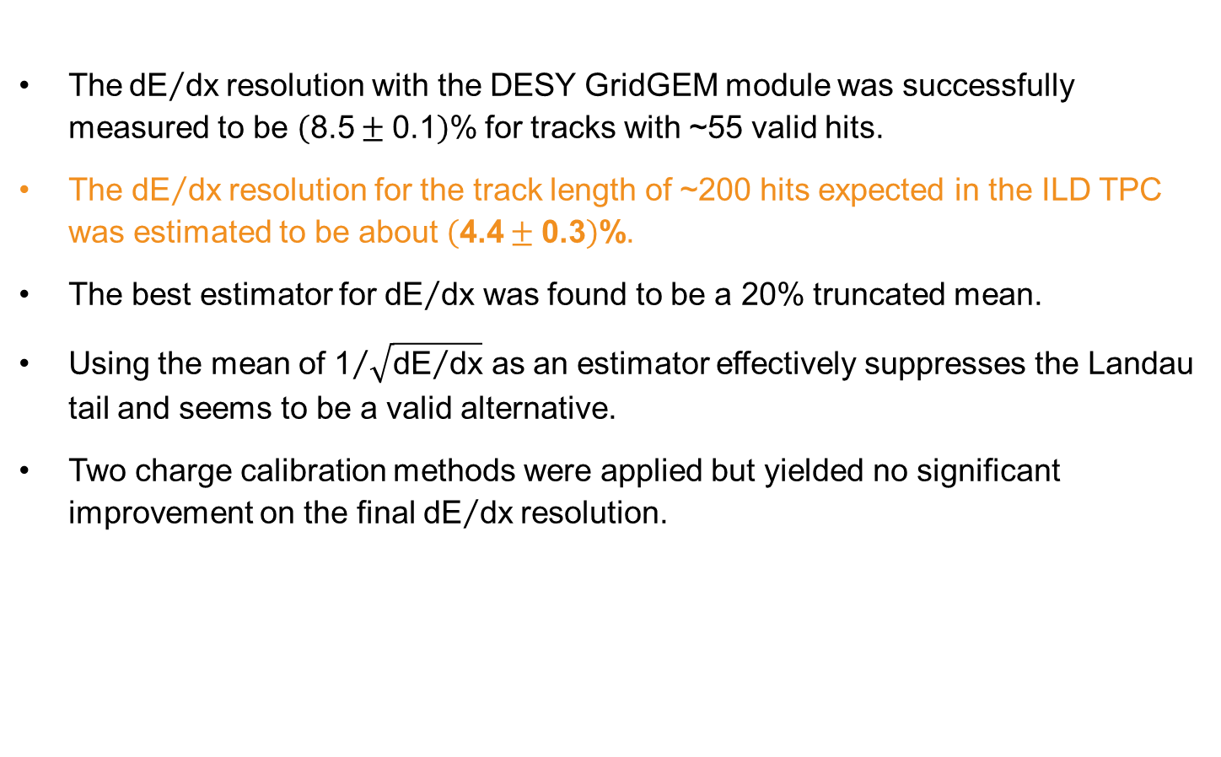
Summary
The${\text{dE}}/{\text{dx}}$resolution with the DESY GridGEM module was successfully measured to be $\left(\text{8.5}±\text{0.1}\right)\text{\%}$ for tracks with ~55 valid hits.
The ${\text{dE}}/{\text{dx}}$resolution for the track length of ~200 hits expected in the ILD TPC was estimated to be about $\left(\text{4.4}±\text{0.3}\right)\text{\%}$.
The best estimator for ${\text{dE}}/{\text{dx}}$ was found to be a 20% truncated mean.
Using the mean of ${\text{1}}/{\sqrt{{\text{dE}}/{\text{dx}}}}$ as an estimator effectively suppresses the Landau tail and seems to be a valid alternative.
Two charge calibration methods were applied but yielded no significant improvement on the final ${\text{dE}}/{\text{dx}}$resolution.

Slide 16
Thank you

Slide 17
Paul Malek
FLC Group
paul.malek@desy.de

Slide 18
Heading
Subheading, optional
Heading Copy
Copy derferecus mint esequiam corepelenet aute dolesti aerorio minctotat.
Essunt qui aut ipsamusandae sunt am ut officiatus maxim quo molesti oriatii ssedit, untiunt.

Slide 19
Heading
Subheading, optional
Heading Copy
Copy derferecus mint esequiam corepelenet aute dolesti aerorio minctotat.
Essunt qui aut ipsamusandae sunt am ut officiatus maxim quo molesti oriatii ssedit, untiunt odit volen totat. Xeris voloressi aut et molo es quae sed.

Slide 20
Heading
Subheading, optional
Heading Copy
Copy derferecus mint esequiam corepelenet aute dolesti aerorio minctotat.
Essunt qui aut ipsamusandae sunt am ut officiatus maxim quo molesti oriatii ssedit, untiunt odit volen totat. Xeris voloressi aut et molo es quae sed.

Slide 21
Heading
Subheading, optional
Heading Copy
Copy derferecus mint esequiam corepelenet aute dolesti aerorio minctotat.
Essunt qui aut ipsamusandae sunt am ut officiatus maxim quo molesti oriatii ssedit, untiunt odit volentotat. Xeris voloressi aut et molo es quae sed enihilit as autestiatur.

Slide 22
Heading
Subheading, optional

Slide 23
Heading
Subheading, optional

Slide 24
Heading
Subheading, optional

