Slide 1
NEWS
LCTPC phone meeting April 5, 2018
P. Colas

Slide 2
NEWS FROM SACLAY
Active preparation of the beam test planned for November 10 to 24 (Ralf, please confirm)
Last week at DESY :
  Commissioning SiPM cosmic trigger (with Serguei Ganjour and Oliver Schäfer)
  Assess possible use of LP2 endplate (with Ralf and Volker) : need to adapt the mounting tool. Should be OK. Probably need to make 7 new dummy modules, to be discussed how.
Construction of 4 new modules in progress
  DLC 2.5 Mohm/sq procured
  New mechanics for connection of pads to the electronics
  Details of the design under study, minor changes to the gerbers. PCB almost ready to be ordered.

Slide 3
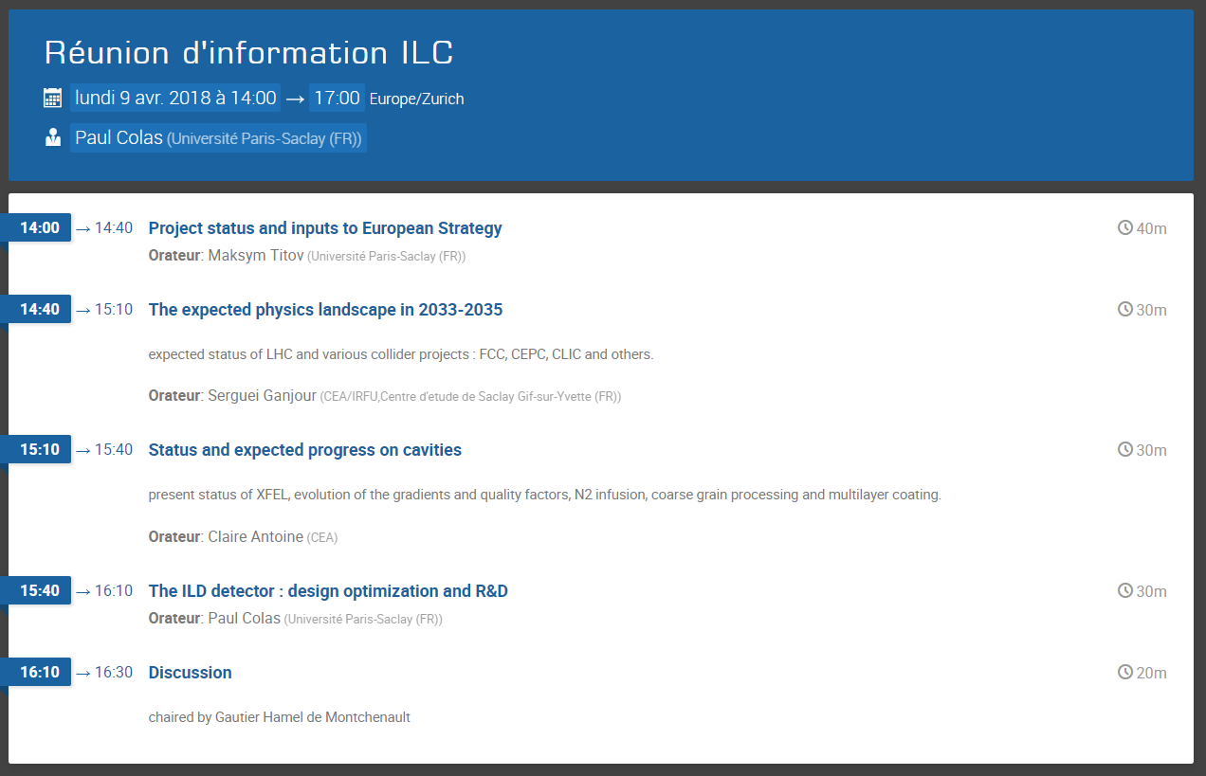
NEWS FROM SACLAY
Information meeting on ILC organized at Saclay (Monday 9th)
Presentations of new developments and expected context
Discussion on ILC in European Strategy

Slide 4
OTHER NEWS : ANALYSIS
Analysis meeting on dE/dx last week. Quite succesful (>27 connected), interesting talks, lots of news ideas and comparisons made possible https://agenda.linearcollider.org/event/7909/
Summary in preparation
Next meeting tentatively between May 15 and 18 on z-coordinate resolution and event time measurement (for matching with silicon trackers). Doodle available https://doodle.com/poll/ygf59q6naudad38k

Slide 5
OTHER NEWS
Ion mobility studies, A. Cortez et al. : Xe-CF4 study just published (Ar-CF4 was done before, see Jan’s talk in Ichinoseki)
Isobutane bottle available at Coimbra, measurement starting. Ar-Isobutane and Ar-CF4-Isobutane studies will be made, to assess the ion disk composition and evolution.
ILD DAQ under discussion in Technical Board. Needs input from TPC (in the past contacts were Gilles de Lentdecker and Martin Killenberg)
ICD released, still far from being complete

