Slide 1


An Update on Simulations
Rebecca Ramjiawan
FONT meeting
Friday, 6th March 2018

Slide 2
Feedback Loop Simulation (MATLAB)
Construct uncorrected e+e- bunch trains (1312 bunches), with noise, drifts, harmonics, etc.
Run for multiple trains and average results.
Determine luminosity from bunch-bunch offset (using nominal luminosity-offset curve)
True beam offset at IP = Uncorrected offset + correction
True beam-beam deflection (using nominal deflection curve)
Delay loop
True offset at BPM (using IP to BPM distance 4m)
Apply correction (inc. kicker error 0.1% offset)
Measured offset at BPM (resolution)
Estimate deflection angle, offset at IP from fit to beam-beam deflection curve (multiple models tested)

Slide 3
Introducing noise, drift, harmonics…
BPM resolution added as Gaussian noise on top of measurement at BPM.
Kicker noise added as 0.1% of bunch-bunch offset.
Harmonics added: can vary magnitude and frequency.
Drift added: can vary magnitude.
Random noise (sample-by-sample) can be added to test performance with a reduced bunch-to-bunch position correlation.
Harmonic
Drift

Slide 4
Ideal Situation – Rigid Beam
Successfully removes bunch-bunch offset by second bunch.
Constant offset throughout train.
0 um resolution.
No error on kick.
Perfect correction maintained correctly with delay loop.
Full luminosity recovery by second bunch.

Slide 5
Resolution effect and error on kicker
Feedback system (BPM resolution 1um) acting on rigid bunch train to remove offset.
Bunch train has constant initial offset (100% position correlation).
BPM resolution 1 um.
Error on kicker: 0.1% of offset.
(Enlarged)

Slide 6
Gains Too High vs. Too Low
Gains too high
Ringing observed if gains set too high.
Would occur if fit to deflection angle curve was too steep compared with the real curve.
Gains too low
Takes too many bunches to bring bunch-bunch offset to zero.
Would occur if fit to deflection angle is too shallow. Curve steepest in few nm around 0 nm offset.

Slide 7
Modelling the deflection angle curve

Slide 8
Modelling the deflection angle curve
The beam positon measured at the BPM depends on the deflection angle not directly on the bunch-bunch offset.
Need to convert the measurement at the BPM into an offset at the IP using the deflection angle curve.
Can use the curve itself in a LUT style operation.
Previously, Javier performed linear fitting to different regions of the curve.
I have considered linear fitting and polynomial fitting and compared them with the performance from using a LUT.

Slide 9
Polynomial Fit to Centre of Curve
3rd order polynomial
5th and 10th order polynomial
Polynomial fitting to the centre of the curve is far from perfect.
It won’t characterise correctly the steeper gradient for offsets of a few nm.

Slide 10
Luminosity Recovery – 3rd order polynomial
Luminosity recovery using polynomial (3rd order) fit to deflection angle curve requires more bunches to reach peak luminosity.
This feedback simulation was operated on a rigid beam with initial offset.
Still achieves peak luminosity, as expected.
Using higher order polynomials has little effect on the luminosity recovery plot, it seems that the poor fit to the small offsets is the dominant driver for poorer performance and this is not improved much by fitting to higher order polynomials.

Slide 11
Linear Fitting to Deflection Angle Curve
Approximate the deflection angle curve with five straight lines.
Green is deflection angle curve, purple is the linear fit.
Data labels show the points between which the linear fit was performed.

Slide 12
Luminosity recover – linear fit to deflection curve
Fitting five linear regions to the deflection angle curve performs better than the polynomial fitting to the curve, as it allows us to better characterise the steeper gradient of the curve at small offsets.
Reaches peak luminosity at approx. five bunches.
This performance improves by including a higher number of linear regions, as expected.

Slide 13
Including bunch train structure

Slide 14
Drift across beam train
Δx
Δx
Simulation run for 20 bunch trains and the results averaged.
Does not recover nominal luminosity as offset between consecutive bunches not taken into account by feedback system.
Luminosity recovered does not equal nominal luminosity 1.8 x 34cm⁻²s⁻¹.

Slide 15
Imperfect bunch-to-bunch correlation
Introduce random noise on a sample to sample basis. (Here 20 nm – very large jitter added)
Reduces bunch-to-bunch position correlation and FB performance.
Mean bunch position reduced to zero, with random noise on top of stabilised mean.
Such uncorrelated jitter not expected to be removed by feedback system.

Slide 16
Bunch train with (exaggerated) harmonic structure
Large harmonic structure added to bunch train, no other noise/jitter.
1 um BPM resolution & kicker error.
Offset remaining after correction reflects gradient of harmonic at a given bunch. (Effectively differential of harmonic)
Large -ve gradient
Lowest luminosity for regions of steepest gradient of harmonic.
Large +ve gradient

Slide 17
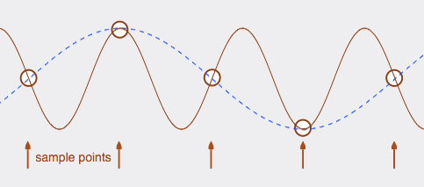
Scanning through frequency of harmonic structure
Dependence of feedback performance on frequency of harmonic structure introduced to bunch train.
Worst performance (peak of curve) occurs when frequency of harmonic =1312*pi, as this corresponds to bunch-to-bunch correlation of -1.
Higher frequencies than 1312*pi when sampled at the bunch frequency are equivalent to lower frequency harmonics and consequently perform better.
http://www.iu.edu/~emusic/361/digitalaudio1.htm

Slide 18


Proportional Integral Control
Calculate gain of proportional term using deflection-angle curve.
Scan through different coefficients for integral term to find minimum.
Will depend on size of drift and harmonic terms compared with resolution/noise terms.

Slide 19
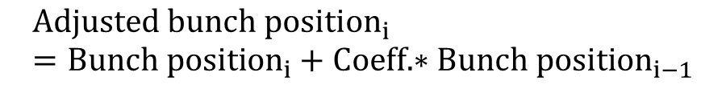
Averaging over multiple bunches
If resolution/low correlation is a dominant effect, averaging over multiple bunches can improve the position measurements and, therefore, the feedback performance.
If drift or harmonics are the dominant effects then averaging across multiple bunches can give a worse performance.
Possible to weight the proportion of bunch I, i-1, i-2 etc used to construct the position measurement.
$$Adjusted bunch position_{i}=Bunch position_{i}+Coeff.∗Bunch position_{i−1}$$

Slide 20
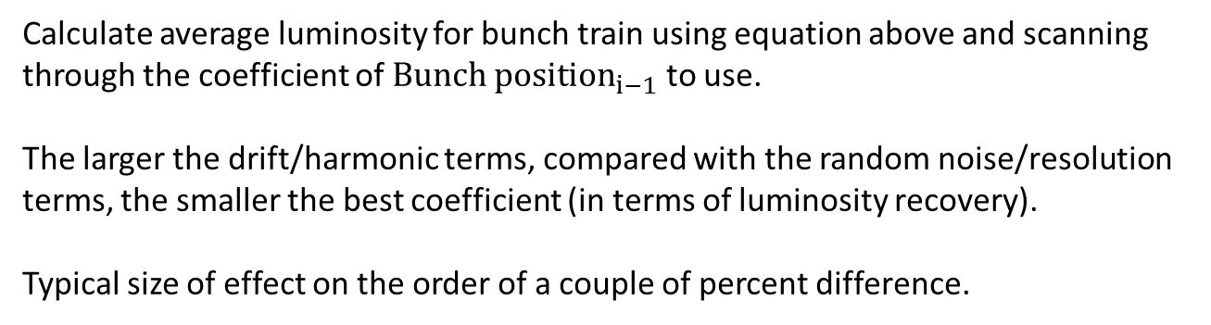
Proportional sum of consecutive bunches
$$Adjusted bunch position_{i}=Bunch position_{i}+Coeff.∗Bunch position_{i−1}$$
Calculate average luminosity for bunch train using equation above and scanning through the coefficient of $Bunch position_{i−1}$ to use.
The larger the drift/harmonic terms, compared with the random noise/resolution terms, the smaller the best coefficient (in terms of luminosity recovery).
Typical size of effect on the order of a couple of percent difference.

Slide 21
Exceeding the turnaround point
Correction for rigid bunch train with initial offset, and BPM resolution 1 um.
With bunch-bunch offsets beyond the turnaround it takes an extra few bunches to remove the offset as under-correcting.
It isn’t possible to know which side of the turnaround the measured deflection angle is from.
Turnaround occurs at a bunch-bunch offset of 125 nm.
200 nm initial offset
400 nm initial offset

Slide 22
Next steps
Use output from Ryan’s ILC Placet simulation to run feedback on a modelled ILC bunch train.
How does the structure of the ILC bunch train depend on charge and wakefield effects? How best would a feedback system deal with different structures?
How does the beam-beam deflection curve depend on bunch charge, bunch length, bunch size etc? How does this effect feedback performance.
How does luminosity curve depend on similar factors?

Slide 23
Thank you for listening

Slide 24
Polynomial Fits to Whole Deflection Angle Curve
3rd order polynomial
6rd order polynomial
15th order polynomial
Fitting to the whole deflection angle curve makes the fit near the centre very poor.
Consider fitting to just the central region between the turnarounds.

Slide 25
Averaging over multiple bunches (offset)
Can introduce ringing into system if first (uncorrected) bunches don’t average to zero.
Solution: Correct bunches at start of train without averaging, use averaging only when the average offset has been brought

