Slide 1


ATF2 April Shifts
R. Ramjiawan
Friday, 11th May 2018

Slide 2
Outline
First look at:
best resolution data set (19/04/2018).
consecutive resolution runs demonstrating reproducible 20-25 nm resolution (19/04/2018).
latency scan (27/04/2018)
All data shown is in high-beta optics at 10dB.

Slide 3
Second Shift 19/04/2018

Slide 4
File details – Best Resolution Run
General shift overview
We started the shift, aligned the 3 BPMs in high beta optics, and immediately saw ~23 nm resolution, which was consistently achievable for 10 data sets, with the best result being 21 nm. We then turned the charge up to ~0.7e10 in an attempt to further improve the resolution. Unfortunately, this made the charge more unstable and we were unable to obtain such good resolution results at a higher charge.
Towards the end of the shift, we became dominated by large beam drifts making recalibrating the beam for a lower charge impossible.
Data file details:
400 trigger data file: yJitterRun10_10dB
18 sample integration giving best resolution: 61:78, charge sample: 68
Position jitters (um): IPA 0.45461, IPB 0.28977, IPC 0.35818
Mean position (um): IPA -0.18721, IPB -0.42826, IPC 3.8979
Charge jitter 30.6 ADCs, mean charge of jitter file: -1998 ADCs, mean charge of calibration = -1985. Charge 0.5e10.

Slide 5
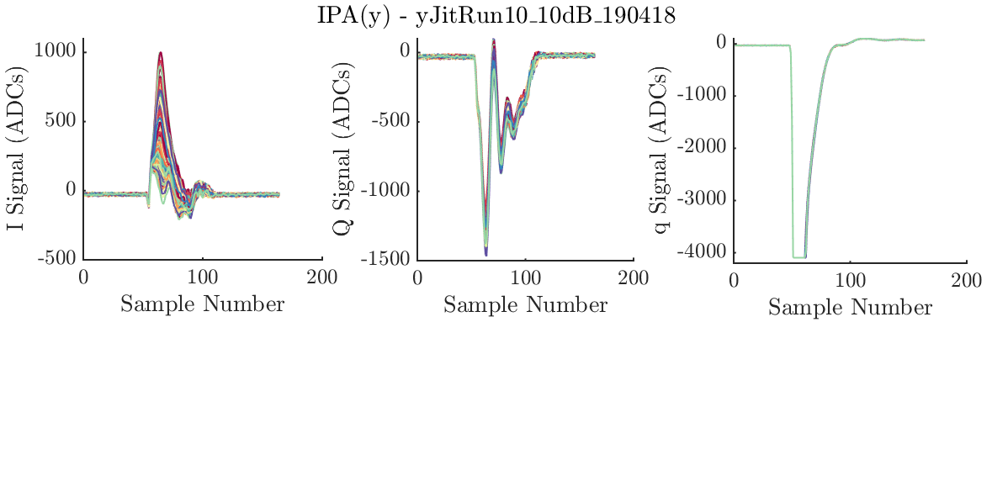
IPA waveforms
392 triggers (8 triggers cut)
Position jitters (um): IPA 0.45461
Mean position (um): IPA -0.18721
Samples used for analysis: 61:78, charge sample: 68

Slide 6
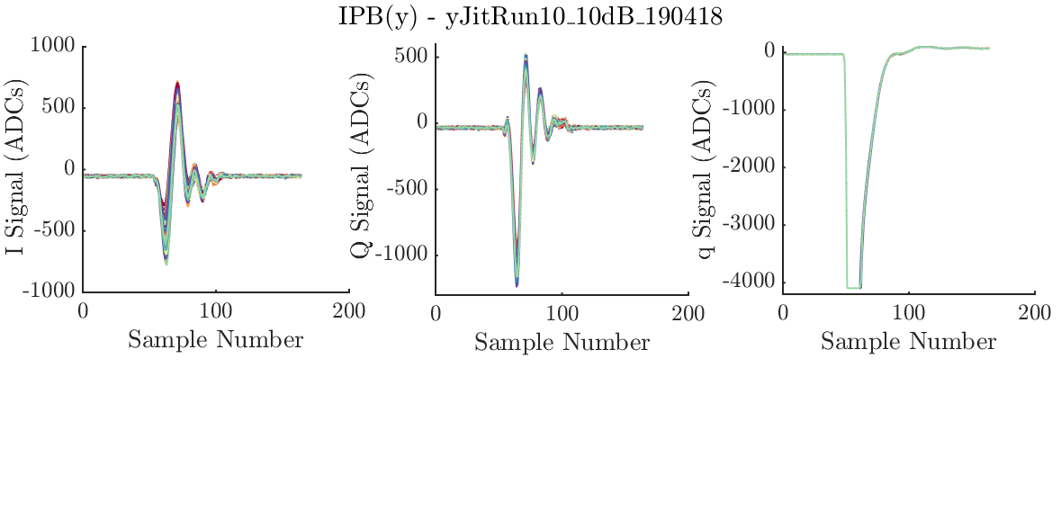
IPB waveforms
Position jitters (um): IPB 0.28977
Mean position (um): IPB -0.42826
Samples used for analysis: 61:78, charge sample: 68

Slide 7
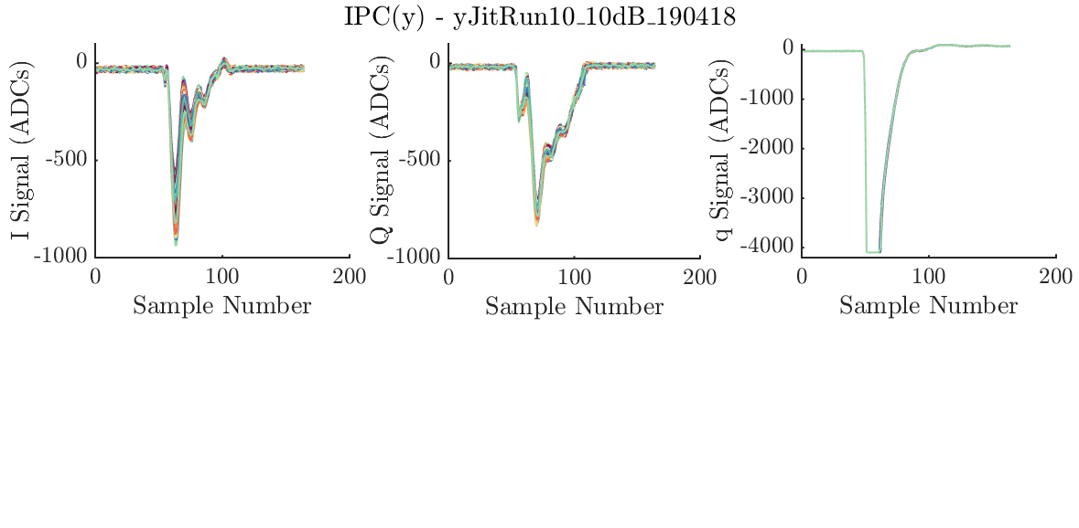
IPC waveforms
Position jitters (um): IPC 0.35818
Mean position (um): IPC 3.8979
Samples used for analysis: 61:78, charge sample: 68

Slide 8
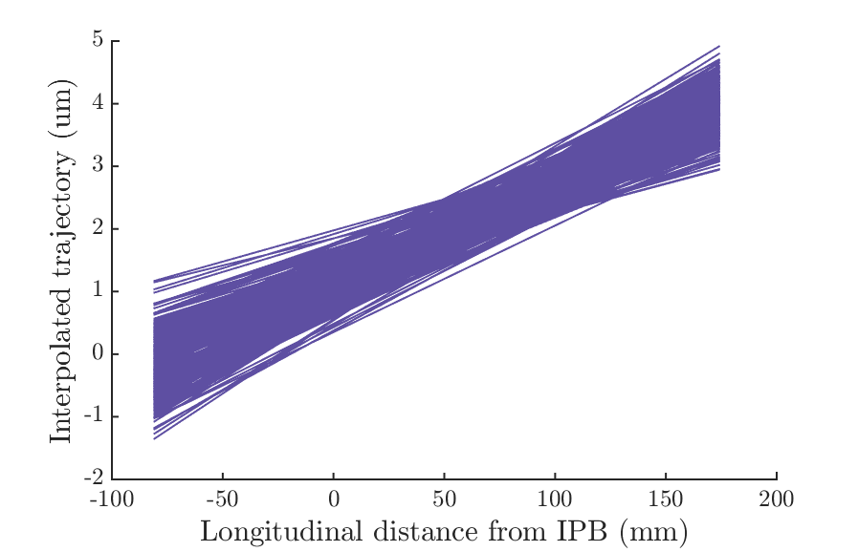
High beta optics
Position jitters (um):
IPA 0.45461, IPB 0.28977, IPC 0.35818
Mean position (um):
IPA -0.18721, IPB -0.42826, IPC 3.8979

Slide 9
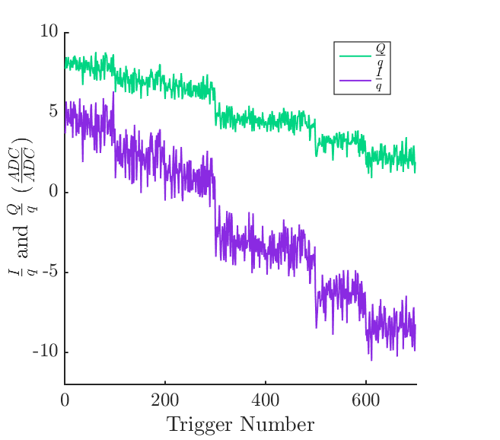
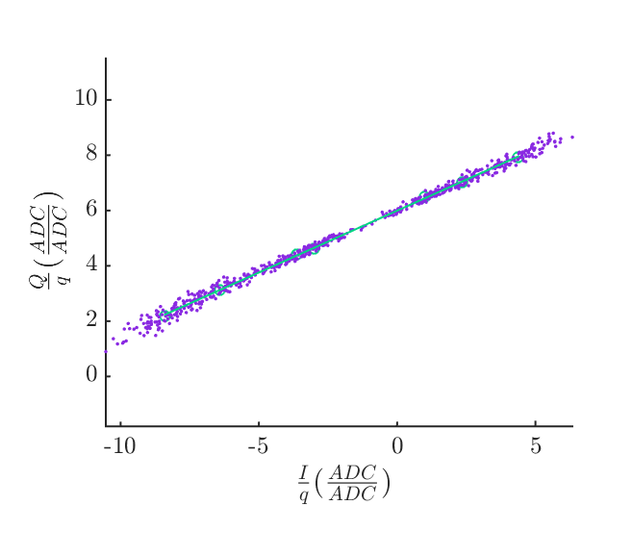
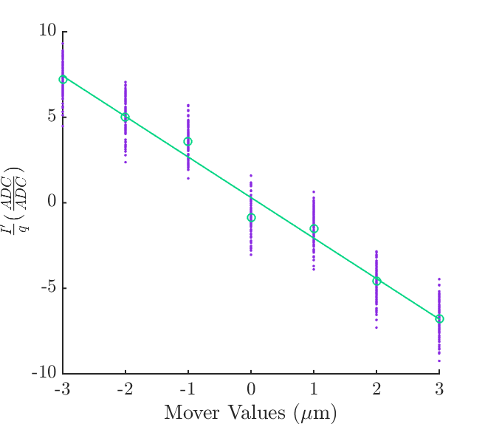
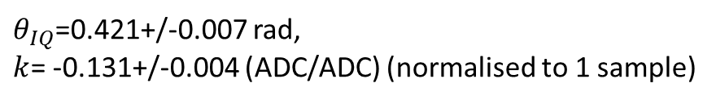
IPA
$θ_{IQ}$=0.421+/-0.007 rad,
$k$= -0.131+/-0.004 (ADC/ADC) (normalised to 1 sample)
Setting removed when calculating calibration constant and theta.

Slide 10
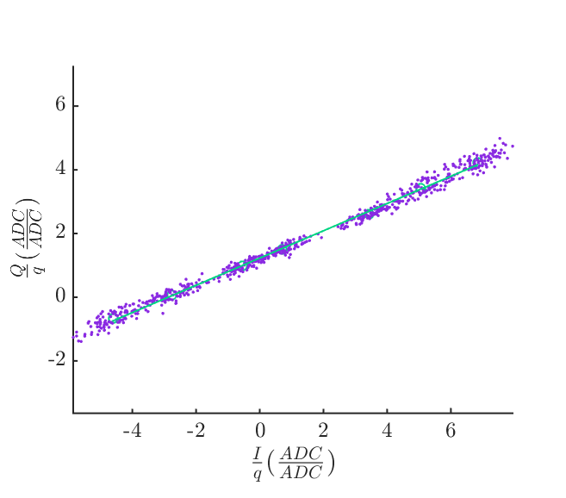
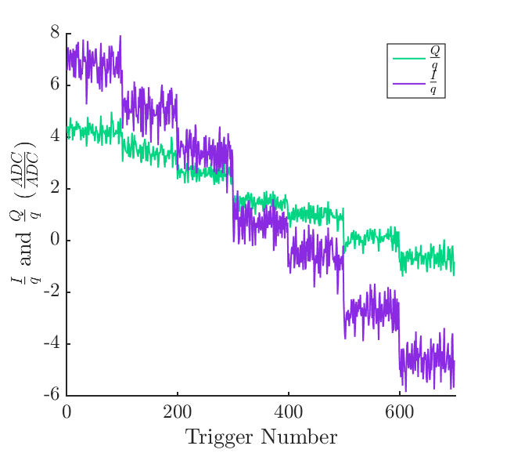
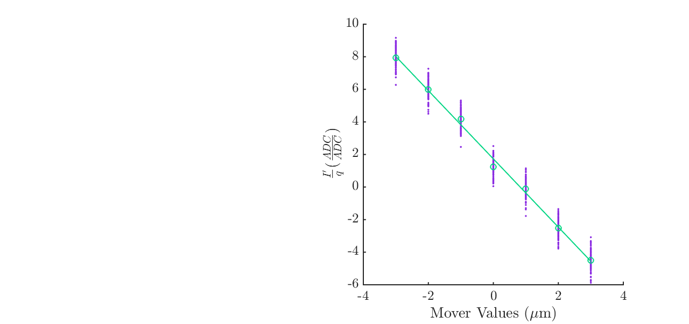
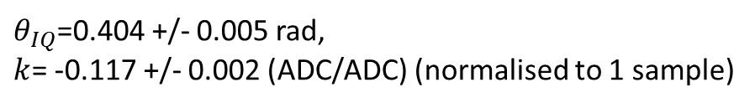
IPB
$θ_{IQ}$=0.404 +/- 0.005 rad,
$k$= -0.117 +/- 0.002 (ADC/ADC) (normalised to 1 sample)
Setting removed when calculating calibration constant and theta.

Slide 11
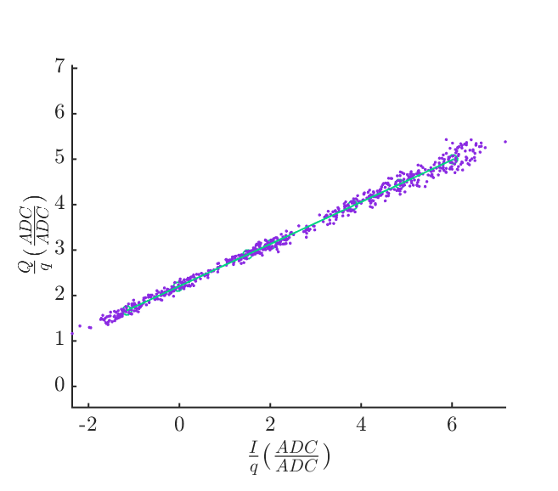
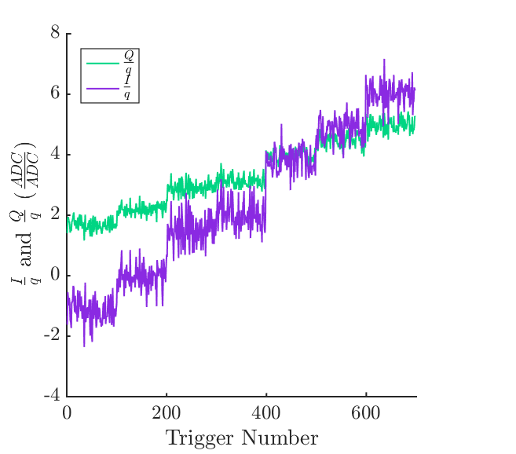
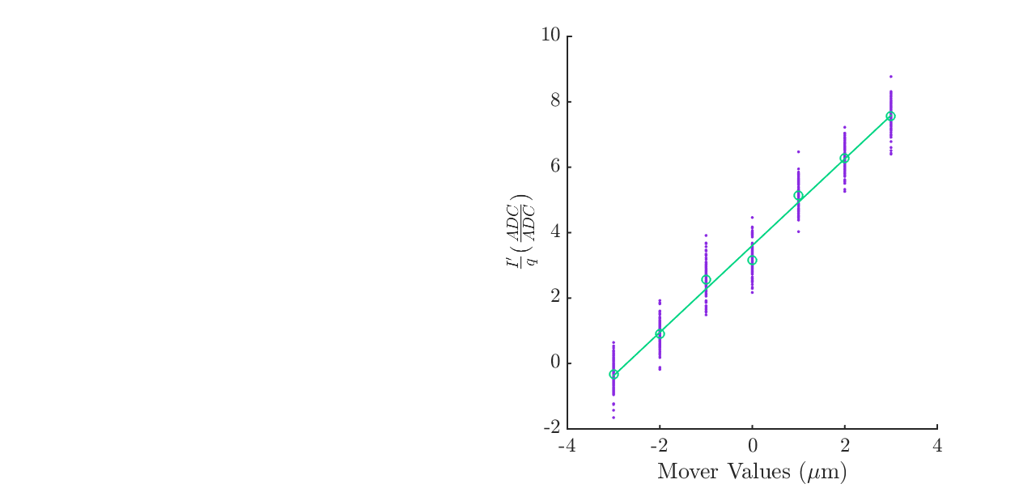
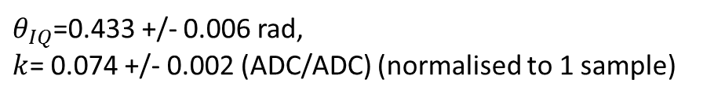
IPC
$θ_{IQ}$=0.433 +/- 0.006 rad,
$k$= 0.074 +/- 0.002 (ADC/ADC) (normalised to 1 sample)
Setting removed when calculating calibration constant and theta.

Slide 12
Beam shift during mover calibration
Positions measured at IPB correlate with positions interpolated at IPB throughout calibration run, suggesting that individual movers did not make any unexpected deviation.

Slide 13
Best Resolution Run (19/04/18)
400 trigger data file: yJitterRun10_10dB
Position jitters (um): IPA 0.45461, IPB 0.28977, IPC 0.35818
Mean position (um): IPA -0.18721, IPB -0.42826, IPC 3.8979
Charge jitter 30.6 ADCs, mean charge: 1998
Resolution | IPA (nm) | IPB (nm) | IPC (nm) | Reason
Geometric | 20.6 ± 1.0 | 20.6 ± 1.0 | 20.6 ± 1.0 | Fit to geometry
Fit to position (fit for k) | 20.4 ± 1.0 | 20.5 ± 0.8 | 20.3 ± 0.8 | Fit out error in k
Fit to position and charge | 19.9 ± 0.9 | 19.9 ± 0.8 | 19.7 ± 0.9 | Fit out error in k and position-charge correlation
Fit for k and theta (fit to I and Q) | 20.3 ± 1.0 | 20.3 ± 0.8 | 20.2 ± 0.9 | Fit out error in k and theta.
Fit for k and theta and to charge | 19.6 ± 0.9 | 19.6 ± 0.8 | 19.6 ± 0.8 | Fit out error in k and theta, and position-charge correlation.
Fit for k, theta, charge and self Q’ | 19.5 ± 0.9 | 19.6 ± 0.8 | 19.2 ± 0.8 | Fit out all of the above, and also residual position information in Q’, or Q’ coupling in through phase jitter.

Slide 14
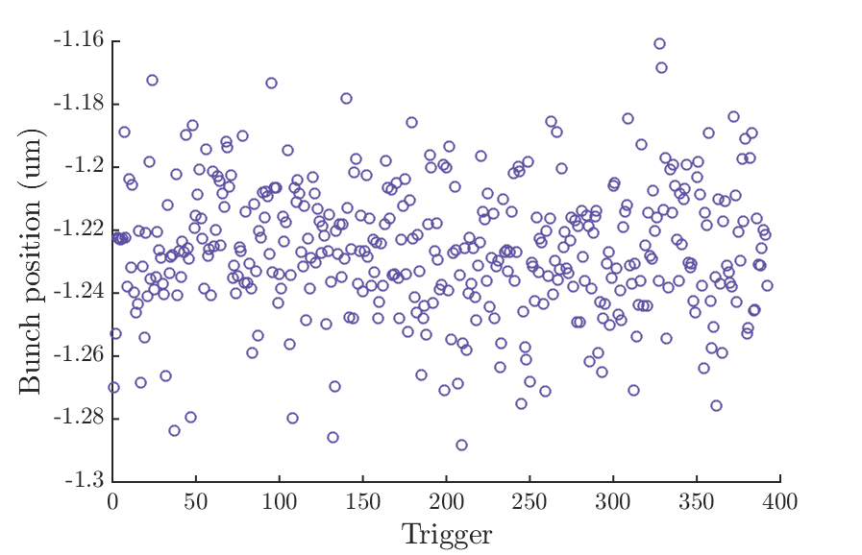
Resolution with Drift Removal
Geometric resolution with drift removal: 19.2 nm.
Geometric resolution without drift removal: 20.6 nm
Position jitters (um): IPA 0.45461, IPB 0.28977, IPC 0.35818
Mean position (um): IPA -0.18721, IPB -0.42826, IPC 3.8979
Appears to make very little difference for this data set. Other files, with larger drifts benefit slightly more from this drift removal.

Slide 15
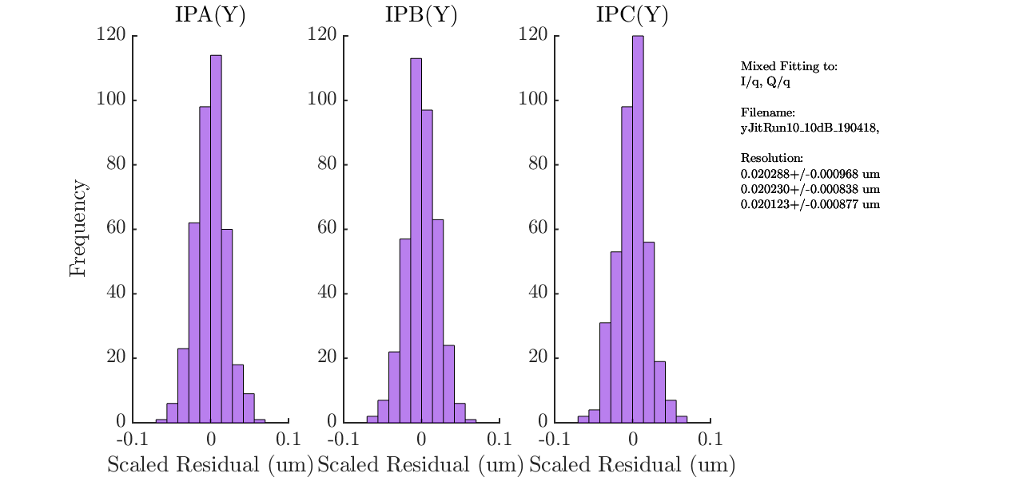
Fitting to Higher Order Polynomials
Preliminary investigation of fitting odd higher order polynomials of I, Q or position offers no improvement above the level of ~0.1nm.
Fitting to I, Q:
IPA 0.0203+/-0.001um
IPB 0.0203+/-0.001um
IPC 0.0202+/-0.001um
Fitting to I, Q, I³, Q³:
IPA 0.0203+/-0.001um
IPB 0.0202+/-0.001um
IPC 0.0201+/-0.001um

Slide 16
IPA Consecutive Resolution Runs
Consecutive resolution runs taken at the start of the shift, with corrected dispersion.
Nothing adjusted between runs except for minor changes to alignment.
Improvements by fitting extra parameters only very small, and mostly by fitting charge.
All are 400 trigger data sets at 10dB, charge 0.5e10. Calibration at q=-1985.
File | 1 | 2 | 3 | 4 | 5 | 6 | 7 | 8 | 9 | 10
Geo | 23.5 ± 1.1 | 22.8 ± 1.1 | 24.5 ± 1.2 | 25.9 ± 1.2 | 24.1 ± 1.1 | 24.3 ± 1.2 | 25.4 ± 1.2 | 23.6 ± 1.1 | 26.0 ± 1.2 | 20.6 ± 1.0
Fit to y | 21.7 ± 1.0 | 22.8 ± 1.0 | 24.2 ± 1.2 | 24.5 ± 1.2 | 24.0 ± 1.1 | 24.1 ± 1.2 | 24.1 ± 1.2 | 23.3 ± 1.1 | 24.9 ± 1.2 | 20.4 ± 1.0
Fit to y, q | 21.3 ± 1.0 | 21.4 ± 1.0 | 23.6 ± 1.1 | 23.6 ± 1.1 | 22.0 ± 1.0 | 21.9 ± 1.0 | 21.7 ± 1.0 | 21.1 ± 1.0 | 22.4 ± 1.1 | 19.9 ± 0.9
Fit to I,Q | 20.8 ± 1.0 | 21.9 ± 1.0 | 23.3 ± 1.1 | 23.4 ± 1.1 | 21.8 ± 1.0 | 23.1 ± 1.1 | 22.4 ± 1.0 | 22.0 ± 1.1 | 23.7 ± 1.1 | 20.3 ± 1.0
Fit to I,Q,q | 20.8 ± 1.0 | 21.4 ± 1.0 | 23.3 ± 1.1 | 23.2 ± 1.1 | 21.6 ± 1.0 | 21.8 ± 1.0 | 21.1 ± 0.9 | 20.3 ± 1.0 | 22.1 ± 1.1 | 19.6 ± 0.9
Fit to I,Q,q, self Q’ | 20.6 ± 1.0 | 21.2 ± 1.0 | 23.2 ± 1.1 | 23.2 ± 1.1 | 21.3 ± 1.0 | 21.8 ± 1.0 | 20.8 ± 0.9 | 20.2 ± 1.0 | 22.1 ± 1.1 | 19.5 ± 0.9
Geo, DR | 22.9 ± 1.1 | 21.4 ± 1.0 | 21.9 ± 1.1 | 22.1 ± 1.0 | 22.2 ± 1.0 | 22.1 ± 1.0 | 23.9 ± 1.1 | 23.1 ± 1.1 | 21.8 ± 1.0 | 19.2 ± 0.8
Charge: mean, std | -2001.8, 32.3 | -1987, 33.5 | -1935, 33.3 | -1946, 33.3 | -1919, 43.9 | -1940, 34.2 | -1994, 29.8 | -1979, 29.6 | -2025, 51.9 | -1998, 30.6

Slide 17
IPB Consecutive Resolution Runs
File | 1 | 2 | 3 | 4 | 5 | 6 | 7 | 8 | 9 | 10
Geo | 23.5 ± 1.1 | 22.8 ± 1.1 | 24.5 ± 1.2 | 25.9 ± 1.2 | 24.1 ± 1.1 | 24.3 ± 1.2 | 25.4 ± 1.2 | 23.6 ± 1.1 | 26.0 ± 1.2 | 20.6 ± 1.0
Fit to y | 23.4 ± 0.9 | 22.7 ± 1.0 | 24.2 ± 1.0 | 25.2 ± 1.0 | 24.0 ± 1.0 | 24.2 ± 1.0 | 24.3 ± 1.0 | 23.3 ± 1.0 | 25.1 ± 1.0 | 20.5 ± 0.8
Fit to y, q | 21.7 ± 0.9 | 21.2 ± 0.9 | 23.5 ± 1.0 | 24.1 ± 1.0 | 22.0 ± 0.9 | 21.9 ± 0.9 | 21.8 ± 1.0 | 20.9 ± 0.9 | 22.4 ± 0.9 | 19.9 ± 0.8
Fit to I,Q | 21.6 ± 0.9 | 21.8 ± 0.9 | 23.4 ± 1.0 | 23.9 ± 1.0 | 22.2 ± 0.9 | 22.6 ± 0.9 | 21.7 ± 0.9 | 22.0 ± 0.9 | 23.0 ± 0.9 | 20.3 ± 0.8
Fit to I,Q,q | 20.8 ± 0.9 | 21.2 ± 0.9 | 23.3 ± 1.0 | 23.8 ± 1.0 | 21.6 ± 0.9 | 21.7 ± 0.9 | 21.3 ± 0.9 | 20.9 ± 0.9 | 22.2 ± 0.9 | 19.6 ± 0.8
Fit to I,Q,q, self Q’ | 20.8 ± 0.9 | 21.1 ± 0.9 | 23.2 ± 1.0 | 23.7 ± 1.0 | 21.5 ± 0.9 | 21.7 ± 0.9 | 20.8 ± 0.9 | 20.2 ± 0.9 | 22.1 ± 0.9 | 19.2 ± 0.8
Geo, DR | 22.9 ± 1.1 | 21.4 ± 1.0 | 21.9 ± 1.1 | 22.1 ± 1.0 | 22.2 ± 1.0 | 22.1 ± 1.0 | 23.9 ± 1.1 | 23.1 ± 1.1 | 21.8 ± 1.0 | 19.2 ± 0.8
Charge: mean, std | -2001.8, 32.3 | -1987, 33.5 | -1935, 33.3 | -1946, 33.3 | -1919, 43.9 | -1940, 34.2 | -1994, 29.8 | -1979, 29.6 | -2025, 51.9 | -1998, 30.6

Slide 18
IPC Consecutive Resolution Runs
File | 1 | 2 | 3 | 4 | 5 | 6 | 7 | 8 | 9 | 10
Geo | 23.5 ± 1.1 | 22.8 ± 1.1 | 24.5 ± 1.2 | 25.9 ± 1.2 | 24.1 ± 1.1 | 24.3 ± 1.2 | 25.4 ± 1.2 | 23.6 ± 1.1 | 26.0 ± 1.2 | 20.6 ± 1.0
Fit to y | 23.1 ± 1.0 | 22.1 ± 1.0 | 24.2 ± 1.1 | 24.9 ± 1.1 | 23.3 ± 1.0 | 24.0 ± 1.0 | 25.1 ± 1.1 | 23.5 ± 1.0 | 25.5 ± 1.1 | 20.3 ± 0.9
Fit to y, q | 21.3 ± 0.9 | 20.7 ± 1.0 | 23.5 ± 1.0 | 23.5 ± 1.0 | 21.8 ± 1.0 | 21.7 ± 0.9 | 22.5 ± 1.0 | 21.3 ± 0.9 | 22.4 ± 1.0 | 19.7 ± 0.9
Fit to I,Q | 21.6 ± 0.9 | 22.1 ± 1.0 | 23.9 ± 1.0 | 24.8 ± 1.1 | 23.0 ± 1.0 | 23.5 ± 1.0 | 24.3 ± 1.1 | 22.8 ± 1.0 | 25.2 ± 1.1 | 20.2 ± 0.9
Fit to I,Q,q | 20.8 ± 0.9 | 20.5 ± 0.9 | 23.1 ± 1.0 | 23.0 ± 1.0 | 21.2 ± 1.0 | 21.6 ± 0.9 | 21.8 ± 1.0 | 20.6 ± 0.9 | 22.2 ± 1.0 | 19.6 ± 0.9
Fit to I,Q,q, self Q’ | 20.3 ± 0.8 | 20.4 ± 0.9 | 23.1 ± 1.0 | 23.0 ± 1.0 | 21.2 ± 1.0 | 21.5 ± 0.9 | 21.8 ± 1.0 | 20.2 ± 0.9 | 22.1 ± 1.0 | 19.2 ± 0.8
Geo, DR | 22.9 ± 1.1 | 21.4 ± 1.0 | 21.9 ± 1.1 | 22.1 ± 1.0 | 22.2 ± 1.0 | 22.1 ± 1.0 | 23.9 ± 1.1 | 23.1 ± 1.1 | 21.8 ± 1.0 | 19.2 ± 0.8
Charge: mean, std | -2001.8, 32.3 | -1987, 33.5 | -1935, 33.3 | -1946, 33.3 | -1919, 43.9 | -1940, 34.2 | -1994, 29.8 | -1979, 29.6 | -2025, 51.9 | -1998, 30.6

Slide 19
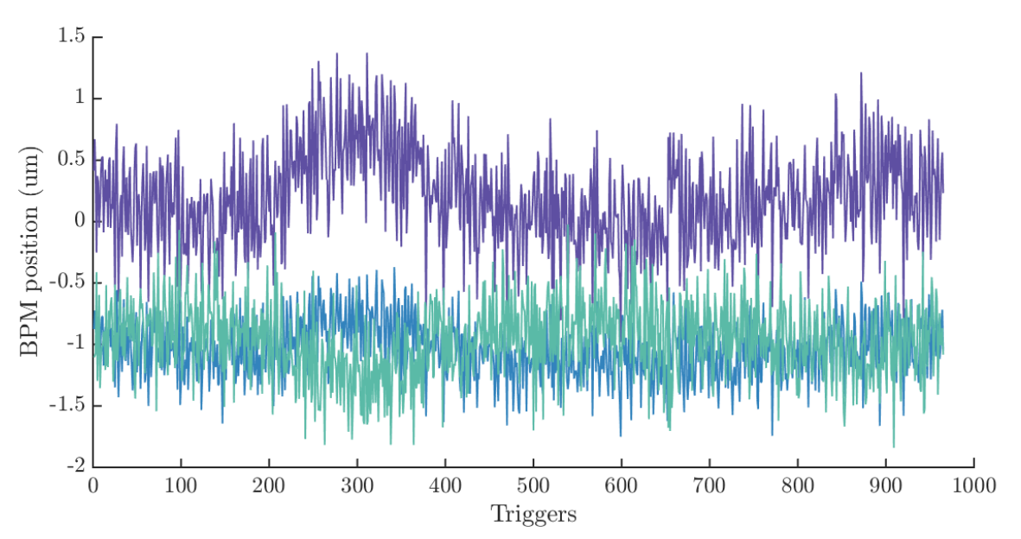
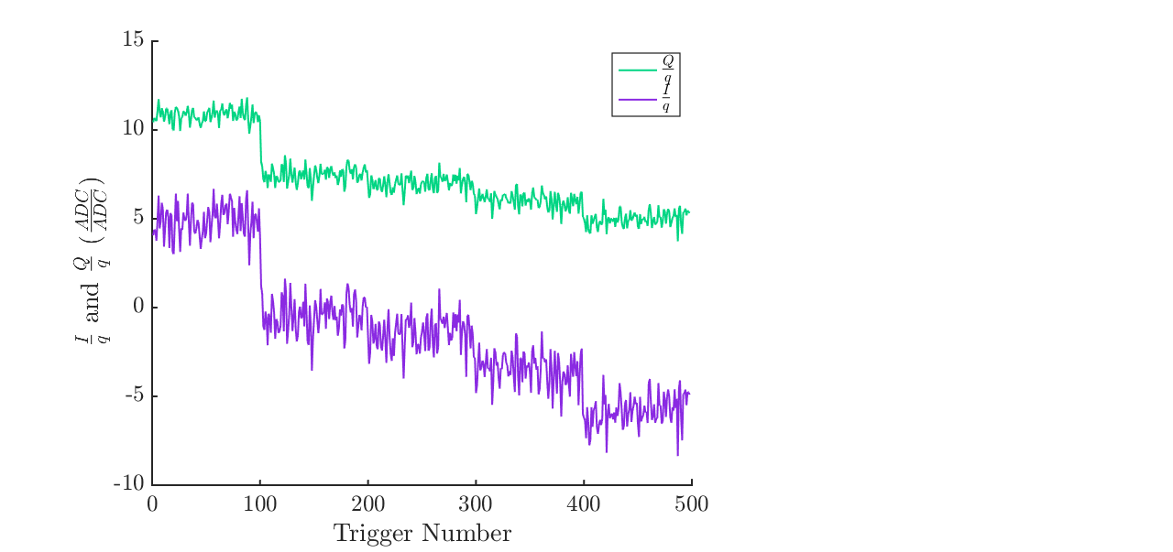
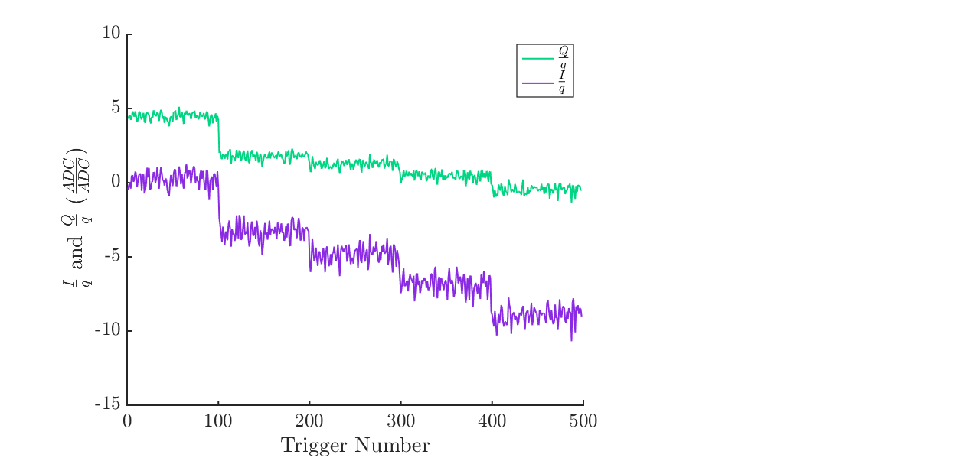
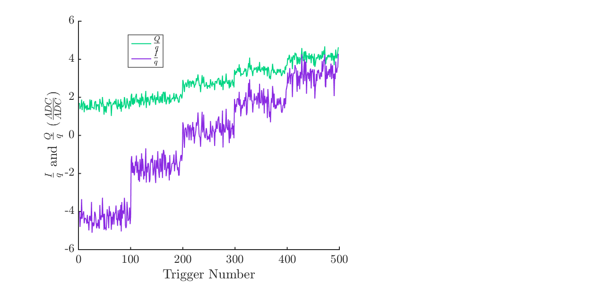
Calibration Issues
After consecutive resolution runs we turned up the charge to 0.6e10.
Beam drifts up to 1 um within 30 seconds make calibration difficult.
Smaller deviations closer to waist.
A
B
C

Slide 20
Beam Drift or Mover Issue?
Triggers plotted from entire calibration (shown on previous slide).
For the first mover setting, the triggers do not fully correlate with triggers at other settings – possibly suggesting for this mover step not all movers shifted by the same amount?
But, calibration looks suspect for all three BPMs suggesting beam effect?

Slide 21
Final Shift 27/04/2018

Slide 22
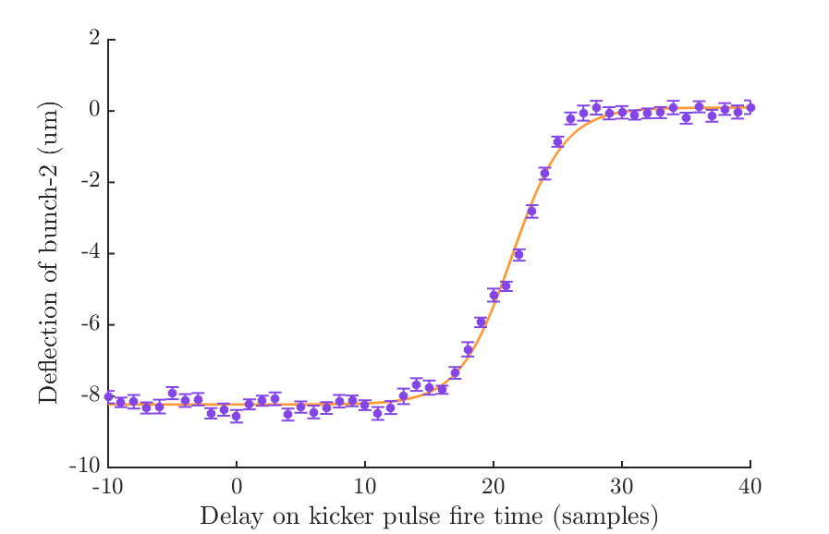
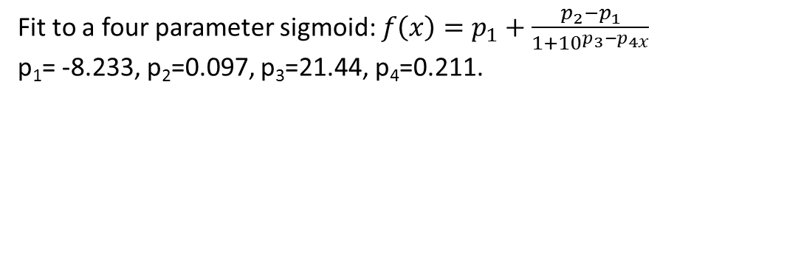
Latency Scan
Latency = bunch spacing – delay required to reduce kick to 90% max.
Bunch spacing: 100 samples (280 ns)
Delay to reduce kick to 90%: 17 samples (47.6 ns)
Latency = 280 ns – 47.6 ns = 232.4 ns.
47.6 ns
Fit to a four parameter sigmoid: $f\left(x\right)=p_{1}+\frac{p_{2}−p_{1}}{1+{10}^{p_{3}−p_{4x}}}$
p₁= -8.233, p₂=0.097, p₃=21.44, p₄=0.211.
Goodness of fit:
Chi squared value: 91.8
Chi squared/ dof: 91.8/49 = 1.9

