Slide 1
FONT Meeting Friday 11th May 2018
Overview of April 2018
Douglas BETT

Slide 2
Contents
Overview of data runs
Resolution measurements
Problems / issues
Planning for future runs

Slide 3
Overview of data runs
 | OWL | DAY | SWING
M 16
T 17
W 18 |  |  | 1
T 19 |  |  | 2a
F 20 | 2b
S 21
S 22
M 23
T 24
W 25 | 3
T 26
F 27 | 4a | 4b
1. BPM Q’ calibration
2. 3-BPM beam-based alignment
3. Nominal optics studies
4. 2-BPM feedback stabilising at IP

Slide 4
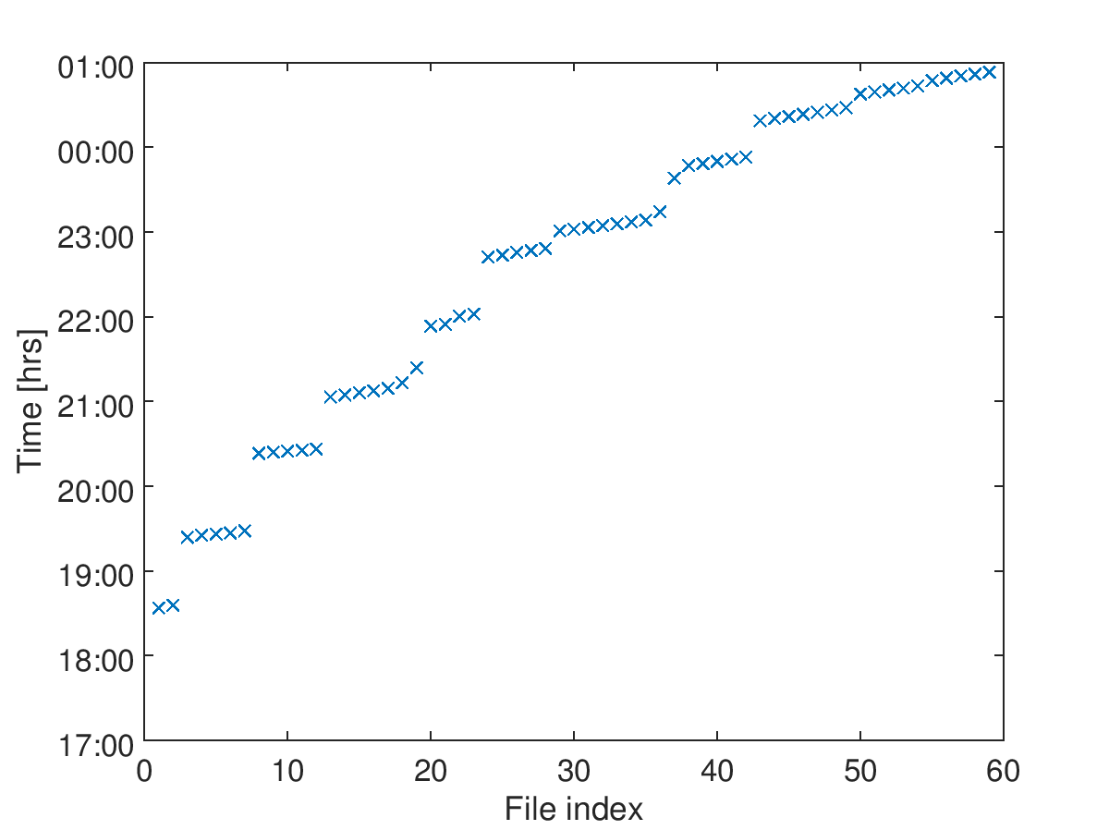
1. 18/04 [swing]
IPCyCal5
IPCTiltScan2
IPCTiltScan1
IPCyCal4
QD0FFyScan2
IPCyCal3
IPCyCal2
QD0FFyScan1
IPCyCal1
IPCxCal1
baseline runs

Slide 5
1. 18/04 [swing]
Nominal optics, single bunch, focus on IPC
IPBPM movers fully operational (with one important caveat)
Horizontal beam alignment checked using 2nd IP board
New LabVIEW DAQ used to continuously harvest upstream orbit data from EPICS
PROBLEMS/ISSUES
Very high jitter
Last user of IPBPM movers had applied a 3V offset between the front and back movers of the IPC block in the ATF user interface

Slide 6
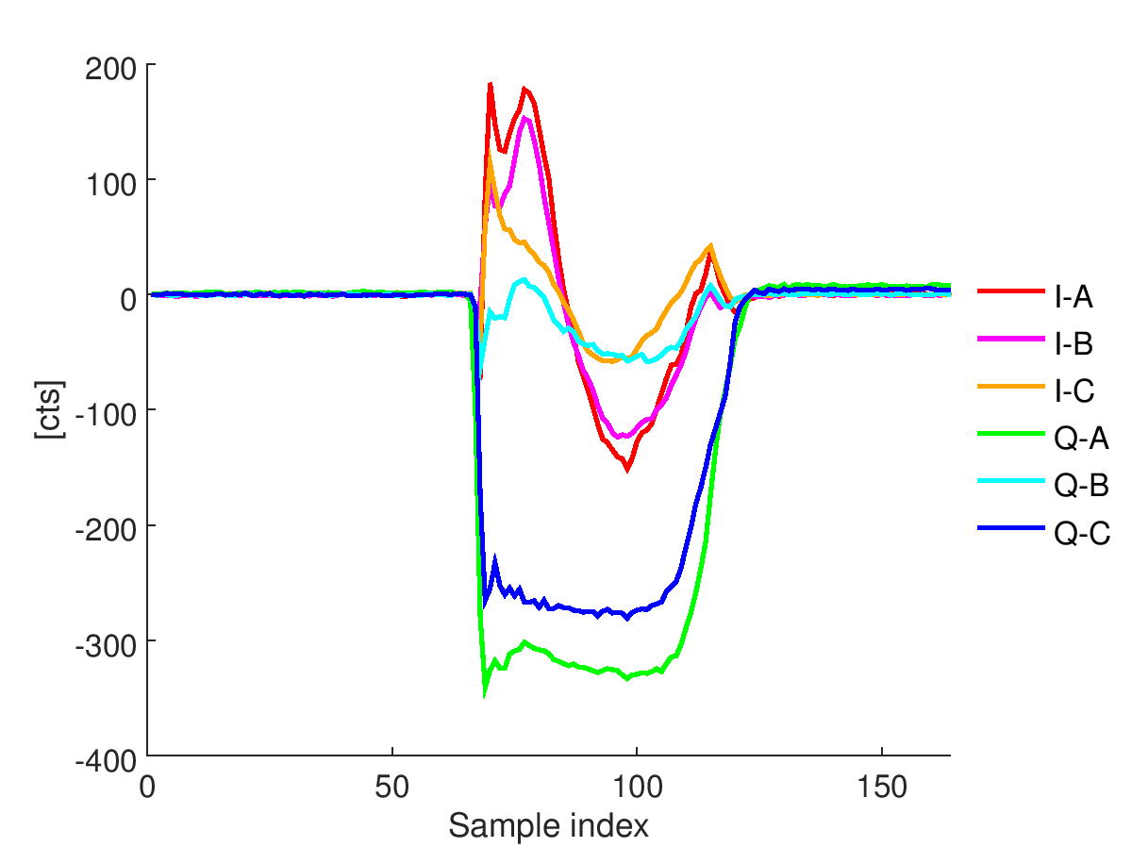
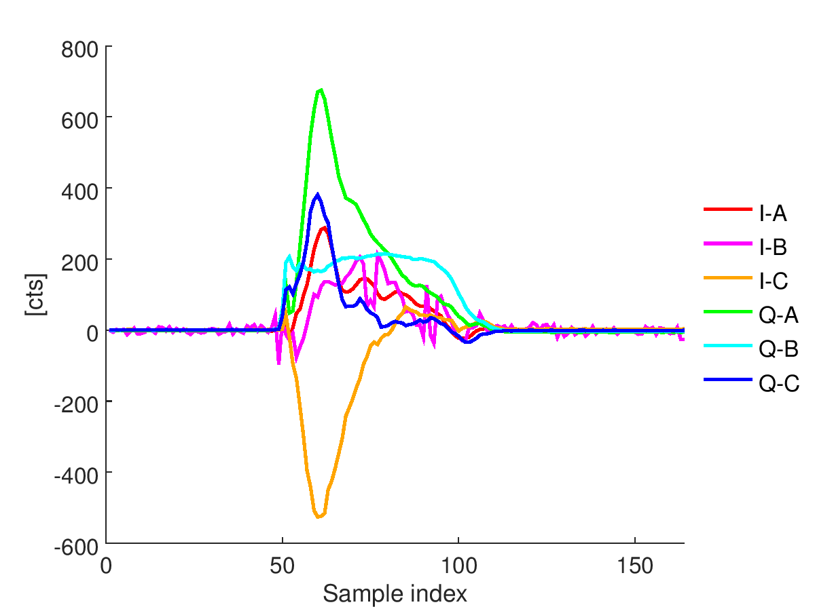
Baseline runs
average over 100 triggers of I and Q channel waveforms with 70 dB attenuation
vertical
horizontal

Slide 7
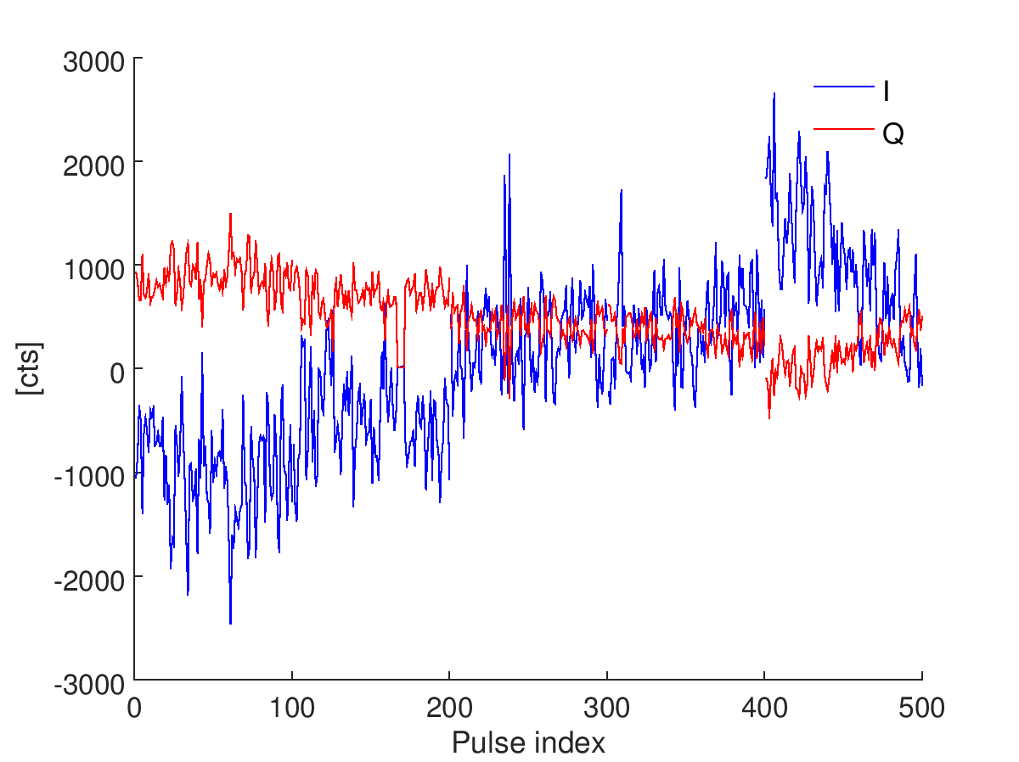
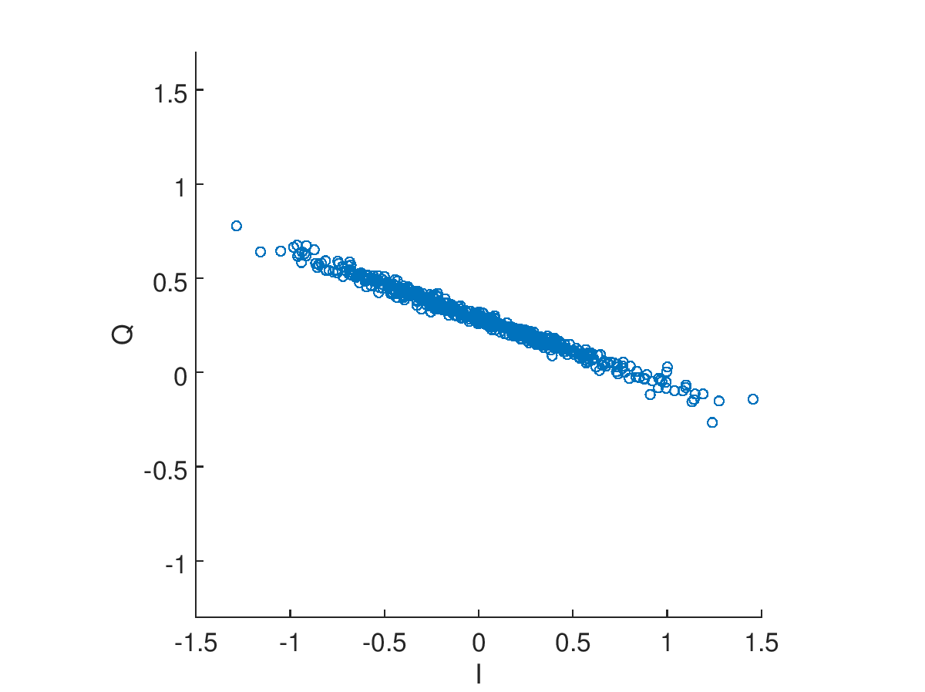
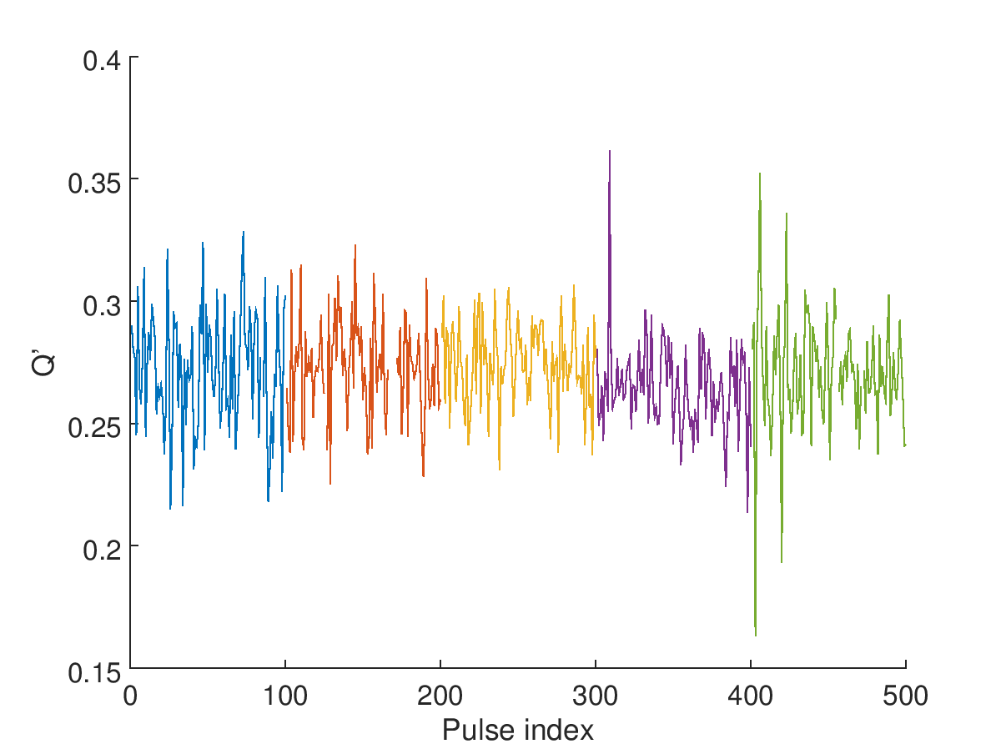
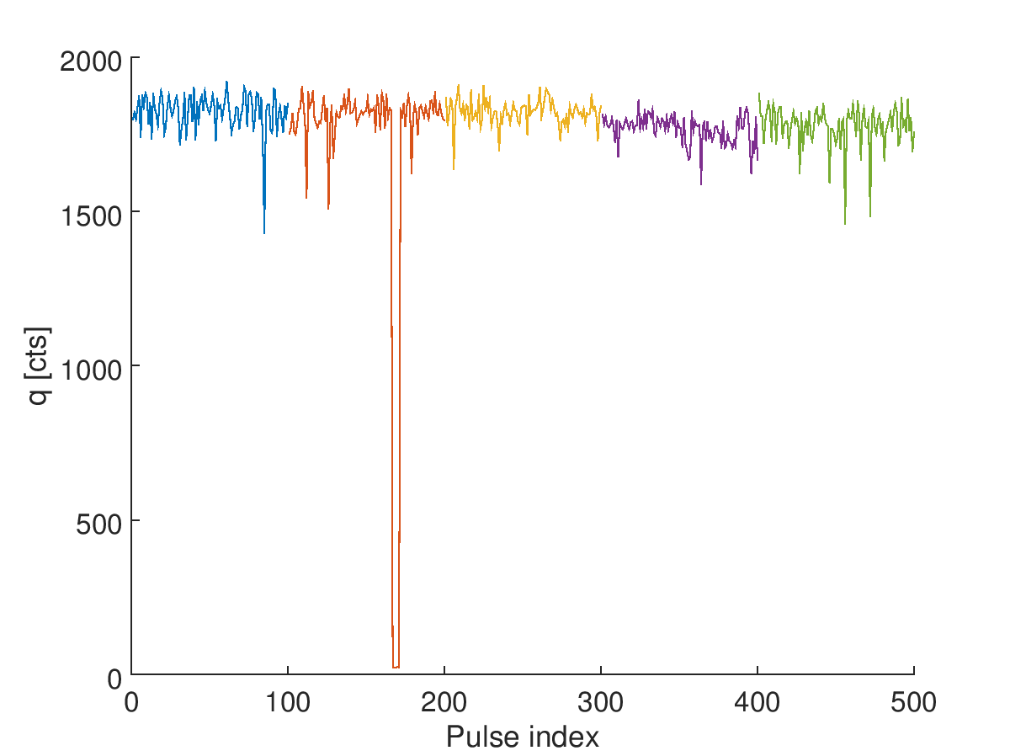
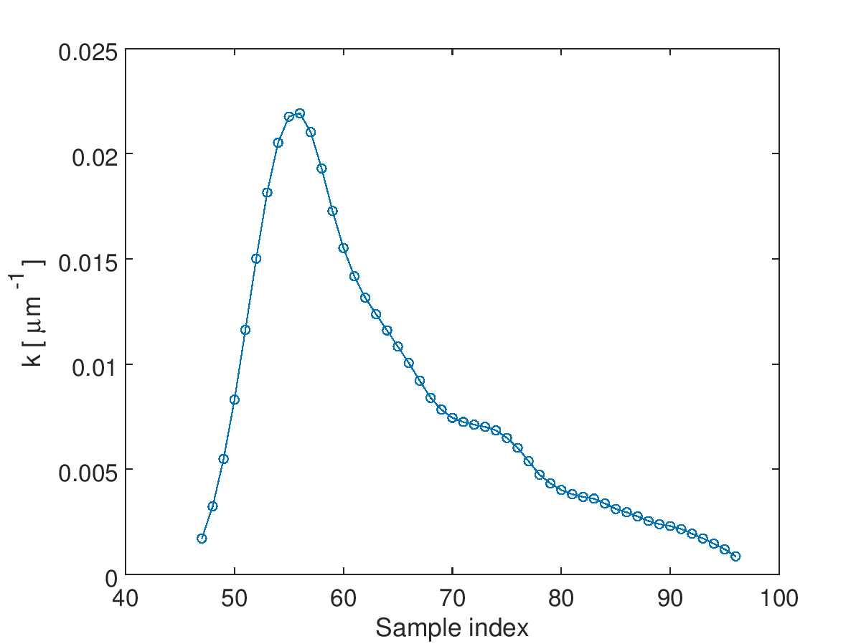
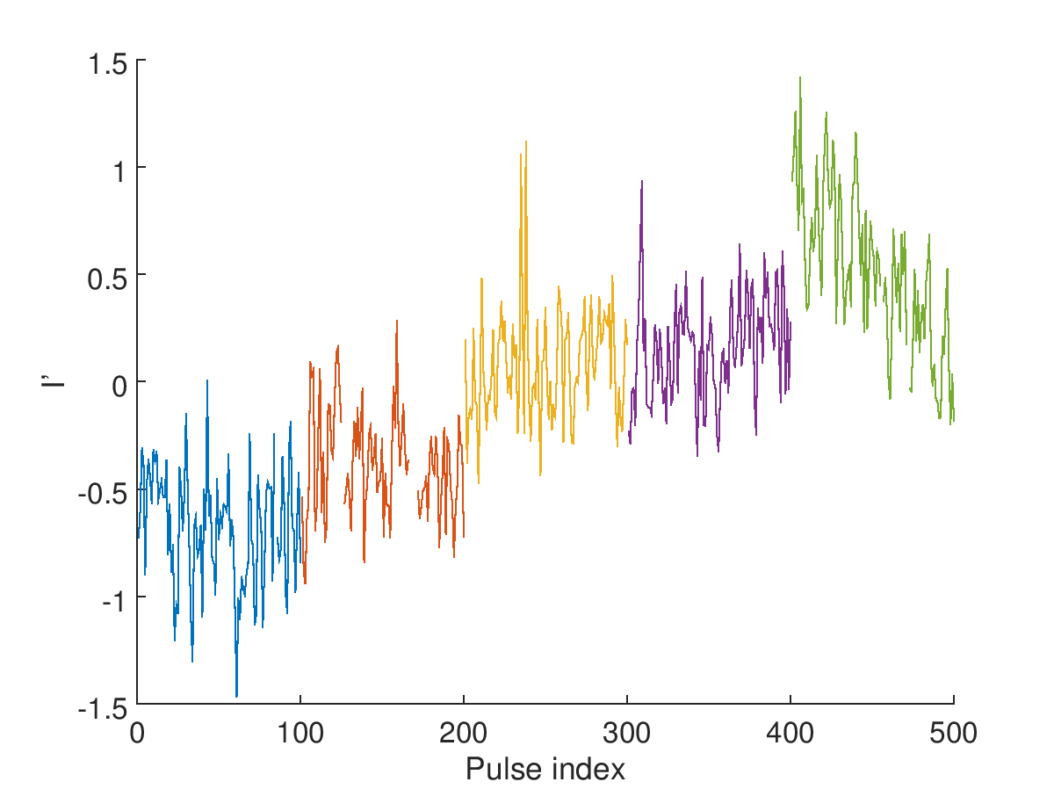
IPCxCal1_30dB_180418
I, Q vs. time
Q vs. I
Q’ vs. time
sample 56
sample 56
sample 56
charge vs. time
k vs. sample index
position vs. time
max @ sample 56
sample 56
sample 58

Slide 8
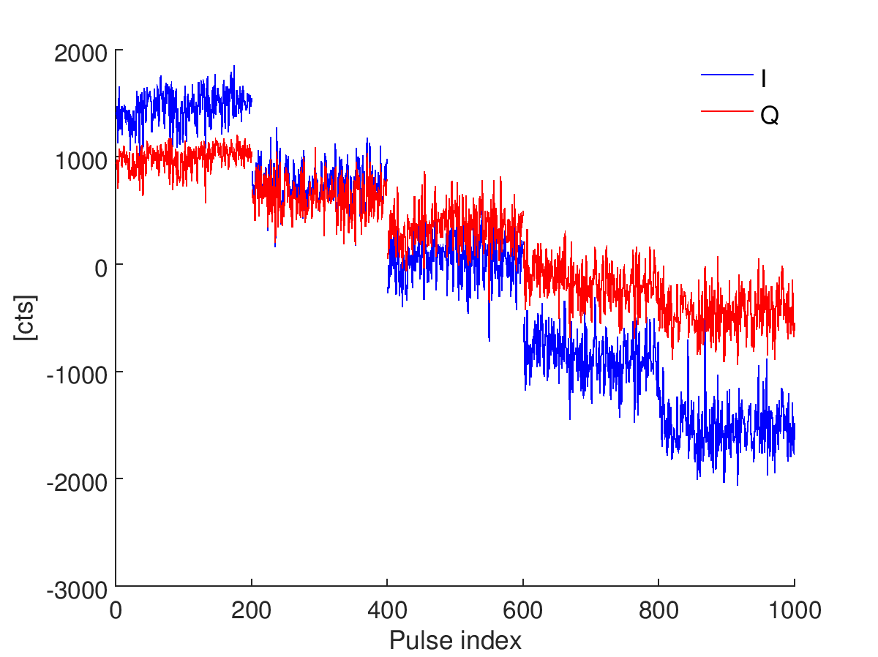
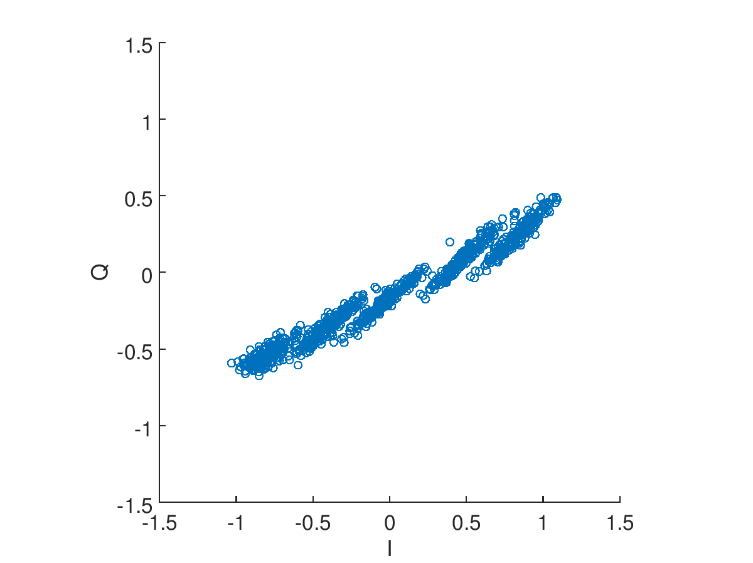
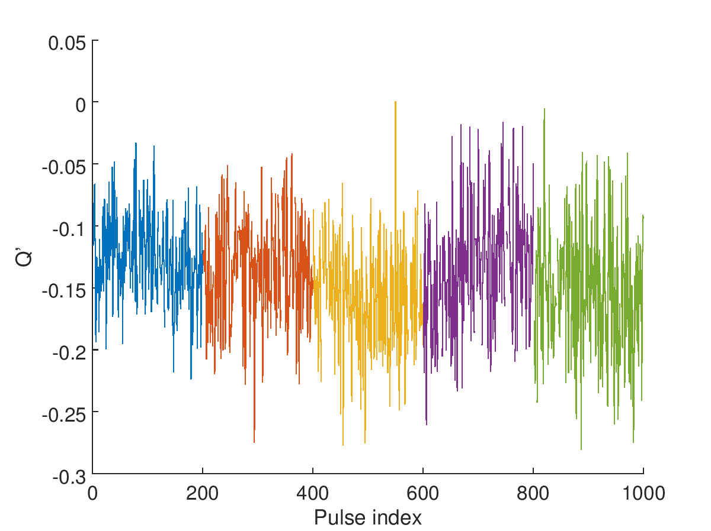
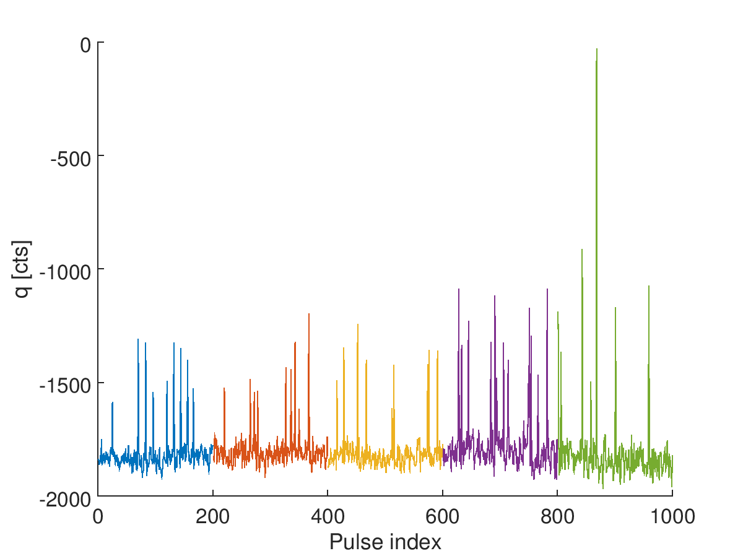
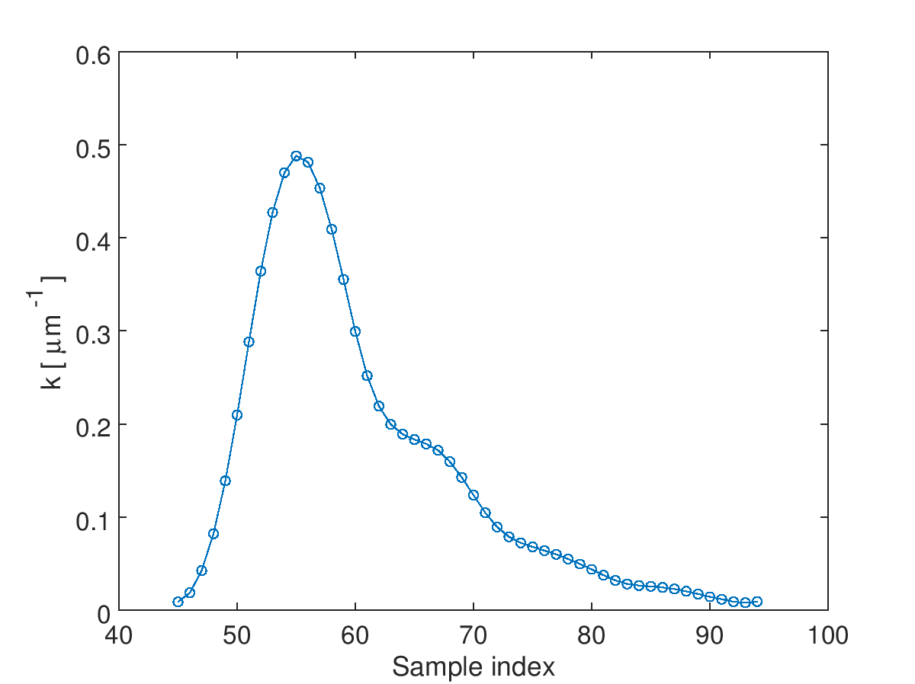
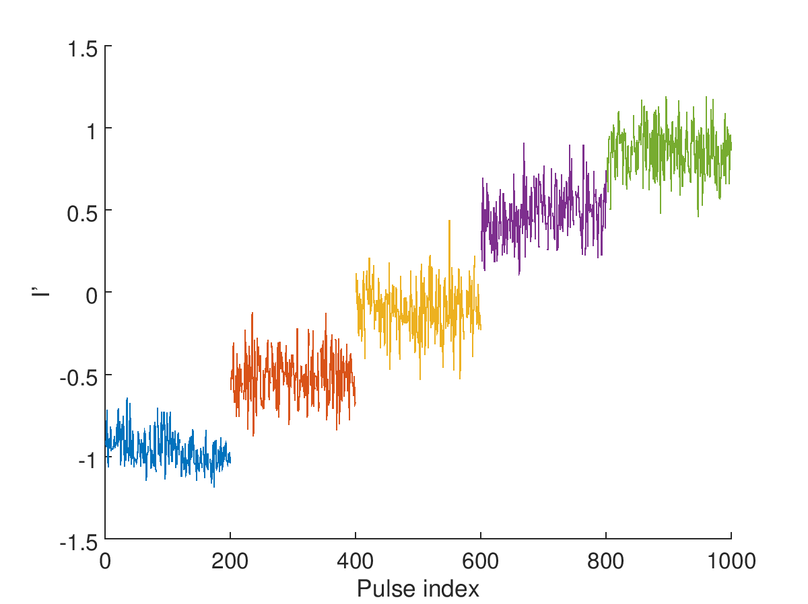
IPCyCal3_0dB_180418
I, Q vs. time
Q vs. I
Q’ vs. time
sample 55
sample 55
sample 55
charge vs. time
k vs. sample index
position vs. time
sample 59
max @ sample 55
sample 55

Slide 9
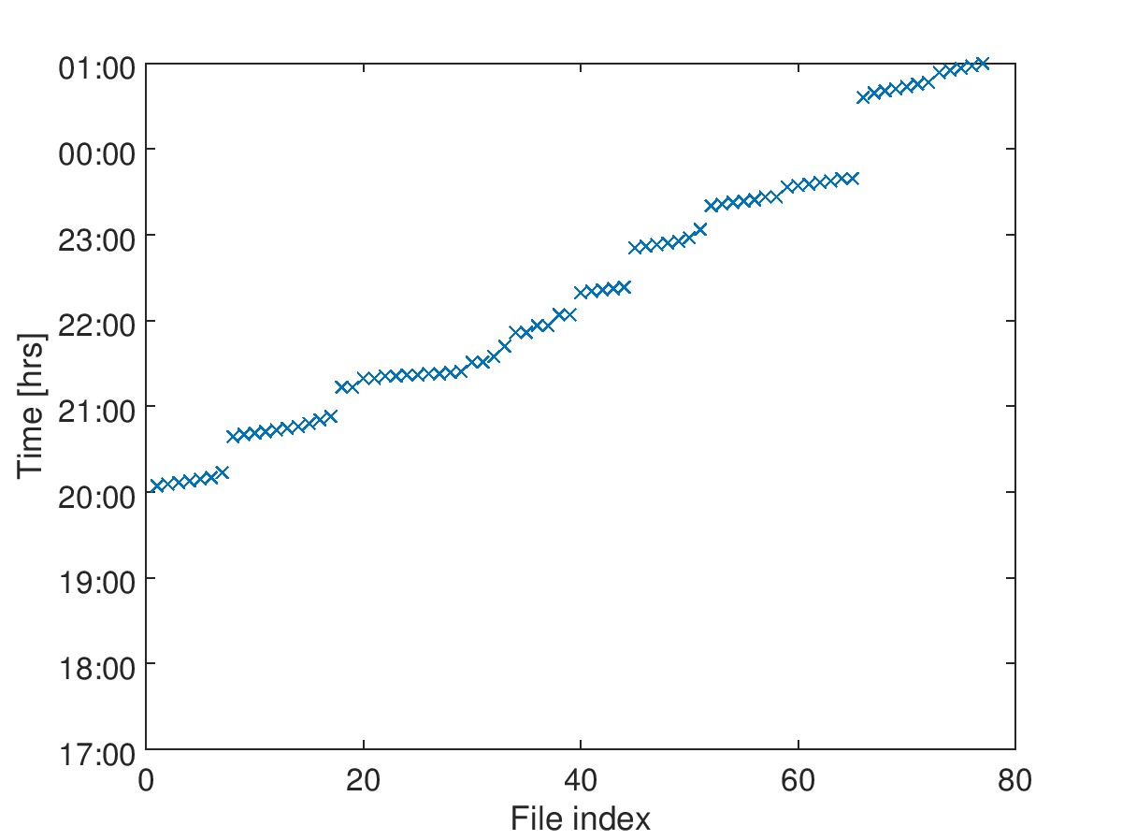
2a. 19/04 [swing]
IPyCal8
IPyCal7
IPyCal5
IPyCal4
IPyCal6
IPyCal3
IPxCal1
IPyCal2
IPyCal1

Slide 10
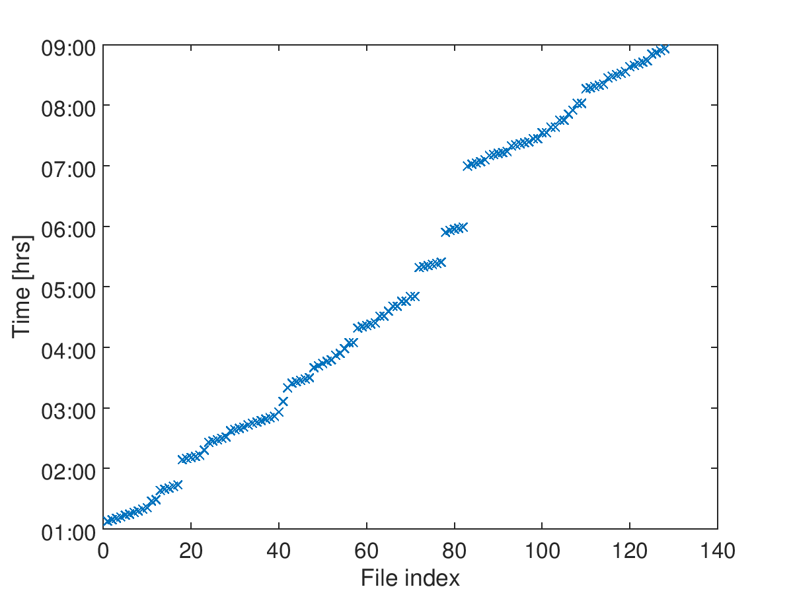
2b. 20/04 [owl]
IPyCal22
IPyCal20
IPyCal21
IPyCal19
IPyCal17
IPyCal18
IPyCal16
06:32 ACCESS
IPyCal15
IPyCal14
05:38 ACCESS
IPyCal13
04:58 ACCESS
IPyCal12
(adjust IPBPM phase)
AQF1FFyScan1
AQD0FFyScan1
yABTilt
yWaistScan
IPyCal11
IPyCal10
IPyCal9
IPyCal9A

Slide 11
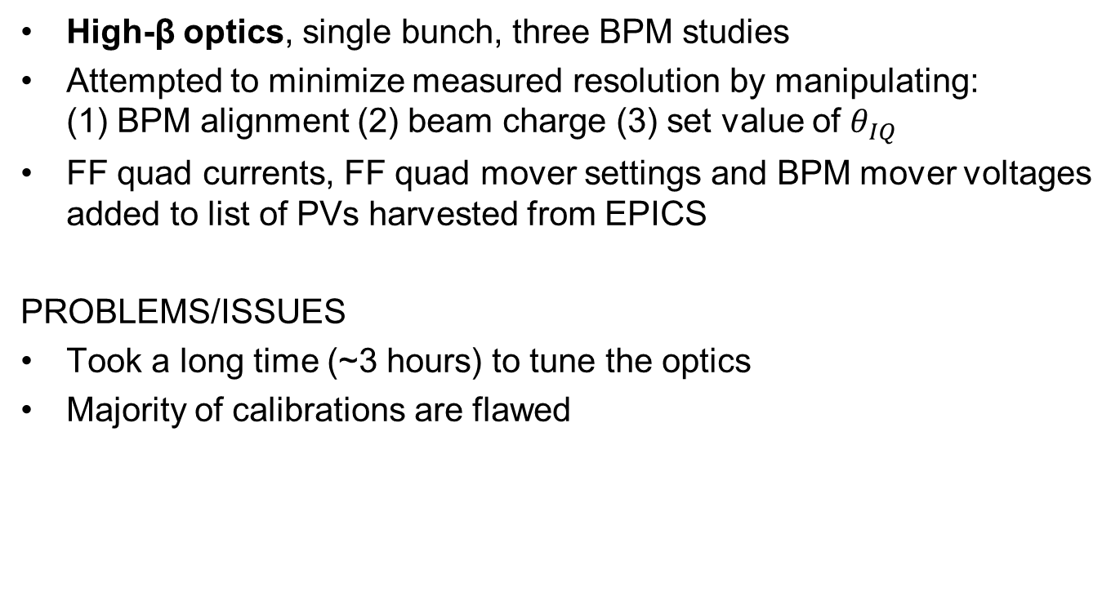
2. (19-20)/04 [swing+owl]
High-β optics, single bunch, three BPM studies
Attempted to minimize measured resolution by manipulating: (1) BPM alignment (2) beam charge (3) set value of $θ_{IQ}$
FF quad currents, FF quad mover settings and BPM mover voltages added to list of PVs harvested from EPICS
PROBLEMS/ISSUES
Took a long time (~3 hours) to tune the optics
Majority of calibrations are flawed

Slide 12
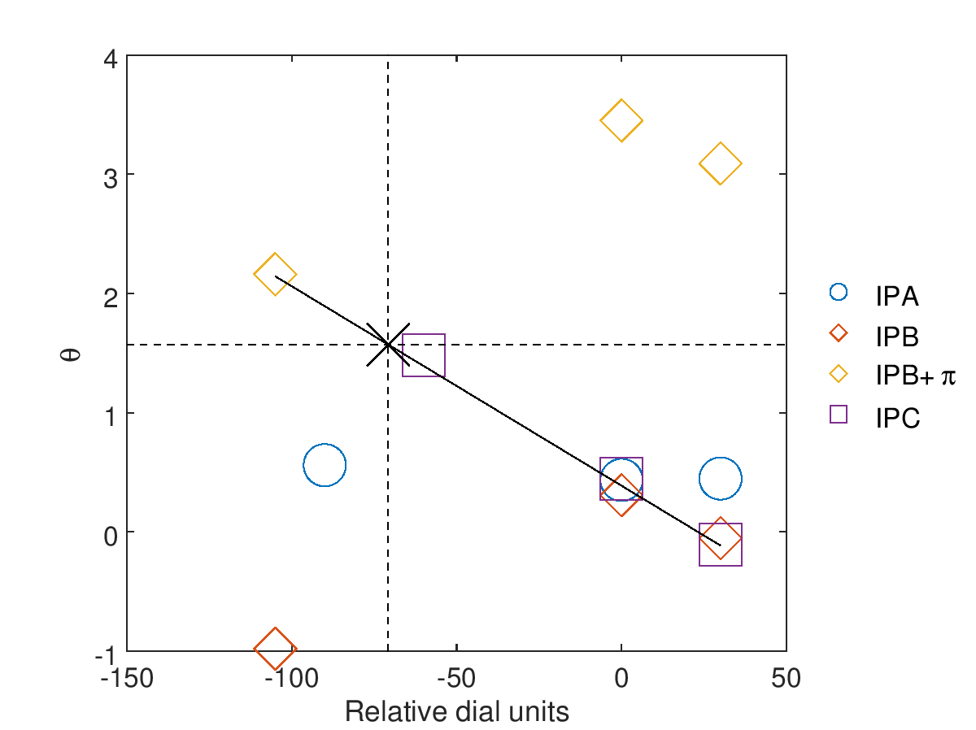
Phase adjustment
INITIAL
 | θ | Dial
IPA | 0.44 | 0
IPB | 0.31 | 0
IPC | 0.45 | 0
iter3
iter1
iter2
FINAL
 | θ | Dial
IPA | 1.39 | -1170
IPB | -1.43 | -71
IPC | 1.46 | -60

Slide 13
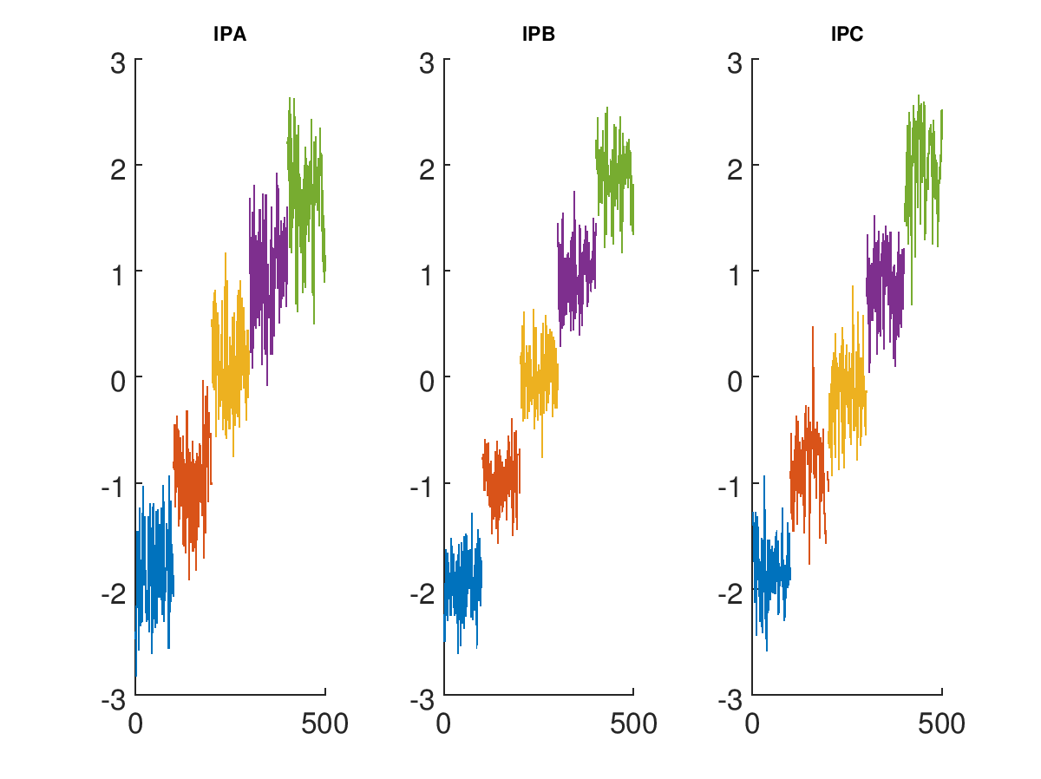
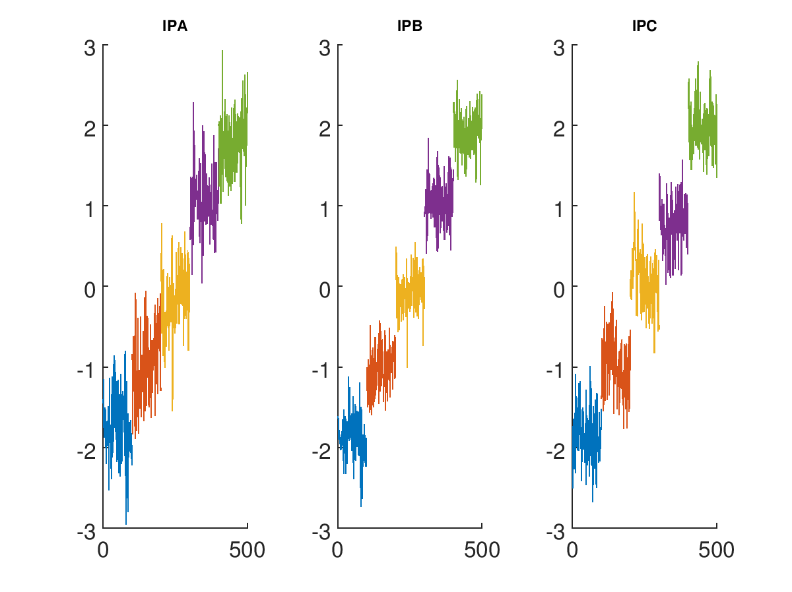
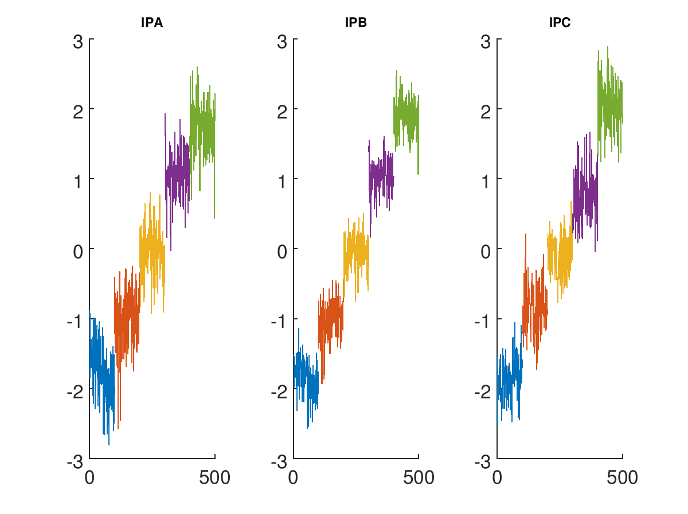
Calibrations
File | Status
IPyCal1
IPyCal2
IPyCal3
IPyCal4
IPyCal5
IPyCal6
IPyCal7
IPyCal8
IPyCal9
IPyCal10
IPyCal11
IPyCal12
IPyCal13
IPyCal14
IPyCal15
IPyCal16
IPyCal17
IPyCal18
IPyCal11
IPyCal15
IPyCal18

Slide 14
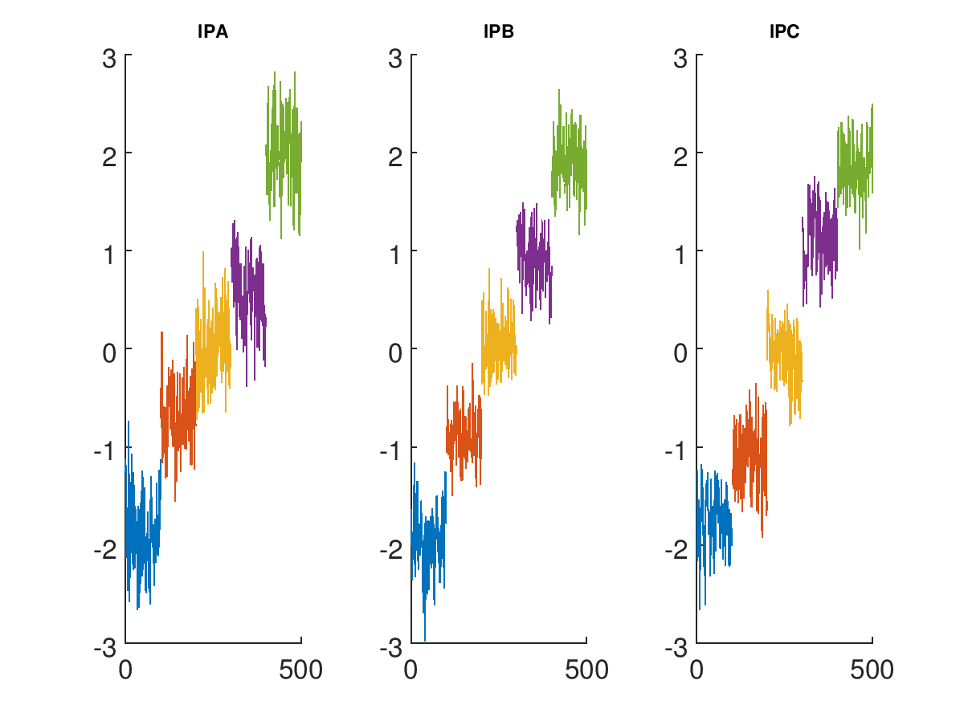
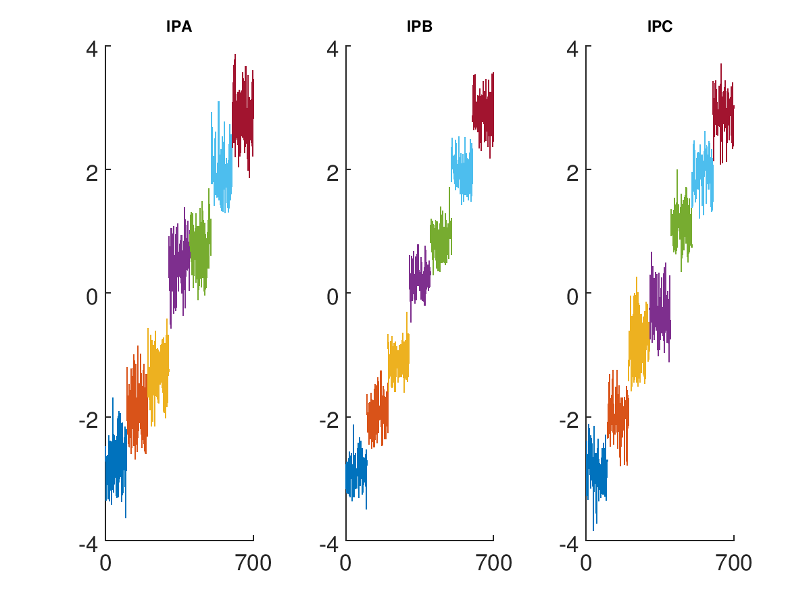
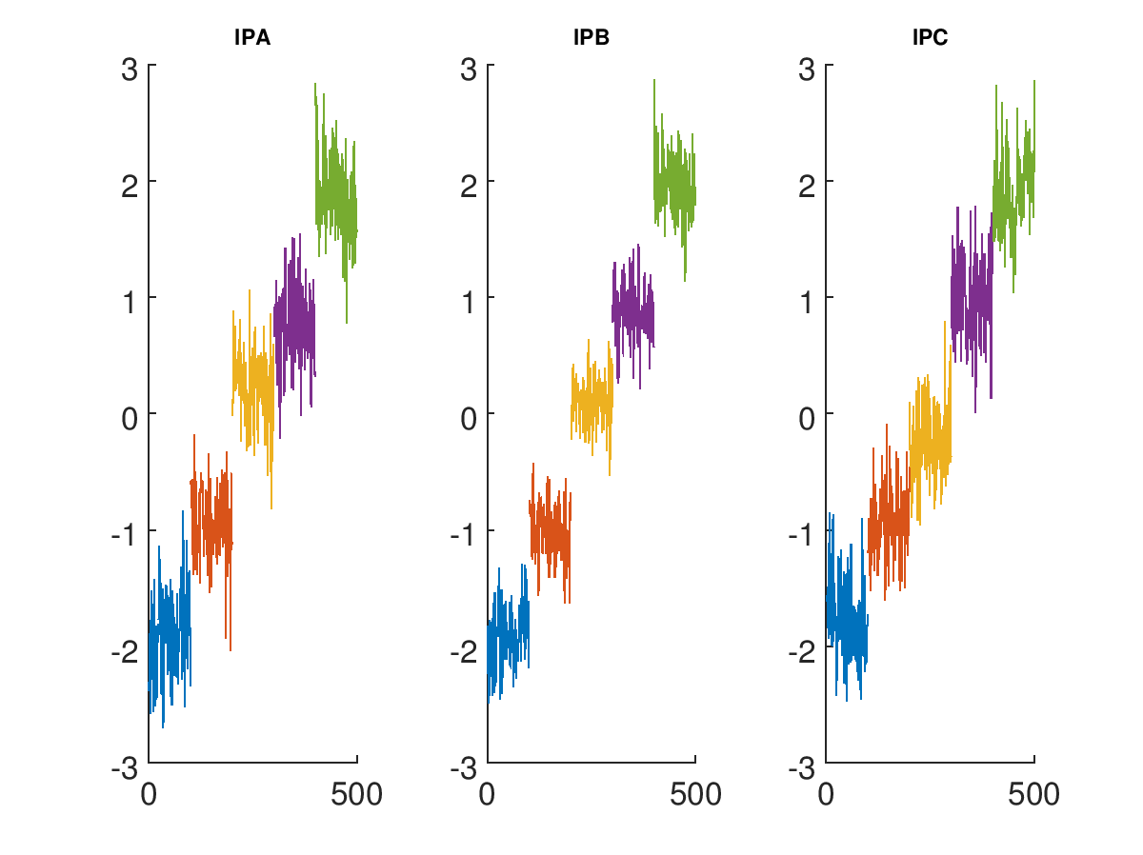
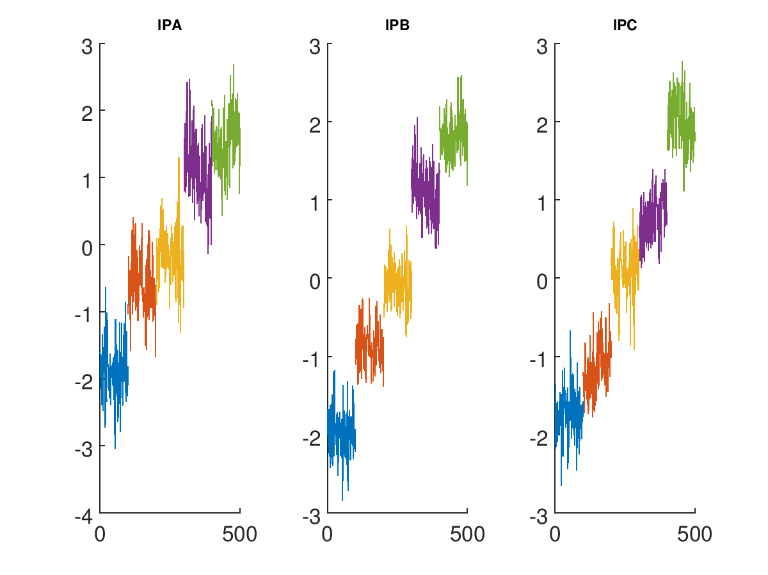
Flawed calibrations I
File | Status
IPyCal1
IPyCal2
IPyCal3
IPyCal4
IPyCal5
IPyCal6
IPyCal7
IPyCal8
IPyCal9
IPyCal10
IPyCal11
IPyCal12
IPyCal13
IPyCal14
IPyCal15
IPyCal16
IPyCal17
IPyCal18
IPyCal1
IPyCal2
IPyCal12
IPyCal14

Slide 15
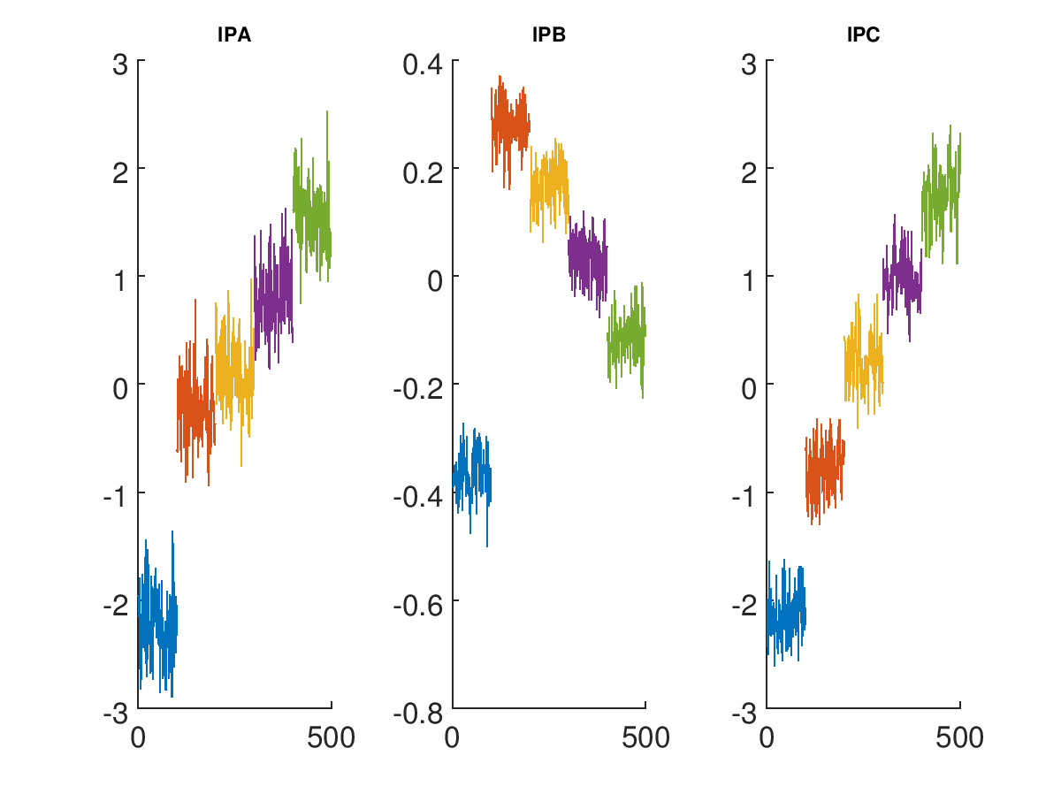
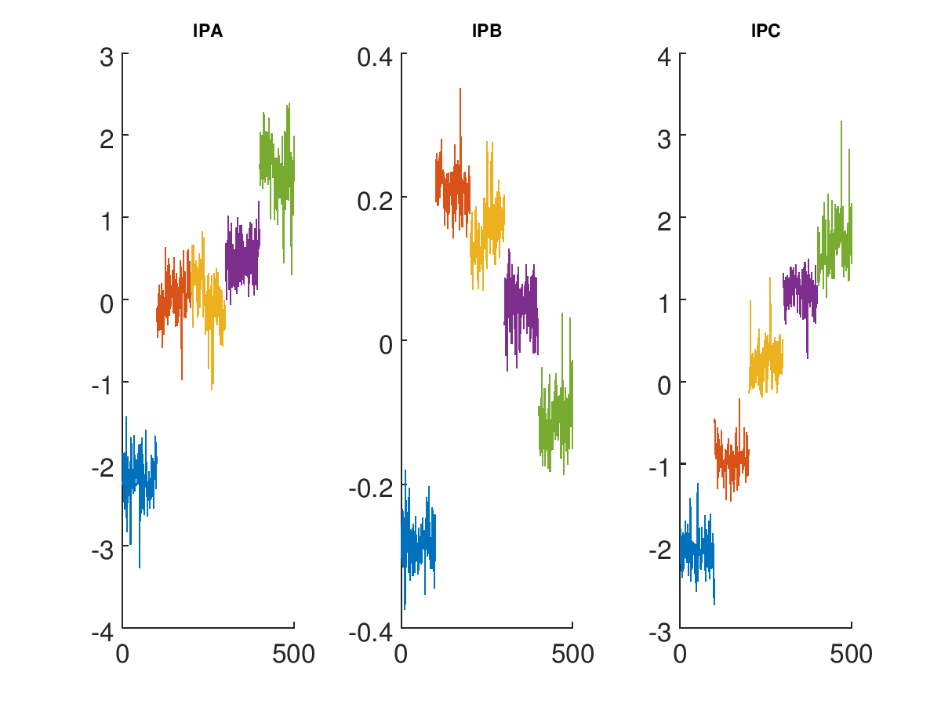
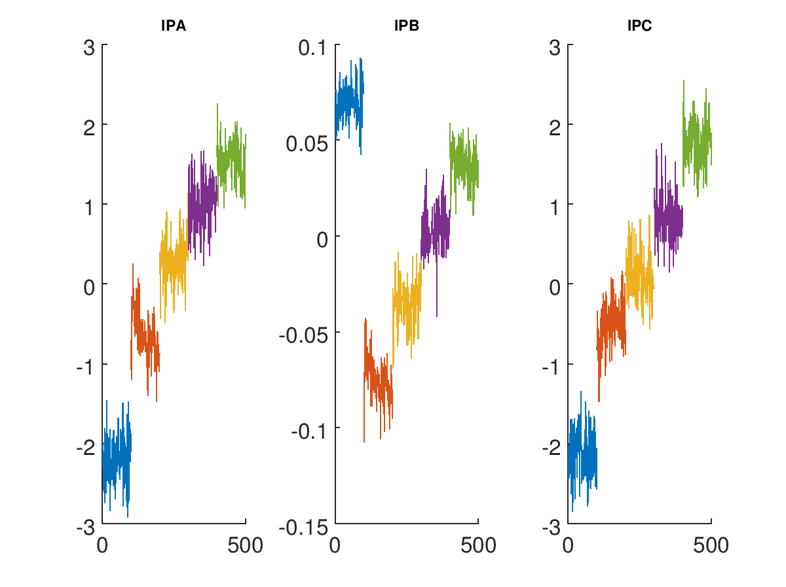
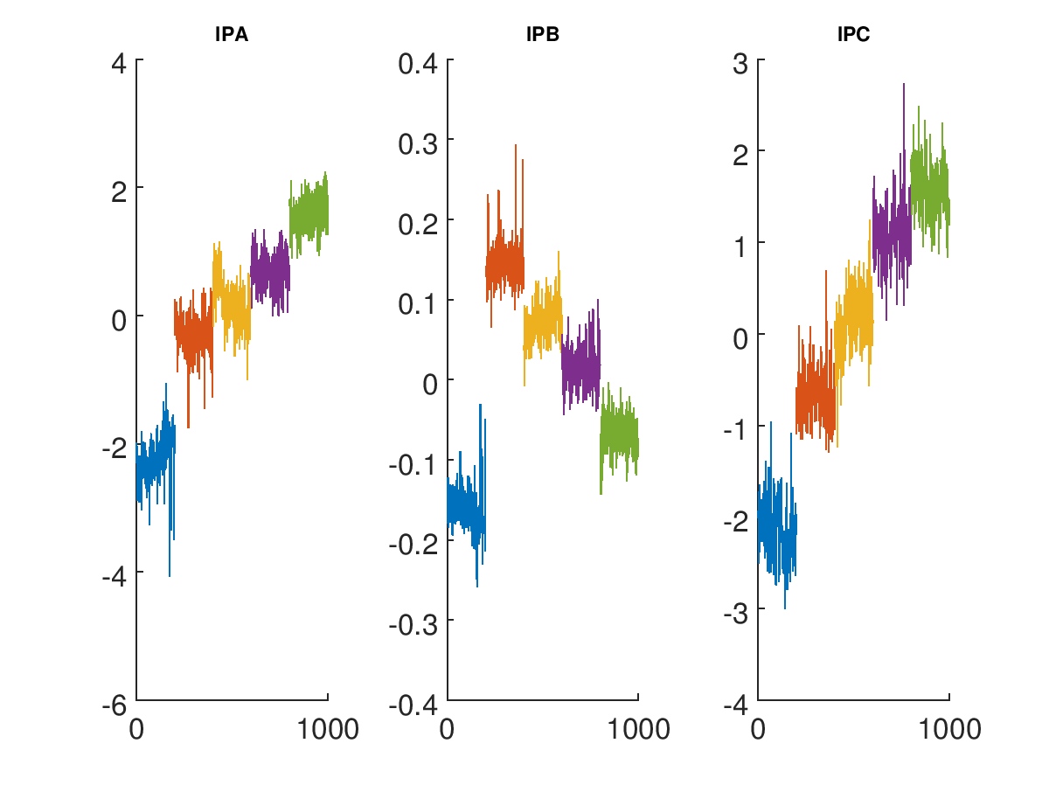
Flawed calibrations II
File | Status
IPyCal1
IPyCal2
IPyCal3
IPyCal4
IPyCal5
IPyCal6
IPyCal7
IPyCal8
IPyCal9
IPyCal10
IPyCal11
IPyCal12
IPyCal13
IPyCal14
IPyCal15
IPyCal16
IPyCal17
IPyCal18
IPyCal4
IPyCal5
IPyCal6
IPyCal7

Slide 16
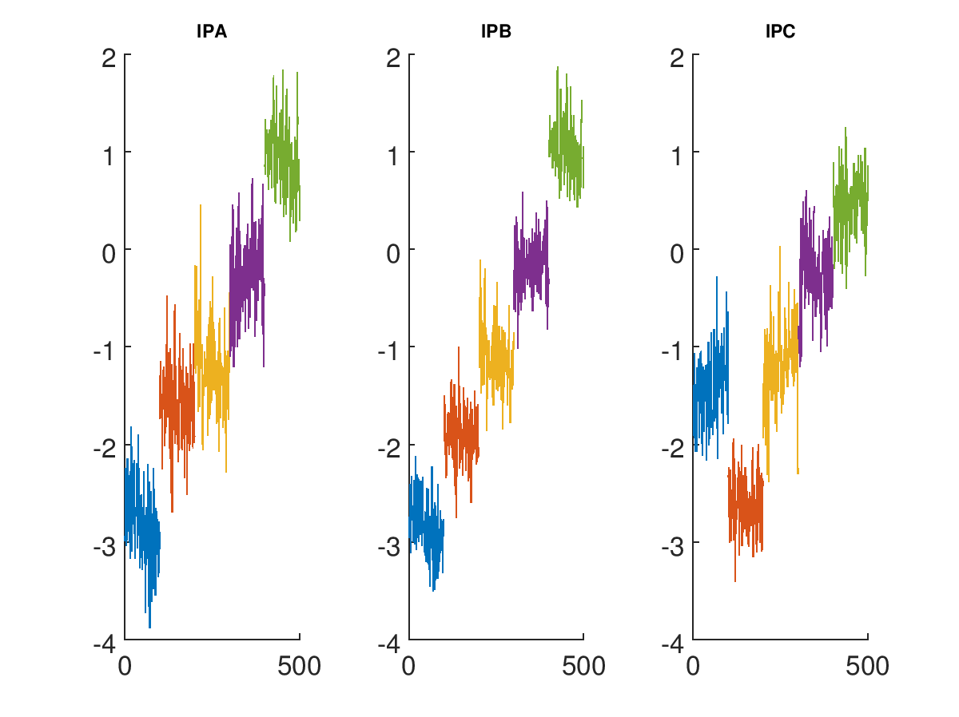
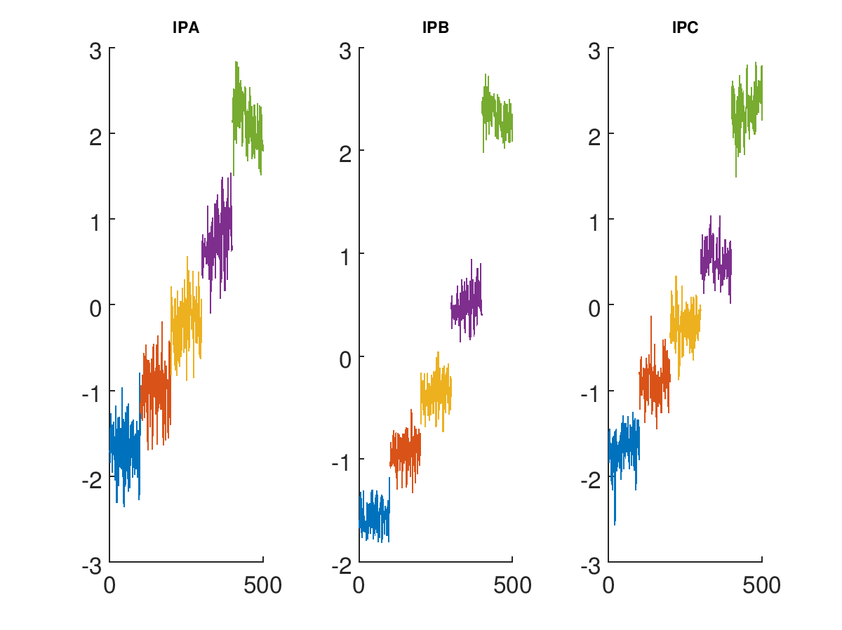
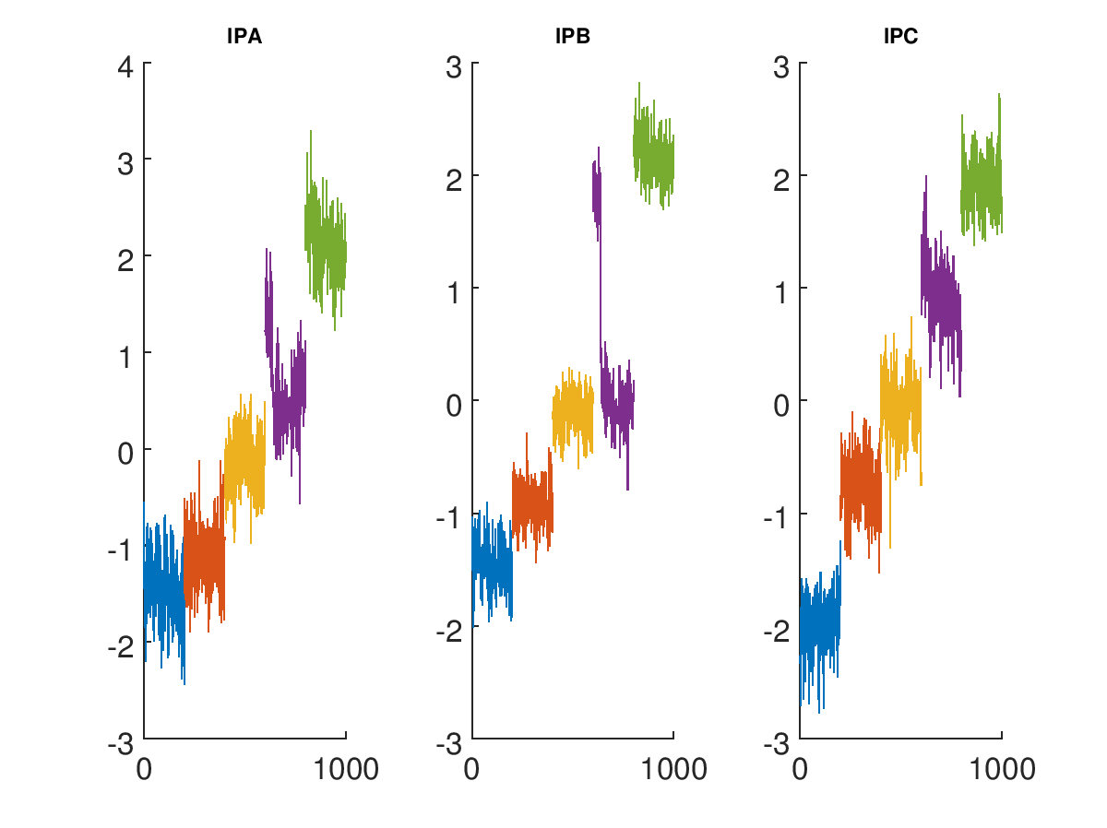
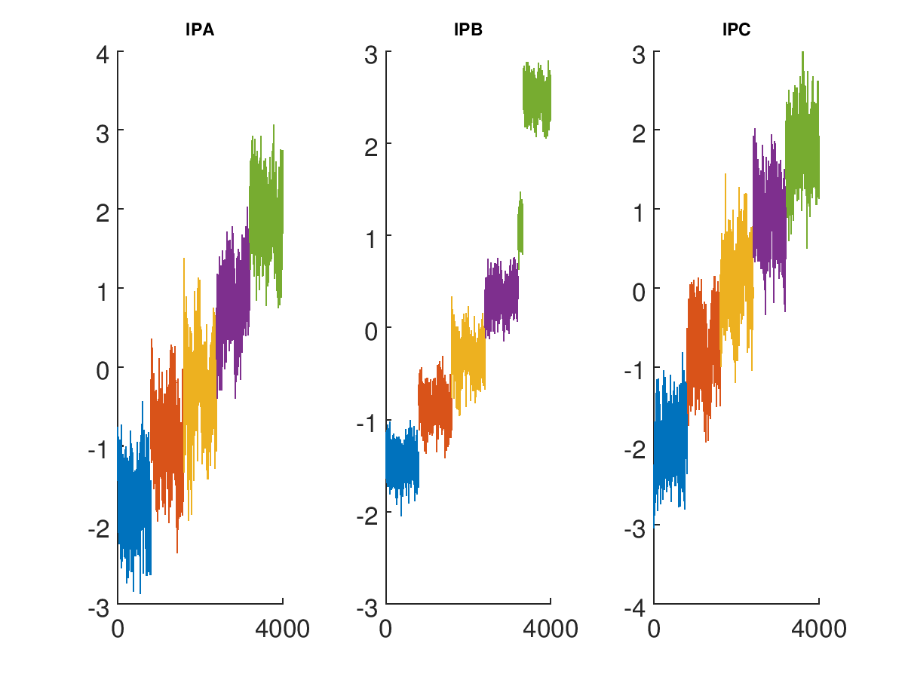
Flawed calibrations III
File | Status
IPyCal1
IPyCal2
IPyCal3
IPyCal4
IPyCal5
IPyCal6
IPyCal7
IPyCal8
IPyCal9
IPyCal10
IPyCal11
IPyCal12
IPyCal13
IPyCal14
IPyCal15
IPyCal16
IPyCal17
IPyCal18
IPyCal3
IPyCal10
IPyCal9
IPyCal13

Slide 17
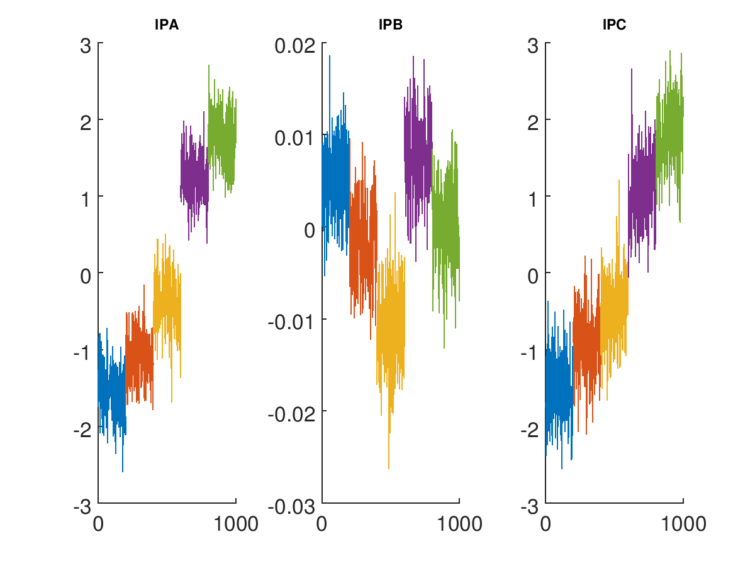
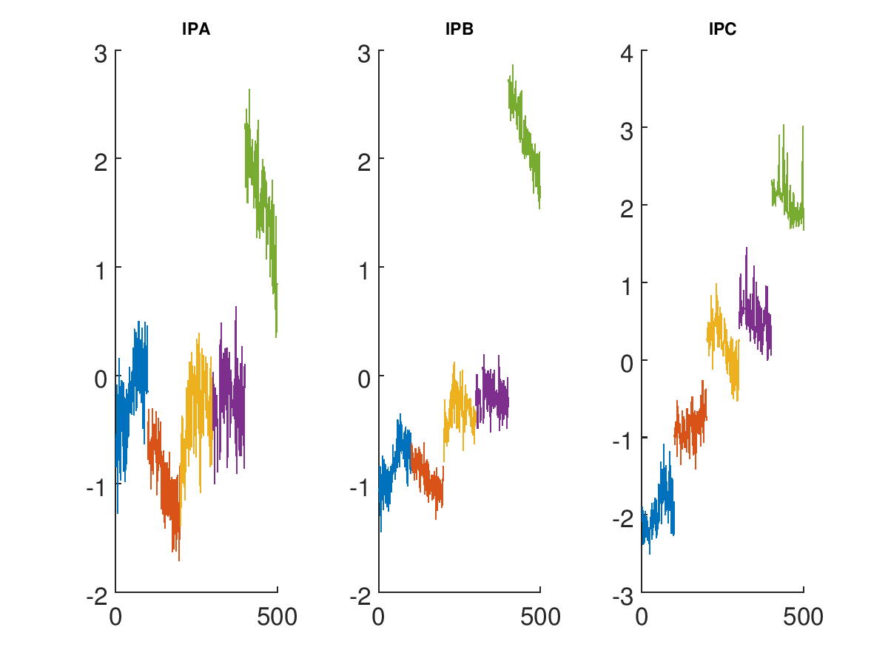
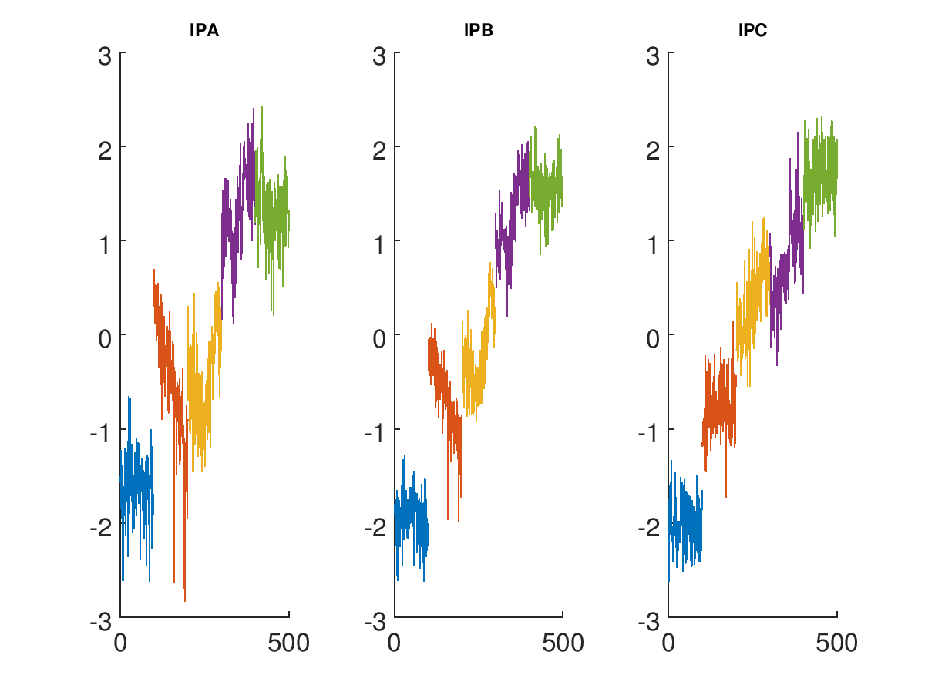
Flawed calibrations IV
File | Status
IPyCal1
IPyCal2
IPyCal3
IPyCal4
IPyCal5
IPyCal6
IPyCal7
IPyCal8
IPyCal9
IPyCal10
IPyCal11
IPyCal12
IPyCal13
IPyCal14
IPyCal15
IPyCal16
IPyCal17
IPyCal18
IPyCal8
IPyCal16
IPyCal17

Slide 18
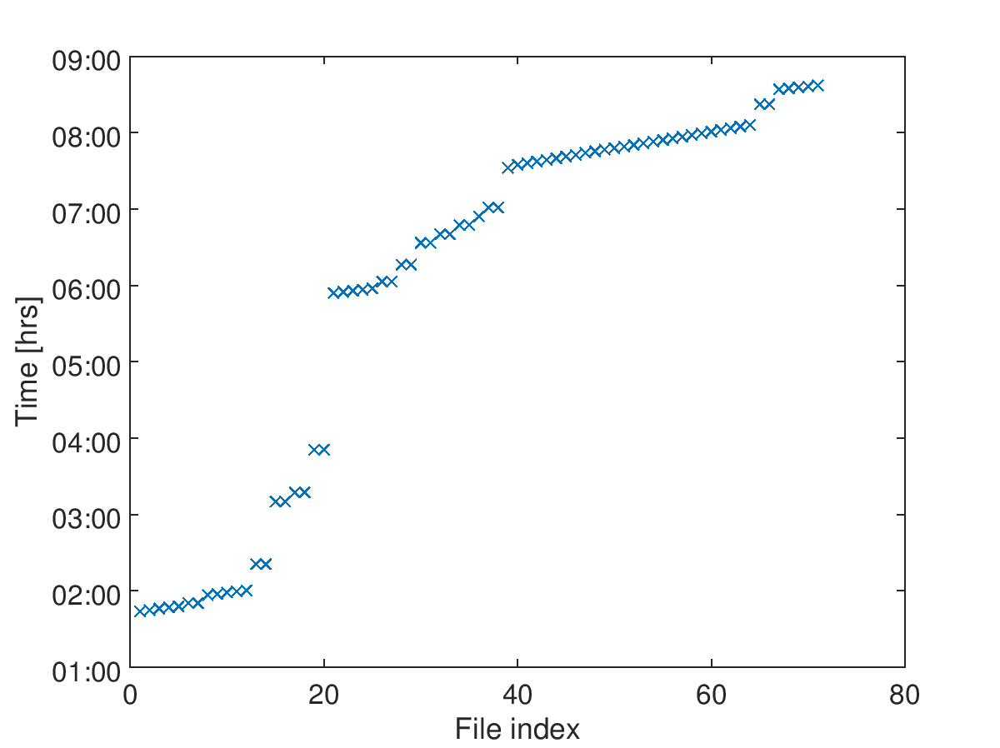
3. 25/04 [owl]
AQD0FFyScan4
latencyScan1
AQD0FFyScan3
AQD0FFyScan2
05:02 ACCESS
04:23 ACCESS
(upstream setup)
AQD0FFyScan1
IPyCal1

Slide 19
3. 25/04 [owl]
Nominal optics, two bunch, three BPM studies
PROBLEMS/ISSUES
Unacceptable offset of the second bunch

Slide 20
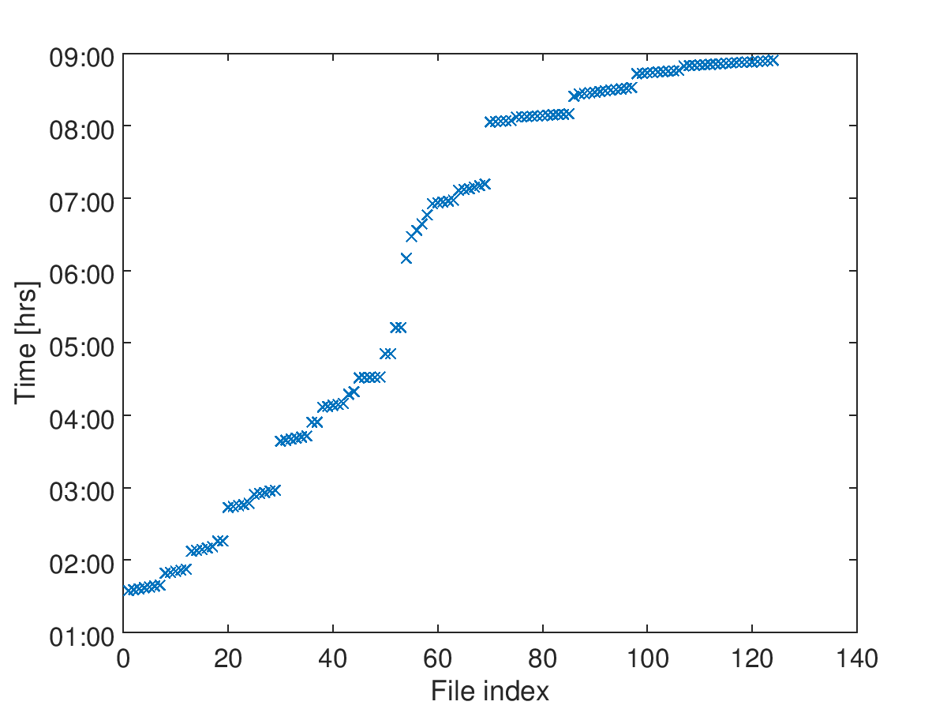
4a. 27/04 [owl]
loPhaseScan1
IPKCal1
IPKCal2
mCal1
AQD0FFyScan10
AQD0FFyScan12
AQD0FFyScan11
07:18 ACCESS
AQD0FFyScan9
(diagnose P2)
AQD0FFyScan8
05:17 ACCESS
AQD0FFyScan7
(upstream setup)
yWaistScan1
AQD0FFyScan6
AQD0FFyScan5
AQD0FFyScan4
AQD0FFyScan3
AQD0FFyScan2
AQD0FFyScan1

Slide 21
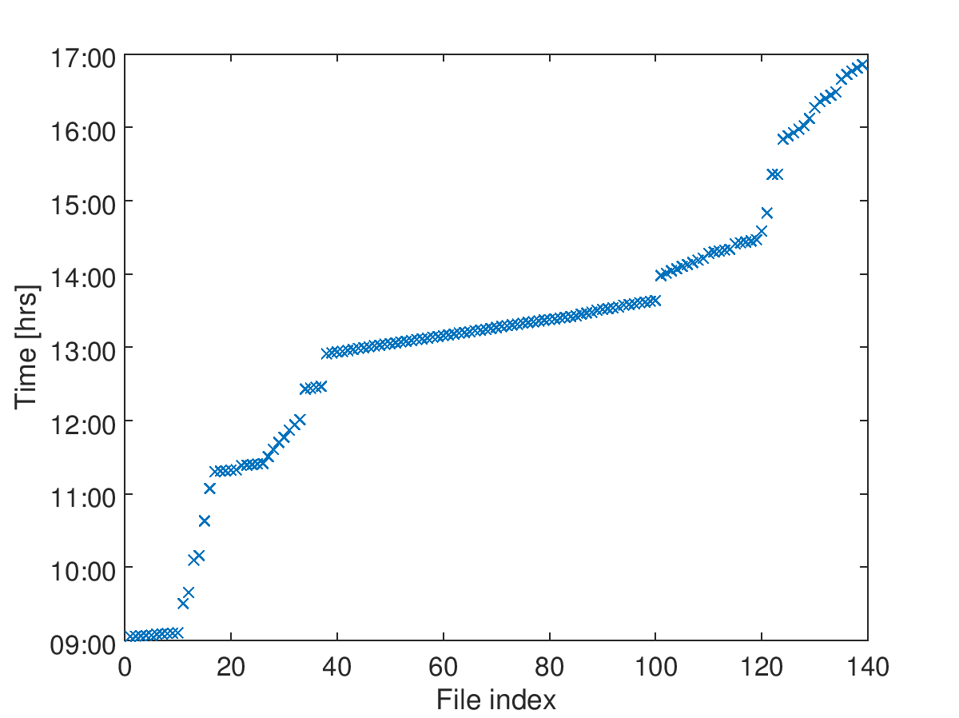
4b. 27/04 [day]
IPAyTiltScan
IPByTiltScan
IPCyTiltScan
yWaistScan2
AQD0FFyScan15
IPKCal
latencyScan2
latencyScan1
yDispersionScan1
AQD0FFyScan14
AQD0FFyScan13
feedback runs
K1 and K2 calibrations

Slide 22
4. 27/04 [owl+day]
High-β optics, two bunch, three BPM studies
Returned to performing BPM calibrations with quadrupole mover
PROBLEMS/ISSUES
Calibrations remain suspect
Feedback unsuccessful – problem with gains?

Slide 23
Conclusion
Resolution plateau reached at ~20 nm
Too much drift to comfortably operate any distance off waist?

