Slide 1
Z resolution and event time
LCTPC 2nd Topical Analysis Meeting
May 18, 2018
P. Colas, CEA/Irfu, Université Paris Saclay
With contributions from A. Bellerive, S. Ganjour, R. Mehdiyev
(No recent work)

Slide 2
Z coordinate given by drift time * v_{drift}
Origin : t zero
Every pad is connected to a sampler with a clock (25 MHz, 511 time bins, for tests at DESY with AFTER electronics)
V_{drift} can be measured by different methods, or taken from simulation. It slightly depends on the row. It is affected by pressure and temperature variations

Slide 3
Hit time determination
A hit is a cluster of several pads, each having a charge vs time information.
Multiplicity depends on RC per unit surface of the resistive-capacitive anode.
Here 2015 data, 100 ns shaping
<m>=2.59
<m>=3.61
Carbon-loaded kapton
Diamond-Like Carbon (DLC)

Slide 4
Hit time determination
Several estimators of the hit time (implemented in Marlin, Rashid Mehdiyev)
Max bin (very crude)
Max bin fitted
Half-max bin
Weighted mean
Gaussian inflexion
Fit an helix through the hits
Calculate z-residuals of the hits to te helix
Sigma of the residuals is your z resolution (geometric mean between inclusive and exclusive residuals)
Example of COSMO data

Slide 5
Hit time determination
Several estimators of the hit time (implemented in Marlin, Rashid Mehdiyev)
Max bin (very crude)
Max bin fitted
Half-max bin
Weighted mean
Gaussian inflexion

Slide 6
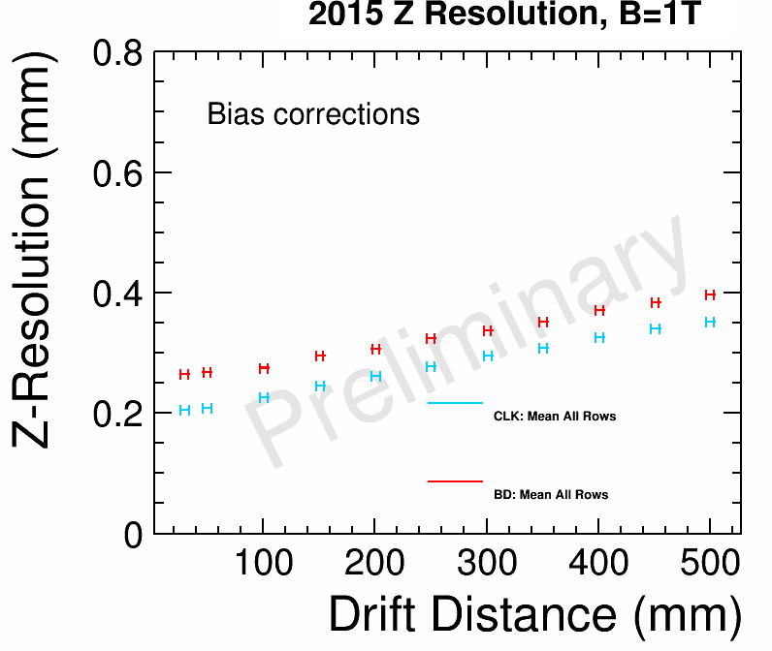
Results
z resolution is better for CLK than for DLC (‘Black Diamond’)
(CLK : 200 µm ; BD: 250 µm – at zero drift distance)
This corresponds to a time resolution of 2.9 ns per hit
DLC is found to spread more the charge than CLK, so it has a lower RC.
Effective number of electrons is rather low (9 instead of 35 as obtained from r φ resolution vs z). Not clearly understood
CLK
BD

Slide 7
EVENT TIME
F. Gaede, calorimetric hit time from MC truth
Assuming independent hits, the resolution on the time of a track of 200 hits is 0.2 ns : not enough to distinguish various particle, but very useful for matching with silicon hits (SET especially) and thus get a TPC event time.

Slide 8
Conclusion
Z-coordinate resolution can be as good as 200 µm (much better than requirement)
If the 200 hits on a track are independent, the track time resolution is 3ns/sqrt(200), that is 0.2 ns, offering interesting possibilities

