Slide 1


ATF2 April Shifts
R. Ramjiawan
Friday, 18th May 2018

Slide 2
Outline
Comparing quad calibrations with mover calibrations
IP BPM angle sensitivity measurements
Comparison with results from Neven
Comparison with results from Honda
Cable length between cavity and hybrid
Resolution from second shift
Start of shift resolution (1 bunch mode)
End of shift resolution (2 bunch mode)

Slide 3
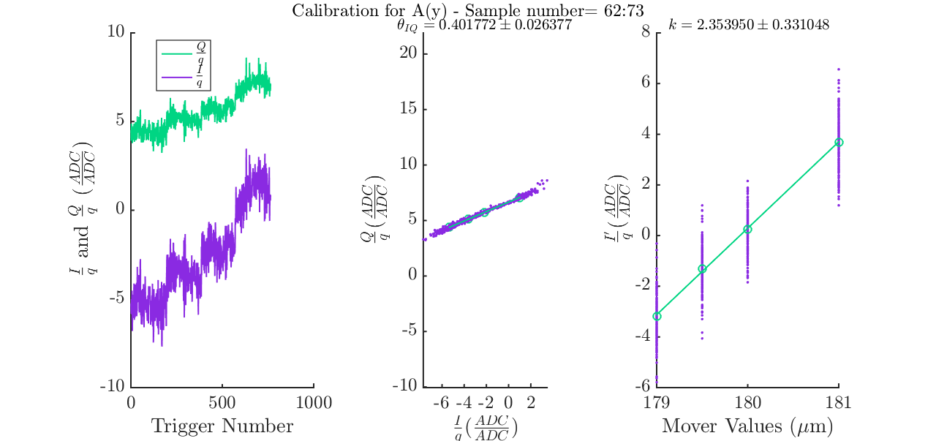
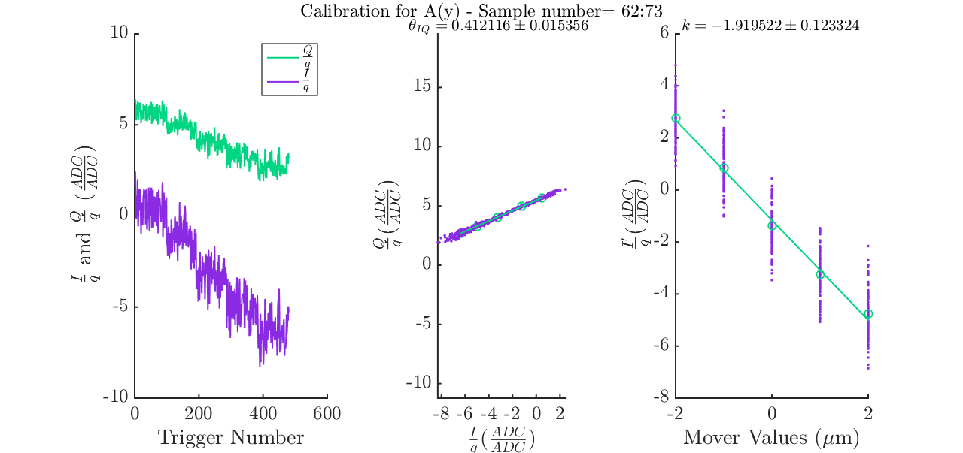
IPA Quad vs. mover calibrations
AQD0FFyScan1_190418 k_{A}: 2.35, θ_{A}: 0.402
IPyCal11
k_{A}:1.92, θ_{A}: 0.412
Quad Calibration
Mover Calibration

Slide 4
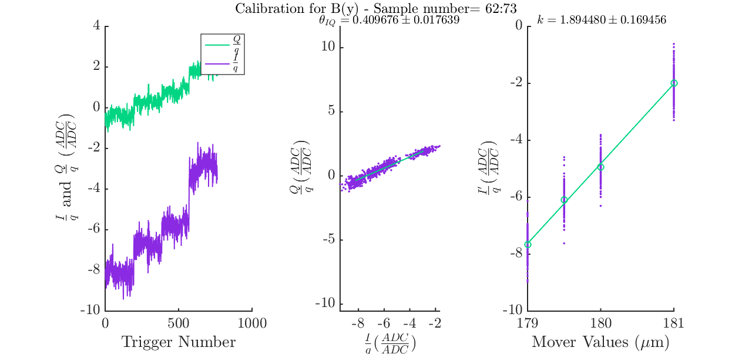
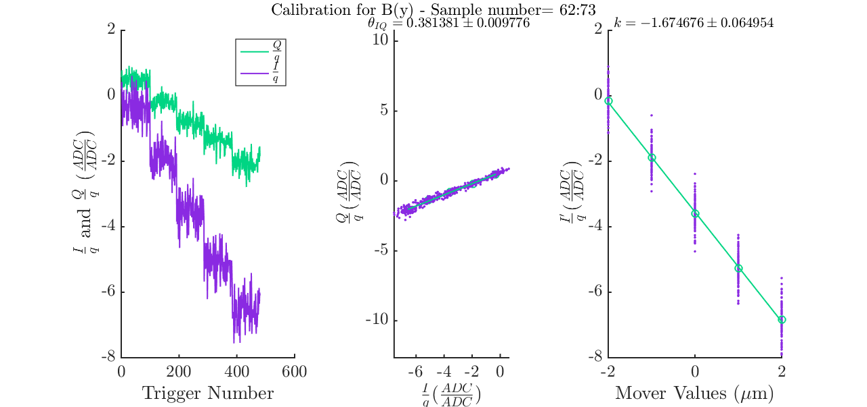
IPB Quad vs. Mover Calibrations
IPyCal11
k_{B}: 1.67, θ_{B} 0.38
AQD0FFyScan1_190418 k_{B}: 1.89, θ_{B}: 0.410
Quad Calibration
Mover Calibration

Slide 5
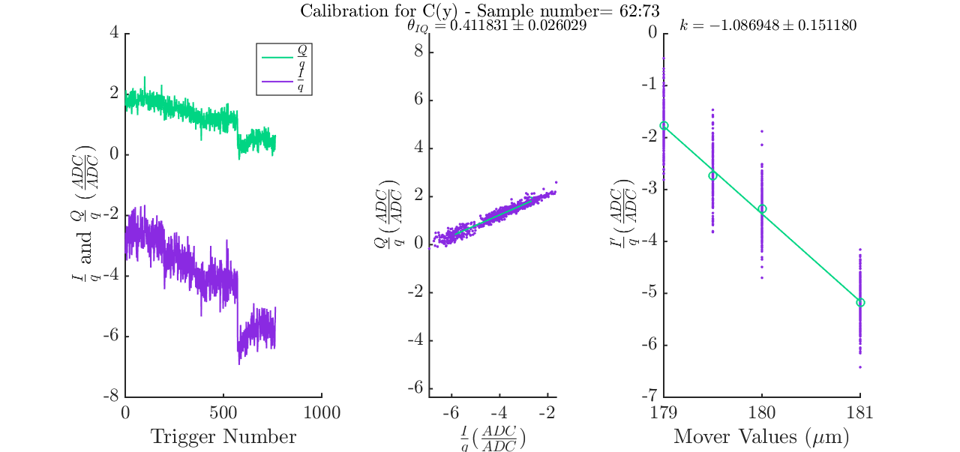
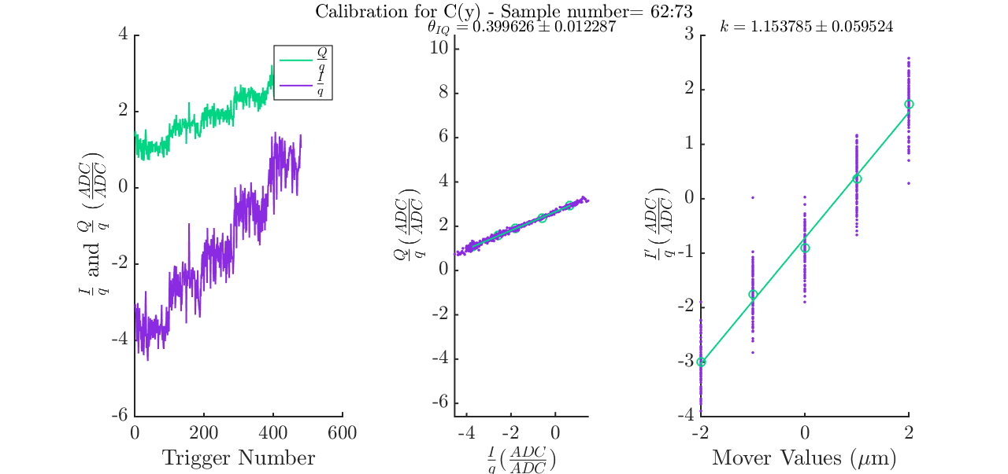
IPC Quad vs. Mover Calibration
AQD0FFyScan1_190418
k_{C}: 1.09, θ_{C}: 0.412
IPyCal11
k_{C}: 1.15, θ_{C}: 0.400
Quad Calibration
Mover Calibration

Slide 6
Second Shift 19/04/2018
Q’ Calibrations

Slide 7
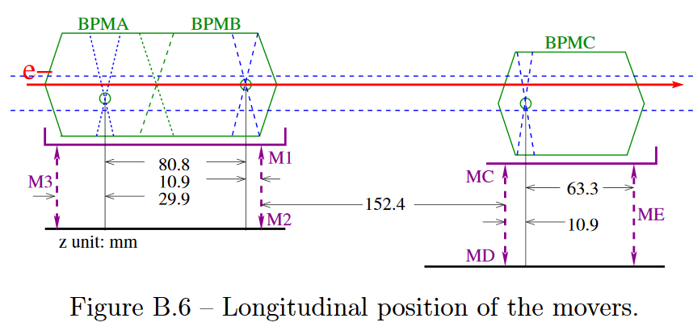
Q’Calibration – Tilting the IP BPMs
Change angle of BPM block whilst leaving the centre position unchanged:
Keep centre of IP A stationary:
M₁₂:M₃
+3:-1
Keep centre of IP B stationary:
M₁₂:M₃
+1:-10
Keep centre of IP C stationary:
M_{CD}:M_{E}
-1:+6
Angular change of block calculated from mover adjustment (um) and longitudinal separation of submovers (mm).
Blanco, O. PhD Thesis, Université Paris Sud (2015)

Slide 8
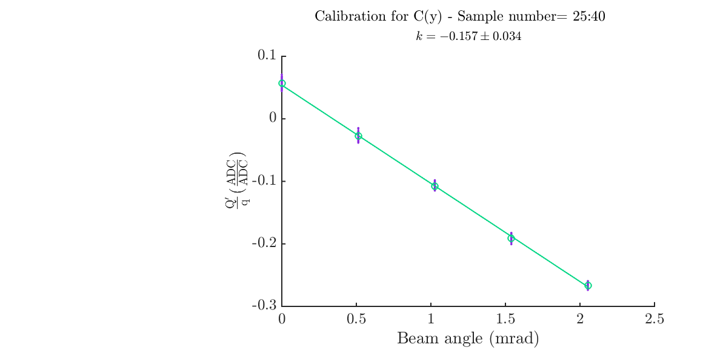
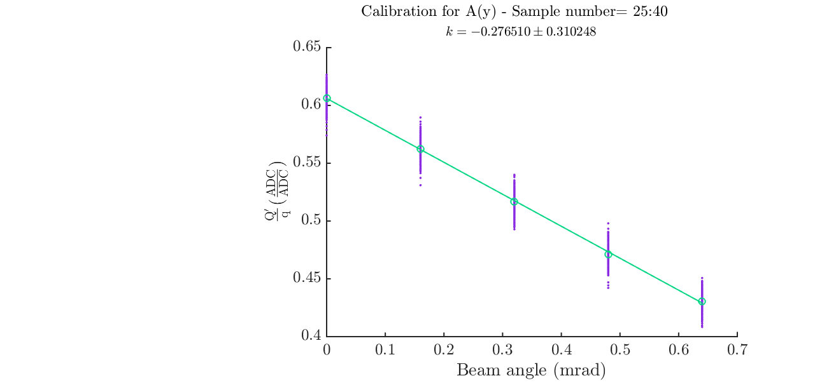
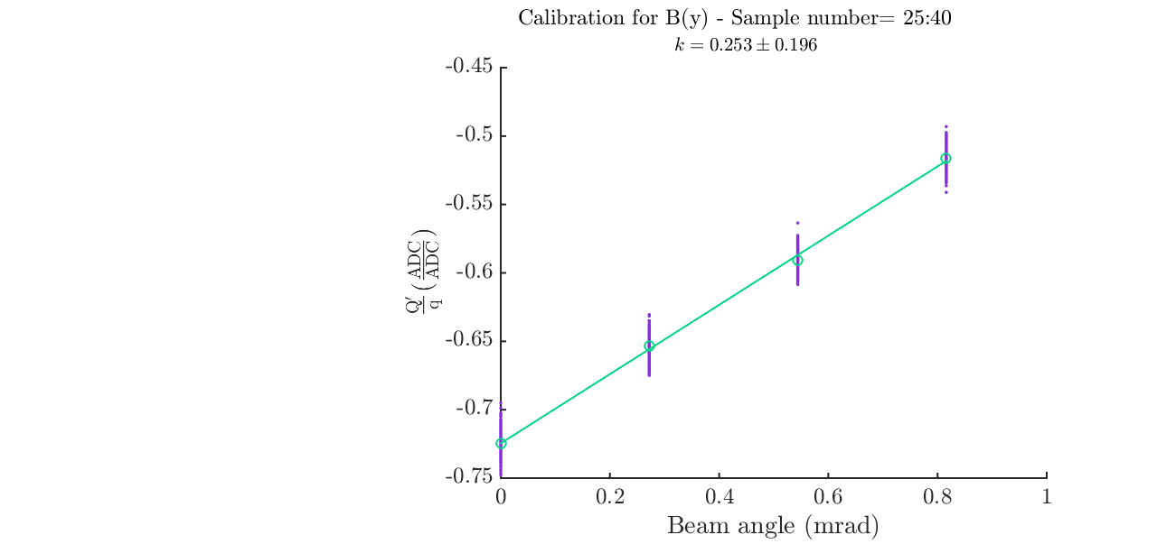
Q’ Calibrations
Q’/q calculated as a function of beam pitch.
I’/q calculated as a function of beam position.
Calculate um/rad sensitivity.
Dipole sample: 25:40, reference sample: 27. Values in plots below are scaled to 1 sample.

Slide 9
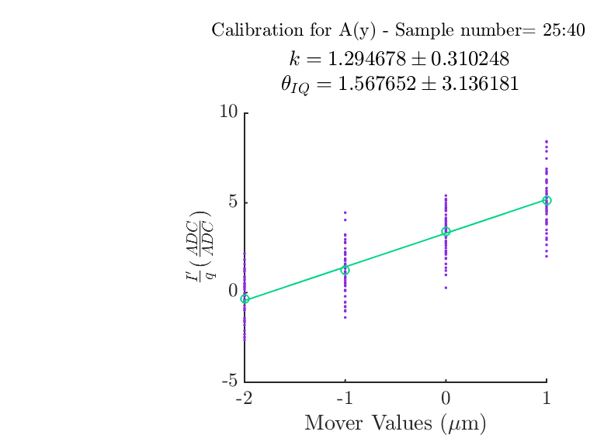
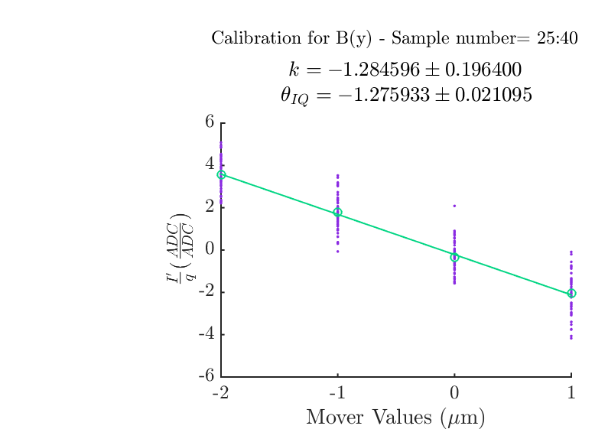
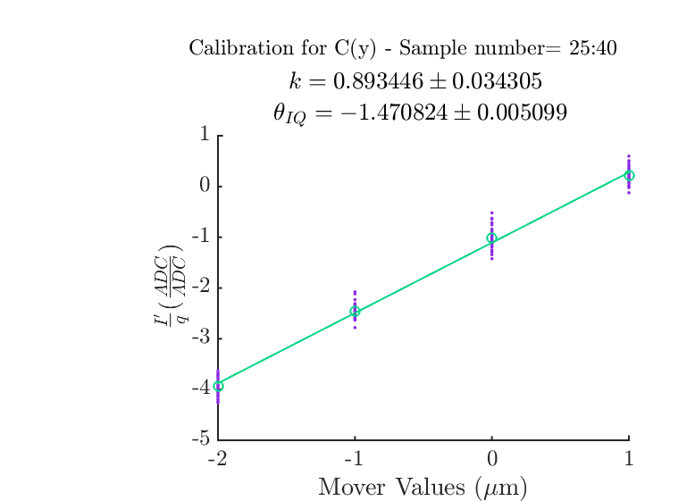
I’ Calibrations
Position calibration with integration range of 16 samples.

Slide 10
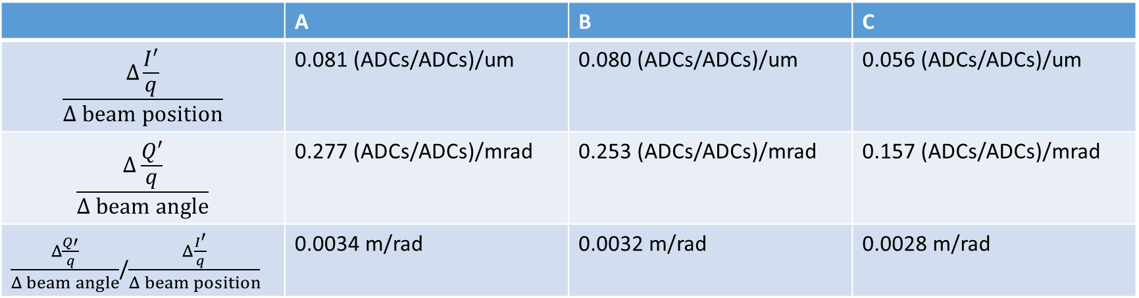
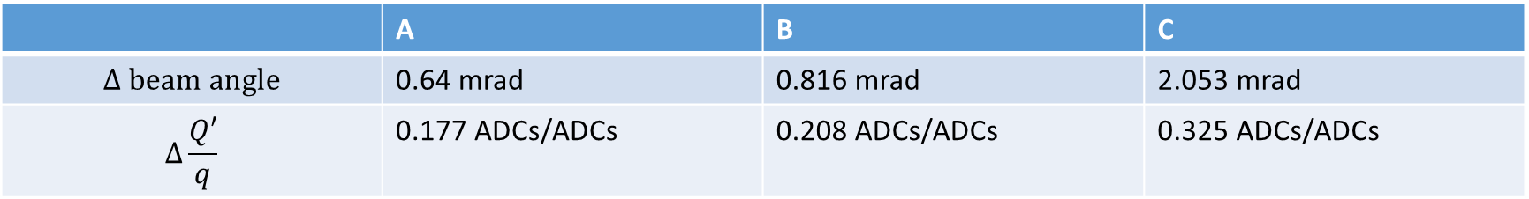
Position to Angle Sensitivity
All I’/q and Q’/q values are scaled to single sample (divided by 16).
 | A | B | C
$$Δ beam angle$$ | 0.64 mrad | 0.816 mrad | 2.053 mrad
$$Δ\frac{Q′}{q}$$ | 0.177 ADCs/ADCs | 0.208 ADCs/ADCs | 0.325 ADCs/ADCs
 | A | B | C
$$\frac{Δ\frac{I^{′}}{q}}{Δ beam position}$$ | 0.081 (ADCs/ADCs)/um | 0.080 (ADCs/ADCs)/um | 0.056 (ADCs/ADCs)/um
$$\frac{Δ\frac{Q′}{q}}{Δ beam angle}$$ | 0.277 (ADCs/ADCs)/mrad | 0.253 (ADCs/ADCs)/mrad | 0.157 (ADCs/ADCs)/mrad
$\frac{Δ\frac{Q′}{q}}{Δ beam angle}$/$\frac{Δ\frac{I^{′}}{q}}{Δ beam position}$ | 0.0034 m/rad | 0.0032 m/rad | 0.0028 m/rad

Slide 11
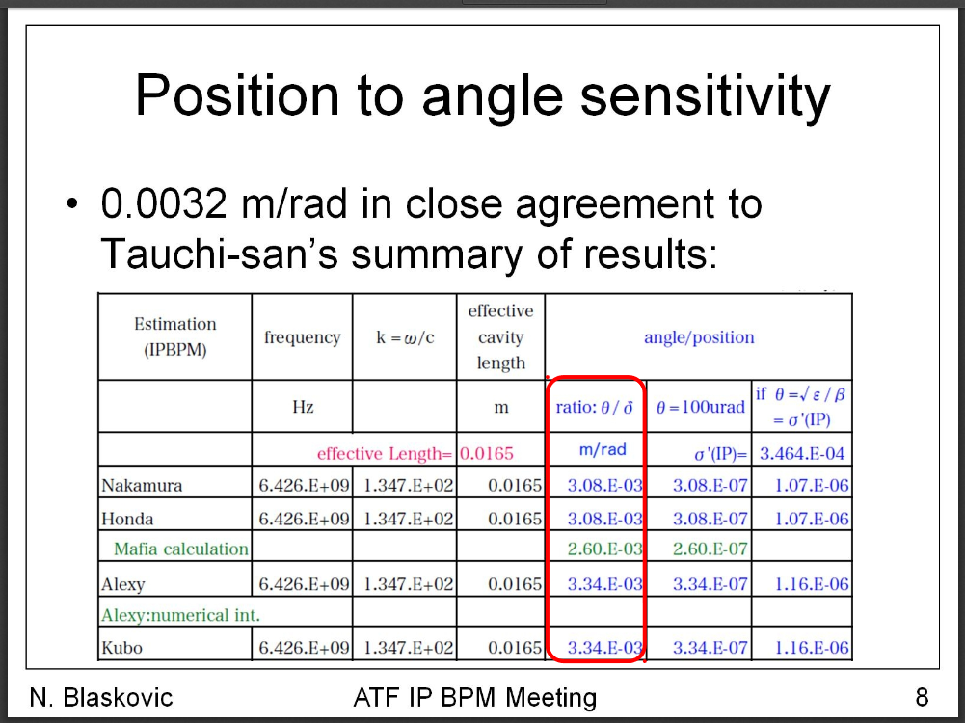
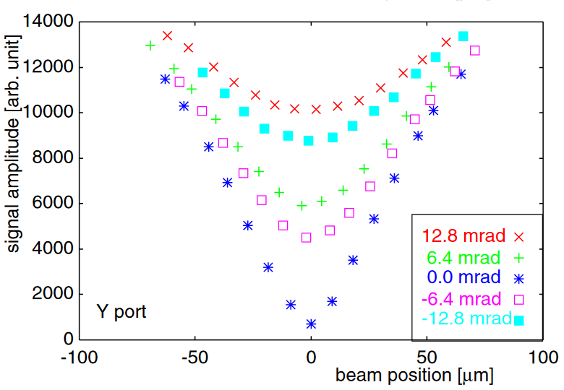
Similar Study (2014)
We measured that IPC had less m/rad sensitivity at 2.2e-3, whereas A and B had 3.4e-3 and 3.3e-3 respectively.
Honda measured ~4 m/rad sensitivity for their copper BPM.
Presentation by Neven, on the ATF twiki under ‘IP BPM - movers’.
Inoue. Y et al., PhysRevSTAB, 11, 062801 (2008)

Slide 12
Cable Length – cavity to hybrid

Slide 13
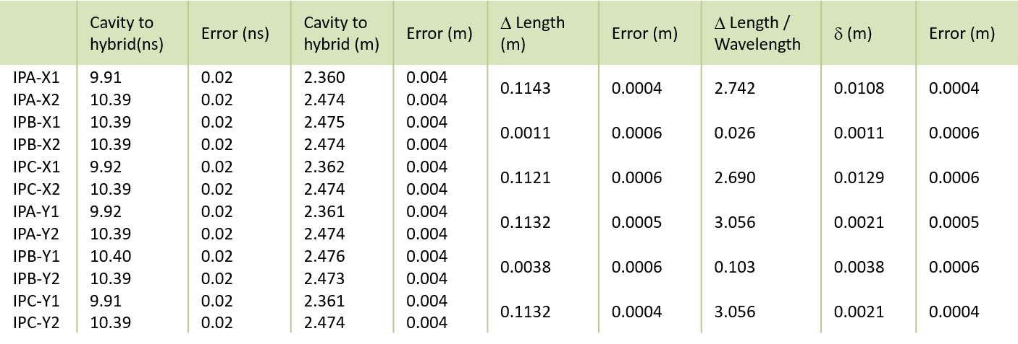
Cable Length – Cavity to hybrid
If reflections occur along cable between cavity and hybrid, the timescale is: ~2*10 ns = ~7 samples.
T. Bromwich, FONT meeting: 27 November 2015

Slide 14
Resolution Results – 2nd shift

Slide 15
Resolution – start of 2nd shift
AQD0FFyScan6, waistScan1_129.4A
Charge -2061, charge jitter: 22.1.
Mean position: 849.3 nm, 3.85 um, 3.36 um
Position jitter : 361.3 nm, 241.8 nm, 276.9 nm
 | IPA (nm) | IPB (nm) | IPC (nm)
Geometric | 41.5 ± 3.6 | 41.5 ± 3.6 | 41.5 ± 3.6
Drift removal Geo | 37.2 ± 3.4 | 37.2 ± 3.4 | 37.2 ± 3.4
Fit for k | 23.7 ± 2.7 | 25.7 ± 2.4 | 32.0 ± 3.3
Fit for k, charge | 23.7 ± 2.7 | 25.7 ± 2.4 | 32.0 ± 3.3
Fit for k, theta | 18.7 ± 2.1 | 21.9 ± 2.0 | 25.4 ± 2.6
Fit for k, theta, charge | 18.7 ± 2.1 | 21.8 ± 2.0 | 25.4 ± 2.6
Fit for k, theta, charge, Q’ | 18.7 ± 2.1 | 20.8 ± 1.9 | 25.3 ± 2.6

Slide 16
Resolution – end of 2nd shift
AQD0FFyScan10, jitRun10 (two bunch mode)
Mean position: 1.48 um, 3.35 um, -0.2 um, Position jitter: 897 nm, 493 nm, 466 nm.
Mean charge: -2035, charge jitter: 21.8.
 | IPA (nm) | IPB (nm) | IPC (nm)
Geometric | 32.5 ± 2.9 | 32.5 ± 2.9 | 32.5 ± 2.9
Drift removal Geo | 30.4 ± 2.6 | 30.4 ± 2.6 | 30.4 ± 2.6
Fit for k | 31.5 ± 2.8 | 30.7 ± 1.9 | 29.6 ± 1.5
Fit for k, charge | 31.1 ± 2.8 | 30.4 ± 1.8 | 29.4 ± 1.5
Fit for k, theta | 29.2 ± 2.6 | 29.3 ± 1.8 | 26.9 ± 1.4
Fit for k, theta, charge | 28.8 ± 2.6 | 29.1 ± 1.8 | 26.7 ± 1.4
Fit for k, theta, charge, Q’ | 28.8 ± 2.6 | 28.3 ± 1.7 | 26.7 ± 1.4

Slide 17
Appendix

Slide 18
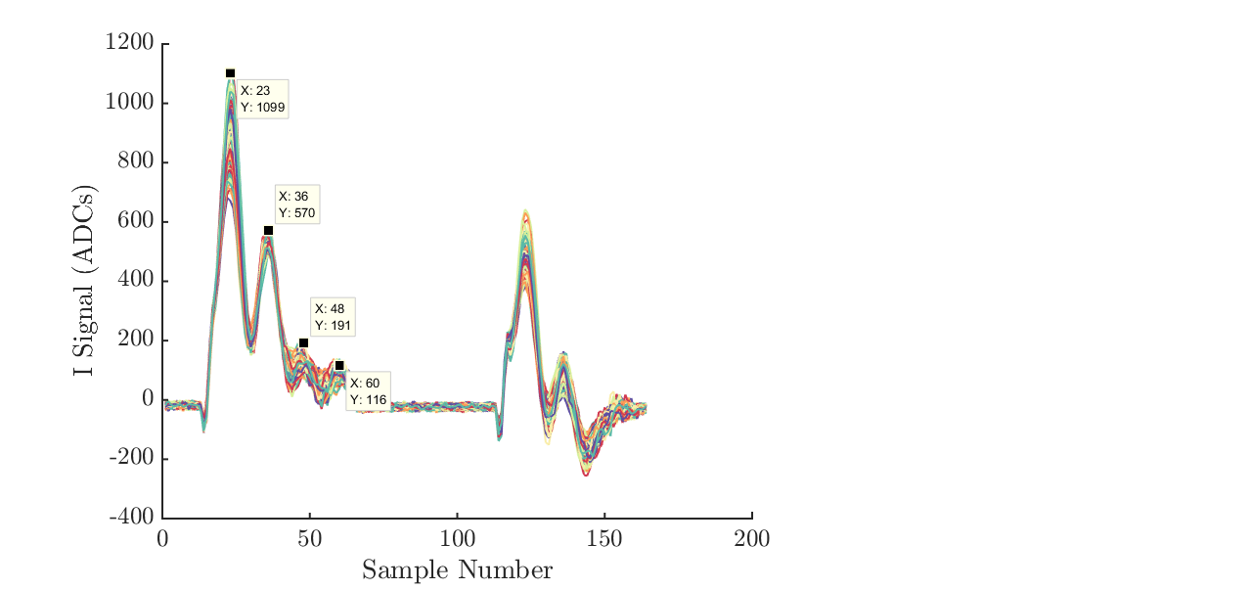
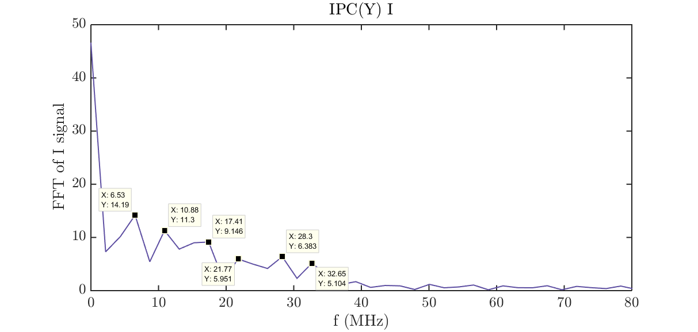

Fourier Analysis of I and Q Signals
13 sample period of oscillation:
Frequency = 1/(13 $×$2.8ns) = 36.4 MHz

Slide 19
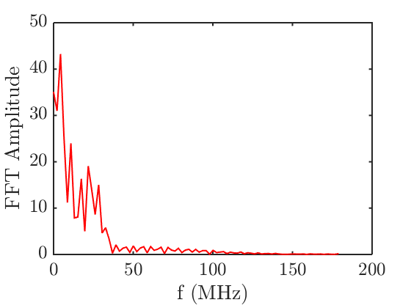
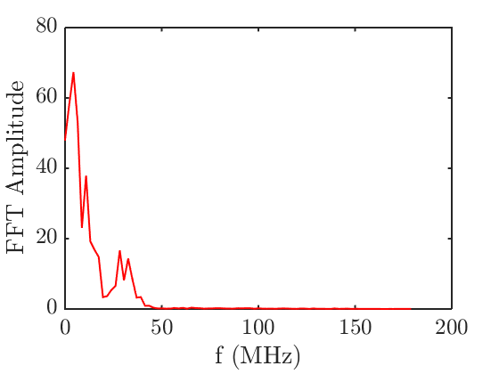
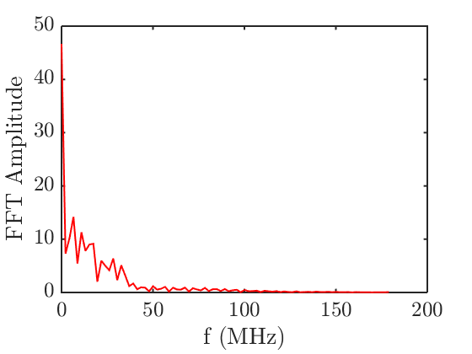
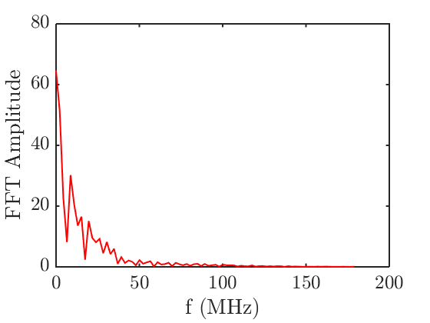
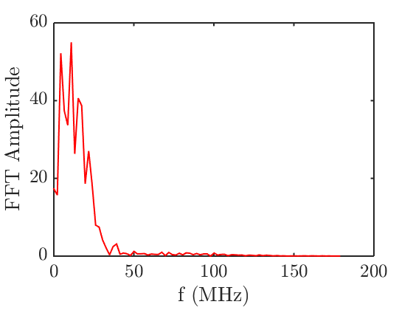
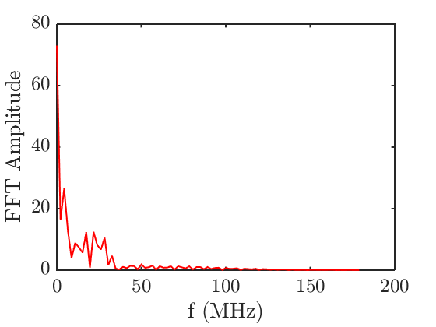
FFT of I and Q signals
All apart from AQ have peaks at (MHz):
4.35
10.88
17.41
21.77
28.30
32.56
AQ peaks at (MHz):
4.35
8.707
15.24
19.6
26.1
30.48
34.8
39.18
AI
BI
CI
CQ
Extra peak at: 6.53 MHz
AQ
BQ

Slide 20
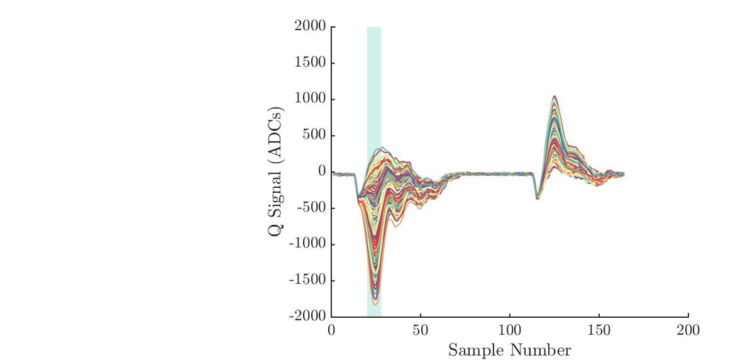
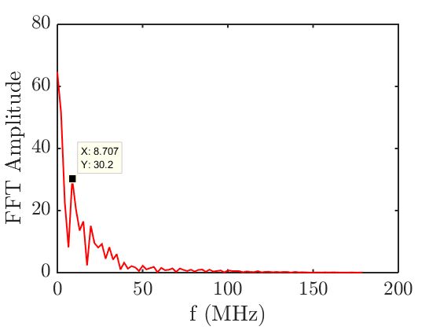
IPA(Q)
AQ peaks at
(MHz):
4.35
8.707
15.24
19.6
26.1
30.48
34.8
39.18

