Slide 1
FONT Meeting
Friday 18th May 2018
Dispersion scan
Douglas BETT

Slide 2
Contents
Calibration comparison
  Single sample to multi-sample
Resolution as function of dispersion

Slide 3
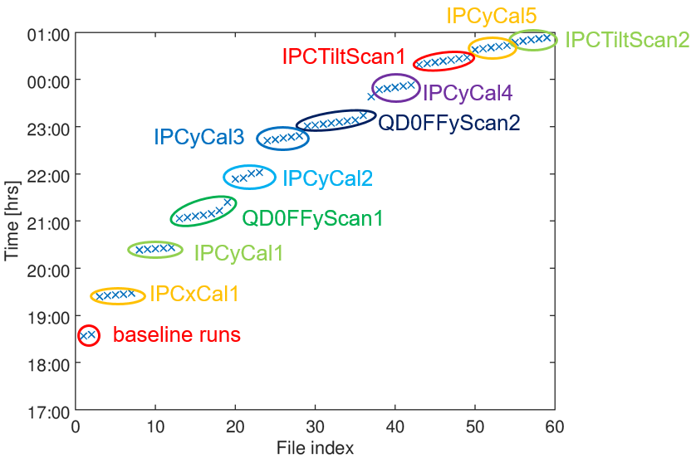
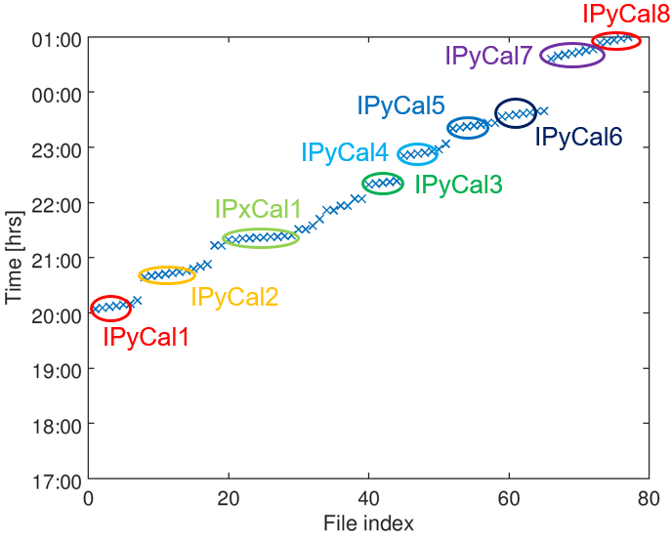
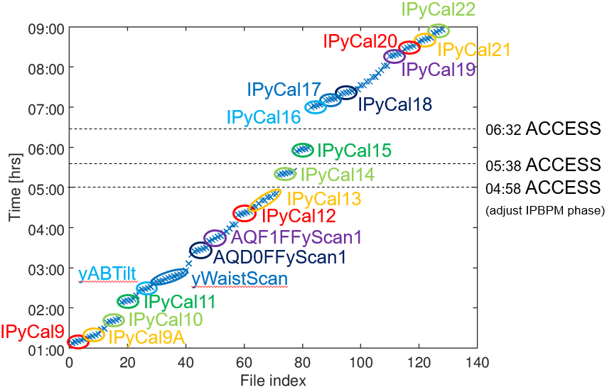
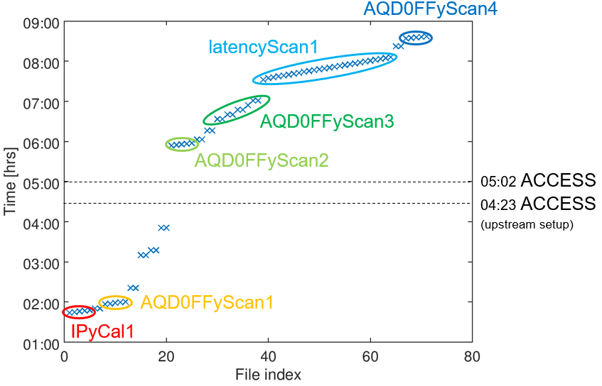
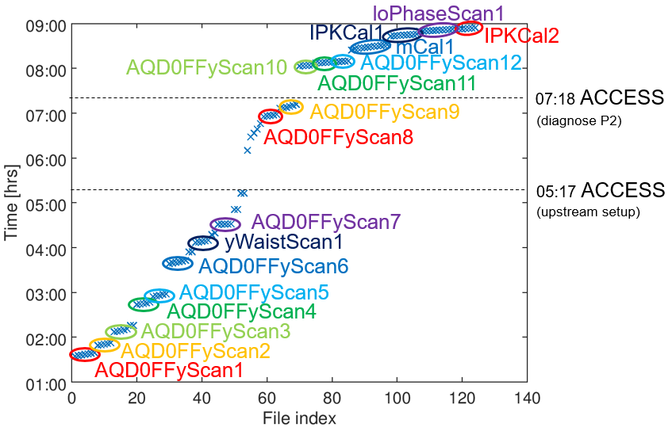
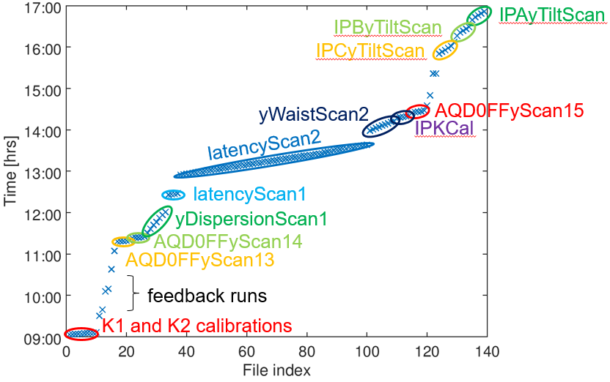
 | OWL | DAY | SWING
M 16
T 17
W 18 |  |  | 1
T 19 |  |  | 2a
F 20 | 2b
S 21
S 22
M 23
T 24
W 25 | 3
T 26
F 27 | 4a | 4b

Slide 4
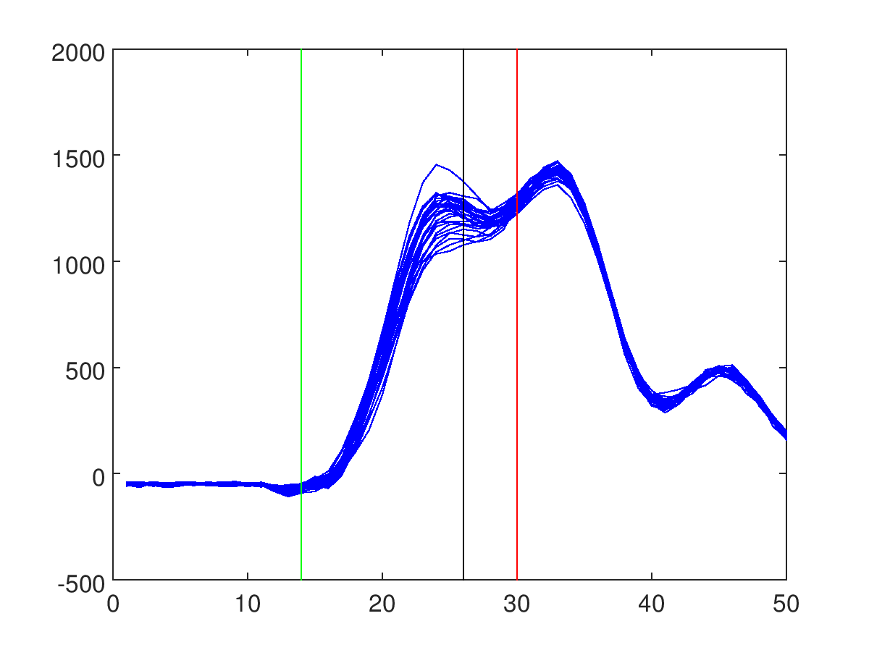
AQD0FFyScan14
14
26
30
Sample ranges that give minimum resolution when applied to jitter run
Single sample: 26
Multi-sample: 14-30
I waveform for IPB
(from 0 um setting)

Slide 5
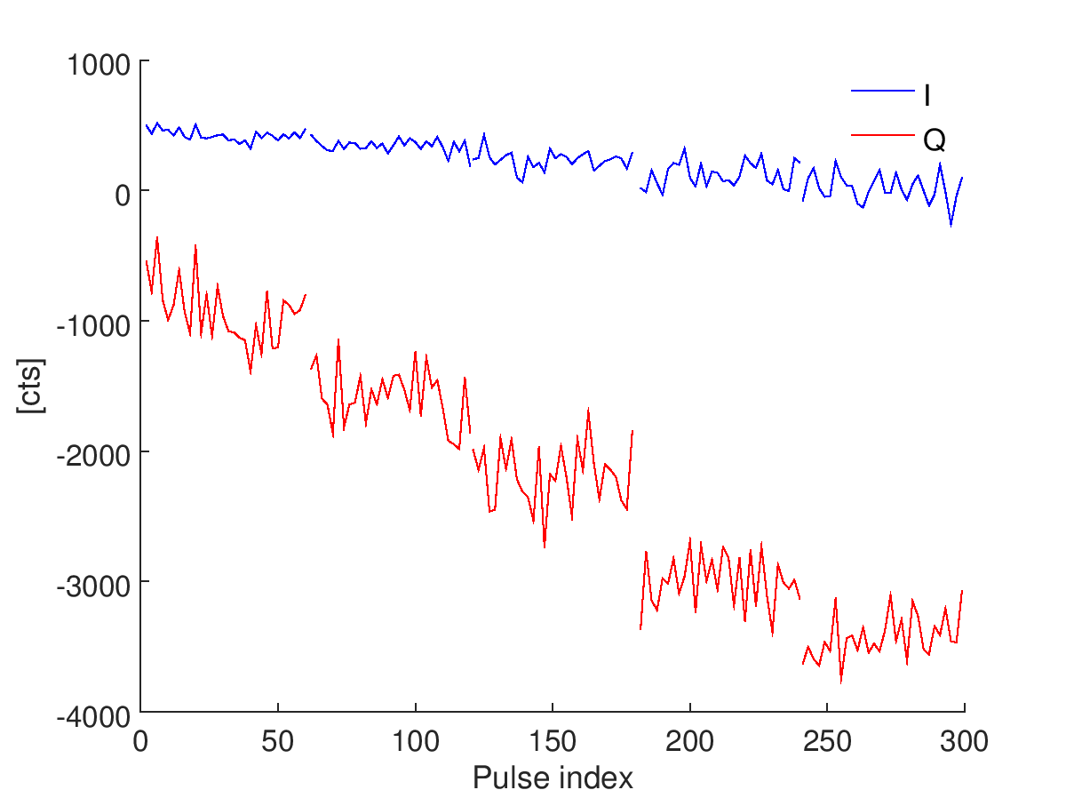
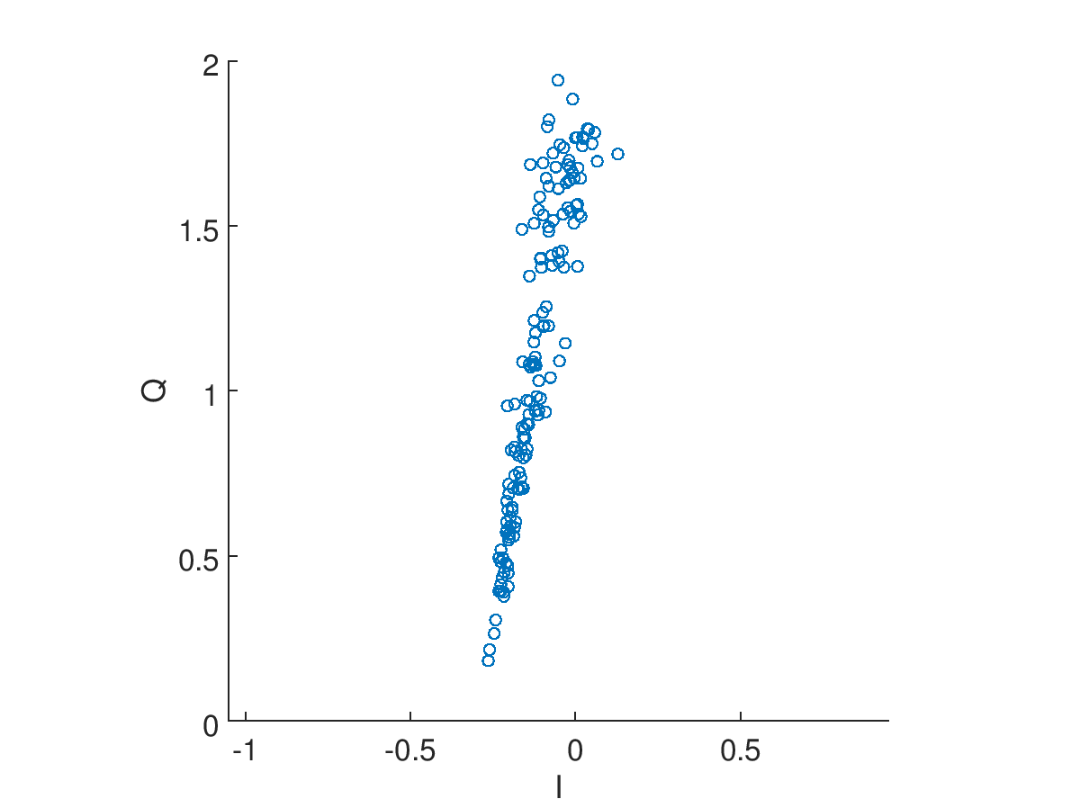
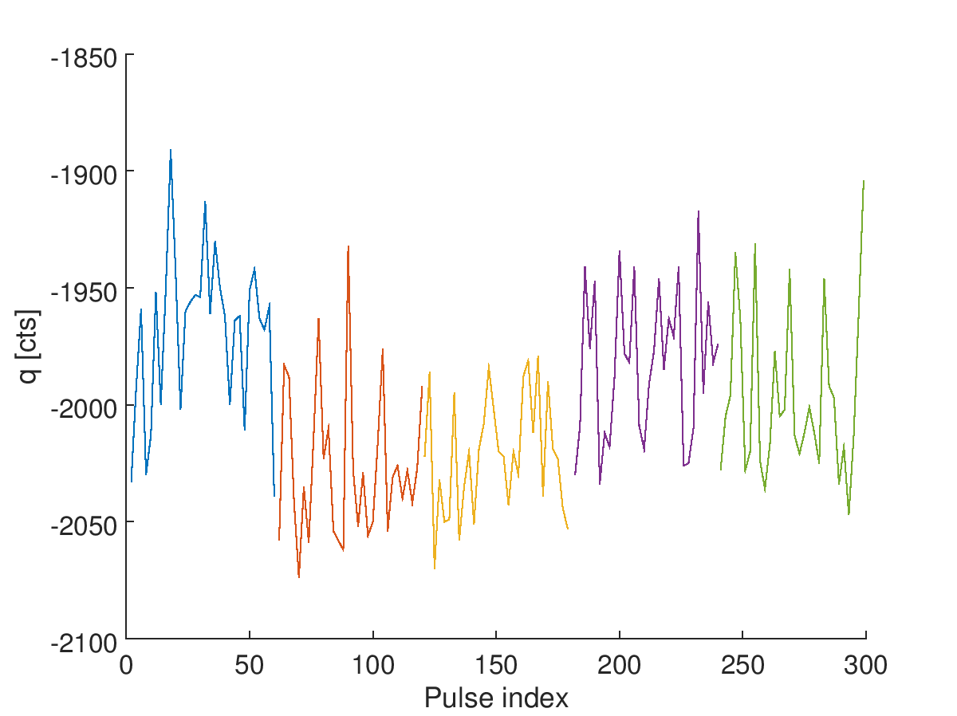
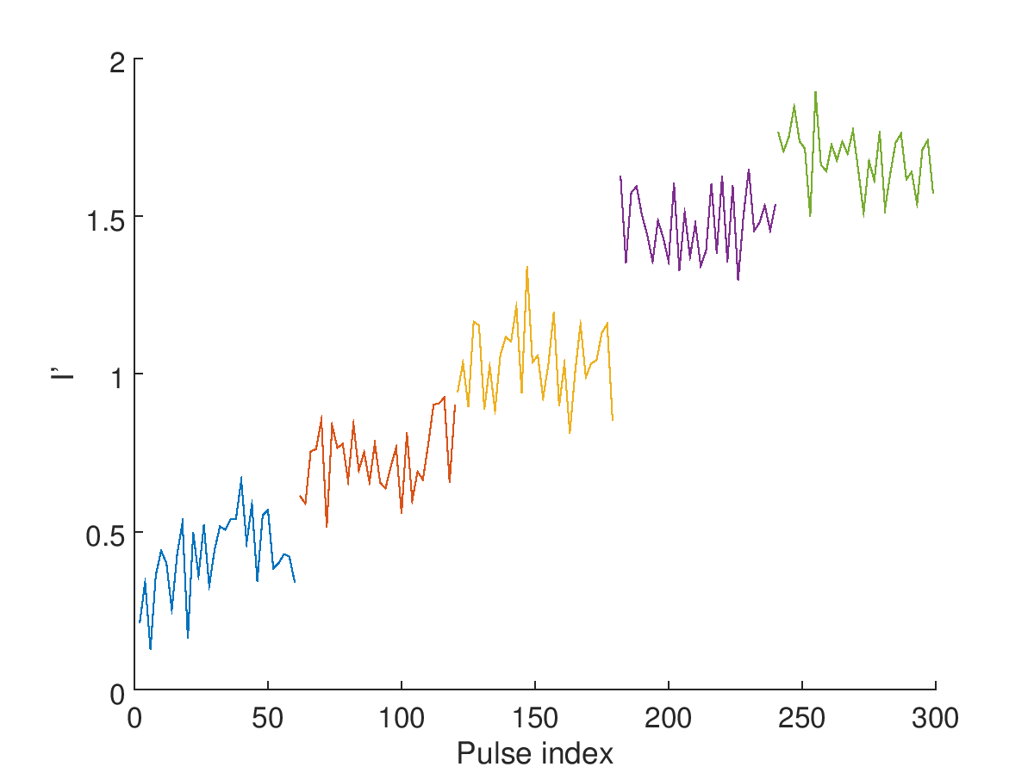
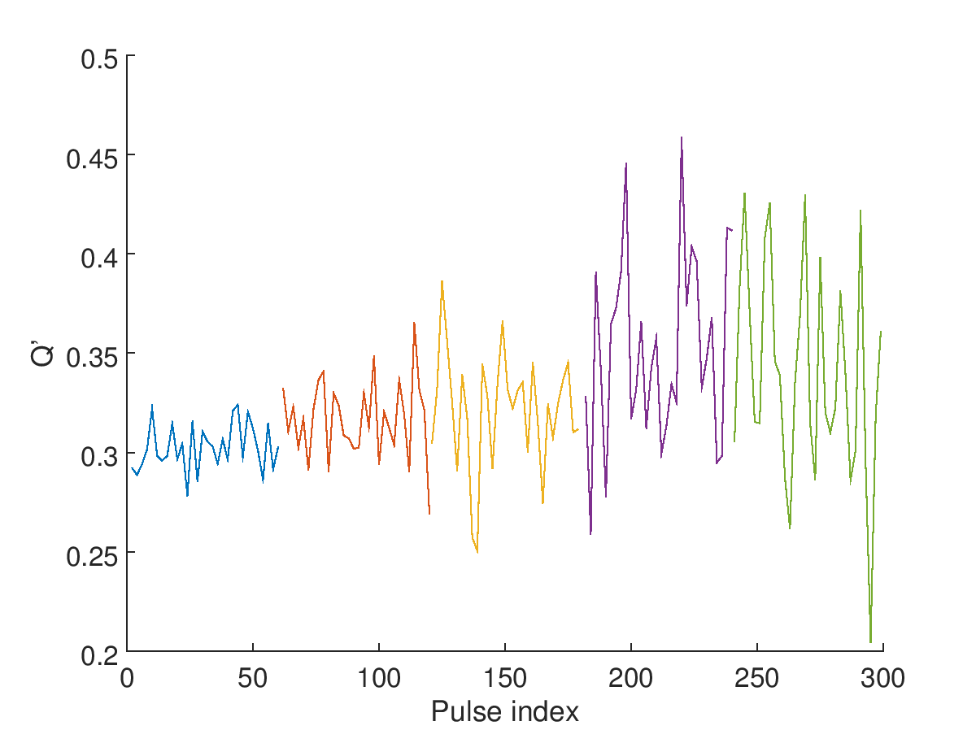
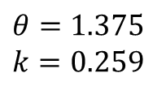
AQD0FFyScan14
IPA: ref = 27, sig = 26
$$θ=1.375$$
$k=0.259$

Slide 6
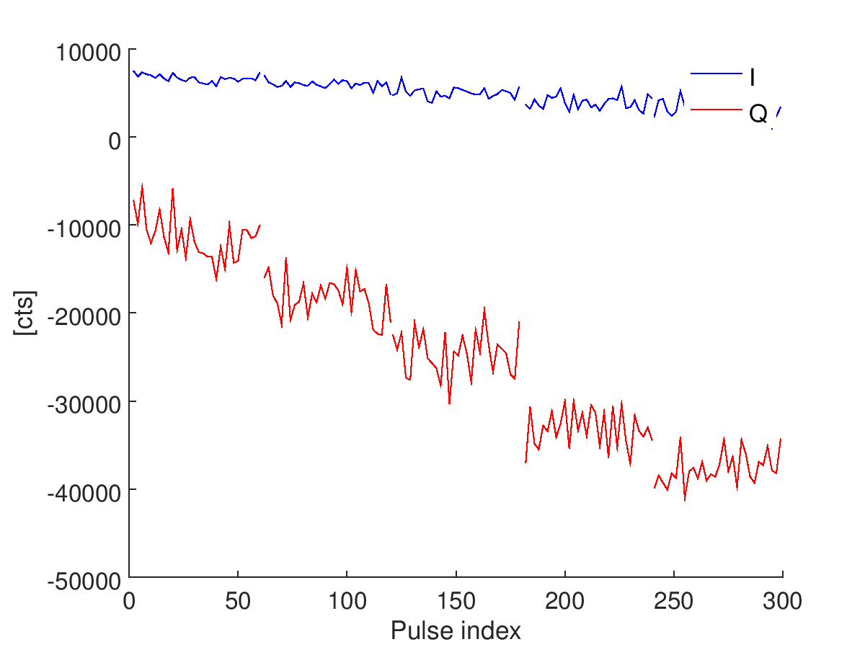
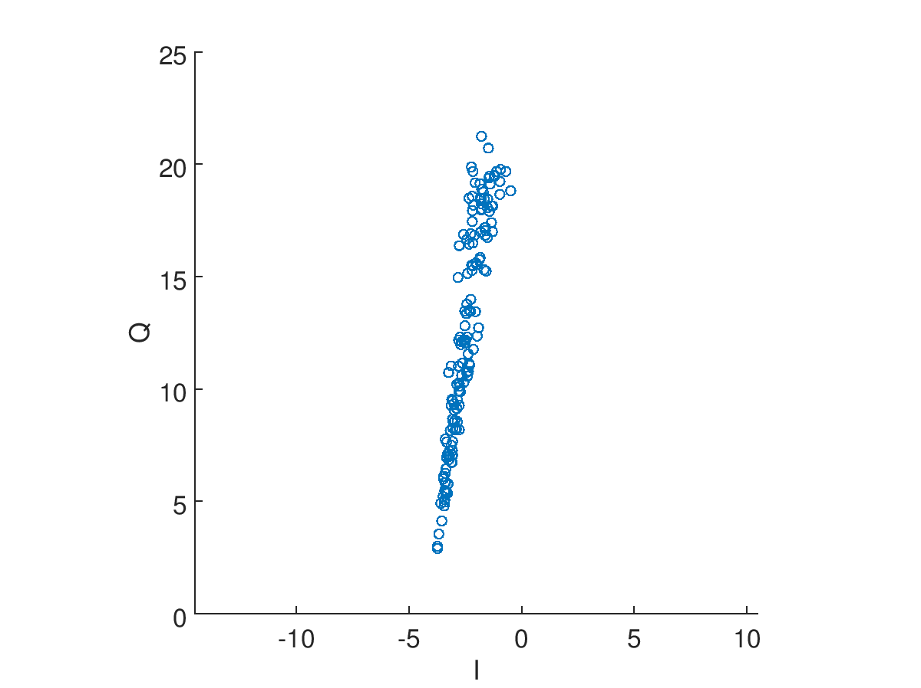
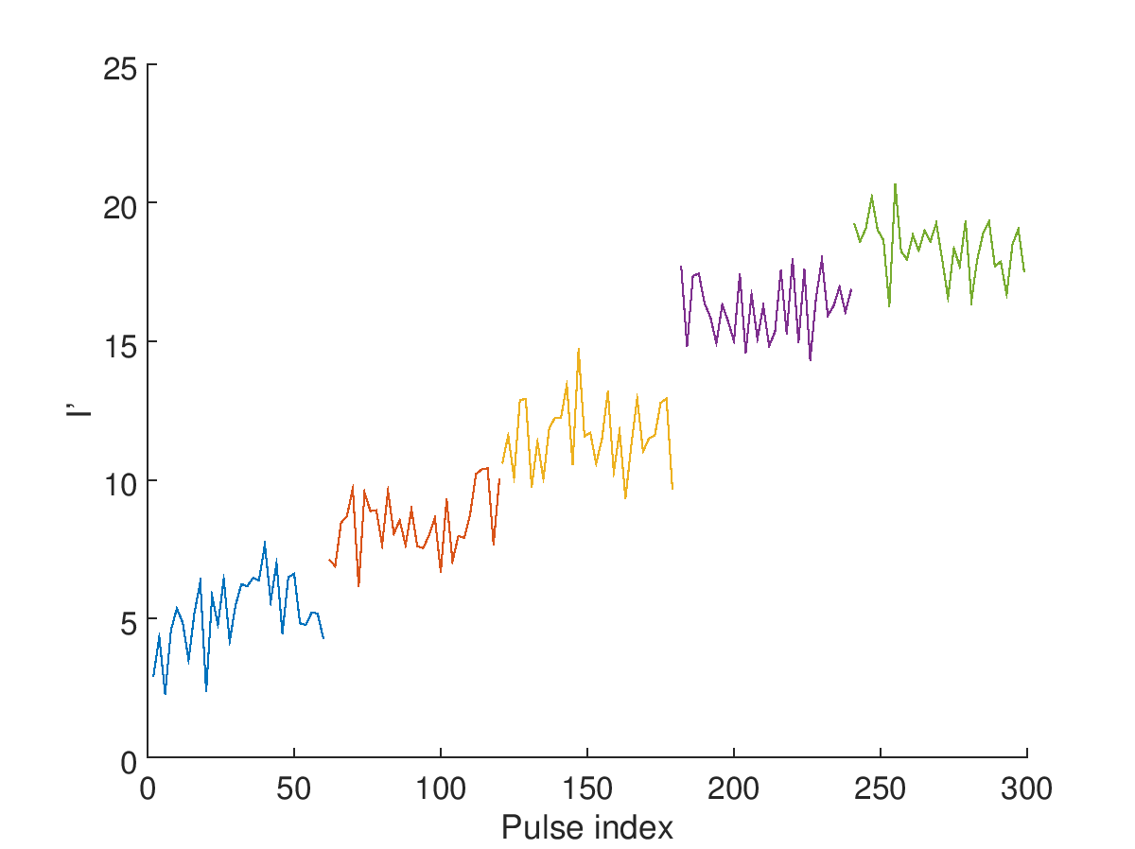
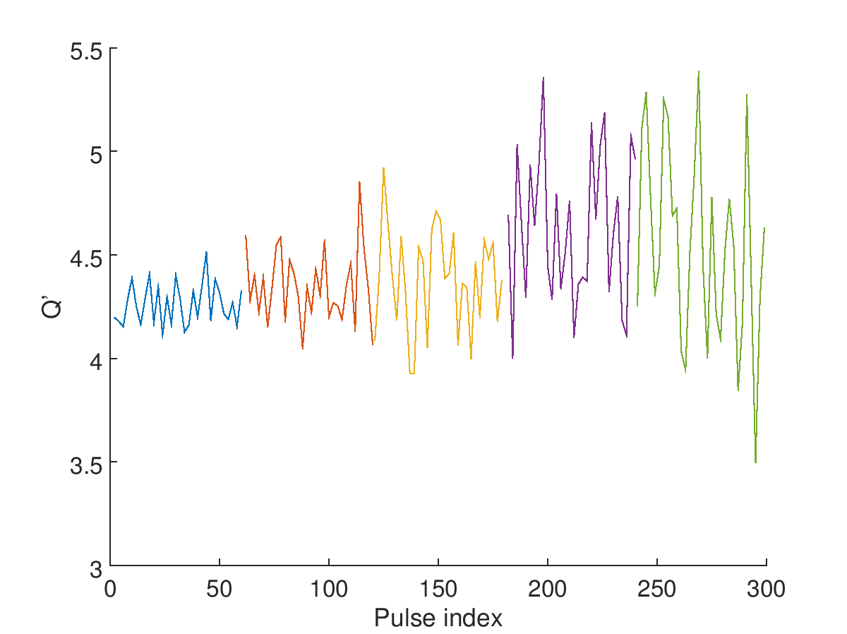
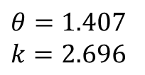
AQD0FFyScan14
IPA: ref = 27, sig = 14:30
$$θ=1.407$$
$k=2.696$

Slide 7
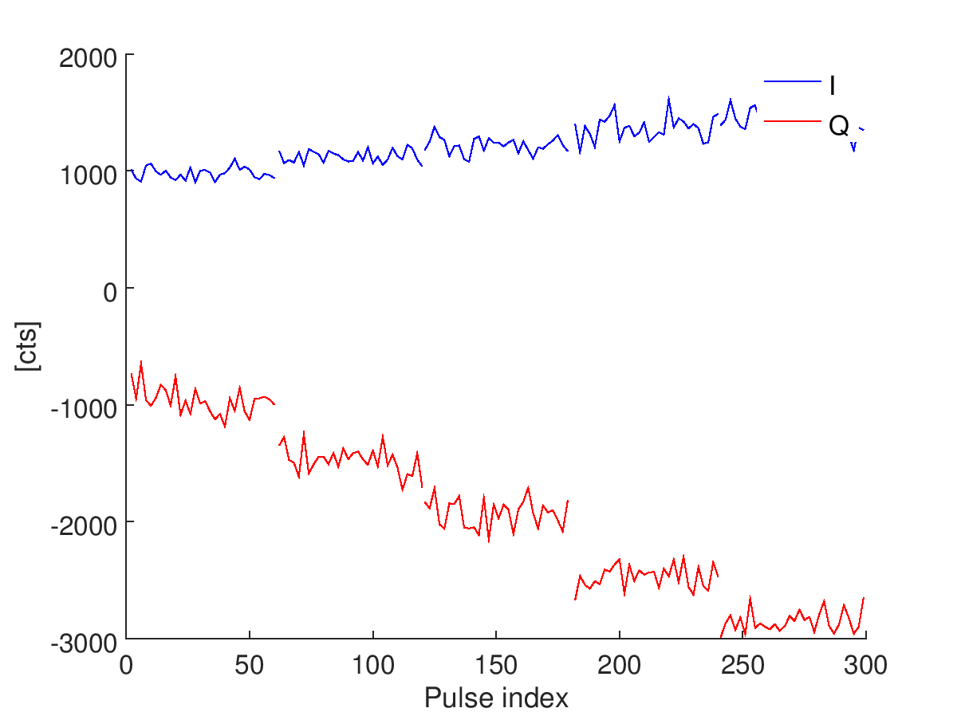
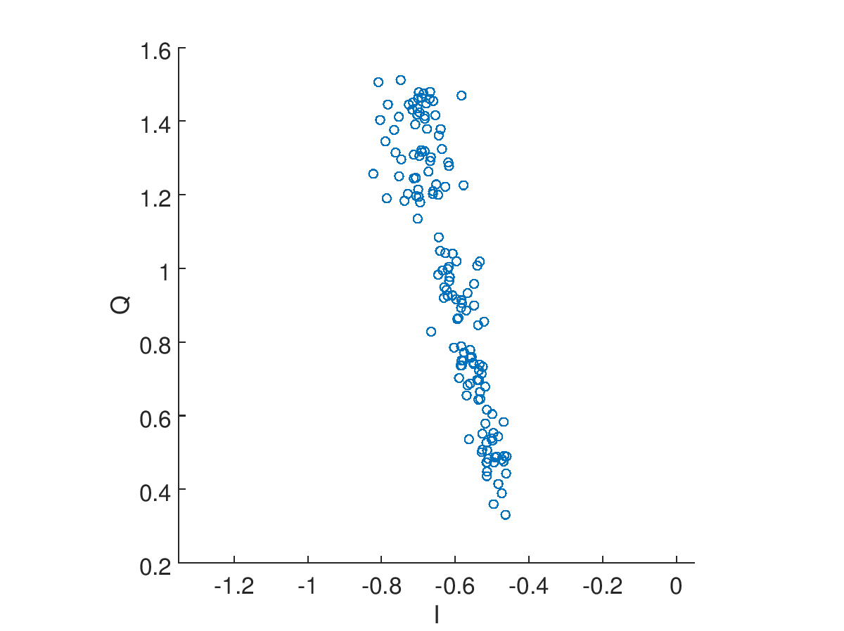
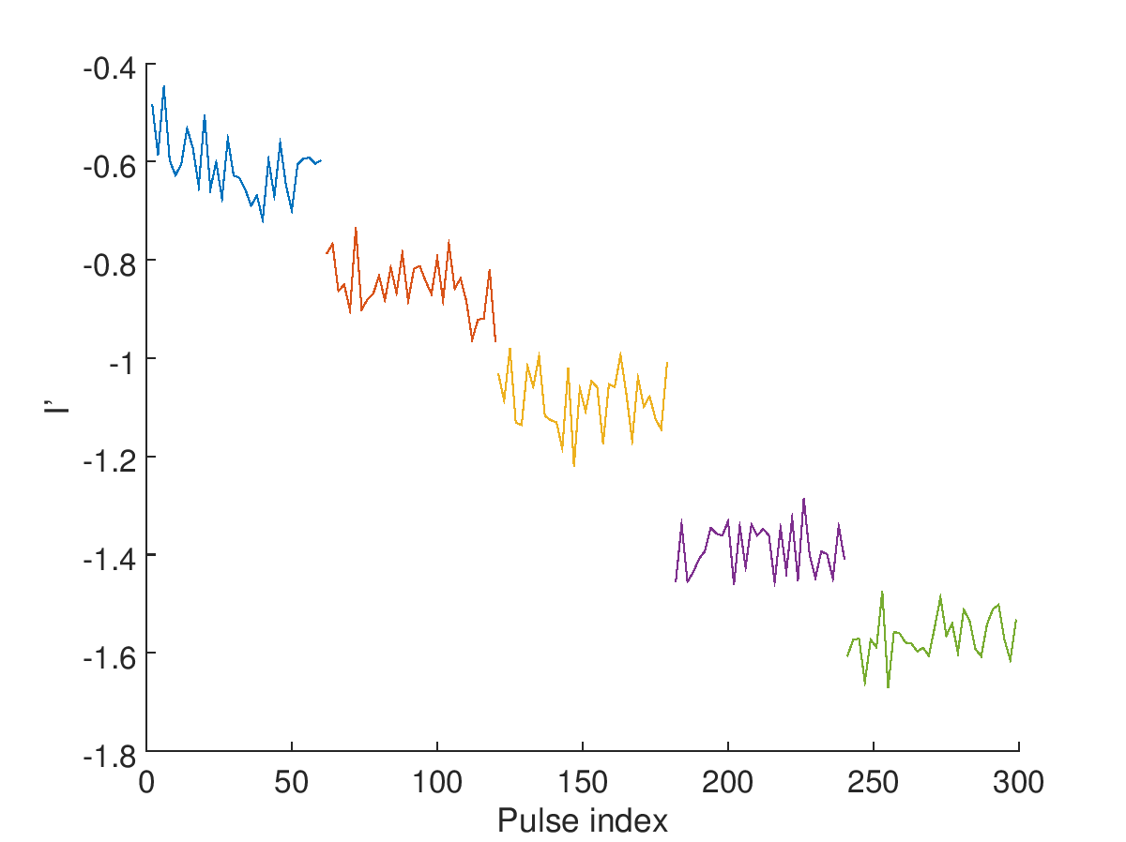
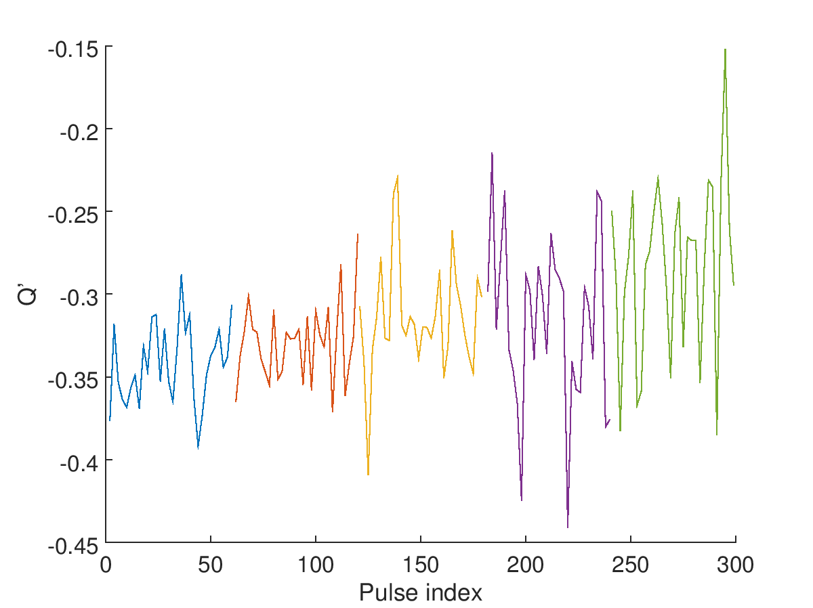
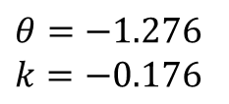
AQD0FFyScan14
IPB: ref = 27, sig = 26
$$θ=−1.276$$
$k=−0.176$

Slide 8
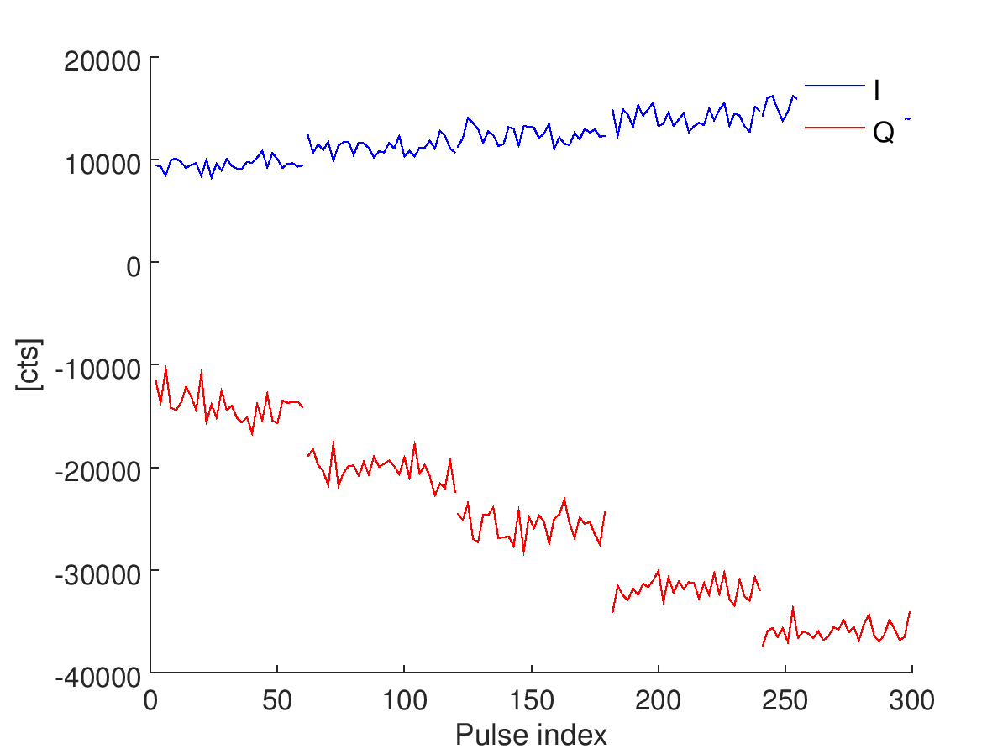
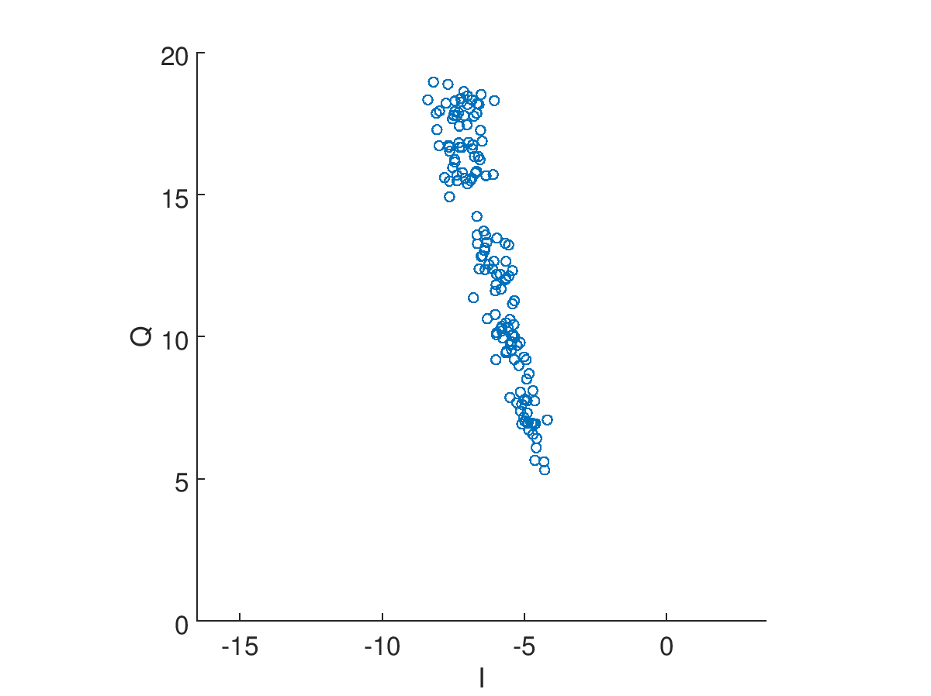
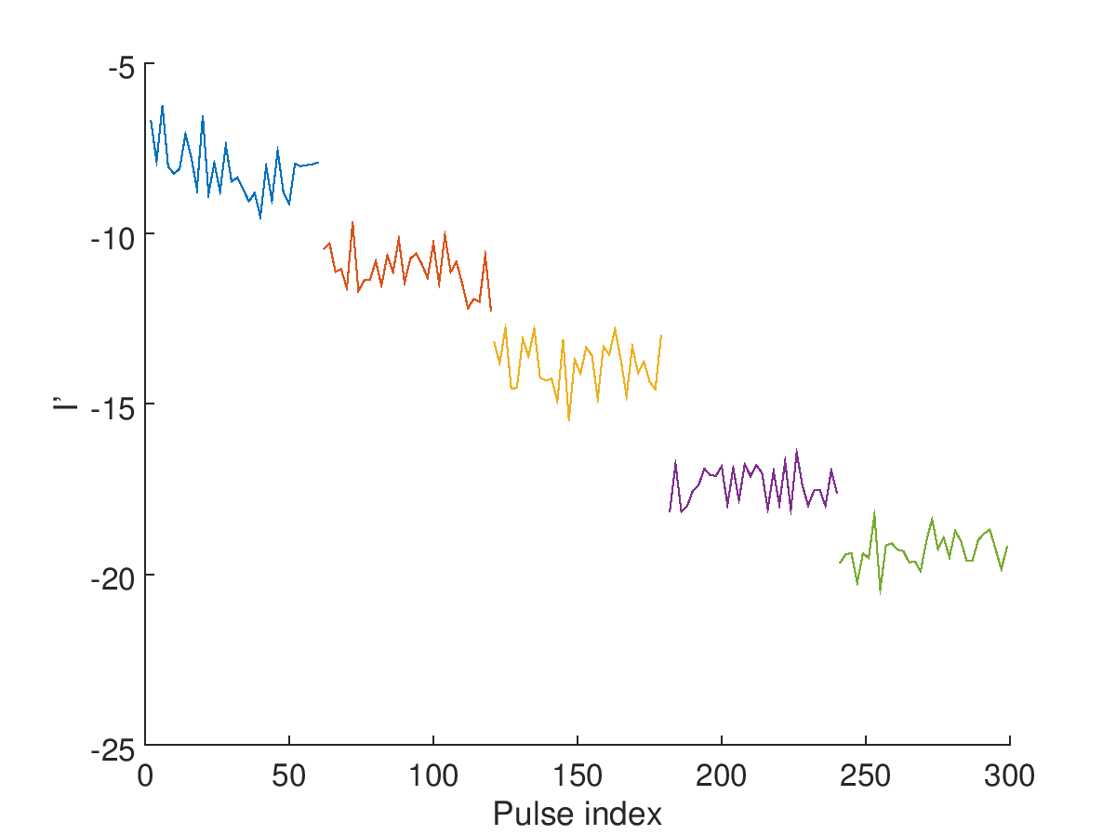
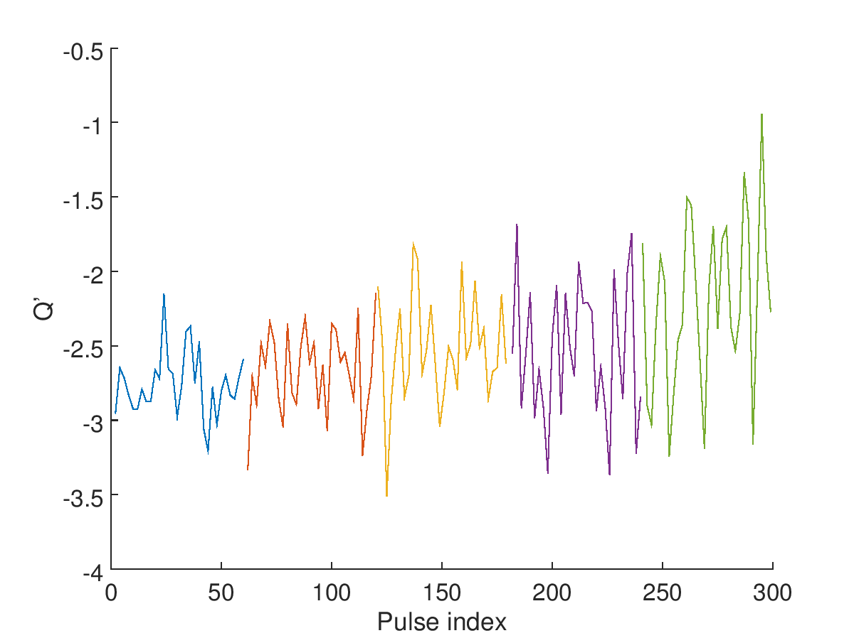
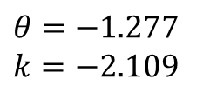
AQD0FFyScan14
IPB: ref = 27, sig = 14:30
$$θ=−1.277$$
$k=−2.109$

Slide 9
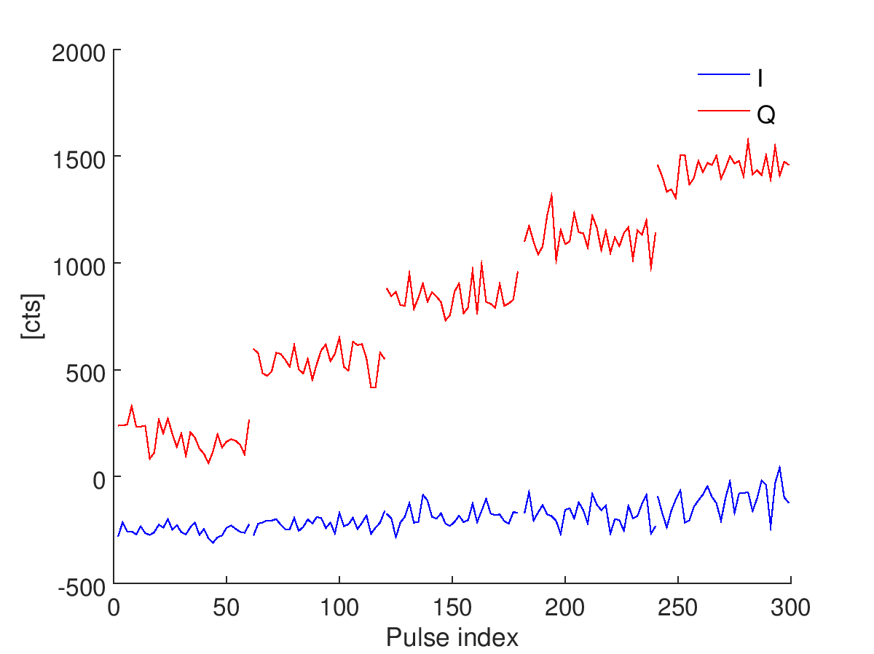
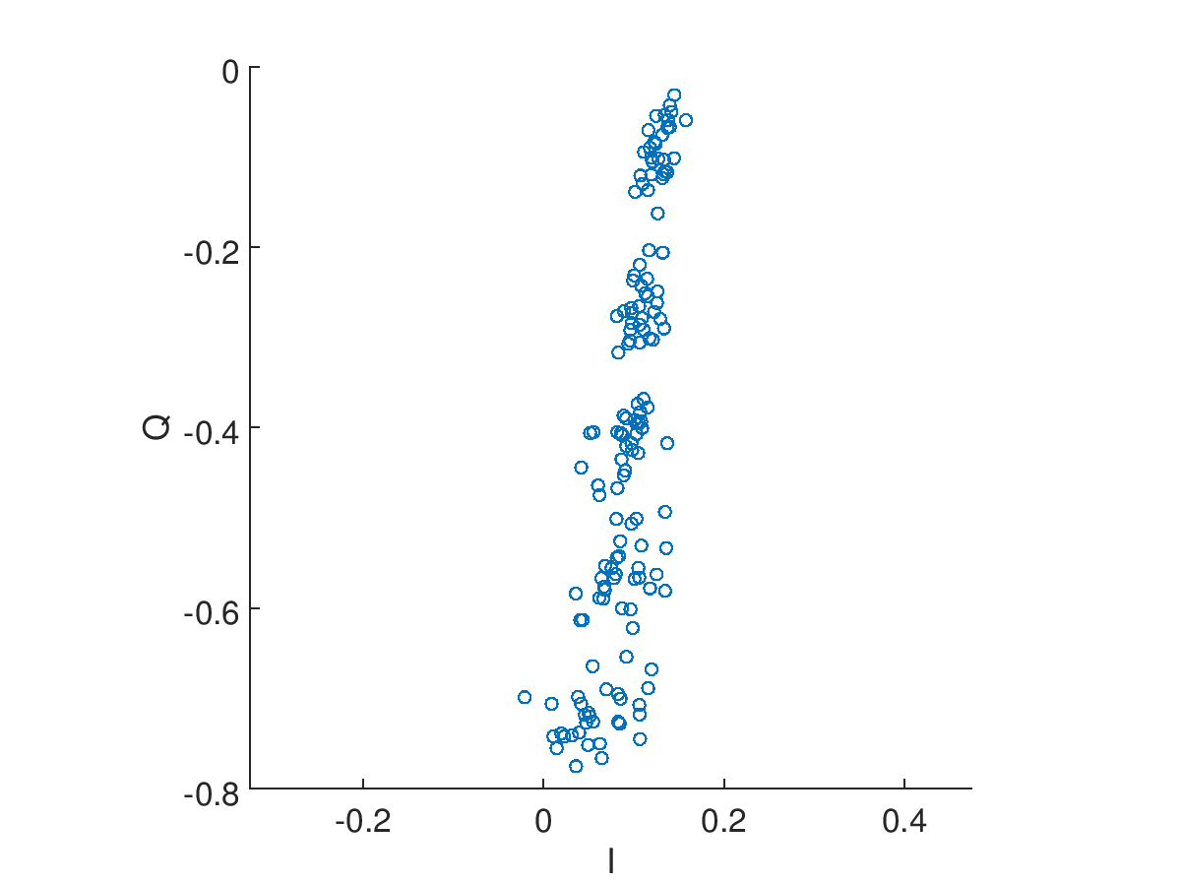
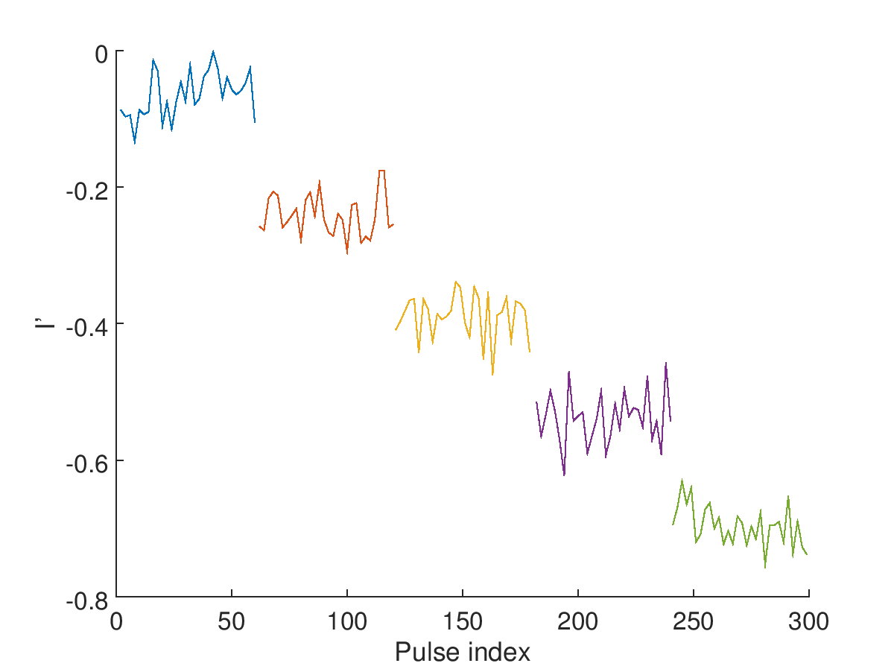
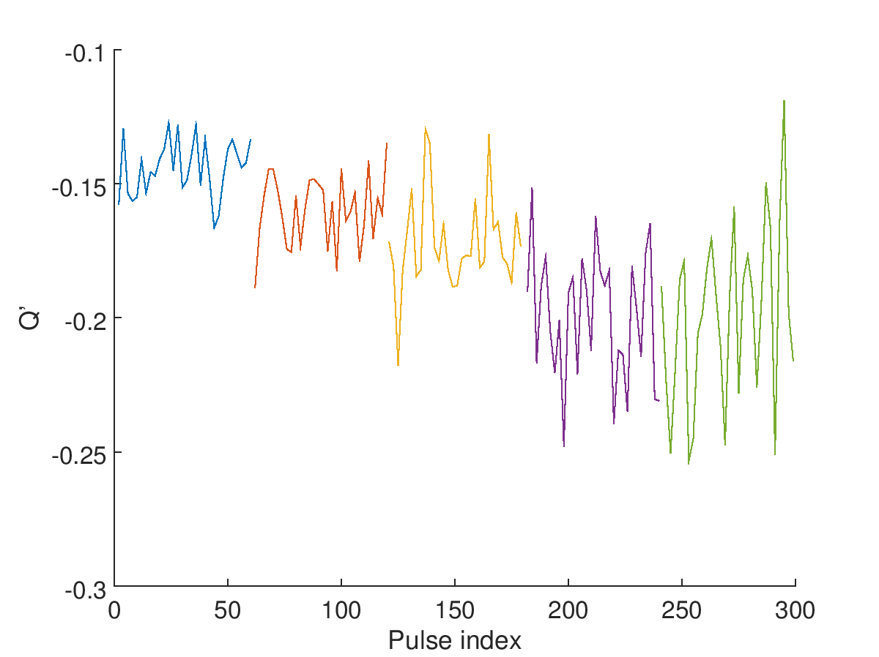
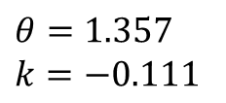
AQD0FFyScan14
IPC: ref = 27, sig = 26
$$θ=1.357$$
$k=−0.111$

Slide 10
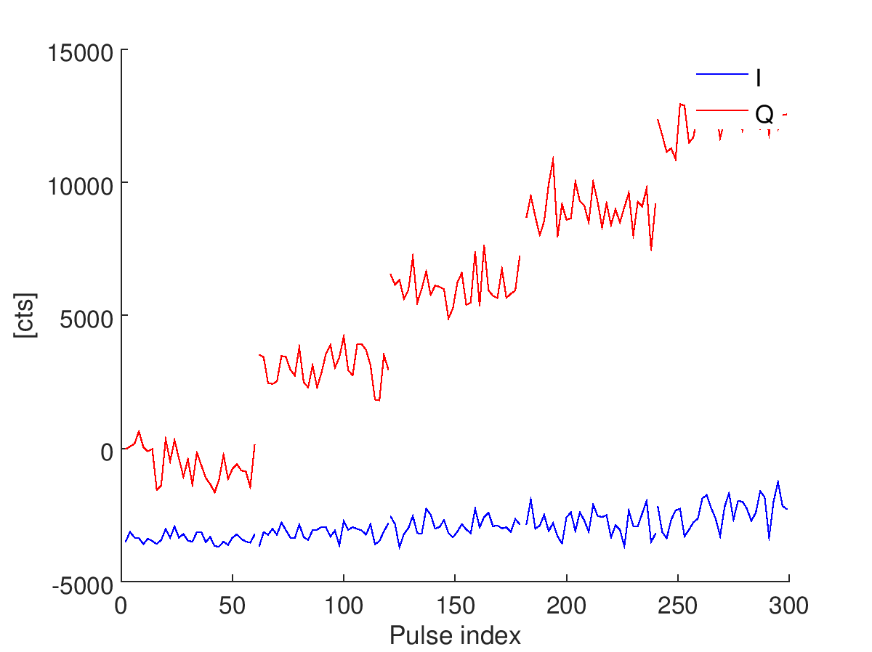
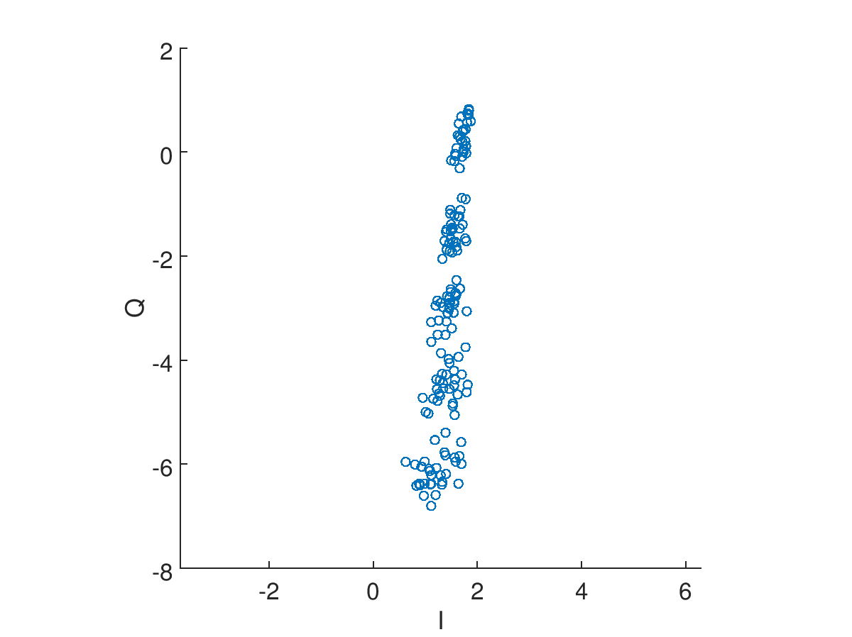
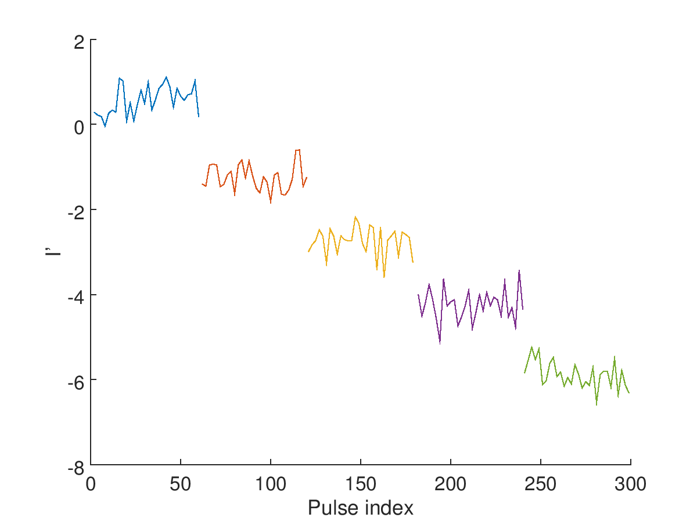
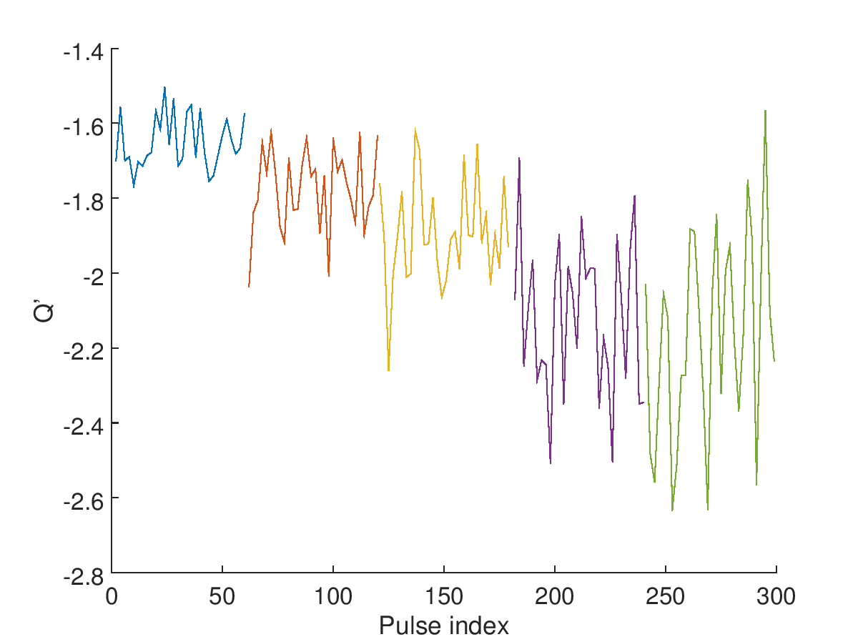
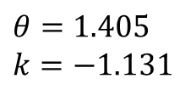
AQD0FFyScan14
IPC: ref = 27, sig = 14:30
$$θ=1.405$$
$k=−1.131$

Slide 11
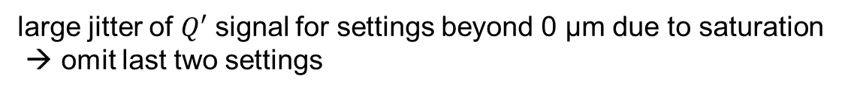
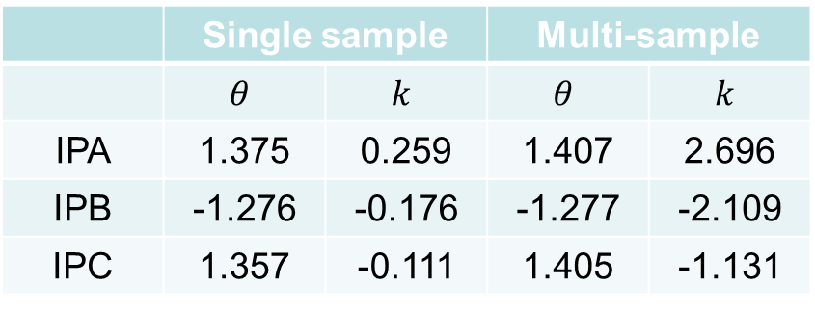
Calibration summary
large jitter of $Q′$ signal for settings beyond 0 μm due to saturation
→ omit last two settings
 | Single sample |  | Multi-sample
 | $$θ$$ | $$k$$ | $$θ$$ | $$k$$
IPA | 1.375 | 0.259 | 1.407 | 2.696
IPB | -1.276 | -0.176 | -1.277 | -2.109
IPC | 1.357 | -0.111 | 1.405 | -1.131
ratio
10.41
11.98
10.19
Note discrepancy between $k_{A}$ and $k_{B}$ - typically they are more similar

Slide 12
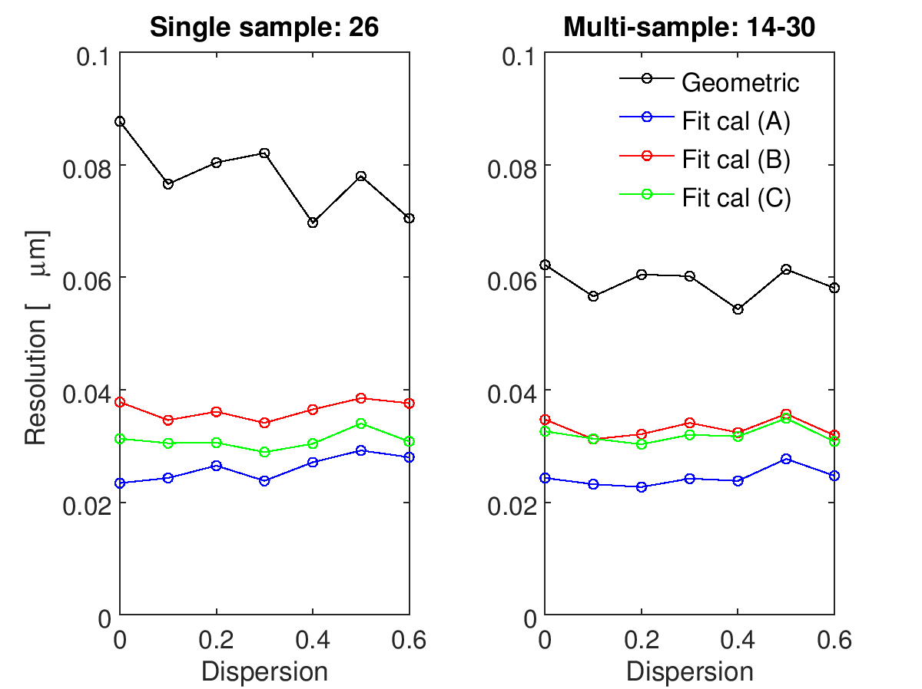
Dispersion scan: resolution
with drift removal applied

Slide 13
Conclusion
Results from scan suggest that resolution is not strongly dependent on dispersion

