Slide 1
ATF Operations Meeting Friday 18th May 2018
Results from April run
P. Burrows, C. Perry, D. Bett, R. Ramjiawan

Slide 2
Contents
IPBPM resolution
IPBPM sensitivity to angle
Measured latency of feedback system

Slide 3
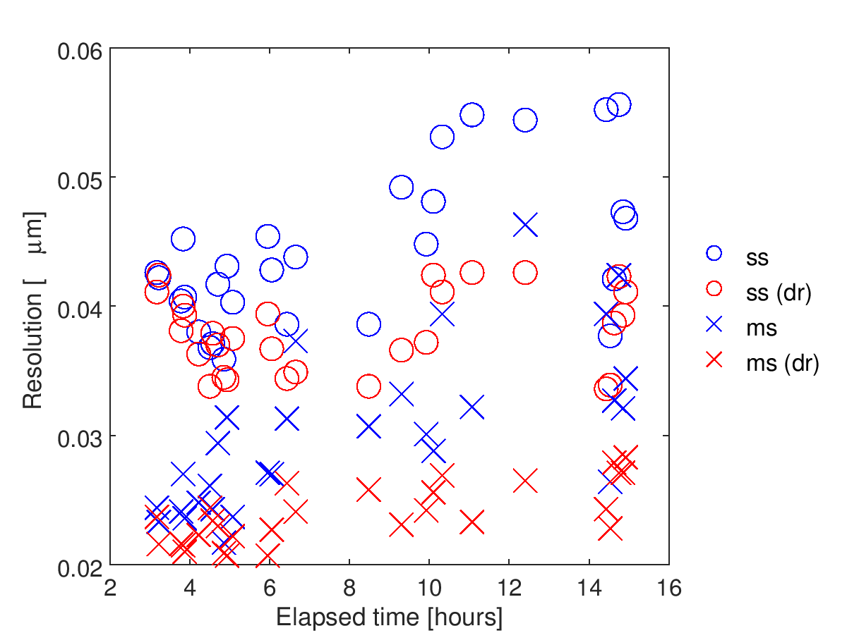
IPBPM resolution
All jitter runs from 1700 Thurs 19 Apr to 0900 Fri 20 Apr
With favourable beam conditions, resolutions in the 20-30 nm range achieved without too much effort
ss = single sample
ms = multi-sample
(i.e. integration of I and Q)
dr = drift removal

Slide 4
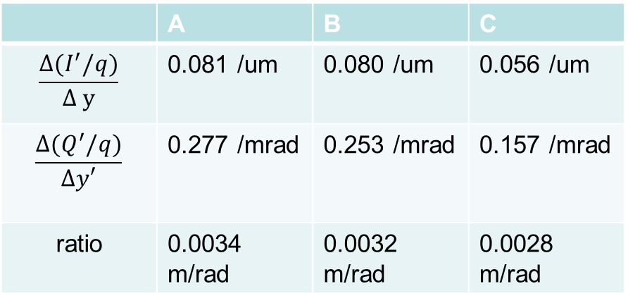
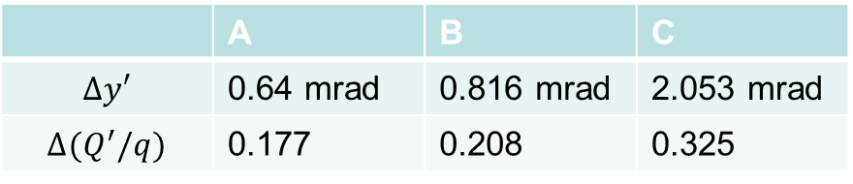
Angle sensitivity
Tilt scan: adjust individual movers by different amounts to maintain a constant vertical offset while changing tilt of BPM with respect to beam
 | A | B | C
$$Δy′$$ | 0.64 mrad | 0.816 mrad | 2.053 mrad
$$Δ(Q^{′}/q)$$ | 0.177 | 0.208 | 0.325
BPM
beam
 | A | B | C
$$\frac{Δ(I^{′}/q)}{Δ y}$$ | 0.081 /um | 0.080 /um | 0.056 /um
$$\frac{Δ(Q^{′}/q)}{Δy′}$$ | 0.277 /mrad | 0.253 /mrad | 0.157 /mrad
ratio | 0.0034 m/rad | 0.0032 m/rad | 0.0028 m/rad
movers
from R. Ramjiawan

Slide 5
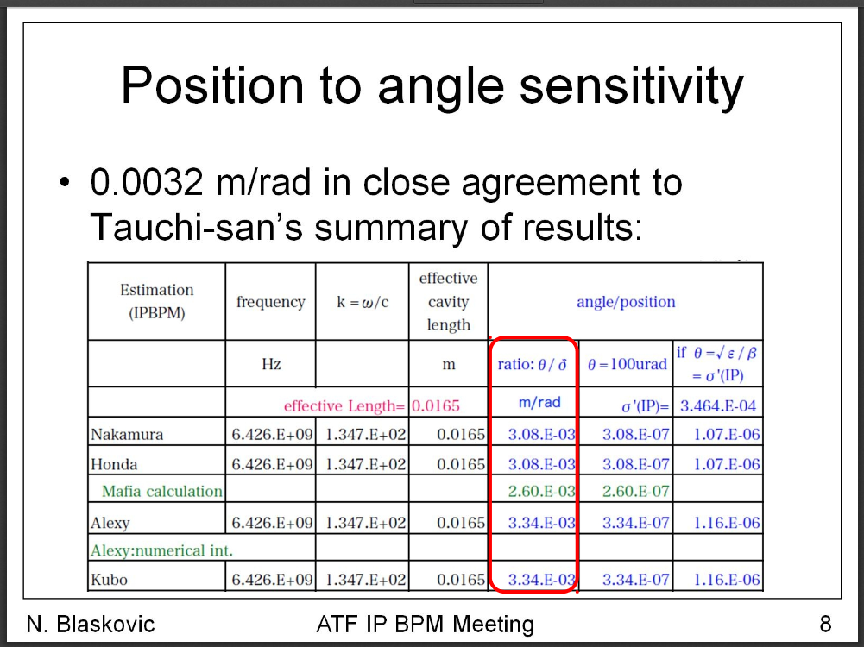
Angle sensitivity

Slide 6
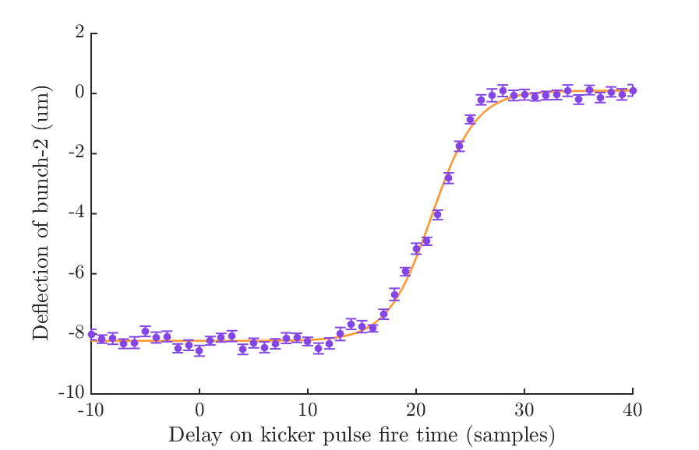
Feedback latency
Latency = bunch spacing – delay required to reduce kick to 90% max.
47.6 ns
Bunch spacing: 100 samples (280 ns)
Delay to reduce kick to 90%: 17 samples (47.6 ns)
Latency = 280 ns – 47.6 ns = 232.4 ns.
from R. Ramjiawan

Slide 7
Shift request
3 shifts during week of June 11
Study: rework IPBPM electronics setup so we can monitor bunch phase and LO jitter
Also: probe maximum resolution of the new diode processors (for stripline BPMs)

