Slide 1


Previous Studies
of the Unwanted Waveform
Compiled from presentations by:
T. Bromwich, N. Blaskovic Kraljevic
FONT meeting – Monday 4th June 2018

Slide 2
Outline
Recap from the last meeting with Alexey.
Previous studies on the 63 MHz waveform feature seen in I and Q signals:
Slides from:
17th Nov 2015 (Neven)
21st Dec 2015 (Talitha)
27th Jan 2016 (Talitha)
12th Feb 2016 (Talitha)
4th March 2016 (Talitha)
6th and 8th July 2016 (Talitha)

Slide 3
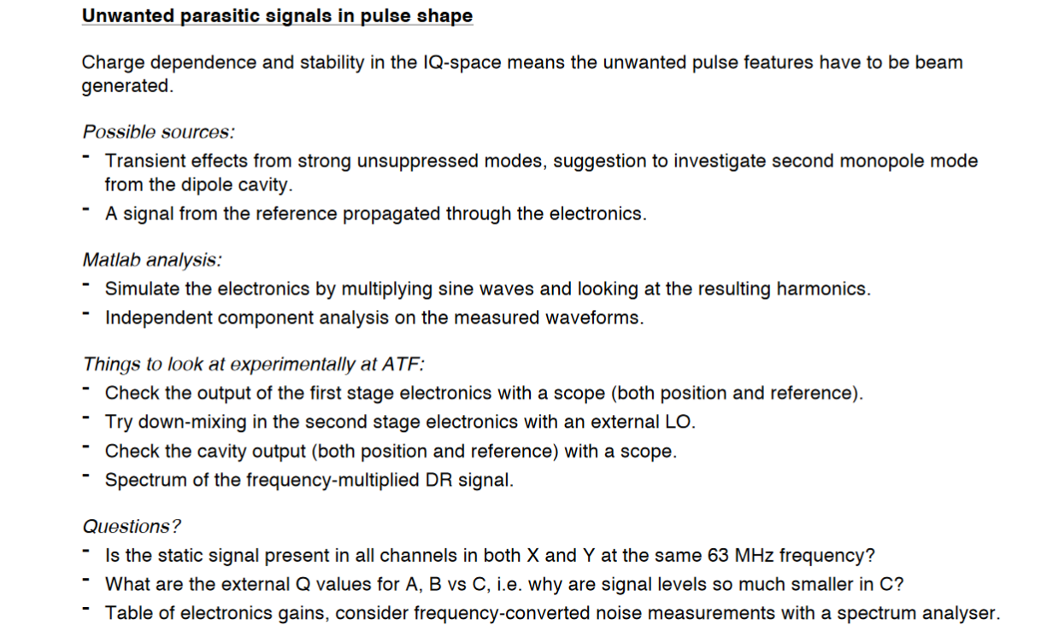
Recap: Previous meeting with Alexey (16/06/17)

Slide 4
Example Waveforms
6th July 2017
T. Bromwich

Slide 5
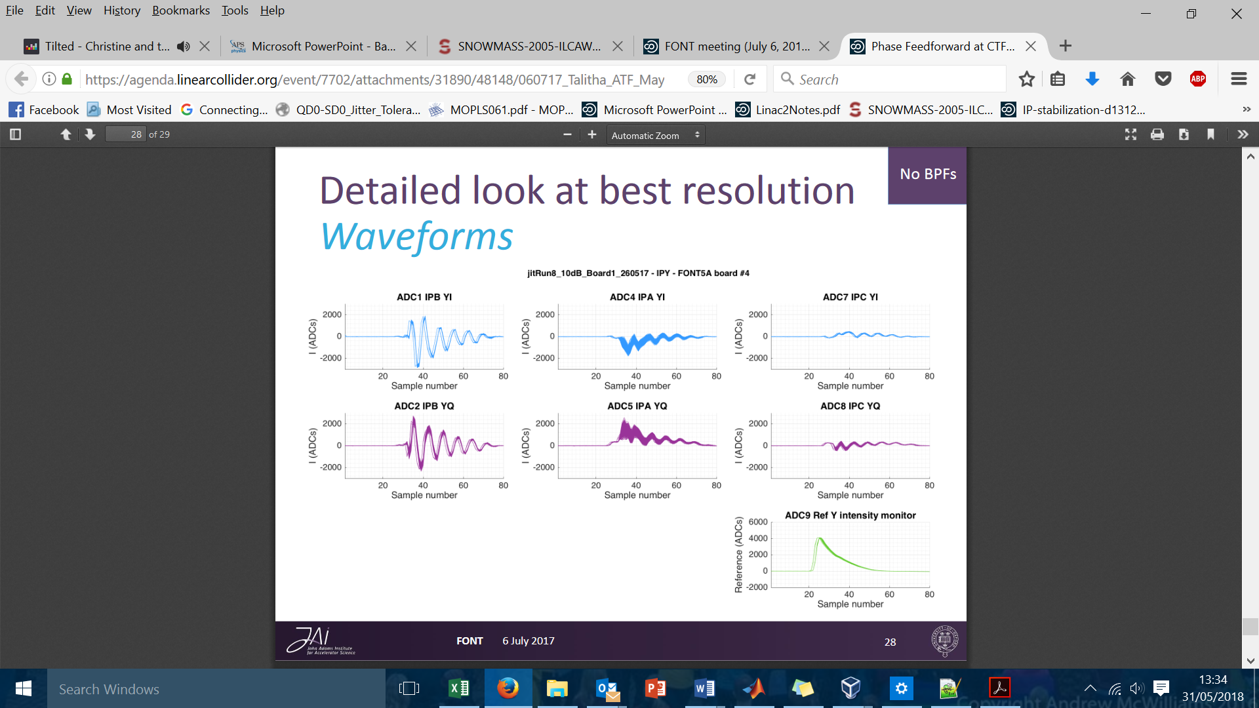

Slide 6
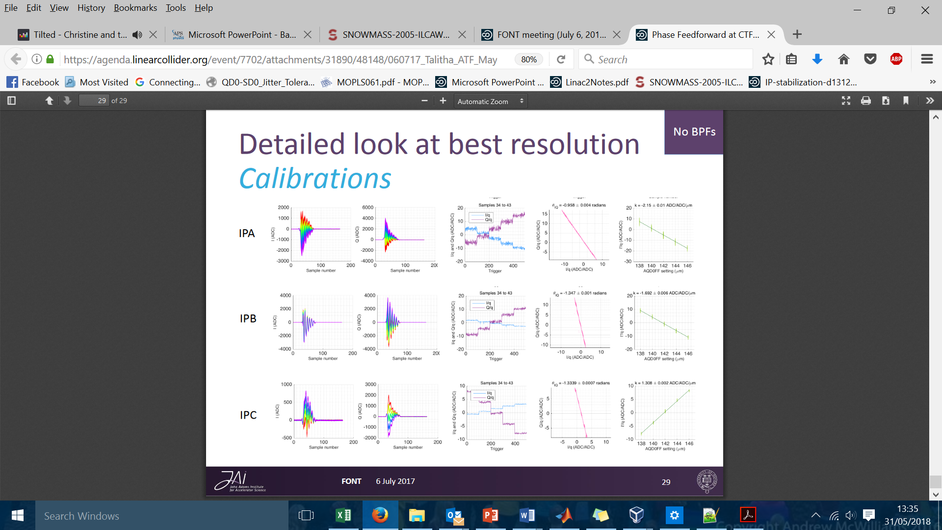
Calibration with Unwanted Waveform

Slide 7
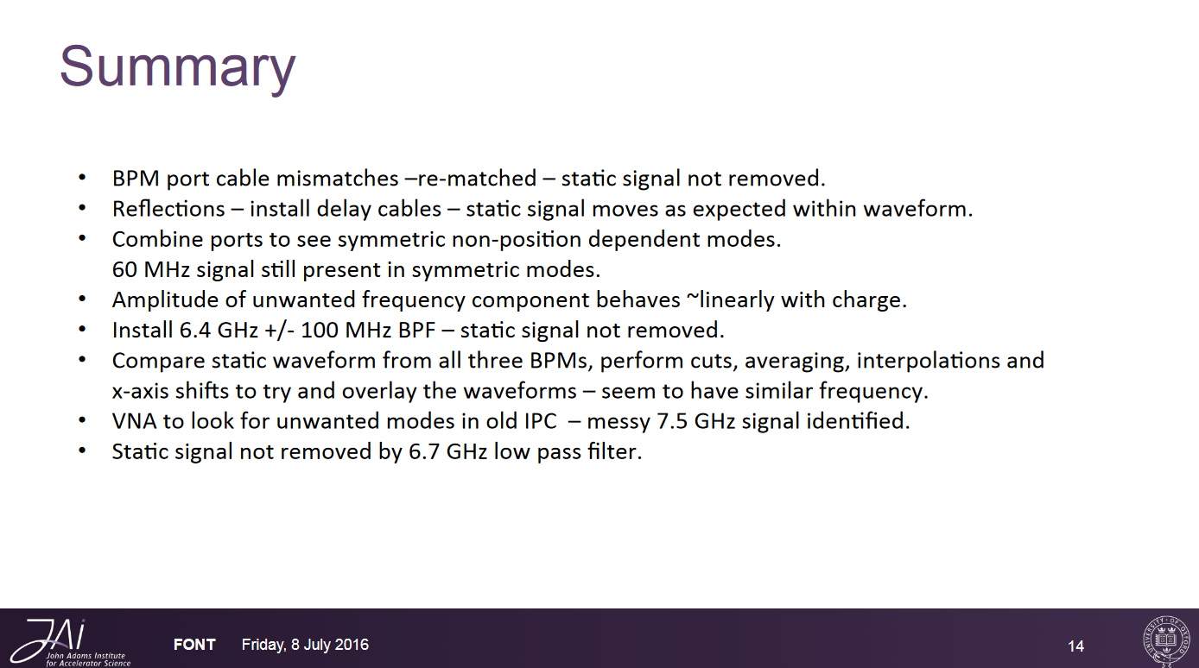

Slide 8
Cable mismatches
Cables re-matched to within 2 mm
and static signal remains

Slide 9
Cable mismatch
BPM
HYBRID
Measured cable lengths from IP BPM dipole cavities inside the IP vacuum chamber to the hybrid prior to the processing electronics using TDR.
BPM ports | Cavity to hybrid(ns) | Cavity to hybrid (m) | Δ Length (cm) | δ (cm) | Error (cm)
IPA-X1 | 9.91 | 2.360 | 11.43 | 1.08 | 0.04
IPA-X2 | 10.39 | 2.474
IPB-X1 | 10.39 | 2.475 | 0.011 | 0.11 | 0.06
IPB-X2 | 10.39 | 2.474
IPC-X1 | 9.92 | 2.362 | 11.21 | 1.29 | 0.06
IPC-X2 | 10.39 | 2.474
IPA-Y1 | 9.92 | 2.361 | 11.32 | 0.21 | 0.05
IPA-Y2 | 10.39 | 2.474
IPB-Y1 | 10.40 | 2.476 | 0.38 | 0.38 | 0.06
IPB-Y2 | 10.39 | 2.473
IPC-Y1 | 9.91 | 2.361 | 11.32 | 0.21 | 0.04
IPC-Y2 | 10.39 | 2.474
BPM port | Frequency (GHz) | Wavelength (m)
Y port | 6426 | 0.037
X port | 5712 | 0.042
Cable velocity 2.381 x 10⁸ m/s.
100 waveforms averaged on the TDR.
δ is phase difference after removing integer wavelength differences.
Cables mismatched inside chamber.
Y: Within 0.38cm (10% of wavelength)
X: Within1.29 cm (31% of wavelength)

Slide 10
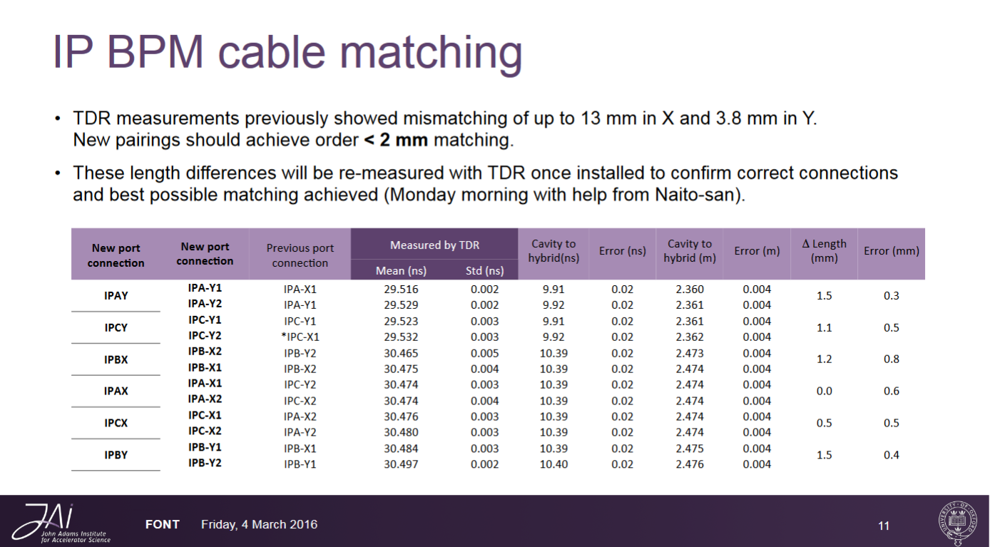

Slide 11
Delay cables
Delay cables between cavity and hybrid
Static signal not seen to shift w.r.t BPM waveform

Slide 12
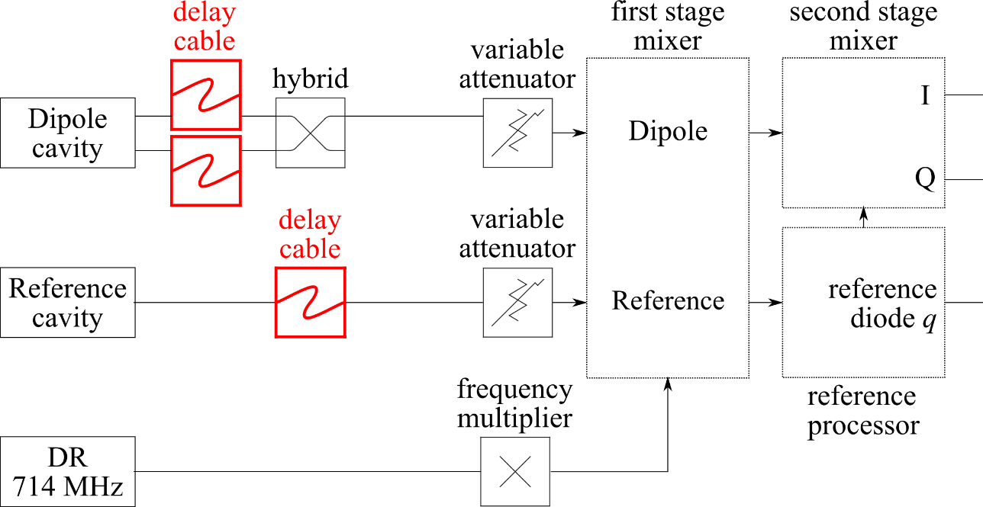
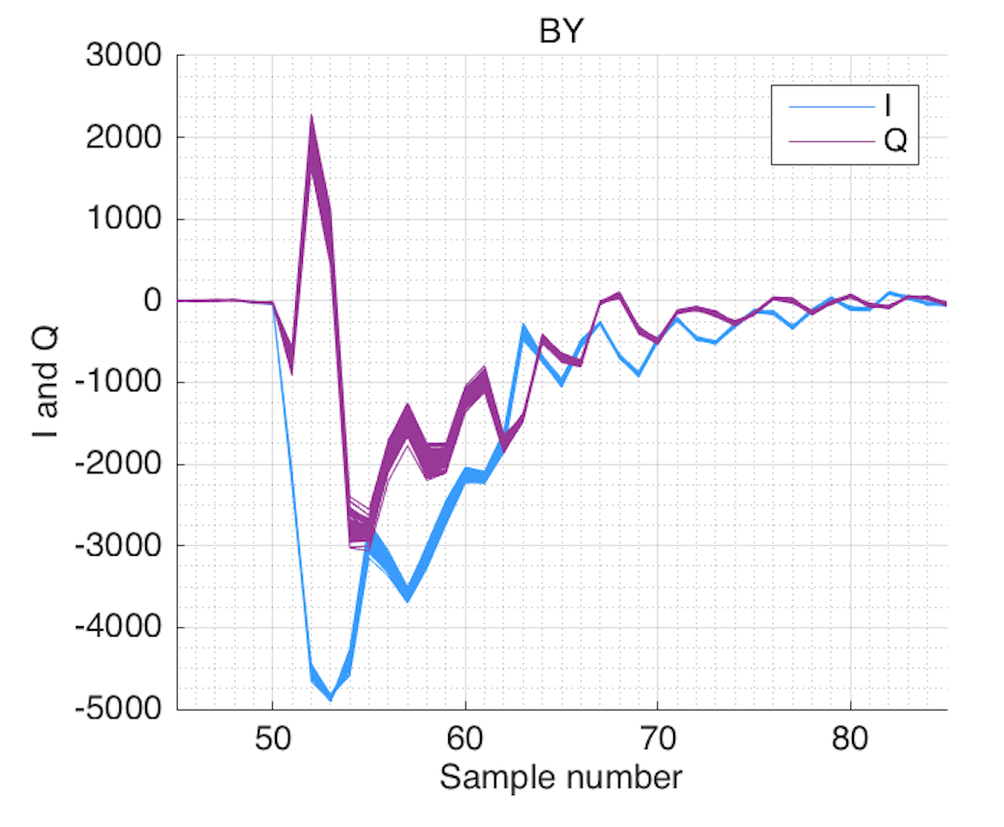
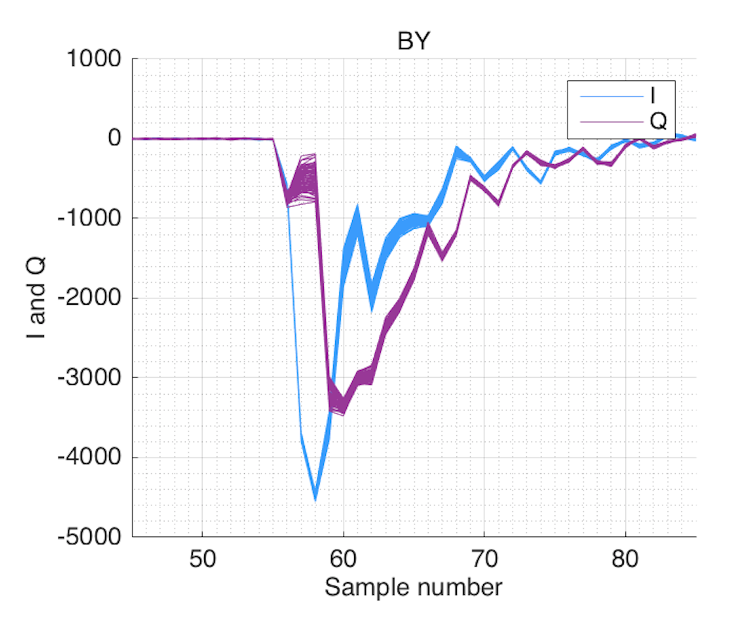
Delay cables
Look for reflections inside the chamber by introducing delay cables outside before the electronics and observing if the static signal moves within the pulse.
Matched 5.5 m (28 ns) delay cables introduced on both ports of IPBY and the reference cavity.
No delay cables
Delay cables
Results:
SIS digitiser (4.2 ns per sample), expect delay of 6.5 samples with 5.5 m cables. Signals delayed as expected.
Static feature does not move noticeably within the pulse.

Slide 13
Splitter study
Replace 180 degree hybrid with splitter
so that symmetric modes remain.
Static signal still present.

Slide 14
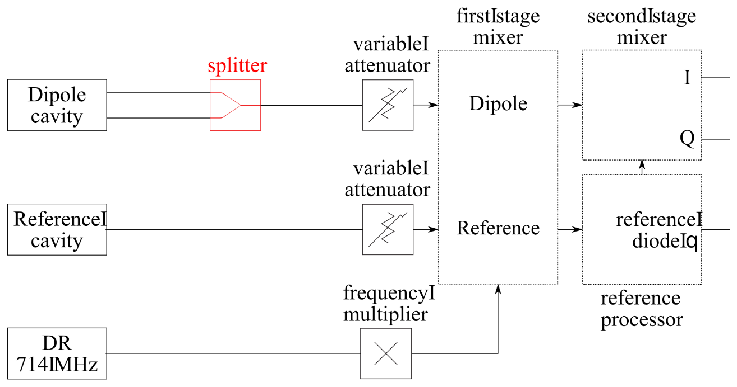
Symmetric mode study
IPB hybrid replaced with a splitter to cancel dipole modes and combine symmetric modes.
Dipole modes (normal set-up)
Symmetric modes (with splitter)

Slide 15
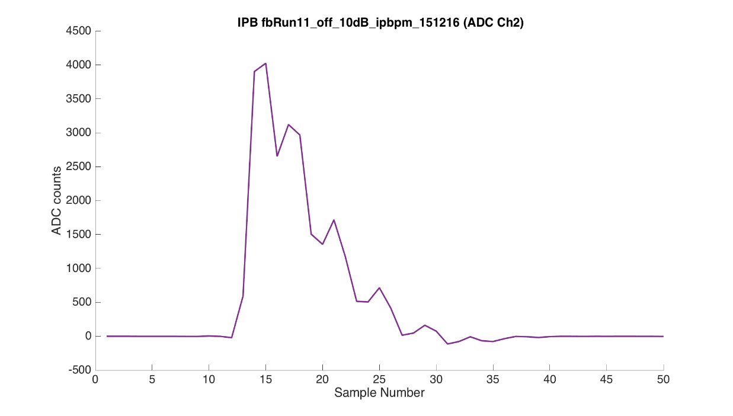
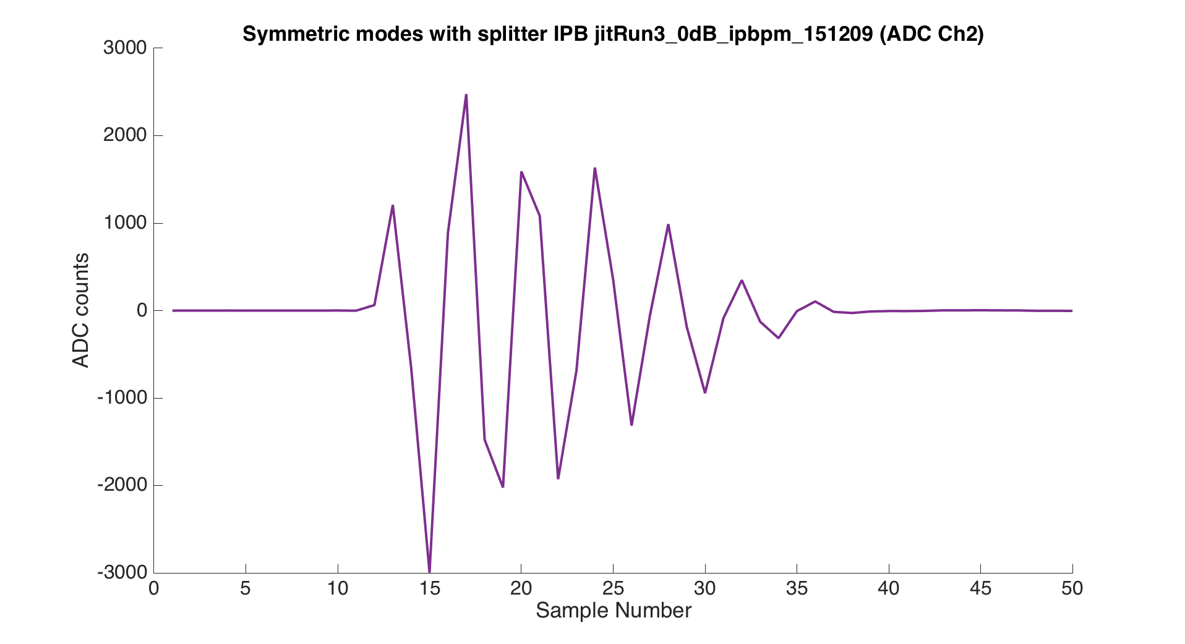
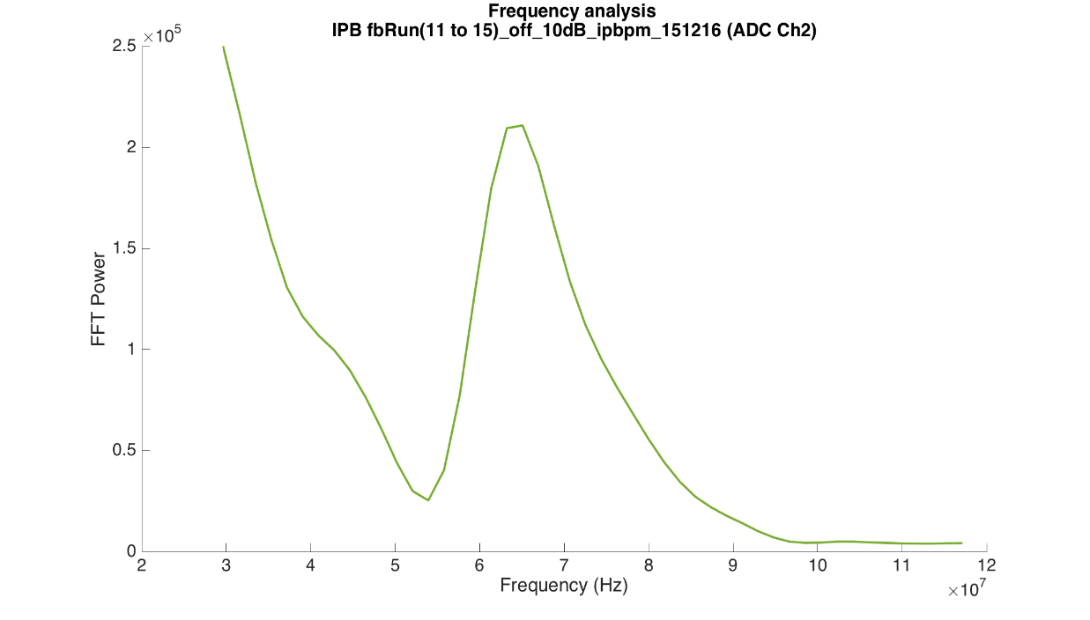
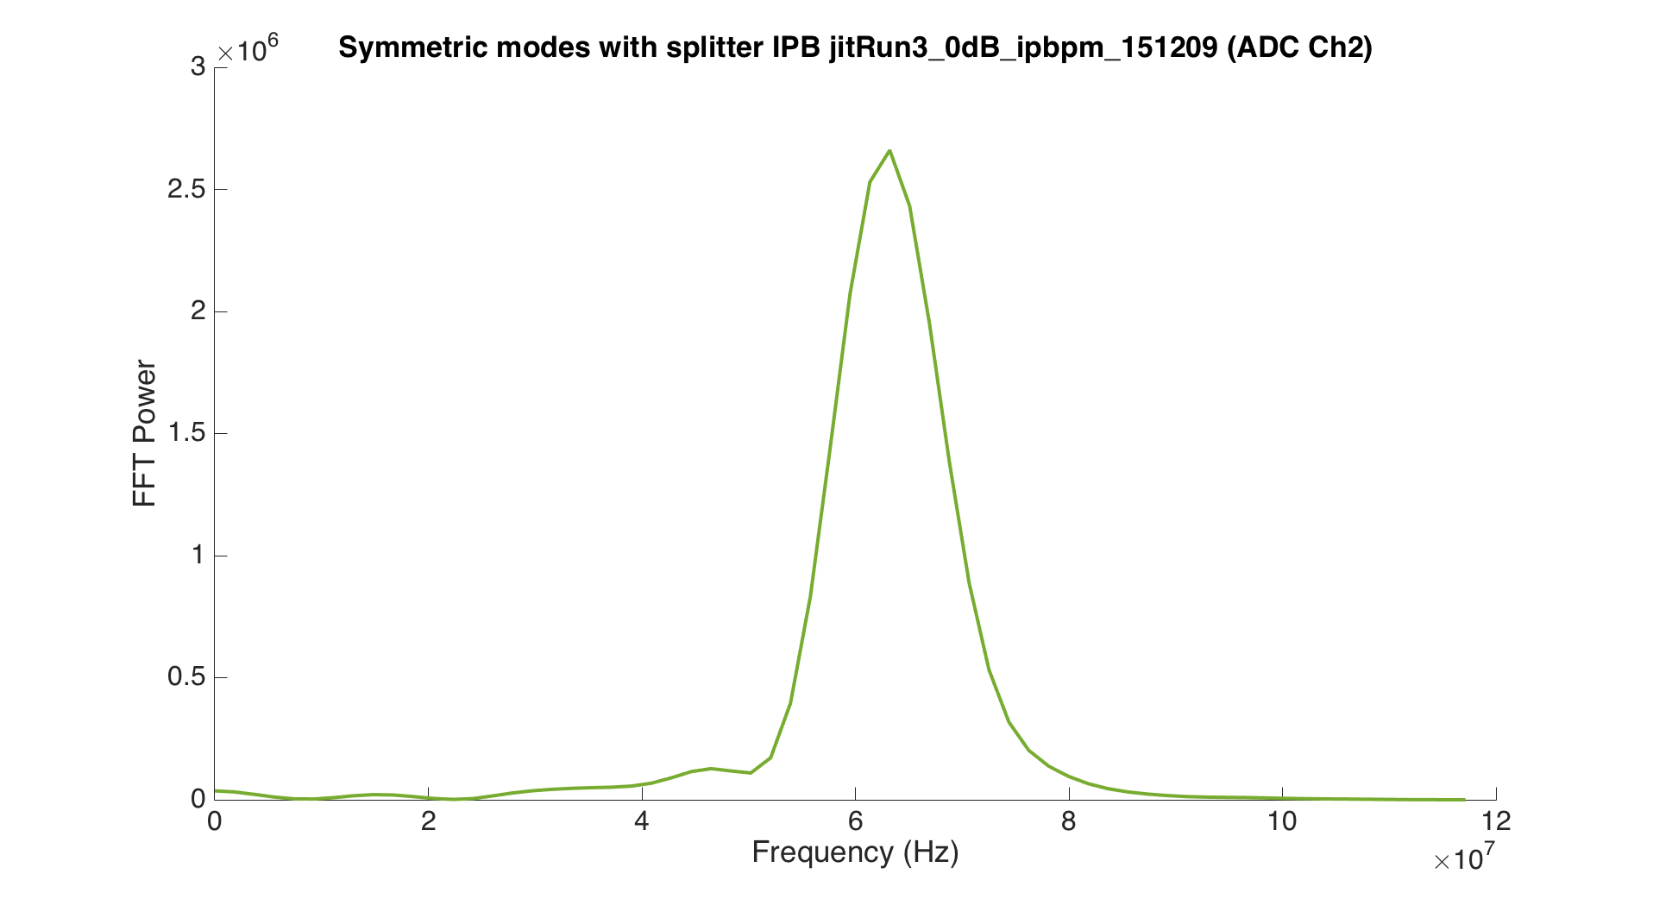
FFT Power
IPBY dipole modes (normal set-up)
IPBY symmetric modes (with splitter)
60 MHz signal seen in symmetric modes.
FFT Power Peak at 63 MHz
FFT Power Peak at 63 MHz

Slide 16
Dependence on charge
Amplitude of unwanted waveform
scales linearly with charge

Slide 17
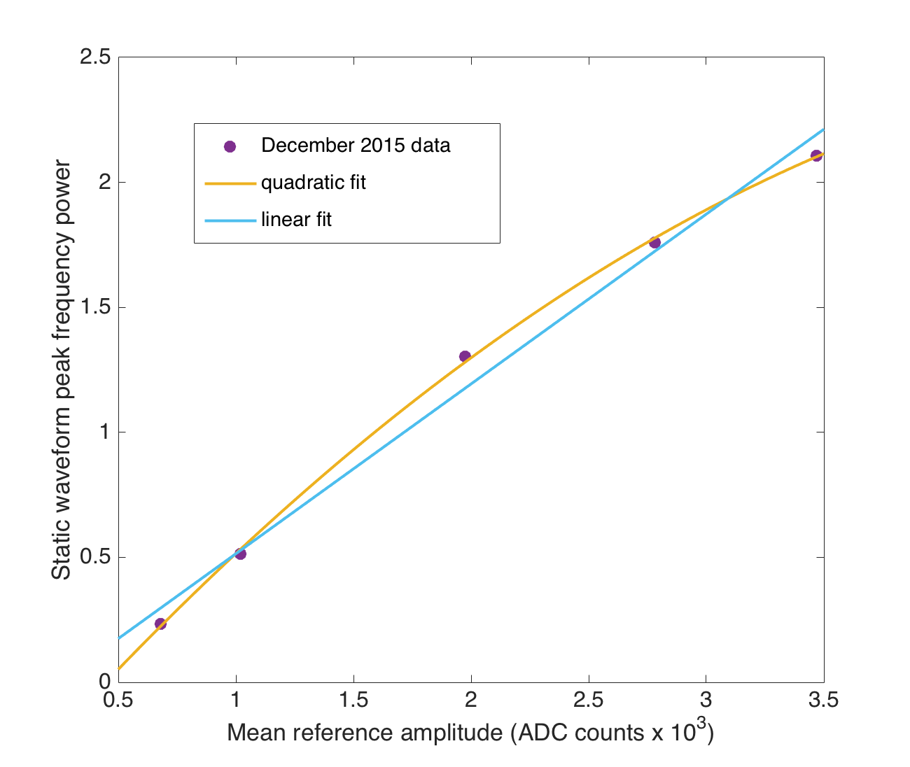
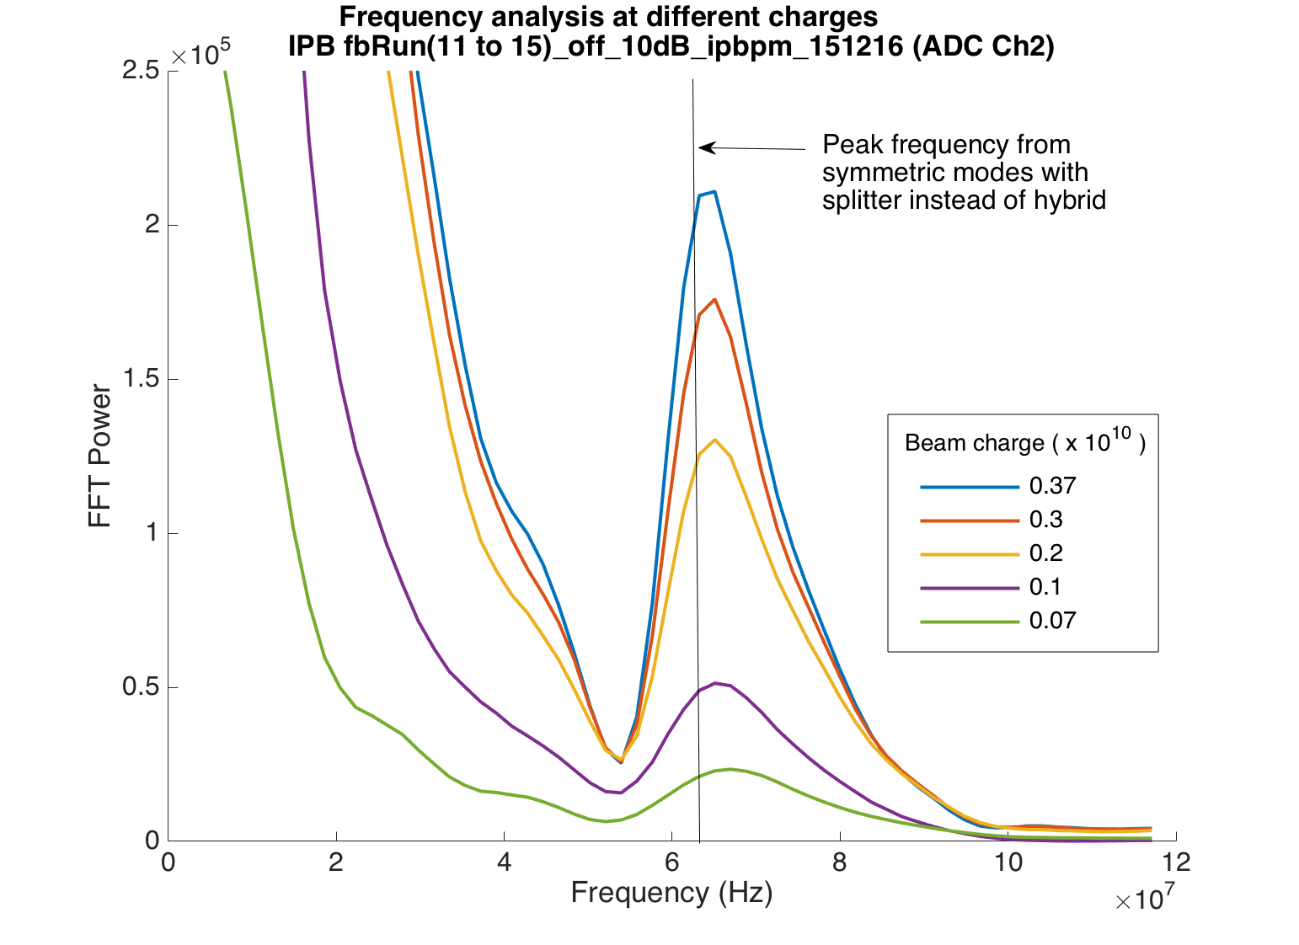
63 MHz amplitude with charge
63MHz signal amplitude in dipole waveforms increases with charge.
However, this data is with normal dipole set-up and may be confused by the dominant position-dependence.

Slide 18
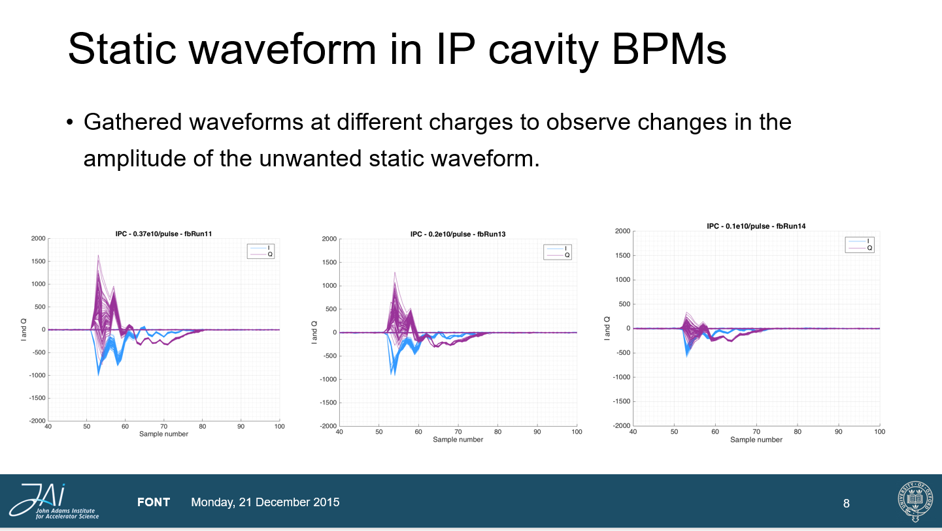

Slide 19
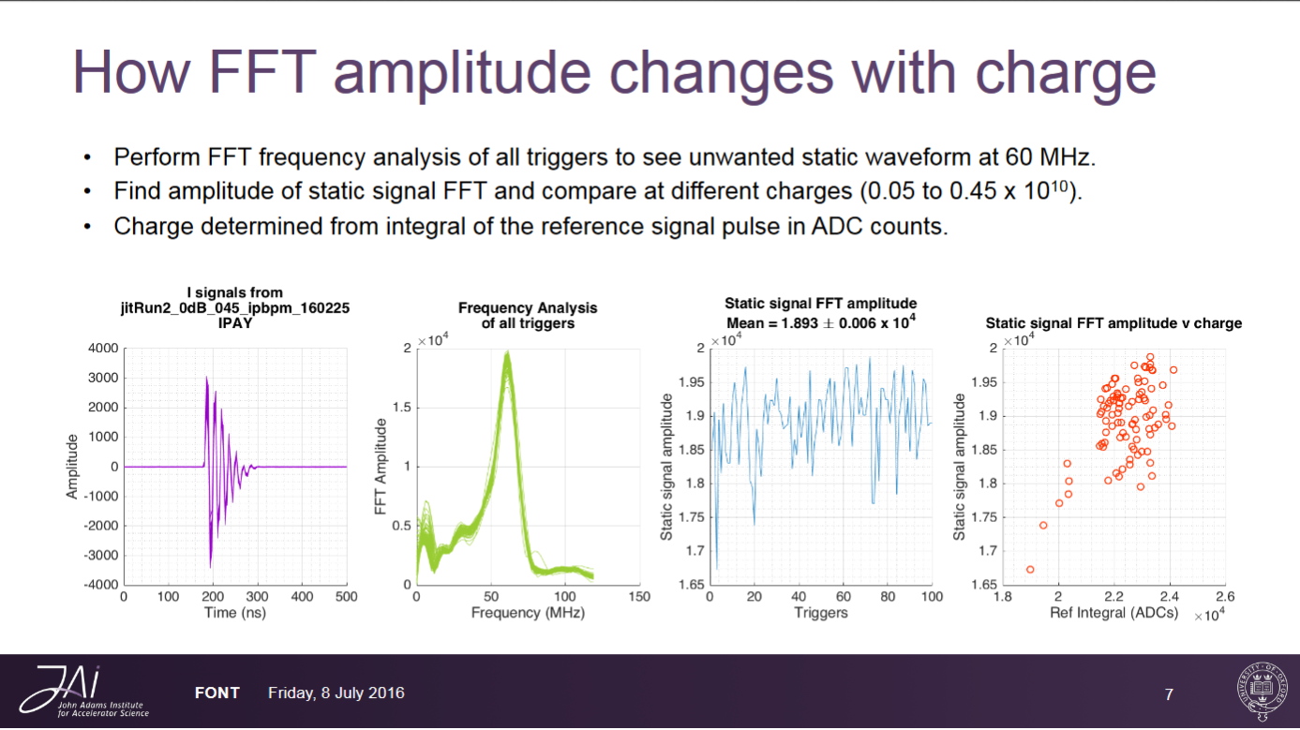

Slide 20
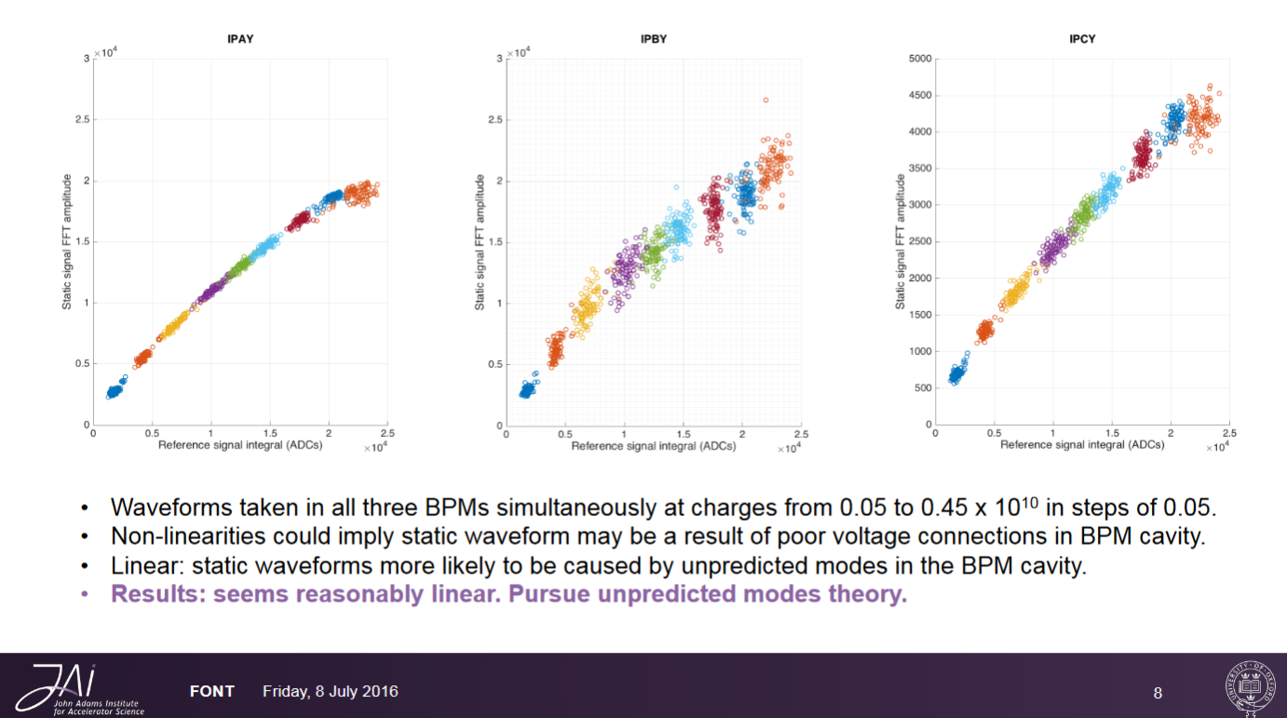

Slide 21
Frequency: X, Y / A, B, C
Similar frequency unwanted waveform seen in
IPA, IPB and IPC for X and Y modes

Slide 22
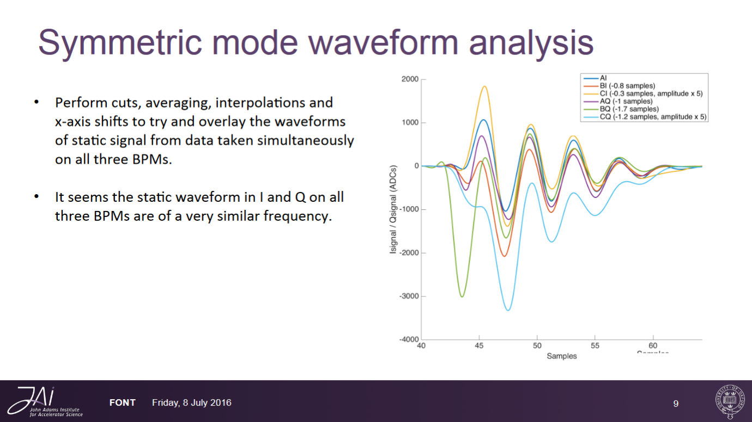

Slide 23
Studies on the old IPC cavity
VNA analysis of cavity
Cluster of modes found at 7.5 GHz

Slide 24
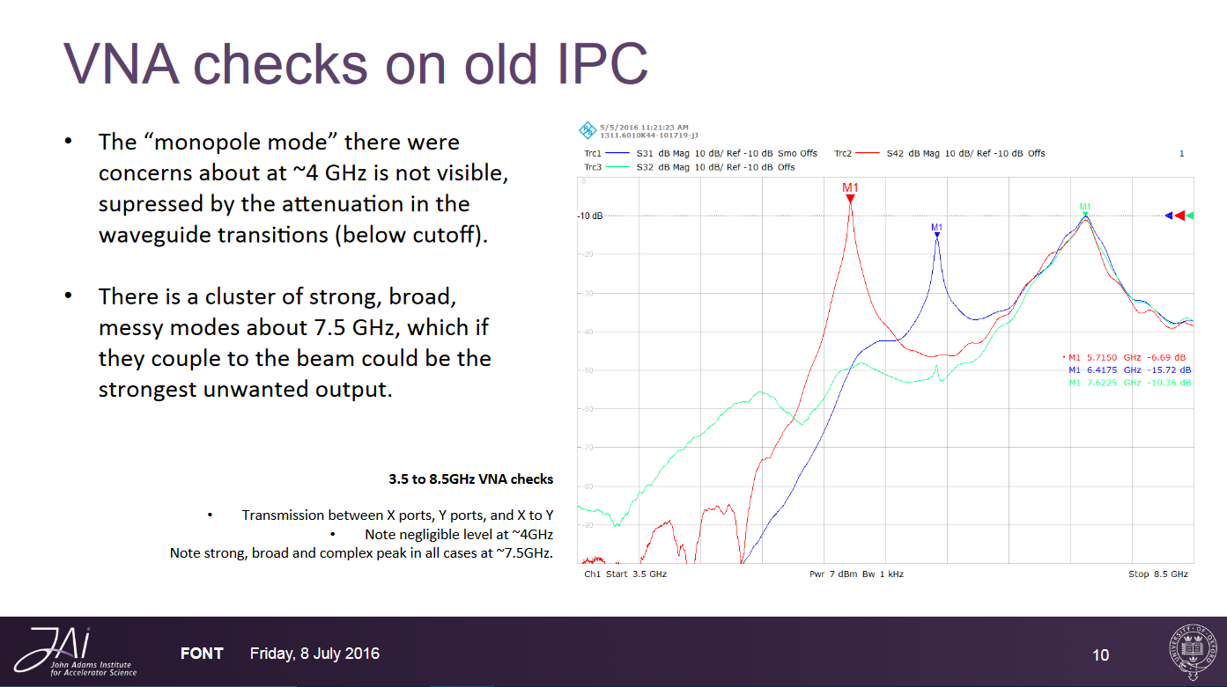

Slide 25
6.7 GHz Low Pass Filter
Should attenuate signal if comes from
higher frequency harmonics.
No change in amplitude of unwanted waveform from LPF

Slide 26
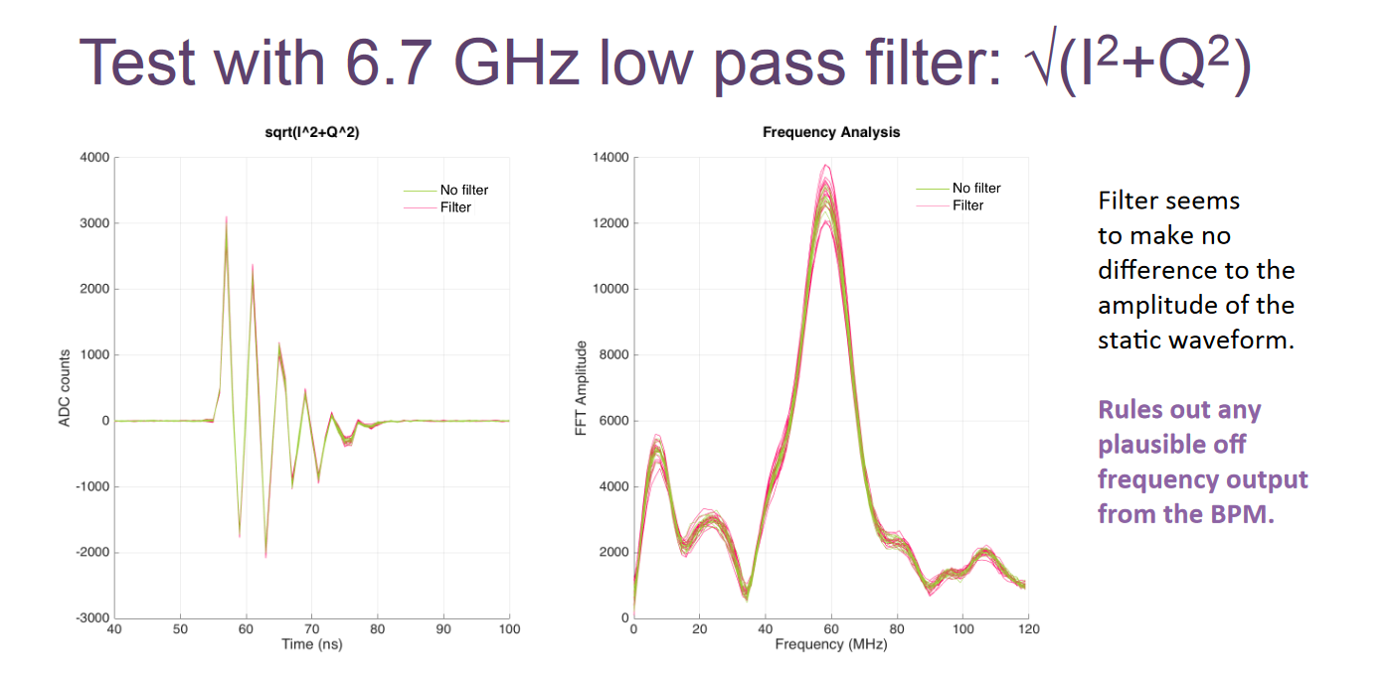
Replace the hybrid on IBPY with a splitter (so only viewing non‐position­‐dependent monopole mode) followed by a low pass filter VLF-­‐6700 .
The static 60 MHz component should be significantly attenuated on addition of the filter if it was a result of higher frequency LO harmonic mixing.

Slide 27
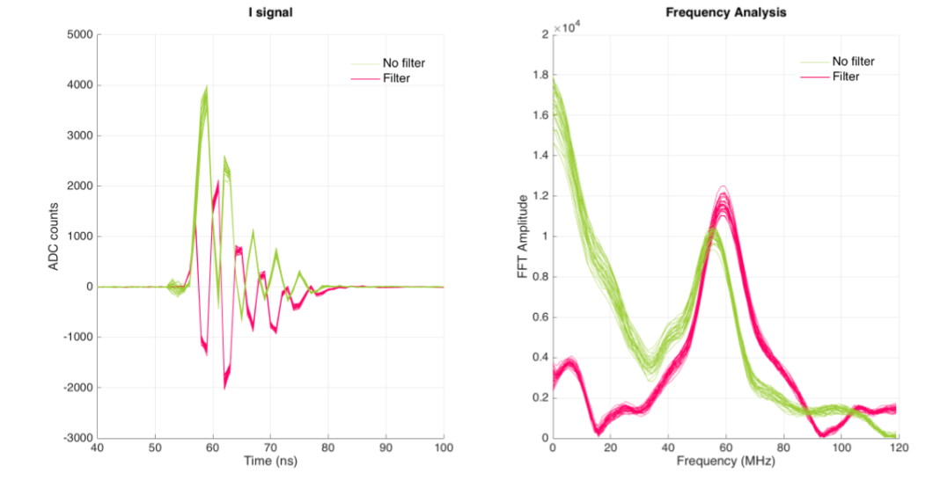
I Signal with 6.7 GHz LPF
T. Bromwich (8th July 2017)
It appears that the introduction of the low pass filter has shifted the frequency with the peak amplitude.

Slide 28
Single Port Studies
Different magnitude and waveform shapes
from the two cavity ports

Slide 29
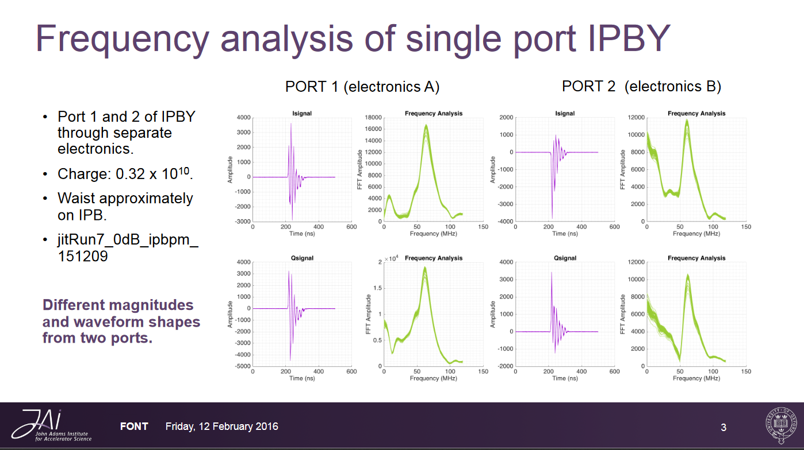

Slide 30
Neven’s Studies (17th Nov 2015)

Slide 31
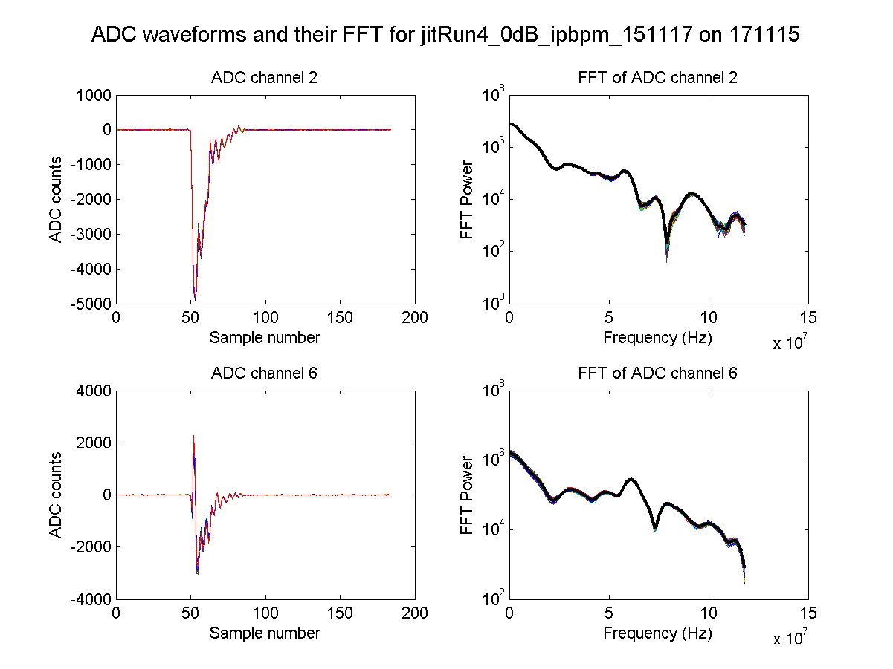
180° hybrid
N. Blaskovic

Slide 32
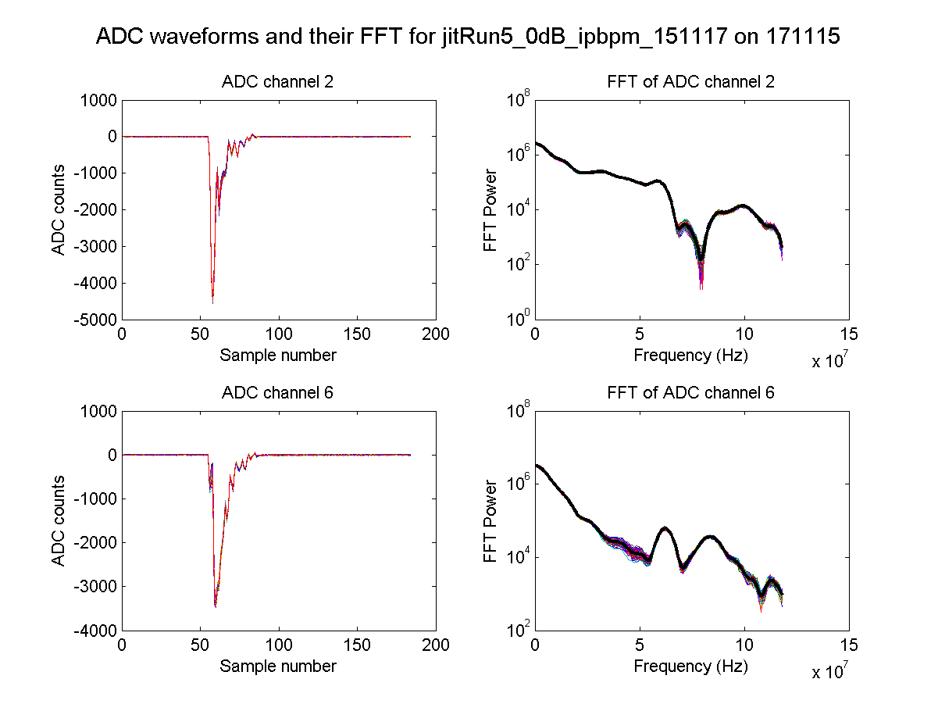
With delay cables
N. Blaskovic

Slide 33
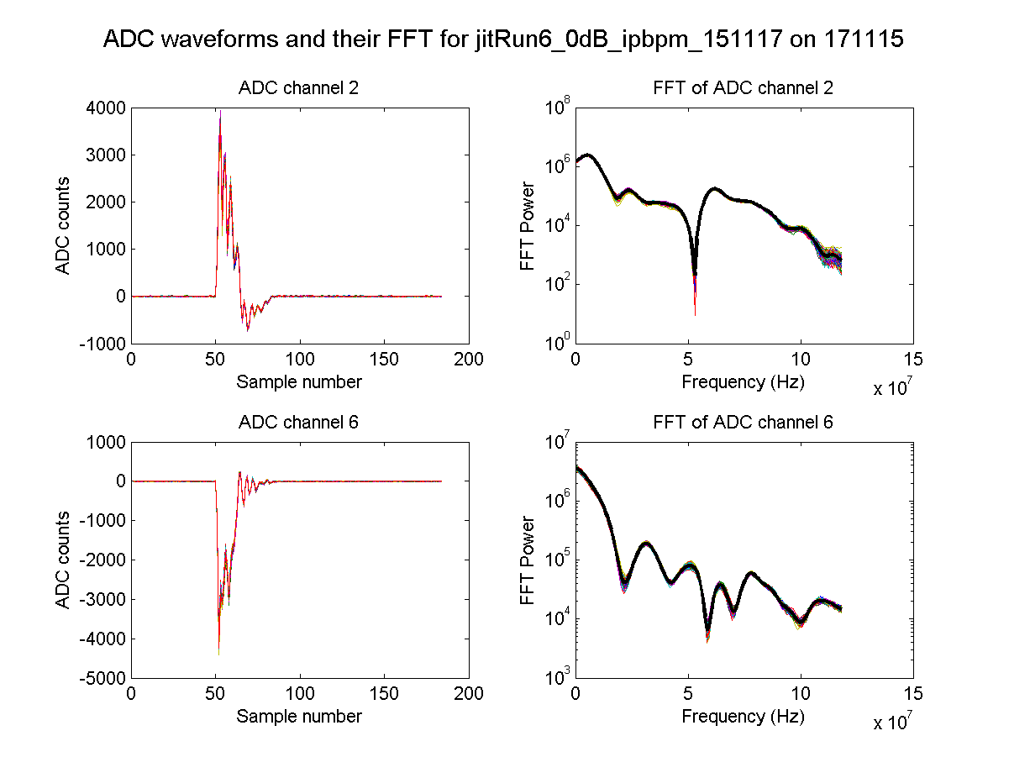
Single port
N. Blaskovic

Slide 34
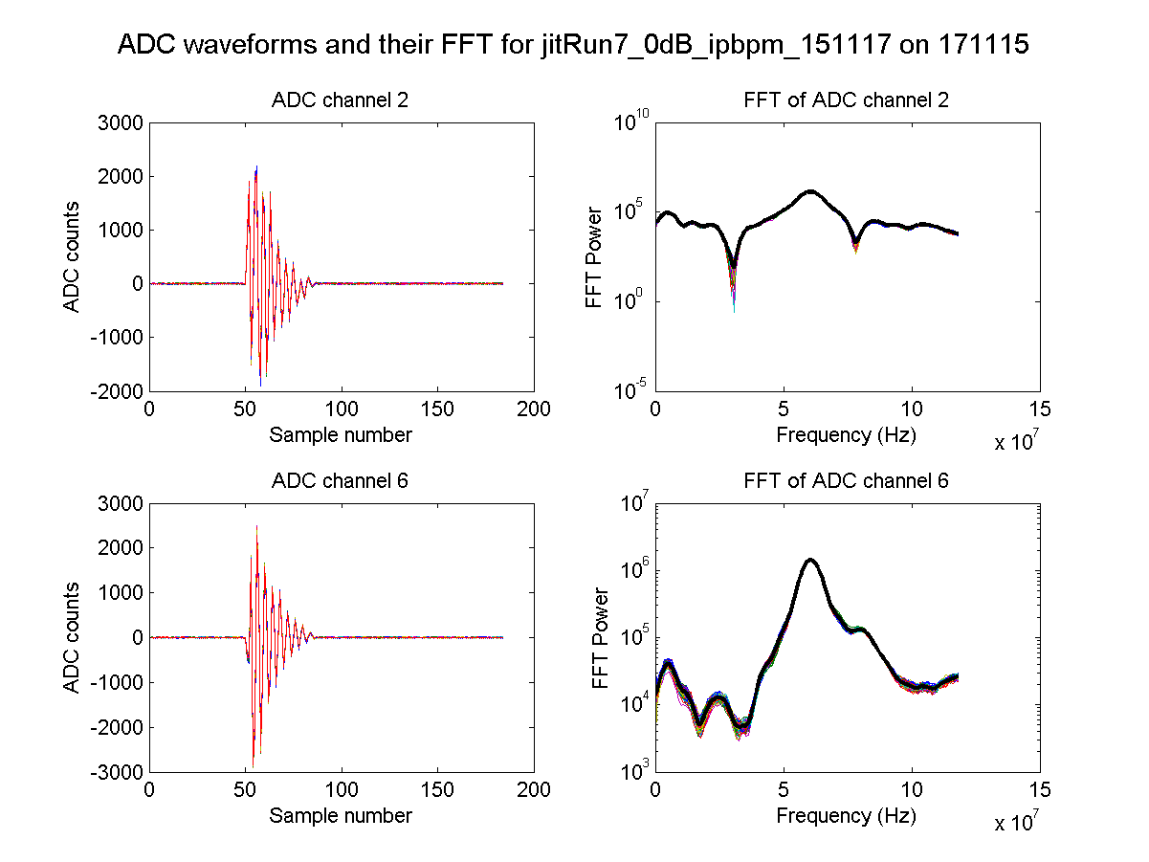
Splitter
N. Blaskovic

