Slide 1
FONT Meeting
Friday 8th June 2018
ATF Plan – June 2018
Douglas BETT

Slide 2
Goals
Use IPBPM electronics to monitor:
  limiter phase
  bunch phase
Measure resolution of diode processors

Slide 3
Limiter phase
Requires either spare detector module or an x module
  IF: 714 MHz ref. input to y limiter
  LO: 714 MHz ref. output of y limiter
Requires single 2-way splitter on the input to the y limiter – amplification not likely to be necessary due to the amount of attenuation already in the reference channel

Slide 4
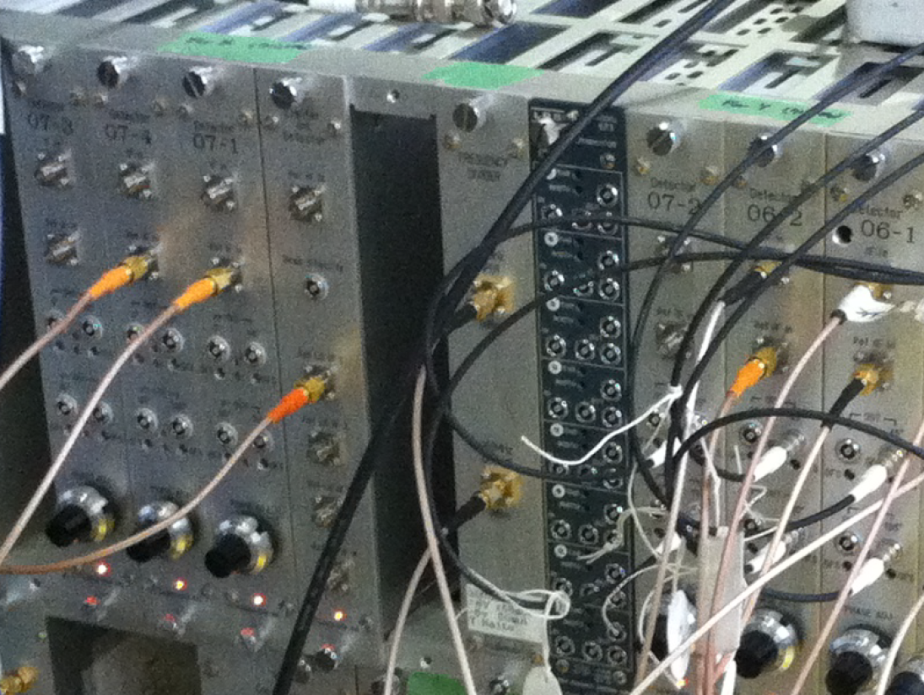
Limiter Int Detector
REF IF in
Limiter input = Ref out from converter module
Beam intensity
(aka q or ref –
digitized on ADC9)
REF LO IF 1-4
Four copies of the reference LO, used as REF IF in for the detector modules

Slide 5
Bunch phase
Requires spare detector module (to measure at IP)
  IF: 714 MHz ref. input to limiter (x or y)
  LO: DR 714 MHz
Requires an additional 2-way splitter for the limiter input (if the input to the y limiter is used, two 2-way splitters could be substituted for a 4-way splitter and a terminator)
The damping ring 714 MHz would require amplification and attenuation after the split is inserted

Slide 6
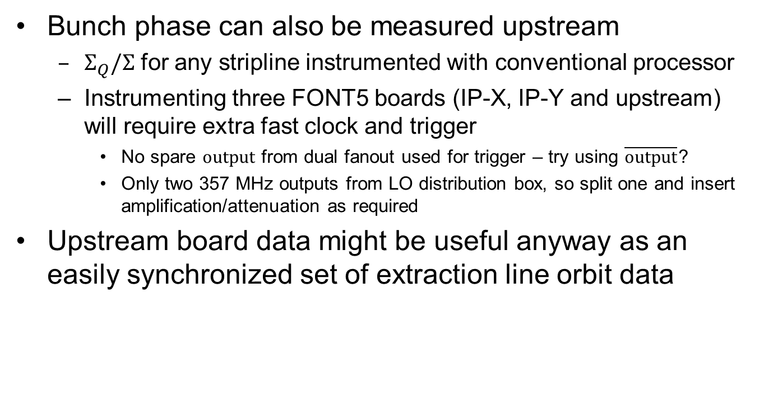
Bunch phase (II)
Bunch phase can also be measured upstream
  $Σ_{Q}/Σ$ for any stripline instrumented with conventional processor
  Instrumenting three FONT5 boards (IP-X, IP-Y and upstream) will require extra fast clock and trigger
    No spare $\text{output}$ from dual fanout used for trigger – try using $\overline{\text{output}}$?
    Only two 357 MHz outputs from LO distribution box, so split one and insert amplification/attenuation as required
Upstream board data might be useful anyway as an easily synchronized set of extraction line orbit data

Slide 7
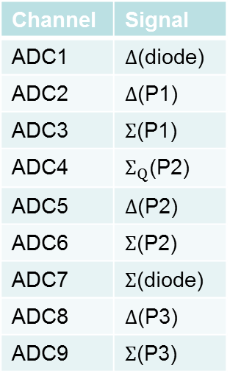
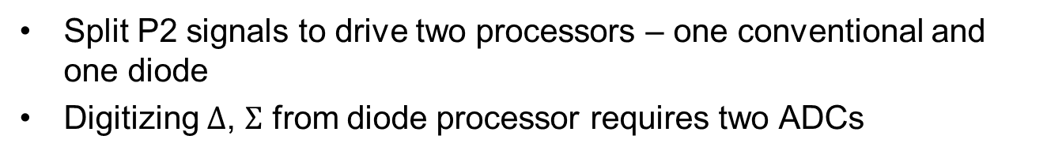
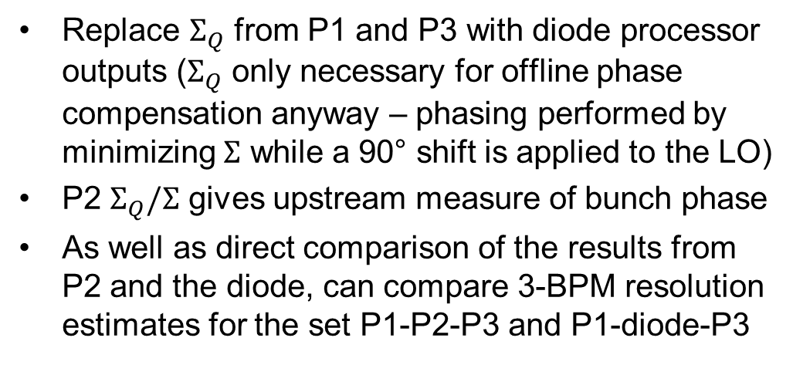
Upstream board
Split P2 signals to drive two processors – one conventional and one diode
Digitizing $Δ$, $Σ$ from diode processor requires two ADCs
Channel | Signal
ADC1 | $Δ$(diode)
ADC2 | $Δ$(P1)
ADC3 | $Σ$(P1)
ADC4 | $Σ_{Q}$(P2)
ADC5 | $Δ$(P2)
ADC6 | $Σ$(P2)
ADC7 | $Σ$(diode)
ADC8 | $Δ$(P3)
ADC9 | $Σ$(P3)
Replace $Σ_{Q}$ from P1 and P3 with diode processor outputs ($Σ_{Q}$ only necessary for offline phase compensation anyway – phasing performed by minimizing $Σ$ while a 90° shift is applied to the LO)
P2 $Σ_{Q}/Σ$ gives upstream measure of bunch phase
As well as direct comparison of the results from P2 and the diode, can compare 3-BPM resolution estimates for the set P1-P2-P3 and P1-diode-P3

Slide 8
Discussion
Considerable amount of setup work – Terunuma-san informs me that they plan to start operations Monday evening, so hopefully all day Monday is sufficient
Ideally, plan would be to take resolution runs to see if including any of limiter phase / bunch phase / x position as parameters in the fit improves the resolution
Other suggestions
  Try changing IQ phase of detector modules from 90° to 45° - historically Siwon claimed this resolved issues with discontinuities during calibration runs and it would be nice to confirm or deny this.
  Reintegrate the second variable attenuator for the reference back into the system for fine control over the reference amplitude.

Slide 9
Colin’s suggested procedure
Jitter runs with normal optics, focus at one BPM (as closely as possible) plus position from a second.
Resolution runs varying position and tilt of one BPM about ‘best’ setting. C is suggested, because it can be moved independently of the others.
  Starting with nominal tilt and position, run at that position, move to the worst position that would be accepted one way and take data, repeat with the same displacement the other way, and finally repeat at the original position.
  Then alter tilt as far as would be accepted, recenter position, and repeat the sequence of 4 runs
  Alter tilt the same amount the other way from nominal, and repeat
  Restore original tilt and position, and take a final run
This is a bit tedious (13 runs), and could be simplified. On the other hand, a
repeat of the entire sequence would be ideal (as opposed to repetitions
within the sequence, which would give more time for drifts

Slide 10
Summary
Signals that will be split:
  DR 714 MHz used as input of converter module
  357 MHz fast clock output of LO distribution box
  P2 top and bottom stripline signals
  Input to y limiter (split into three)
Will need to conduct a thorough check of exactly what amplification / attenuation already exists but…
Expect DR 714 MHz and 357 MHz clock to require additional amplification pre-split and extra attenuation post-split
Follow Colin’s procedure to probe the effect of tilt on resolution and ascertain whether including limiter phase, bunch phase and x orbit data makes a difference at this level

