Slide 1
Progressing with the Post-Collision Line for the 380 GeV Stage of CLIC
Ryan Bodenstein
FONT Meeting
Friday, 8 June, 2018
Oxford

Slide 2
Goals of post-collision study

Slide 3
Guide the beam to the dump
If can scale down 3 TeV version, do that first
See if can improve on scaled-down 3 TeV version
Decrease radiation damage
Decrease number of components
Reduce costs
Check if ILC version can be made compatible
May be unfeasible
If above fails, redesign
This is a backup, and likely unnecessary

Slide 4
Previous studies

Slide 5
Previous work in CDR for 3 TeV

Slide 6
Post-CDR work…apparently gone.
L. Deacon in 2013
Used fewer and weaker magnets
Reduced radiation damage to magnets after intermediate dump
Reduced stray fields to incoming beamline
IN THE ETHER – No available lattices or codes to be found

Slide 7
Strategy

Slide 8
Trying not to re-invent the wheel
Use BDSIM for tracking and interactions with beamline components
Have CDR MADX lattice for starting point
Have or can make GUINEA-PIG outputs at IP for beam distribution of 380 GeV machine
Both for perfect beamlines and perturbed
If CDR lattice is inadequate at 380 GeV, try adjusting ILC lattice
If adjusted ILC lattice is infeasible or inadequate, attempt redesign based upon CDR and/or L. Deacon version.

Slide 9
What do I have so far?

Slide 10
BDSIM Installed and working
Currently, must run on local machine.
Only works on Linux or Mac
Given an old iMac at CERN
Being loaded on LXPLUS, but not working yet
Laurie Nevay and Stewart Boogert are trying to set this up
Currently failing due to timeouts, etc…
Loading onto AFS system
Should work for a while, but AFS is being phased out
Will have to reinstall on EOS system later
My old iMac is SLOW!
9 years old, pre i-series processor
Asked for new(er) desktop

Slide 11
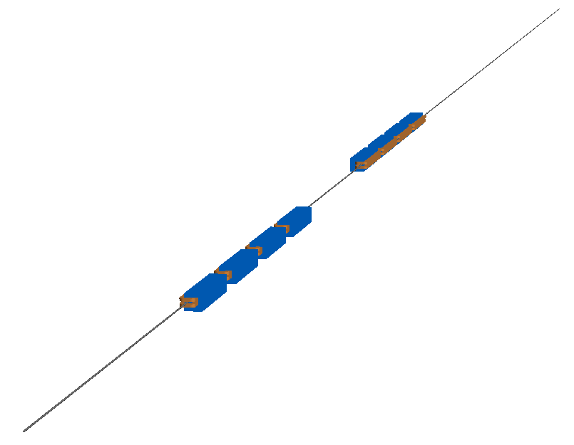
Despite slowness, still have something

Slide 12
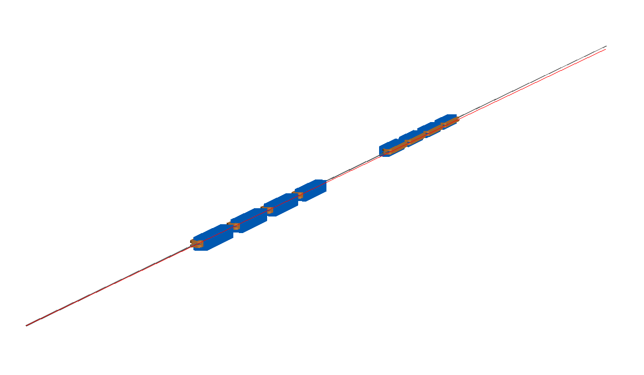
Despite slowness, still have something

Slide 13
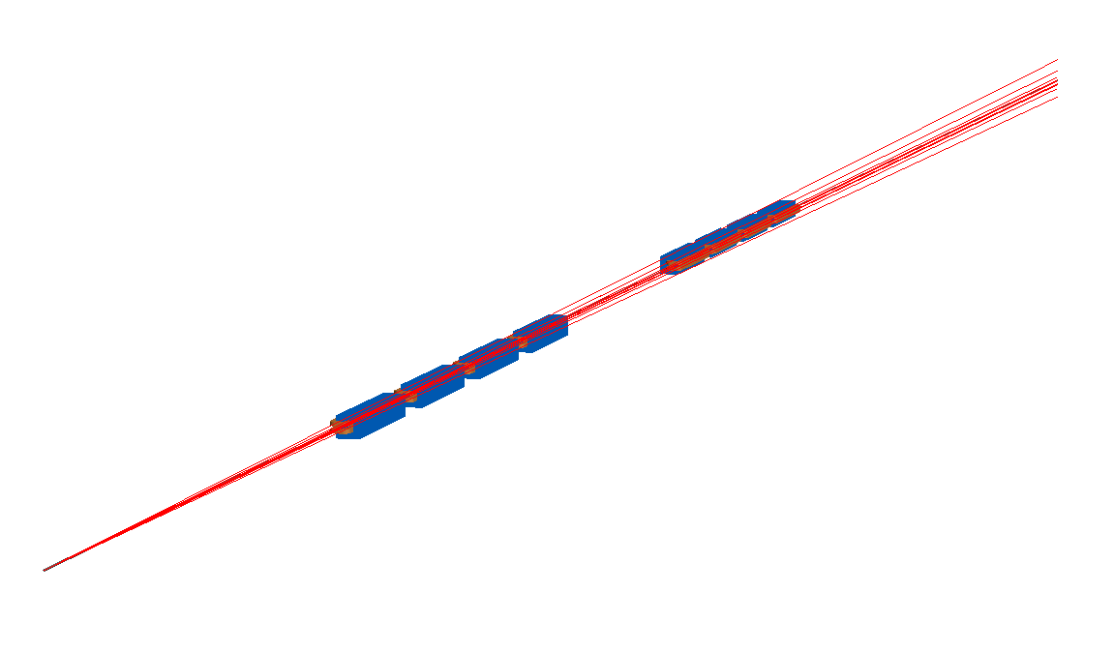
Despite slowness, still have something

Slide 14
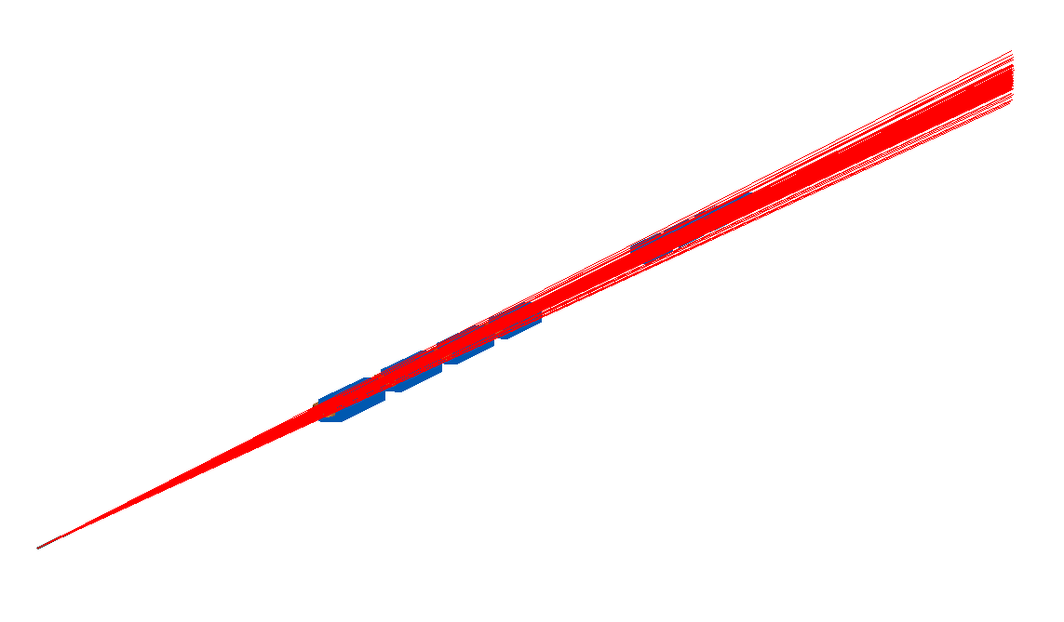
Despite slowness, still have something

Slide 15

Despite slowness, still have something

Slide 16
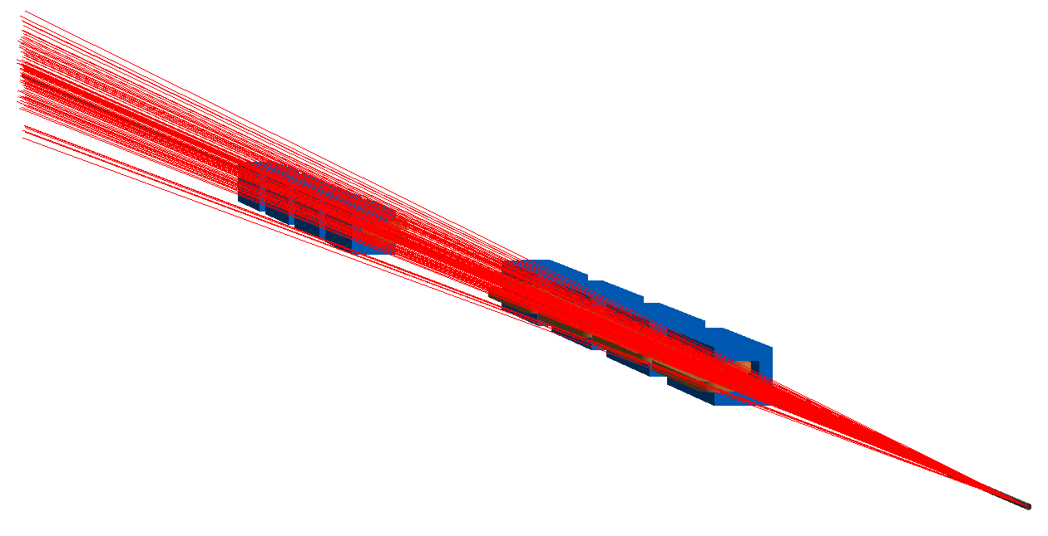
Despite slowness, still have something

Slide 17
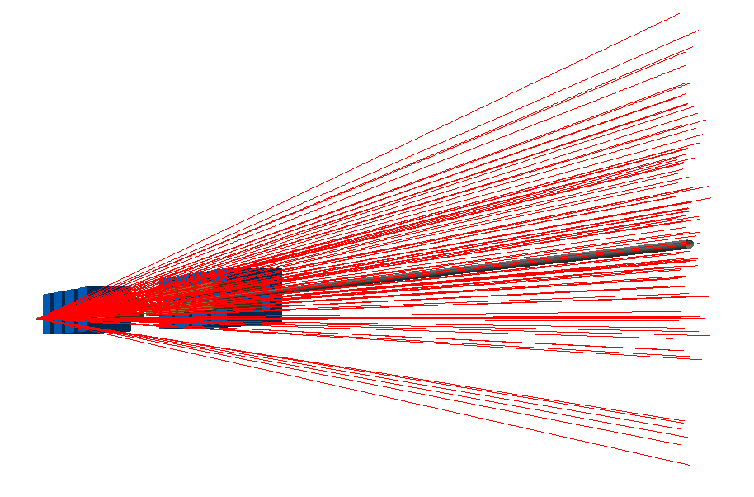
Despite slowness, still have something

Slide 18
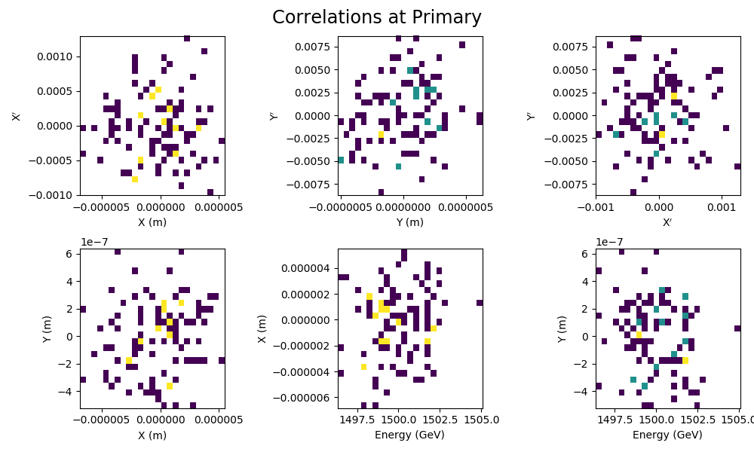
Even some automatic analysis…

Slide 19
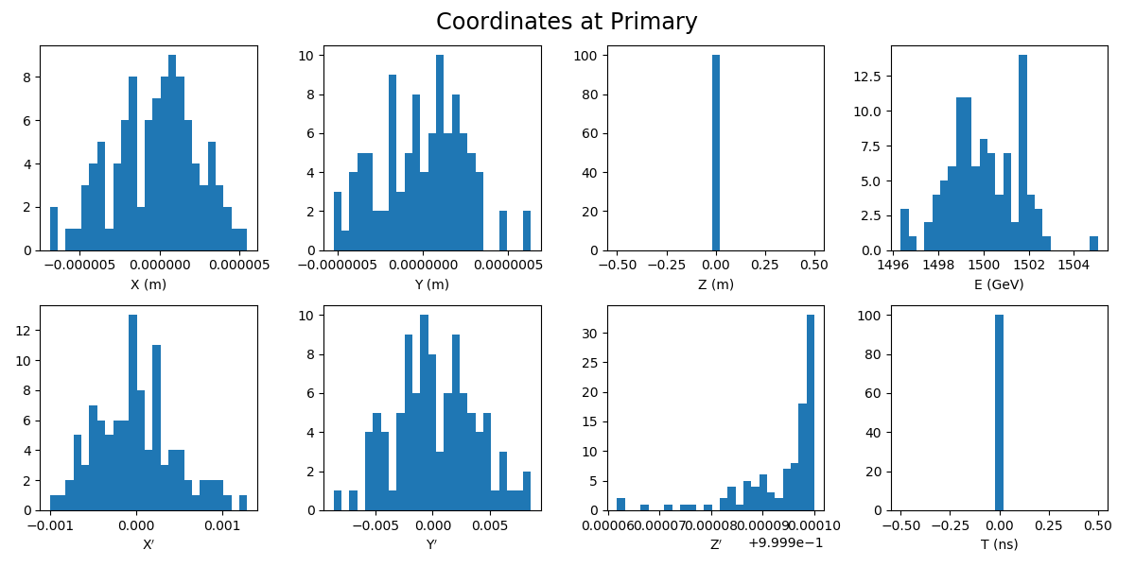
Even some automatic analysis…

Slide 20
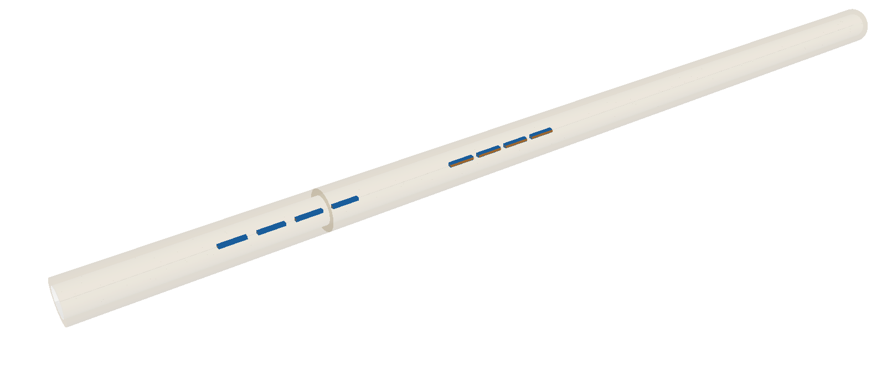
Increasing the complexity a bit…

Slide 21
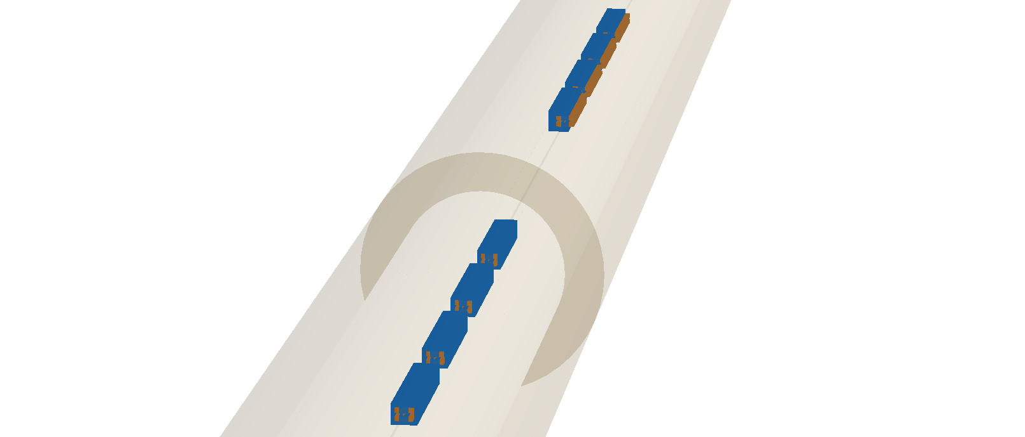
Increasing the complexity a bit…

Slide 22
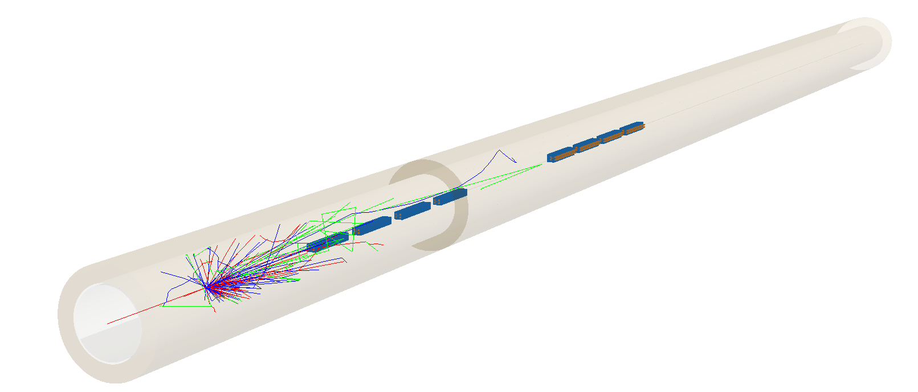
A single beam…

Slide 23
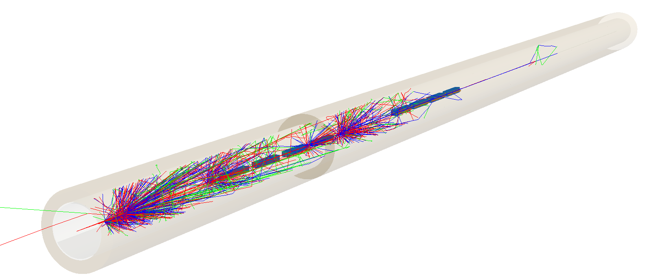
10 beams

Slide 24
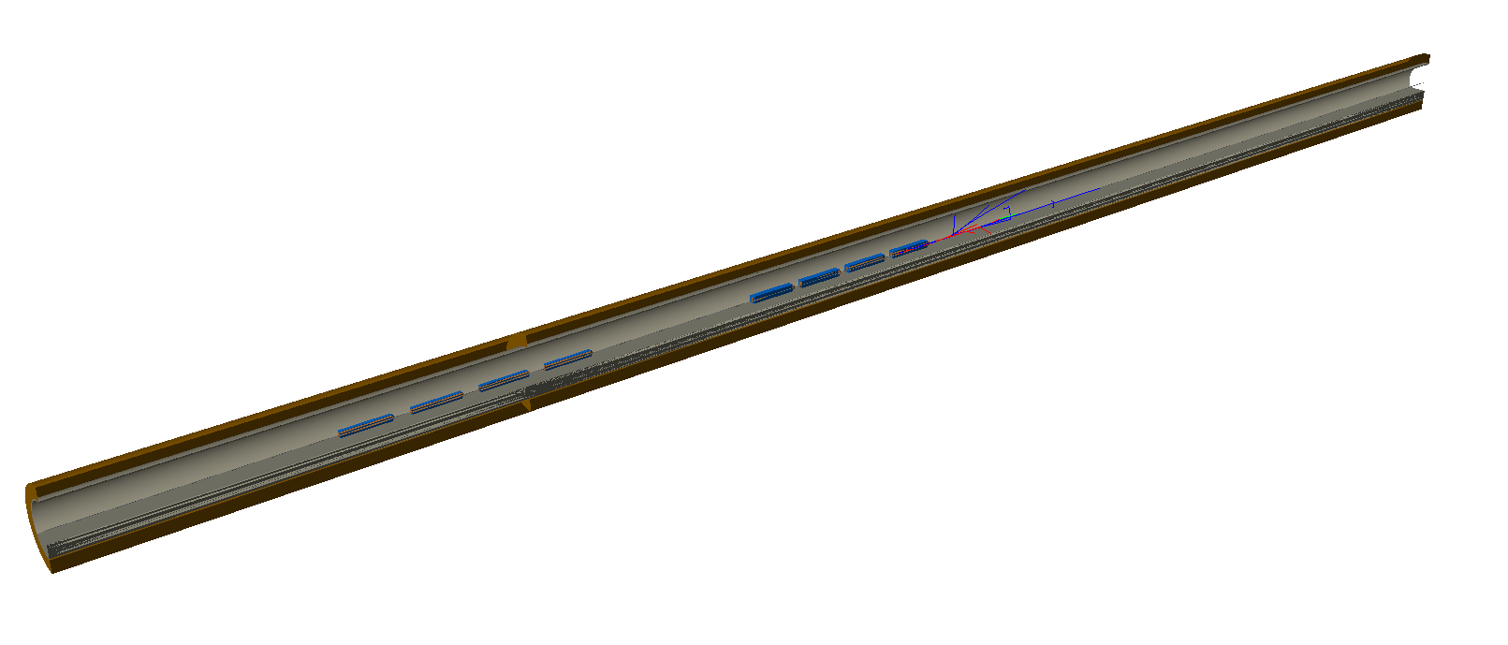
Cutaway – single beam

Slide 25
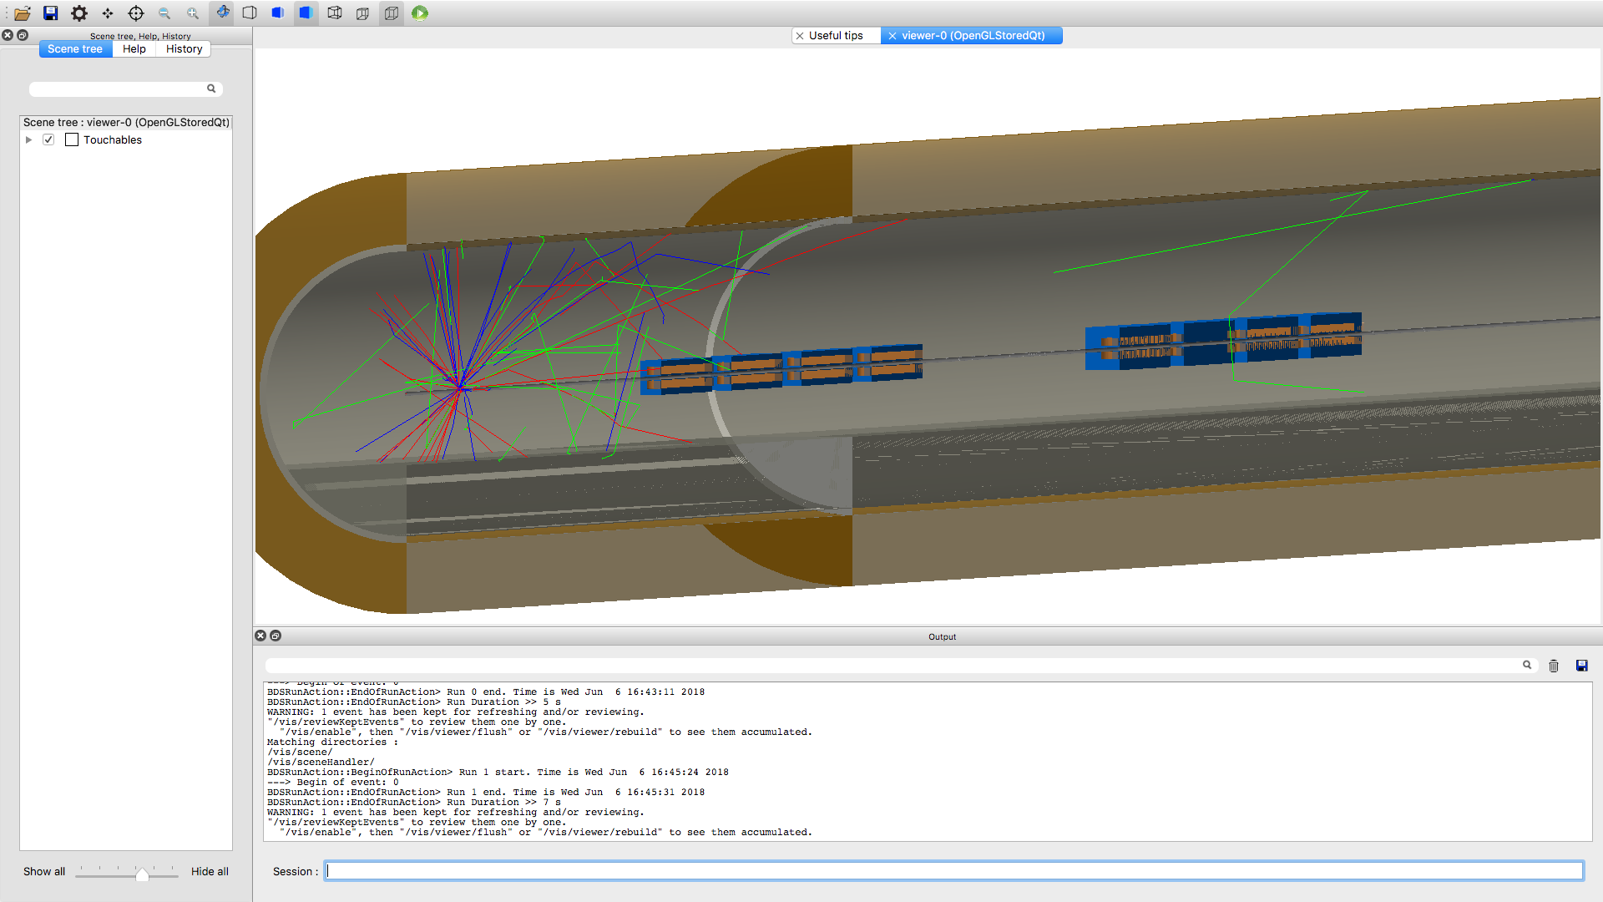
Cutaway – screenshot while running

Slide 26
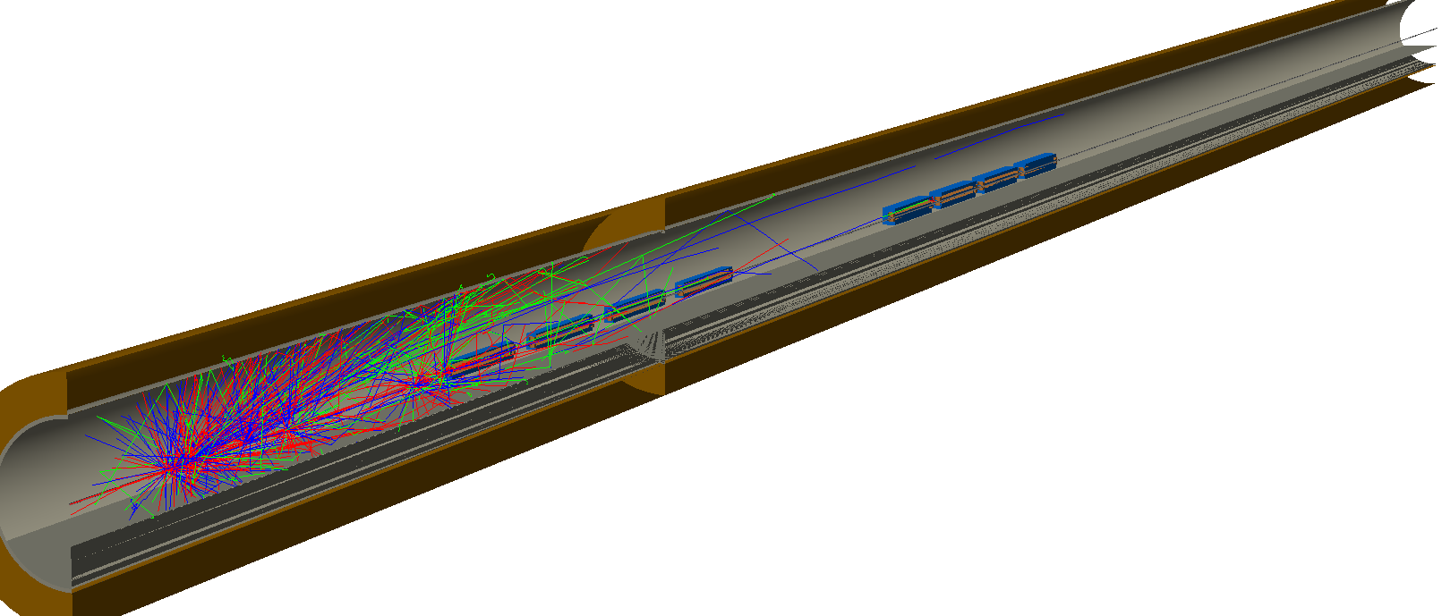
Cutaway – 10 beams

Slide 27
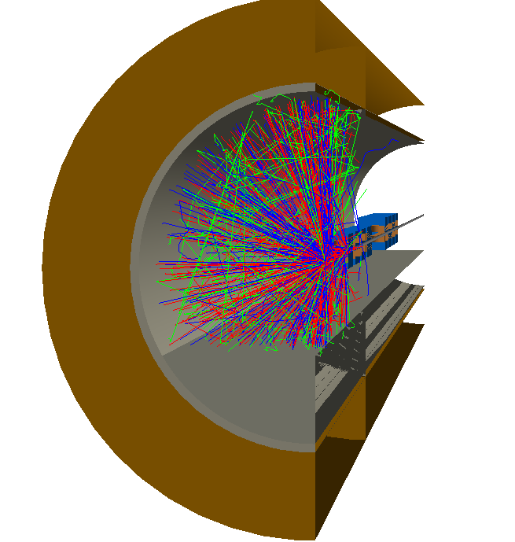
Cutaway – view from the starting end

Slide 28
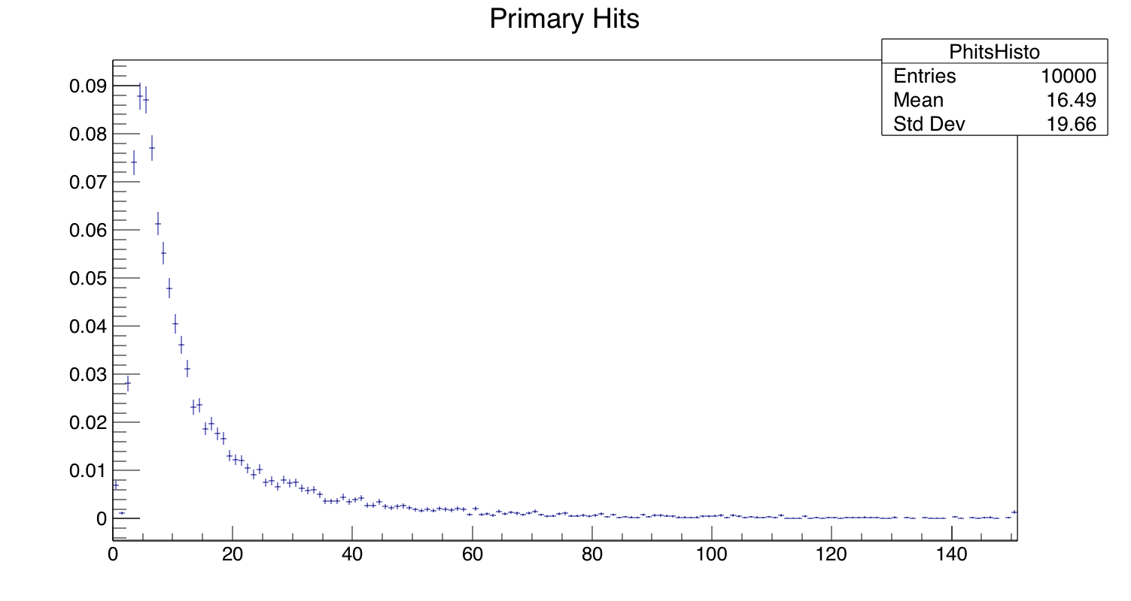
Running 10,000 beams in batch mode

Slide 29
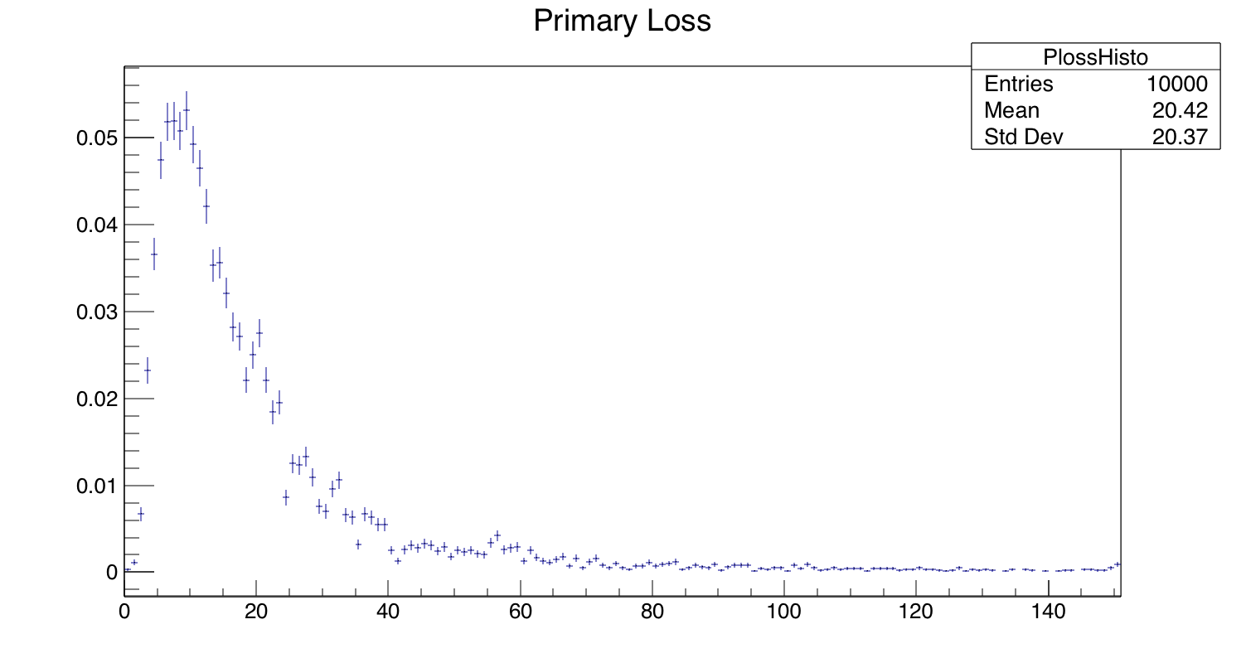
Running 10,000 beams in batch mode

Slide 30
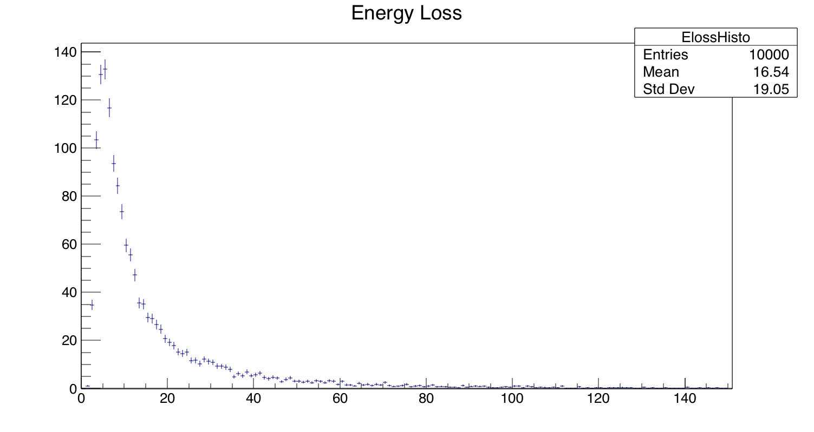
Running 10,000 beams in batch mode

Slide 31
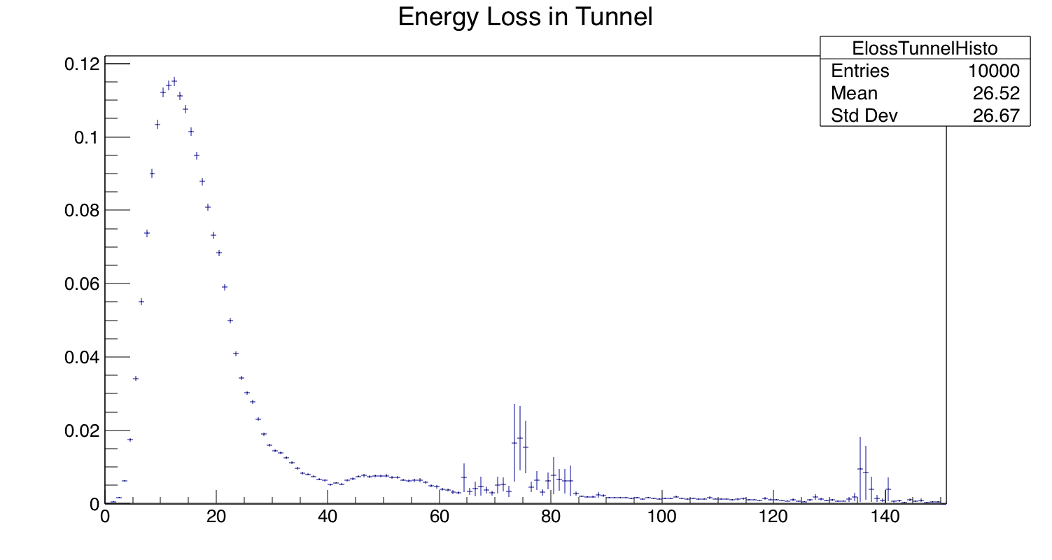
Running 10,000 beams in batch mode

Slide 32
Clearly, this isn’t correct
Looks to be problem with beam distribution at beginning
Could be missing quadrupole (?)
Still a way to go before I get everything set right and understand all of the outputs
Still need to learn how to add shielding, change the tunnel design, etc…
Occasional bugs in the code, but quickly fixed
Tiny drifts cause errors, etc…

Slide 33
I’ll plug away
I want to get the 3 TeV case working reasonably before I start on the 380 GeV.
It’ll give me a sanity check.
We can make sure the updated code works well.
I’ll be trying to improve upon the CDR design, perhaps with guidance from Deacon’s work
However, he had no polarimetry
I’ll do this at 380 GeV instead of 3 TeV…if design is better we can try scaling up.
May investigate ILC version as well

