Slide 1
FONT Meeting Friday 29 June 2018
Overview: ATF June 2018
Douglas BETT

Slide 2
Shift schedule
 | OWL | DAY | SWING
M 11 |  | 0
T 12
W 13
T 14 | 1
F 15 | 2a | 2b
S 16
S 17
M 18
T 19
W 20 | GM
T 21 | GM | 3
F 22 |  | 4 | GM
0: setup
1: IPBPM alignment IPBPM calibrations upstream diagnostics
Colin (b) (jitter runs w/ normal optics)
2: Colin (c) (2D tilt/position scan)
charge/ref. atten. scan
IQ phase adjustment
3: bunch-to-bunch correlation
4: upstream feedback runs

Slide 3
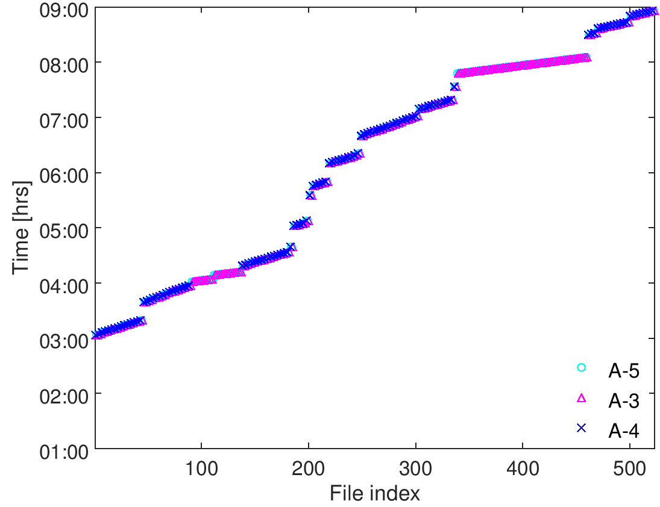
1
IPyCal4-5
QD0FFyScan1-3
jitRun3
dynamicRange1
AQF1FFxScan5-6
jitRun2
AQF1FFxScan3-4
AQF1FFxScan1-2
IPxCal8
jitRun1
IPxCal7
IPxCal4-6
mCal1, loPhase1
IPxCal1-3
IPyCal1-3
upstream
IP - x
IP - y

Slide 4
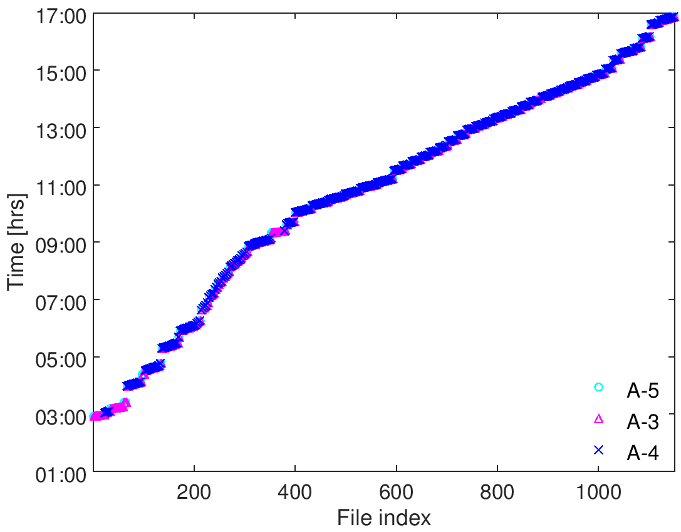
2
AQD0FFyScan38-44, jitRun33-35
charge/ref. atten. scan
AQD0FFyScan31-37, jitRun26-32
AQD0FFyScan23-30, jitRun18-25
q ~ 0.2
AQD0FFyScan15-22, jitRun10-17
q ~ 0.4
AQD0FFyScan3-14, attScan2
q ~ 0.65
attScan1
loPhase2
IPyCal10
IPyCal9, AQD0FFyScan1-2, jitRun7-8
jitRun2
Colin1-3
jitRun1
IPyCal7,8
IPyCal5,6
IPyCal3,4
IPxCal1,2
upstream
loPhase1, zeroMover1
IP - x
IPyCal1
mCal1
IP - y

Slide 5
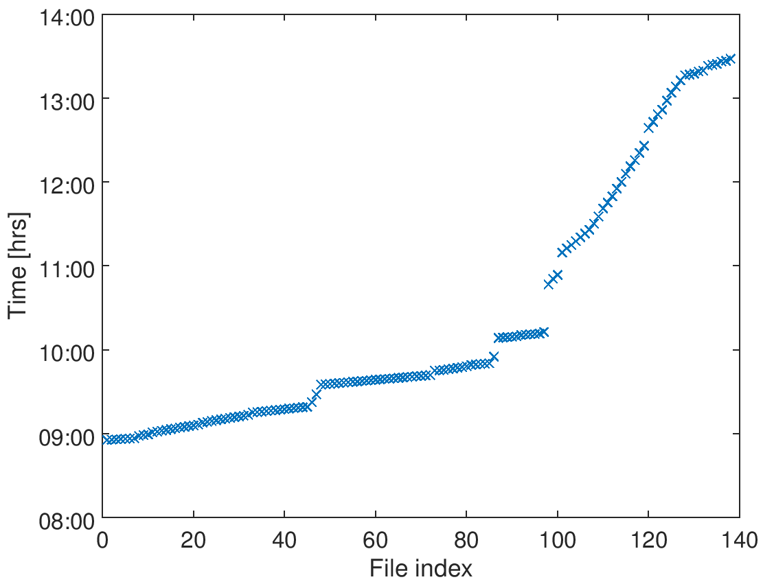
4
longJitRun1
zeroMover1,2,3
fbRun29-33
q~0.1
fbRun25-28
q~0.2
fbRun19-24
q~0.4
fbRun6-18
q~0.65
fbRun4,5
K1Cal2, K2Cal2
fbRun3
jitRun2
K1Cal1, K2Cal1
fbRun2
jitRun1
dynRange1
loPhaseCal1
mCal1,2
loPhase1
zeroMover1
upstream board only

