Slide 1
FONT Meeting Friday 29 June 2018
Diode processor resolution
Douglas BETT

Slide 2
Contents
Initial measurements with P2 signals split to drive both diode processor and conventional processor
phase/position calibration
resolution and dynamic range
Revised setup with diode processor on P1, P2 and P3 instrumented as usual

Slide 3
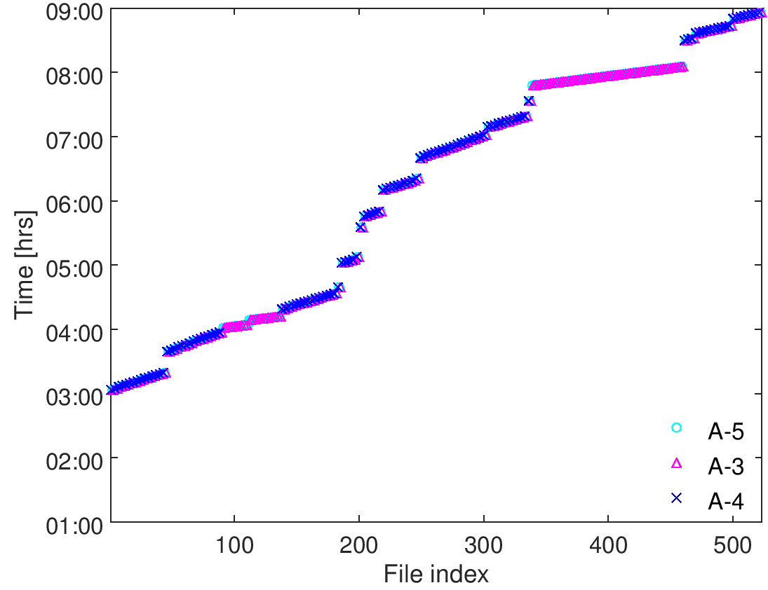
1
IPyCal4-5
QD0FFyScan1-3
jitRun3
dynamicRange1
AQF1FFxScan5-6
jitRun2
AQF1FFxScan3-4
AQF1FFxScan1-2
IPxCal8
jitRun1
IPxCal7
IPxCal4-6
mCal1, loPhase1
IPxCal1-3
IPyCal1-3
upstream
IP - x
IP - y

Slide 4
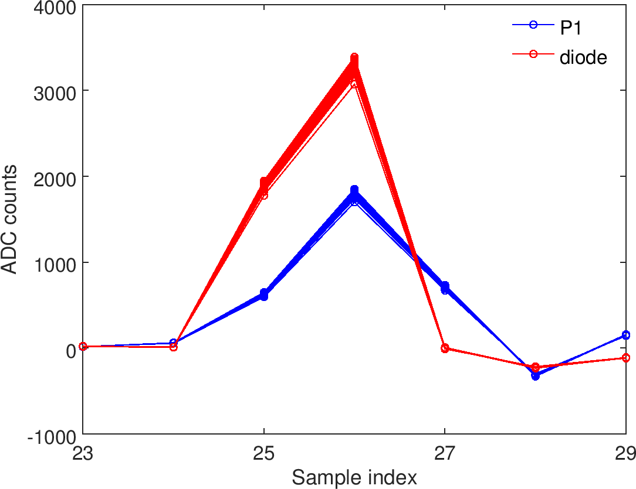
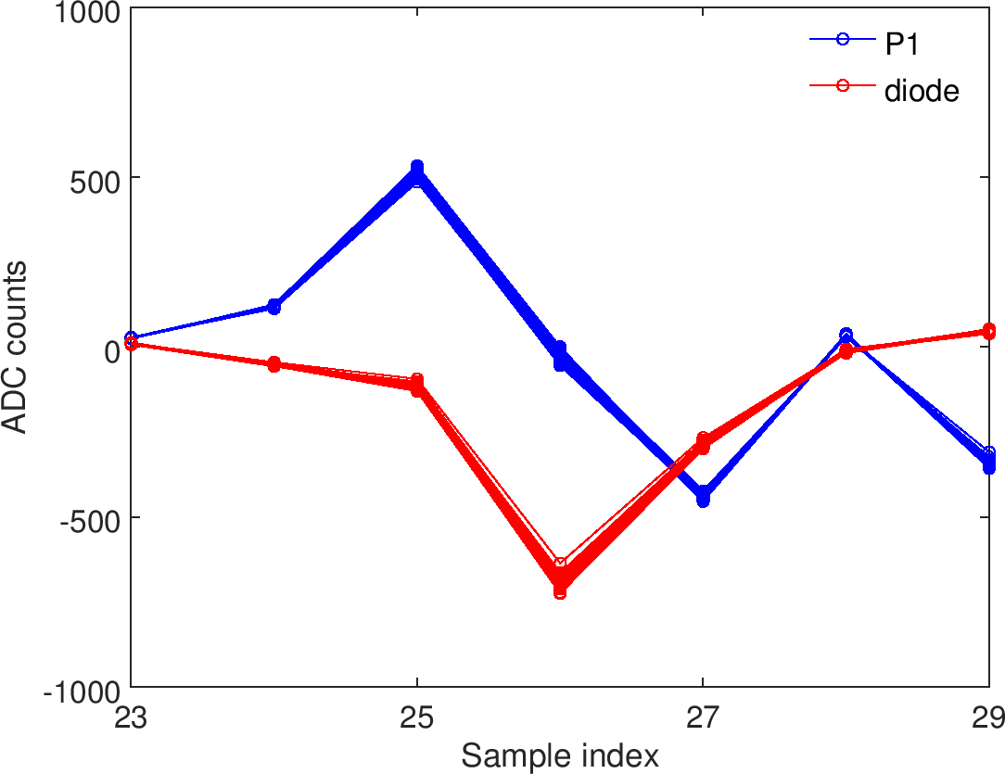











Note on sample timing
BPM signal to ADC assignment has diode processor signals split across the P1 and P3 banks
Scan delays set for optimal sampling of P1 and P3 signals, so diode processor signal sampling sub-optimal
Sub-optimal sampling could have negative impact on resolution but with only ~3 dB attenuation possibly necessary anyway due to high signal level from diode
bank 1
bank 2
bank 3
$$Σ_{I}$$
$$Δ$$
Ch1
DP-$Σ$
P2-$Σ_{Q}$
DP-$Δ$
Ch2
P1-$Δ$
P2-$Δ$
P3-$Δ$
Ch3
P1-$Σ_{I}$
P2-$Σ_{I}$
P3-$Σ_{I}$

Slide 5
1
IPyCal4-5
QD0FFyScan1-3
jitRun3
dynamicRange1
AQF1FFxScan5-6
jitRun2
AQF1FFxScan3-4
AQF1FFxScan1-2
IPxCal8
jitRun1
IPxCal7
IPxCal4-6
mCal1, loPhase1
IPxCal1-3
IPyCal1-3
upstream
IP - x
IP - y

Slide 6
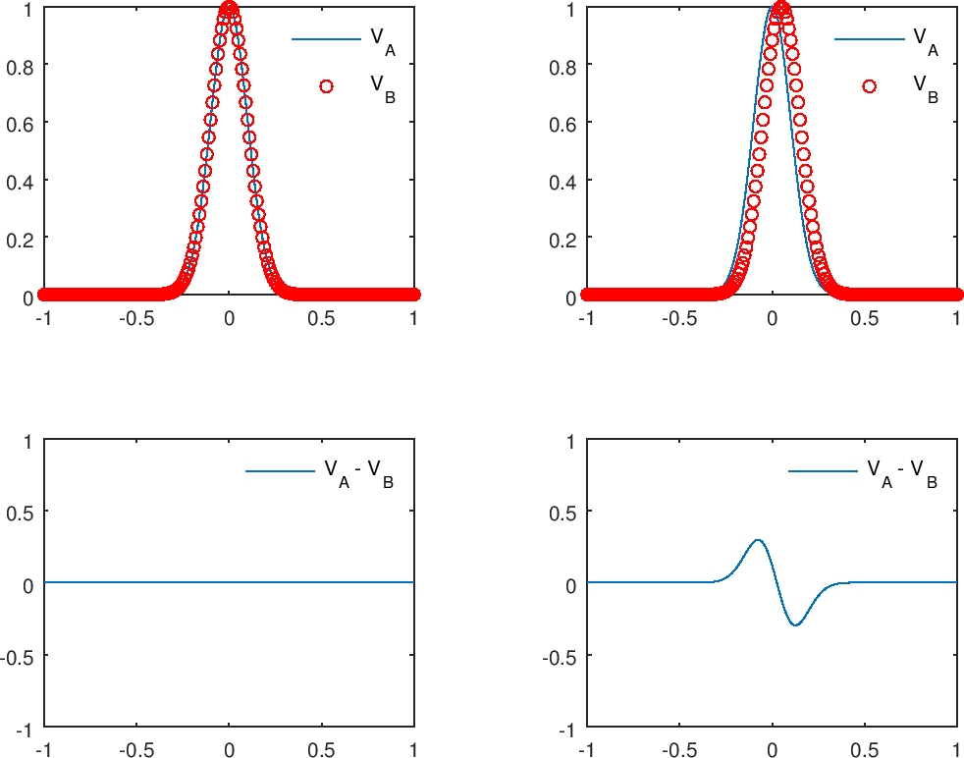
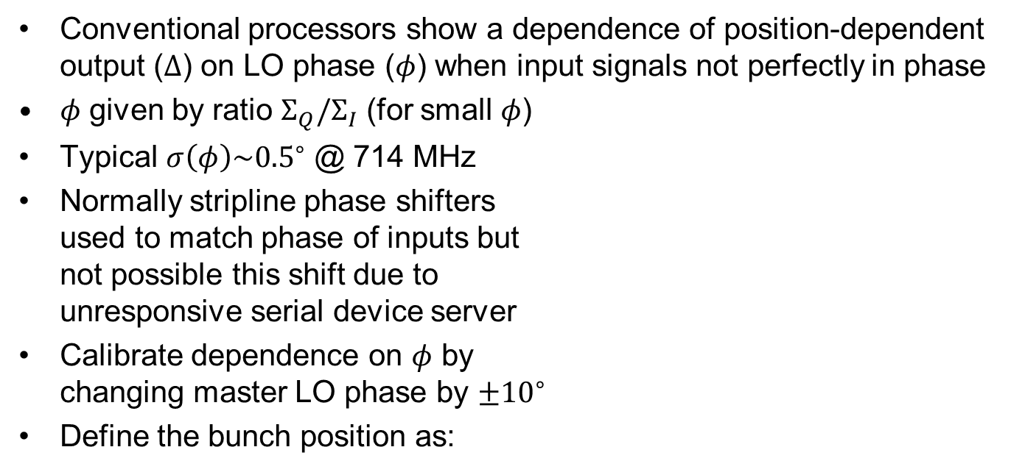

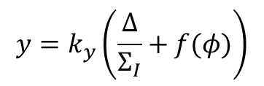
LO phase calibration
Conventional processors show a dependence of position-dependent output ($Δ$) on LO phase ($φ$) when input signals not perfectly in phase
$φ$ given by ratio $Σ_{Q}/Σ_{I}$ (for small $φ$)
Typical $σ\left(φ\right)\sim {0.5}^{∘}$ @ 714 MHz
Normally stripline phase shifters used to match phase of inputs but not possible this shift due to unresponsive serial device server
Calibrate dependence on $φ$ by changing master LO phase by $±{10}^{∘}$
Define the bunch position as:
$$y=k_{y}\left(\frac{Δ}{Σ_{I}}+f(φ)\right)$$
where $f(φ)$ is such that $y$ exhibits no dependence on phase

Slide 7
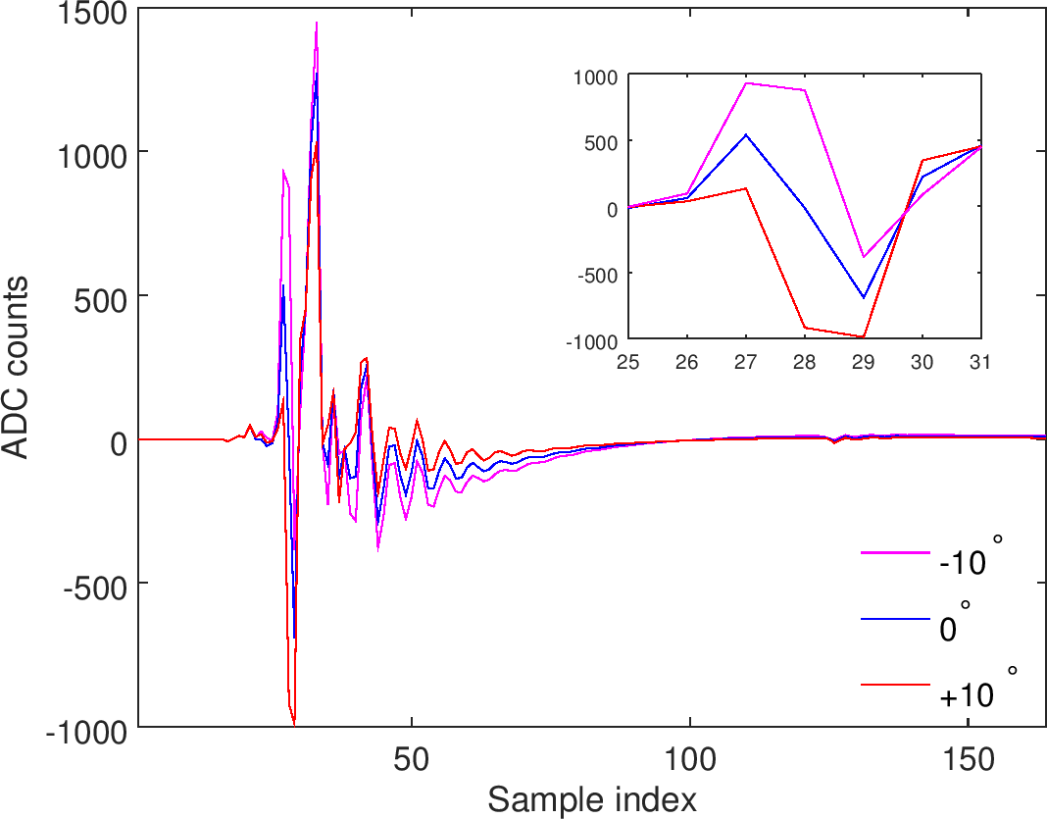

loPhase1: P2 $Δ$ waveforms
waveforms averaged over LO phase shifter setting

Slide 8
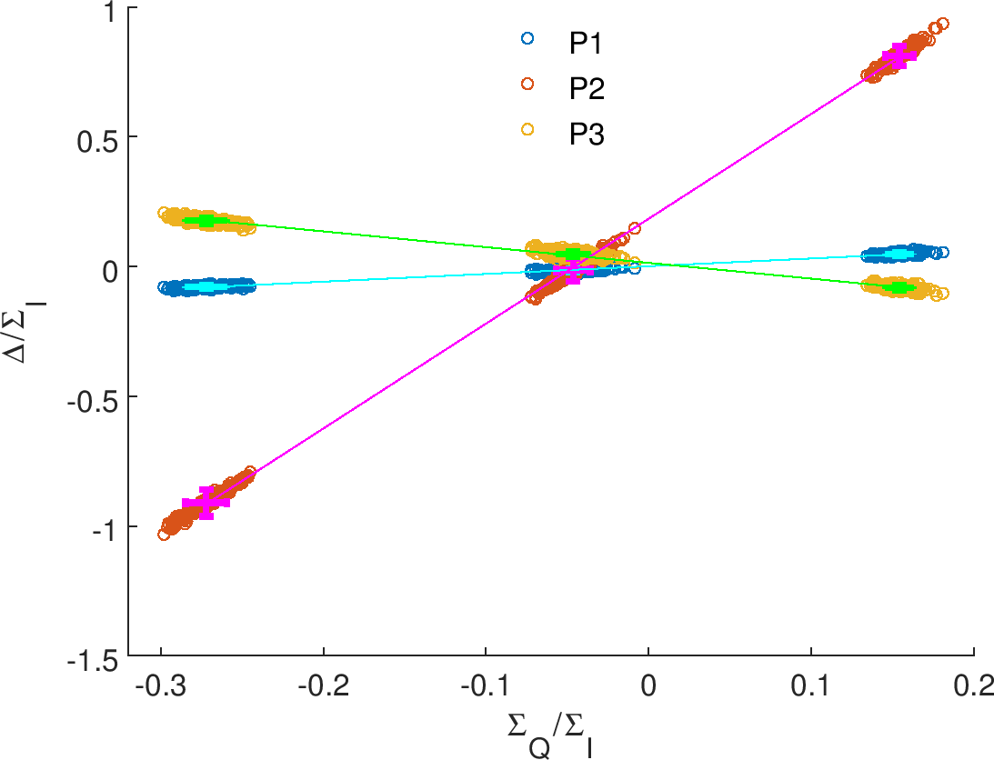

loPhase1: $Σ_{Q}/Σ_{I}$ vs. $Δ/Σ_{I}$
P2 shows extreme dependence on phase, likely a result of the split and poorly matched cables

Slide 9
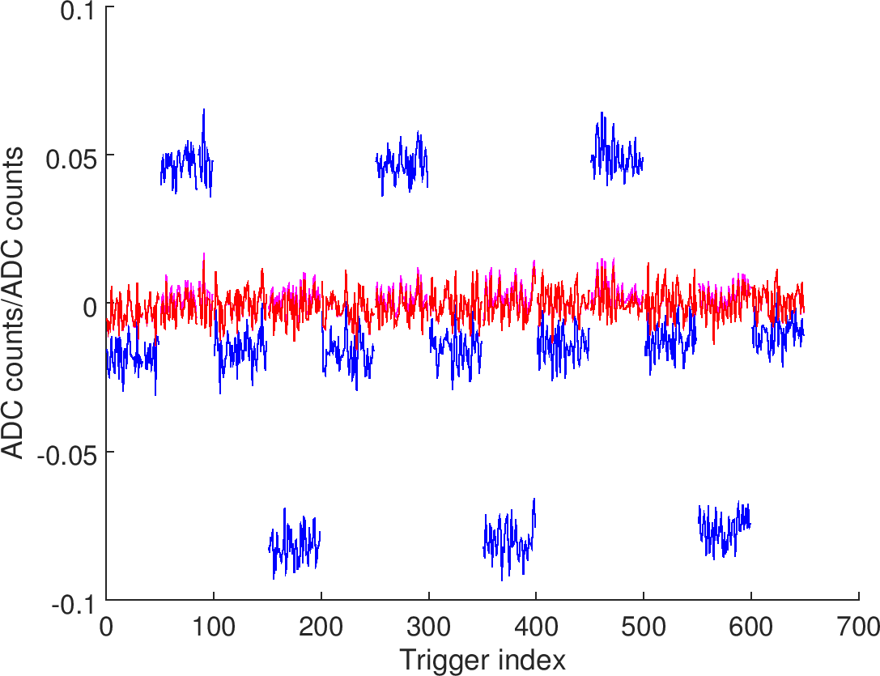



loPhase1: P1 position over time
$$Δ/Σ_{I}$$
$$Δ/Σ_{I}−a_{1}φ$$
$$Δ/Σ_{I}−(b_{2}φ^{2}+b_{1}φ)$$

Slide 10
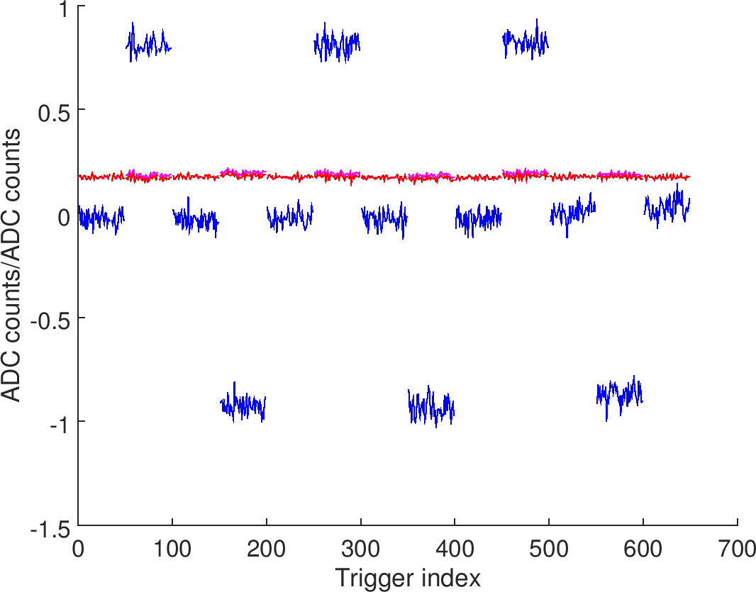
loPhase1: P2 position over time
$$Δ/Σ_{I}$$
$$Δ/Σ_{I}−a_{1}φ$$
$$Δ/Σ_{I}−(b_{2}φ^{2}+b_{1}φ)$$

Slide 11
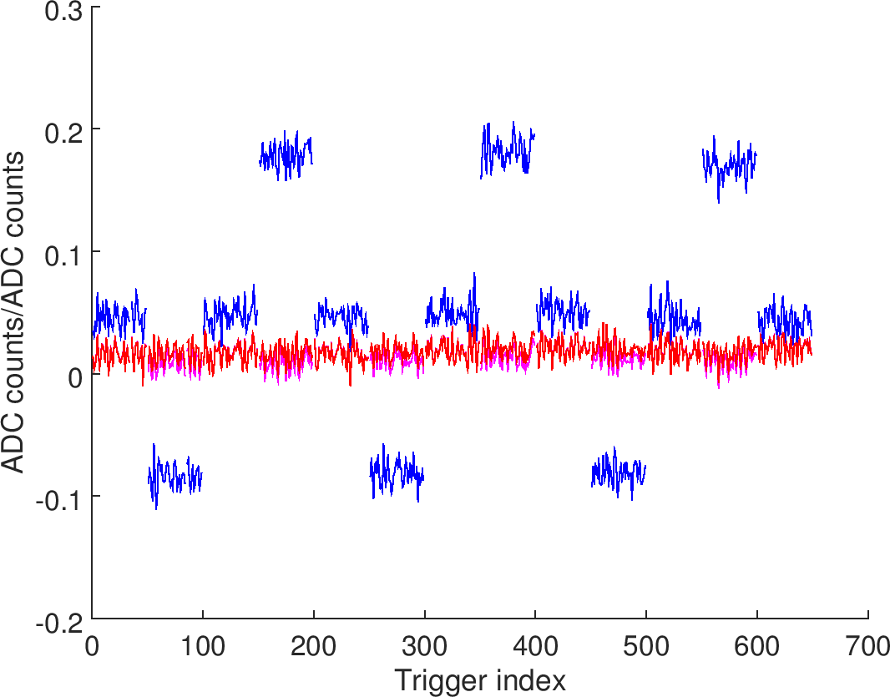
loPhase1: P3 position over time
$$Δ/Σ_{I}$$
$$Δ/Σ_{I}−a_{1}φ$$
$$Δ/Σ_{I}−(b_{2}φ^{2}+b_{1}φ)$$

Slide 12
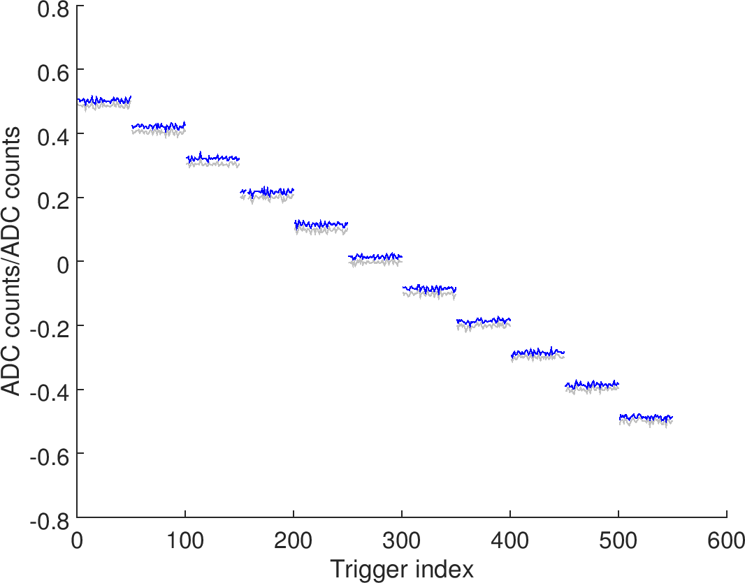


mCal1: P1 position over time
$$Δ/Σ_{I}$$
$$Δ/Σ_{I}−(b_{2}φ^{2}+b_{1}φ)$$

Slide 13
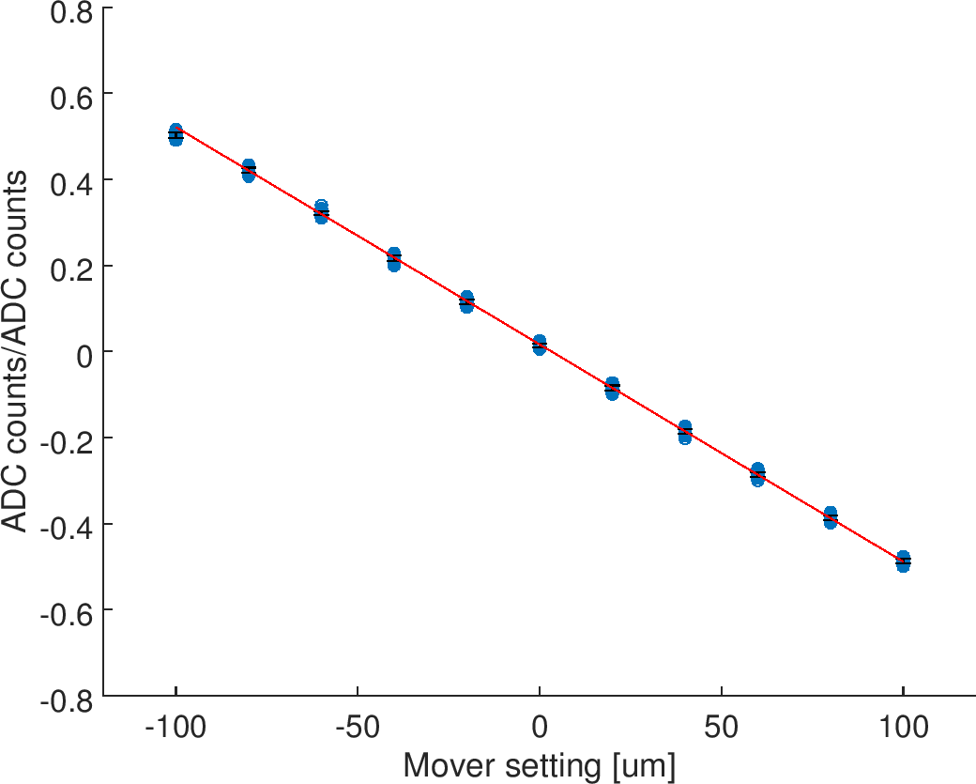
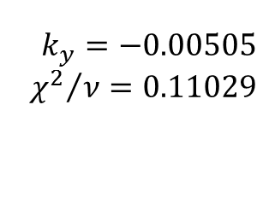
mCal1: P1 fit to data
$$k_{y}=−0.00505$$
$${χ^{2}}/ν=0.11029$$
±100 um points omitted from fit

Slide 14
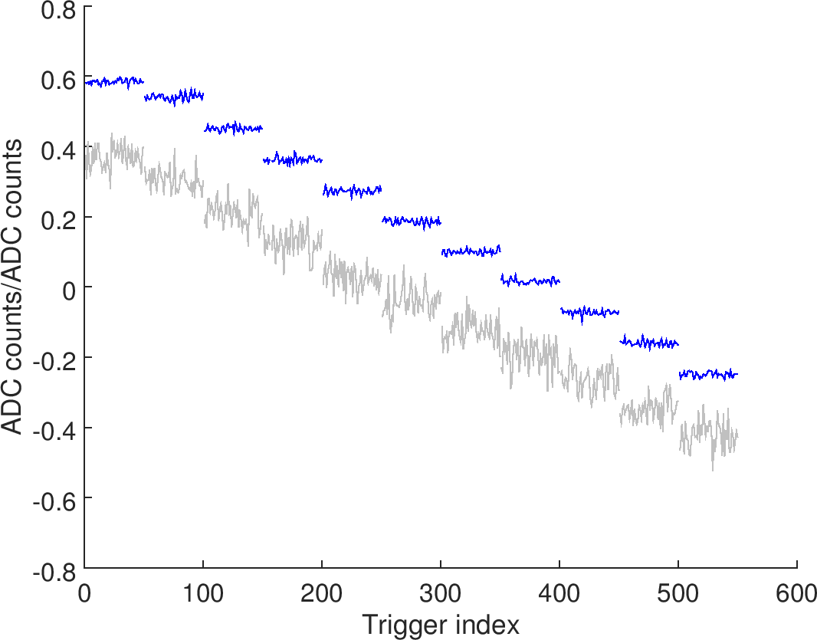
mCal1: P2 position over time
$$Δ/Σ_{I}$$
$$Δ/Σ_{I}−(b_{2}φ^{2}+b_{1}φ)$$

Slide 15
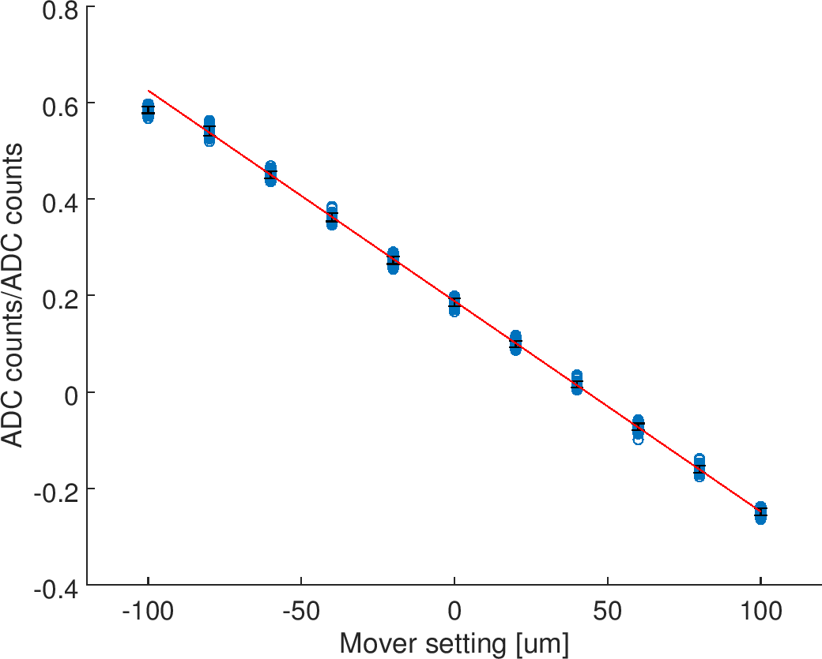
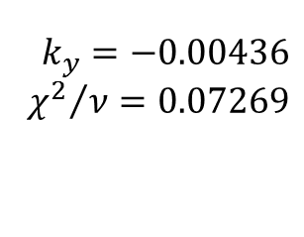
mCal1: P2 fit to data
$$k_{y}=−0.00436$$
$${χ^{2}}/ν=0.07269$$
±100 um points omitted from fit

Slide 16
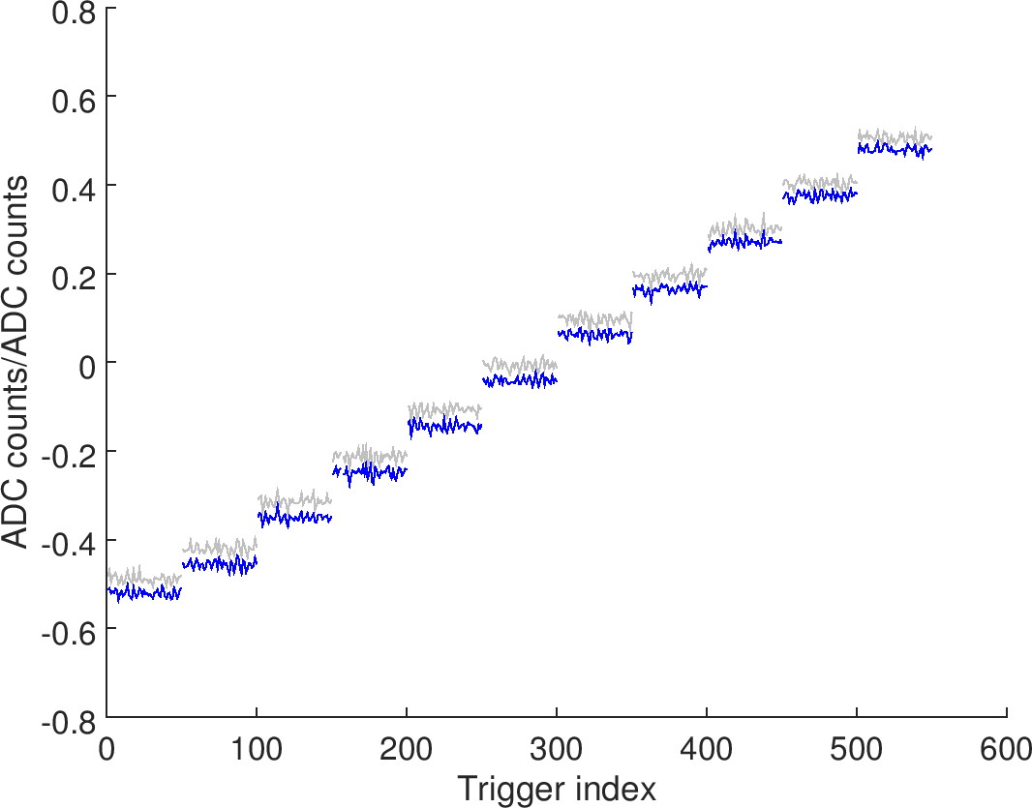
mCal1: P3 position over time
$$Δ/Σ_{I}$$
$$Δ/Σ_{I}−(b_{2}φ^{2}+b_{1}φ)$$

Slide 17
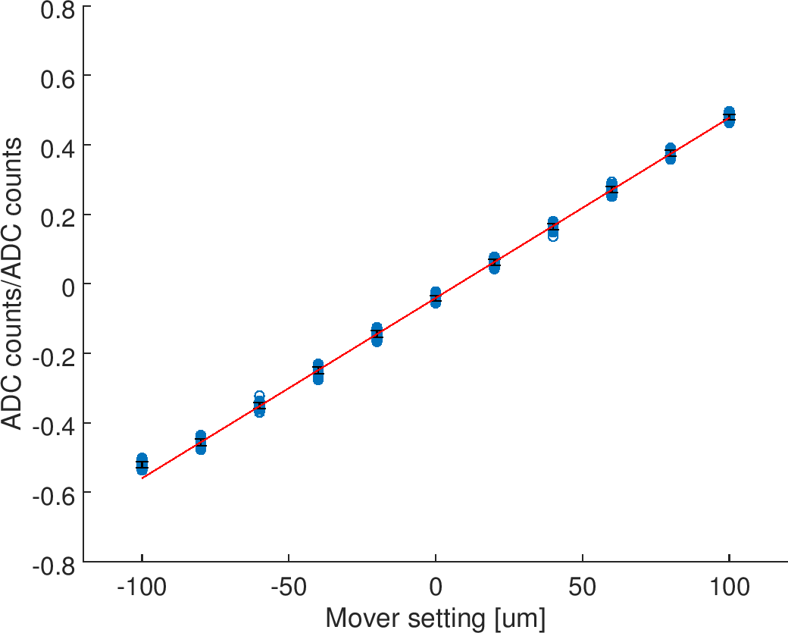
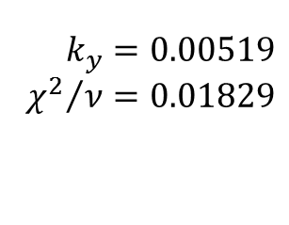
mCal1: P3 fit to data
$$k_{y}=0.00519$$
$${χ^{2}}/ν=0.01829$$
±100 um points omitted from fit

Slide 18
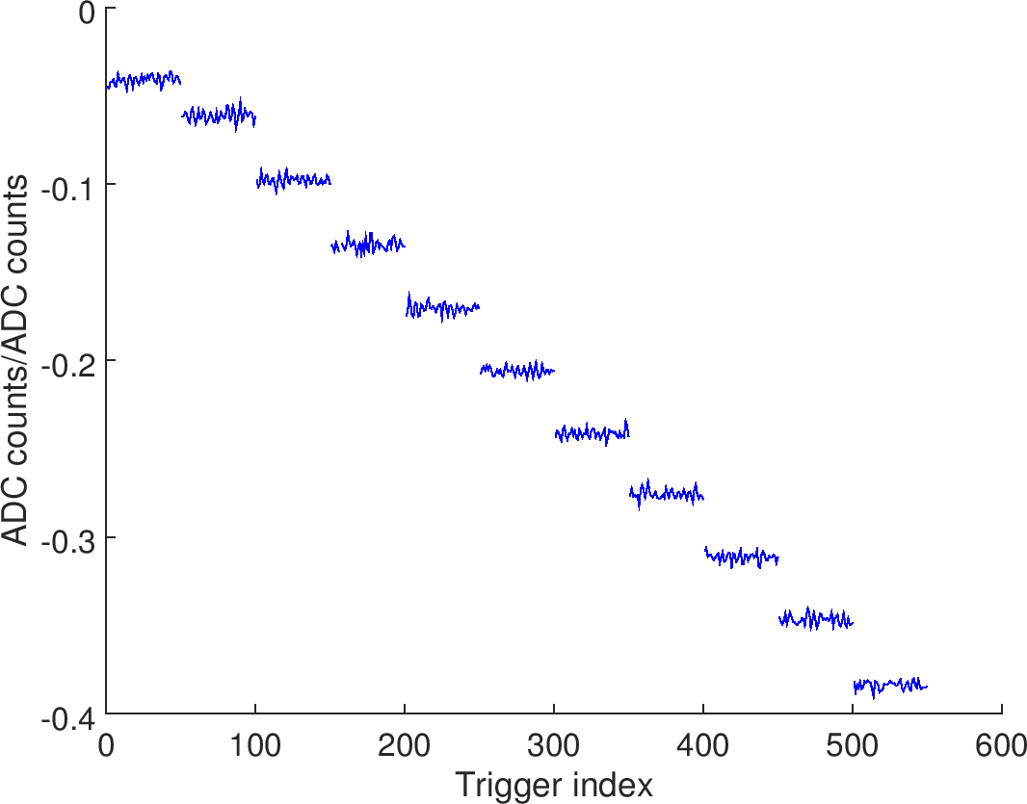

mCal1: diode position over time
$$Δ/Σ_{I}$$

Slide 19
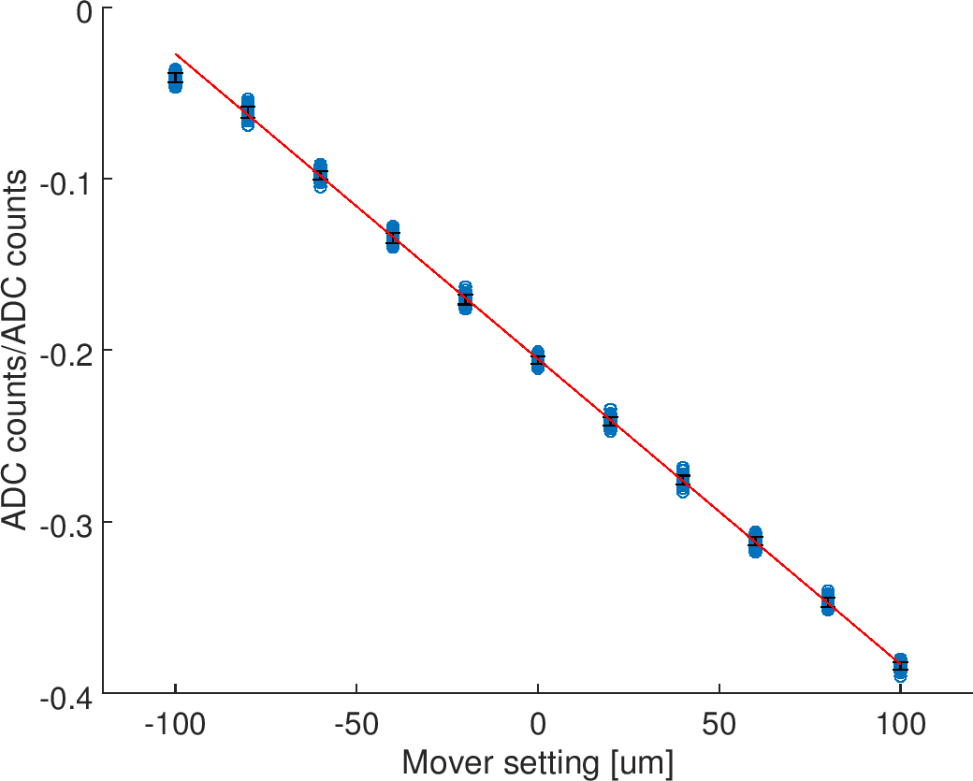
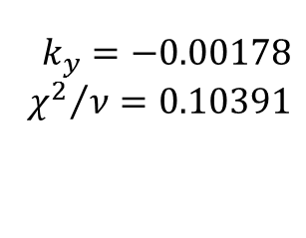
mCal1: diode fit to data
$$k_{y}=−0.00178$$
$${χ^{2}}/ν=0.10391$$
±100 um points omitted from fit

Slide 20
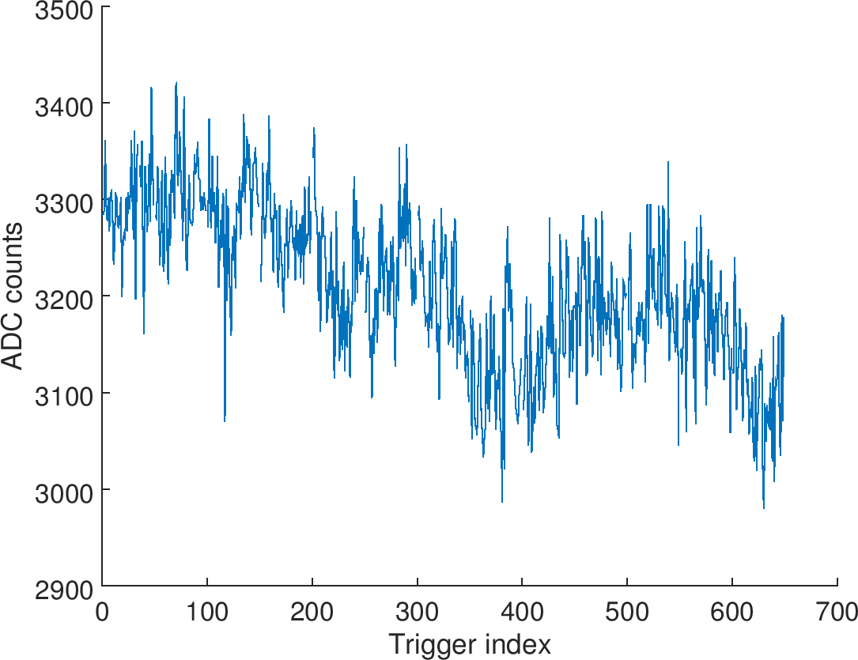
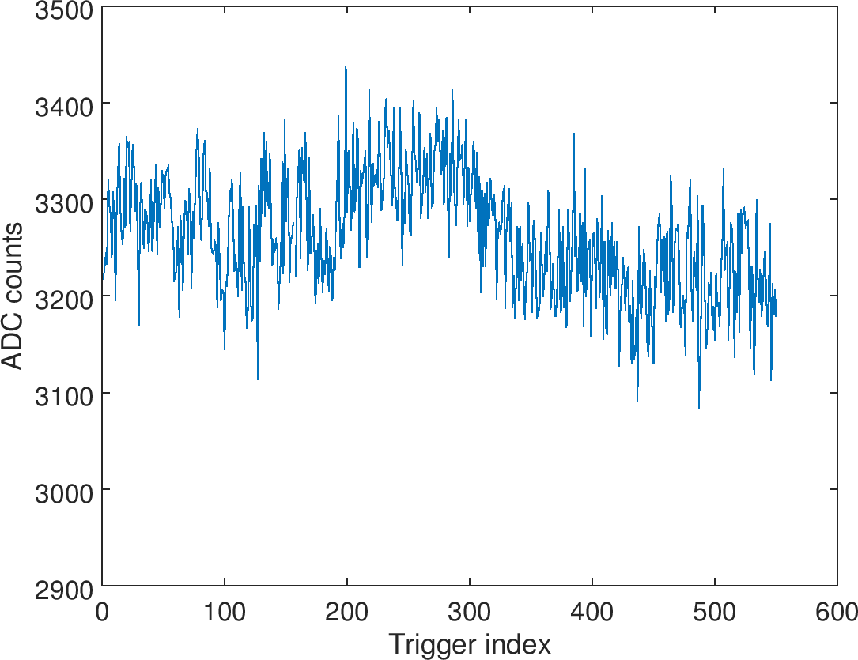
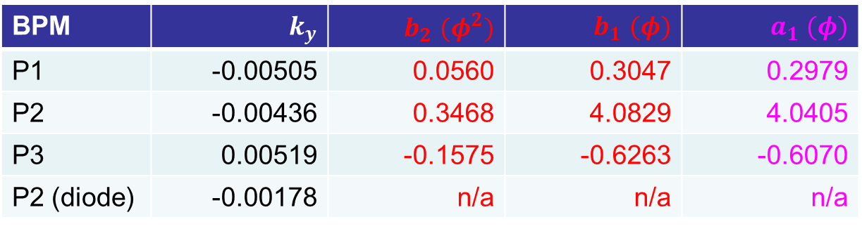


Calibration summary
BPM | $$k_{y}$$ | $b_{2}$ $(φ^{2})$ | $b_{1}$ $(φ)$ | $a_{1}$ $(φ)$
P1 | -0.00505 | 0.0560 | 0.3047 | 0.2979
P2 | -0.00436 | 0.3468 | 4.0829 | 4.0405
P3 | 0.00519 | -0.1575 | -0.6263 | -0.6070
P2 (diode) | -0.00178 | n/a | n/a | n/a
$Σ$ from diode: loPhase1
$Σ$ from diode: mCal1

Slide 21
1
IPyCal4-5
QD0FFyScan1-3
jitRun3
dynamicRange1
AQF1FFxScan5-6
jitRun2
AQF1FFxScan3-4
AQF1FFxScan1-2
IPxCal8
jitRun1
IPxCal7
IPxCal4-6
mCal1, loPhase1
IPxCal1-3
IPyCal1-3
upstream
IP - x
IP - y

Slide 22
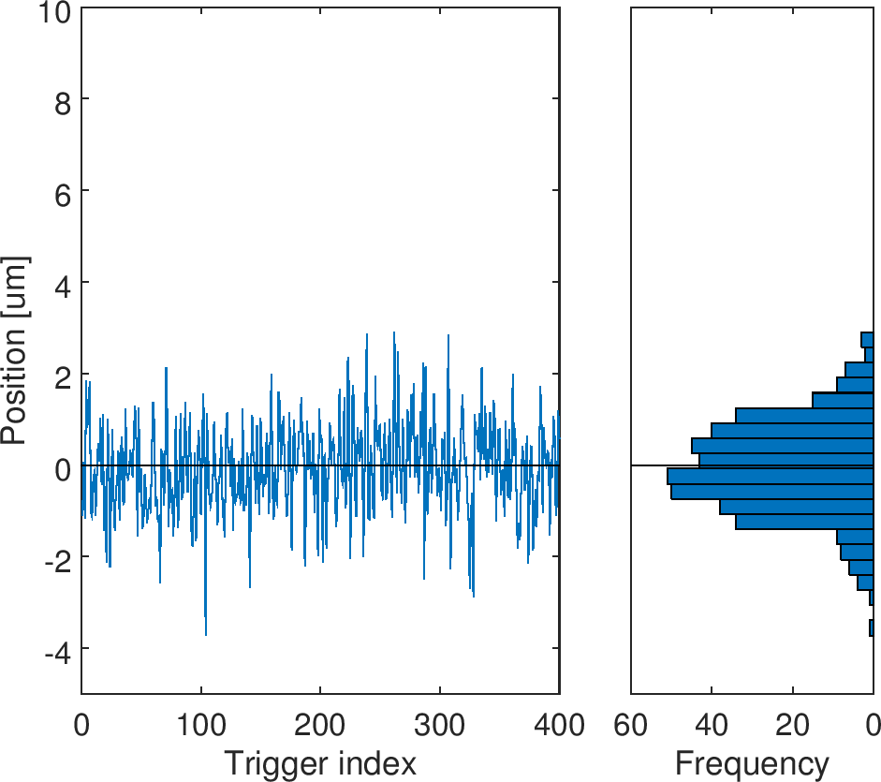
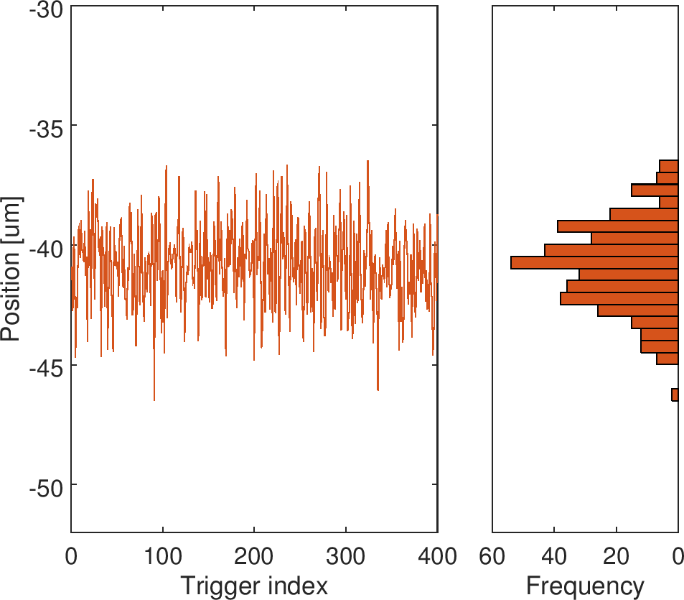
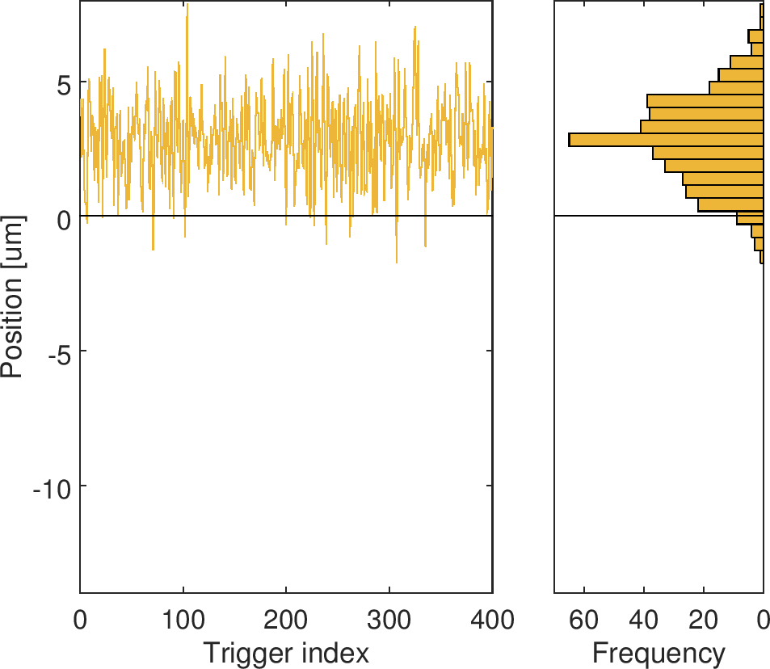
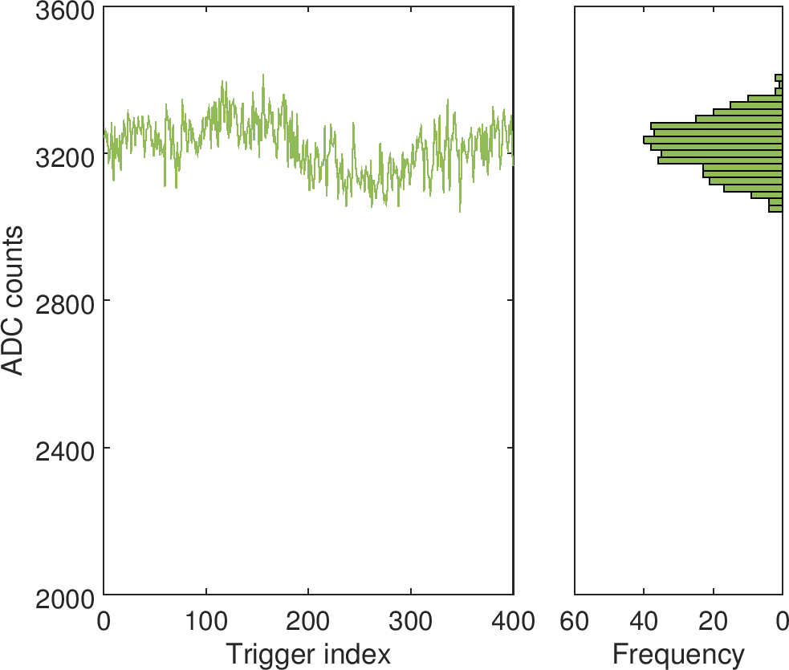
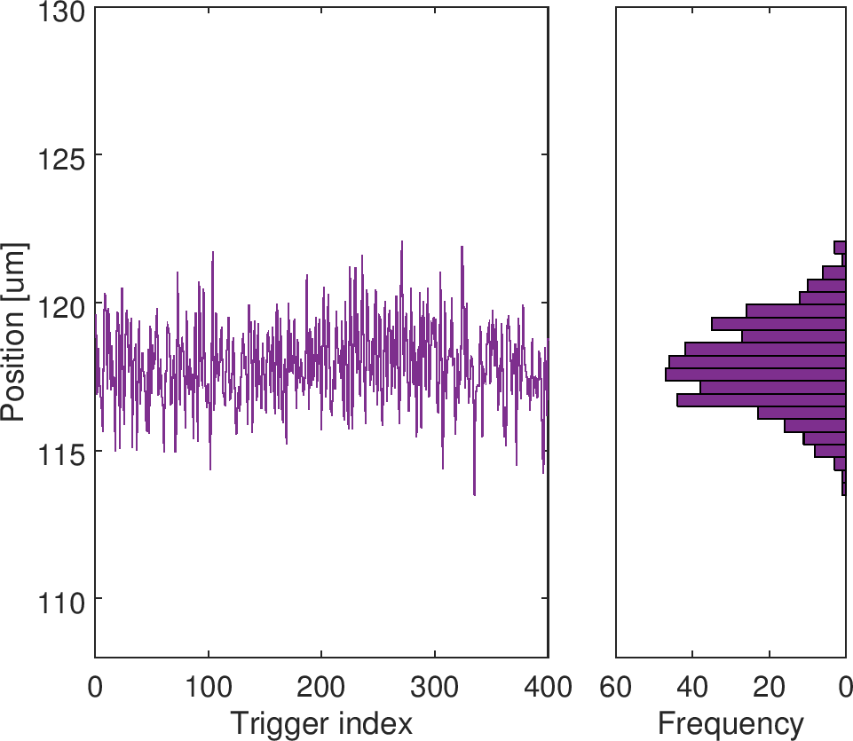

jitRun1
P1
P2
P3
$Σ$ (diode)
P2 (diode)
BPM | Jitter [um]
P1 | 1.031
P2 | 1.807
P2 (diode) | 1.465
P3 | 1.613

Slide 23
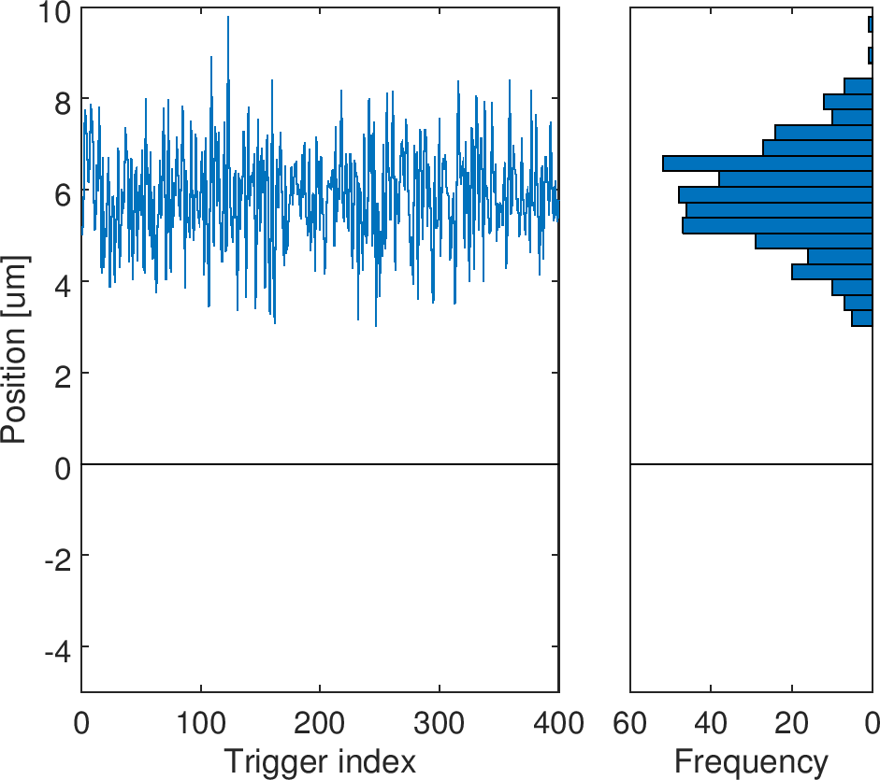
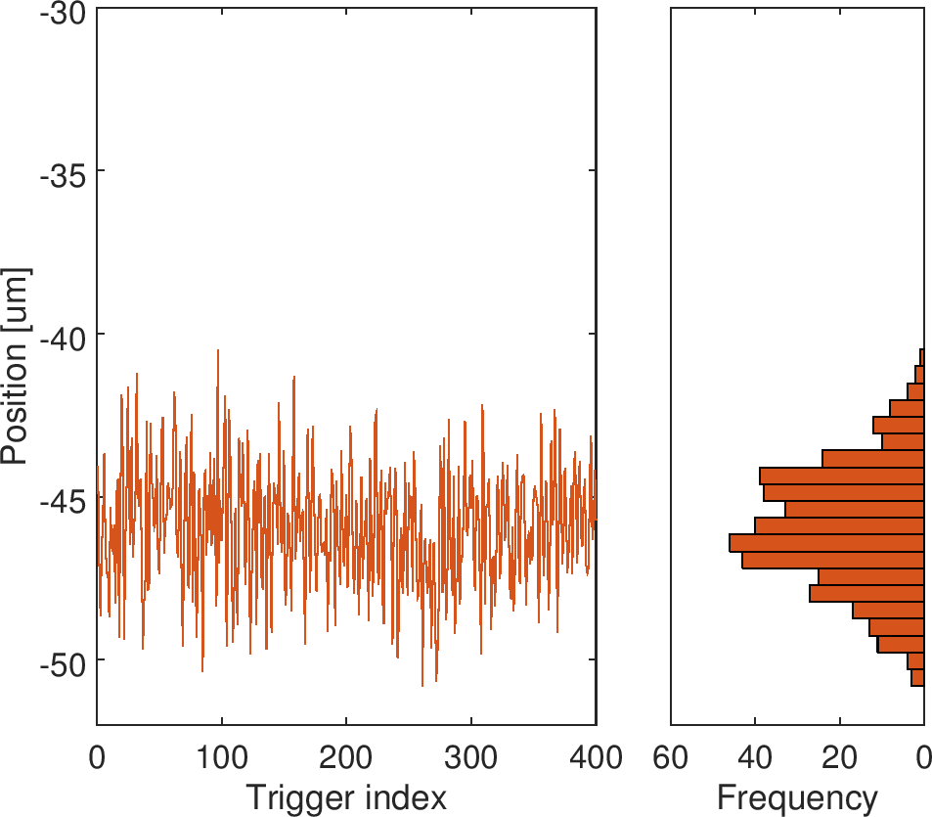
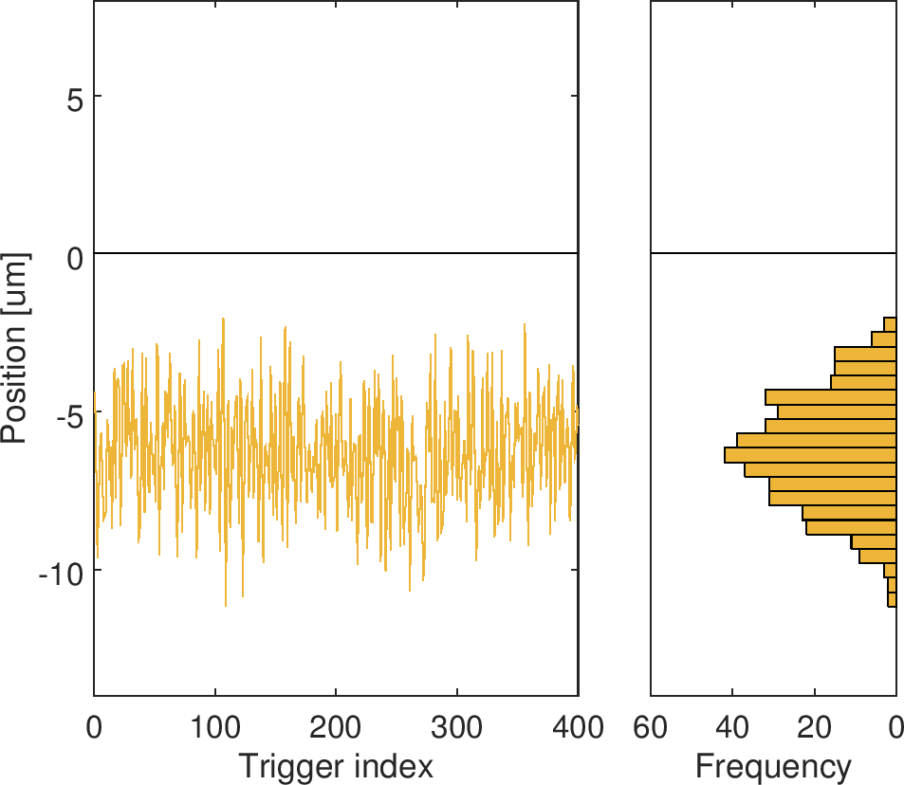
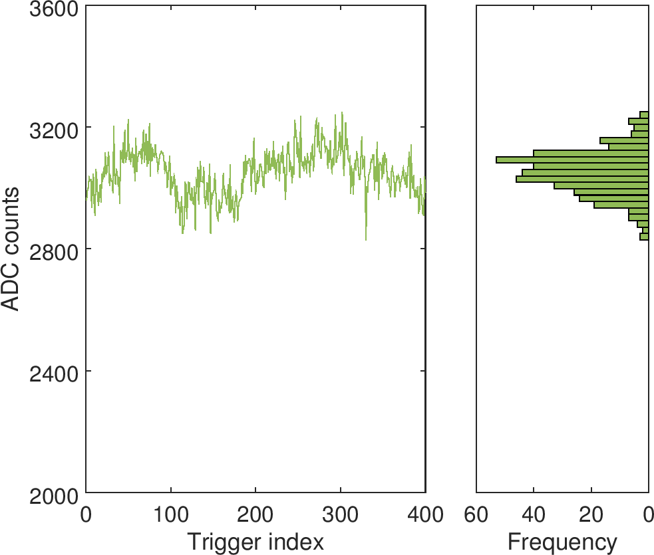
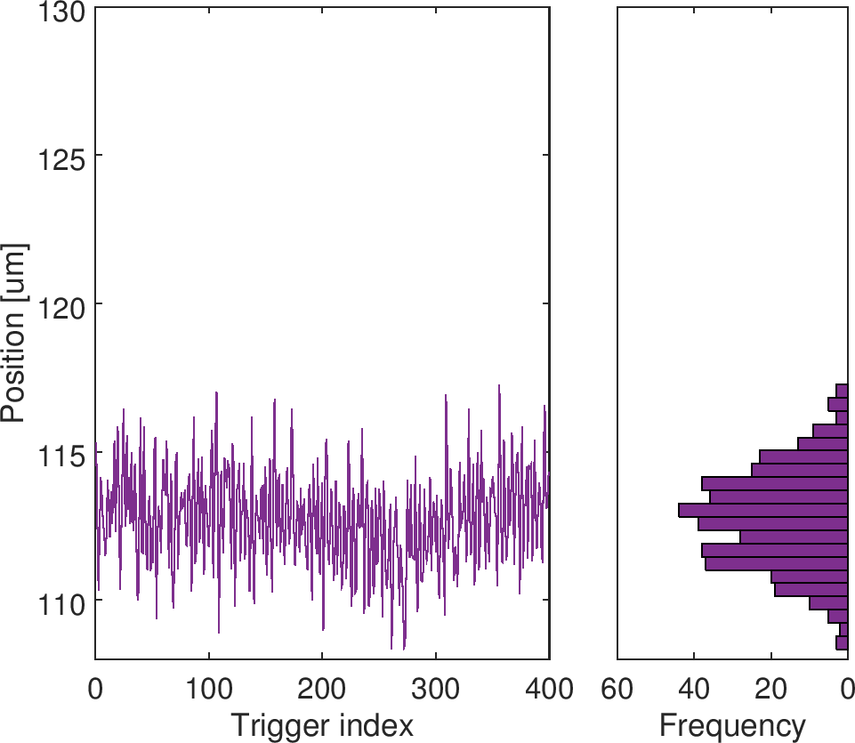
jitRun2
P1
P2
P3
$Σ$ (diode)
P2 (diode)
BPM | Jitter [um]
P1 | 1.114
P2 | 1.881
P2 (diode) | 1.665
P3 | 1.778

Slide 24
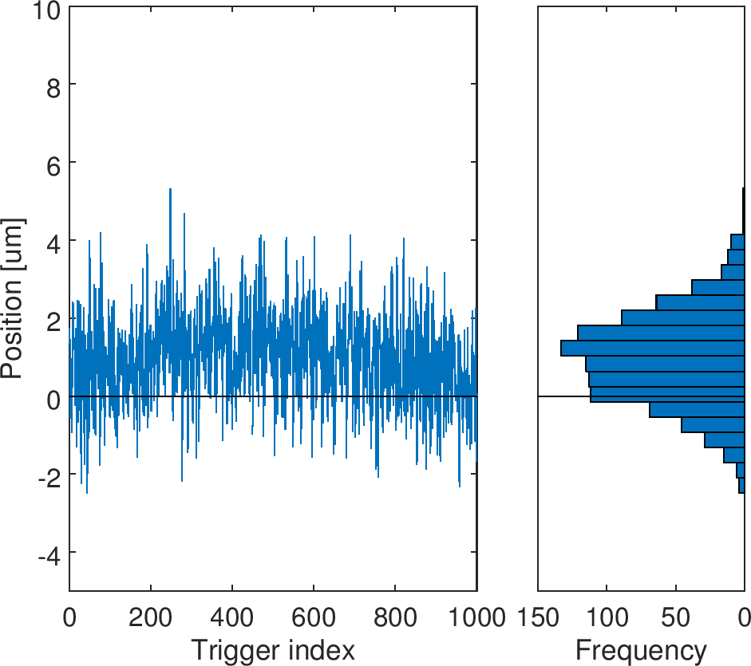
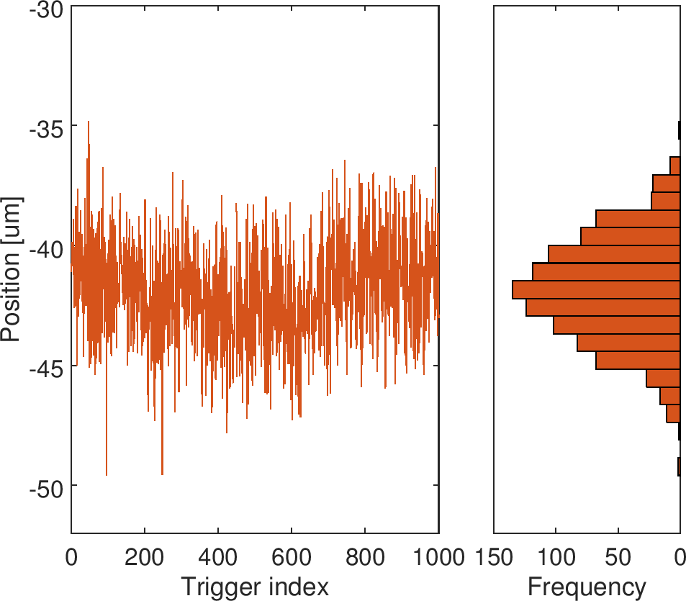
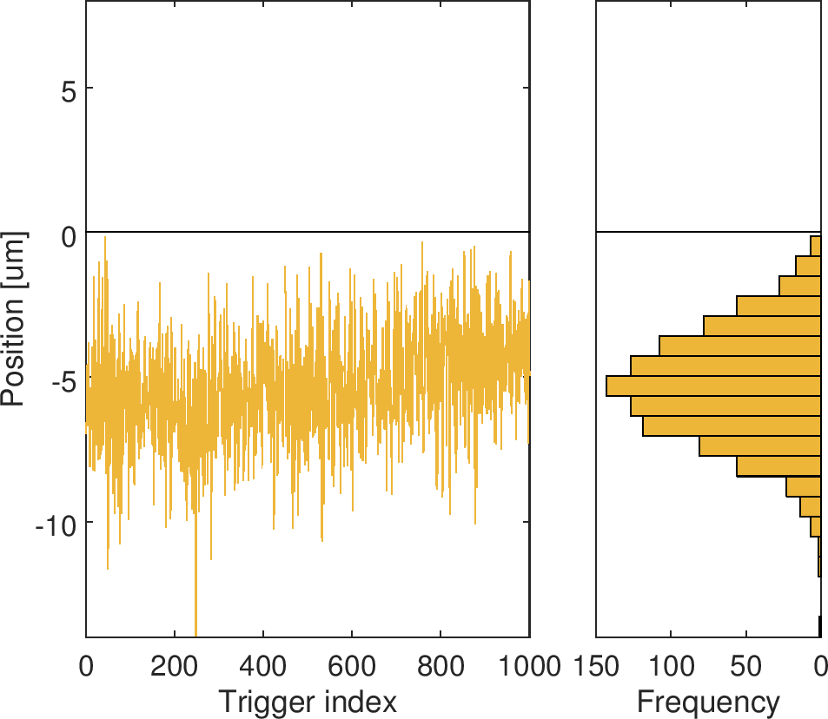
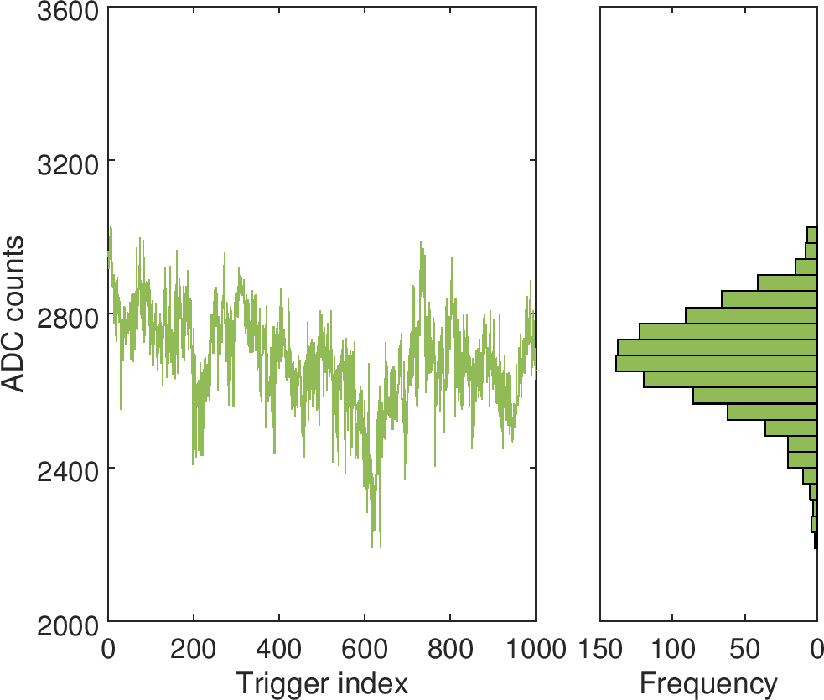
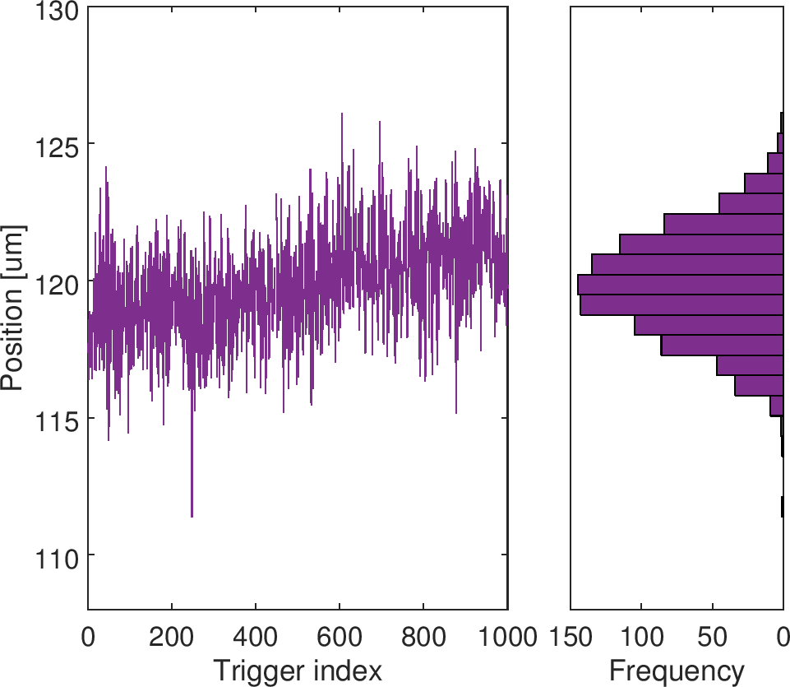
jitRun3
P1
P2
P3
$Σ$ (diode)
P2 (diode)
BPM | Jitter [um]
P1 | 1.182
P2 | 2.165
P2 (diode) | 1.950
P3 | 1.939

Slide 25

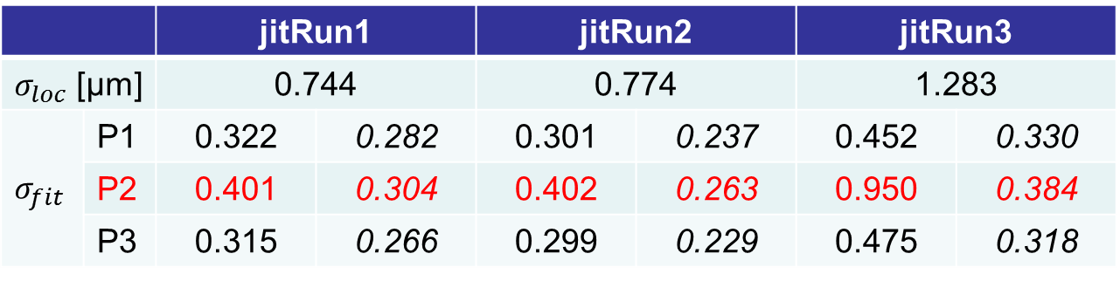
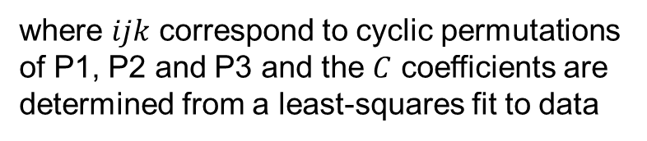
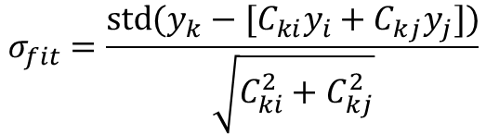
Resolution summary
 |  | jitRun1 |  | jitRun2 |  | jitRun3
$σ_{loc}$ [μm] |  | 0.744 |  | 0.774 |  | 1.283
$$σ_{fit}$$ | P1 | 0.322 | 0.282 | 0.301 | 0.237 | 0.452 | 0.330
 | P2 | 0.401 | 0.304 | 0.402 | 0.263 | 0.950 | 0.384
 | P3 | 0.315 | 0.266 | 0.299 | 0.229 | 0.475 | 0.318
$$σ_{loc}=\frac{1}{\sqrt{2}}\text{std}\left(y_{P2}−y_{DP}\right)$$
left: using conventional processor
right: using diode processor
$$σ_{fit}=\frac{\operatorname{std}{(y_{k}−[C_{ki}y_{i}+C_{kj}y_{j}])}}{\sqrt{C_{ki}^{2}+C_{kj}^{2}}}$$
where $ijk$ correspond to cyclic permutations of P1, P2 and P3 and the $C$ coefficients are determined from a least-squares fit to data
CONCLUSION: resolution of diode processor better than that of conventional processor - at least while signals attenuated by ~3 dB due to split

Slide 26
1
IPyCal4-5
QD0FFyScan1-3
jitRun3
dynamicRange1
AQF1FFxScan5-6
jitRun2
AQF1FFxScan3-4
AQF1FFxScan1-2
IPxCal8
jitRun1
IPxCal7
IPxCal4-6
mCal1, loPhase1
IPxCal1-3
IPyCal1-3
upstream
IP - x
IP - y

Slide 27
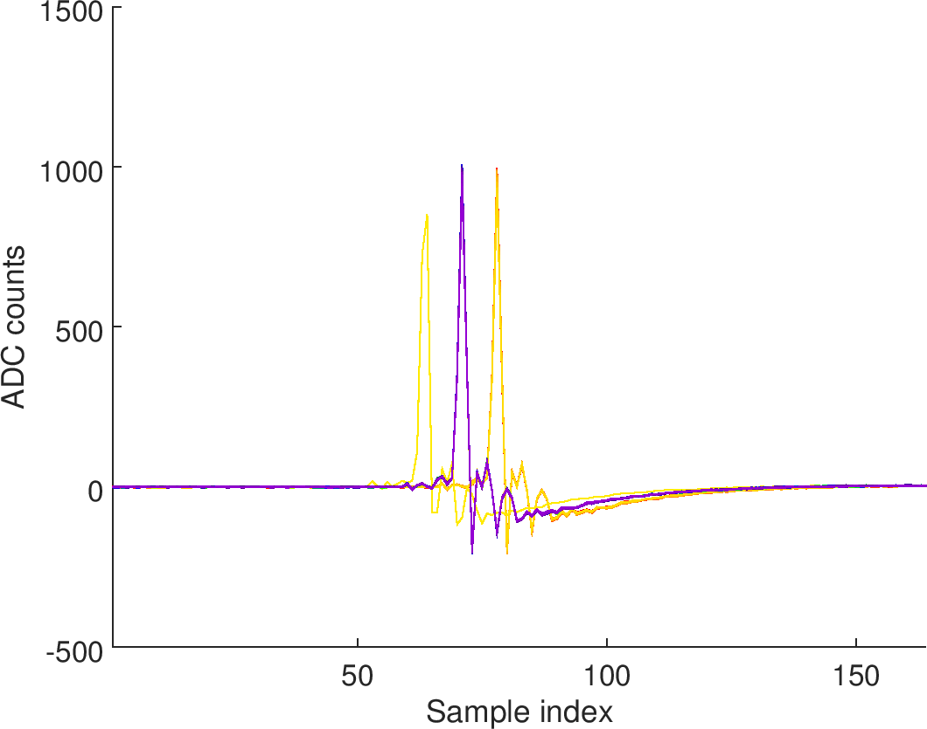
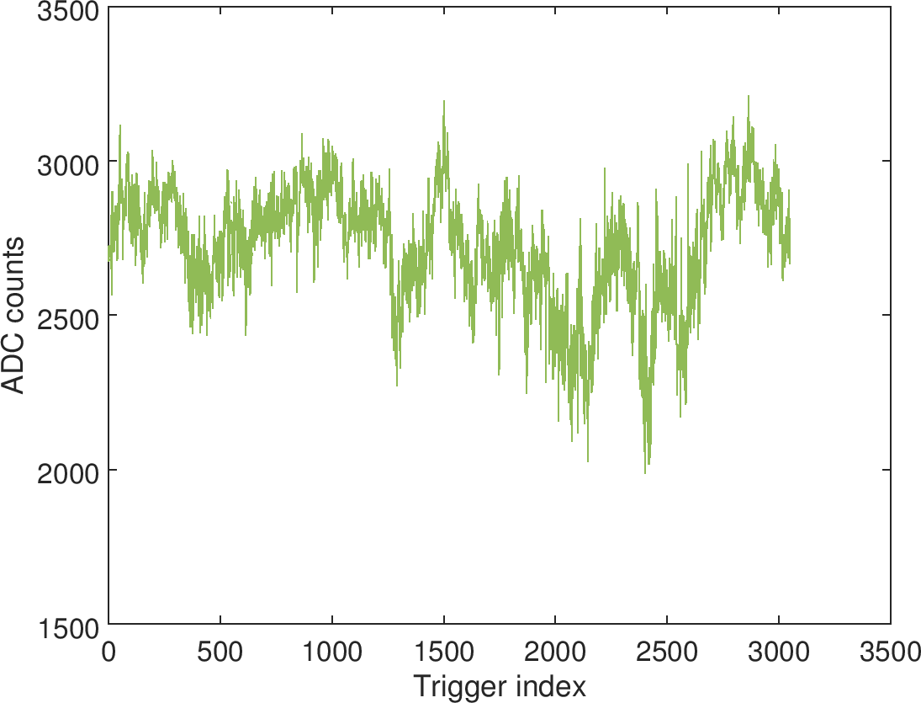
dynamicRange1
Absolute scan of all three BPM movers across wide range
Large orbit offset (~1 mm) observed at P2 (as usual)
P2 and diode start to saturate as P1 and P3 come out of saturation, so data set less useful for estimating resolution (no 3BPM resolution estimates)
Δ from diode saturates digitizer earlier than conventional processor but processor saturation occurs later (judging by measured jitter)
Sample timing jumped twice during -1 mm run but data set still usable as both times jumped by half- integer number of clock cycles
ADC6
$Σ$ (diode)
2nd jump
1st jump

Slide 28
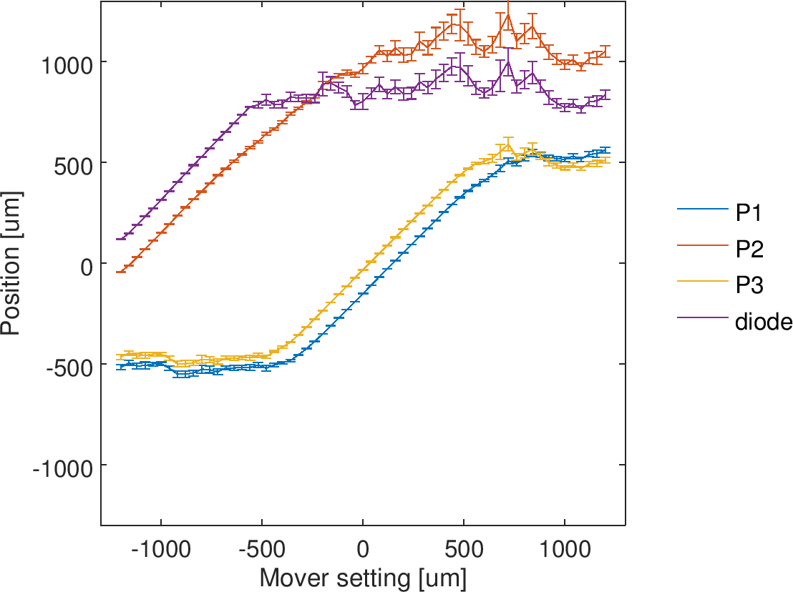
dynamicRange1 – linear range

Slide 29
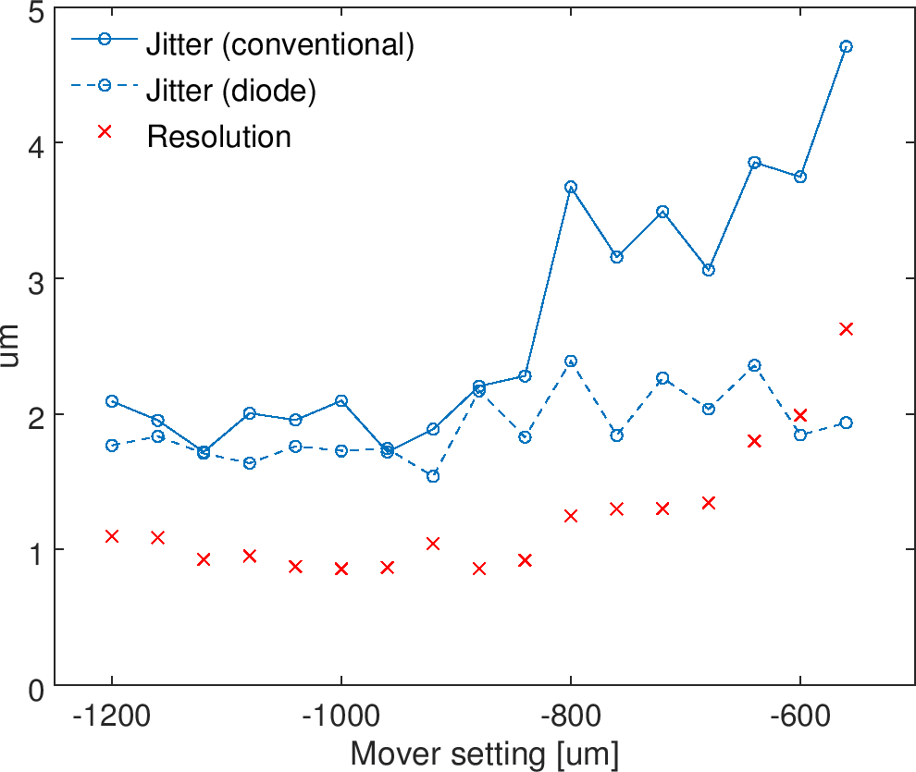
dynamicRange1 - resolution

Slide 30
Summary
Large phase dependence at P2 (apparent 20 μm/°)
Stripline phase shifters inoperable during shift due to unresponsive serial device server, so removed in analysis
Estimating resolution from jitter runs by direct comparison of measurements from diode and conventional processor suggests a resolution significantly better than 1 μm
3BPM resolution estimate using least-squares fit gives very different answer depending on which processor used for P2 position
300-1000 nm using conventional processor
200-400 nm using diode processor
Results suggest diode processor likely to have superior resolution to conventional processor (for low input signal levels)

