Slide 1


ATF2 June Shifts
R. Ramjiawan
Friday, 29th June 2018

Slide 2
Outline
First look at high-beta optics shift –
  Outline of shift
  Waveforms
  Calibrations with BPM movers (X & Y)
  Calibrations with AQD0FF mover (Y)
  Resolution measurements at nominal and large (but acceptable) position and tilt offsets

Slide 3
Analysis from Shift 15/06/2018

Slide 4
Shift Outline (15/06/18)
Owl and day shift: Resolution studies with X information, limiter phase information, bunch phase information from upstream board.
  Resolution scan: is resolution degraded my changing position/tilt within acceptable limits (i.e not in saturation)
  Resolution as function of charge
  Resolution as function of attenuation
  Resolution/limiter jitter as function of reference attenuation
High-beta optics
Beam jitter: IPA(X) 2.4 um, IPC(X) 2.6 um
IPA(Y) 250 nm, IPB(Y) 180 nm, IPC(Y) 450 nm
QD0FF: 133.5A – waist between IPB and the IP.
Data taken at multiple different charges between ~0.3e10 and ~0.7e10.
This presentation: Scan of resolution within acceptable limits
  For data in this presentation: charge 0.6e10, baseline subtraction implemented on all I, Q channels.
  Samples analysed: 59:64, ref 67.
  Data sets have typically 400 triggers.
  Data synchronised using timestamps.

Slide 5
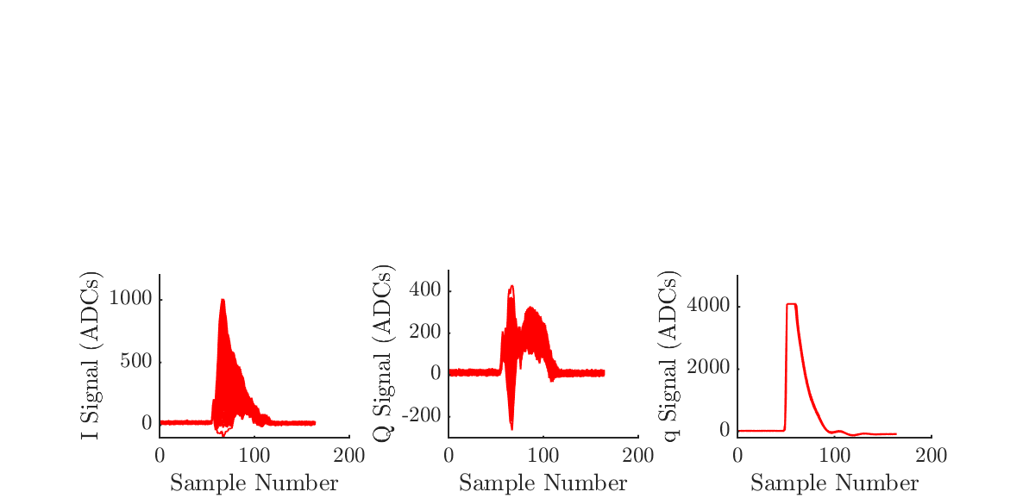
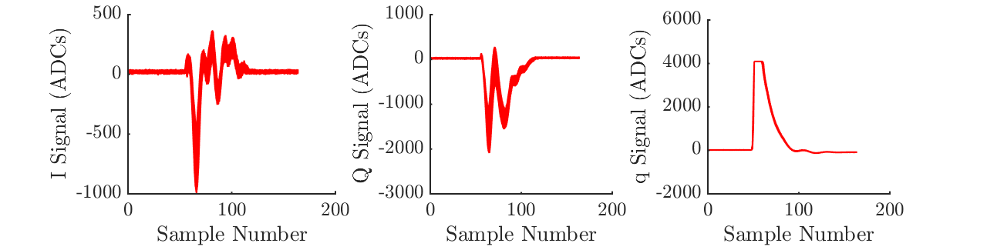
Waveforms (X) - 20dB
IPA(X)
IPC(X)

Slide 6
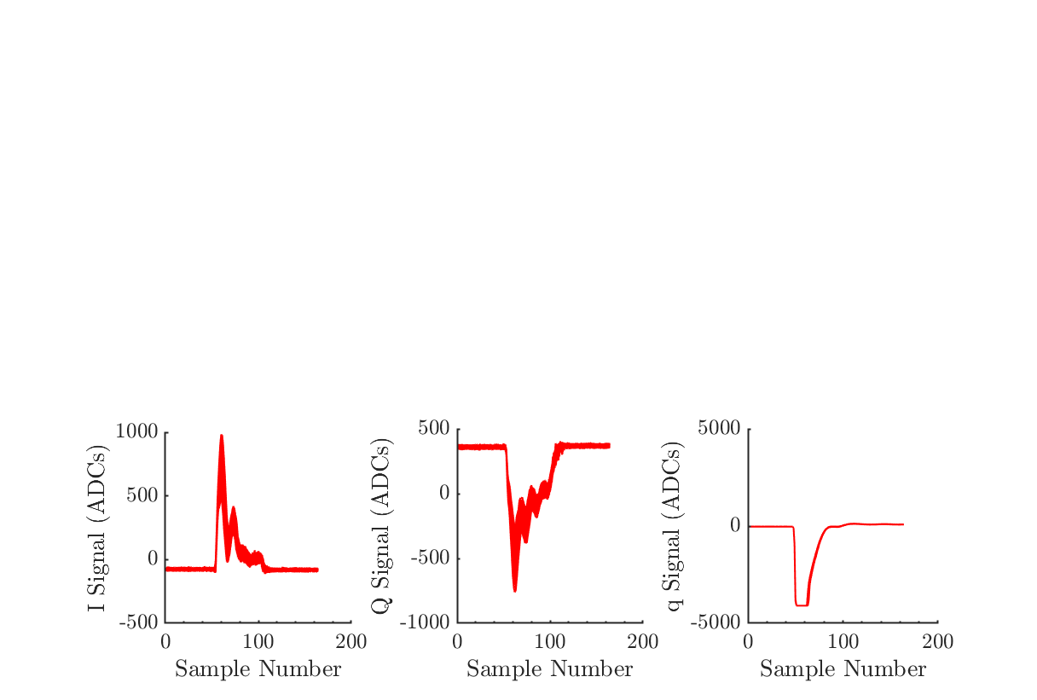
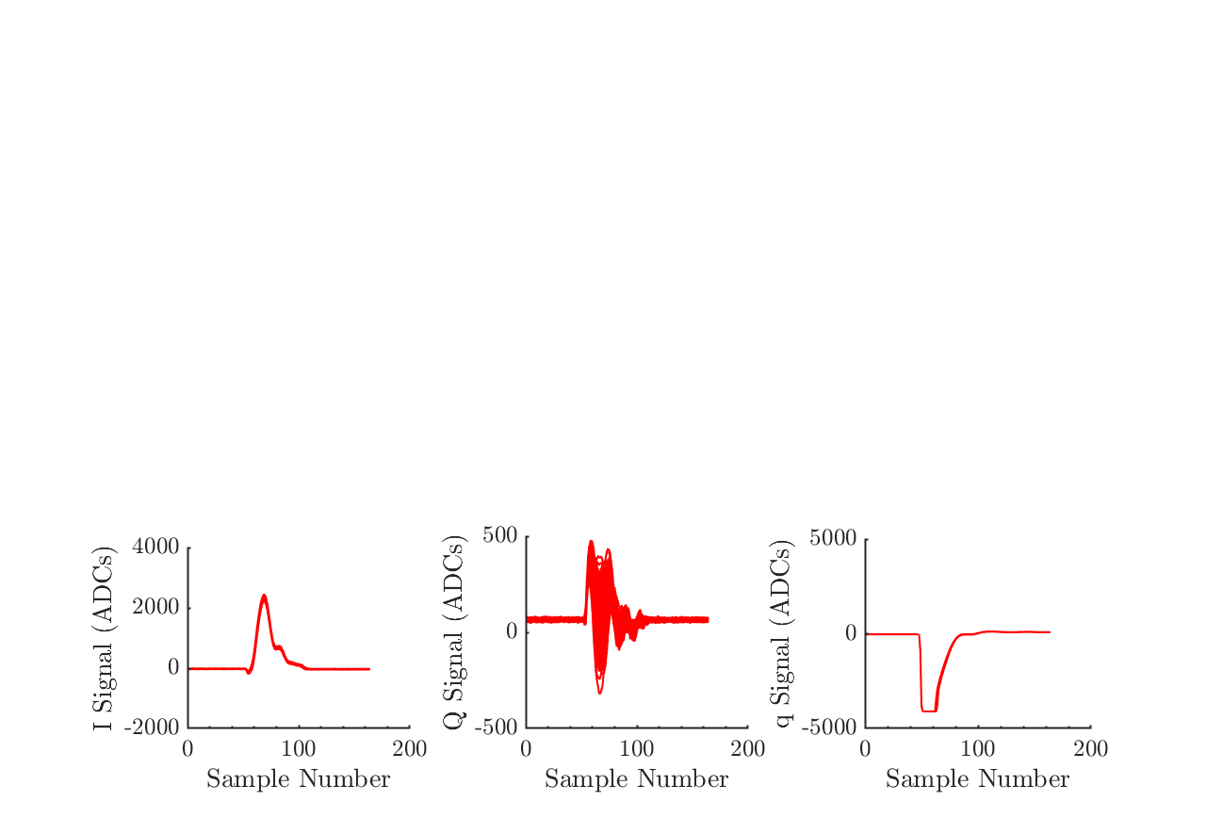
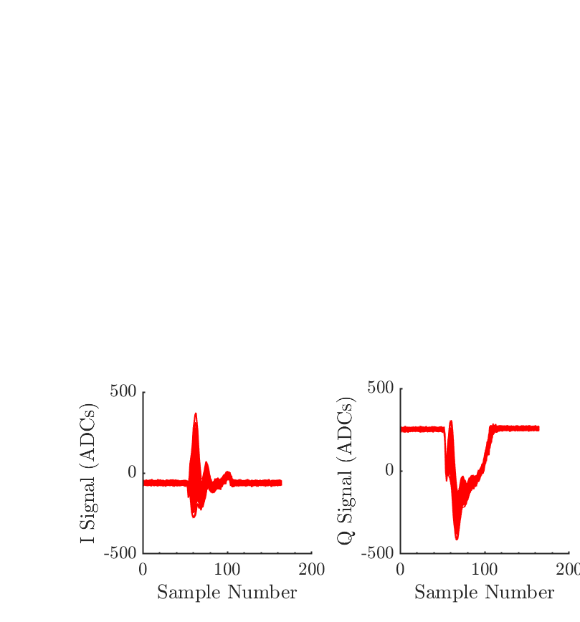
Waveforms (Y) – 10dB
IPA
The signal IPB(I) was highly insensitive to beam position and as such we weren’t able to reduce this throughout the shift.
Waveforms shown with baseline subtraction applied.
IPB
IPC

Slide 7
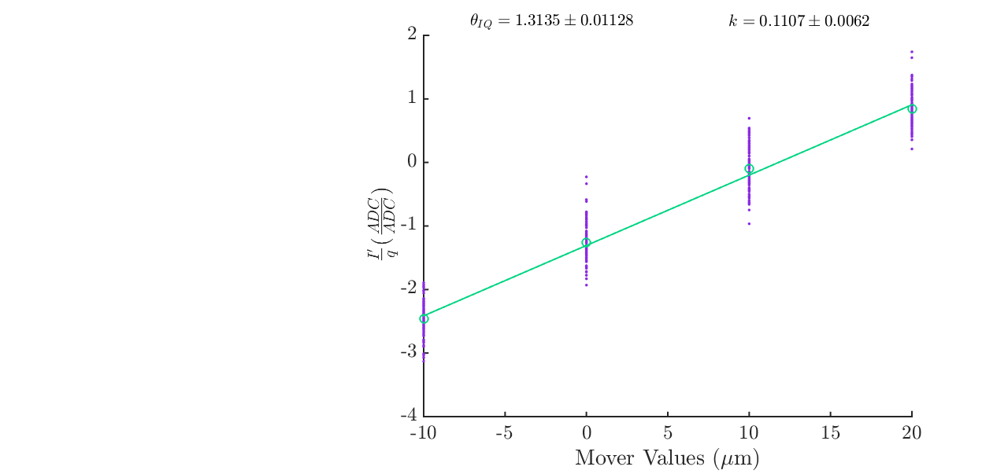
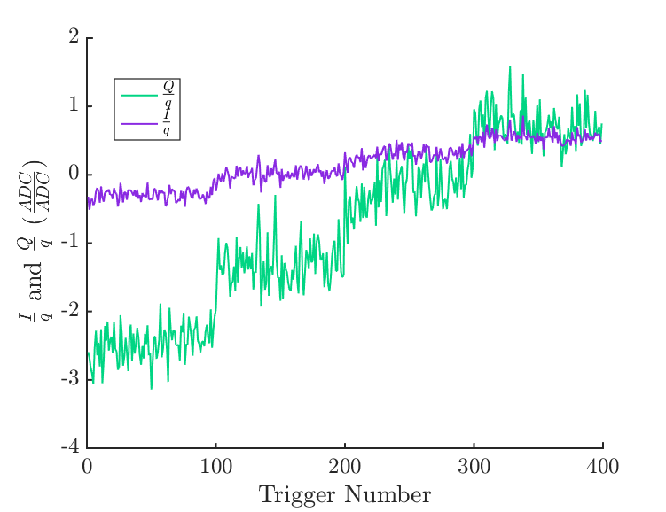
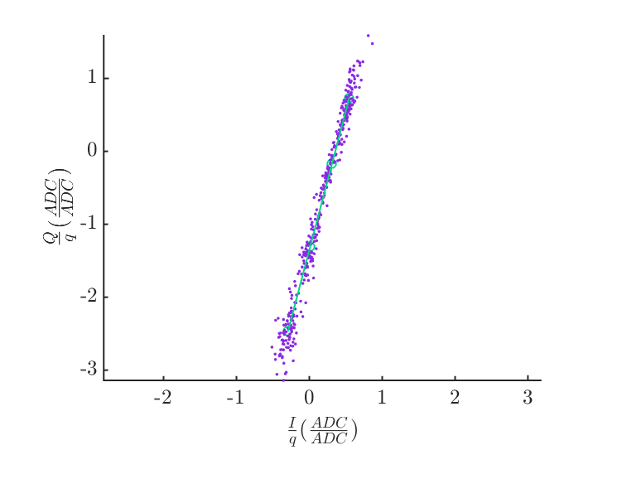
IPA(X) Calibration
Samples analysed – 59:64, ref sample: 67.
IPxCal2

Slide 8
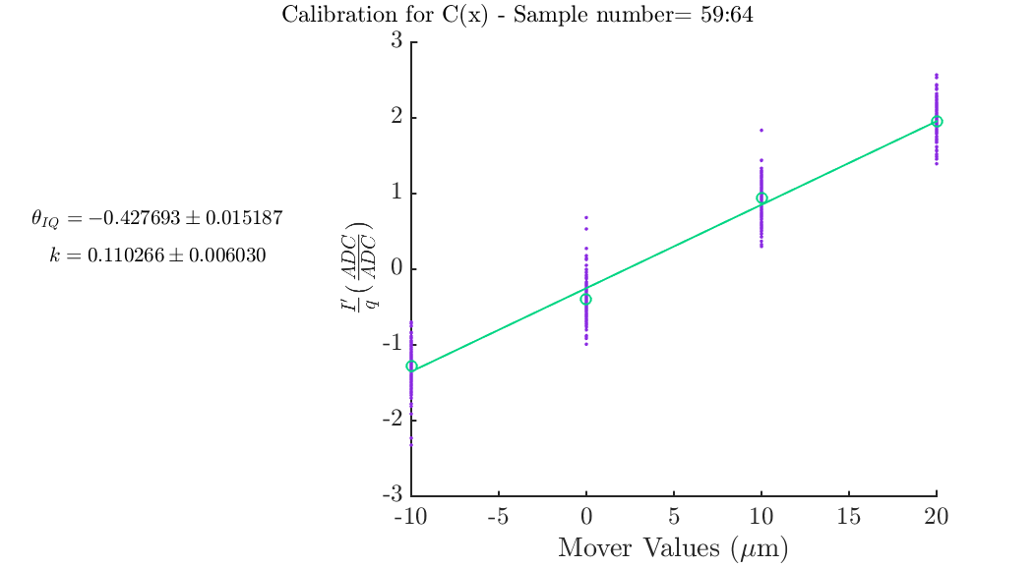
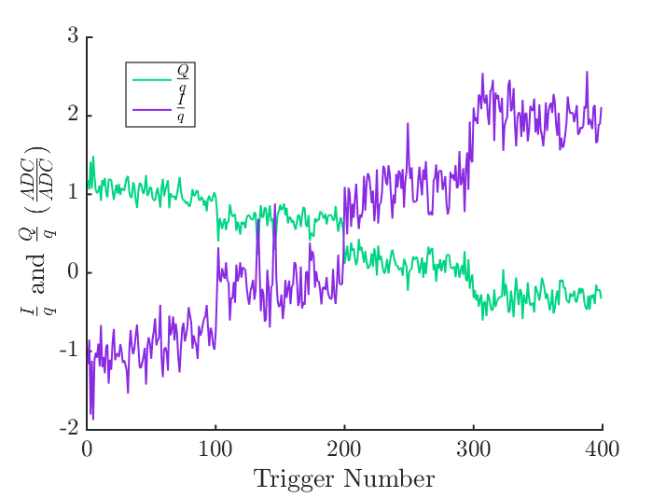
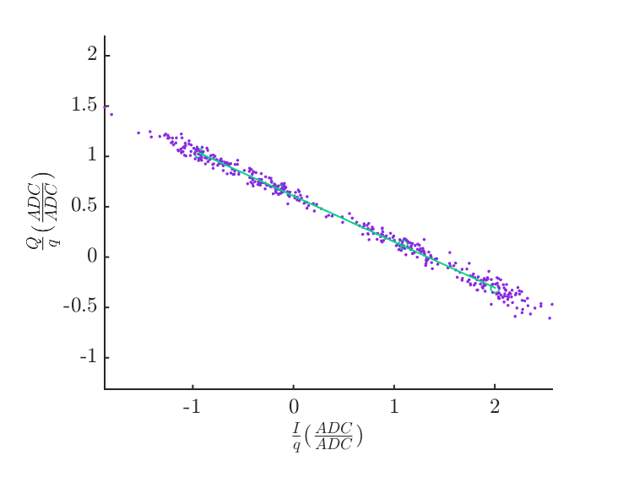
IPC(X) Calibration
Samples analysed – 59:64, ref sample: 67.
IPxCal2

Slide 9
Comparing BPM mover
And AQD0FF calibrations

Slide 10
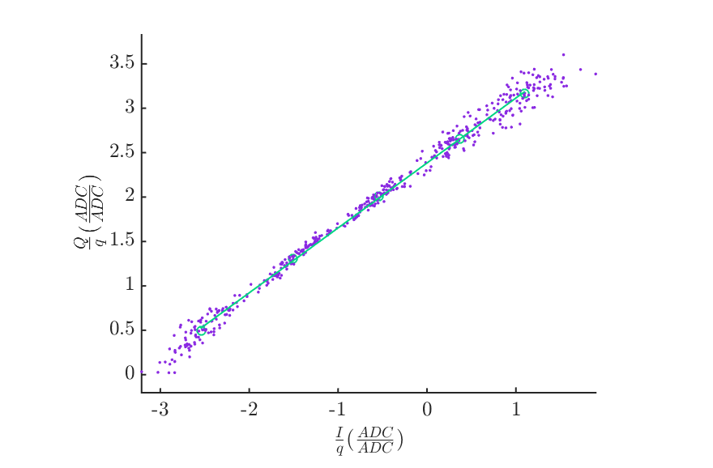
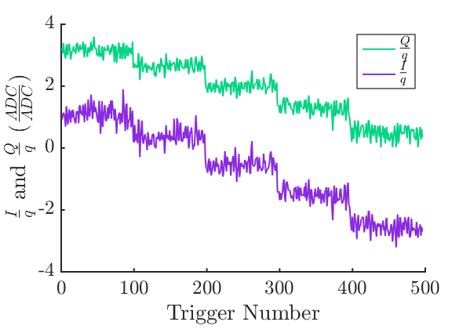
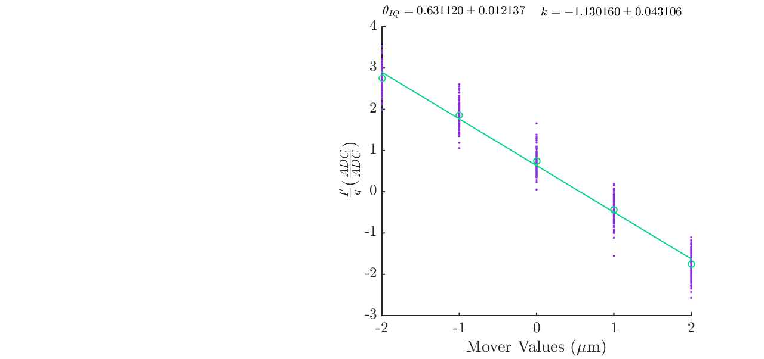
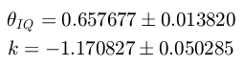
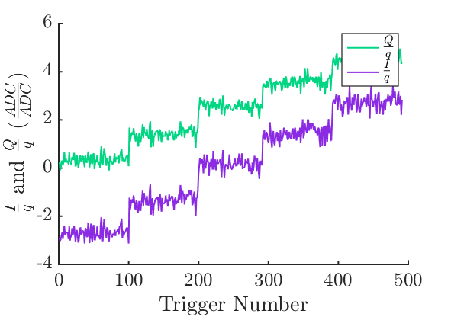
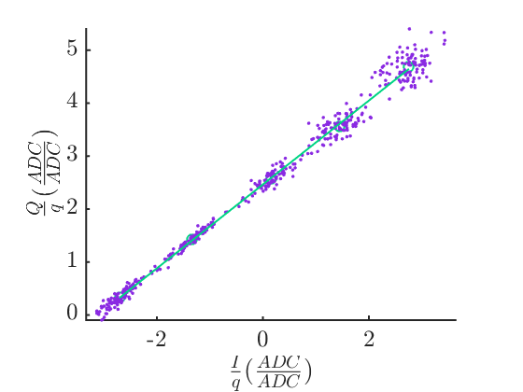
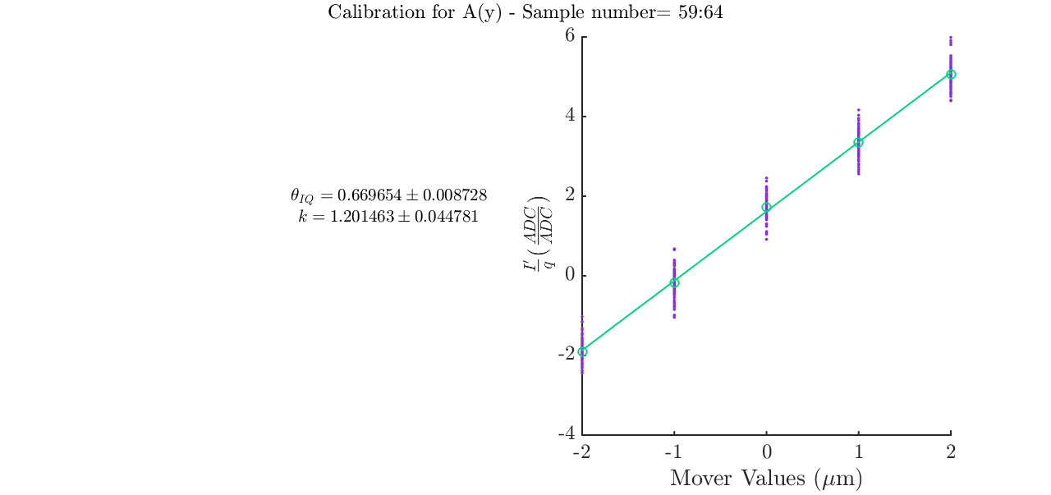
IPA(Y) Calibration (IPyCal9)
BPM mover
Samples 59:64, 67
QD0FF mover

Slide 11
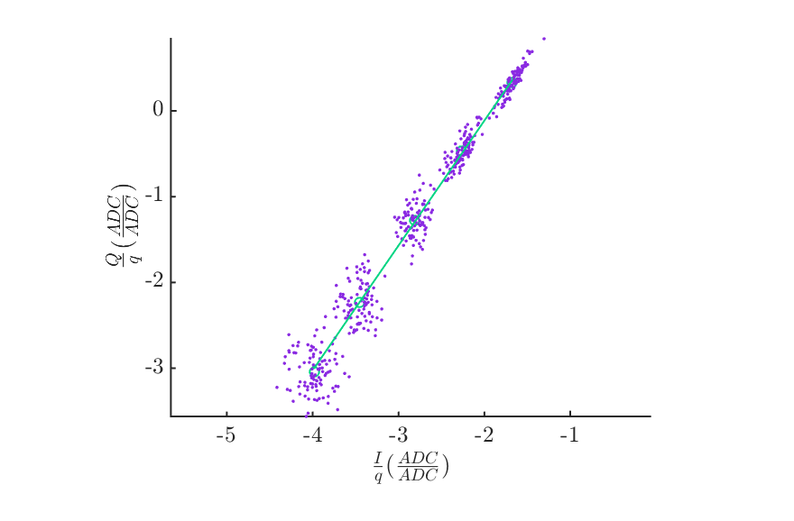
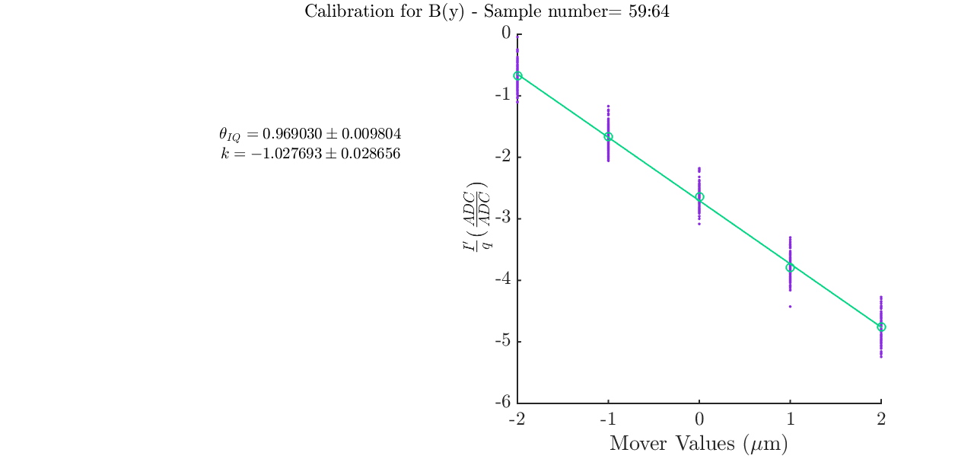
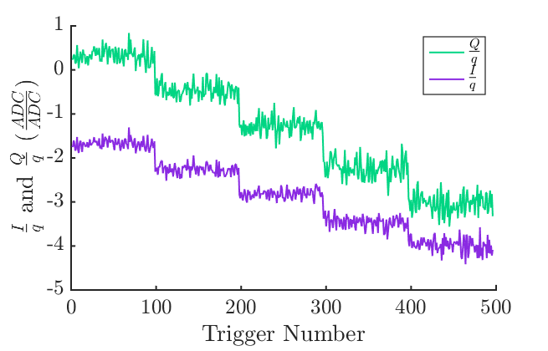
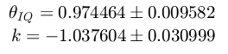
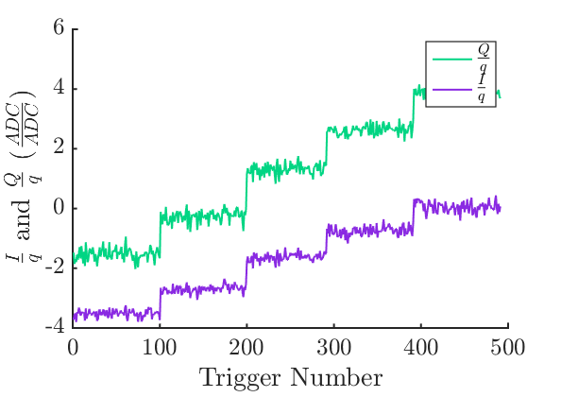
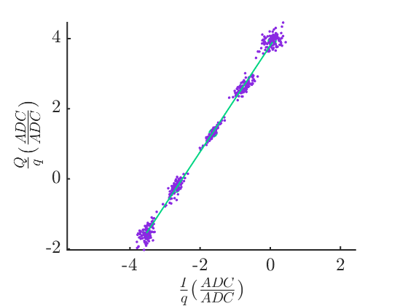
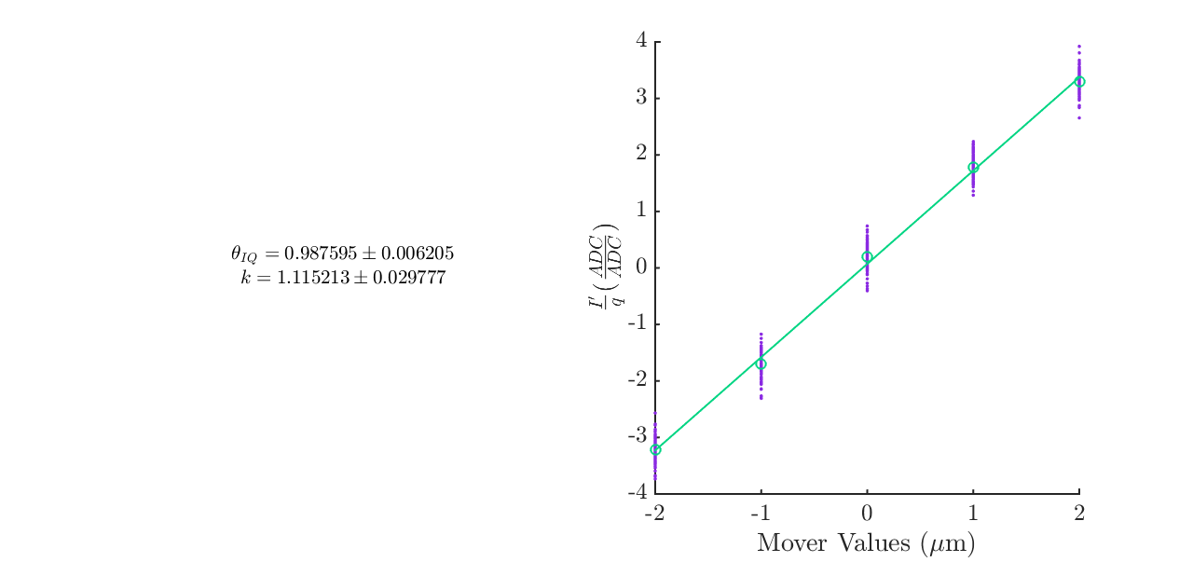
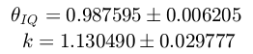
IPB(Y) Calibration (IPyCal9)
BPM mover
Samples 59:64, 67
QD0FF mover

Slide 12
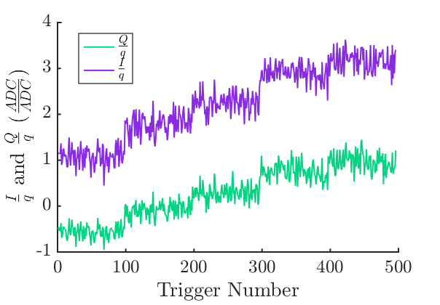
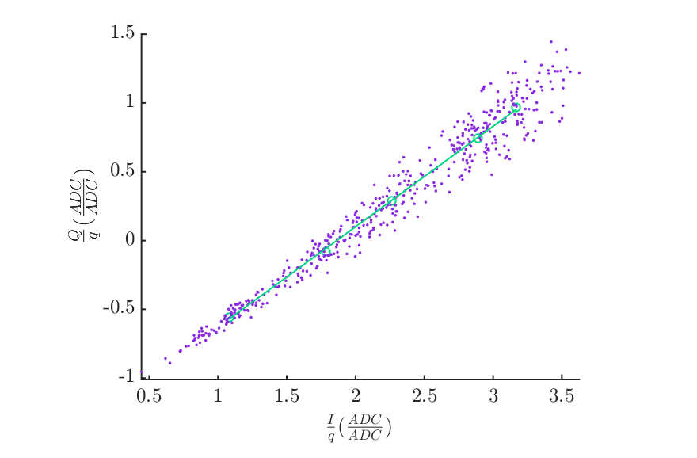
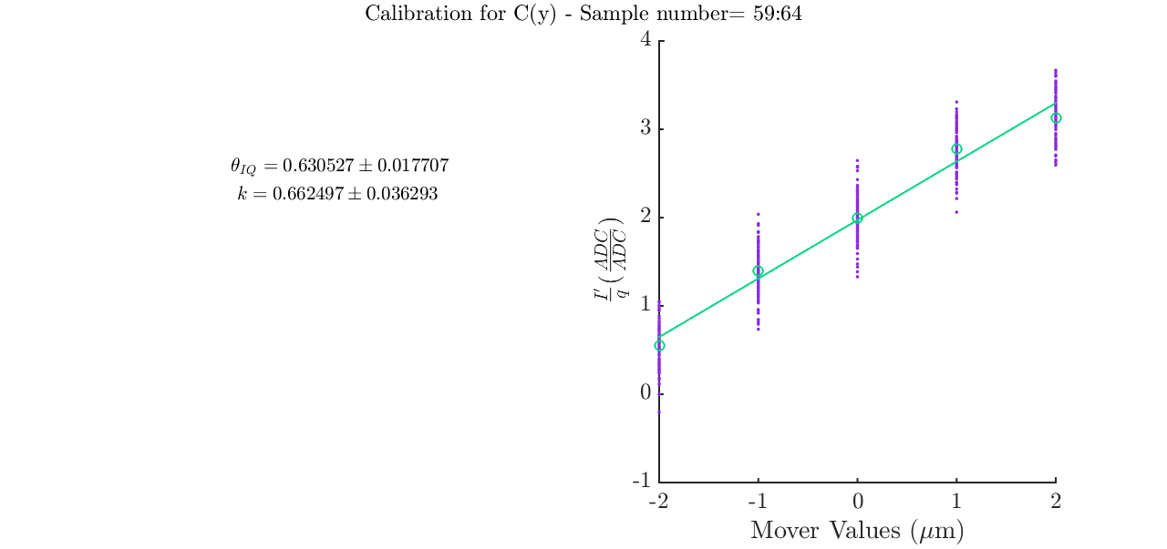
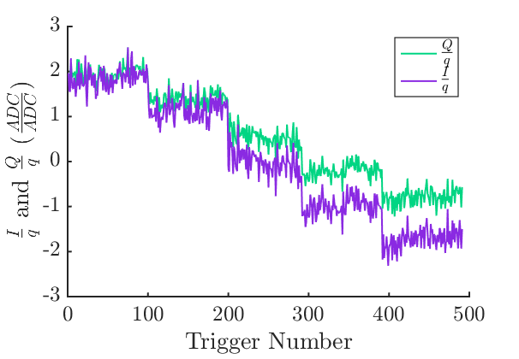
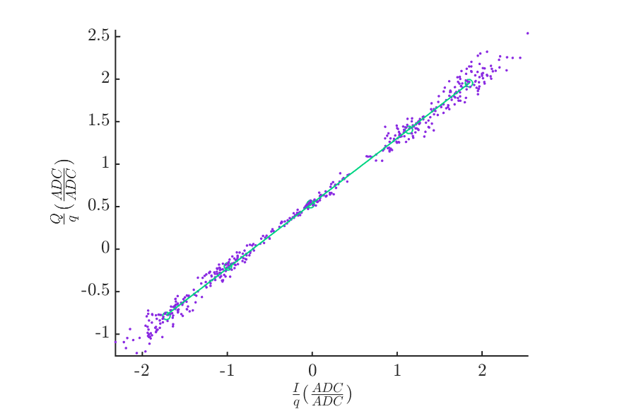
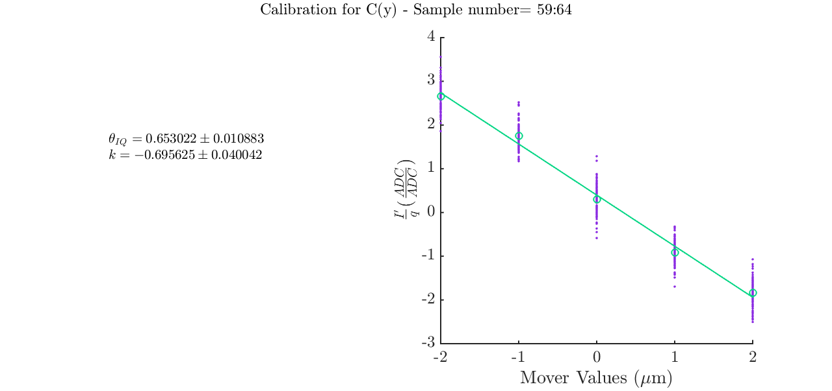
IPC(Y) Calibration (IPyCal9)
BPM mover
Samples 59:64, 67
QD0FF mover

Slide 13
Limiter phase jitter
&
Bunch phase jitter

Slide 14
Limiter Phase Jitter as Function of Sample
Colin2_posNom_tiltNom1
Single sample limiter phase jitter
First sample: 59
Integrated window limiter jitter as function of sample window.
Line shows window used for analysis 59:64

Slide 15
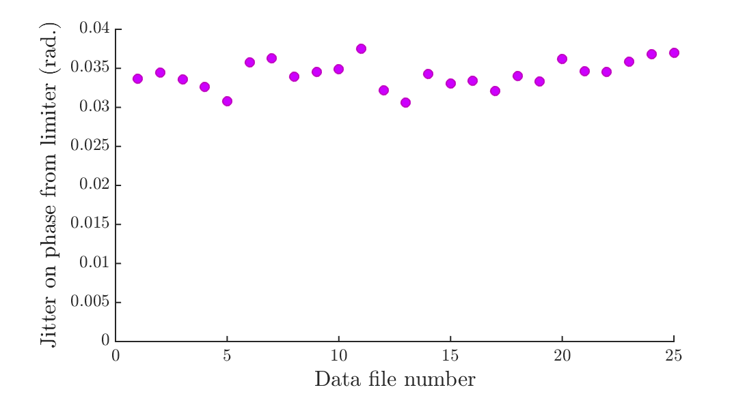
Limiter phase jitter
Limiter phase jitter for the ‘resolution within acceptable limits’ scan and its repeat.
Charge decreased across course of scan.
Samples analysed 59:64, ref 67.
Average value: 0.034 radians.
23 % correlation between the limiter phase jitter and the mean bunch charge.
Consistent with previous measurements of 0.03 radians.

Slide 16
Bunch Phase Jitter
Mean and standard deviation of bunch phase across the ‘resolution within acceptable limits’ scan and its repeat.
Sample used: 48 – corresponds to peak of Sum I waveform.
Error bars show bunch phase jitter.

Slide 17
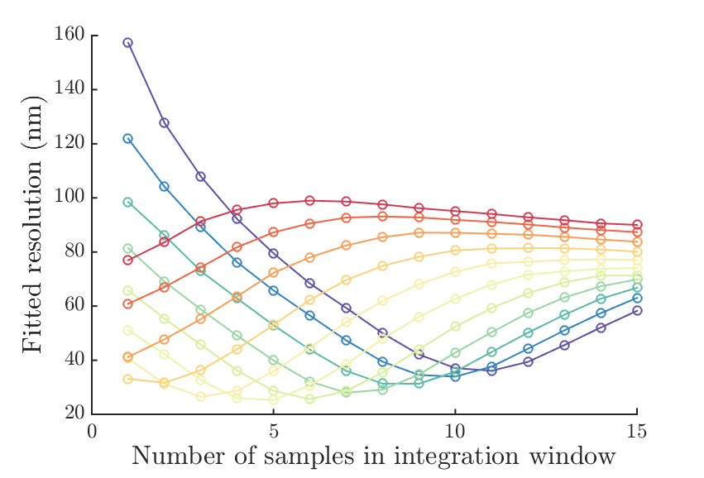
IPA Resolution-Fitting for calibration constant: k
Sample 55
File: jitRun3
Ref sample: 67.
Geometric to Position Resolution= 23.2 ± 1.3 nm
Fitting to (Y) - nm
I'/q = 22.5 ± 1.1
I'/q and 1/q= 21.2 ± 1.1
I'/q, Q'/q and 1/q= 21.2 ± 1.1
I'/q, Q'/q, Self Q'/q and 1/q= 21.0 ± 1.1
I'/q, Q'/q, Self Q'/q, Lim. Phase and 1/q= 20.4 nm ± 1.0
I'/q, Q'/q, Self Q'/q, Bunch Phase and 1/q= 21.0 ± 1.1
Fitting to (X and Y) - nm
I'/q = 21.8 ± 1.1
I'/q and 1/q = 21.2 ± 1.1
I'/q, Q'/q and 1/q= 21.1 ± 1.1
I'/q, Q'/q, Self Q'/q, 1/q= 20.9 ± 1.1
I'/q, Q'/q, Self Q'/q, Lim. Phase, 1/q= 20.2 ± 1.0
I'/q, Q'/q, Self Q'/q, Bunch phase and 1/q= 20.9 ± 1.1
Sample 65

Slide 18
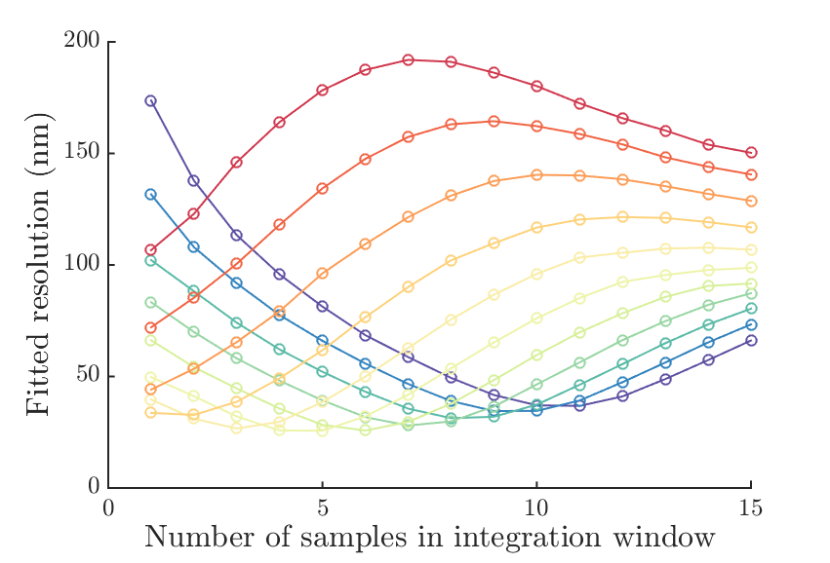
IPB Resolution-Fitting for calibration constant: k
File: jitRun3
Ref sample: 67.
Geometric to Position Resolution= 23.2 ± 1.3 nm
Fitting to (Y) - nm
I'/q = 23.2 ± 1.0
I'/q and 1/q= 21.7 ± 1.0
I'/q, Q'/q and 1/q= 21.5 ± 1.0
I'/q, Q'/q, Self Q'/q and 1/q= 21.4 ± 1.0
I'/q, Q'/q, Self Q'/q, Lim. Phase and 1/q= 21.0 ± 1.0
I'/q, Q'/q, Self Q'/q, Bunch Phase and 1/q= 21.4 ± 1.0
Fitting to (X and Y) - nm
I'/q = 23.1 ± 1.0
I'/q and 1/q = 21.7 ± 1.0
I'/q, Q'/q and 1/q= 20.0 ± 0.9
I'/q, Q'/q, Self Q'/q, 1/q= 19.9 ± 0.9
I'/q, Q'/q, Self Q'/q, Lim. Phase, 1/q= 19.9 ± 0.9
I'/q, Q'/q, Self Q'/q, Bunch phase and 1/q= 19.9 ± 0.9
Sample 55
Sample 65

Slide 19
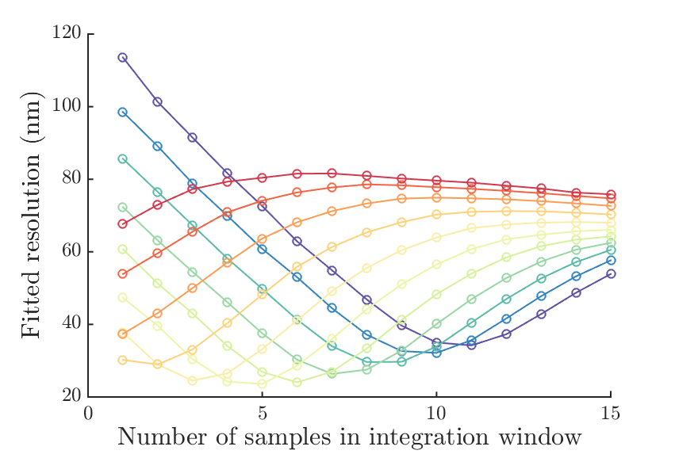
IPC Resolution-Fitting for calibration constant: k
Geometric to Position Resolution= 23.2 ± 1.3 nm
Sample 55
File: jitRun3
Ref sample: 67.
Fitting to (Y) - nm
I'/q = 22.6 ± 1.5
I'/q and 1/q= 21.7 ± 1.5
I'/q, Q'/q and 1/q= 21.5 ± 1.5
I'/q, Q'/q, Self Q'/q and 1/q= 21.5 ± 1.5
I'/q, Q'/q, Self Q'/q, Lim. Phase and 1/q= 20.8 ± 1.4
I'/q, Q'/q, Self Q'/q, Bunch Phase and 1/q= 21.5 ± 1.5
Fitting to (X and Y) - nm
I'/q = 21.9 ± 1.5
I'/q and 1/q = 21.6 ± 1.5
I'/q, Q'/q and 1/q= 19.9 ± 1.4
I'/q, Q'/q, Self Q'/q, 1/q= 19.8 ± 1.3
I'/q, Q'/q, Self Q'/q, Lim. Phase, 1/q= 19.6 ± 1.3
I'/q, Q'/q, Self Q'/q, Bunch phase and 1/q= 19.8 ± 1.3
Sample 65

Slide 20
Scan of Acceptable
Positions and Angles

Slide 21
Acceptable range of positions/angles
Scan through minimum, nominal and maximum acceptable positions.
Scan through minimum, nominal and maximum acceptable tilts.
Repeat.
Min position, max tilt | Nominal position, max tilt | Max position, max tilt
Min Position, nominal tilt | Nominal position, nominal tilt | Max position, nominal tilt
Min position, min tilt | Nominal position, min tilt | Max position, min tilt
I’/q across scan
Q’/q across scan

Slide 22
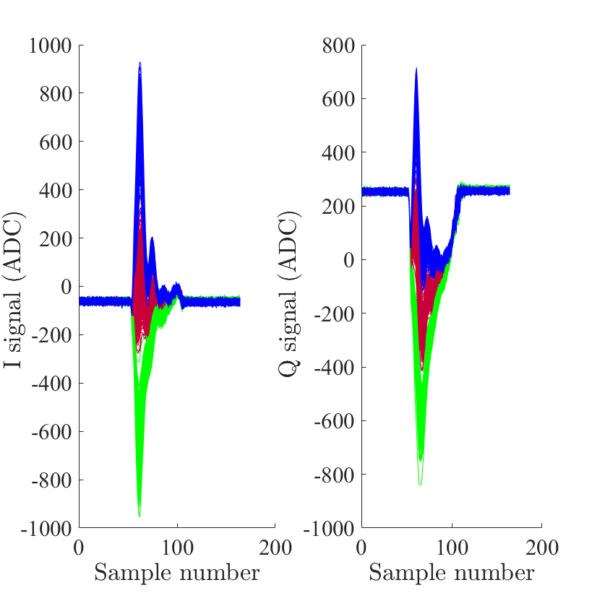
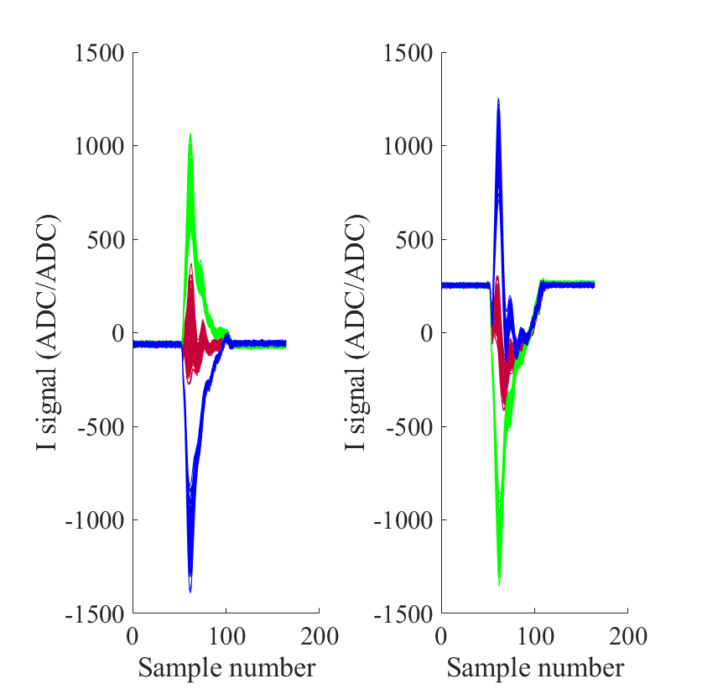
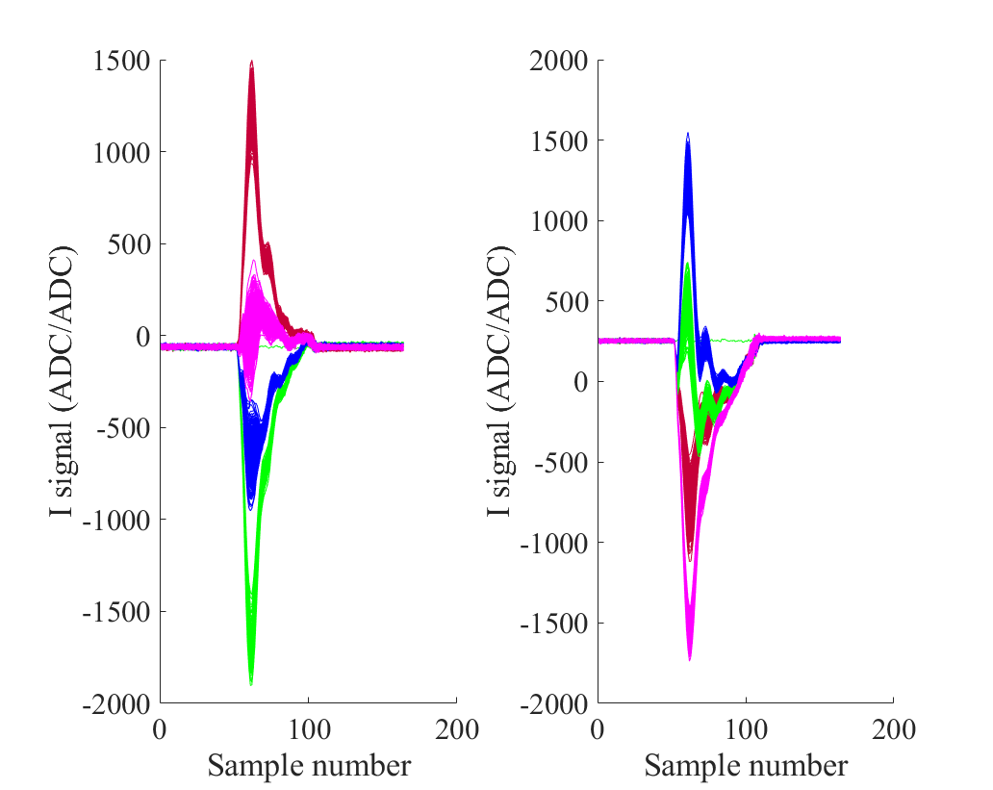
Waveforms at min, nom, max of scan
Position Scan at nominal tilt
Tilt Scan at nominal position
Position and tilt scan
Min pos, min tilt
Min pos, max tilt
Max pos, min tilt
Max pos, max tilt
Min pos
Nom pos
Max pos
Min tilt
Nom tilt
Max tilt

Slide 23
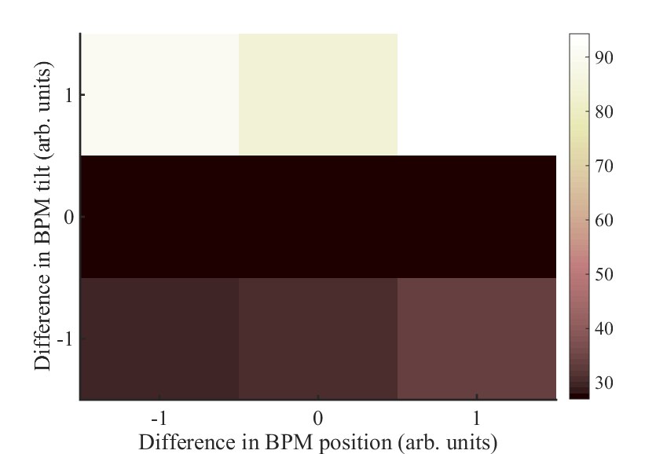
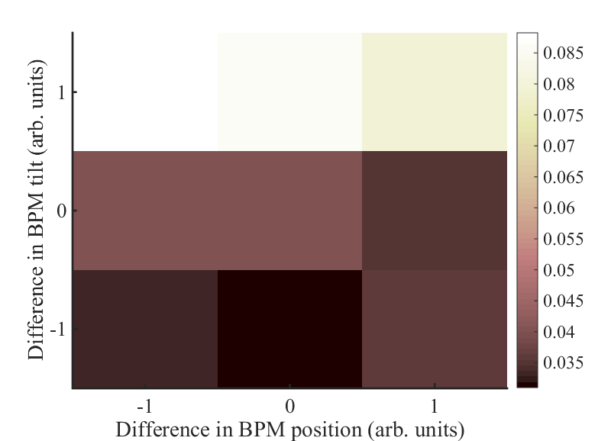
Scan 1 and Scan 2
Colour in heat-map corresponds to geometric resolution.
First scan: appear to be well centred about origin in both I’ and Q’
Second scan: no longer well centred and best resolution found at minimum tilt setting.
Scan 1
Scan 2

Slide 24
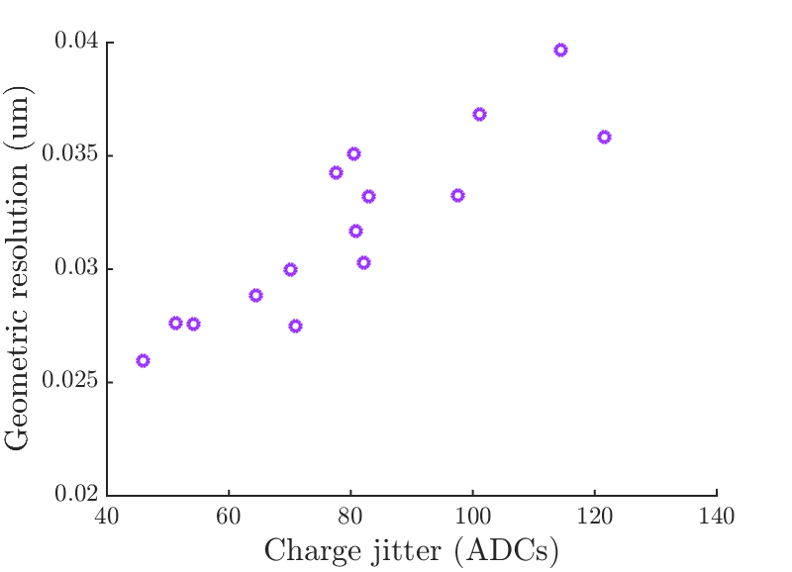
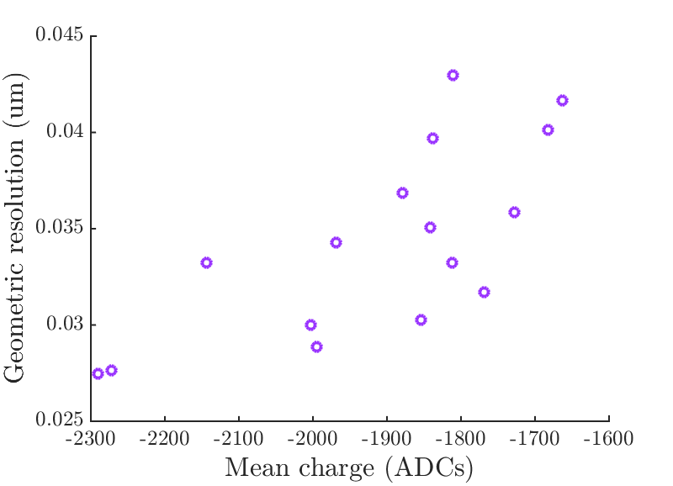
Charge during the scan
Charge dropped across the course of the scan leading to a decreasing resolution (plots to the right).
79.1 % correlation
72.4 % correlation
Files from resolution scan that have geometric resolution of better than 60 nm

Slide 25
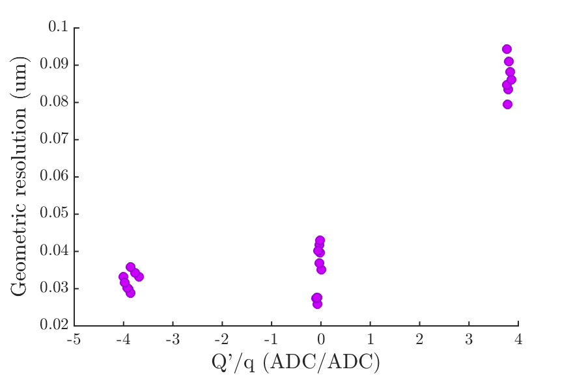
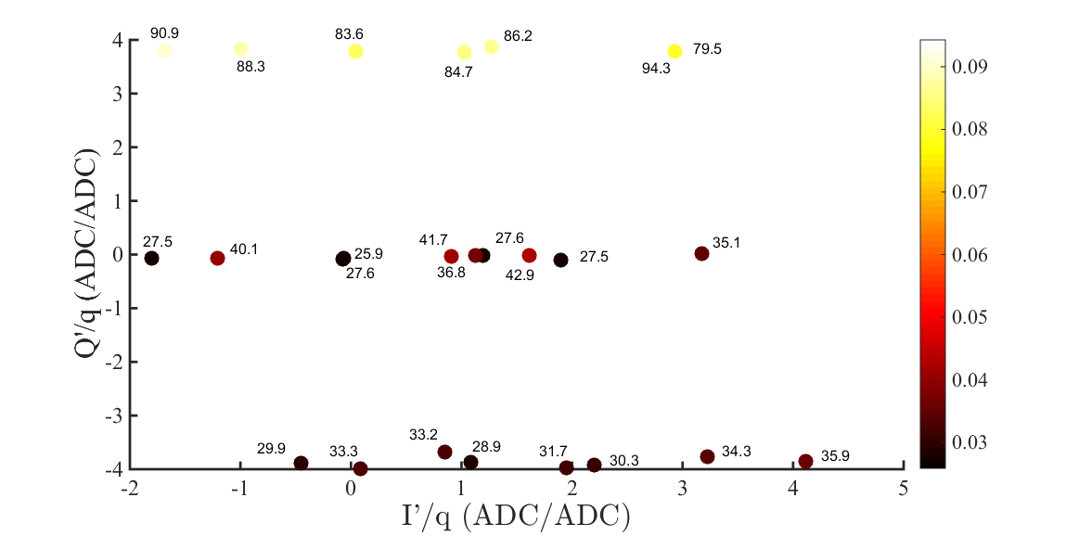
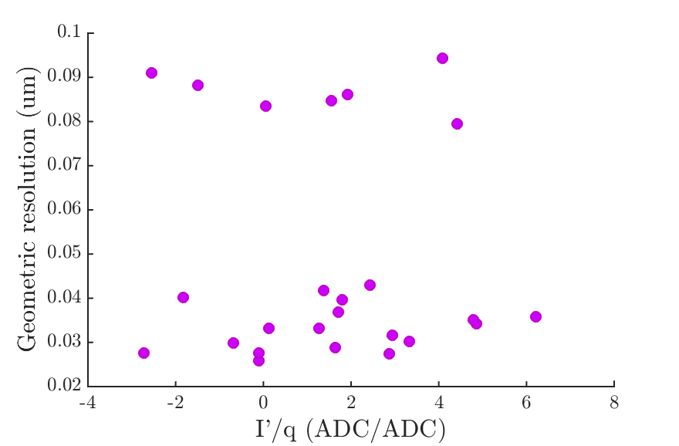
Geometric resolution as function of pos. and tilt
Including data from scan 1 and scan 2.
Colour corresponds to geometric resolution.
Geometric resolutions are given as data labels in nm.
Res. Vs. Q’/q
Res. Vs. I’/q

Slide 26
Improvement by using fitting
Geometric resolution and resolution by fitting to just position shown below.
Plots on the right show the progression of Q’/q and I’/q across the scan.
Q’/q
I’/q

Slide 27
Beam position, angle drift across the scan
Geometric resolution across scan. Worst resolution settings not shown.
Nominal settings in red
Beam drift across the scan mostly seen in IPA and IPC not in IPB, possibly suggesting drift in angle rather than position.
Data shown here taken over ~2 hours.
Mean IPC I’/q across scan.
Nominal settings in red
IPB
IPA
2.4 um

Slide 28
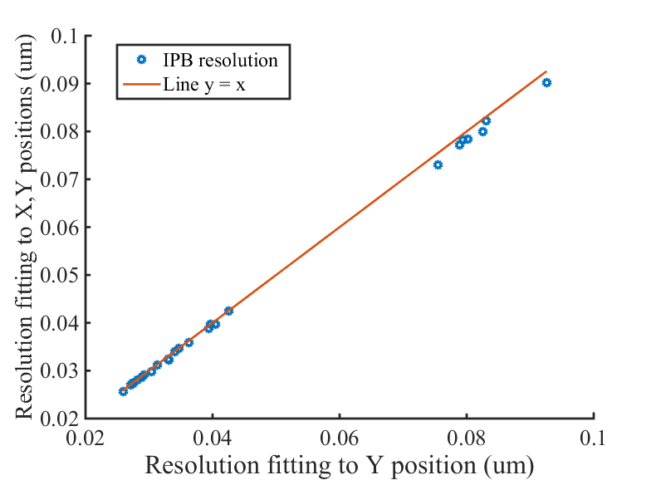
Improvement to resolution – fitting X
IPB resolution with fitting to:
IPA(X), IPA(Y), IPC(X), IPC(Y), charge compared with fitting to
IPA(Y), IPC(Y), charge.
Appears to have most impact at poorer resolution.

Slide 29
Fitting for bunch phase, limiter phase
Showing the improvement to resolution gained from fitting out the bunch phase and limiter phase.
Fitting to Y data
Fitting to X and Y data

Slide 30
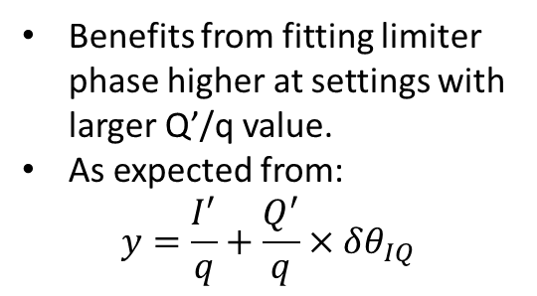
Improvement from fitting lim. phase
Benefits from fitting limiter phase higher at settings with larger Q’/q value.
As expected from:
$$y=\frac{I^{′}}{q}+\frac{Q^{′}}{q}×δθ_{IQ}$$
Plotted: Resolution fitting 7 parameters – resolution fitting 7 parameters & limiter phase.
(nm)

Slide 31
Summary
BPM mover calibration agreed with AQD0FF calibration.
Resolution shows dependence on Q’/q within ‘acceptable limits of operation’.
Improvements by fitting to limiter phase seen for data sets with larger Q’/q.
  Limiter phase jitter ~0.034 radians.
No real improvement seen by fitting to the bunch phase.
  Bunch phase jitter ~0.0105 radians.
Slight improvement seen by fitting to X orbit for data sets with poorer resolution.

Slide 32
Extra Slides

Slide 33
Extra slide
ColinRun2 _posNomTiltNom1_10dB | 203, 203, 162, 26 nm (1/13)
ColinRun2 _posMinTiltNom1_10dB | 200, 200, 159, 27.7 nm (2/13)
ColinRun2 _posMaxTiltNom1_10dB | 206, 206, 165, 27.6 nm (3/13)
ColinRun2 _posNomTiltNom2_10dB | 203, 203, 162, 27.4 nm (4/13)
ColinRun2 _posNomTiltMin1_10dB | 173, 173, 280, 31.1 nm (5/13)
ColinRun2 _posMinTiltMin1_10dB | 170, 170, 277 (6/13)
ColinRun2 _posMaxTiltMin1_10dB | 176, 176, 283 (7/13)
ColinRun2 _posNomTiltMin2_10dB | 173, 173, 280, 29.4 nm (8/13)
ColinRun2 _posNomTiltMax1_10dB | 173, 173, 280 (9/13)
ColinRun2 _posNomTiltMax1_10dB | 233, 233, 44 (10/13)
ColinRun2 _posMinTiltMax1_10dB | 230, 230, 41 (11/13)
ColinRun2 _posMaxTiltMax1_10dB | 236, 236, 47 (12/13)
ColinRun2 _posNomTiltNom3_10dB | 203, 203, 162 (13/13)

