Slide 1
FONT Meeting Friday 6 July 2018
Charge/reference attenuation scan: waveforms
Douglas BETT

Slide 2
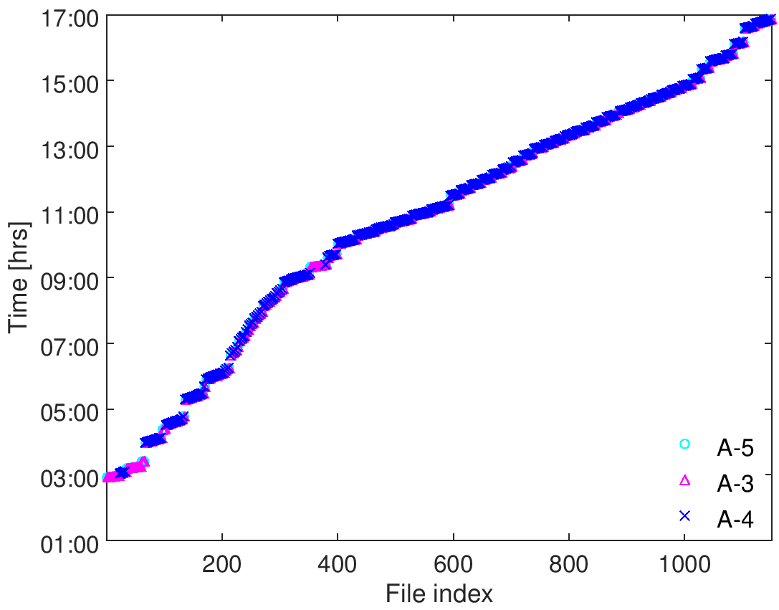
2
AQD0FFyScan38-44, jitRun33-35
charge/ref. atten. scan
AQD0FFyScan31-37, jitRun26-32
AQD0FFyScan23-30, jitRun18-25
q ~ 0.2
AQD0FFyScan15-22, jitRun10-17
q ~ 0.4
AQD0FFyScan3-14, attScan2
q ~ 0.65
attScan1
loPhase2
IPyCal10
IPyCal9, AQD0FFyScan1-2, jitRun7-8
jitRun2
Colin1-3
jitRun1
IPyCal7,8
IPyCal5,6
IPyCal3,4
IPxCal1,2
upstream
loPhase1, zeroMover1
IP - x
IPyCal1
mCal1
IP - y

Slide 3
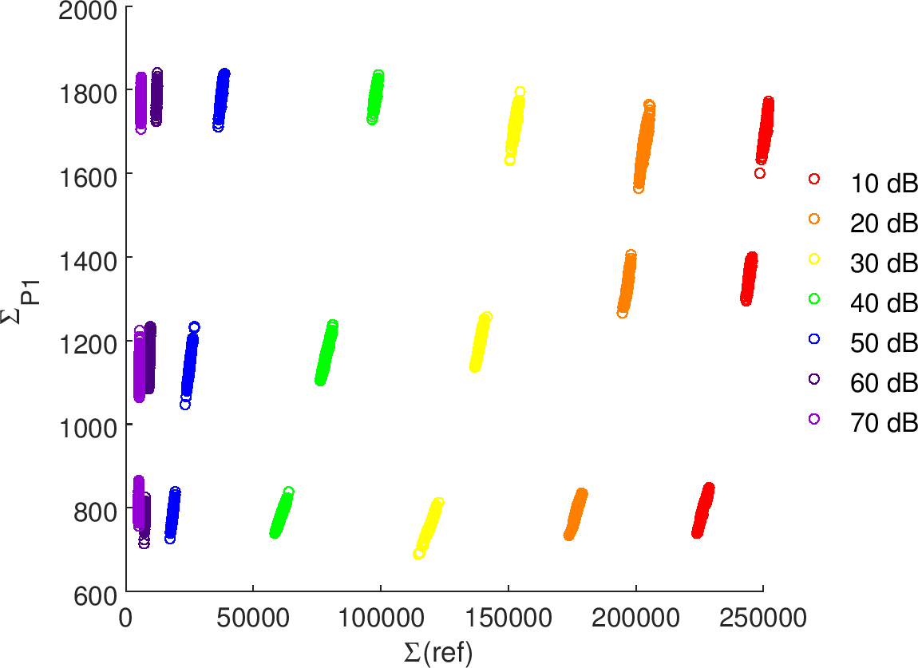
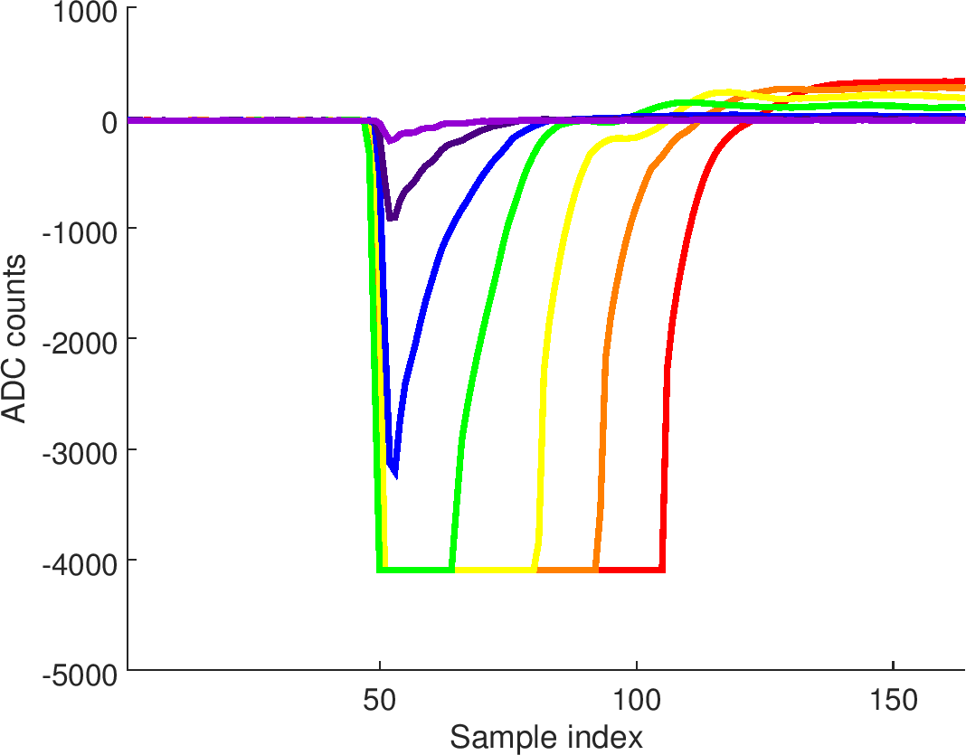
Integrated reference vs. upstream sum
little/no digitizer saturation
severe digitizer saturation
Average reference waveforms (high charge)
high charge
medium charge
low charge

Slide 4
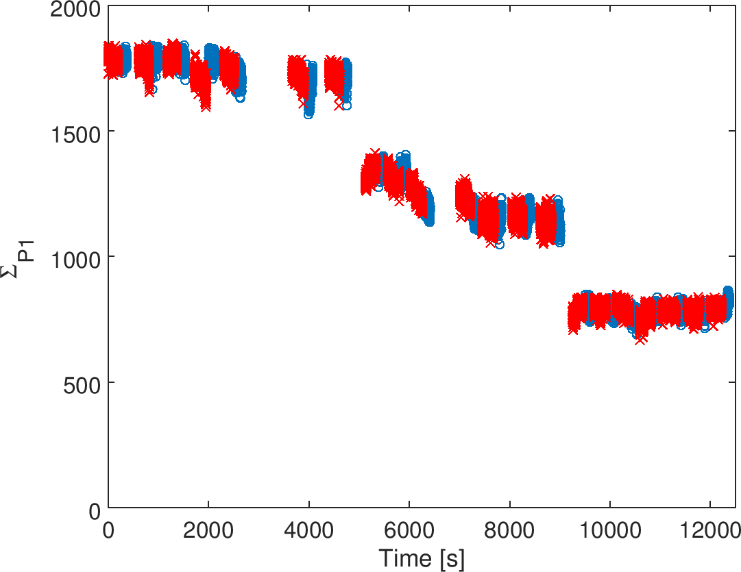
Charge as function of time
Order of settings for high charge: 40 – 50 – 60 – 70 – 30 – 20 – 10
Otherwise 10 to 70
Blue: jitter runs (400 triggers)
Red: calibration runs (-2 μm to +2 μm, 100 triggers / setting)
high charge
medium charge
low charge

Slide 5
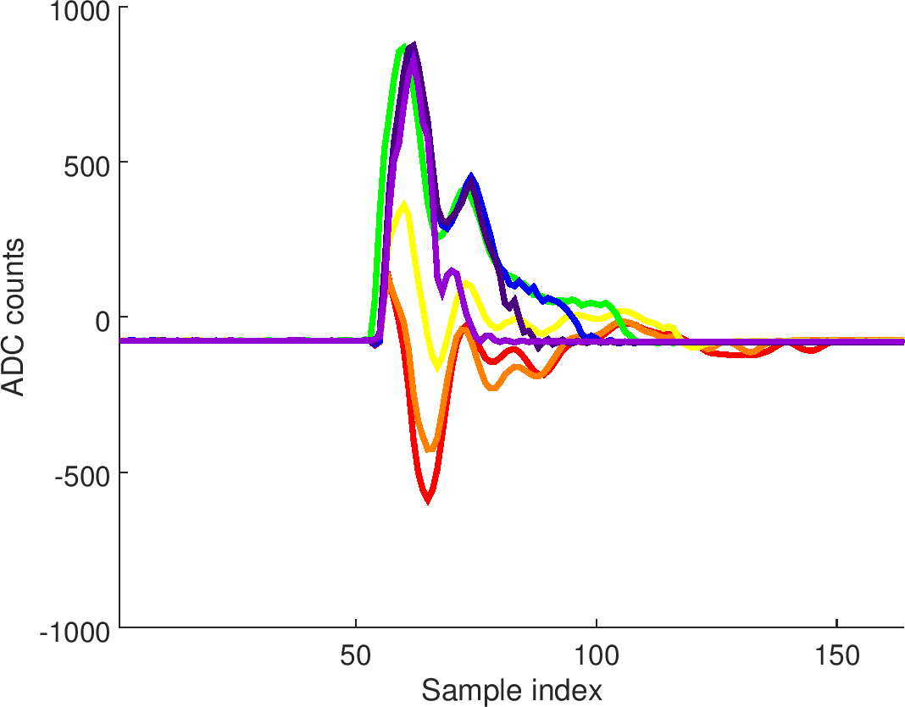
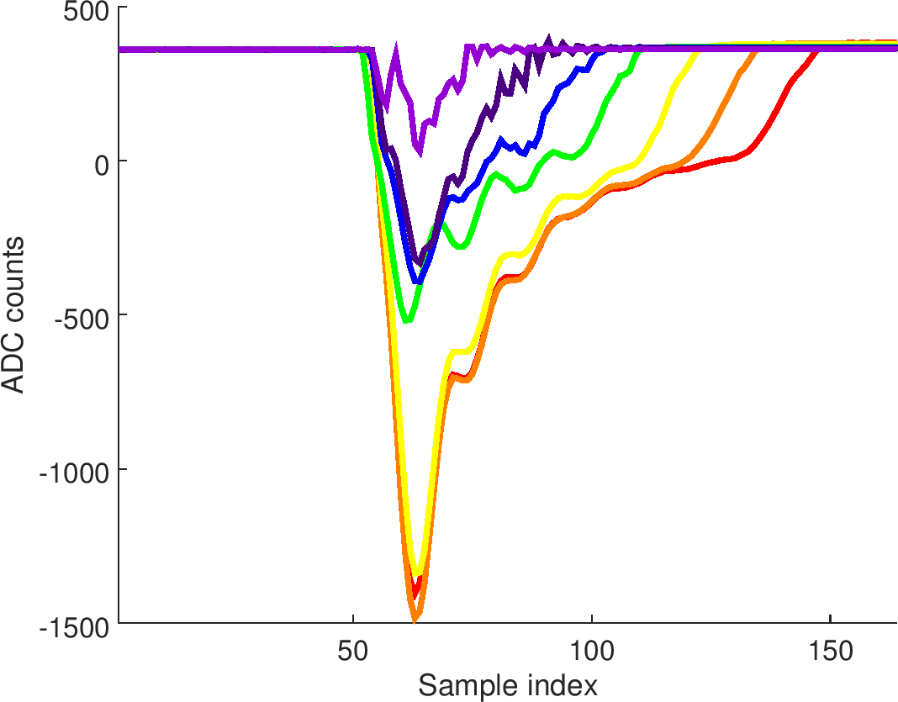
Average IPA waveforms – high charge
I
Q

Slide 6
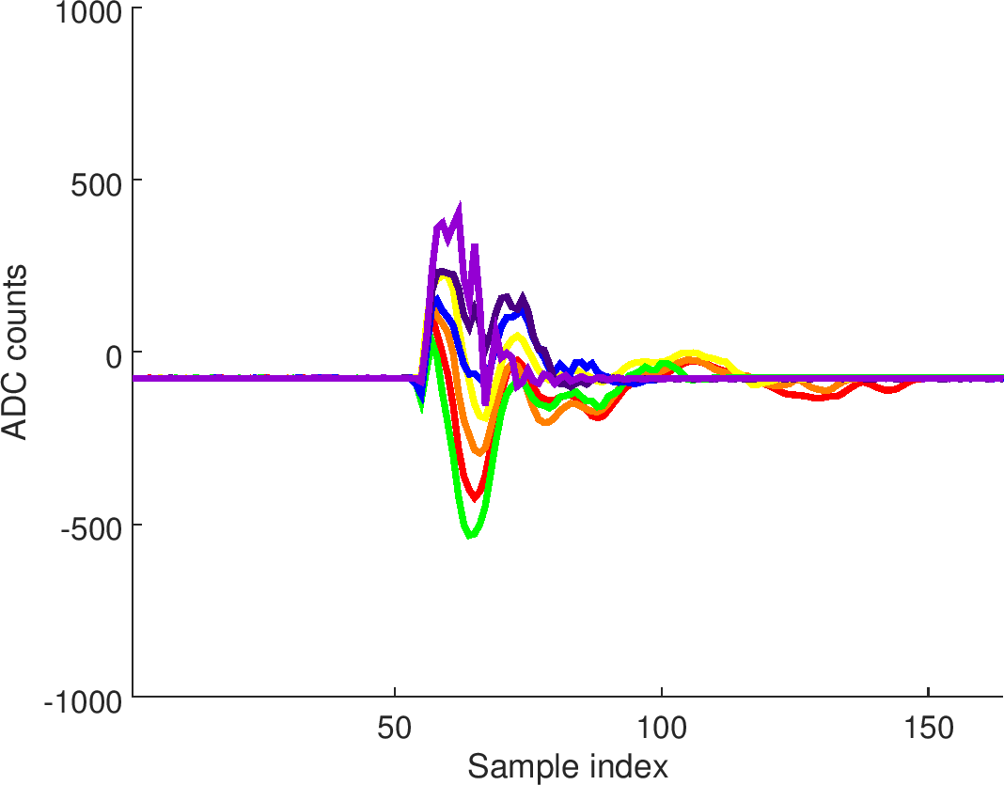
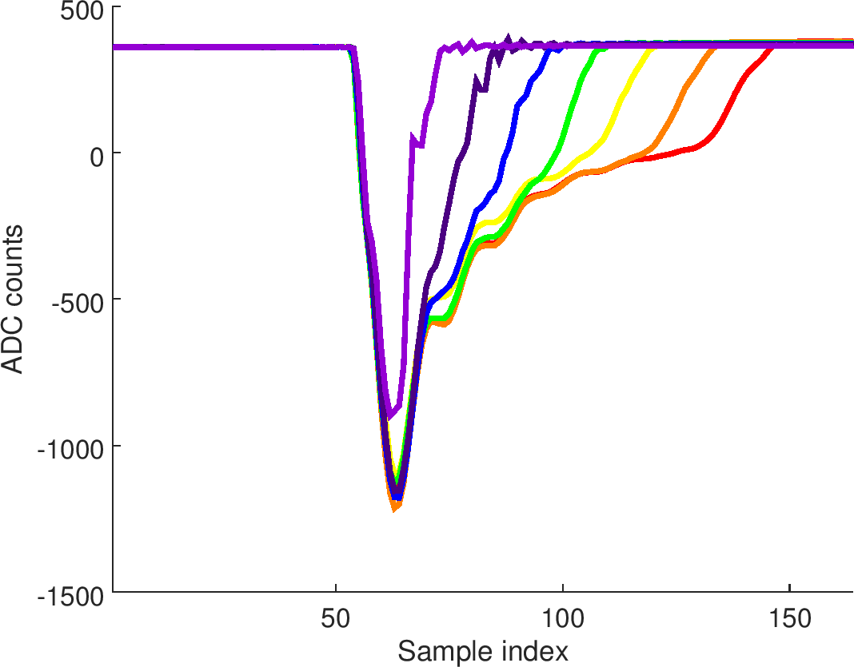
Average IPA waveforms – medium charge
I
Q

Slide 7
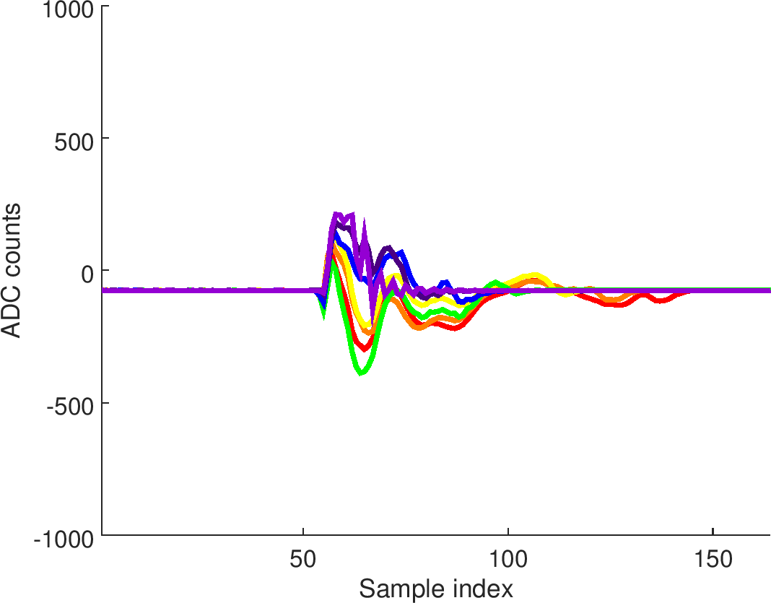
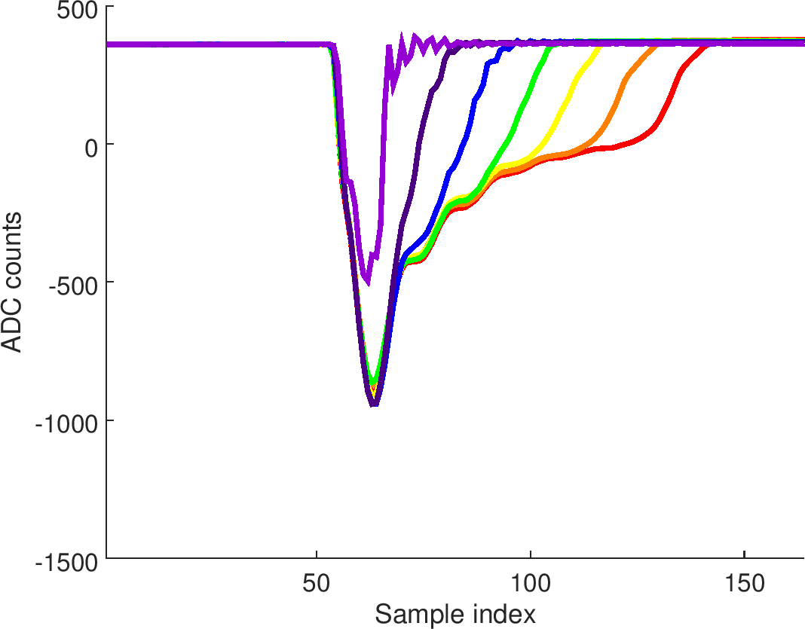
Average IPA waveforms – low charge
I
Q

Slide 8
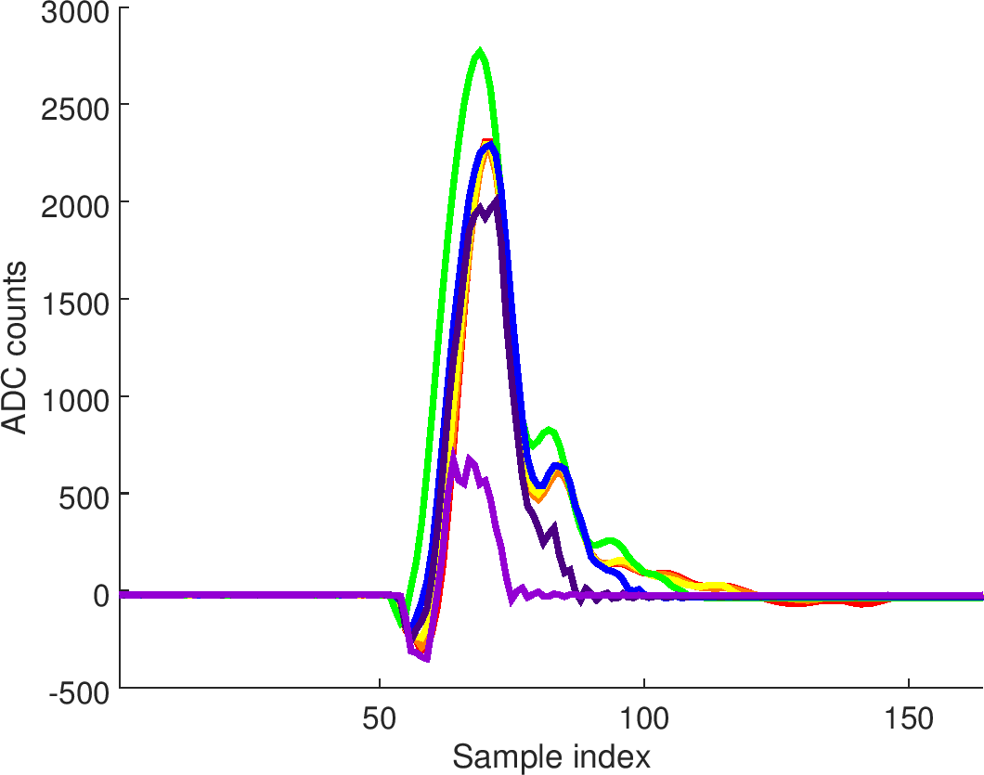
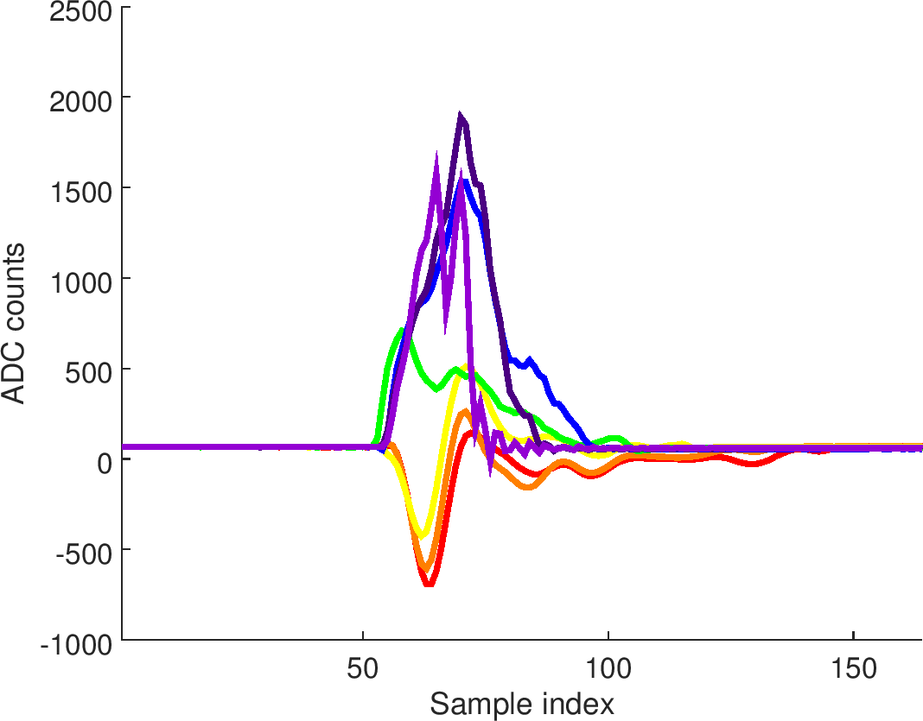
Average IPB waveforms – high charge
I
Q
I

Slide 9
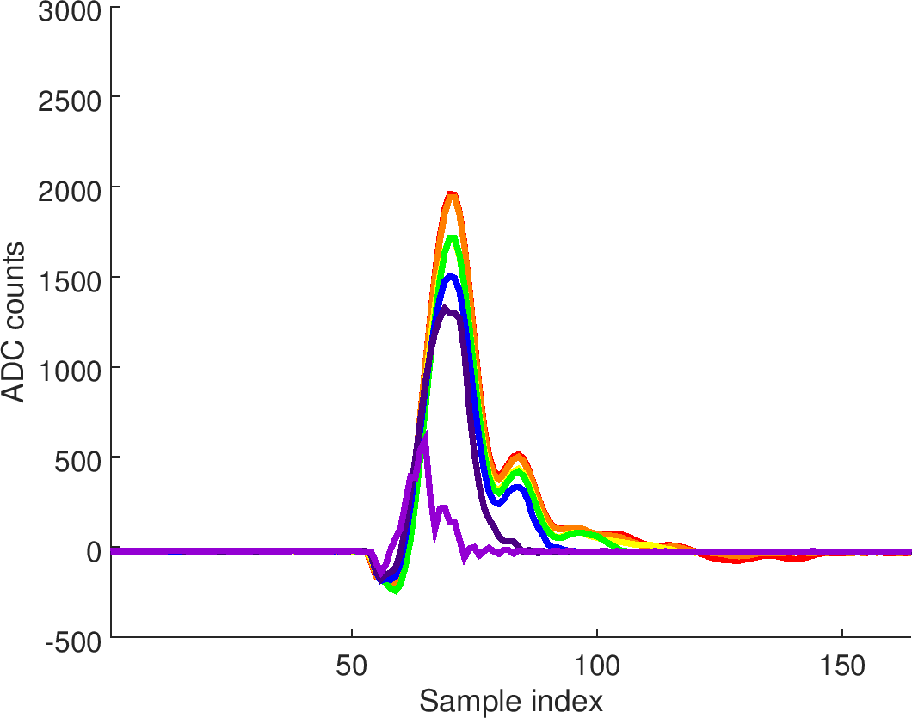
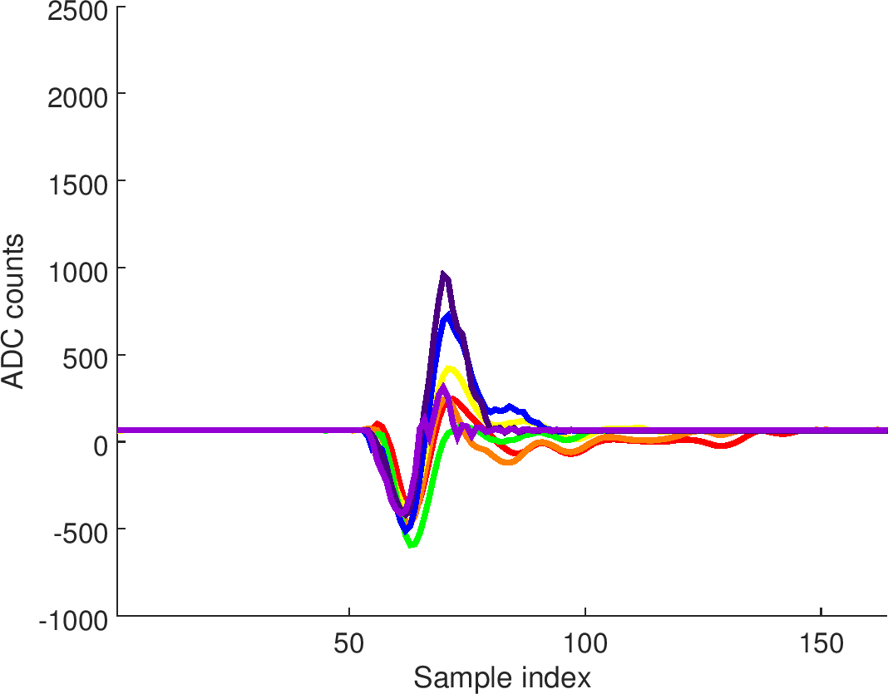
Average IPB waveforms - medium charge
I
Q

Slide 10
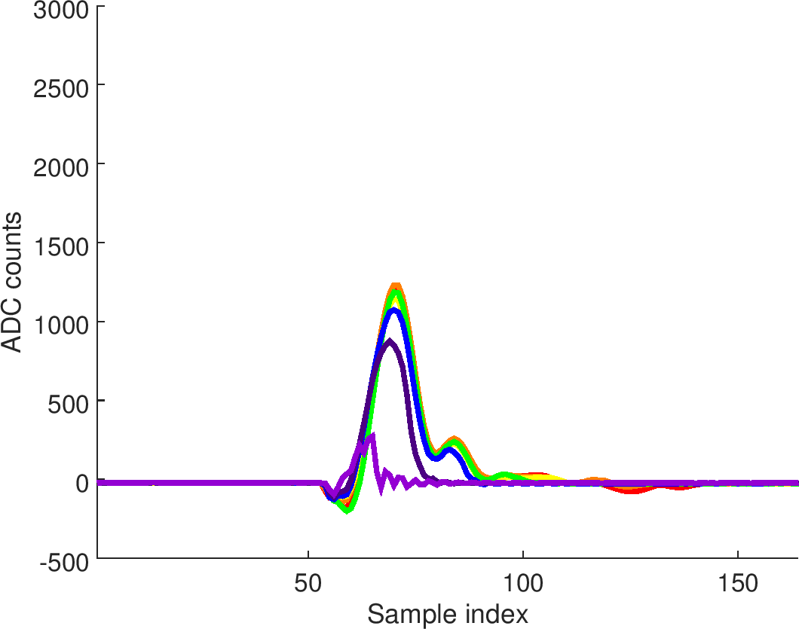
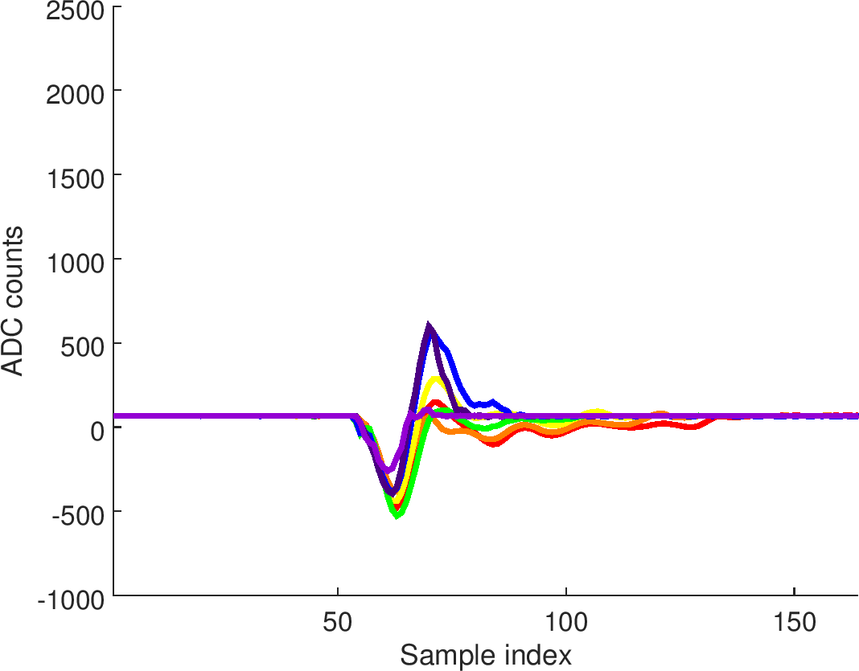
Average IPB waveforms - low charge
I
Q

Slide 11
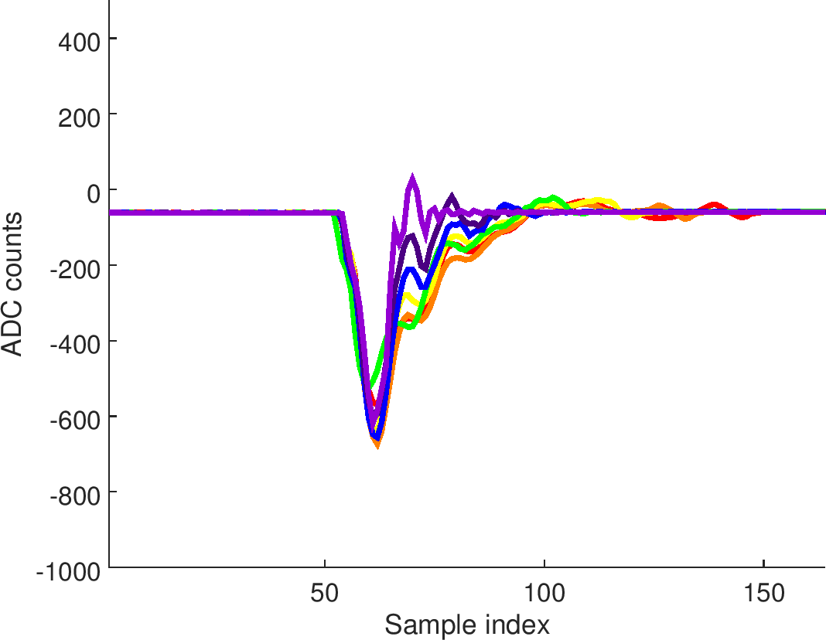
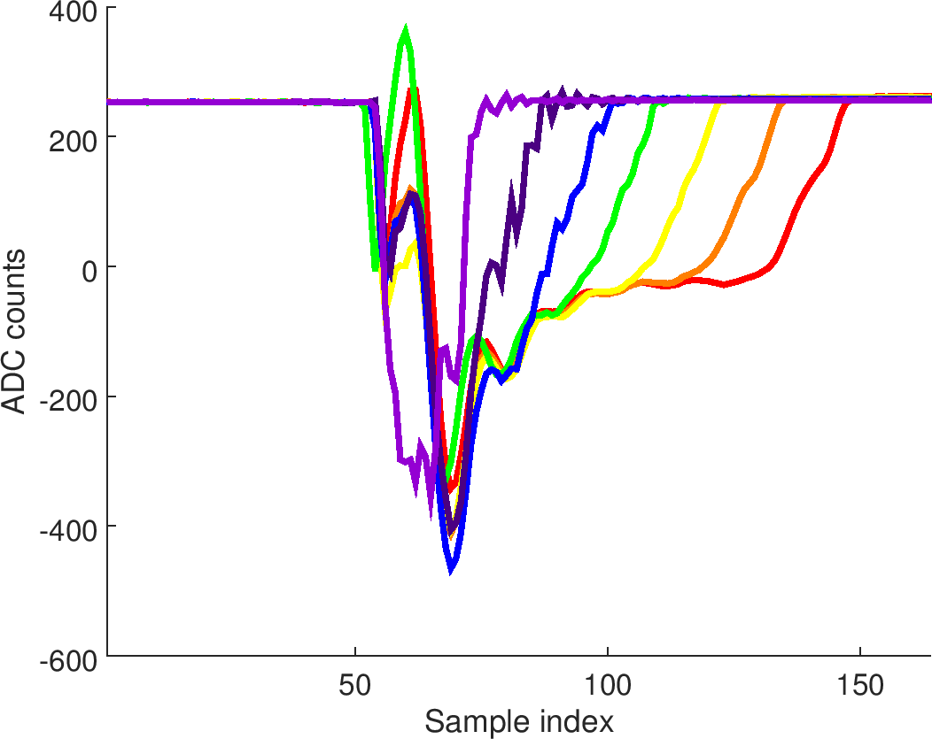
Average IPC waveforms – high charge
I
Q

Slide 12
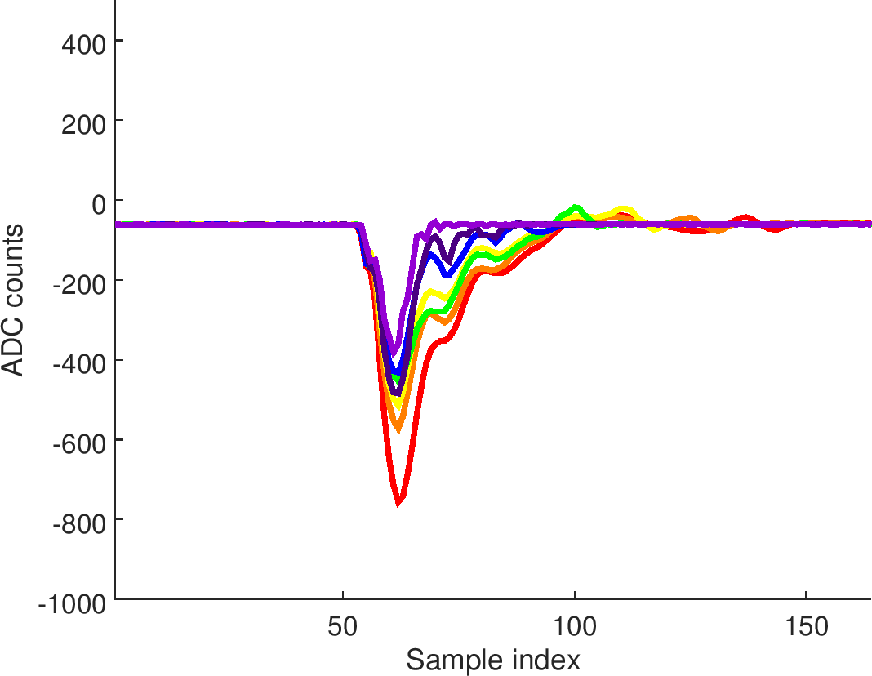
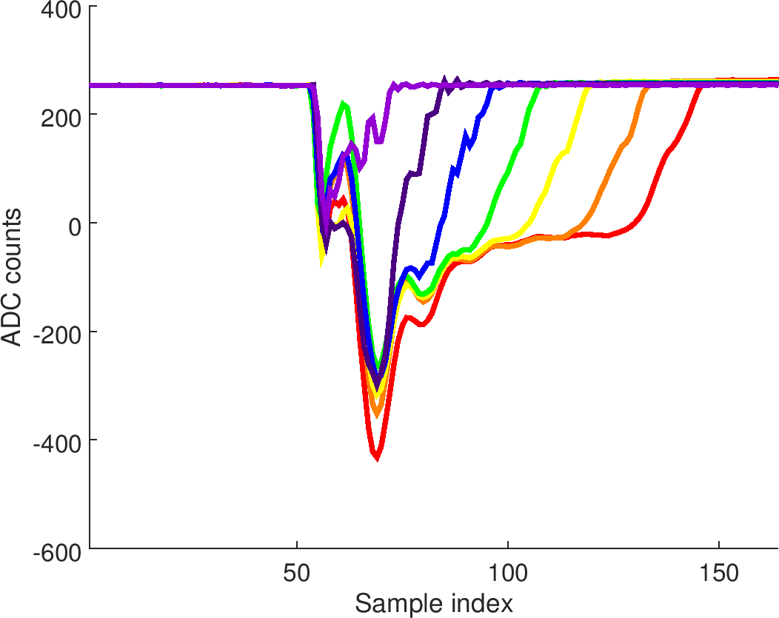
Average IPC waveforms – medium charge
I
Q

Slide 13
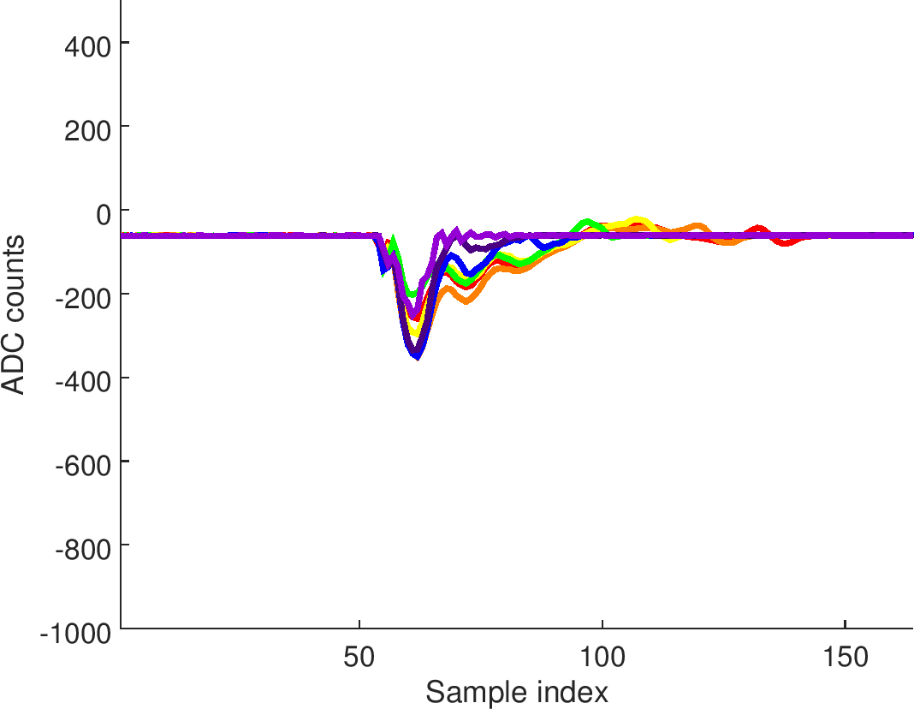
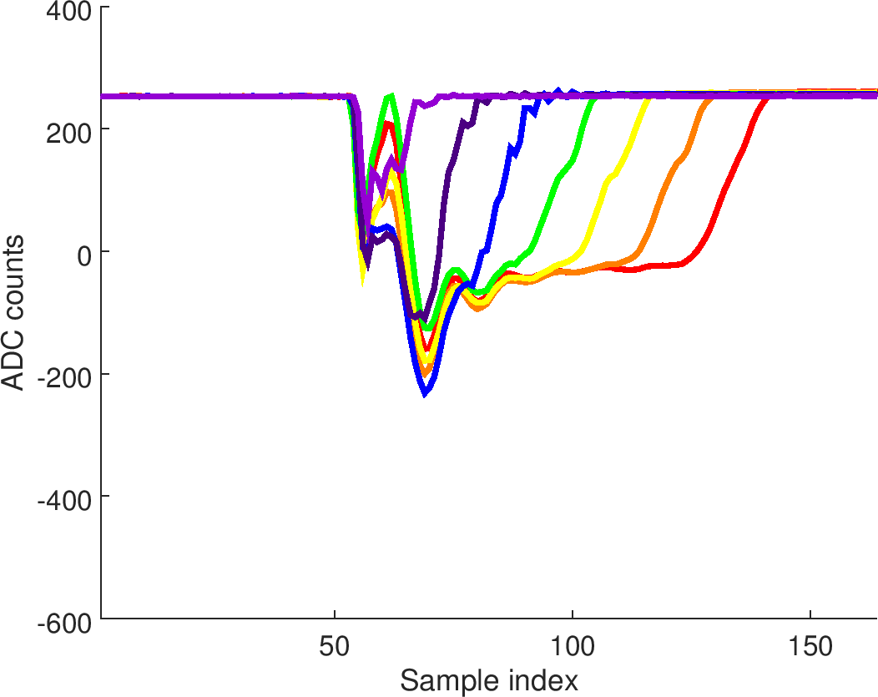
Average IPC waveforms – low charge
I
Q

Slide 14
Conclusion
Very pronounced Q baseline for IPA, IPC
Several puzzling features have to be checked but are presumably due to position drifts:
IPA-Q @ 70 dB larger for high charge than medium charge
IPB-I @ high charge larger for 40 dB than lower attenuation settings

