Slide 1
CFS design status (based on Tohoku candidate site)
TCMB 07/24/2018
H. Hayano, KEK

Slide 2
History of ILC250 Design Discussion
ILC WG2 (Staging Plan) was initiated by S. Michizono
after the discussion at LCWS2016-Morioka
Discussion of WG2 (Staging Plan for CFS) has been done
by domestic(KEK, Tohoku) and international tele-conference.
Machine mapping research on Kitakami candidate site, and site-specific CFS
design, in parallel. (by Tohoku, KEK, AAA and expert from univeristies)
(access portal location, IP location are included)
Discussion of WG2 was held at CFS@ALCW2017-SLAC
Cost review of WG2(derivation from TDR and Tohoku estimation)
at KEK Sep 26, 2017 (Lyn, Nakada, Steinar, J.Brau, Benno, etc)
Discussion of WG2 at CFS@LCWS2017-Strausburg
Discussion of ILC250 at CFS@ALCW2018-Fukuoka

Slide 3
Slide at AWLC2017(SLAC)
How to estimate the cost of each option
TDR cost
WG2
Subtract cost reduction of
2014-2016 TDR cost reduction and design change
TDR-updated cost
Decide working assumptions,
and cryomodule configuration,
tunnel configuration.
cost estimation conditions.
Subtract cost reduction of each staging option
each option cost
Estimation of cost for each staging option
in case of 31.5MV/m
Subtract cost reduction by change of 31.5MV/m to 35MV/m, assuming success of 35MV/m Q₀=1.6x10¹⁰ SRF HG,HQ
WG3
decrease of RF unit,
Nb material cost reduction,
surface process cost-reduction,
cryogenics cost reduction,
HLRF cost-increase, etc
each option cost with HG HQ success
35MV/m
Estimation of cost for each staging option
in case of 35MV/m

Slide 4
Slide at AWLC2017(SLAC)
Working assumption (1)
(1) Considering collision timing adjustment, condition must keep in any option,
option C = remove length between PM+10 and PM+12,
and remove TDR timing adjustment,
and adjust to n=6
option D = adjust to n=10, it is option C + simple tunnel of 6477m (total).
option D’ =adjust to n=8, it is option C + simple tunnel of 3238m (total).
In TDR(Ecm=500GeV), this equation is not satisfied as follows ( additional 294m exist);
collision condition
C_{DR}=3238.68m
Change Request is to adopt n=10;
( L₁ + L₂ + L₃ ) – L₄ = n x C_{DR}
(L₁ + L₂ + L₃’) - L₄ = 10 x C_{DR}
n=integer
with putting 1473m space
in both LINAC (updated TDR)
e⁺

Slide 5
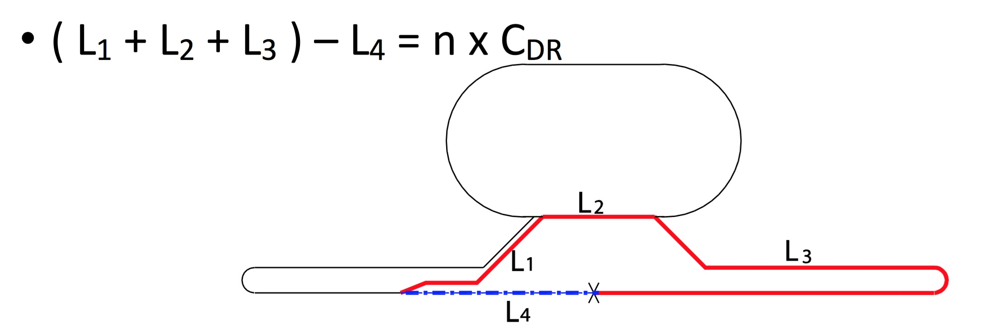
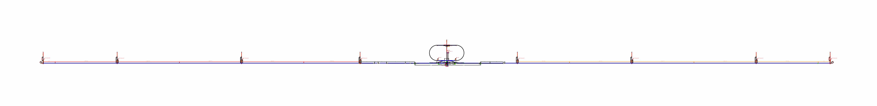
Slide at AWLC2017(SLAC)
In Option-C(Ecm=250GeV), required Linac length become half, then we can adopt n=6
Shortning the e⁺ LINAC length is possible
as a unit of C_{DR} /2 = 1619.34m.
Keep the same length of e⁻ LINAC
for the symmetric collision energy.
remove 1367.74m
at BDS entrance
(timing adjustment)
remove 202.02m at end of Linac area.
remove L _{(PM+10 – PM+12)} = 4907.8m
( -1367.74m - 4907.8m - 202.02m) x 2 = -12955.12m = - 4 x C_{DR}
L₃ is shortened by 4 x C_{DR} , it means LINAC length is shortened by 6477.56m
1264m
1375m
4907.8m
4911.6m
3413.8m
2334.9m
4795.2m
4907.8m
1375m
1264m
PM-13
PM-12
PM-10
PM-8
PM+8
PM+10
PM+12
PM+13
put 1473m
by change Request
TDR
put 1473m
by change Request
n=10

Slide 6
Slide at AWLC2017(SLAC)
Working assumption (2)
(2) Keep Energy Reach Margin enough safe to reach target energy (250GeV).
for enough positron production and meaningful energy reach of Higgs physics
(1) Module margin : margin to reach the target energy of the target experiment (0% in TDR)
2.5% module margin(3.1GeV each) for Ecm=250GeV
(2) Availability margin : margin to compensate cryomodule trip (1.5% in TDR, ~3 RF unit trip )
3 RF unit margin correspond to 3% for Ecm=250GeV
(3) Space margin : cryomodule space to be installed more cryomodule in future.
*Anytime 0.5% is required in the operation with cavity phase offset.
Total margin: 1.5%+ 0.5% = 2% for TDR Ecm=500GeV
2.5% + 3% + 0.5% = 6% for Ecm=250GeV, Option C
(3) In case of HG,HQ R&D success;
HG HQ upgrade :from 31.5MV/m Q0=1E10 → 35MV/m Q0=1.6E10 by N-infusion.
Same RF unit configuration, but increase of klystron output to 11MW, 1.75ms.
Consider decrease of number of RF unit for 35MV/m.
The length of tunnel is kept the same as 31.5MV/m.

Slide 7
Slide at AWLC2017(SLAC)
Working assumption (3)
(4) Only 5Hz Linac operation is considered (not 10Hz).
(5) Maximum cryo-line length of one cryogenics is 2.5km+/-10%, the same as TDR.
This determines the interval of the access point, such as PM+/-8, PM+/-10, PM+/-12
(6) Adopt CR0009 and CR0014 for cryogenics. The access hall is re-considered
with this design change. Angle cross with Linac tunnel and access tunnel
for cryomodule carry in, is considered.
(7) Linac central shield wall is 1.5m thick. Total width of Linac tunnel is 9.5m.
(8) Two Vertical shaft access to detector hall is assumed.
(9) Design change of positron side BDS tunnel and injector-linac position are adopted.
(10) Number of beam dump and power of them proposed by Yokoya are adopted.

Slide 8
Slide at AWLC2017(SLAC)
Working assumption (4)
(11) TDR-undulator-based positron is kept in this study.
The length of undulator is streched to 230m from 147m with 125GeV beam.
This determines energy sensitivity of positron production
(12) Remove access tunnels at turn-around (PM-13 and PM+13) of TDR tunnel,
not for staging tunnel.
(13) One water-drain-tunnel is considered in the collision point, not at PM-13/PM+13.
(14) Simple tunnel means: normal wall finish, but no central shield wall,
no AC power line, no cooling water line,
however air-condition, lighting and water drain are installed.
(15) Digging tunnel during accelerator operation without serious interference.
(16) Keep the Damping Ring circumference. No design change for DR.
This determines the requirement of collision timing condition.

Slide 9
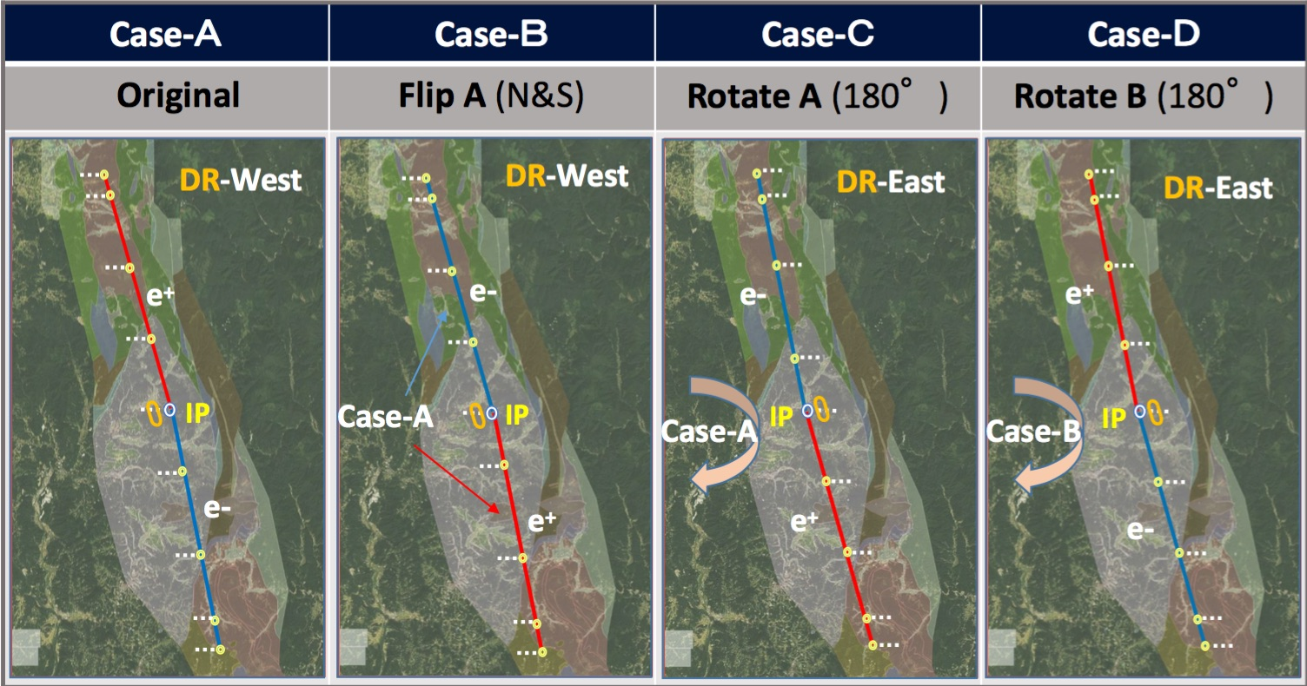
Tunnel Optimization Tool development (1)
TOT(Tunnel Optimization Tool): CERN-KEK-ARUP development during 2015-2016
(originally developed for FCC)
Layout of accelerator tunnel into detailed geology & topography map
(1) optimize accelerator layout
(2) search access tunnel portal location
Slide from KEK internal review March2017
example of accelerator layout

Slide 10
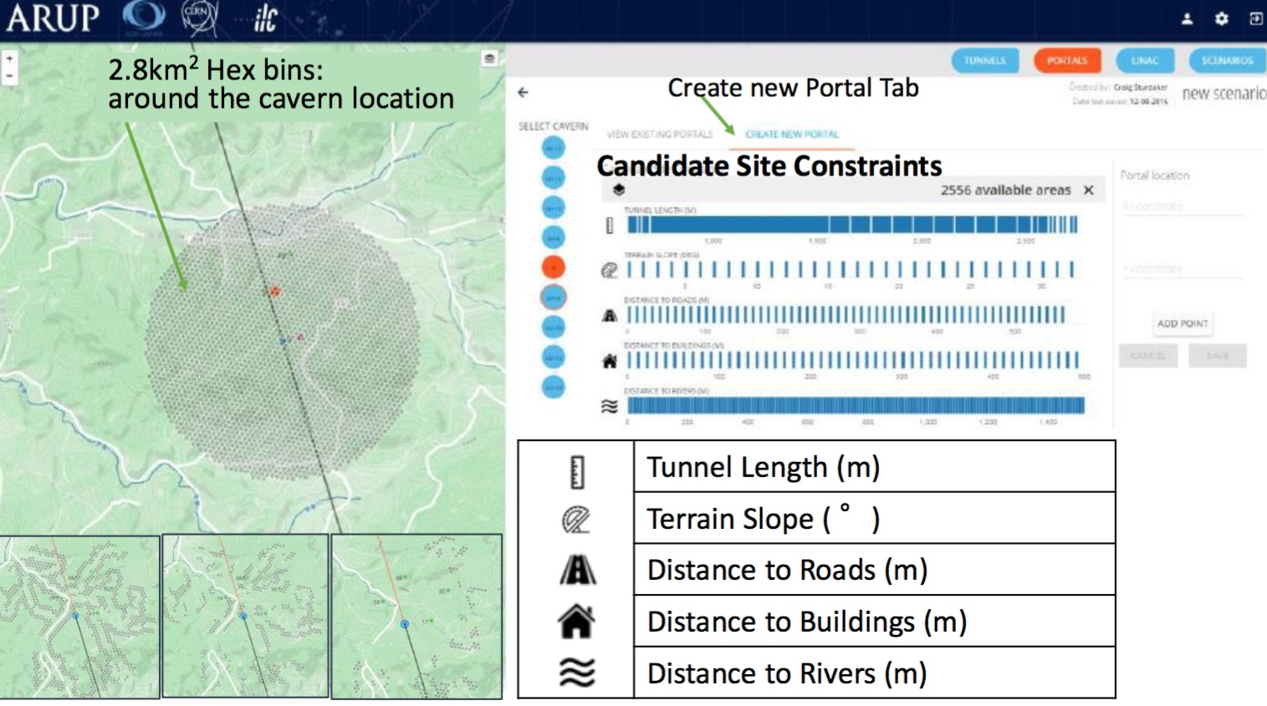
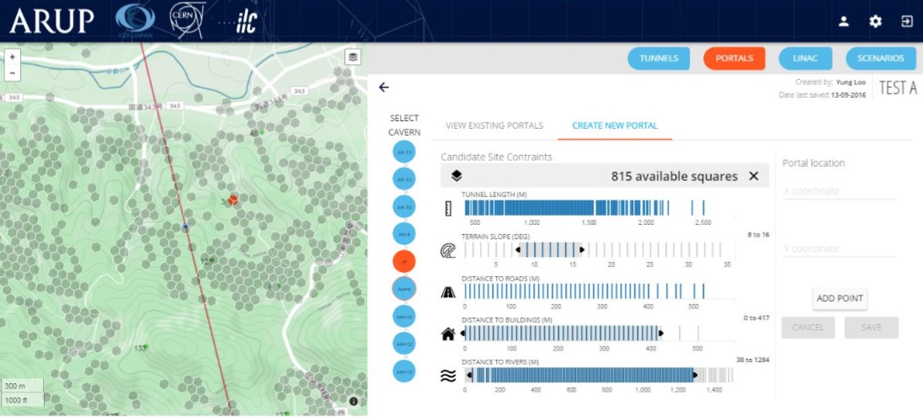
Tunnel Optimization Tool development (2)
Slide from KEK internal review March2017

Slide 11
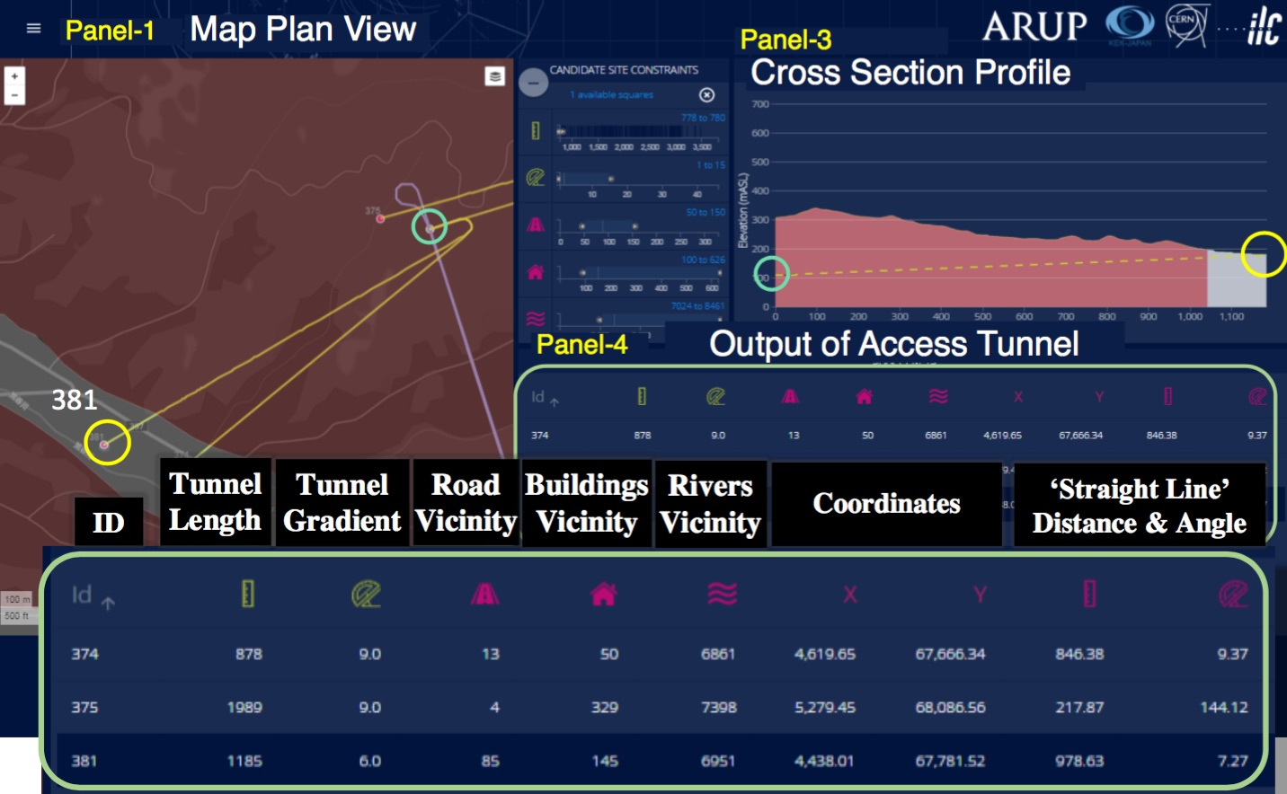
Tunnel Optimization Tool development (3)
Slide from KEK internal review March2017

Slide 12


Most updated ILC250 Design was reported in AWLC2018 Fukuoka

Slide 13
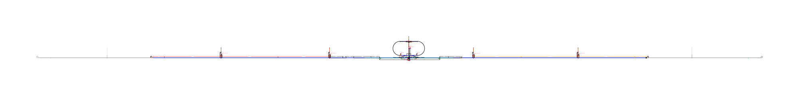
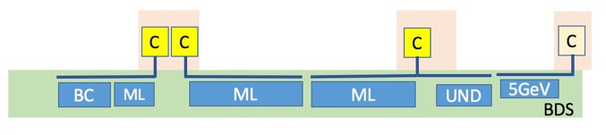
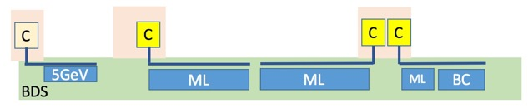
Slide at AWLC2018(Fukuoka)
Option A’
ECM=250GeV
SRF 35MV/m
2437.58m
4950.26m
3489.0m
2361.46m
4795.2m
2516m
PM-12
PM-10
PM-8
PM+8
PM+10
PM+12
1049m space
1049m space
module space margin
for option A’, 35MV/m
module space margin
for option A’, 35MV/m
IR
BC
Ecm=250GeV
BC
e+inj
e-inj
51
90
189
189
24
module space
24
180
189
90
51
51
4.5
189
189
24
cryomodules
24
180
189
4.5
51
17
1
42
42
8
RF unit
8
40
42
1
17
e⁻ 135.6GeV =
10.0
1.4
59.6
59.6
5.0
E gain (GeV)
5.0
56.7
59.6
1.4
10.0
= e⁺ 132.7GeV
+6.2%margin
Total tunnel length = 20549.5m
(20.5km)

Slide 14
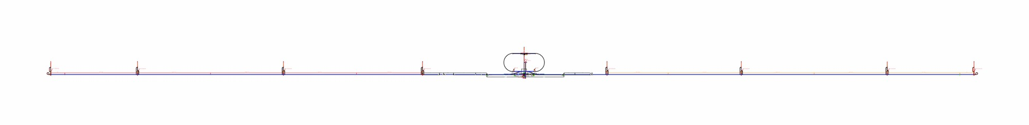
Slide at AWLC2018(Fukuoka)
Acc. length manipulation from TDR Recent Optics Deck
Ecm = 500GeV
timing path length is matched with n=10
Total length of TDR accelerator = 17266.9m+16149.9m=33417m
2639.6m
4907.8m
6318m
3401.5m
3729.2m
4795.1m
4907.6m
2718m
PM-13
PM-12
PM-10
PM-X
PM+8
PM+10
PM+12
PM+13
1264m
1375.6m
IP
1454m
1264m
remove this length
for option-A
delta-L = -4907.6m
Option A’ with n=6
3401.5m + 87.5m = 3489m
2718m – 404.04m/2
=2516m
Vertical bend
Timing adjust
remove TDR timing adjust
6318m – 1367.74m = 4950.26m
(2015 Okugi BDS) + 87.5m = 2361.46m
2639.6m
– 404.04m/2
=2437.48m
Vertical bend
delta-L = -1367.74m
remove this length for option-A
delta-L = -4907.6m
remove TDR timing adjust
Timing adjust
collision condition
( L₁ + L₂ + L₃ ) – L₄ = n x C_{DR}
( L₁ + L₂ + L₃ ) – L₄ =(L₁’+87.5)+L₂+(L₃’-1367.74x2-4907.6x2 -X) – (L₄’+87.5)
=(L₁’+L₂+L₃’)-L₄’ -( 12550.68m +X)
=10 x C_{DR} - 4 x C_{DR}
= 6 x C_{DR}
C_{DR}=3238.68m
4 x C_{DR}=4 x 3238.68m = 12550.68m + X
X = 404.04 m
Timing adjust

Slide 15
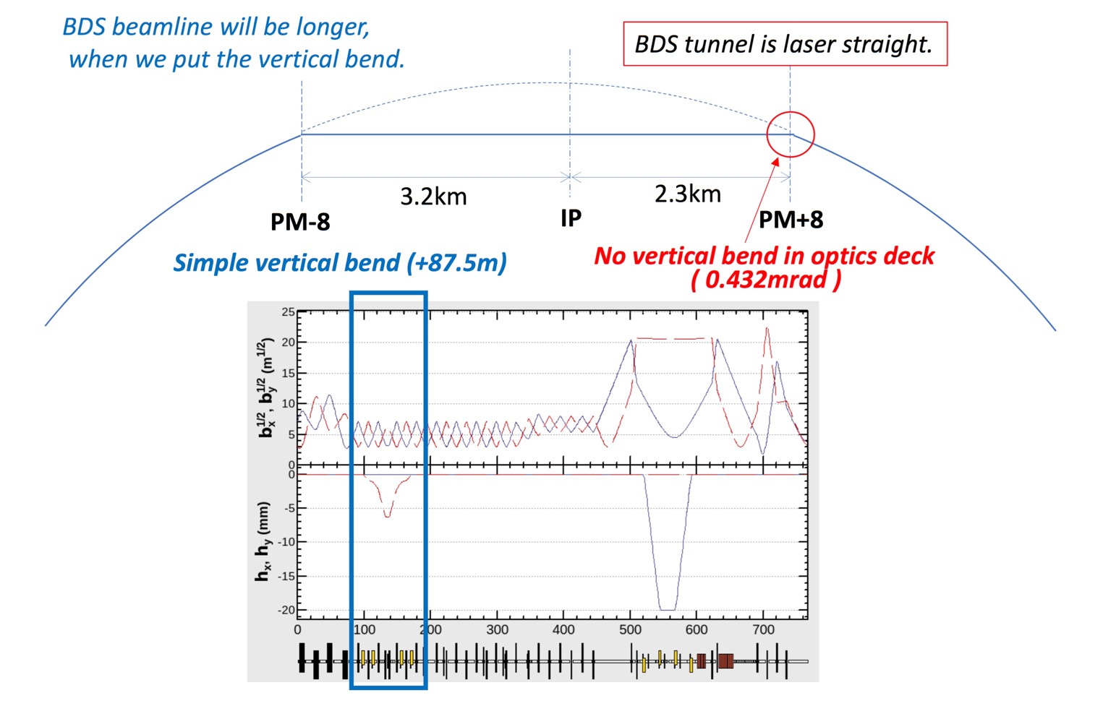
Slide at AWLC2018(Fukuoka)
Keep BDS tunnel length as TDR, but put verical bend 87.5m on both entrance of BDS
There is no vertical bend in the optics deck.

Slide 16
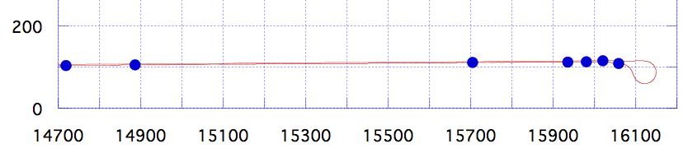
Slide at AWLC2018(Fukuoka)
e+ Main Linac end region details
PM+12
TURN
←ML
LAUNCH
BC2
BC1
EMIT
SPIN
TDR
e+ ML
LAUNCH
BC2
BC1
^{emit}
spin rotator
turn around
167.6m
818.6m
230.6m
77.8m
1454m
1264m
45.1m
~92m
This is the same length for e- side and e+ side
Option A’
1049m
e+ ML
Open space
LAUNCH
BC2
BC1
^{emit}
spin rotator
turn around
1252m
1264m
PM+10
This is the same length for e- side and e+ side

Slide 17
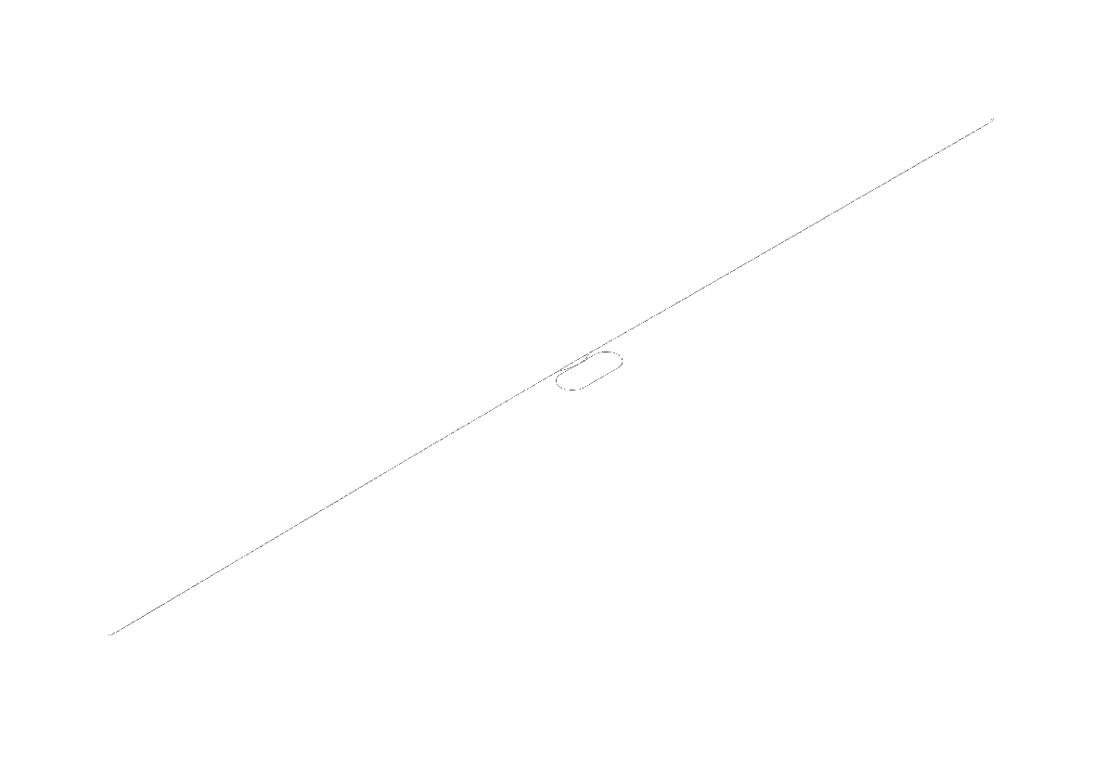
Slide at AWLC2018(Fukuoka)
Accelerator
Option A, A’
Total Accelerator tunnel length
= 20,549.5m (20.5km)
Positron Linac
20.5km
IP
Damping Ring
North
Electron Linac

Slide 18
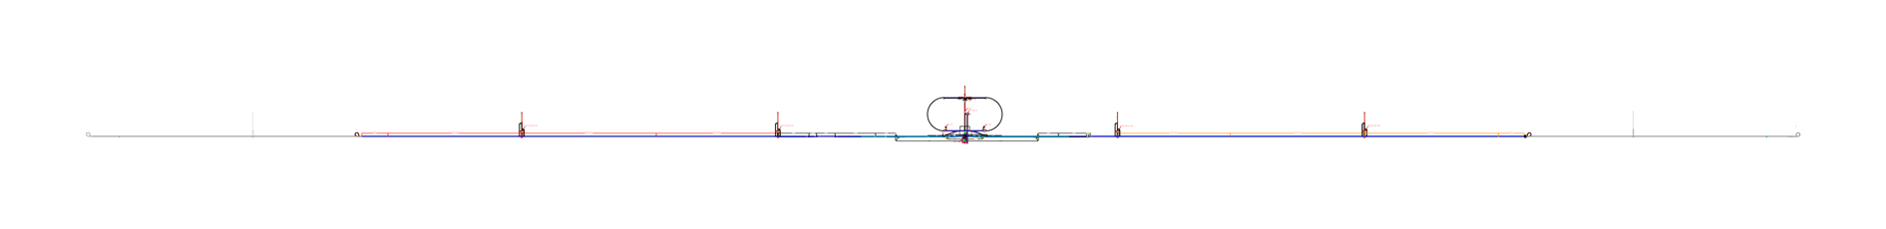
Slide at AWLC2018(Fukuoka)
Option A, A’
Access Tunnels
PM-10
Site-specific design of
Access tunnels
AT-10： 1503m
electron linac
PM-8
Total Accelerator tunnel length
= 20,549.5m (20.5km)
AT-8： 691m
AT・DR (access point to DR)：763m
AT・DH (branch to detector hall)：693m
Interaction Region
damping
ring
AT+8： 283m
PM+8
AT+10： 943m
positron linac
access tunnels 5
total length 4876m
Detector shaft 1
φ18m depth 75m
Utility shaft 1
φ10m depth 75m
PM+10

Slide 19
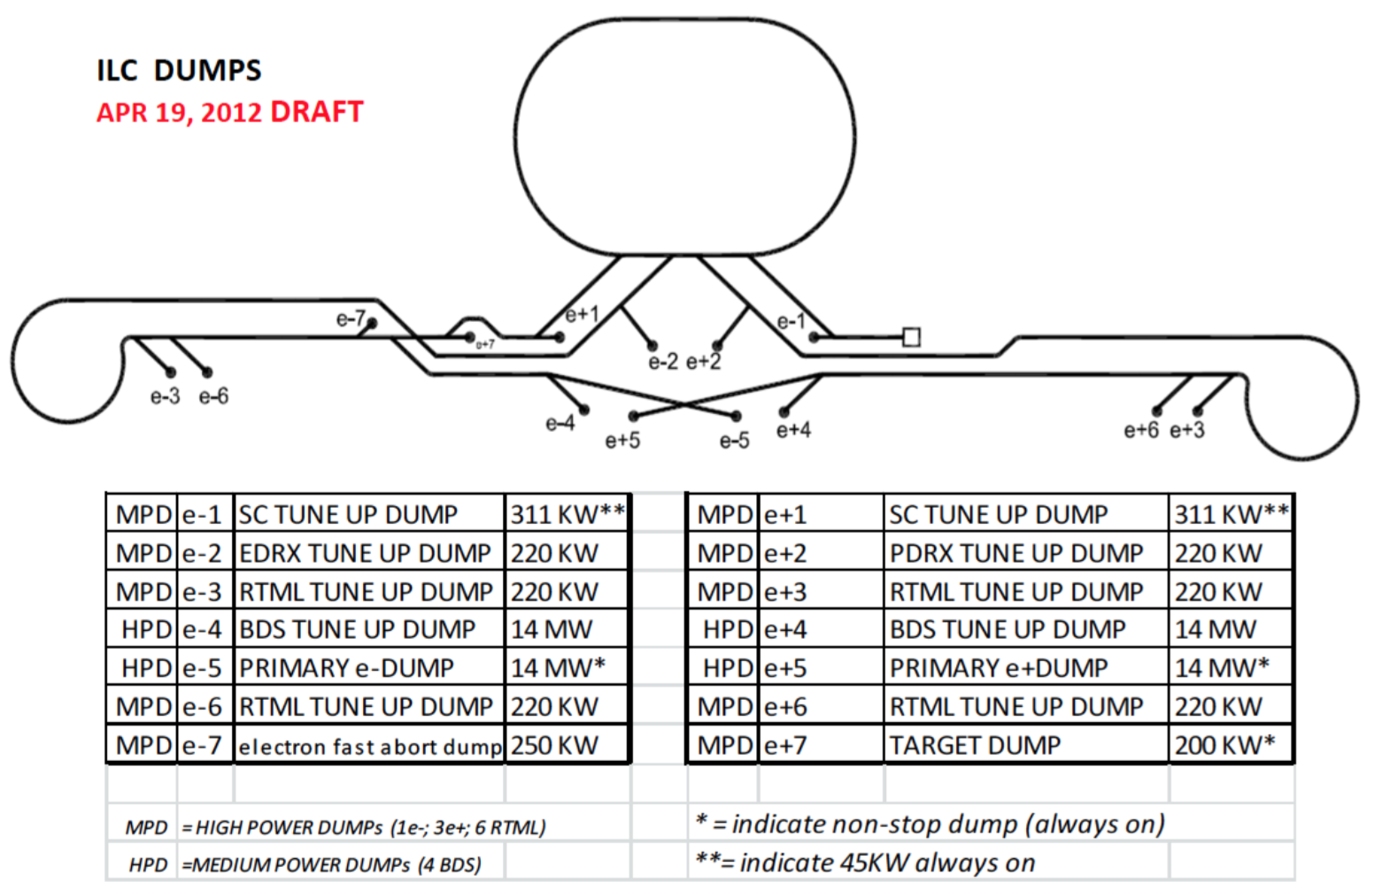
Slide at AWLC2018(Fukuoka)
Beam Dump
Change Request on beam dump in 2016
was approved.
ILC-CR-0013 (Beam dump)
60kW
60kW
60kW
60kW
60kW
60kW
400kW
400kW
17MW
17MW
60kW
60kW
60kW
300kW
e-8 electron 10Hz dump
8MW

Slide 20
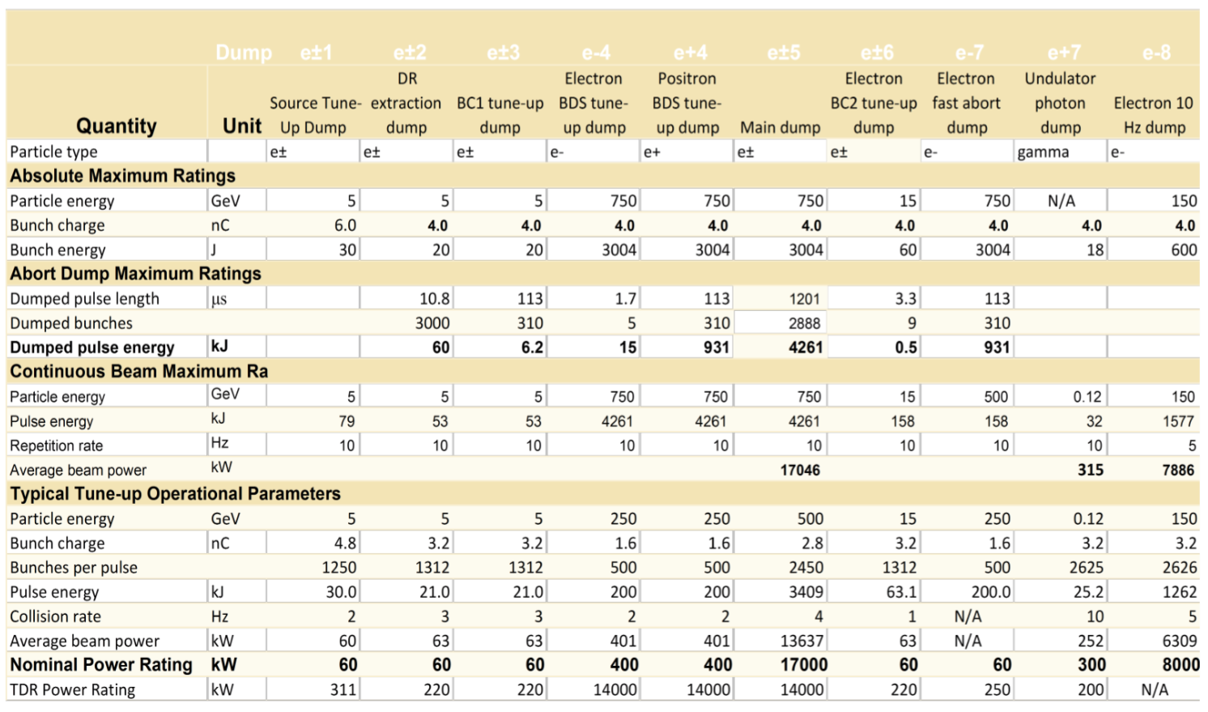
ILC-CR-0013 (Beam dump)
Slide at AWLC2018(Fukuoka)

Slide 21
Slide at AWLC2018(Fukuoka)
Kitakami Site-specific design
BDS
tuneup
Main dump
Main dump
10Hz
dump
BDS tuneup
BC2 tuneup
BC1 tuneup
BC2 tuneup
Fast abort
BC1 tuneup
Source
tuneup
Photon
dump
Source
tuneup
DR extraction
DR extraction
North
South

Slide 22
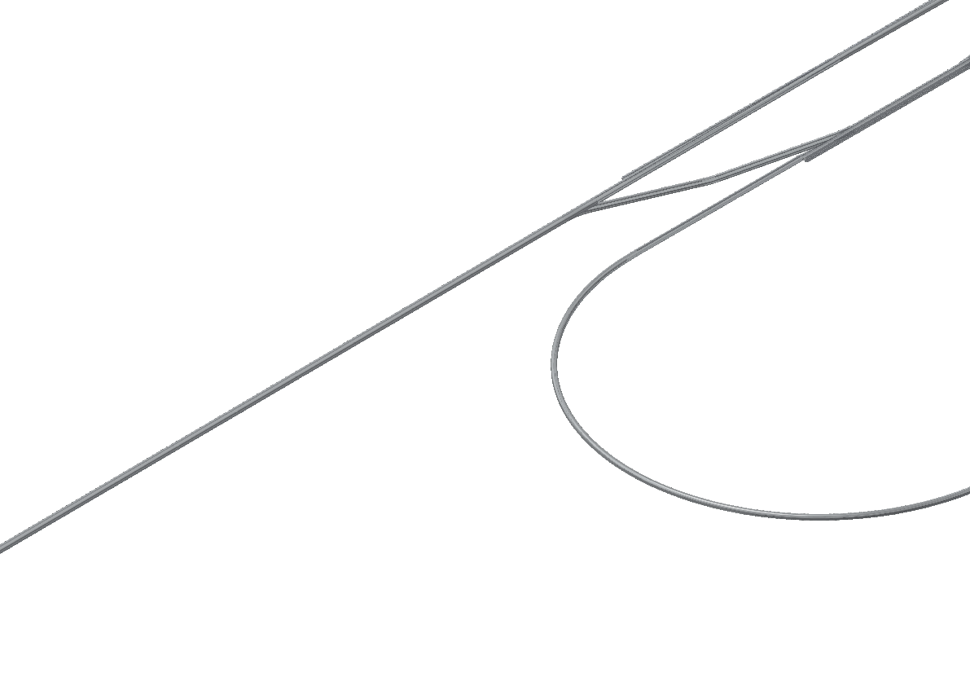
Slide at AWLC2018(Fukuoka)
We need dump hausing design.
Photon
dump
e⁺ Main dump
10Hz e⁻ dump
DR e⁻ extraction dump
Source tuneup
dump
e⁺ Target
Fast abort dump
e⁻ BDS tuneup dump
Position not scale

Slide 23
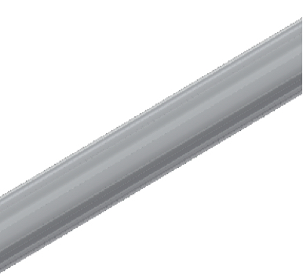
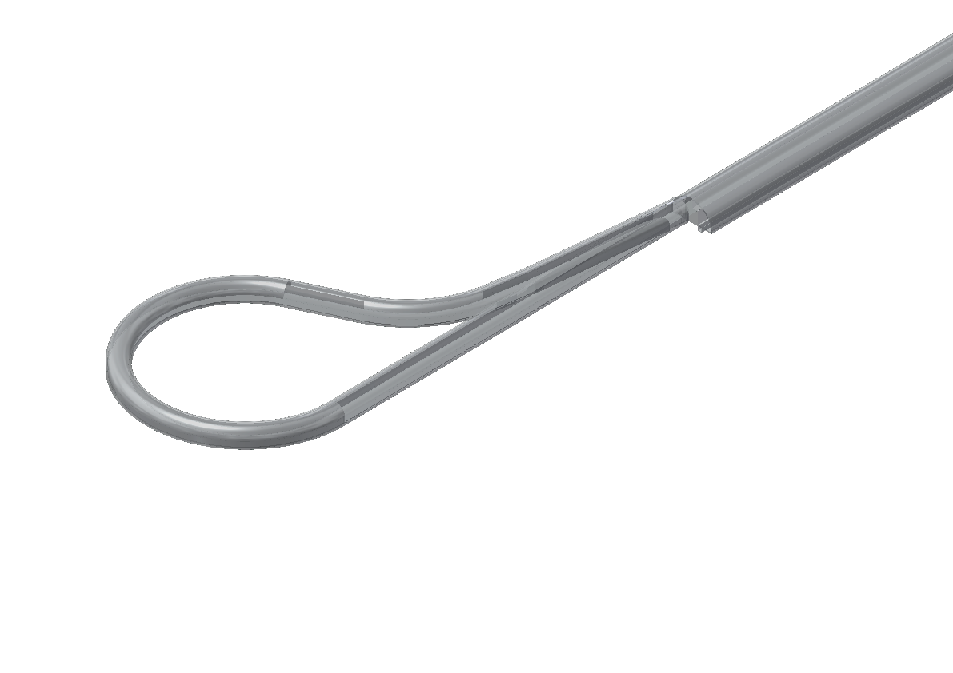
Slide at AWLC2018(Fukuoka)
e⁻ BC2 tuneup dump
We need dump hausing design.
e⁻ BC1 tuneup dump
Electron turn around
Position not scale

Slide 24
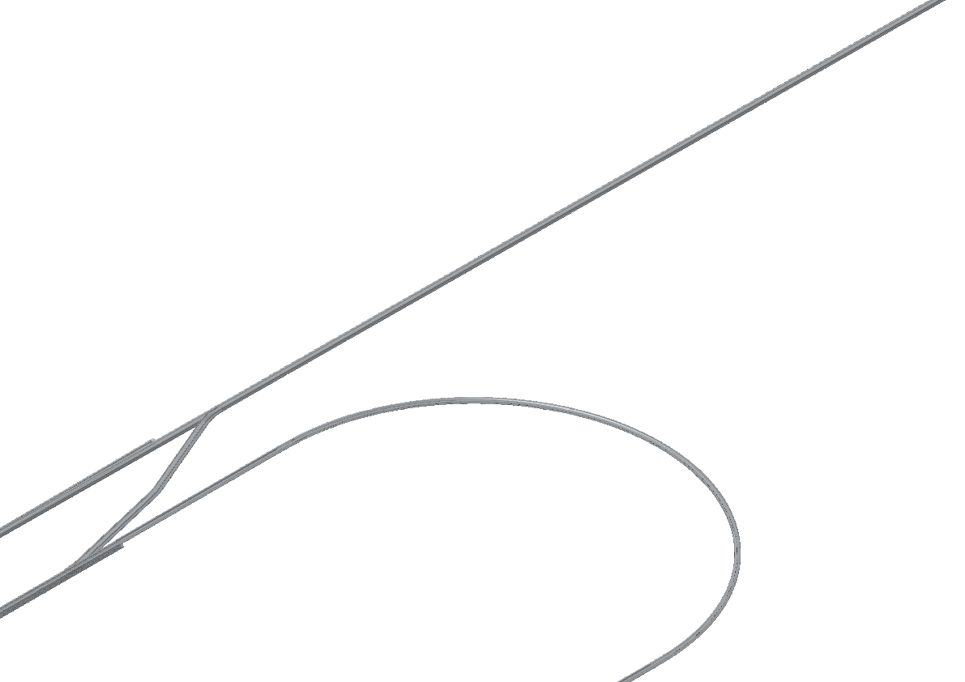
Slide at AWLC2018(Fukuoka)
We need dump hausing design.
e⁺ BDS tuneup dump
e⁻ Source tuneup
dump
e⁻ Main dump
DR e⁺ extraction dump
Position not scale

Slide 25
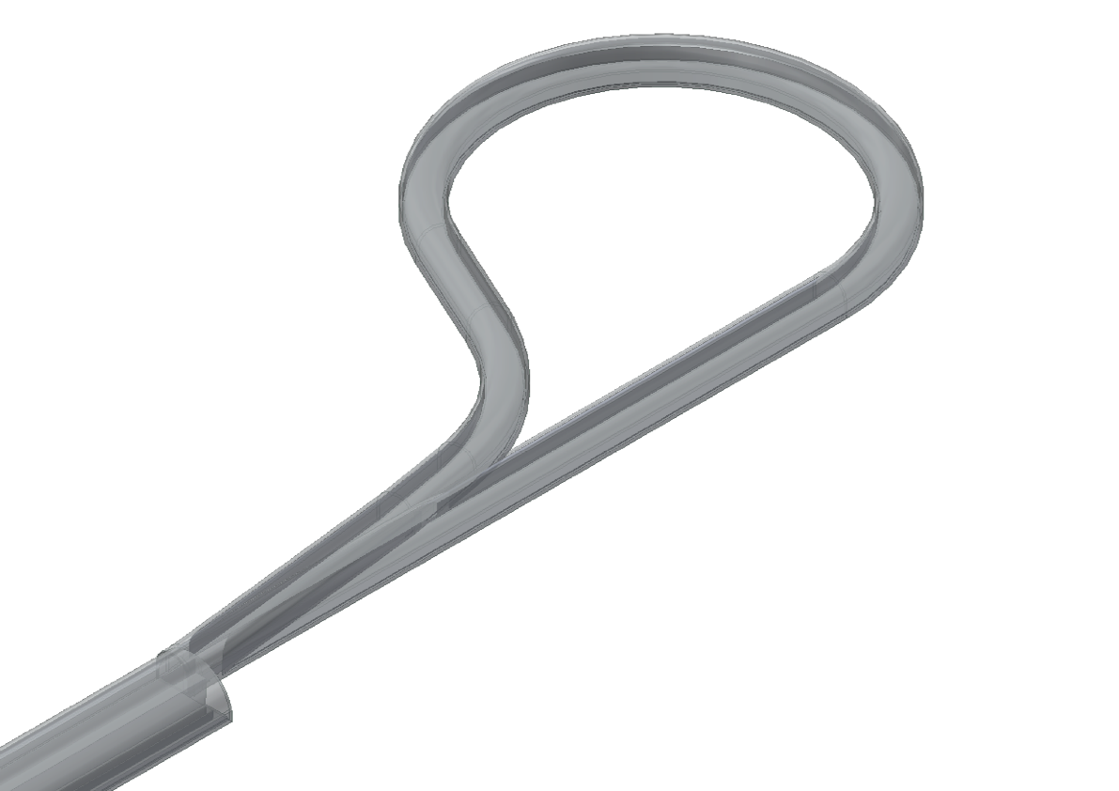
Slide at AWLC2018(Fukuoka)
We need dump hausing design.
Positron turn around
e⁺ BC1 tuneup dump
e⁺ BC2 tuneup dump
Position not scale

Slide 26
End of Slide

