Slide 1
Works for the CFS detailed design
Nobuhiro Terunuma, KEK
July 24, 2018, TCMB meeting

Slide 2
We presented the CFS timeline on “Pre- and Preparation Phase” in ALCW2018, Fukuoka.
It assumes followings.
  Positive signal by government in this year
  It will initiate the process of funding in 2019 for preparation phase.
  Then, 4-years preparation phase will start in 2020.
  Ground Breaking in 2024

Slide 3
4-years preparation phase (mid-2020 to mid-2024)
  It should be a detailed design phase of CFS to realize the ground breaking in 2024.
  Establish the construction ready documents by CFS engineer consultants.
Pre-preparation phase
  CFS Basic-Design documents as the inputs for the detailed design should be finalized by mid-2020.
  For all the sections, summarize the drawings of the basic cross section, beam line and power supply arrangement and required specifications.
  Requirements from accelerator and detector, should be prepared by mid-2019 for the Basic-design documentation.

Slide 4
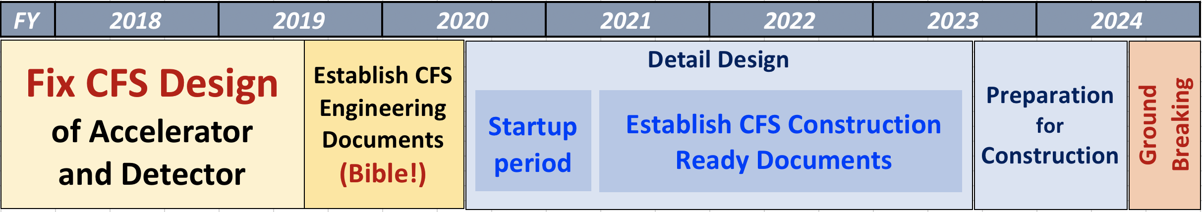
CFS timeline on “Pre- and Preparation Phase”
Our possible contribution
minor correction only
Basic Design linked to CFS should be fixed.
(B) Selection of
Positron Source
Scheme
Accelerator layout
  beamline
Requirement of Utilities
  specification and route
power supplies
Note:
This timeline has been discussed and reached a consensus by the KEK LC-CFS members.
  M. Miyahara,
  H. Hayano,
  N. Terunuma,
  S. Michizono,
  K. Yokoya
Exception: Positron Source
Prepare designs for all possible schemes by (A)
Scheme choice should be done by (B)?

Slide 5
What do we need for CFS Basic Design?
Beamline layout
  TDR DECK have to be updated to include followings.
    tune-up beam dumps (need beamline and its requirement on CFS)
    vertical dipoles to follow the geoid
    updated photon dump (2km-long photon-line pushes the positron booster to the side)
  DECK should be prepared for possible Positron schemes
    Undulator (mentioned above)
    e-driven schemes (replace or add the undulator)
  K.Yokoya and K.Kubo will lead this work.
  We wish to have layouts of these schemes in early 2019, to proceed the CFS designs.

Slide 6
What do we need for CFS Basic Design?
Requirement for utilities
  Accelerator
    update the requirements in TDR to ILC250
    have the possibility for future upgrade.
  Detector
    Utility Hall (location, size, access)
    asking the required power to ILD/SiD groups by Y.Sugimoto

Slide 7
What do we need for CFS Basic Design?
Radiation Safety for the heavily activated areas
  Establish the CFS design
    i.e., Beam Dumps, Positron Target, collimators
    capability to have a future improvement?
    Local control of activated air and water, if need
  define the guideline to keep activation of rock and groundwater low
  Design the decommissioning; remove the heavily activated materials
  N.Terunuma and T.Sanami will lead the works.

Slide 8
Shielding of Highly activated devices
using FLUKA simulation
Beamline beside the shielding room
  No workers when beam ON
  Radiation doze by residual radioactives should be less than 20 uSv/h (rad. workers)
Outside of the tunnel
  Evaluate the activation of Soil, rock and ground water when beam ON
  Assumption: An activated water flows into the public area. Its activation should be lower than the authorized guideline.
  for exam; J-PARC guideline for soil and ground water
          neutrons: 5 mSv/h, muons: 500 mSv/h

Slide 9
Examples

Slide 10
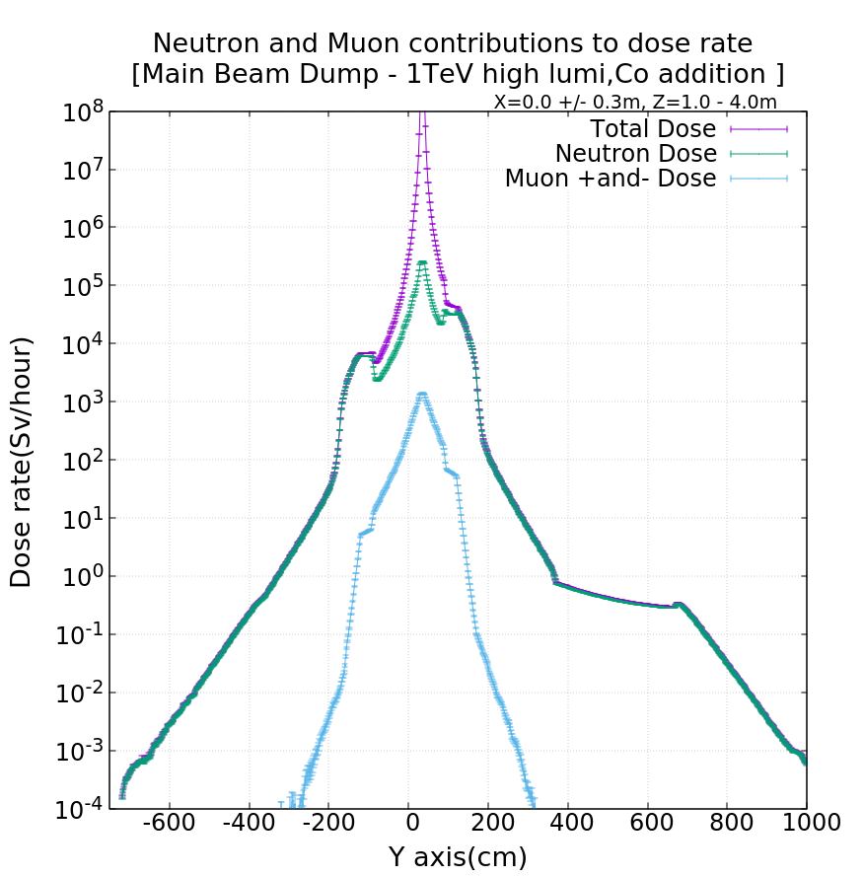
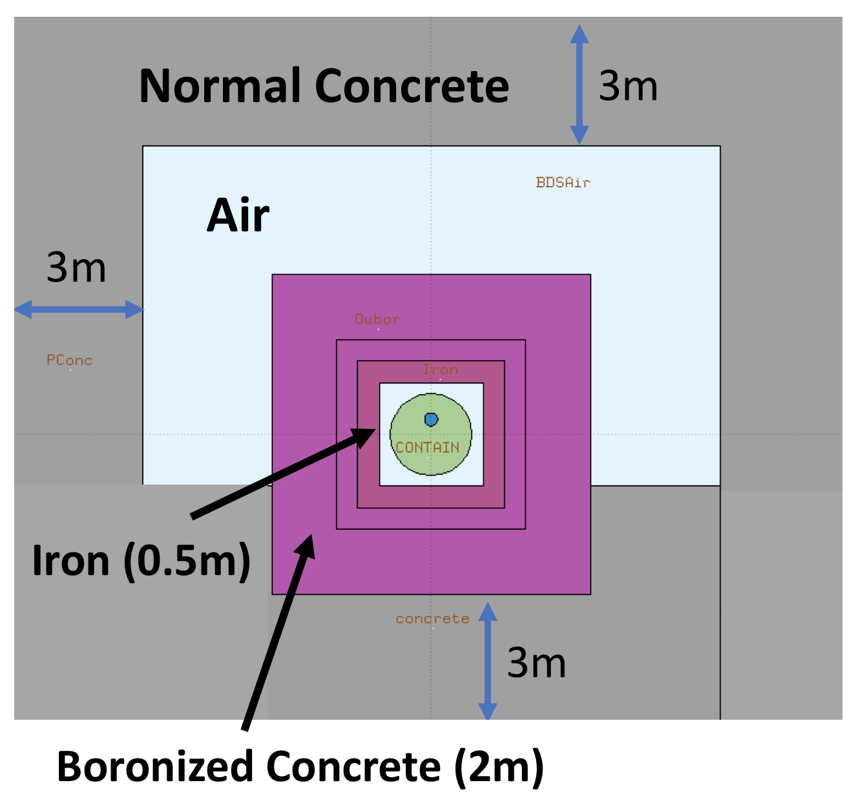
Radiation dose from Main Dump
Beam for simulation
  → 1 TeV, 14 MW
Dump design with 20% margin
  → 17 MW
Iron Shield 0.5 m
and
(Boronized) Concrete 4 m
Geometry used for FLUKA Study
Iron 0.5m
Normal Concrete 3m
Boronized Concrete 2m
5 mSv/h
4m

Slide 11
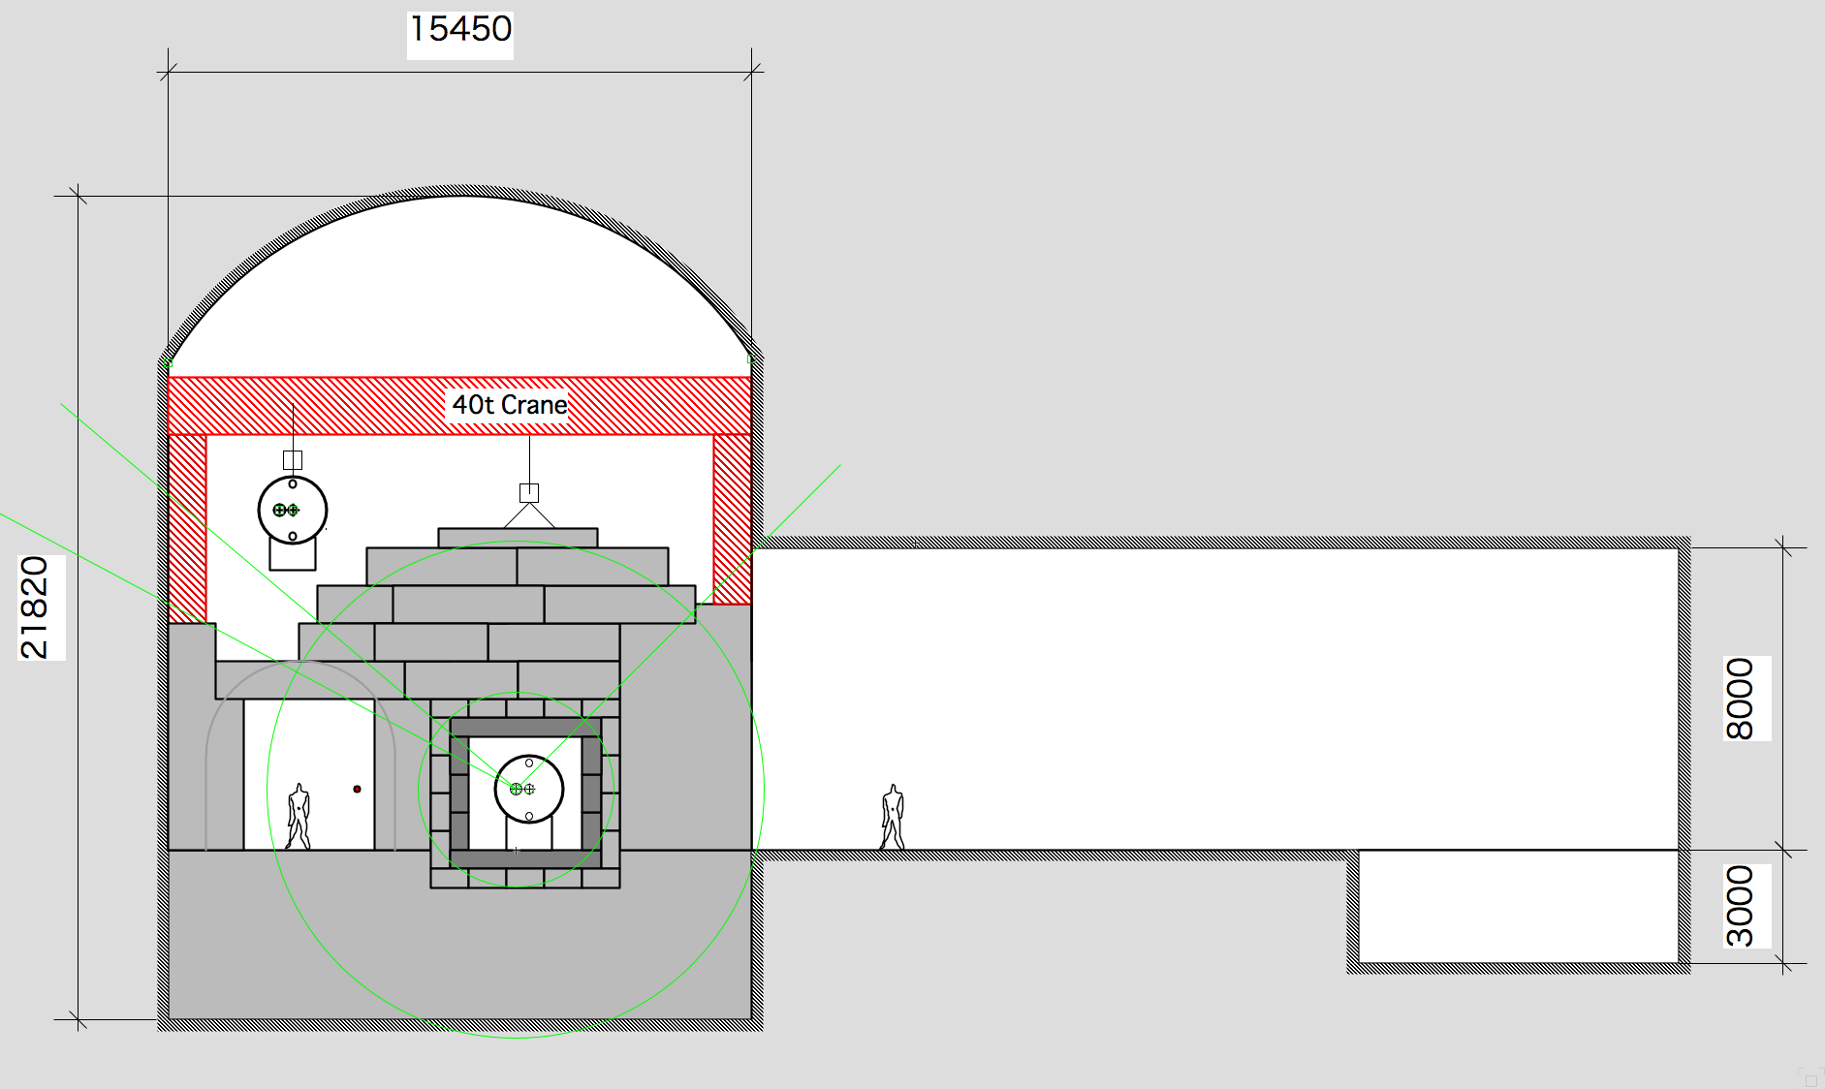
Main Dump Cavern
Shield blocks
For the decommissioning in future
Avoid 2m-thick selling shield
Crane (40t) for dump and blocks
Utility cavern
for activated water and air

Slide 12
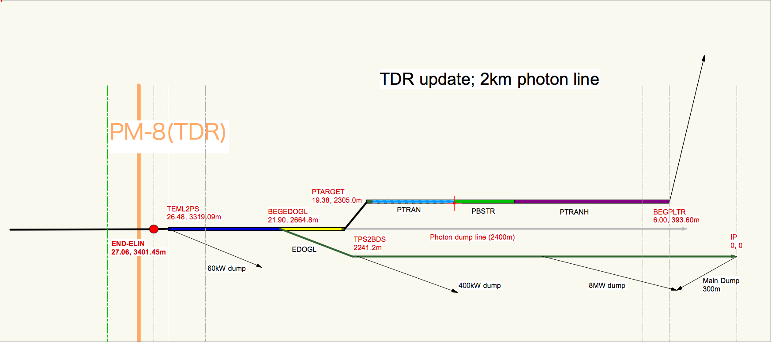
Positron source beamline: baseline
The beamline layout have to be updated with long photon line to the photon dump.
Location of photon dump should be defined with a maintenance scenario.
Undulator
e-
Main Linac
2 km photon line
IP
BDS

Slide 13
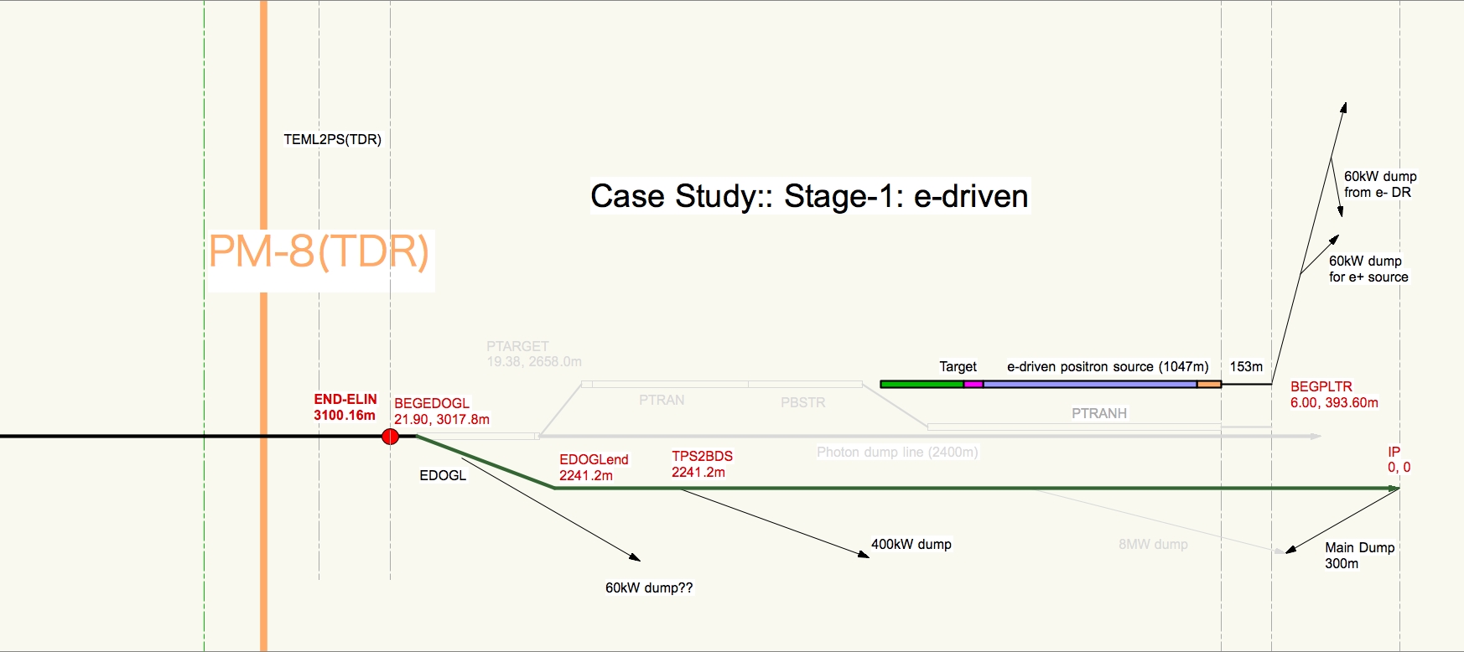
Positron source beamline: backup(1)
In the case of starting with e-driven and change to undulator,
but if e-driven is heavily activated, schematic layout will be as follows.
e-driven positron source
IP
e- Main Linac
BDS
X
X

Slide 14
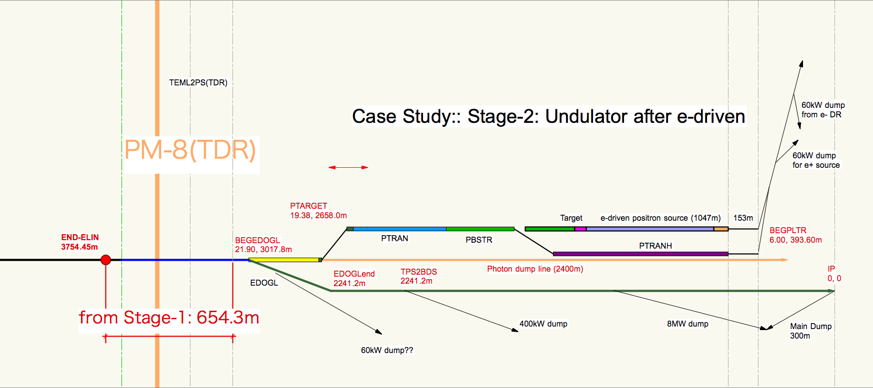
Positron source beamline: backup(2)
In the case of starting with e-driven and change to undulator,
but if e-driven is heavily activated, schematic layout will be as follows.
e-driven positron source
IP
e- Main Linac
Undulator
BDS
X
X
60kW dump

Slide 15
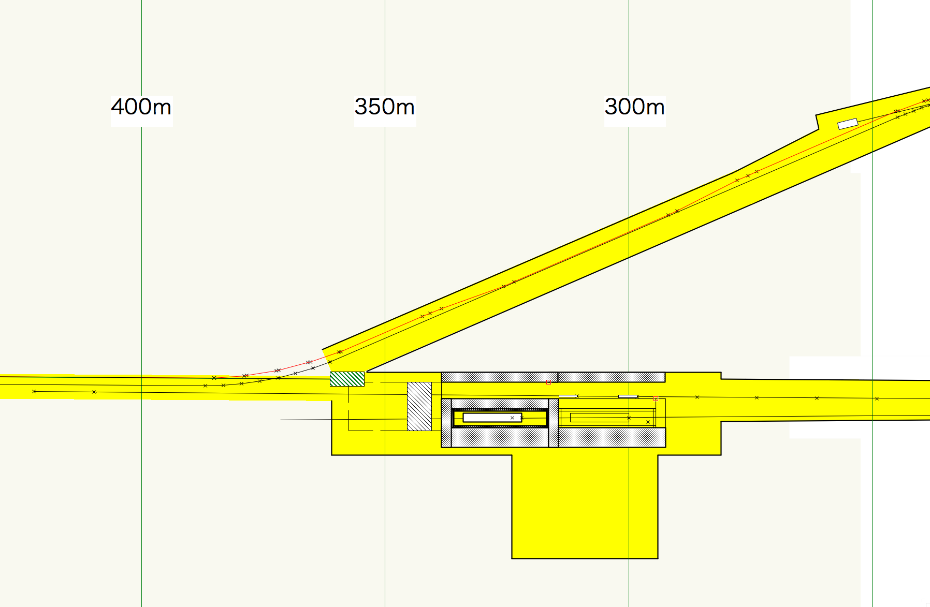
Summary: Main Beam Dump and Around
Time for the CFS engineering design is limited.
Fix beamlines, location and size of systems!
Positron Linac Tune-up Dump (60kW)
Photon Dump (120kW)
DR
Positron Source
IP
Reserved for
8MW e- dump
(5+5Hz)
Reserved for
2nd Dump
Reserved for
Muon wall
1st Main
Dump
Utility Cavern for main dump
Where the 2nd-loop water come from?

Slide 16
What we need to do for the basic design
- Ideal Schedule -
Pre-preparation
Phase
Preparation
Phase
mid-2018
2019
mid-2019
2020
mid-2020
DECK
(Undulator)
Detail
Design
Basic Design
Documentation
(all areas)
DECK
(e-driven)
Central Region
(DR, LTR, Detector Utils)
Conceptual Design
(Target, Dumps)
with Engineering Consultants
We are here.
We need to have a design margin on CFS for the items under R&D, such as positron source, beam dump.

