Slide 1


ILC Simulations
Rebecca Ramjiawan FONT meeting
Friday, 10th August 2018

Slide 2
Outline
Basic model of FB system implemented in MATLAB, generate bunch trains and model BPM, kicker and lever-arm effect.
MATLAB model 1312 bunch trains: bunch train structures with constant offsets, offsets between consecutive bunches, harmonics of a range of frequencies.
MATLAB model FB system: BPM with resolution effects, kicker with kicker noise, proportional control, proportional and integral control, averaging over multiple bunches, weighted averaging over two bunches (bunch_{i} and bunch_{i-1}).
Lucretia: generate 1312 bunch train and track through the BDS to the IP, model bunch-bunch interaction at the IP using Guinea-Pig.
Deflection angle curves modelled for various beam parameters showing dependence on: bunch size (x,y), bunch length, charge.

Slide 3
Feedback Loop Simulation (MATLAB)
Construct uncorrected e+e- bunch trains (1312 bunches), with noise, drifts, harmonics, etc.
Run for multiple trains and average results.
Determine luminosity from bunch-bunch offset (using nominal luminosity-offset curve)
True beam offset at IP = Uncorrected offset + correction
True beam-beam deflection (using nominal deflection curve)
Delay loop
True offset at BPM (using IP to BPM distance 4m)
Apply correction (can inc. kicker error 0.1% offset- as Javier)
Measured offset at BPM (resolution)
Estimate deflection angle, offset at IP from fit to beam-beam deflection curve

Slide 4
Ideal Situation – Rigid Beam
Constant offset 70 nm throughout 1312 bunch train.
0 um resolution.
Perfect correction maintained correctly with delay loop ✓
Successfully removes bunch-bunch offset by second bunch.
Full luminosity recovery by second bunch.

Slide 5
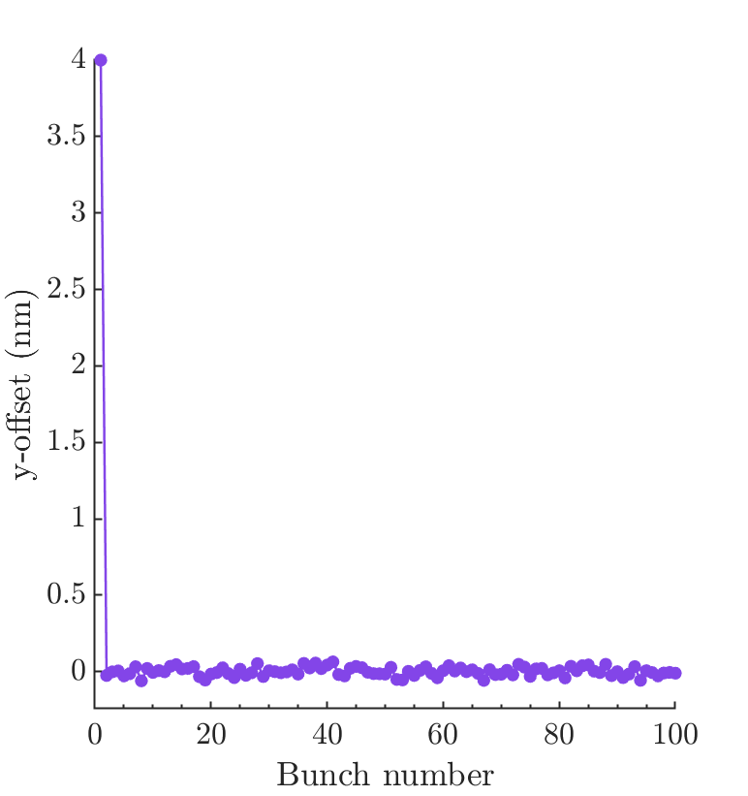
Resolution Effects
Rigid bunch trains, with 4 nm offset, with feedback with BPM resolution 1 um operating.

Slide 6
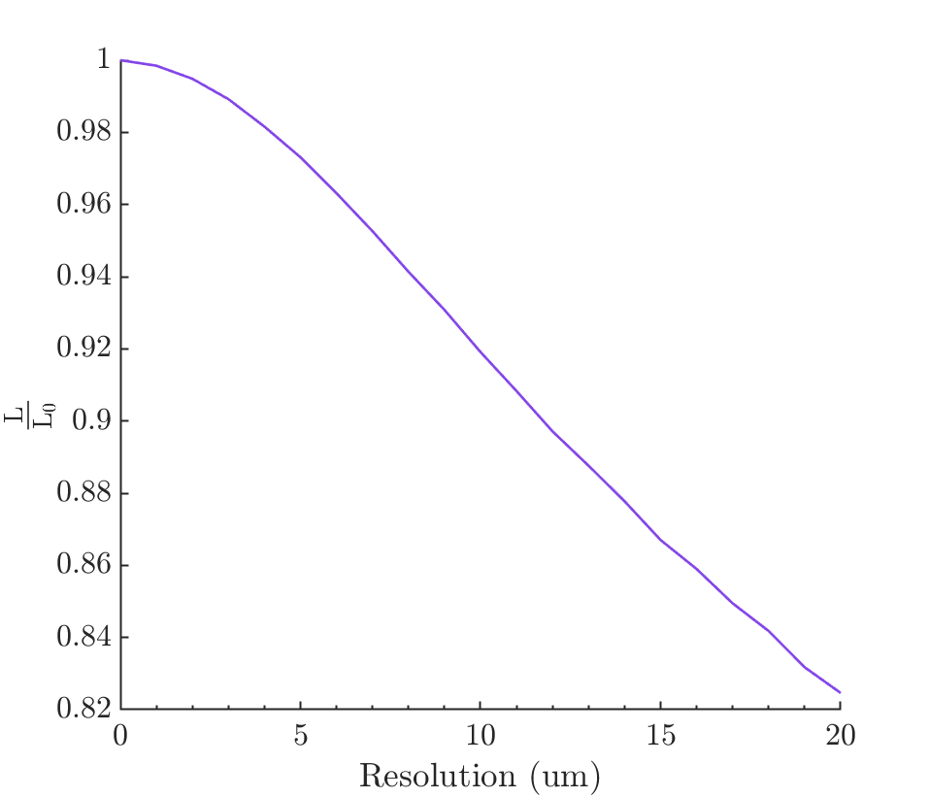
Luminosity vs. Resolution
Two rigid bunch trains with zero offset (i.e requiring no correction), with a BPM with a range of resolutions (0 to 20 um).
As expected, very little degradation to luminosity from a BPM with up to 1 um resolution.
Fractional luminosity for FB system with 1 um resolution BPM and rigid beam: 0.9985 * L₀.

Slide 7
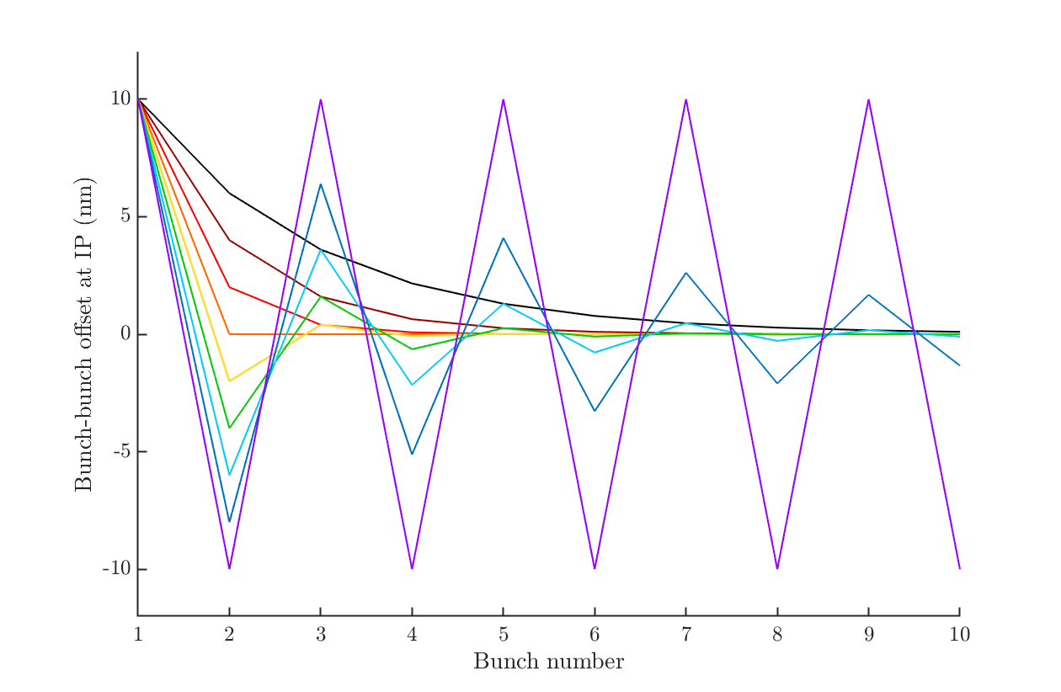
Gain scan
Rigid bunch trains with 10 nm initial offset and proportional gain feedback. Scaling the feedback gain. (1 is nominal)
Gain:
0.4, 0.6, 0.8, 1, 1.2, 1.4, 1.6, 1.8, 2

Slide 8
Bunch train structures

Slide 9
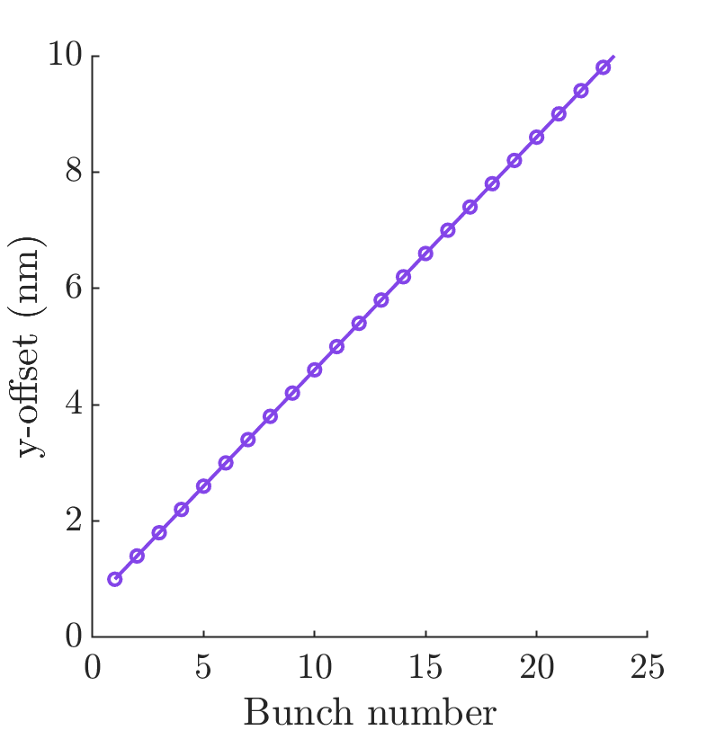
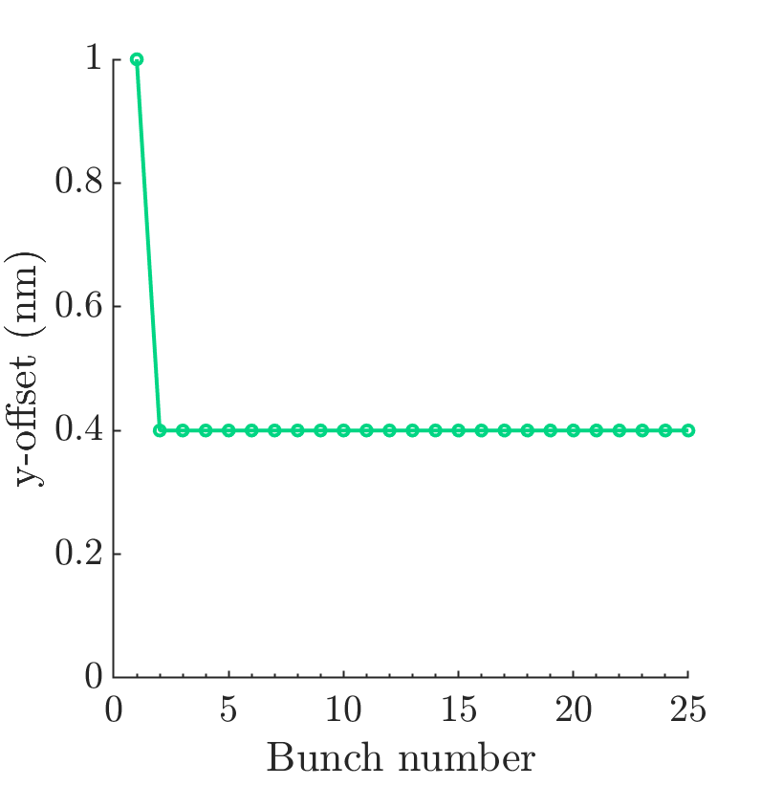
Bunch train structure
Bunch train: 1 nm initial offset with offset of 0.4 nm between consecutive bunches.
Proportional gain feedback, with 0 nm resolution. Would not take out the 0.4 nm difference between consecutive bunches.
Δx = 0.4 nm
Leading to a loss in luminosity.
Feedback off, offset between beams.
Feedback on, offset between bunches.

Slide 10

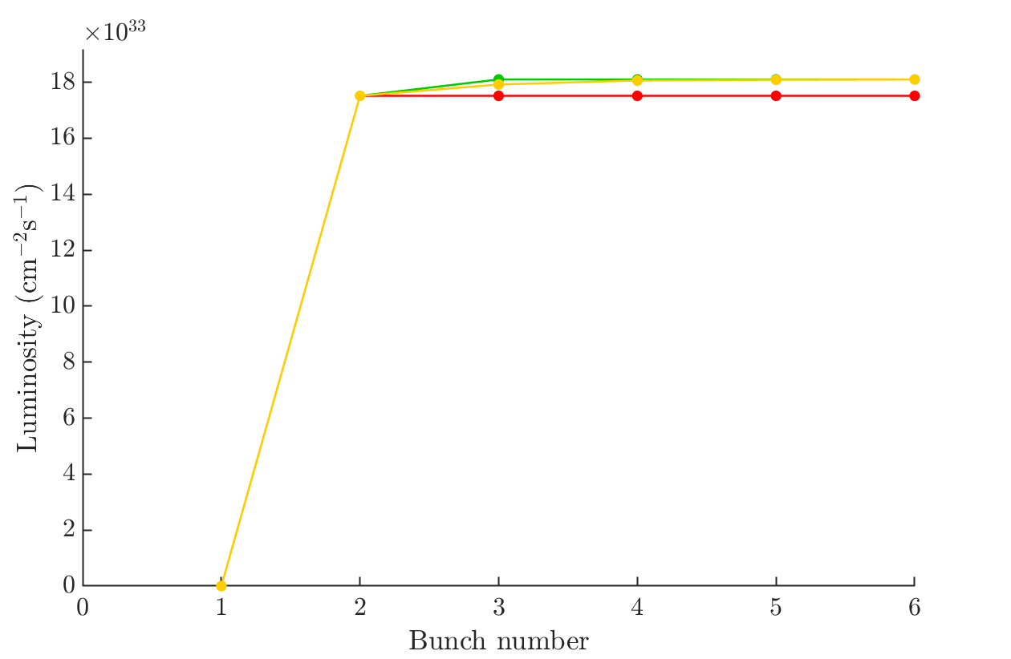

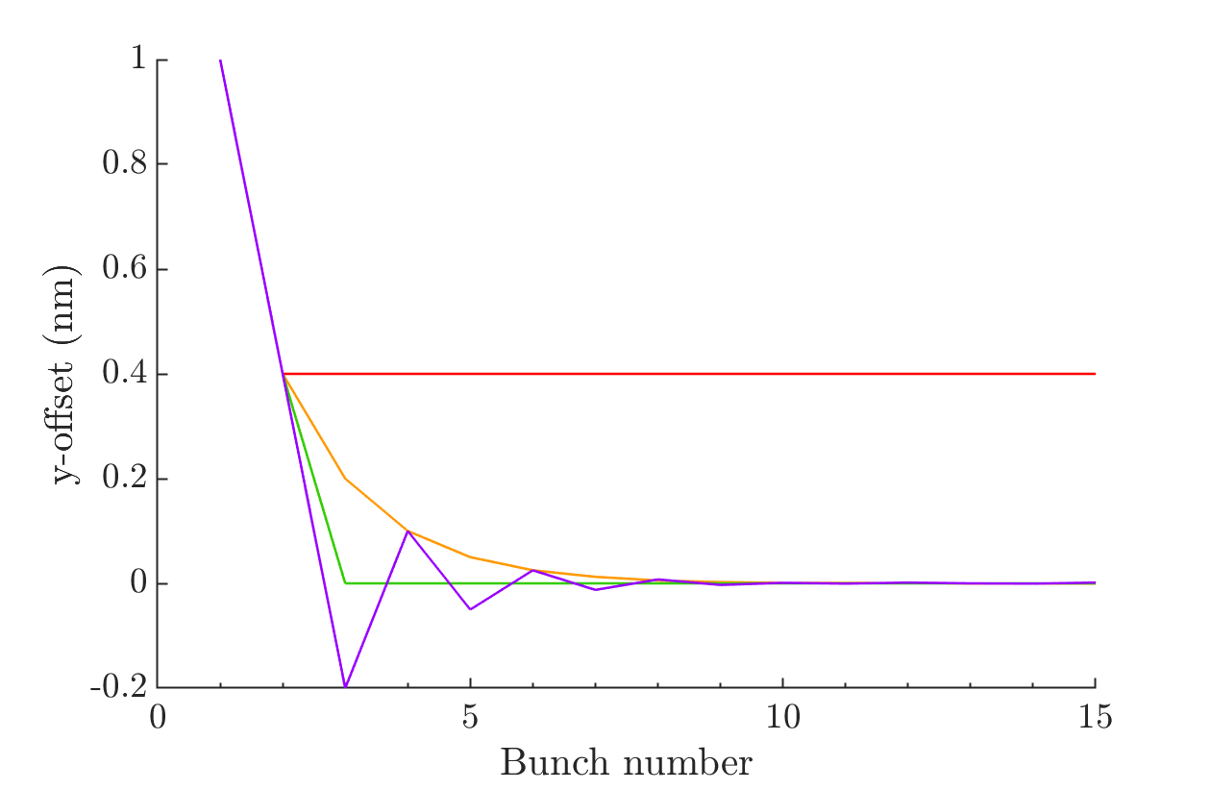
Proportional Integral Control
0.4 nm offset between consecutive bunches. The 0.4 nm is not removed by just proportional feedback.
Nominal gains for proportional term,
Gains for integral term: 0, 0.5, 1, 1.5
Proportional term
Integral term

Slide 11
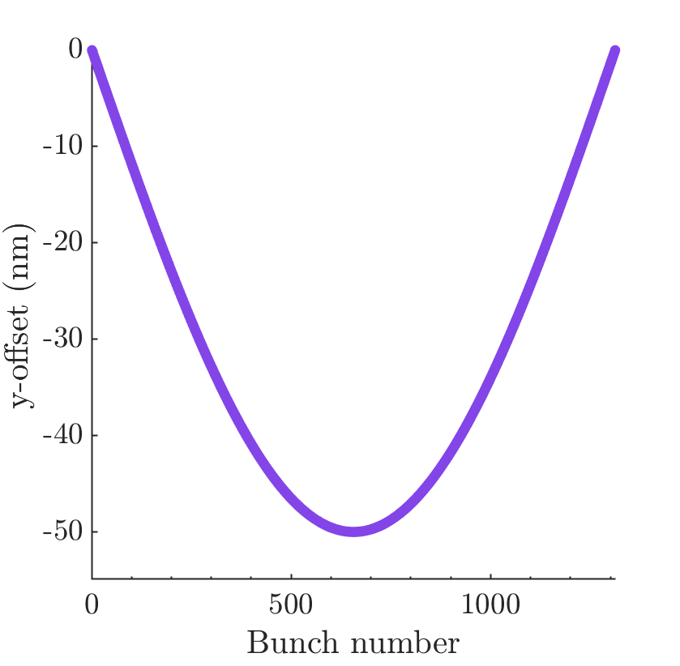
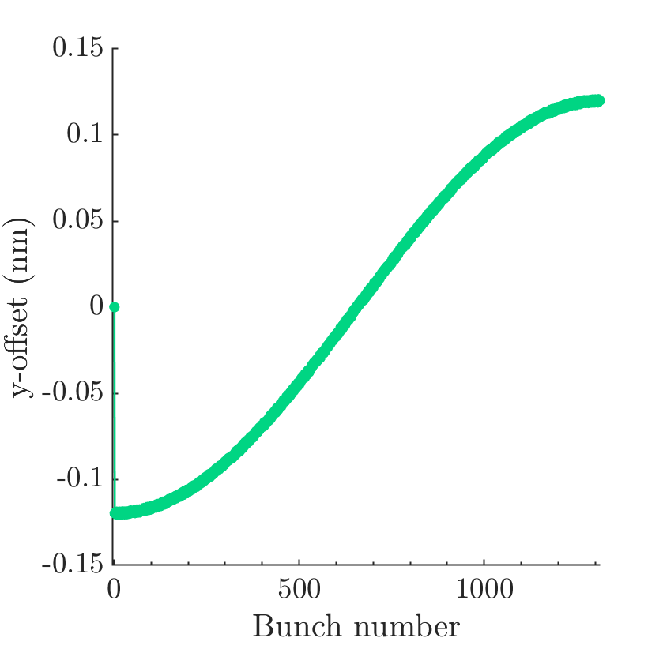
Harmonic (across train)
Proportional gain feedback, with 0 nm resolution. Would not take out the difference between consecutive bunches. (Effectively differential of harmonic)
Bunch train: Banana shape (half cycle across bunch train).
Leading to a loss in luminosity.
Feedback off, offset between bunches.
Feedback on, offset between bunches.

Slide 12
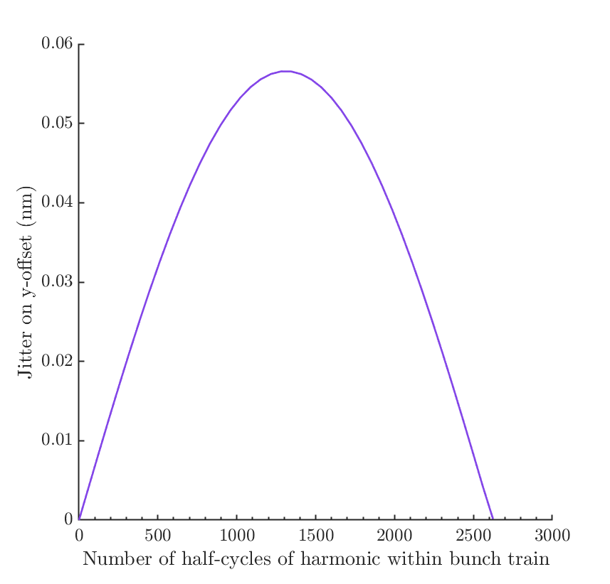
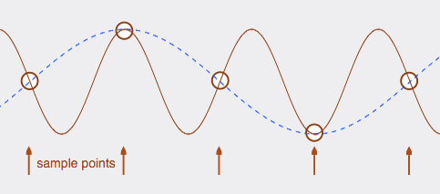
Frequencies of harmonic
Jitter here defined as standard deviations of y-offsets (between beams at the IP) across a bunch train after feedback.
Dependence of feedback performance on frequency of harmonic structure introduced to bunch train.
Worst performance (peak of curve) occurs when frequency of harmonic =1312*pi, as this corresponds to bunch-to-bunch correlation of -1.
Higher frequencies than 1312*pi when sampled at the bunch frequency are equivalent to lower frequency harmonics and consequently perform better.

Slide 13
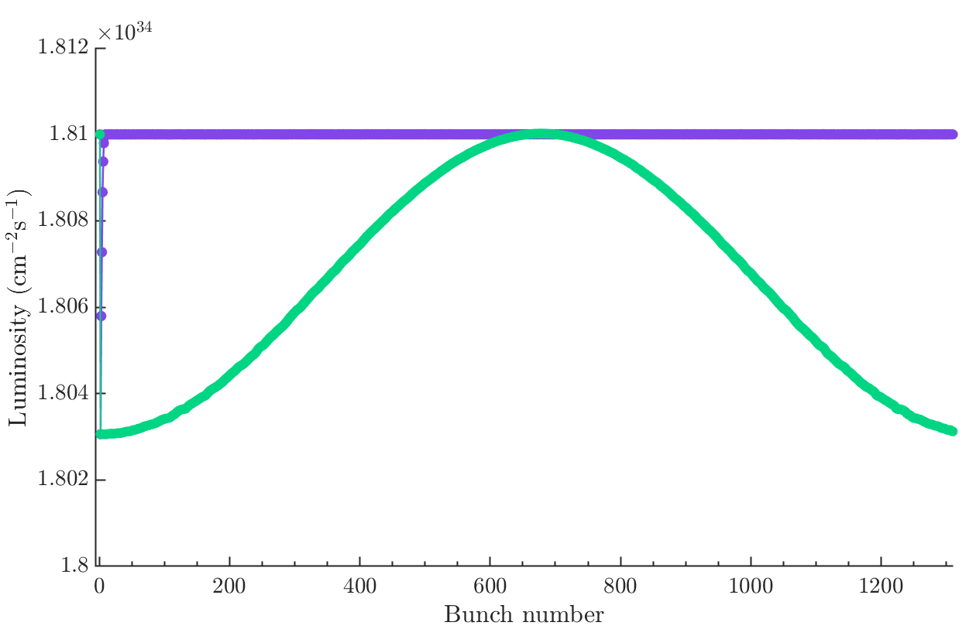
Proportional Integral Control: Harmonic
Proportional control vs. proportional integral control. For harmonic bunch train shape shown on slide 17.
Integral gain K_{i}: 0
Integral gain K_{i}: nominal
Proportional term
Integral term

Slide 14
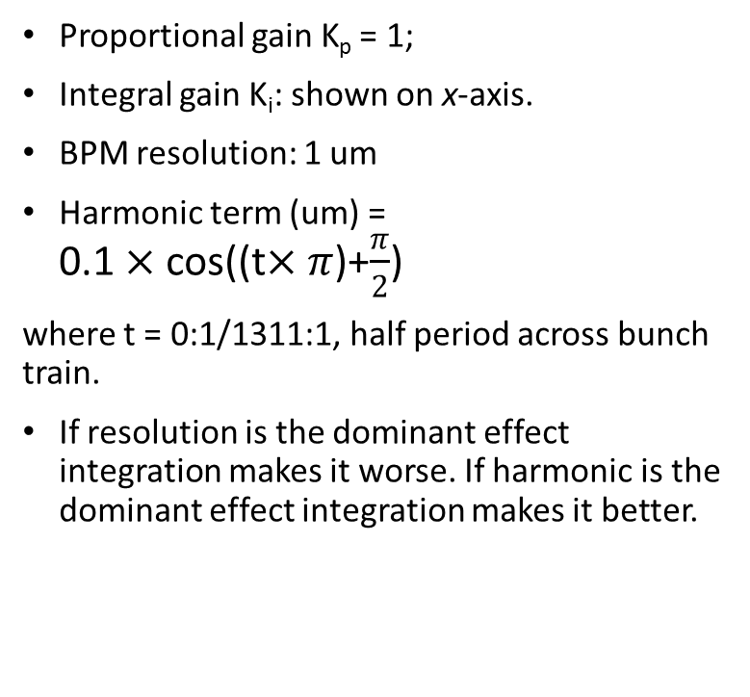
Harmonic structure and BPM Resolution
Integral gain scan
Proportional gain K_{p} = 1;
Integral gain K_{i}: shown on x-axis.
BPM resolution: 1 um
Harmonic term (um) = 0.1$×$cos((t$×π$)+$\frac{π}{2}$)
where t = 0:1/1311:1, half period across bunch train.
If resolution is the dominant effect integration makes it worse. If harmonic is the dominant effect integration makes it better.

Slide 15
Averaging Bunches to Improve
Bunch Position Measurement

Slide 16
Averaging over multiple bunches
If noise added is uncorrelated between consecutive bunches, e.g resolution effects then averaging offers some improvement. Very minor improvement for resolution of 1 um. Initially rigid trains with offset 70 nm.
Would become important for beams with poorer bunch to bunch correlation.
1 um resolution
10 um resolution

Slide 17
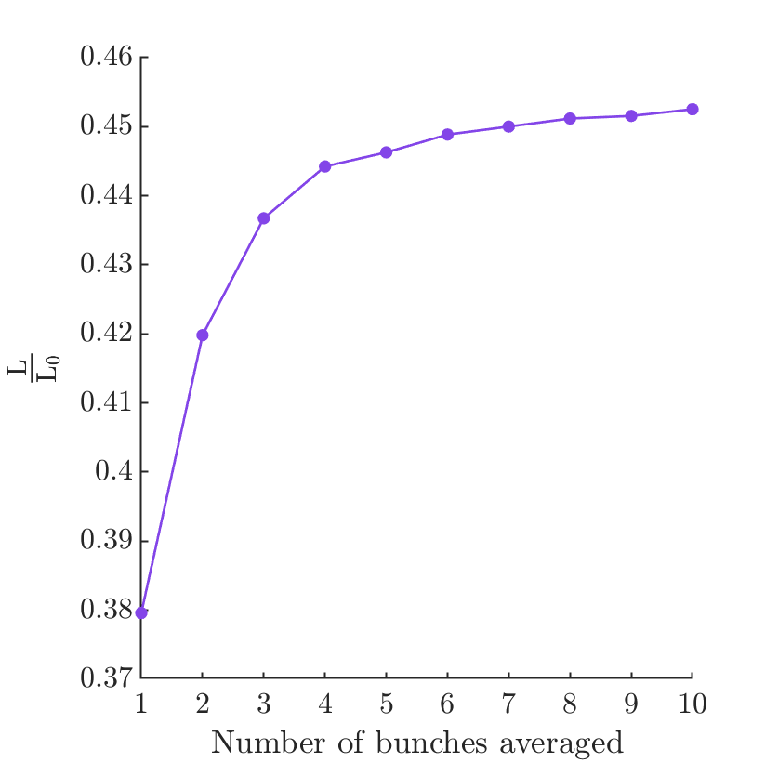
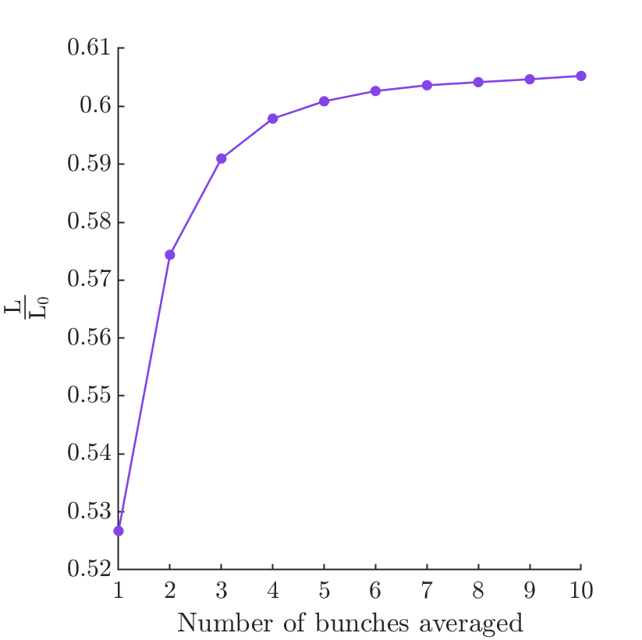
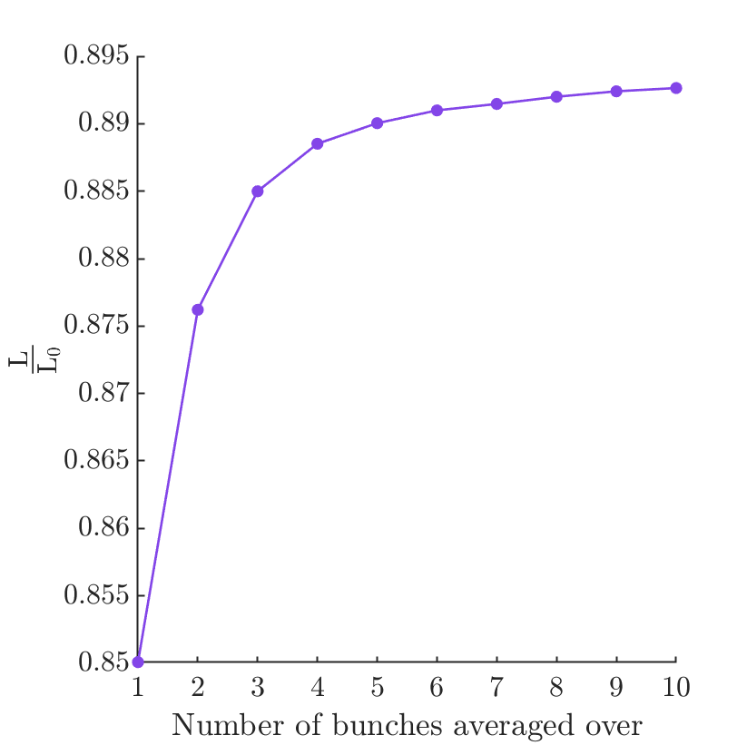
Reduced bunch-to-bunch correlation
Initial offset 70 nm with random noise added to each bunch.
Random noise introduced bunch by bunch to reduce correlation and degrade feedback performance.
Position measurements fed into feedback system are now averaged over some number of bunches (x-axis) and the average luminosity recovered shown (y-axis)
10 nm std random noise
5 nm std random noise
1 nm std random noise

Slide 18
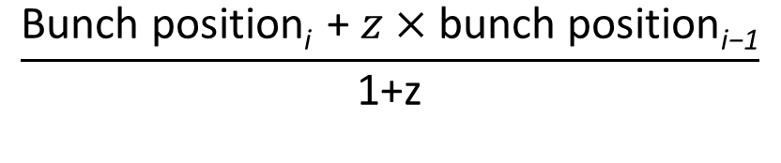
Weighted averaging over two bunches
1 nm random noise added bunch by bunch AND
1 nm amplitude harmonic – half period across bunch train.
Averaging improves if random noise is the dominant effect but degrades luminosity if harmonic is the dominant effect. If combination of correlated and uncorrelated bunch-to-bunch effects then can use weighted averaging.
Optimum weighting coefficient depends on magnitude of effects which are correlated and uncorrelated between consecutive bunches.
Bunch position_{i} =
$$\frac{\text{Bunch} \text{position}\text{i} \text{+ }z×\text{bunch} \text{position}\text{i}\text{−1}}{\text{1+}\text{z}}$$
z

Slide 19
Tracking the bunches through the BDS

Slide 20
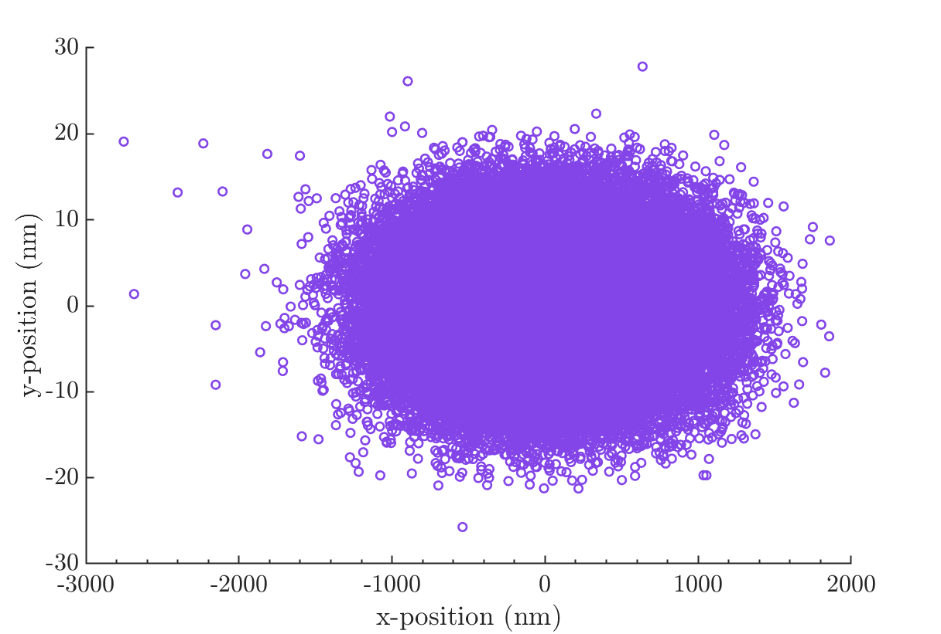
Bunches at IP (Lucretia)
Horizontal beam size = 474 nm
Vertical beam size = 5.9 nm
80000 macroparticles.
I still need to figure out which/if any wakefields are implemented.
MATLAB structure called WF.ZSR, possibly short range wakefields?
First bunch in train shown.

Slide 21
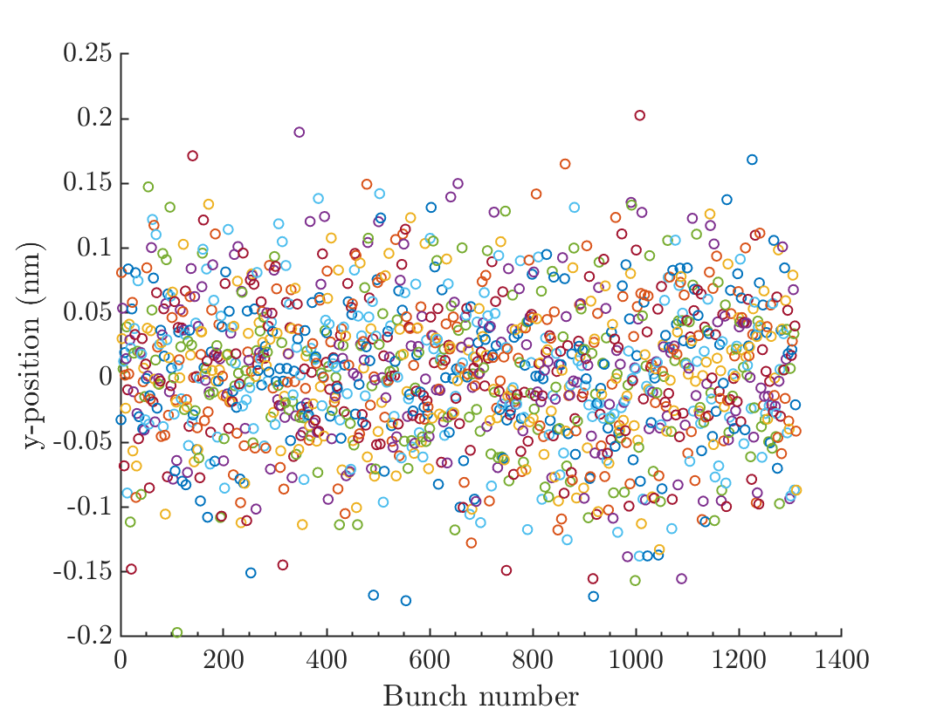
1312 bunch train tracked through BDS
y-position of bunches at IP modelled in Lucretia for a train of 1312 bunches tracked through the BDS to the IP.
10000 macroparticles modelled per bunch, mean bunch position shown.

Slide 22
Deflection Angle Curves

Slide 23
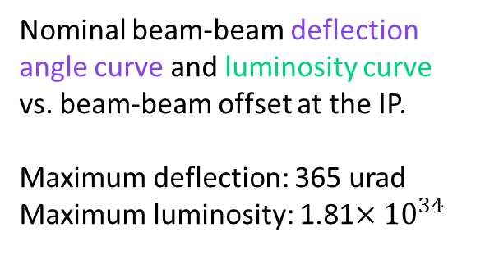
Nominal Curves
Nominal beam-beam deflection angle curve and luminosity curve vs. beam-beam offset at the IP.
Maximum deflection: 365 urad
Maximum luminosity: 1.81$×{10}^{34}$

Slide 24
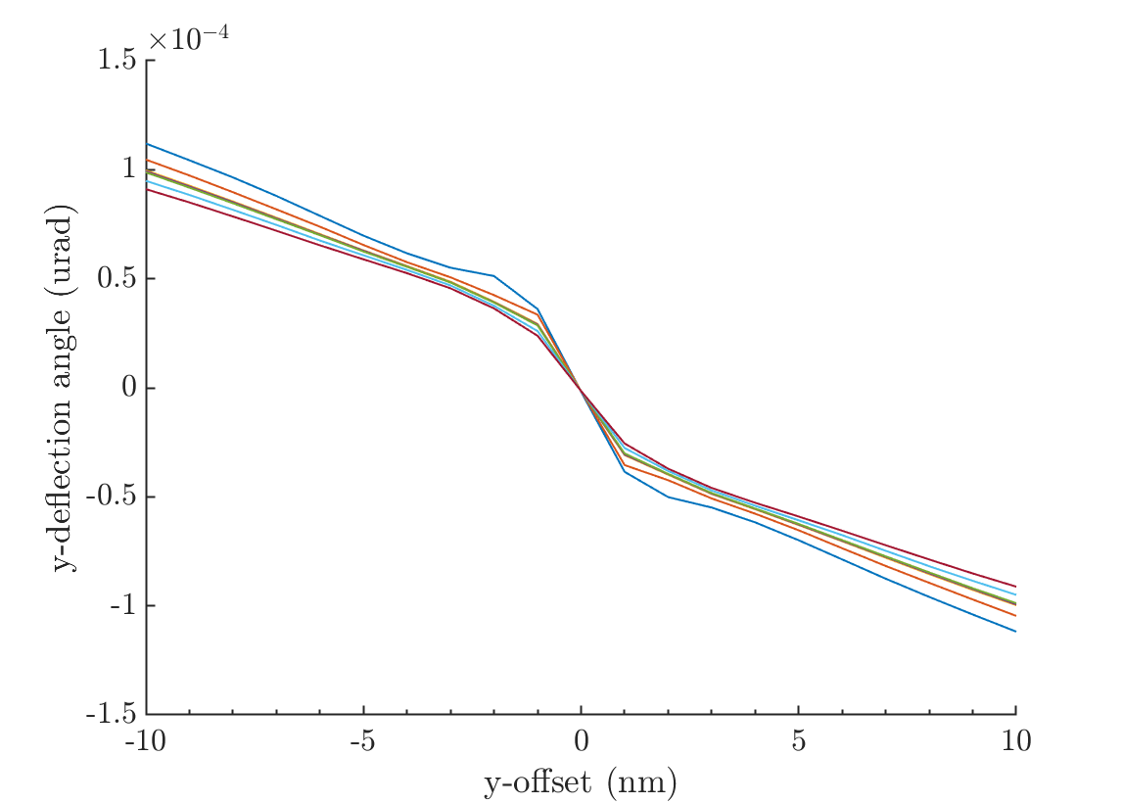
Horizontal beam size (sigma_x)
Deflection-angle curves for a range of horizontal beam size values (sigma_x):
[0.8,0.9,0.99,1,1.01,1.1,1.2]*474 nm

Slide 25
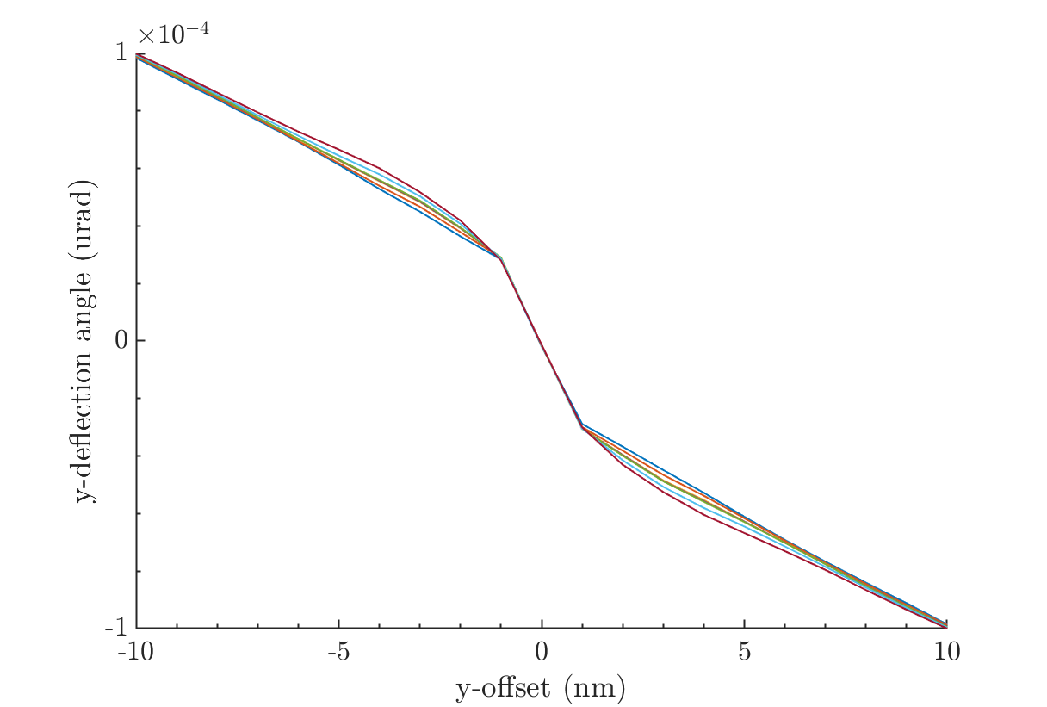
Vertical beam size (sigma_y)
Deflection-angle curves for a range of vertical beam size values:
[0.8,0.9,0.99,1,1.01,1.1,1.2]*5.9 nm

Slide 26
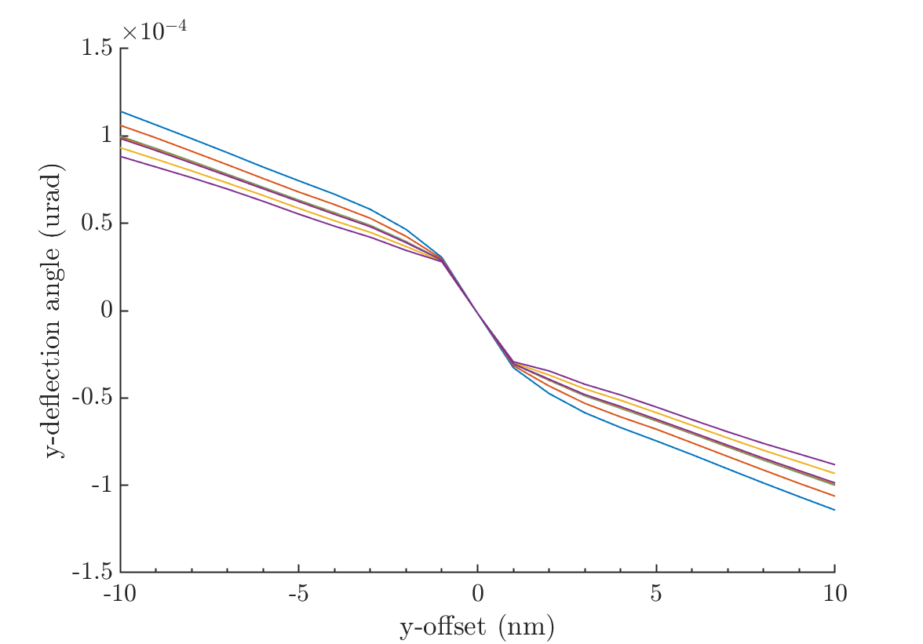
Bunch length (sigma_z)
Deflection-angle curves for a range of longitudinal beam size values:
[0.8,0.9,0.99,1,1.01,1.1,1.2]*300 um

Slide 27
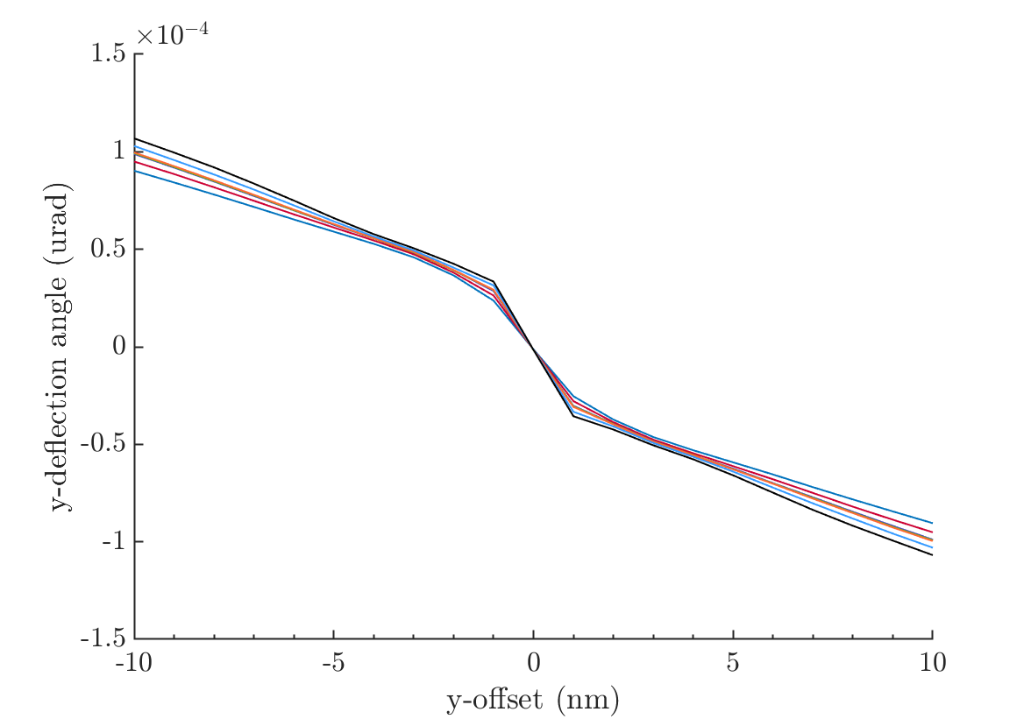
Charge (number of particles per bunch)
Deflection-angle curves for a range of bunch charges:
As function of number of particles per bunch
[0.8,0.9,0.99,1,1.01,1.1,1.2]*2e10.

Slide 28
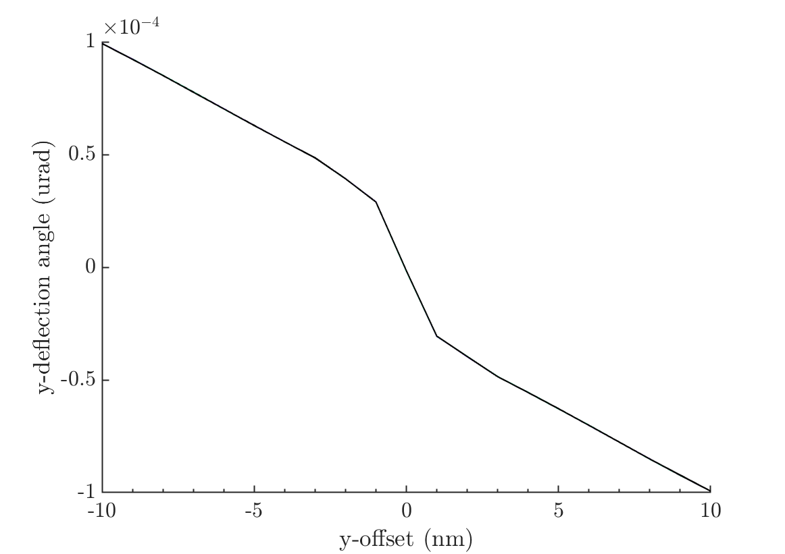
Energy
Deflection-angle curves for a range of energies:
[248:0.1:252] GeV.
Shows no real variation with bunch energy ✓

Slide 29
Summary
Basic model of FB system implemented in MATLAB.
Ability to model bunch trains: - bunch structures inc. constant offsets, offsets between consecutive bunches, harmonics of a range of frequencies.
Ability to model FB system: proportional control, proportional and integral control, averaging over multiple bunches, weighted averaging.
Generate 1312 bunch train in Lucretia and track through the BDS to the IP, model bunch-bunch interaction at the IP using Guinea-Pig.
Deflection angle curves modelled for various beam parameters showing dependence on: bunch size (x,y), bunch length, charge.

