Slide 1


ILC Simulations
Rebecca Ramjiawan FONT meeting
Friday, 31th August 2018

Slide 2
Outline
Lucretia: bunch profiles, x-y, z-y (wakefields?), effect of 0.2 seconds of ground motion between trains.
Guinea-pig: Beam-beam deflection curves, dependent on sigma_y, sigma_x, sigma_z, charge (nparticles).
Placet: Installed, running, getting out bunch parameters and positions – but losing the beam before the IP.

Slide 3
Lucretia

Slide 4
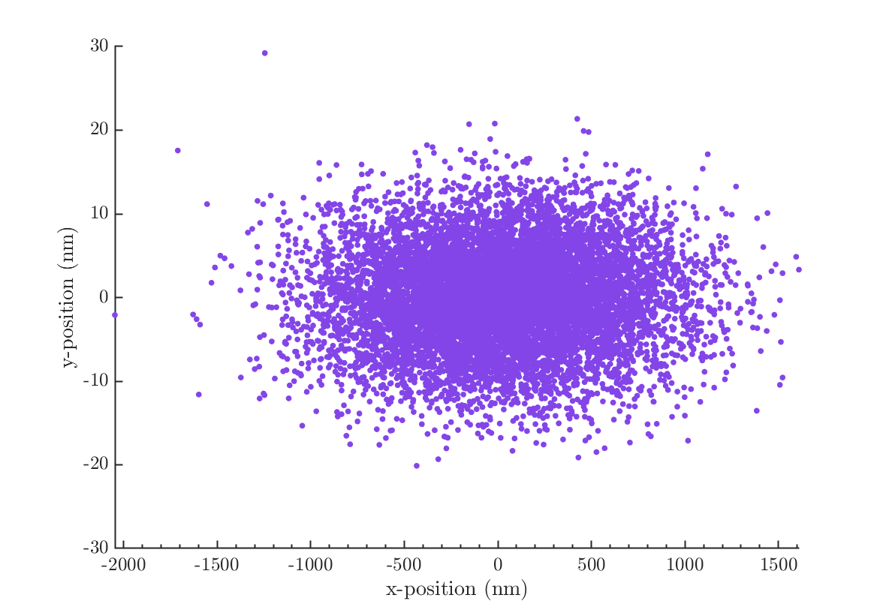
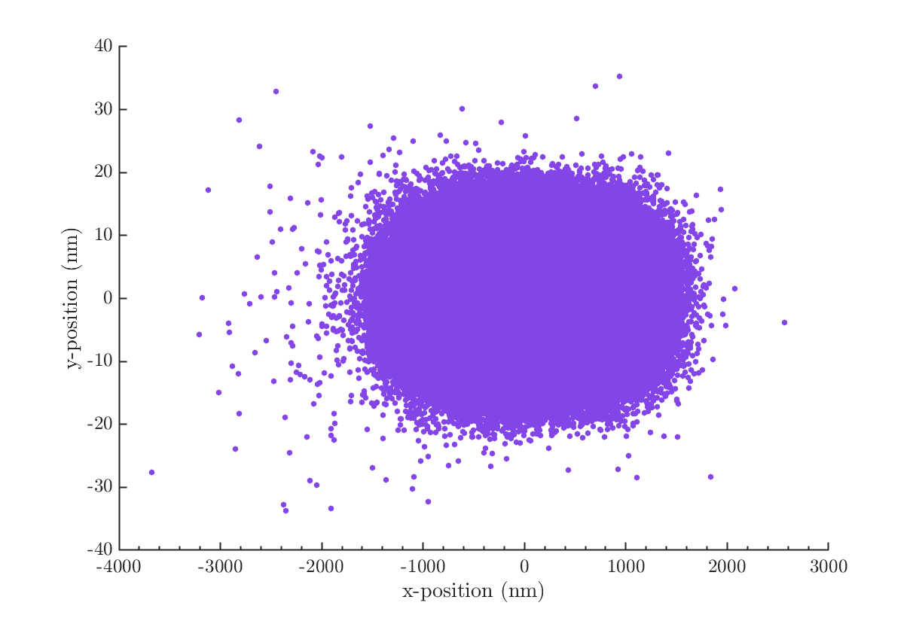
Bunch profile x-y
Track one bunch through the accelerator with 0 nm offset applied. Bunch simulated with 10,000 macroparticles and 80,000 macroparticles.
10,000 macroparticles
80,000 macroparticles

Slide 5
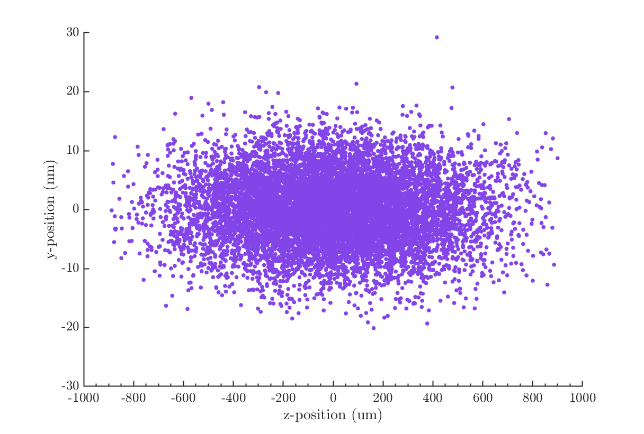
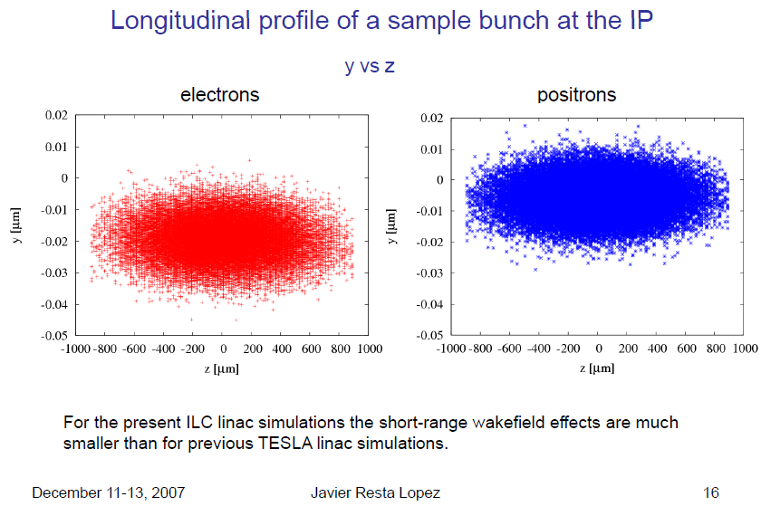
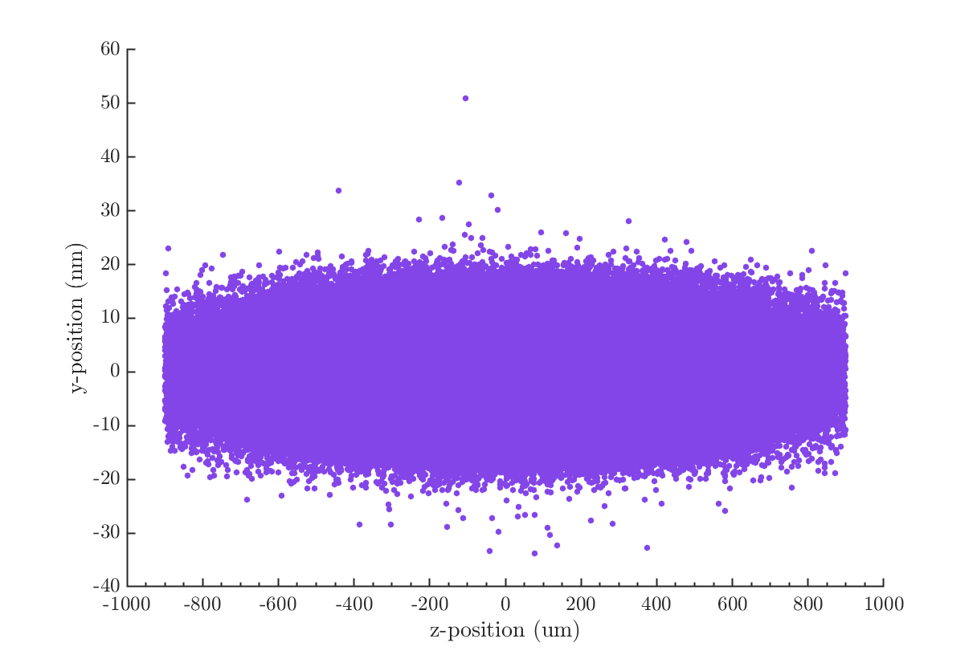
Bunch profile z-y
J. Resta Lopez previous start-to-end ILC simulations.
10,000 macroparticles
Lucretia simulation – short range wakefields implemented.
80,000 macroparticles

Slide 6
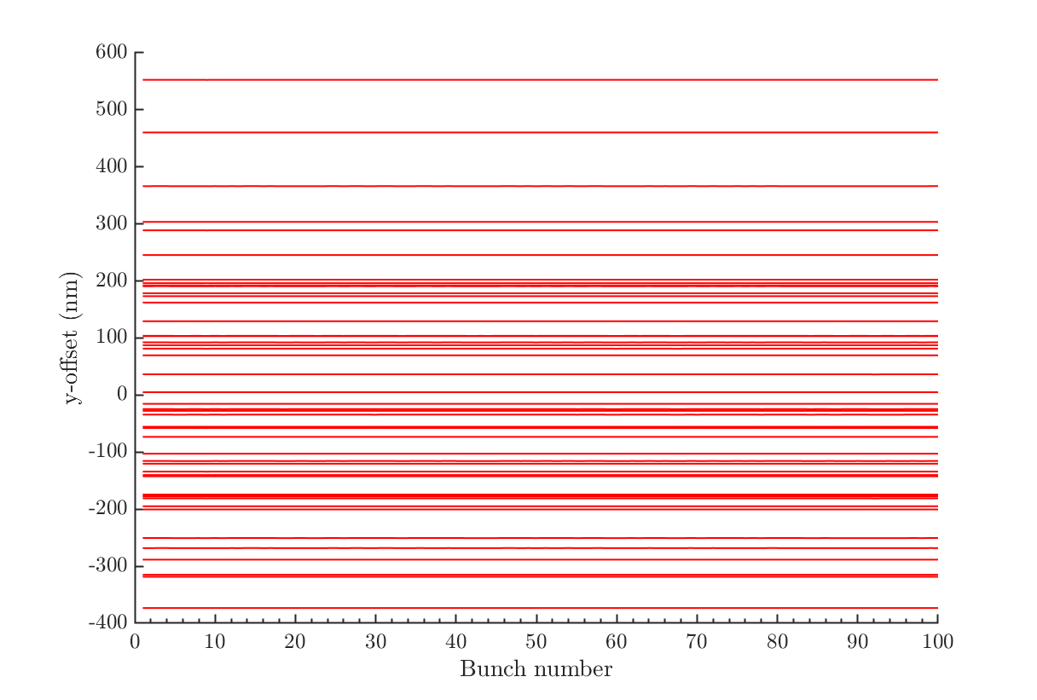
GM for trains of 100 bunches
Simulated 50 seeds of 100 bunch trains tracked through the BDS with 0.2 seconds of ground motion model ‘C’ applied.

Slide 7
Guinea Pig

Slide 8
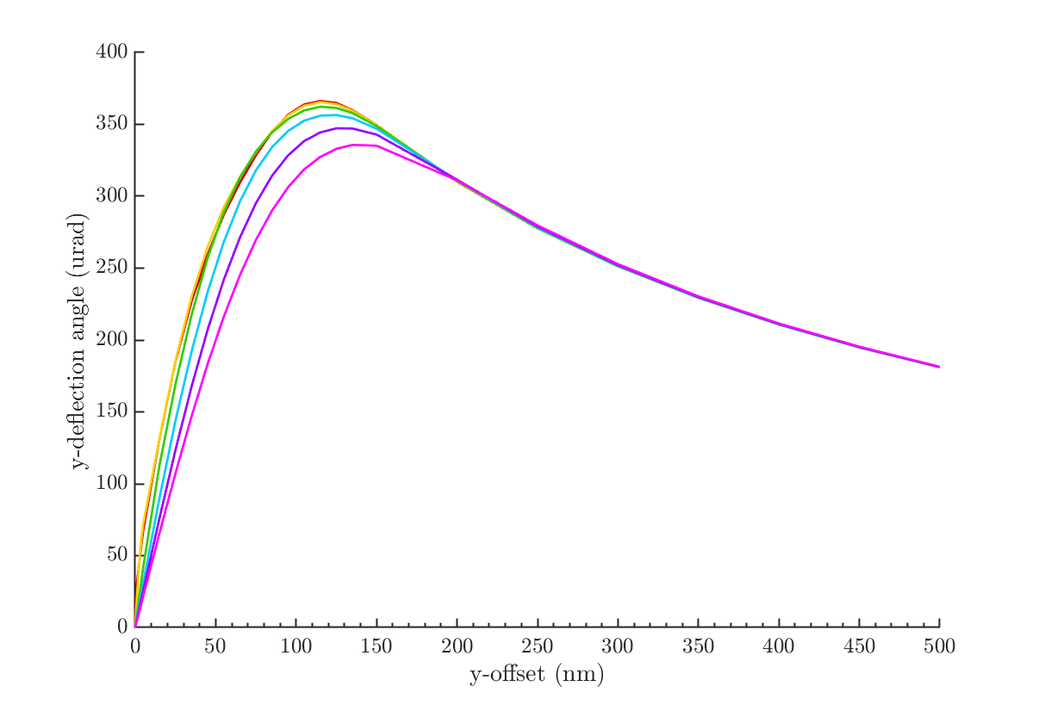
Guinea-pig – sigma_y
Beam-beam deflection curve for bunches with [1,2,4,6,8,10]*nominal sigma_y (5.9 nm).
Sigma_y: (nm)
5.9 (nominal),
11.8,
23.6,
35.4,
47.2,
59.
I need to double check I’ve got the mesh size correct for this simulation – it might need a finer mesh.

Slide 9
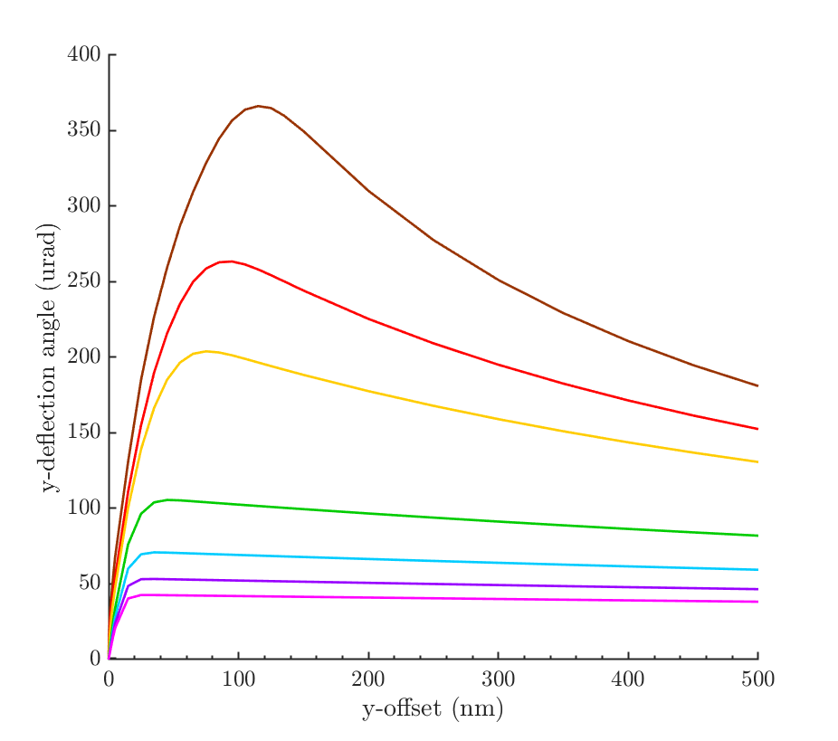
Guinea-pig – sigma_x
Beam-beam deflection curve for bunches with [1,1.5,2,4,6,8,10]*nominal sigma_x (474 nm).
Sigma_x: (nm)
474 (nominal),
711,
948,
1896,
2844,
3792,
4740.

Slide 10
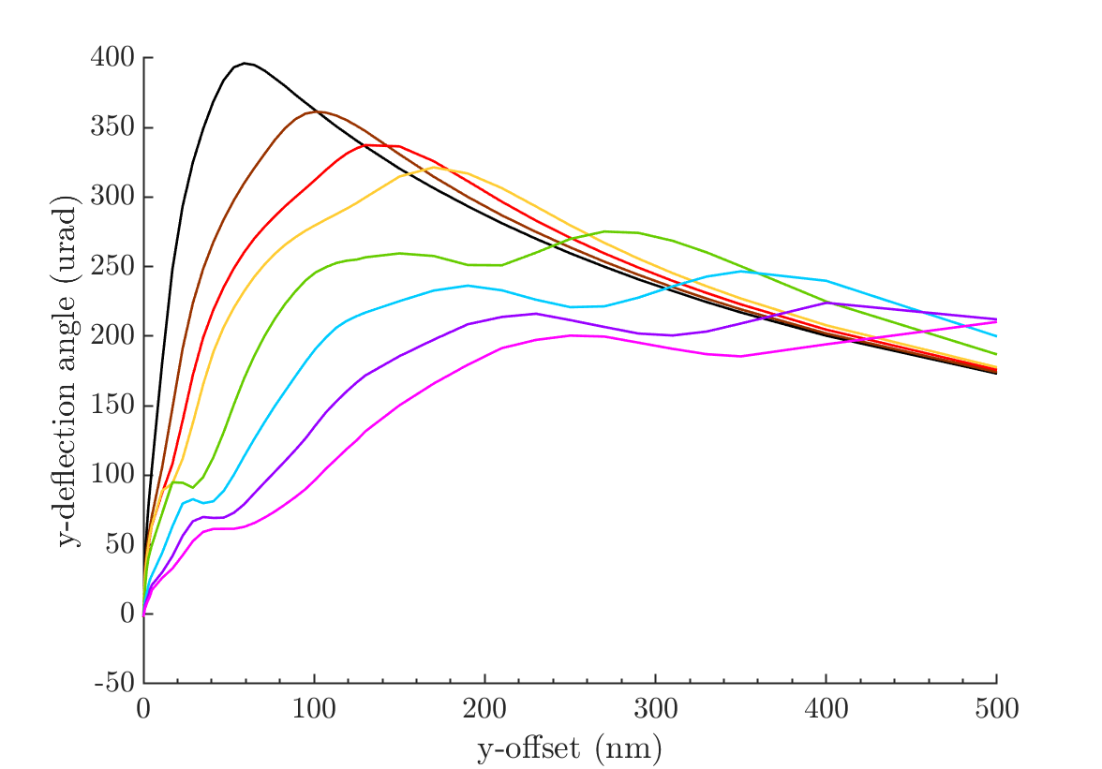
Guinea-pig – sigma_z
Beam-beam deflection curve for bunches with [0.5,1,1.5,2,4,6,8,10]*nominal sigma_y (300 um).
Sigma_z (um):
150,
300 (nominal),
450,
600,
1200,
1800,
2400,
3000.

Slide 11
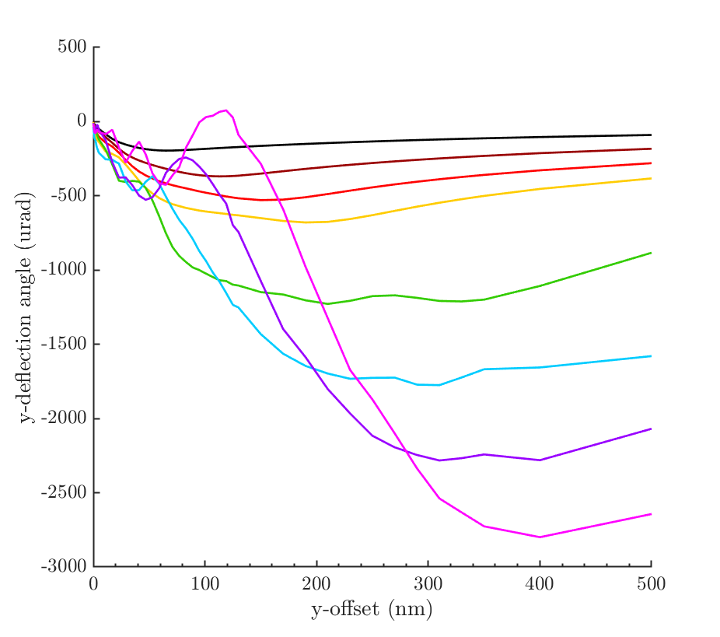
Guinea-pig – Charge (nparticles)
Definite problems with the mesh for charges higher than 4 x 10¹⁰, work still ongoing.
Charge: (x 10¹⁰)
1,
2 (nominal),
3,
4,
8,
12,
16,
20

Slide 12
Placet

Slide 13
Placet
Installed and running – with help from Chet, Pierre and Ryan.
I have lattice files to run for the BDS, ML+BDS, RTML+ML+BDS.
So far I am having trouble tracking the beam through the lattice, as the beam keeps blowing up so that I lose it considerably before the IP.

Slide 14
MATLAB: Follow up from last meeting
MATLAB: model of IP feedback system

Slide 15
Proportional FB: rigid train with offset

Slide 16
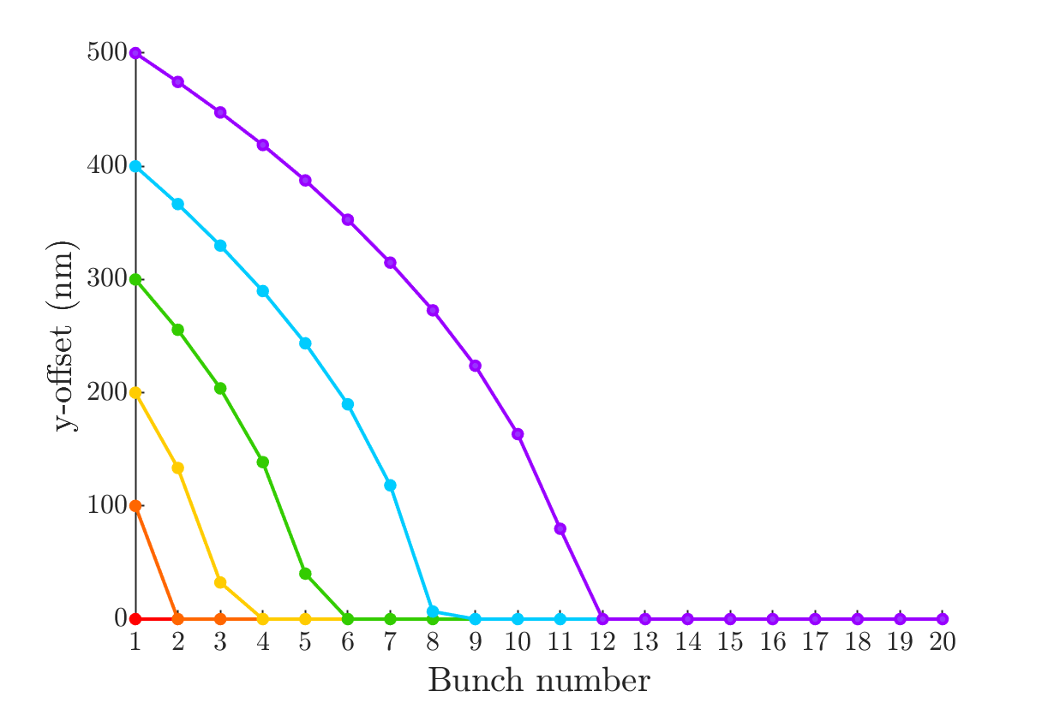
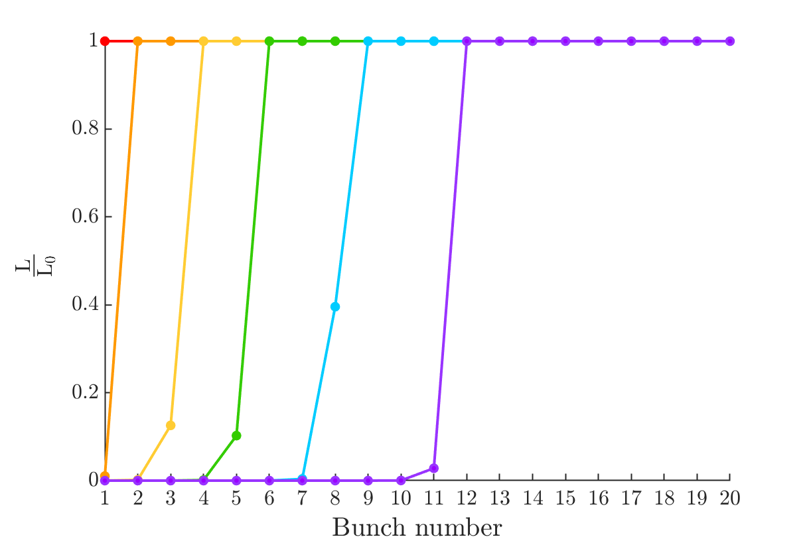
Proportional FB – rigid trains w/ offset
Proportional gain feedback on a rigid train – all bunches with constant offset specified by the colour of the line.
Run feedback on rigid trains with various different offsets, some of which exceed the turnaround (+/- 125 nm) of the beam-beam deflection curve.
Uncorrected offset (nm)
0,
100,
200,
300,
400,
500
Corrected bunches

Slide 17
Proportional and Integral FB: harmonic
Test performance of different integral gains

Slide 18
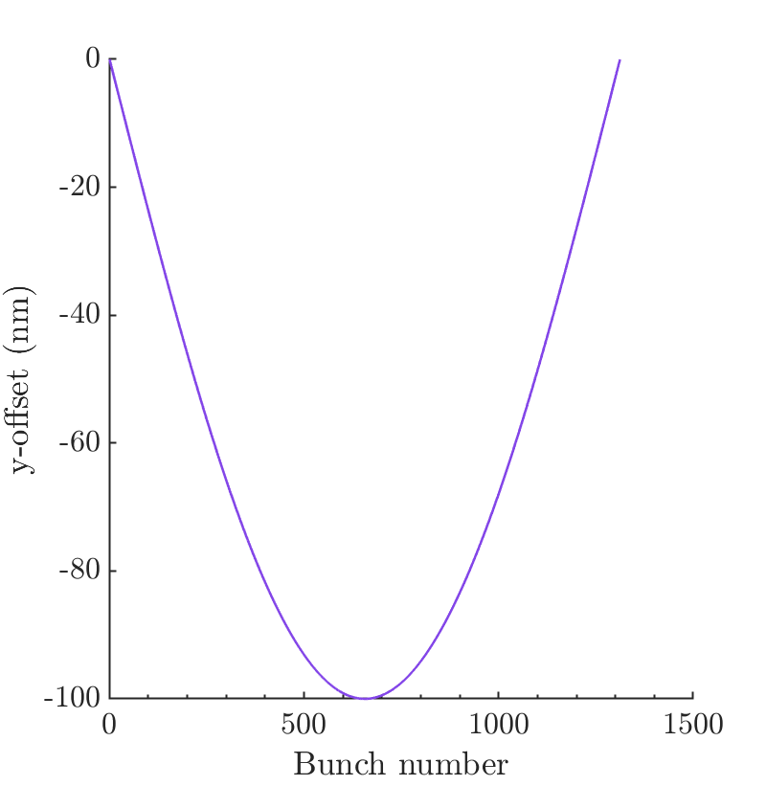
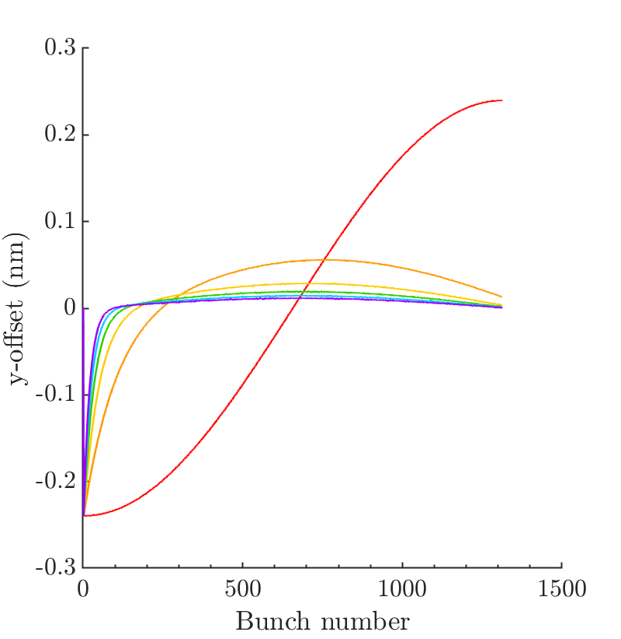
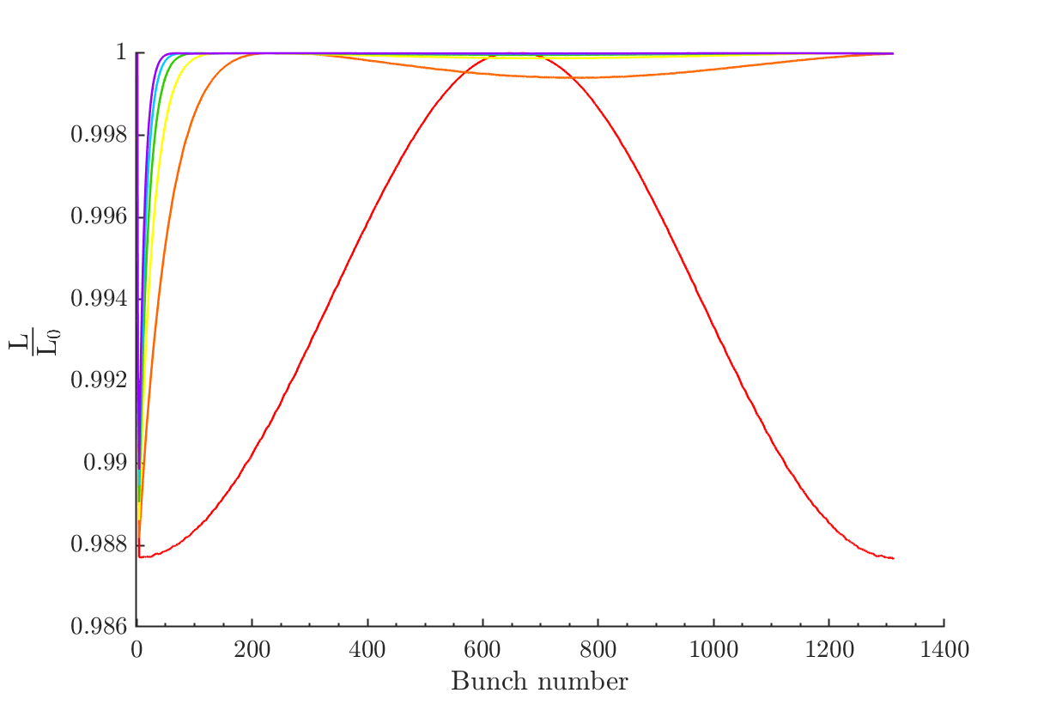
Effect of changing integral gain
Uncorrected bunch trains.
Harmonic: amplitude 100 nm.
Bunch trains with proportional and integral fb. With integral gains:
0, 0.01, 0.02, 0.03, 0.04, 0.05
Integrated luminosity for bunch trains with proportional and integral fb. With integral gains:
0, 0.01, 0.02, 0.03, 0.04, 0.05

Slide 19
Proportional FB: harmonic
Test performance of FB on different frequencies of harmonic

Slide 20
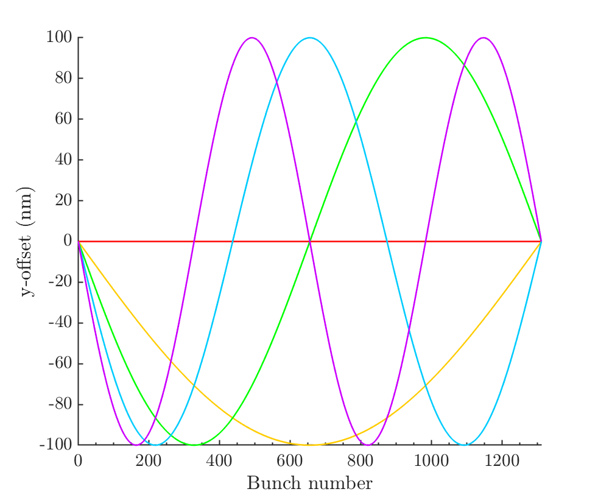
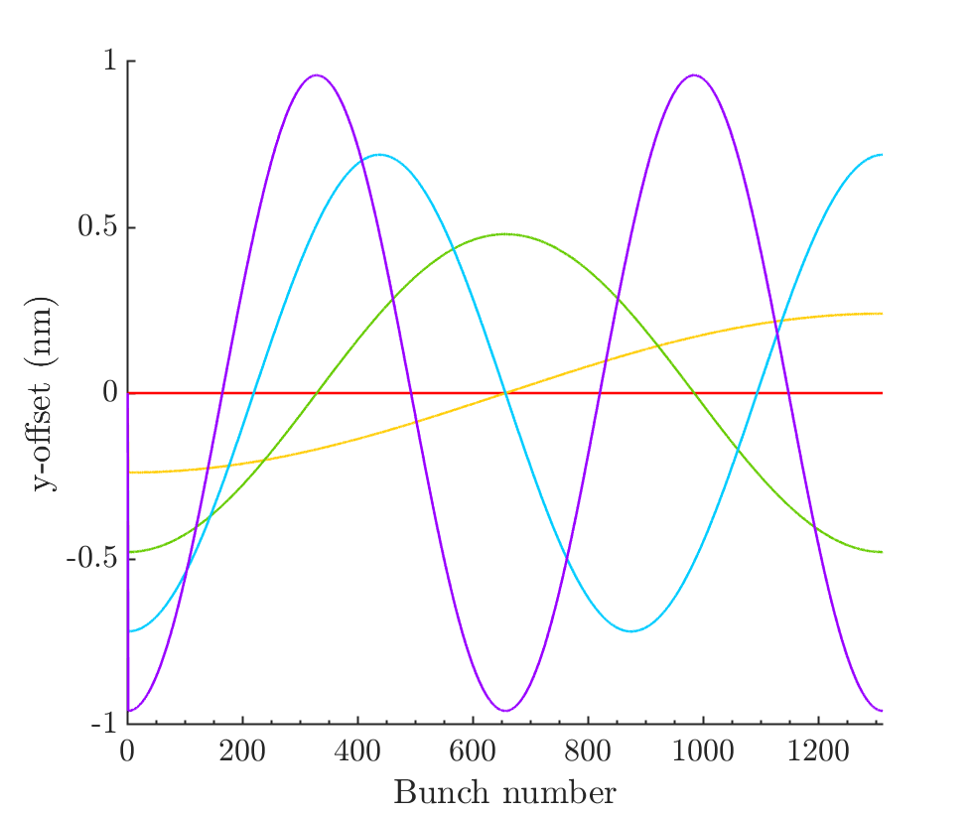
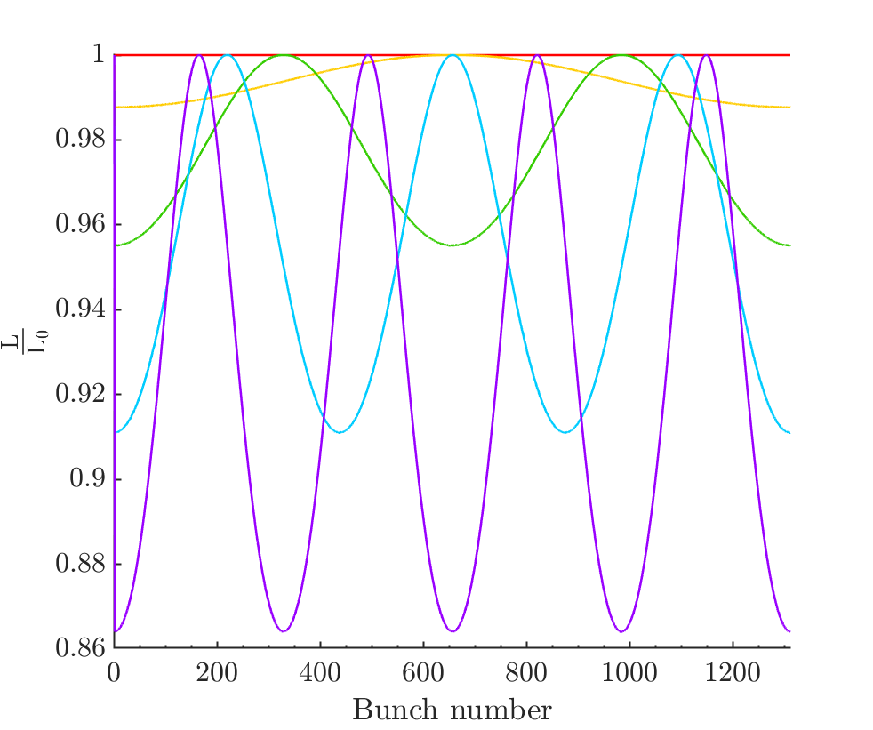
100 nm magnitude harmonic
Performance of proportional feedback on 100 nm harmonics with a range of frequencies.
0, 1, 2, 3, 4 half-cycles within the bunch train.

Slide 21
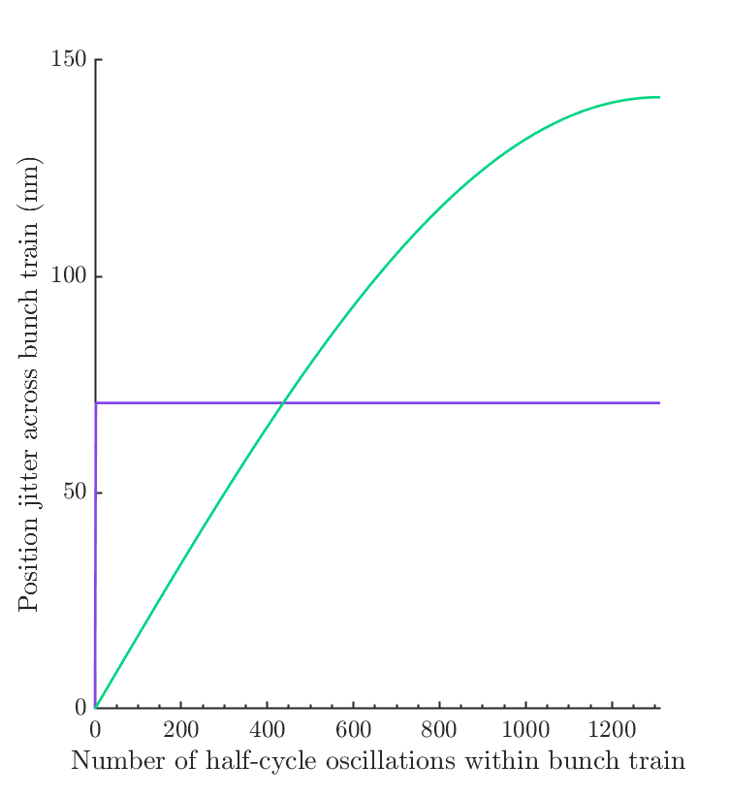
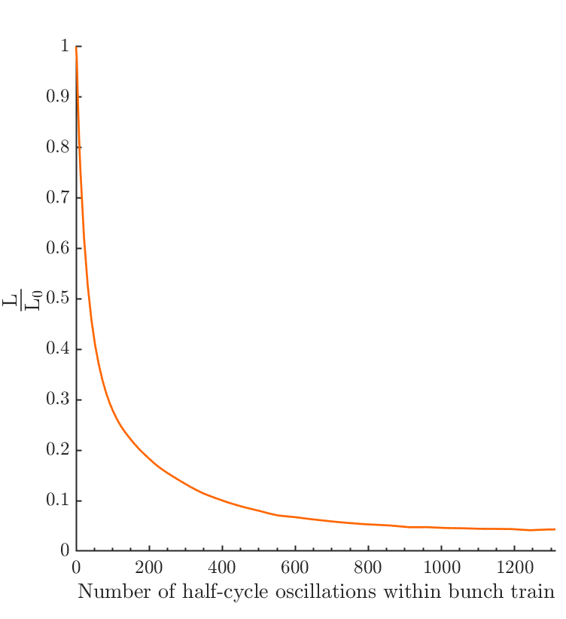
FB performance as function of harmonic frequency
Proportional feedback acting on bunch train with harmonic structure.
Position jitter across bunch train as a function of number of half-cycles of harmonic within the bunch train, for feedback off and on.
Integrated luminosity for beam with feedback acting.
FB off
FB on

Slide 22
Beam-beam deflection curve

Slide 23
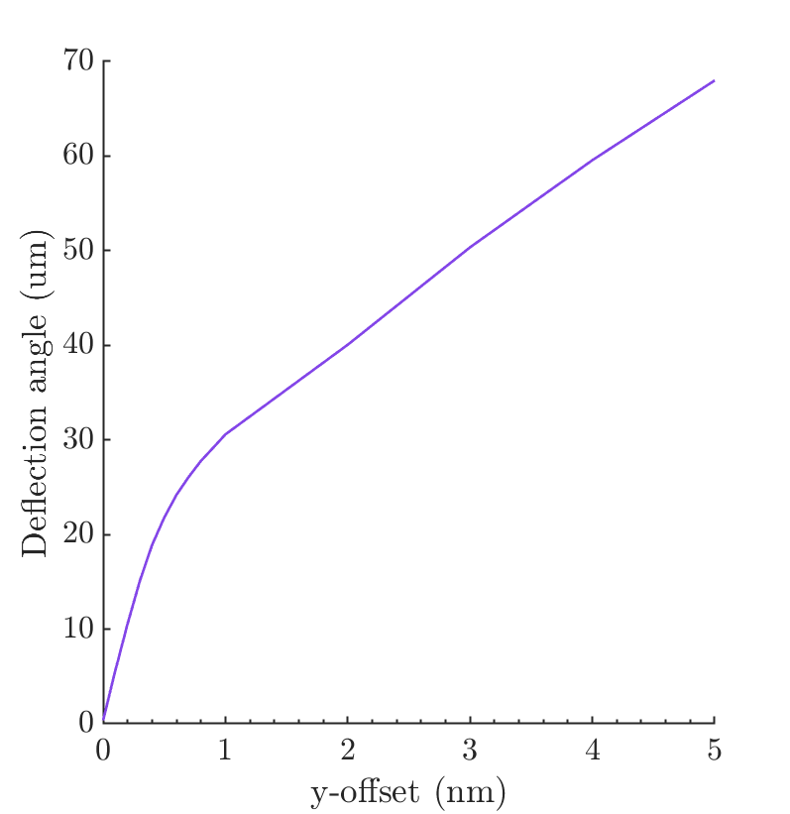
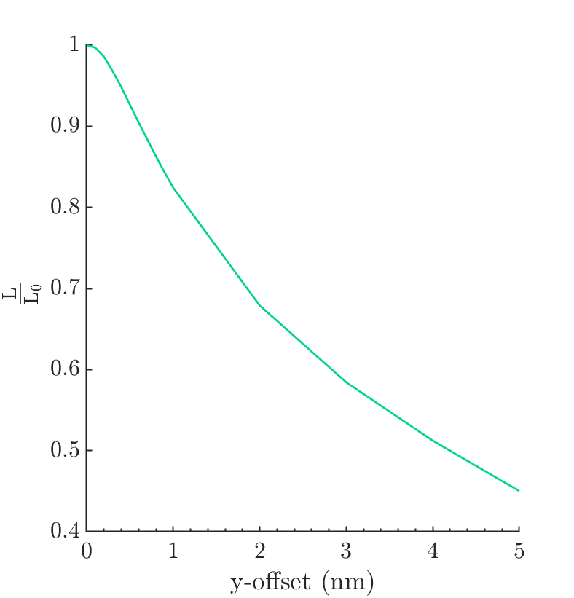
Luminosity/Deflection Angle Plots
Central region of beam-beam deflection curve and luminosity curve.
I intend to rerun this with a slightly higher sampling density to make the curves smoother.

Slide 24
Summary
Lucretia: running BDS, short range wakefields applied but nothing included in the simulation to produce much structure across the bunch train.
Guinea-pig: beam-beam deflection curves are making slow progress as they take >30 hours to run and I’m having trouble developing an algorithm for adaptive meshing that works for cases which are far from nominal.
Placet: Installed, running and I am beginning to figure out how it works. Still having problems getting the beam to reach the IP without losing the beam.

Slide 25
Additional slides

Slide 26
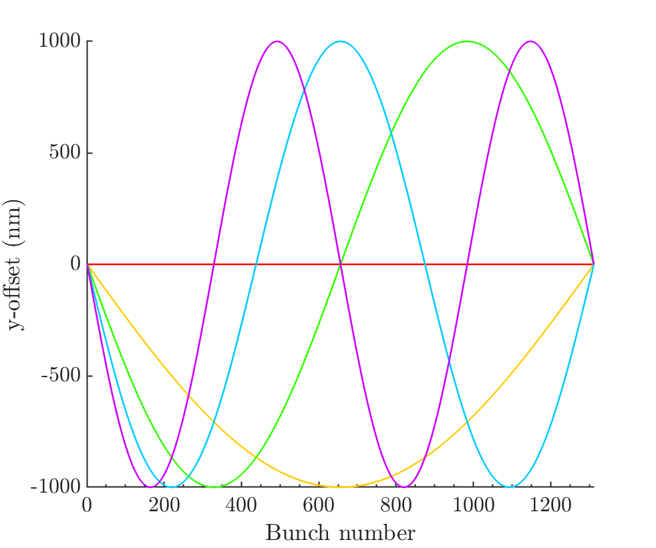
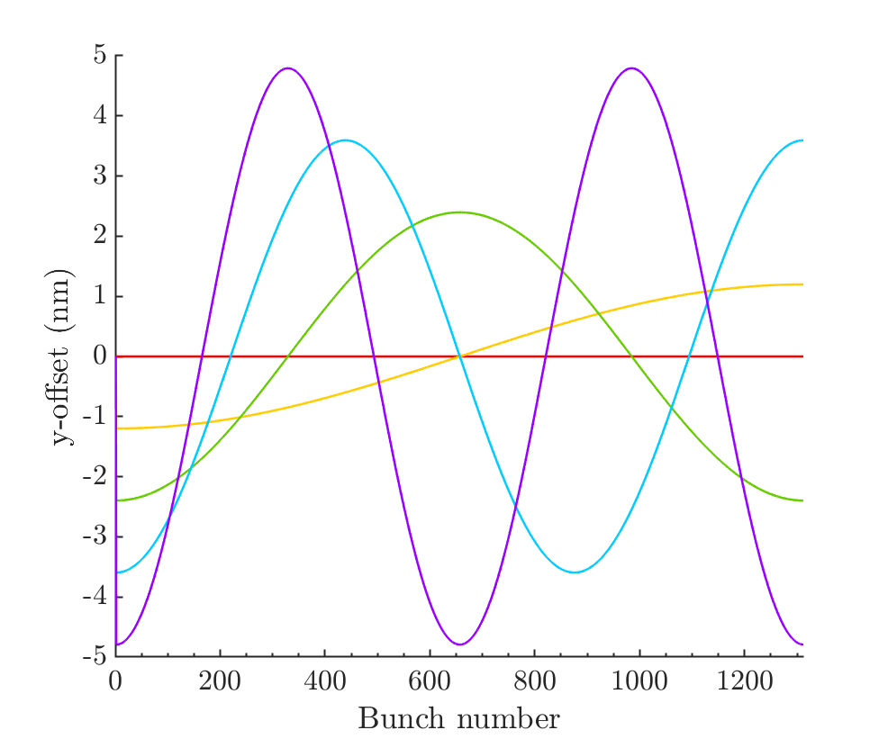
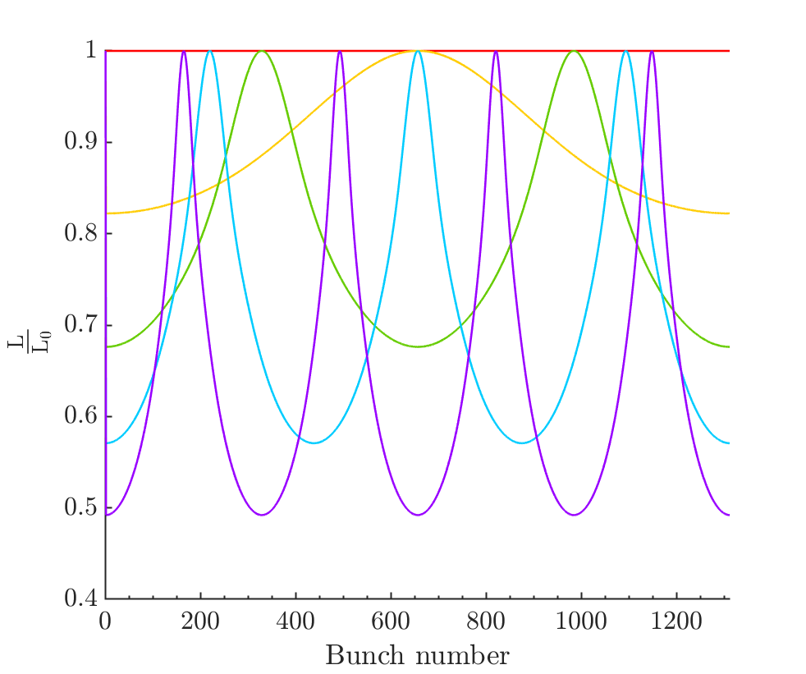
1 um magnitude harmonics

