Slide 1

HCAL/Pandora/Tracking Update
Andy White, Andrew Myers, Ross McCoy, Sakshi Nag, Divyanshu Sharma

Slide 2
Clean Rebuild of lcgeo
ILCSoft v02-00-01
https://www.evernote.com/shard/s157/sh/6a8bf792-3942-4db1-ab72-776a13ee38d4/1a6995993ad1f0f9
Ran Simulations with model SiD_o2_v03
Ran Reconstruction
xml: SiDReconstruction_o2_v03_calib1ct2
Errors occurred while running reco
Checked HCAL endcap geometry
https://github.com/iLCSoft/lcgeo/blob/master/SiD/compact/SiD_o2_v03/HCalEndcap_brass_v03.xml

Slide 3
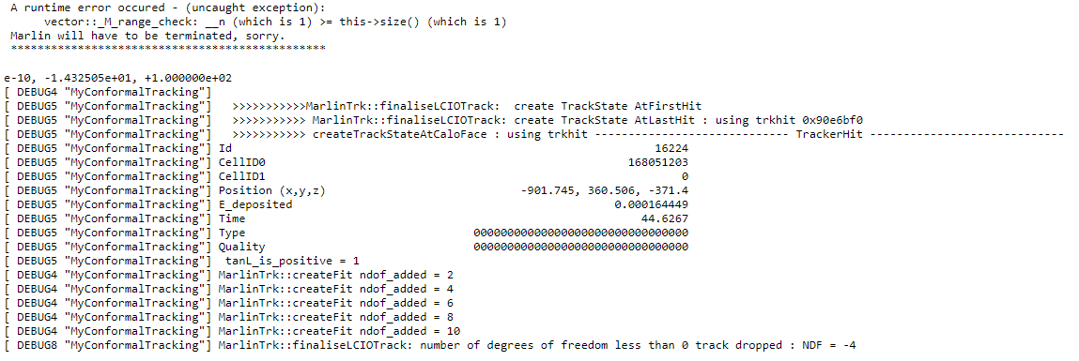
Reconstruction Errors
Log file: https://files.slack.com/files-pri/T0E3R2E6L-FCNH2U4JJ/nohup.out or can be provided

Slide 4
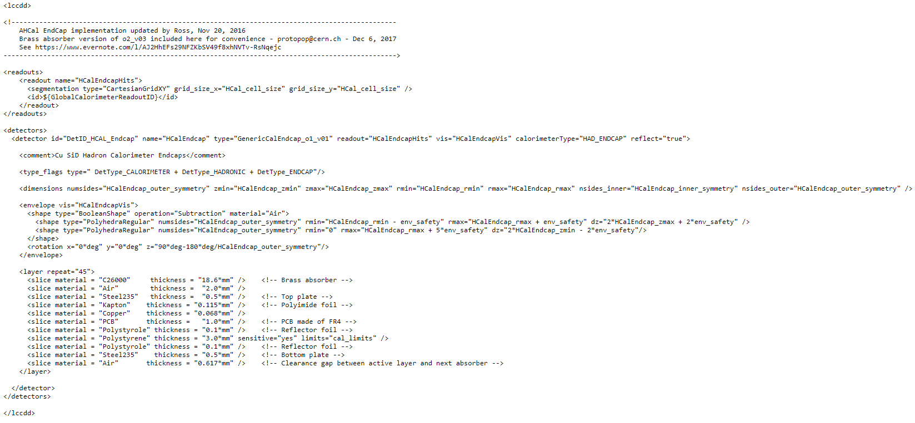
HCAL Endcap Geometry
Rpc gas?

