Slide 1
ILD News
P. Colas

Slide 2
Liaison report being updated as discussed in previous WP meeting (M. Titov). Was mostly from 2016. Includes a new Micromegas section with 2-3 figures.
IDR in progress (ILD Design Report = update of the DBD):skeletton available.
For the TPC, need to write <1 page on Subdetector layout, section 5.1.2 (structure and readout options), and 3 pages in the Subdetector technology status, section 5.2.2 (Paul and Akira).
TPC prototype for generic beam tests of all readout options, the gating scheme and cooling. Mention LYCORIS silicon telescope and new field cage in construction.
CO2 Cooling measurements
Successful gating achieved with GEM
GEM and Micromegas spacial and ionization resolutions
Ongoing technological developments: improved module planarity, GRIDPIX RO options, etc.

Slide 3
News from Saclay
P. Colas

Slide 4
Beam test preparation.
Preparation period : October. DAQ, Assembly (Gluing, connectors, electronics, cooling) and tests at Saclay. Participation from engineers and technicians.
Travel and installation period: November 12-16. Saclay team (D. Attié, PC, Marc Riallot, Serguei Ganjour, Tomohisa Ogawa)
Data taking period November 19-30. Doodle sent, a few answers…

Slide 5
Status of the preparation
New DAQ computer. The DAQ program was not compiling, now OK, but still ‘features’ to update.
DLC pressed on 4 new module PCBs, but slight drips on the DLC. Decided to go on with bulk MM on one module and see if it holds voltage.

Slide 6
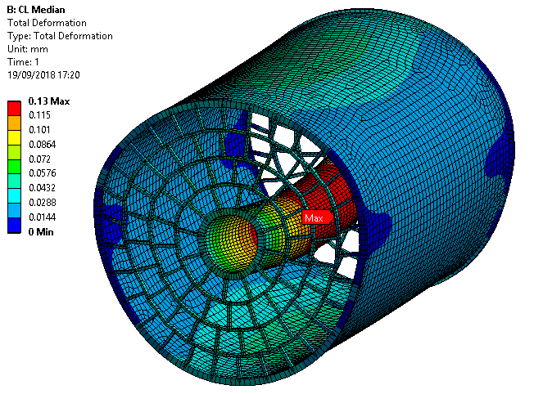
Mechanical studies
Several meetings in May, July, and yesterday
Calculations of deformation and strains started
The model for suspension is 4 horizontal ribbons fixed to the HCAL

Slide 7
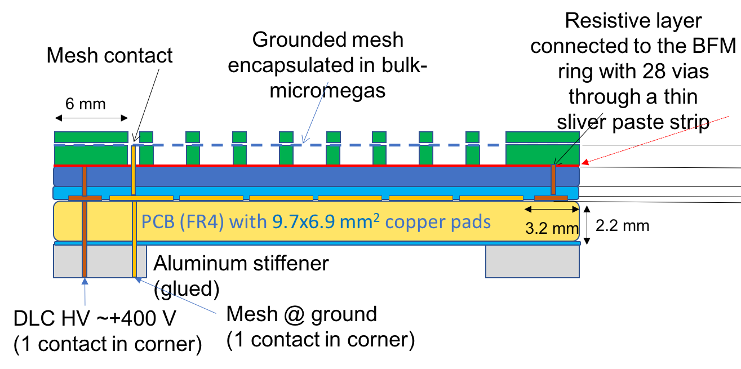
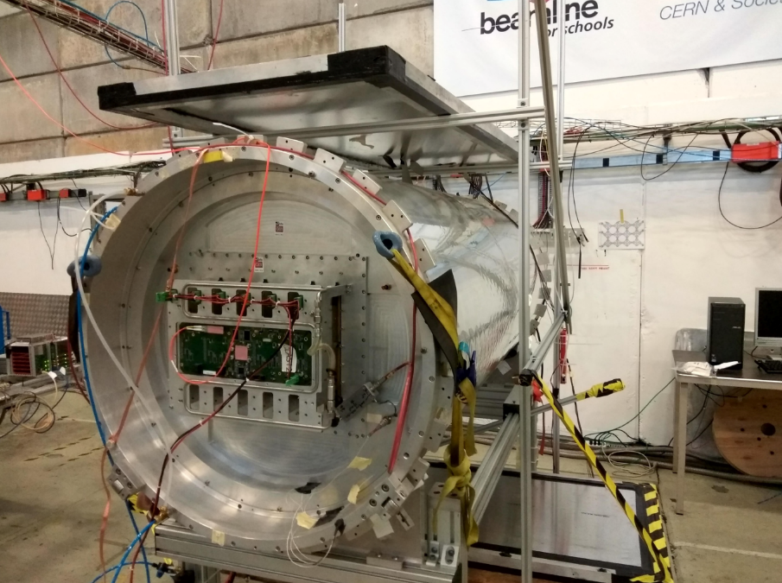
Successful T2K beam test at CERN T9 in August-September (see also report WP meeting)
First analyses going on: Good e-µ separation at 0.5-1GeV/c with dE/dx. 10-11% resolution with 30 cm tracks.
Start looking at resolution.

Slide 8
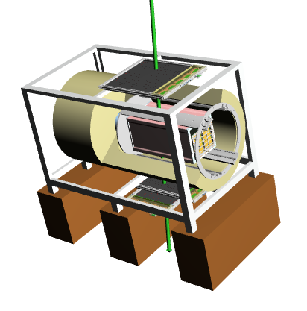
Plan for 2019 : T2K prototype test at DESY
M. Zito applied for a test in T24/1 in June
Plan to test a new MM module (42x36 cm²) in a 1m long field cage (inspired from the DESY design)

