Slide 1


Simulations:
Interaction profiles & deflection angle curves
R. Ramjiawan
Friday, 14th September 2018

Slide 2
Outline
Placet: I’m still having problems with the lattice files, there are a few problems with the simulation of the {RTML, ML and BDS} together. So far I have the BDS alone working, with the correct emittance at the IP. The ML standalone simulation is failing with emittance increase, and I’m still unsure why this isn’t working either.
Lucretia: I’ve increased the cut-off (in terms of standard deviation) of the Gaussian beam generated, so that I’m not getting a sharp edge to the distribution.
Guinea-pig: Further work on beam-beam deflection curves:
Horizontal bunch size – scan across wider range
Charge – finer scan of central region of deflection angle curve
Vertical bunch size – finer scan of central region of deflection angle curve
MATLAB FB model: Feedback on beam with non-nominal parameters with the feedback system assuming nominal deflection angle curve.

Slide 3
Placet
I’m still working through a lot of issues with getting the lattice files (kindly provided by Pierre to work). Issues with the RTML_ML_BDS simulation so far have included:
the emittance was wrongly defined at the start of the RTML and BDS.
resistive walls were added (which I have now removed) and no correction for the wakefields introduced by these resistive walls led to beam loss.
angular offsets were introduced in the RTML (1 urad, 5 urad) - these have also now also been removed.
I think I have found a way to set the number of bunches in the train, but I’m yet to test this – and it was suggested by Chet/Ryan that this wasn’t possible – so I need to look further into this.

Slide 4
Bunch Profiles –
At IP before interaction

Slide 5
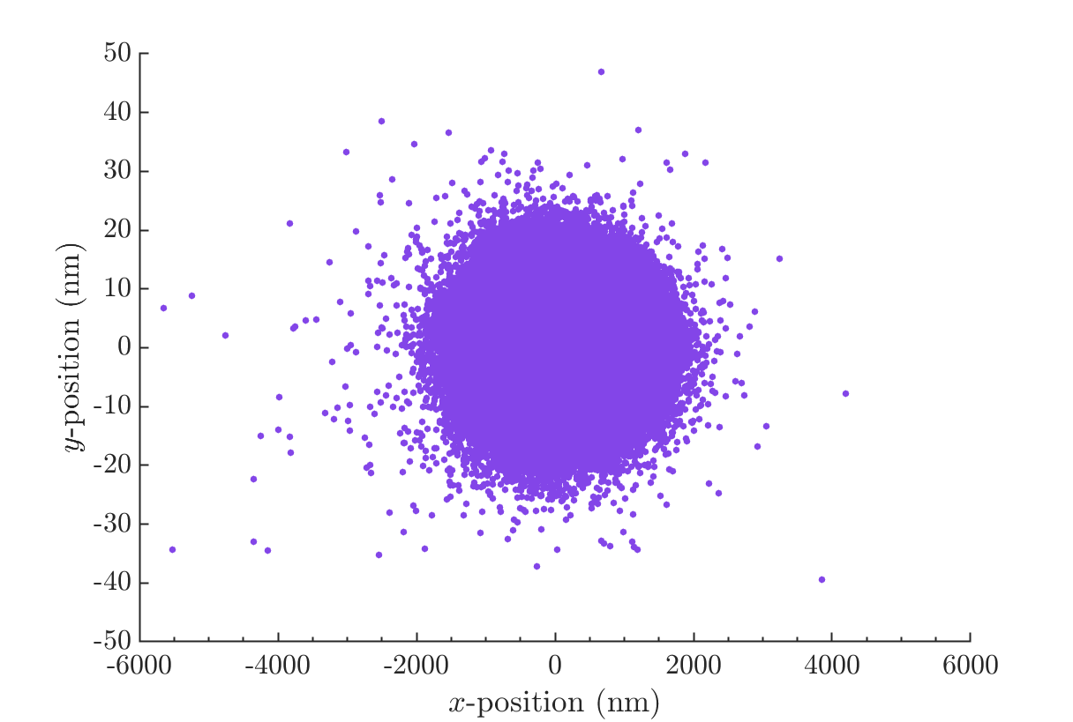
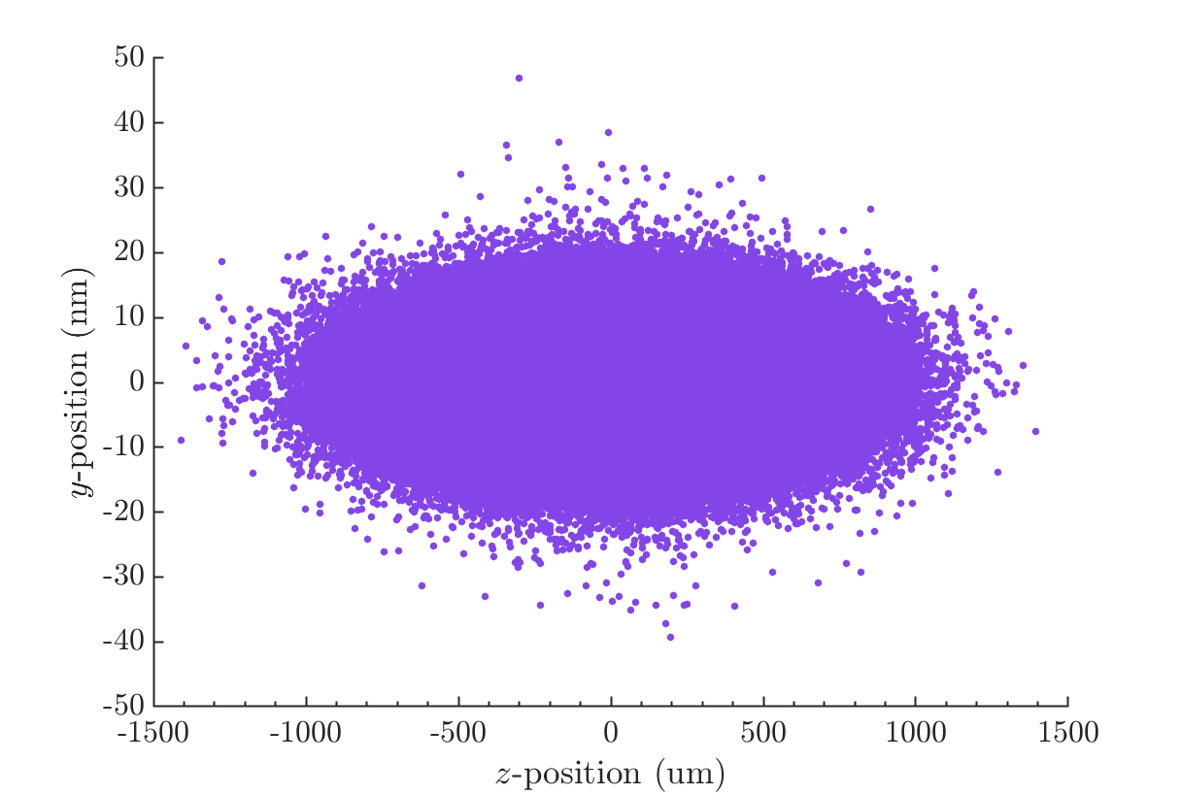
Bunch profiles
I extended the cut-off for the 6D Gaussian Beam generator so that it wasn’t cutting off as much of the tail of the distribution. This beam is a Gaussian up to 10 sigma.
Plotted: 80,000 macroparticle bunches distributions tracked through the BDS to the IP.

Slide 6
Bunch Profiles –
At IP after interaction

Slide 7
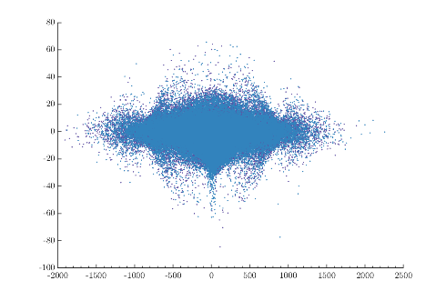
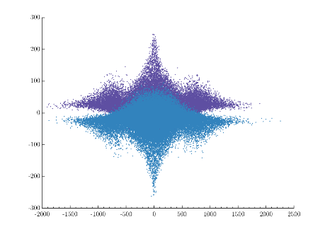
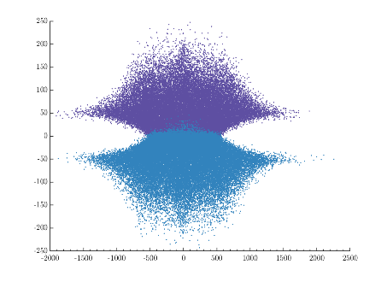
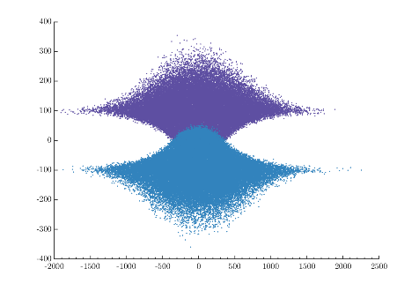
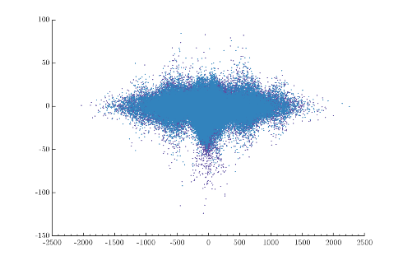
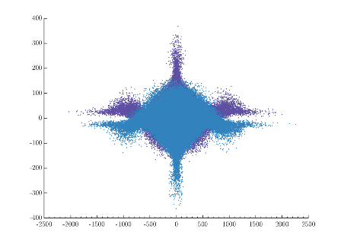
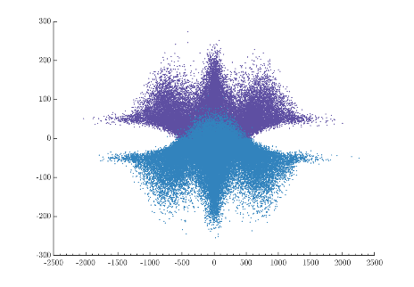
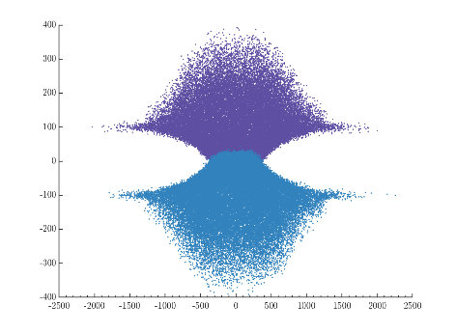
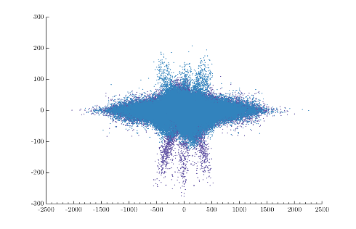
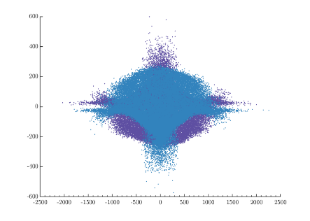
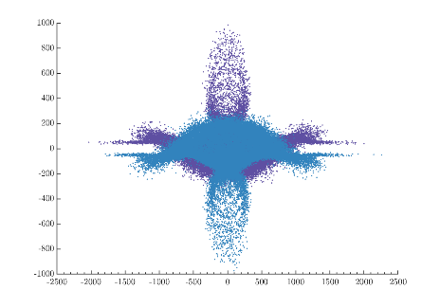
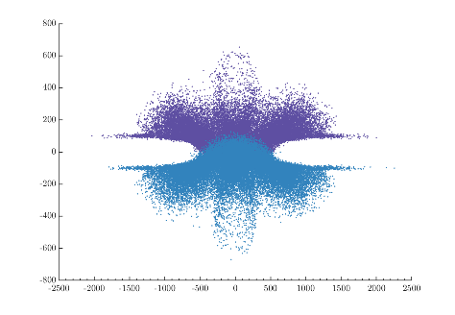

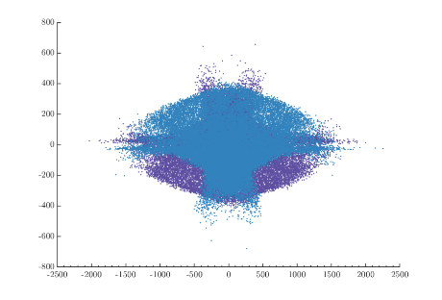
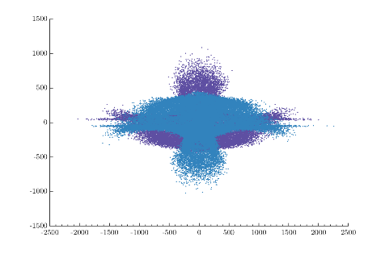
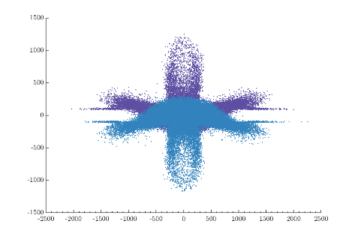
Offset 2*
0 nm
25 nm
50 nm
100 nm
SigmaZ=
300 um
SigmaZ=
500 um
SigmaZ
1000 um
SigmaZ
1500 um

Slide 8
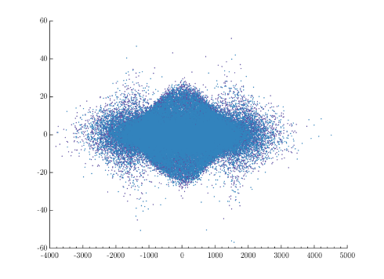
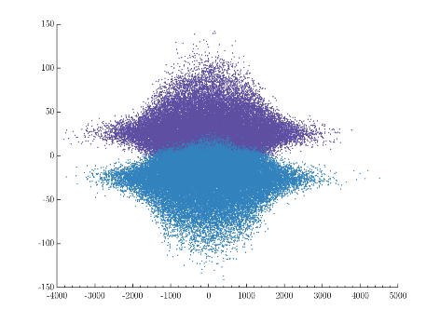
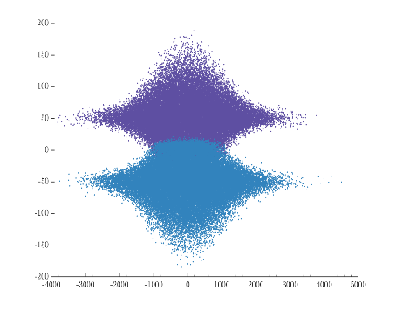
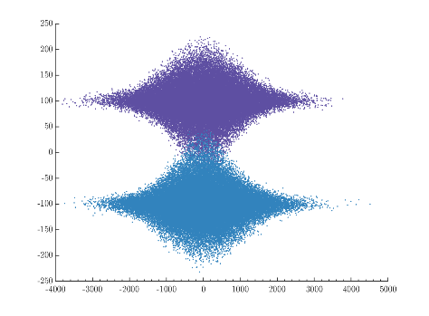
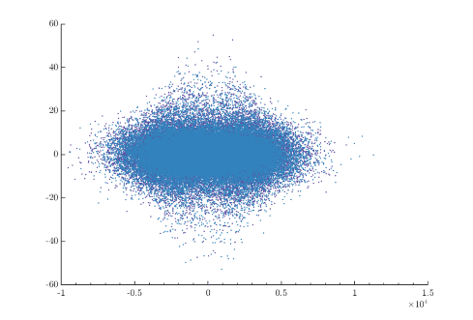
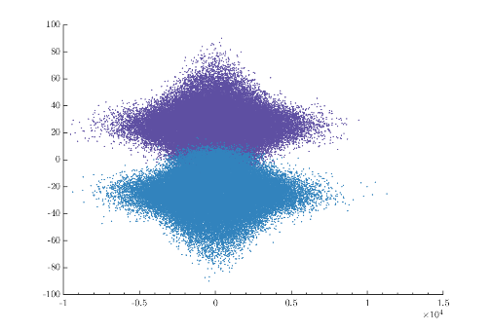
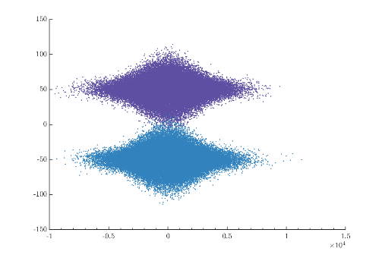
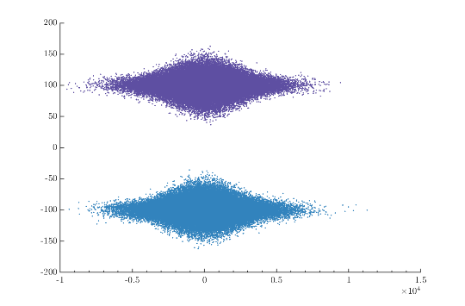
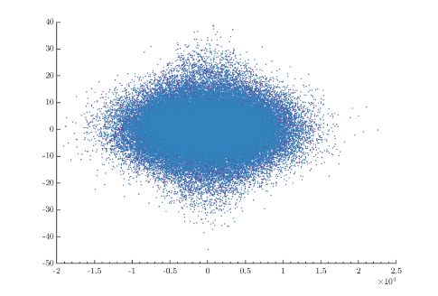
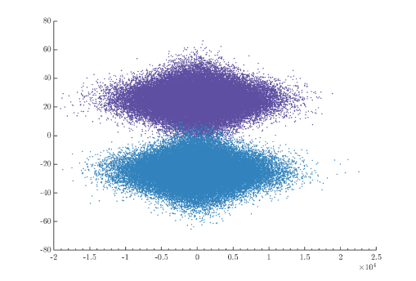
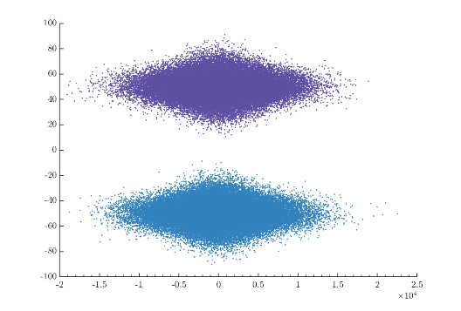
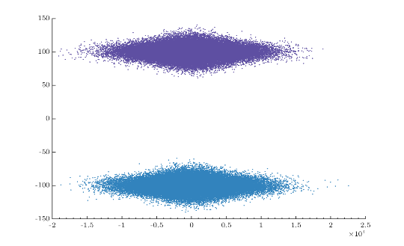
Offset 2*
0 nm
25 nm
50 nm
100 nm
SigmaX=
474 nm
SigmaX=
948 nm
SigmaX
2370 nm
SigmaX
4740 nm

Slide 9
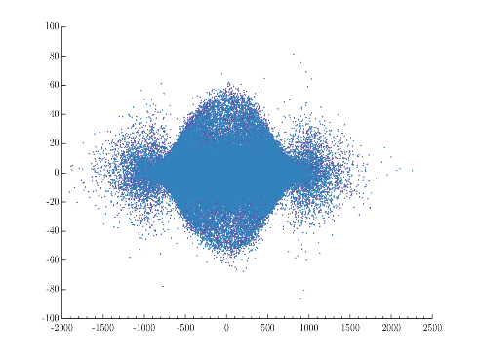
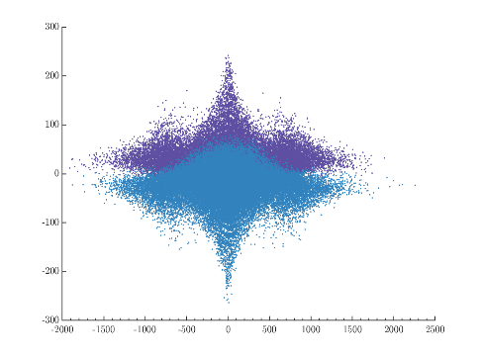
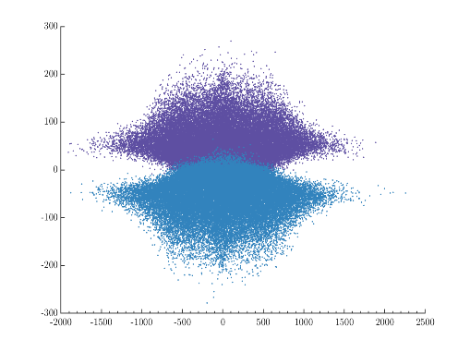
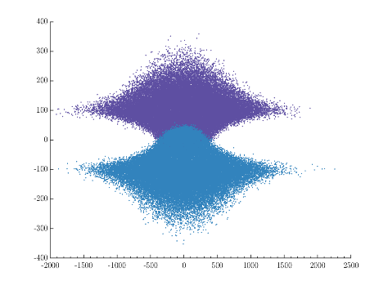
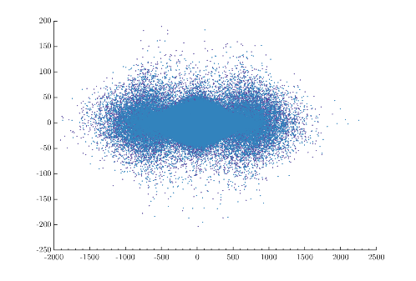
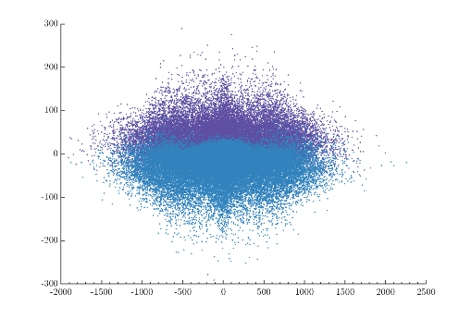
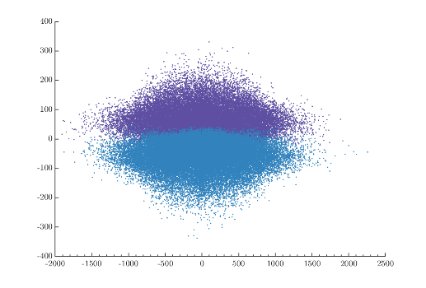
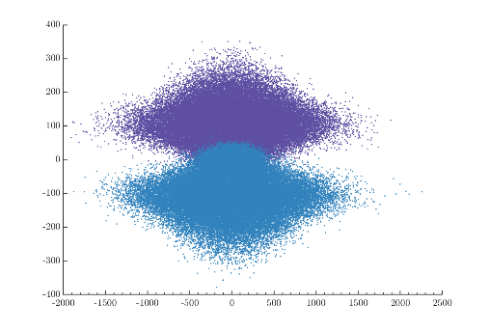
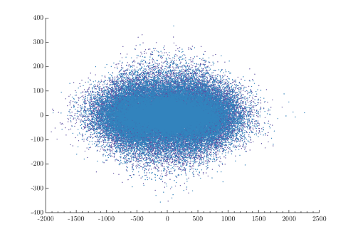
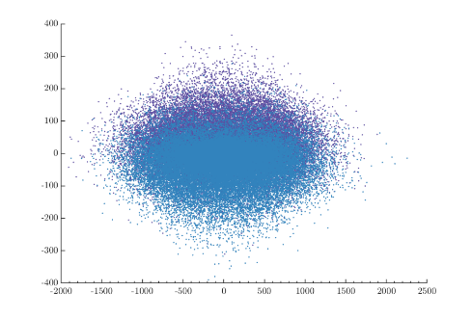
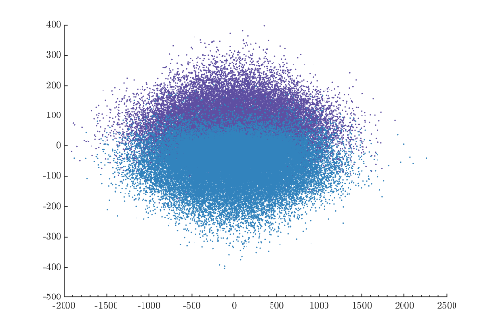

Offset 2*
0 nm
25 nm
50 nm
100 nm
SigmaY=
5.9 nm
SigmaY=
11.8 nm
SigmaY
29.5 nm
SigmaY
59 nm

Slide 10
Beam-beam deflection curves

Slide 11
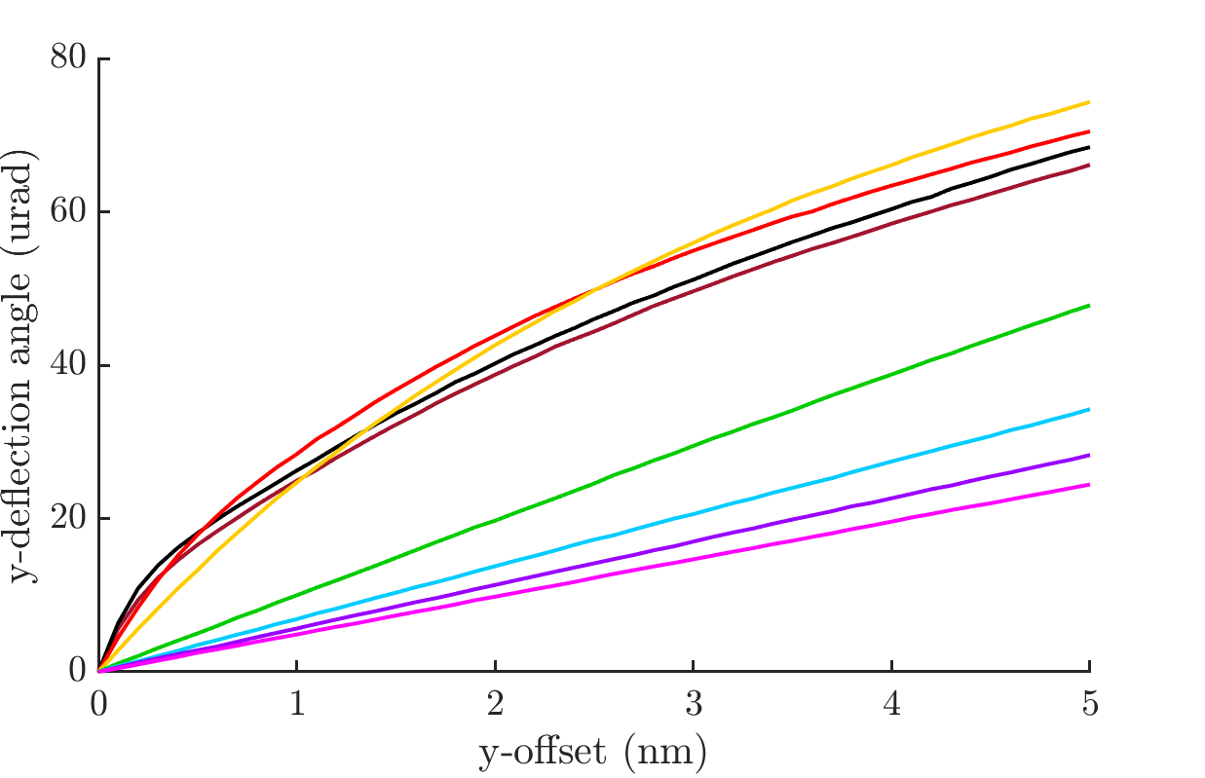
Deflection angle curves: sigma_y
Finer scan of the central region of the deflection angle curves for a range of vertical bunch sizes.
Sigma_y: (nm)
2.95
5.9 (nominal),
8.85,
11.8,
23.6,
35.4,
47.2,
59.

Slide 12
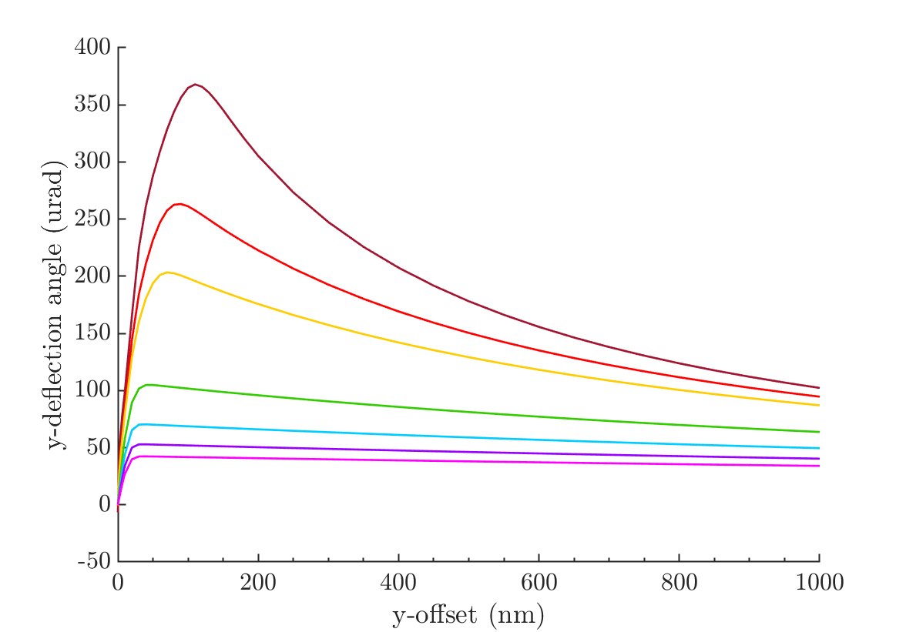
Curves: as a function of sigma_x
Beam-beam deflection curve plotted for a wider range – now up to 1000 um y-offset for different values of horizontal bunch size.
Sigma_x: (nm)
474 (nominal),
711,
948,
1896,
2844,
3792,
4740.

Slide 13
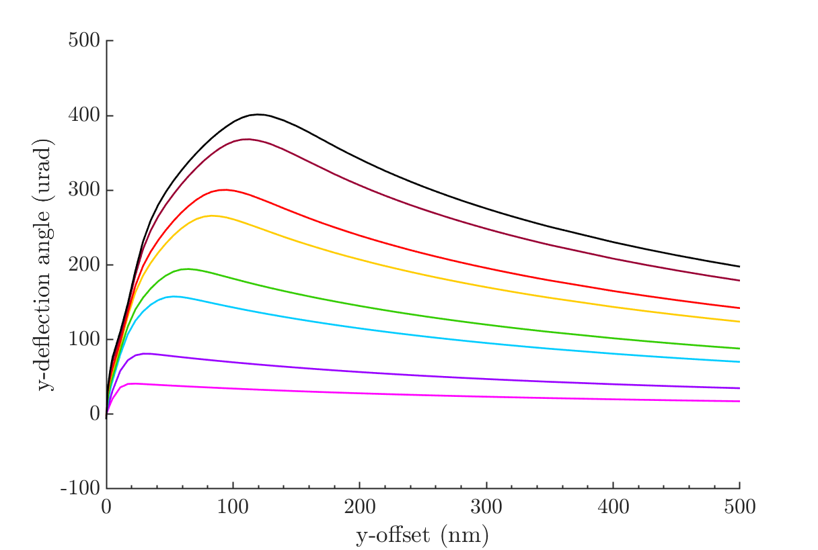
Bunch charge – beam-beam deflection
Beam-beam deflection curve plotted for a range of charges (x10¹⁰)
0.2,
0.4,
0.8,
1,
1.4,
1.6,
2 (nominal),
2.2

Slide 14
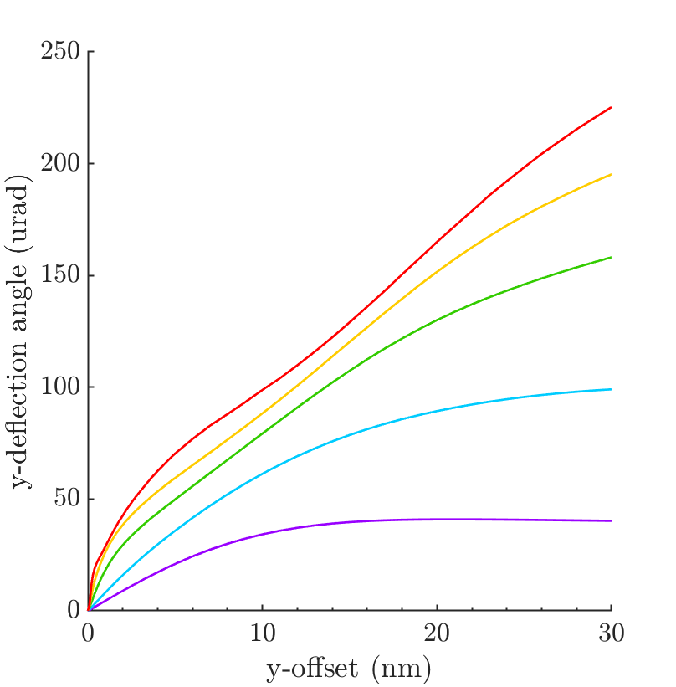
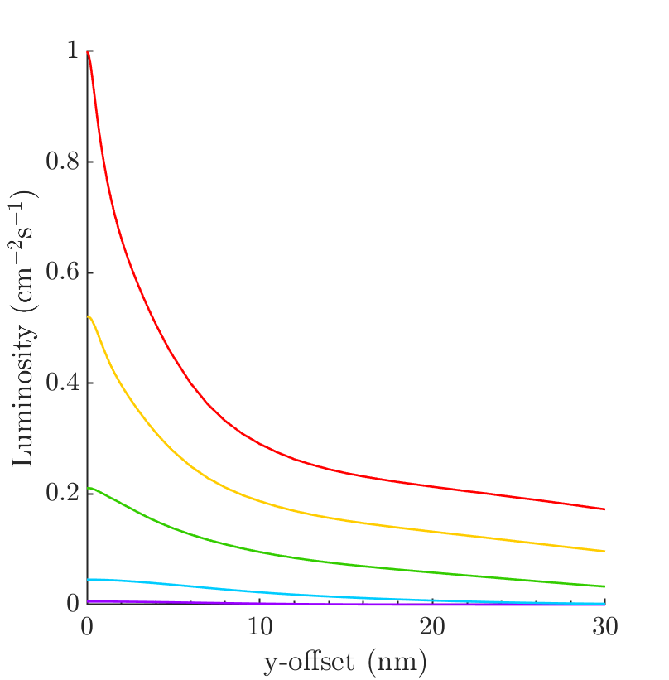
Deflection Angle Curves: charge
Colours represent bunch charge (x 10¹⁰)
0.2,
0.5,
1,
1.5,
2 (nominal)

Slide 15
Feedback with non-nominal beams
- But assuming nominal deflection angle curve during feedback

Slide 16
Non-Nominal Feedback Loop Simulation
Construct uncorrected e+e- bunch trains (1312 bunches), with noise, drifts, harmonics, etc.
Run for multiple trains and average results.
Determine luminosity from bunch-bunch offset (using nominal luminosity-offset curve)
True beam offset at IP = Uncorrected offset + correction
True beam-beam deflection (using non-nominal deflection curve)
Delay loop
True offset at BPM (using IP to BPM distance 4m)
Apply correction (inc. kicker error 0.1% offset)
Measured offset at BPM (resolution)
Estimate deflection angle curve – will be different from true curve – here using nominal curve

Slide 17
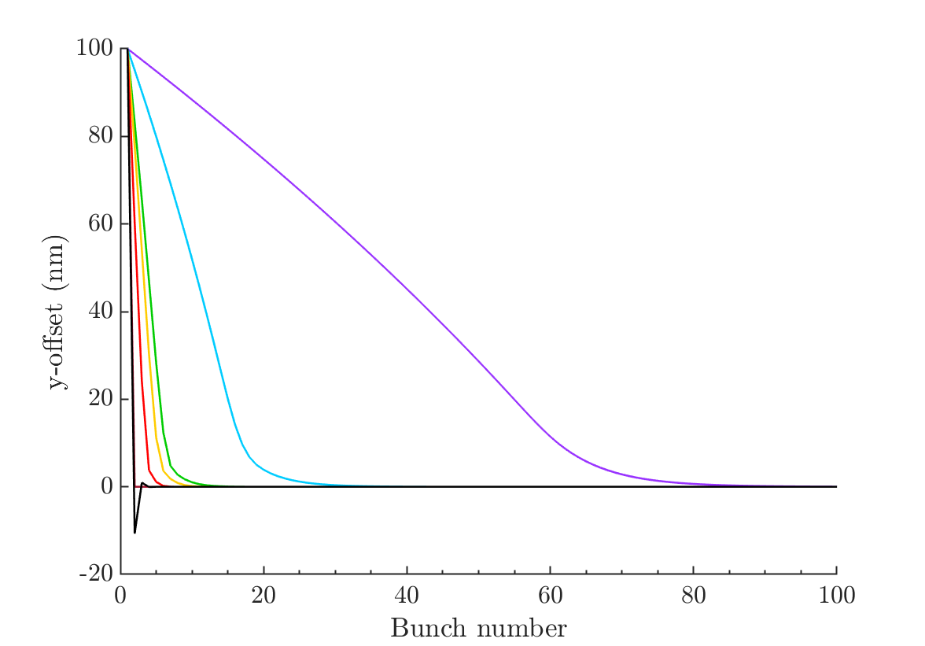
Non-nominal charge
Bunch-bunch offset with feedback on, acting on rigid bunch with 100 nm offset. Assuming nominal deflection angle curve.
Beam-beam deflection curve plotted for a range of charges– [0.2,0.4,0.8,1,1.4,2,2.2]x10¹⁰.
Beam-beam deflection angle curves (brown is nominal curve)

Slide 18
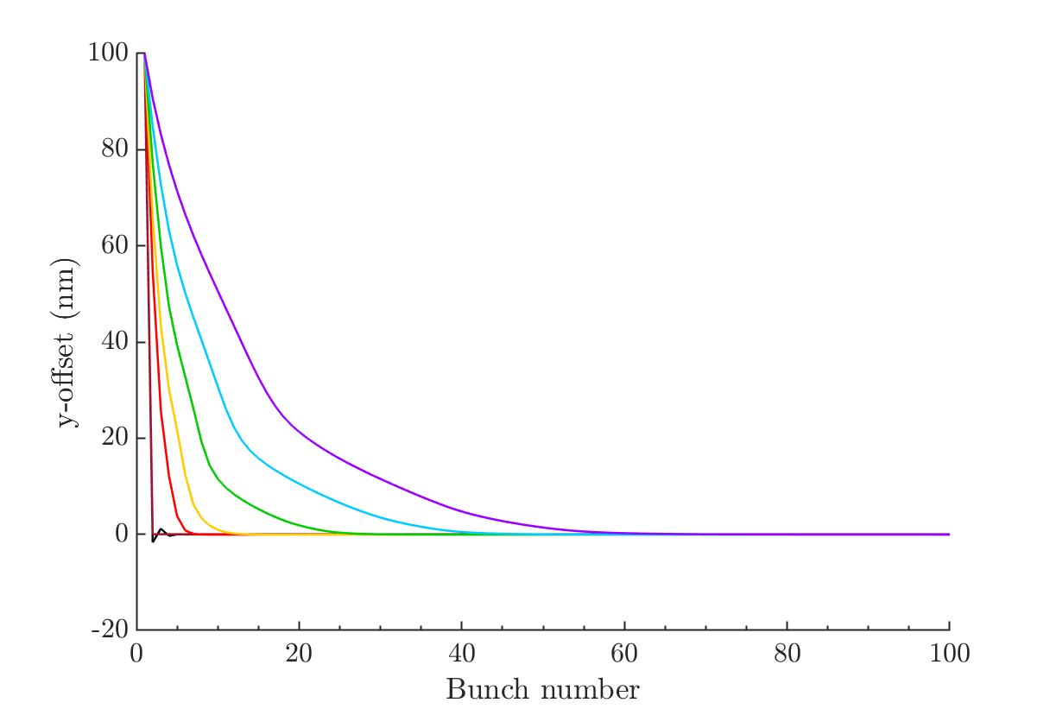
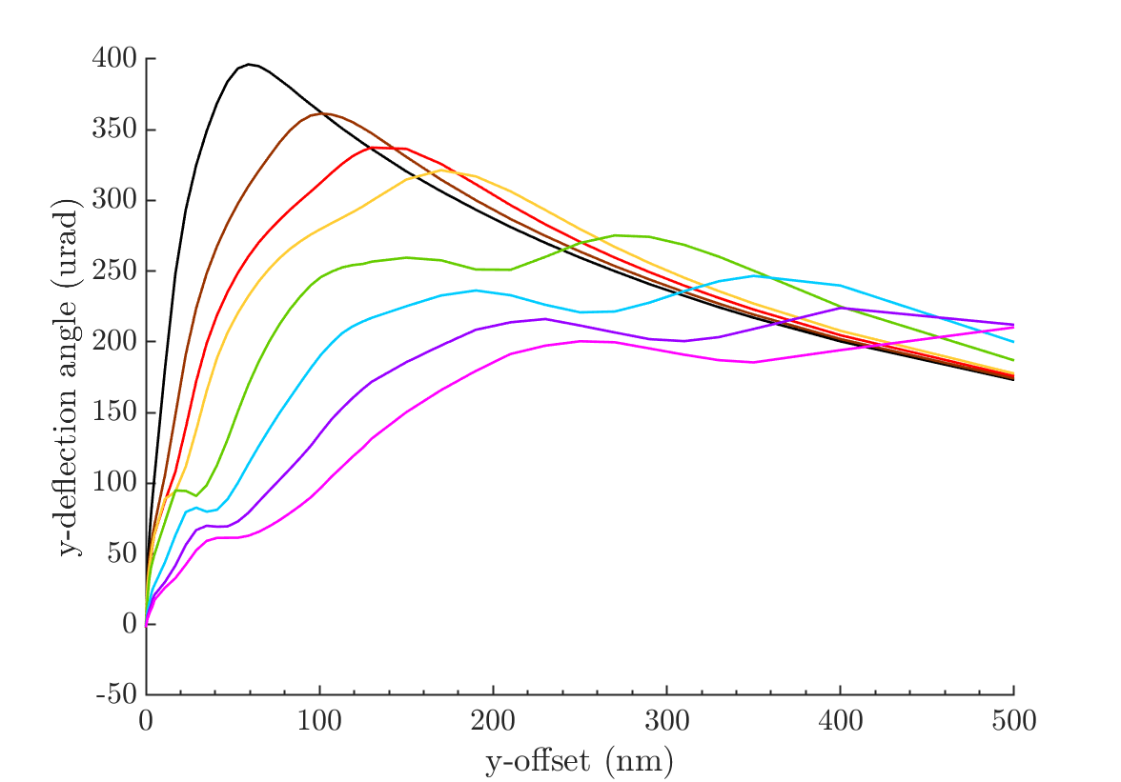
Non-nominal bunch length
Bunch-bunch offset with feedback on, acting on rigid bunch with 100 nm offset. Assuming nominal deflection angle curve.
Sigma_z (um):
150,
300 (nominal),
600,
1200,
1800,
2400,
3000.
Beam-beam deflection angle curves (brown is nominal curve)

Slide 19
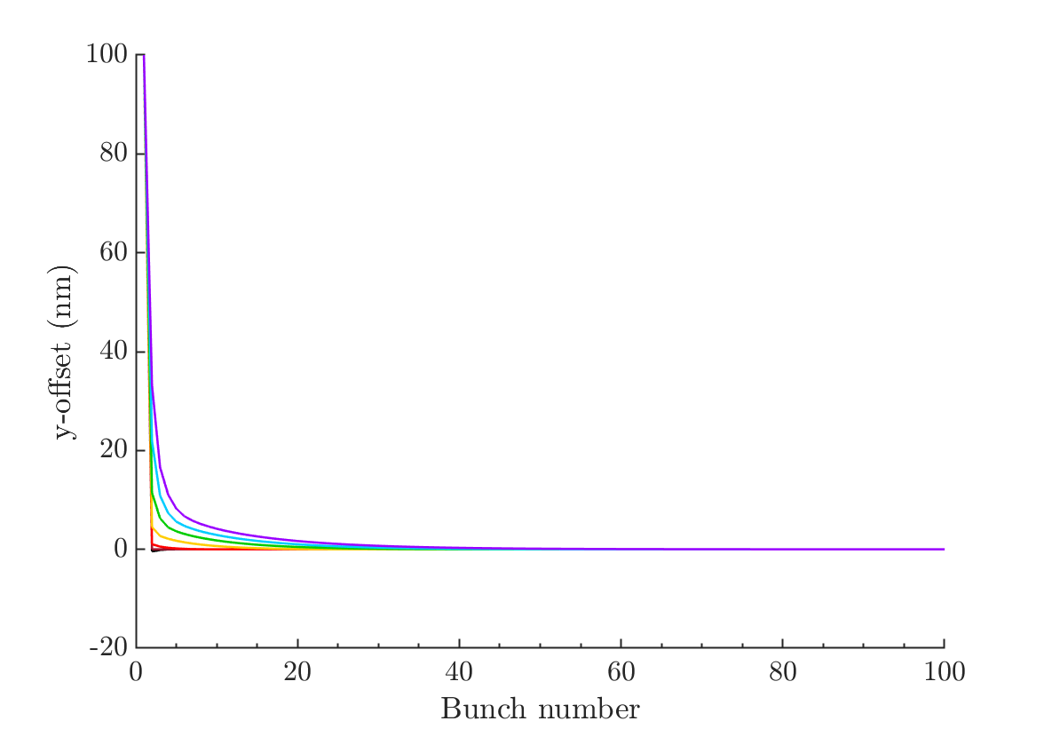
Non-nominal vertical bunch size
Bunch-bunch offset with feedback on, acting on rigid bunch with 100 nm offset. Assuming nominal deflection angle curve.
Sigma_y: (nm)
2.95
5.9 (nominal),
11.8,
23.6,
35.4,
47.2,
59.
Beam-beam deflection angle curves (brown is nominal curve)

Slide 20
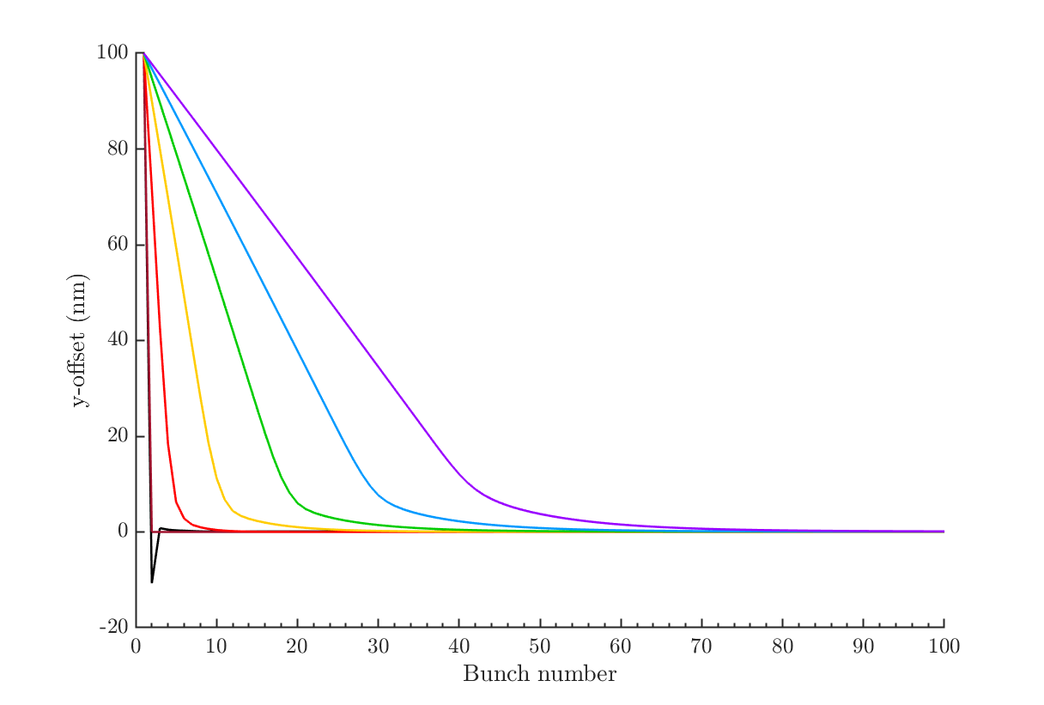
Non-nominal horizontal bunch size
Bunch-bunch offset with feedback on, acting on rigid bunch with 100 nm offset. Assuming nominal deflection angle curve.
Sigma_x: (nm)
474 (nominal),
711,
1896,
2844,
3792,
4740.
Beam-beam deflection angle curves (brown is nominal curve)

Slide 21
Summary
Placet: So far I have the BDS alone working, with the correct emittance at the IP, but I am having problems with emittance growth in both the ML standalone simulation and the simulation of the RTML, ML and BDS together.
Guinea-pig: Further work on beam-beam deflection curves:
Possibly still some meshing issues with the curves for non-nominal vertical bunch sizes, lines cross and I’m unsure whether this is physical.
MATLAB FB model: I’ve begun to test the effect of feedback with non-nominal beam parameters if this has not been accounted for in the feedback system by adjusting the beam-beam deflection curve used.

