Slide 1
Report on ILD
Ties Behnke
02.10.2018

Slide 2
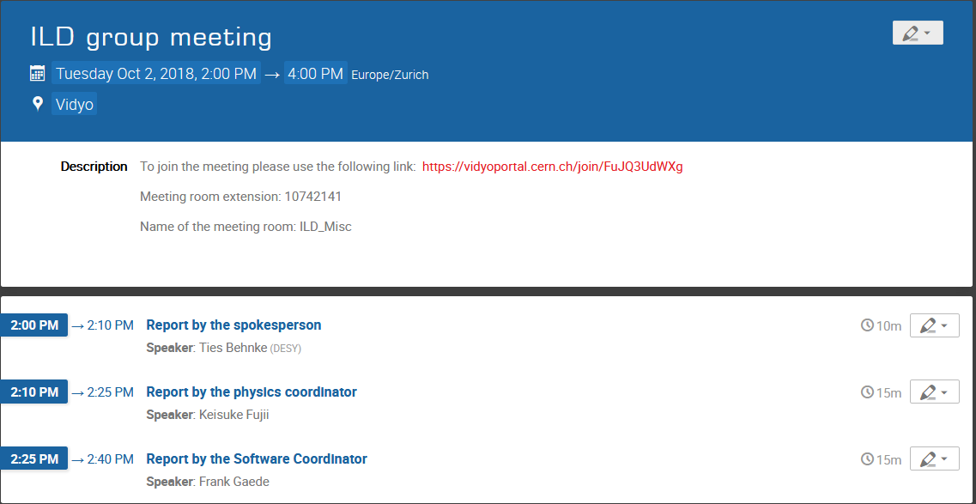
Today’s Agenda

Slide 3
ILD: General News
Preparations for Arlington:
  ILD talk (Monday): Jenny List
  ILD meeting on Wednesday afternoon
  ILD Institute Assembly most likely on Wednesday morning
Pre-meeting (benchmarking days) on the weekend before LCWS
  https://agenda.linearcollider.org/event/8011/

Slide 4
NEWS FROM TECHNICAL GROUPS
Subdetectors:
Vertex: CMOS MIMOSIS-0 prototype chip under test in Strasbourg
TPC: new micromegas layout beam-tested in DESY
Si-ECAL: successful beam test in DESY including first RO plane built in Kyushu
AHCAL: successful 2nd beam test at CERN with improved beam conditions
Integration:
New excel file to collect requests for cavern utilities distributed to subdetectors by Yasuhiro,
answers requested for early November.
Background simulations:
GEANT tracking parameter “delta_chord” identified as critical for amount of back-scattering
by Daniel Jeans, may explain discrepancies in BG simulations → more details in software report.
IDR:
First draft text received from Si-ECAL, more expected until Arlington.
First draft of LCC PD R&D Liaison Report released, discussions foreseen with Maxim Titov to synchronize
its content with the IDR technical content.

Slide 5
ILD: the 2018 meeting route
Regular ILD phone meetings: usually first Tuesday each month
Regular bi-weekly software / analysis meetings each on Wednesday
Convener meetings are happening regularly
ET meets bi-weekly: minutes are on confluence

Slide 6
ILD preparing the IDR
IDR: a comprehensive document on ILD, decribing its overall layout,
philosophy, technical details, etc.
Should be self contained, and document the work we have done until now.
Little progress since last meeting, we need to get going.
Arlington will be a chance to really picj up speed.
If ILC goes ahead, this will be the basis for our next steps
If ILC is stalled, this will be a documentation of the work we have done
Confluence:
https://confluence.desy.de/display/ILD/The+ILD+Design+Report%2C+IDR
overleaf: https://v2.overleaf.com/read/jrxfxbssqfgs
Access to svn: https://svnsrv.desy.de/basic/ILDIDR ILDReader@desy.de, ILD2018

Slide 7
Summary
A lot of activity in the analysis side (benchmarking)
Little activities elsewhere, we are all waiting for a decision what is going
to happen with the ILC

Slide 8
Backup: a reminder

Slide 9
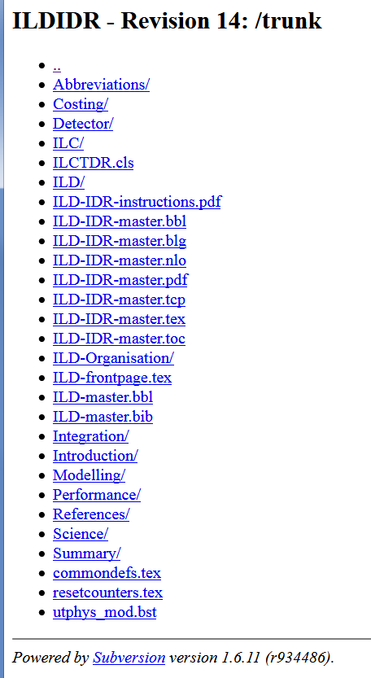
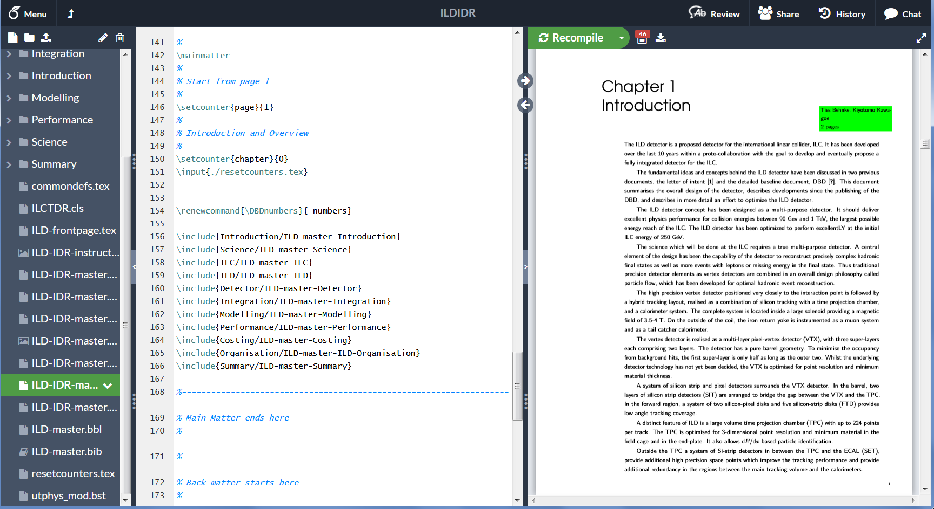
Contributing to the IDR
Convenient editing interface: overleaf online system
Synchronised to svn repository for offline work
For experts: synchronisation to github exists as well

Slide 10
European Strategy
What is planned from the ILC to contribute to the ESU:
10-page document on the overall project status
  Accelerator
  Physics
  Editor Jim Brau
10-page document on the European Perspective
  Summary of European Action plan
  European role in detectors
  Editors Steinar Stapnes, Juan Fuster
10-page document on ILD
  The ILD detector
  Technoloiges in ILD
  The ILD community
More extensive backup document
written by Mike Peskin etal. (80 pages)
Full European Action plan as backup

Slide 11
ILD contribution to the ESU
Short document, 10 pages at most
Need updated list of ILD members:
Soon request will go out to all of you to confirm / update your ILD membership
and list of ILD members
Please advertise ILD: we should show our strength
Need updated list of “who is interested in which part of ILD”

Slide 12
IDR Schedule
Technical setup | June 2018 | Done
Editor definition | July 2018 | Ongoing
Document outline | May 2018 | Done
First section draft | September 30, 2018
Editing and iteration phase | Until December 2018
Reading and commenting ILD wide | Until February 2019
Finalisation | March 2019

Slide 13
ILD-ESU Schedule
Technical setup | June 2018 | Done
Editors defined | May 2018 | Done
Structure defined | June 2018 | Done
First draft version | July 2018 | missed
First public version | September 30, 2018
Finalization | November 2018
Submit to ESU | 18.12.2018

