Slide 1


Simulations
R. Ramjiawan
Friday, 28th September 2018

Slide 2
ATF Plans

Slide 3
ATF – what was done
Improvements to the resolution seen by fitting the limiter phase for situations where Q’ cannot be reduced sufficiently using the movers. No improvement noted from fitting the bunch phase.
By placing the variable attenuator before the split on the reference it meant we were shifting the useable limiter jitter samples, which means the data for various charges and attenuations is incorrect.
Resolution scan as a function of BPM offset shows asymmetry – this was concluded as being from the static waveform overlaid with the position signal adding a constant offset to position and angle measurements.
Saturation effects demonstrated from signals approaching (but still below 2000 ADC counts) – reconsider the region we deem acceptable to operate.
Good scaling with attenuation for geometric resolution, but extremely poor scaling for fitted resolution – large deviation between the fitted resolution for the three BPMs at 30/40/50 dB.
Excellent scaling of calibration constant with attenuation for all three BPMS.
------------------------------------------------------------------------------------------------------------------------------------------------
Work with the upstream system:
Bunch charge dependence on the bunch spacing at extraction.
Resolution of 3BPM system including diode processor on P1 = 311 ±5 nmcf. result from paper = 291 ±10 nm
Feedback correction factor > 4 achieved; consistent with observed bunch correlation

Slide 4
ATF –future runs
Running feedback while we have ~20 nm resolution has not yet been demonstrated.
The studies of varying charge/attenuation and measuring the resolution fitting to the limiter phase had a mistake with the location of the variable attenuator. This could be redone.
Running upstream feedback to correct orbit of second bunch before running IP feedback.

Slide 5
Bunch profiles

Slide 6
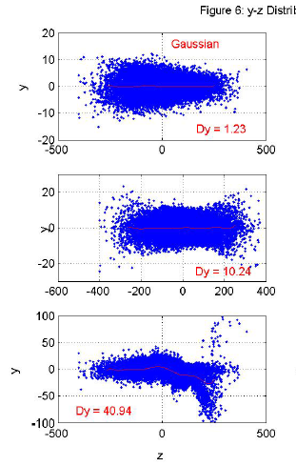
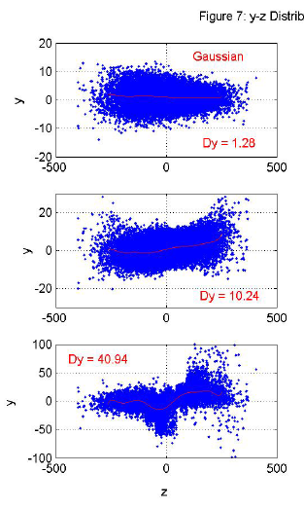
Previous study of y-z bunch profiles (NLC)
Sramek, Christopher & Raubenheimer, Tor & Seryi, Andrei & Woods, M & Yu, J. (2003). Beam-Beam Interaction Simulations with Guinea Pig.
0 nm bunch-bunch offset
1 nm bunch-bunch offset
(where Dy is the vertical disruption parameter)

Slide 7
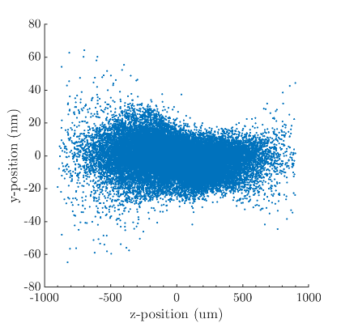
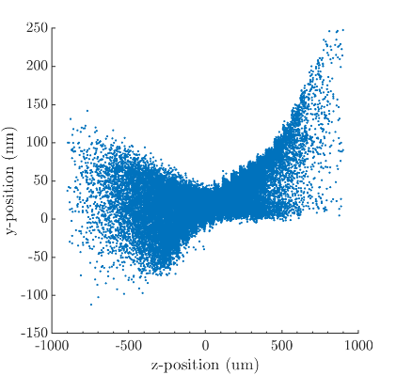
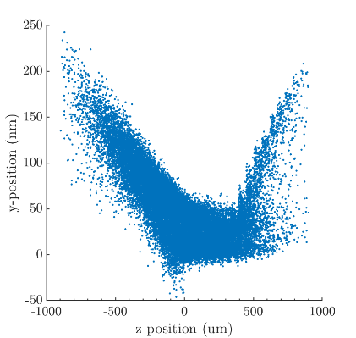
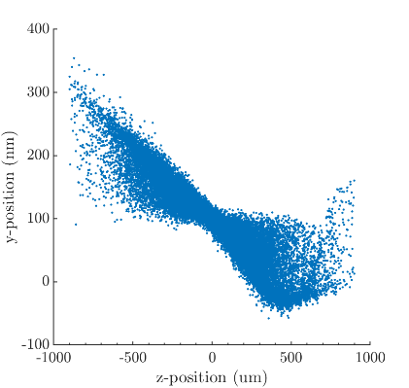
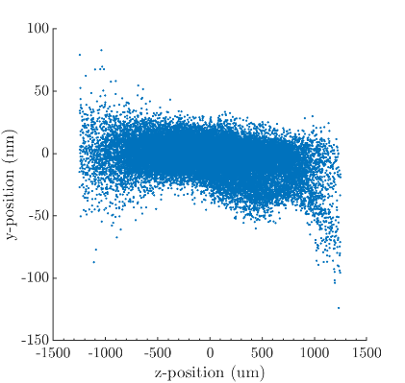
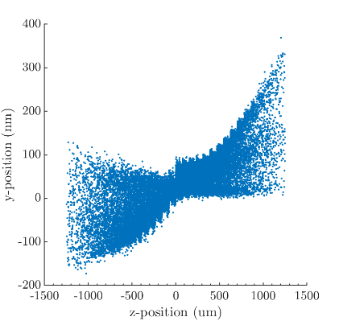
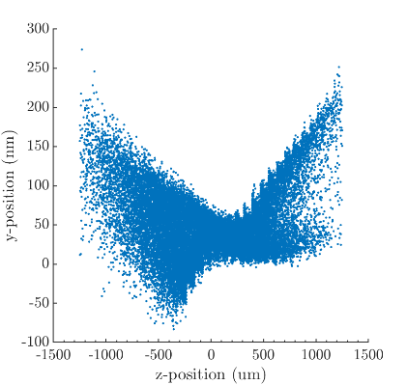
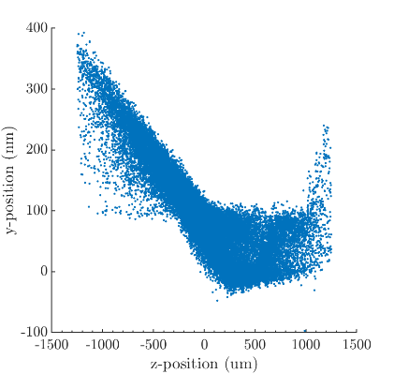
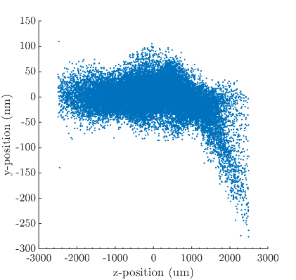
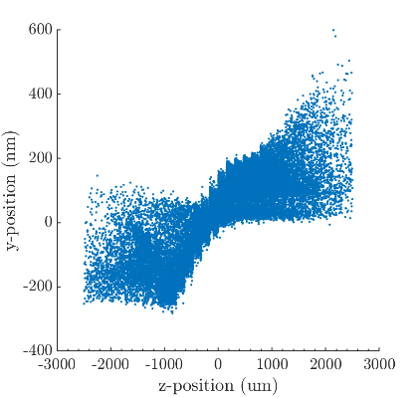
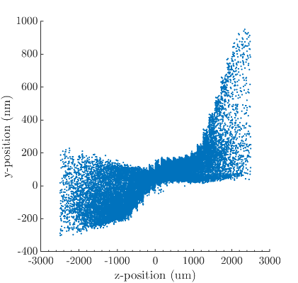
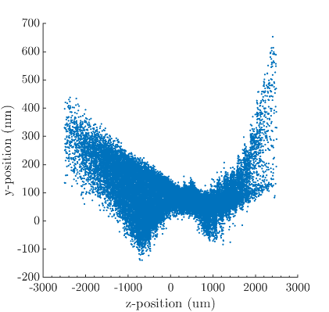
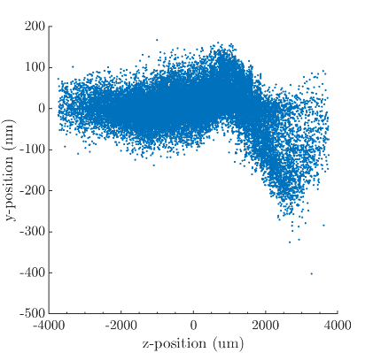
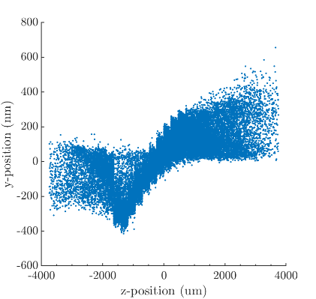
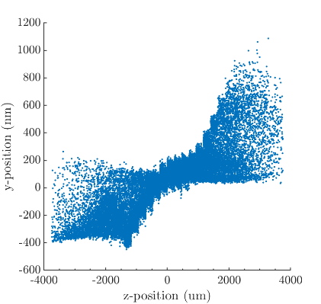
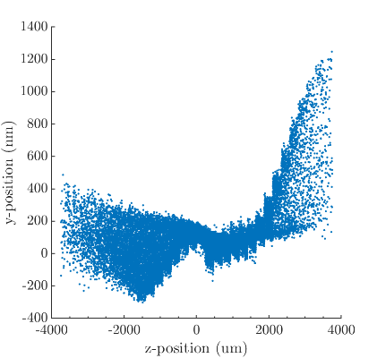
Offset 2*
0 nm
25 nm
50 nm
100 nm
SigmaZ=
300 um
Only up to 3 sigma
Y-z plots
SigmaZ=
500 um
SigmaZ
1000 um
SigmaZ
1500 um

Slide 8
Semi-analytic formula

Slide 9
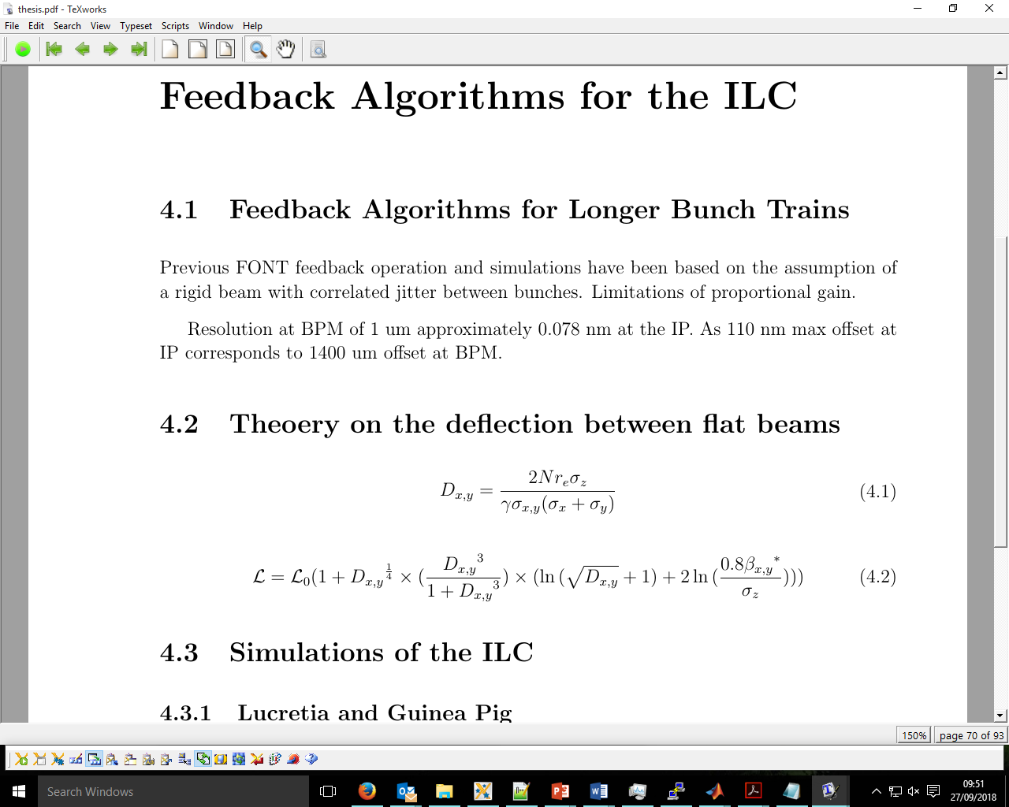
Semi-analytic: Disruption parameter
Disruption parameter: the oncoming beam acts as a focussing lens. The disruption parameter represents the focal length of this imaginary lens.
D<<1 beam acts as thin lens.
D>>1 beam oscillates in the field from the opposing bunch (Beam-beam interaction lecture 15 D. Schulte CERN).
In linear colliders one usually finds Dx <<1 and Dy >>1

Slide 10
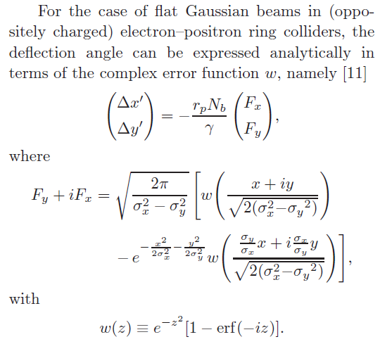
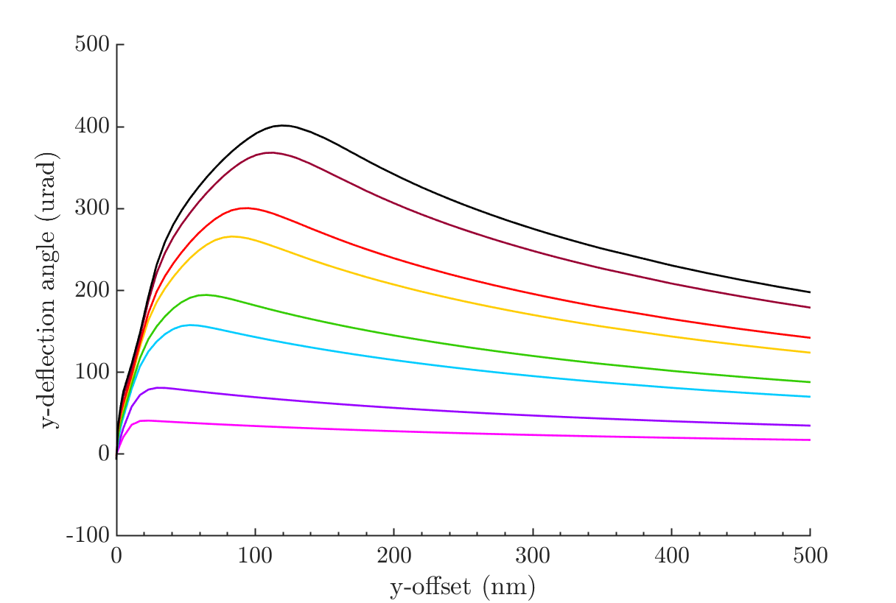
Semi-analytic: Deflection angle
As a function of charge – brown is nominal, (see previous presentation)
Only dependence on the charge should be the magnitude, not the shape – according to the semi-analytic formula
Reviews of Accelerator Science and Technology
Vol. 7 (2014) 177–205
World Scientific Publishing Company
DOI: 10.1142/S1793626814300096

Slide 11
Semi-analytic: Luminosity
Semi-analytic formula for the luminosity in terms of the disruption parameter.
L0 = luminosity excluding the beam-beam interaction effects.

Slide 12
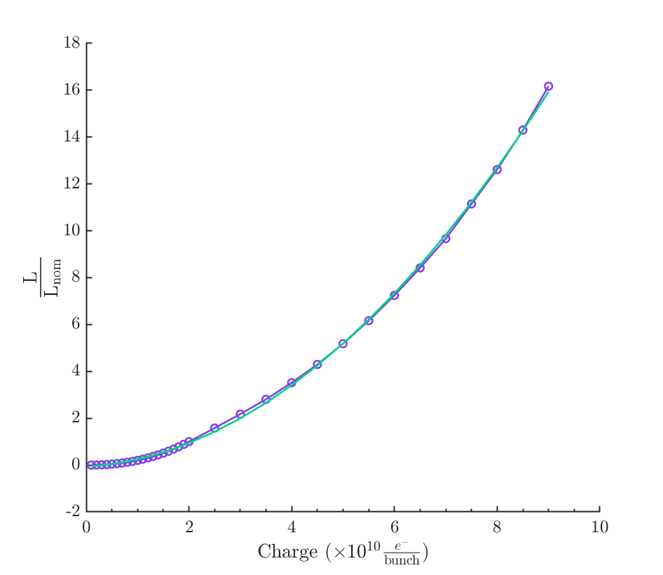
Semi-Analytic Formula
Calculate luminosity for 0 nm beam-beam offset at a range of charges (2e10 = nominal).
L_{nom}= 1.79e34 for charge=2e10.
Purple: luminosity calculated in guinea-pig scaled by the luminosity for nominal charge.
Green: scaling for the luminosity calculated using the semi-analytic formula from non-nominal bunch charge.

Slide 13
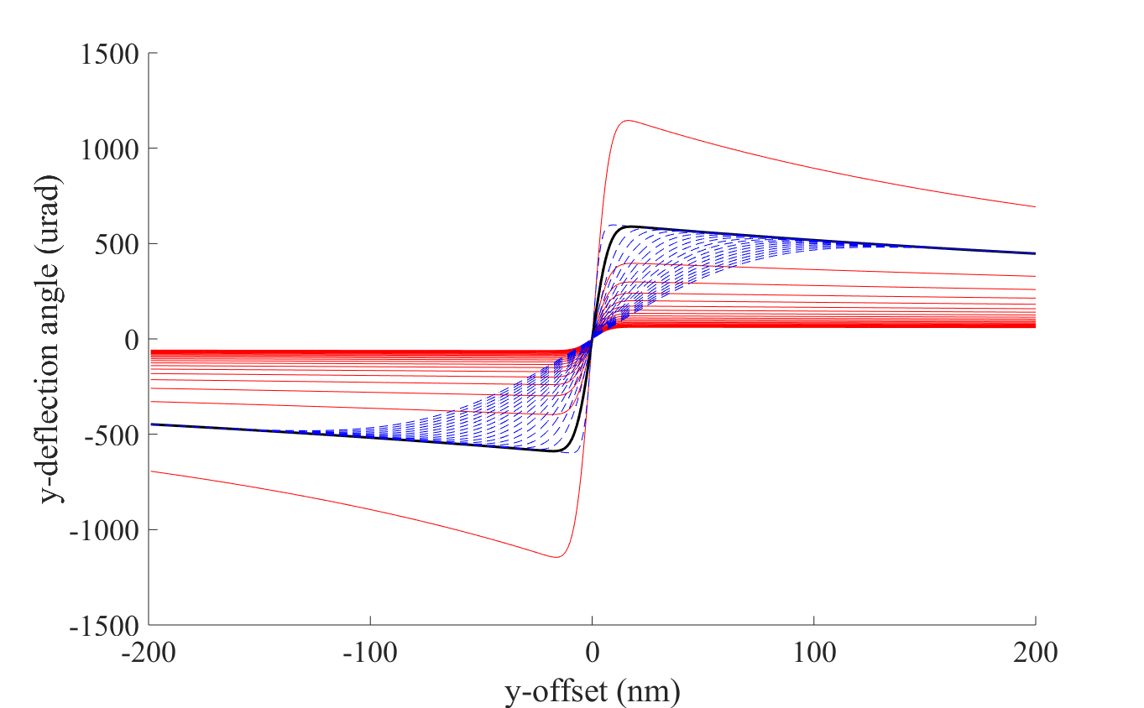
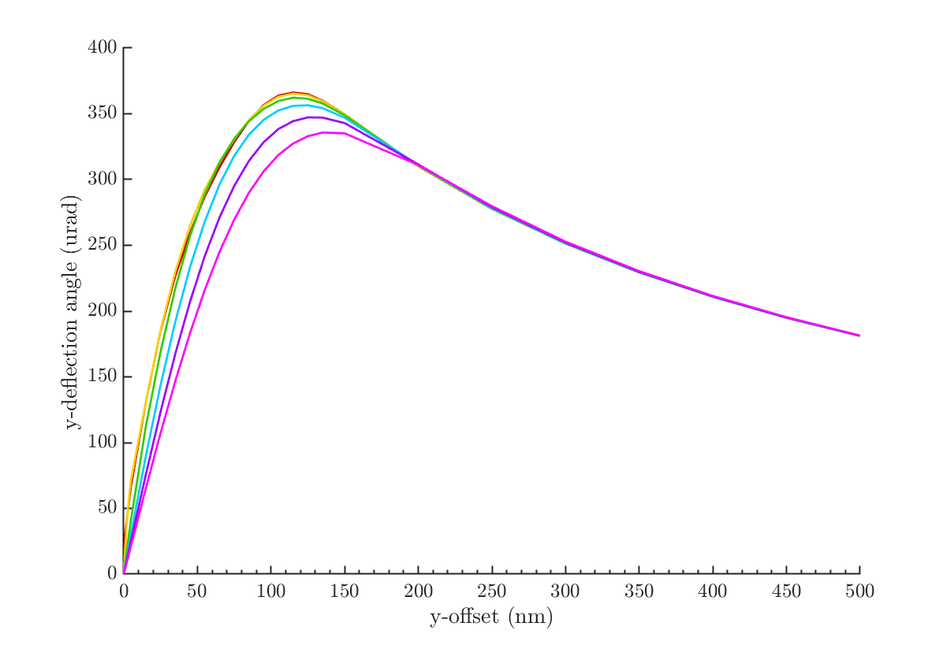
Sigma_y: GP vs semi-analytic formula
Semi-analytic formula
Guinea-pig
Sigma_y: (nm)
5.9 (nominal),
11.8,
23.6,
35.4,
47.2,
59.
Blue lines: sigma_y*[0:0.5:10]
Red lines: sigma_x*[0:0.5:10]
Nominal in black

Slide 14
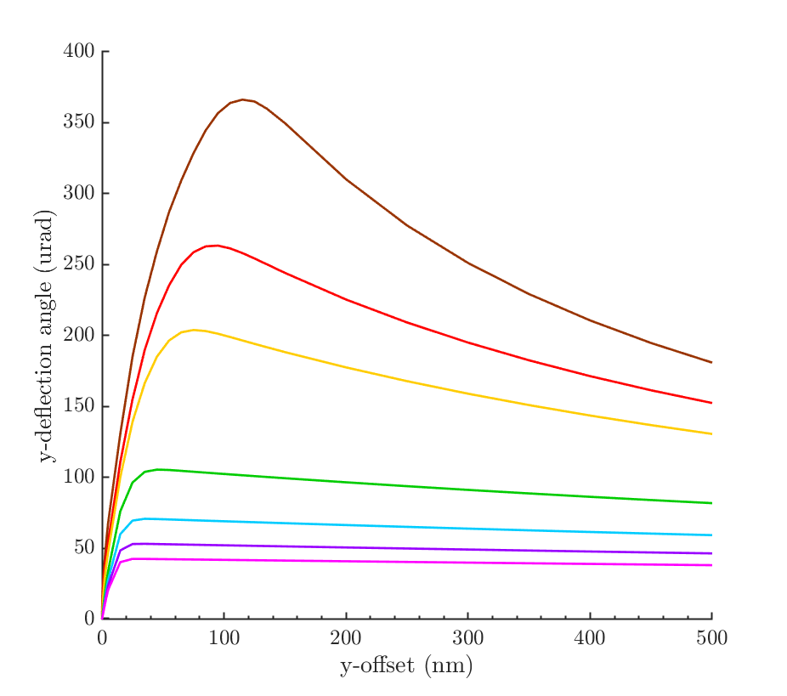
Sigma_x: GP vs. semi-analytic formula
Semi-analytic formula
Guinea-pig
Sigma_x: (nm)
474 (nominal),
711,
948,
1896,
2844,
3792,
4740.
Blue lines: sigma_y*[0:0.5:10]
Red lines: sigma_x*[0:0.5:10]
Nominal in black

Slide 15
Bunch length
Semi-analytic formula predicts no change to deflection angle by increasing bunch length as it’s the same force affecting the bunch just spread over a larger region.
I am still seeing a dependence on bunch length in simulations, and I think this is a meshing issue. I’m trying to improve the mesh, but I haven’t finished yet (see plot).
300 um
450 um
600 um

Slide 16
Placet

Slide 17
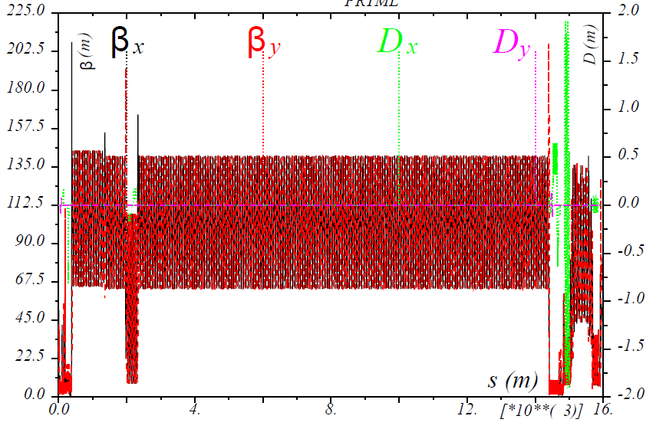
Placet – RTML (until beam lost)
βx
Beam not matched between RTML and ML and I think one of the reasons for this is because the bunch compressor isn’t compressing the bunch at all, so it arrives at the main linac 20 times too long.
βy
Proceedings of IPAC2012, New Orleans, Louisiana, USA TUPPR043

Slide 18
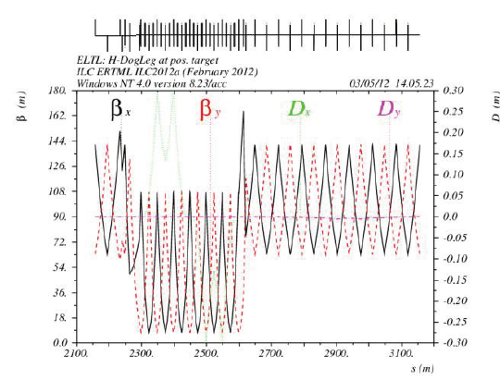

ELTL dogleg
$$β_{x} β_{y}$$
Proceedings of IPAC2012, New Orleans, Louisiana, USA TUPPR043

Slide 19
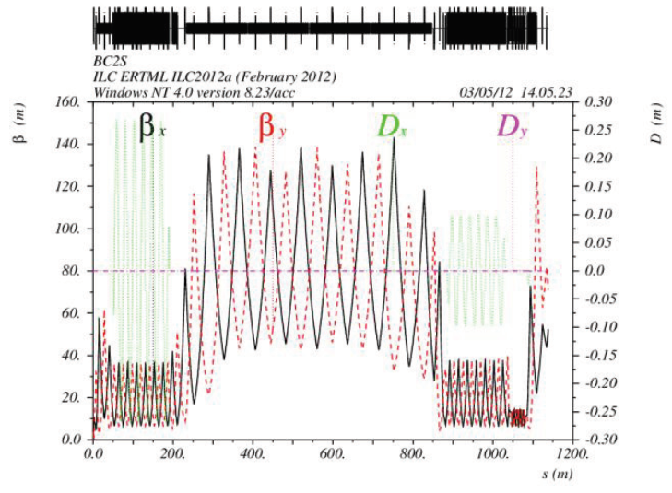


Bunch compressor
Placet
IPAC2012 TUPPR043
$${ β}_{X}{ D}_{x}$$
$$β_{y}{ D}_{y}$$
Proceedings of IPAC2012, New Orleans, Louisiana, USA TUPPR043

Slide 20
Energy
Appears to be progressing as expected through the RTML and main linac.
Previously, this was one of the things which was incorrectly implemented in the lattice file, but it is now sorted and working with help from Pierre.
IP
Main linac
Bunch leaves RTML at 15 GeV

Slide 21
Transition to Main Linac
RTML to ML
RTML to ML
‘QDBC1CM1’
X positions
Y positions
X emittance
Y emittance

