Slide 1
FONT Meeting Friday 28th September 2018
Multiple regression analysis
Douglas BETT

Slide 2
Contents
Introduction to multiple regression
Results from shift on 15th June 2018

Slide 3
Multiple linear regression
In statistics, linear regression is a linear approach to modelling the relationship between a dependent variable and one or more independent variables. The case of one independent variable is called simple linear regression. For more than one independent variable, the process is called multiple linear regression.
Basically this is the technique already used in the fitting method for calculating the resolution.
Instead of going to the trouble of implementing all the statistical tests in Octave, why not use a dedicated statistics package? Colin recommended SPSS (Statistical Package for the Social Sciences) but the IT Services website isn’t very user friendly so I went with R instead.
R is a programming language and free software environment for statistical computing and graphics.
I downloaded R version 3.5.1 for Windows. It features a command line interface very similar to MATLAB/Octave.

Slide 4
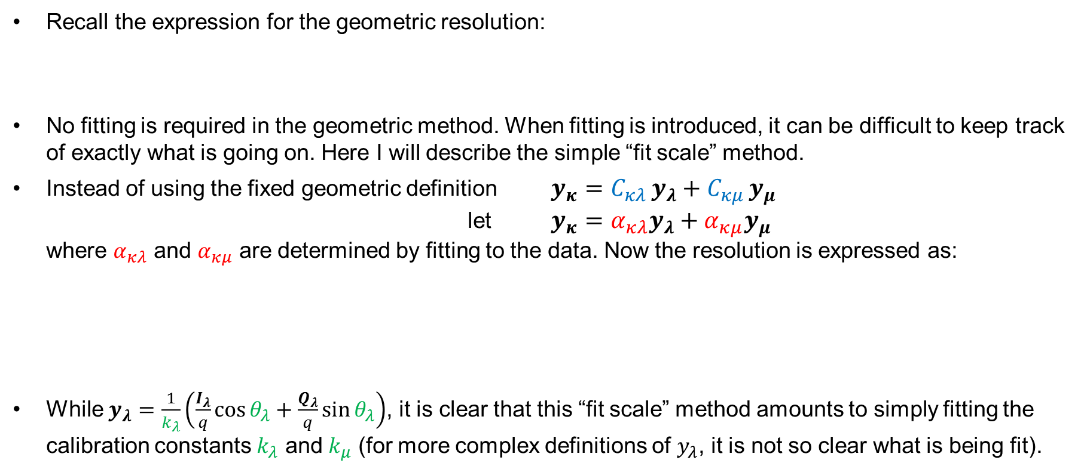

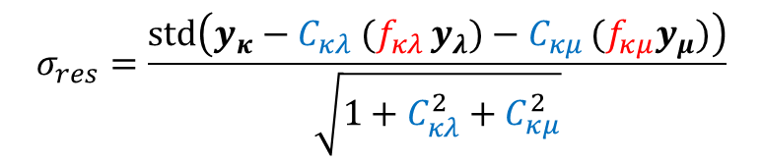
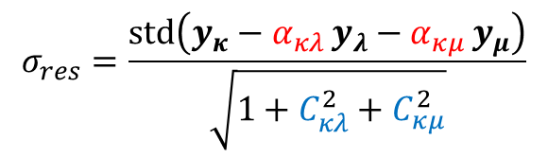
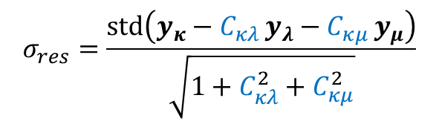
Note on resolution calculation
vector of residual position
Recall the expression for the geometric resolution:
No fitting is required in the geometric method. When fitting is introduced, it can be difficult to keep track of exactly what is going on. Here I will describe the simple “fit scale” method.
Instead of using the fixed geometric definition $y_{κ}=C_{κλ }y_{λ}+C_{κμ }y_{μ}$ let $y_{κ}=α_{κλ}y_{λ}+α_{κμ}y_{μ}$ where $α_{κλ}$ and $α_{κμ}$ are determined by fitting to the data. Now the resolution is expressed as:
While $y_{λ}=\frac{1}{k_{λ}}\left(\frac{I_{λ}}{q}\cos{θ_{λ}}+\frac{Q_{λ}}{q}\sin{θ_{λ}}\right)$, it is clear that this “fit scale” method amounts to simply fitting the calibration constants $k_{λ}$ and $k_{μ}$ (for more complex definitions of $y_{λ}$, it is not so clear what is being fit).
$$σ_{res}=\frac{\text{std}\left(y_{κ}−C_{κλ }y_{λ}−C_{κμ }y_{μ}\right)}{\sqrt{1+C_{κλ}^{2}+C_{κμ}^{2}}}$$
geometric
constants
$$σ_{res}=\frac{\text{std}\left(y_{κ}−α_{κλ }y_{λ}−α_{κμ }y_{μ}\right)}{\sqrt{1+C_{κλ}^{2}+C_{κμ}^{2}}}$$
$$σ_{res}=\frac{\text{std}\left(y_{κ}−C_{κλ} (f_{κλ }y_{λ})−C_{κμ }(f_{κμ}y_{μ})\right)}{\sqrt{1+C_{κλ}^{2}+C_{κμ}^{2}}}$$
define $f_{κλ}=\frac{α_{κλ}}{C_{κλ }}$

Slide 5
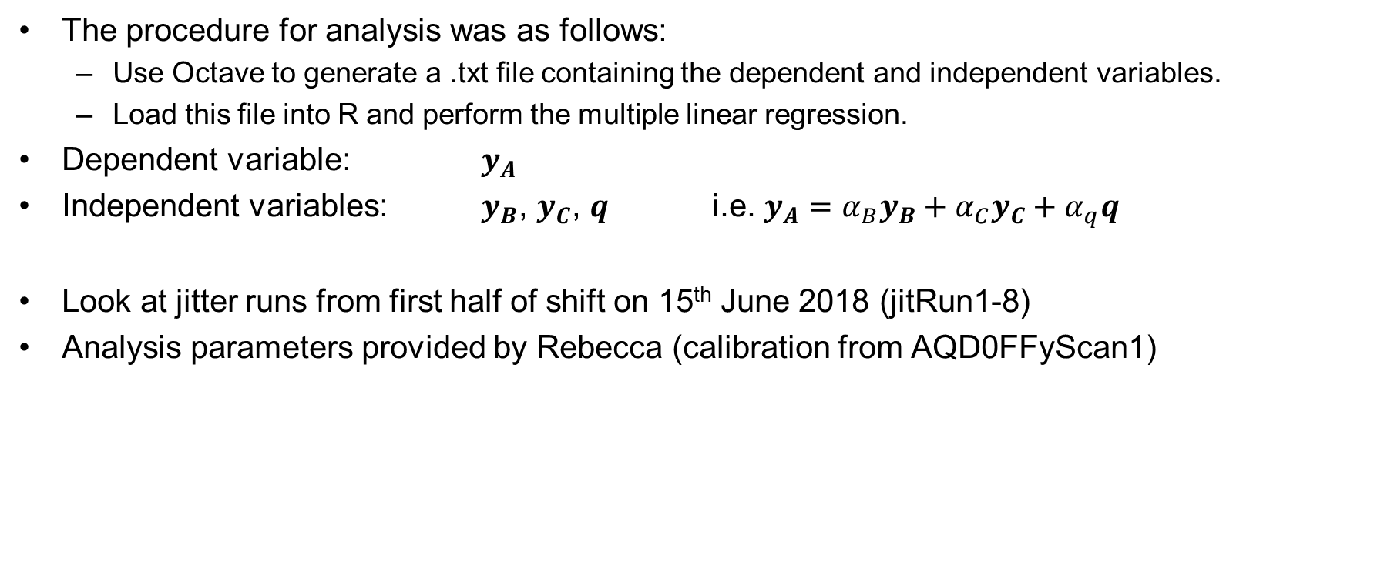
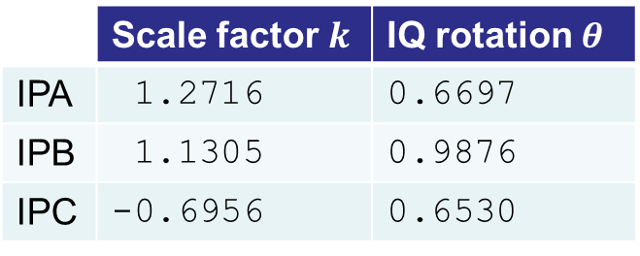
Analysis method
The procedure for analysis was as follows:
Use Octave to generate a .txt file containing the dependent and independent variables.
Load this file into R and perform the multiple linear regression.
Dependent variable: $y_{A}$
Independent variables: $y_{B}$, $y_{C}$, $q$ i.e. $y_{A}=α_{B}y_{B}+α_{C}y_{C}+α_{q}q$
Look at jitter runs from first half of shift on 15th June 2018 (jitRun1-8)
Analysis parameters provided by Rebecca (calibration from AQD0FFyScan1)
 | Sample index
Sample for reference | 67
Sample range for I, Q | 59 : 64 (6 samples)
 | Scale factor $k$ | IQ rotation $θ$
IPA | 1.2716 | 0.6697
IPB | 1.1305 | 0.9876
IPC | -0.6956 | 0.6530

Slide 6
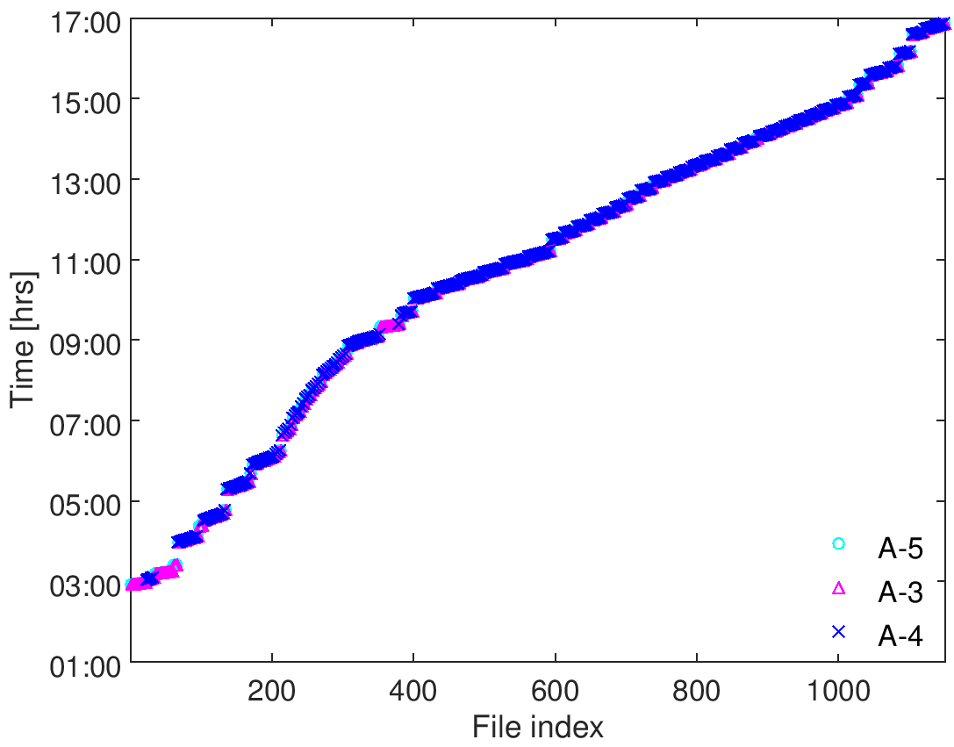
2
15 June 2018
jitRun7-8
AQD0FFyScan1
jitRun3-6
jitRun2
jitRun1
upstream
IP - x
IP - y

Slide 7
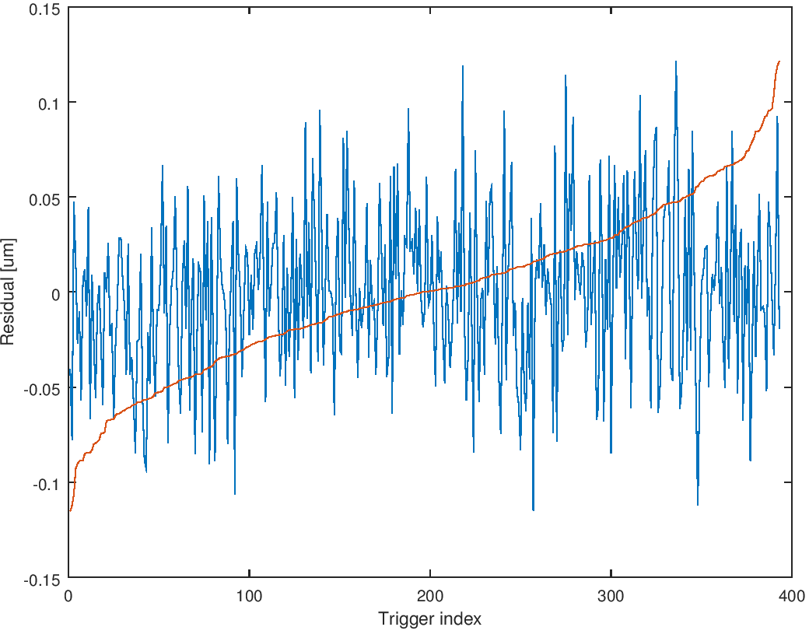
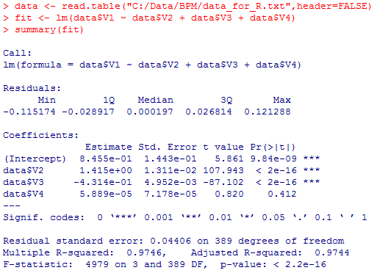
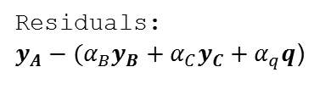
jitRun1
Residuals:
$y_{A}−(α_{B}y_{B}+α_{C}y_{C}+α_{q}q$)
Coefficients:
c.f. results from \ operator in Octave:
8.4545e-01
1.4153e+00
-4.3137e-01
5.8890e-05
Min
1Q
Median
3Q
Max
t value
A measure of how many standard errors the parameter estimate is from zero
Adjusted R-squared: 0.9744
% of variance of the dependent variable explained by the independent variables (adjusted for the number of independent variables)
F-statistic: 4979
F >> 1 → can reject the null hypothesis that there is no relationship between dependent variable and independent variables

Slide 8
R plots: residuals against fitted values

Slide 9
R plots: Scale-Location plot (√|residuals| against fitted values)

Slide 10
R plots: Normal Q-Q plot (residuals plotted against set of normally generated values)

Slide 11
R plots: residuals against leverages
Leverage: a measure of how far away the independent variable values of an observation are from those of the other observations

Slide 12
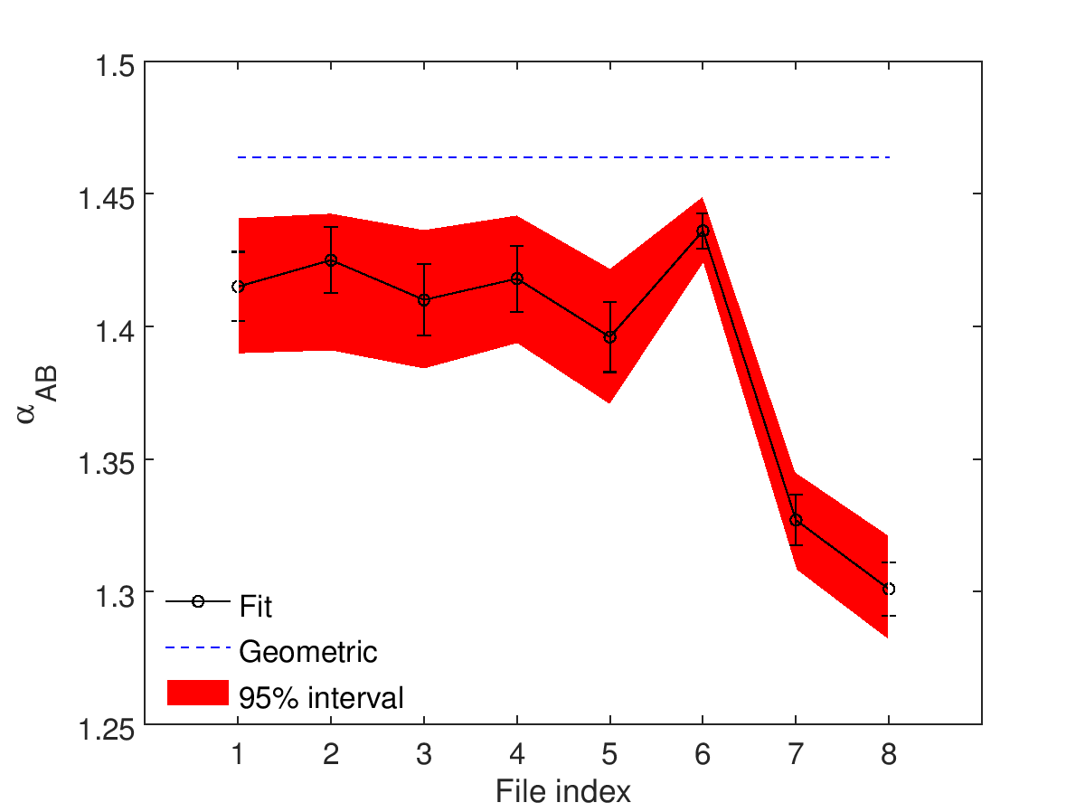
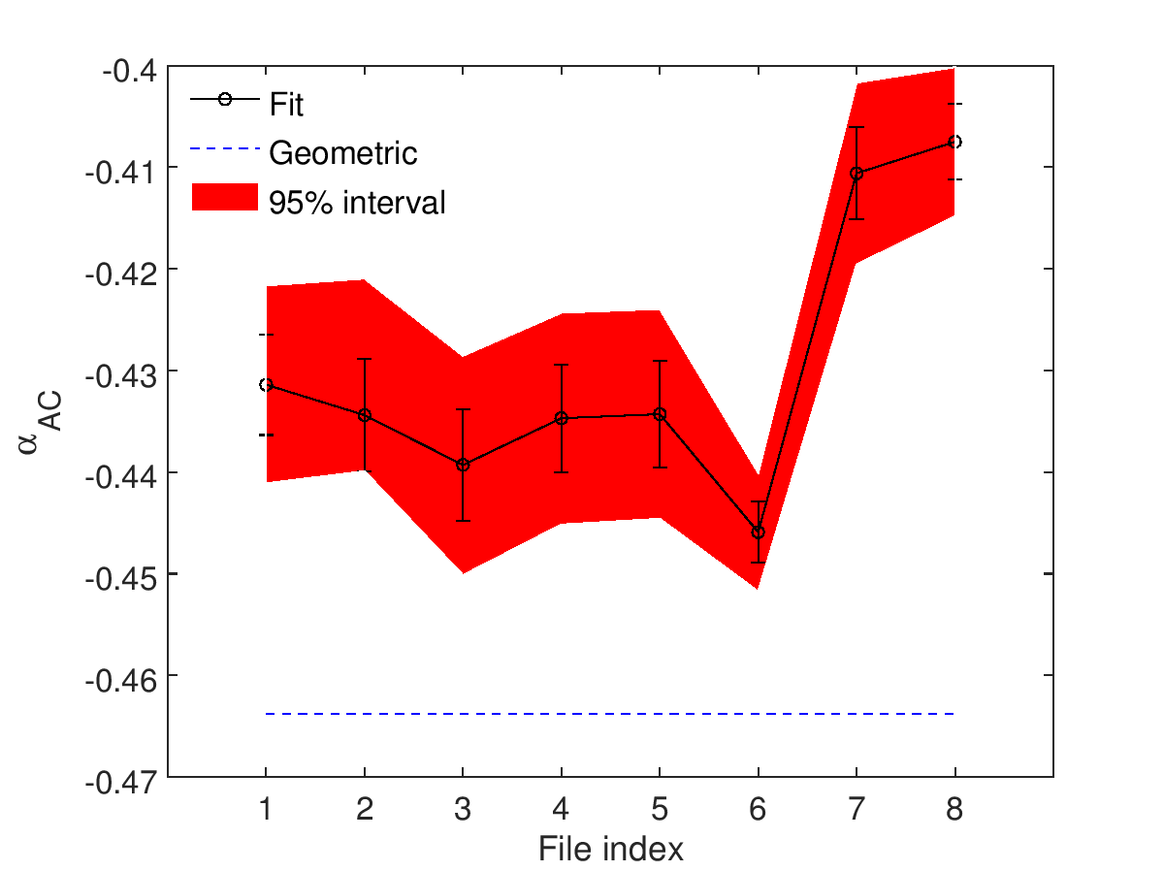
Coefficients (IPB and IPC)

Slide 13
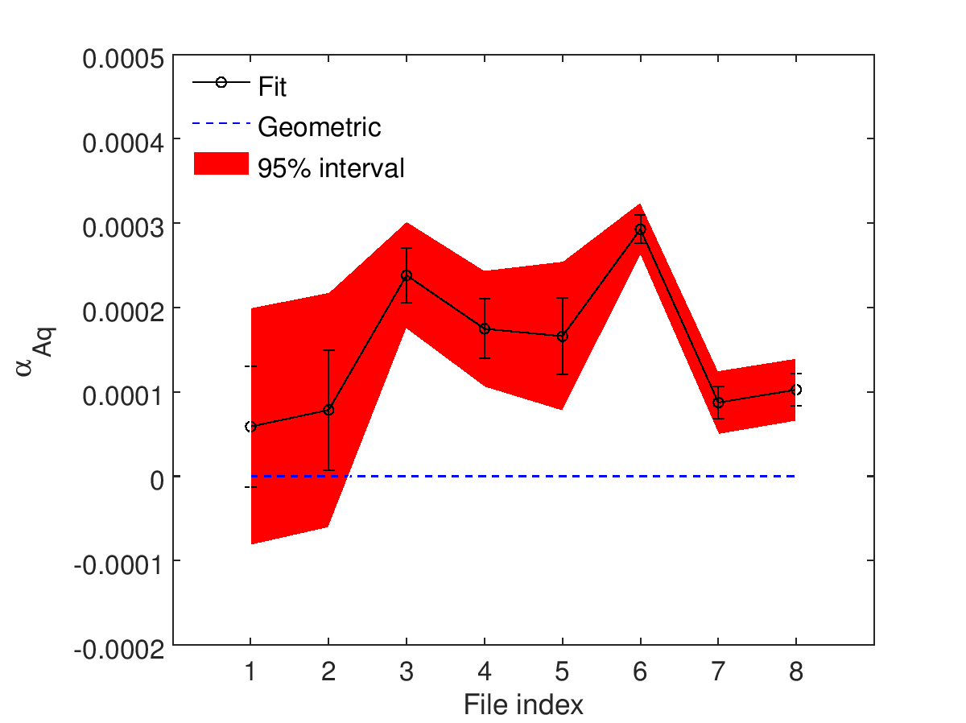
Coefficients (charge)

Slide 14
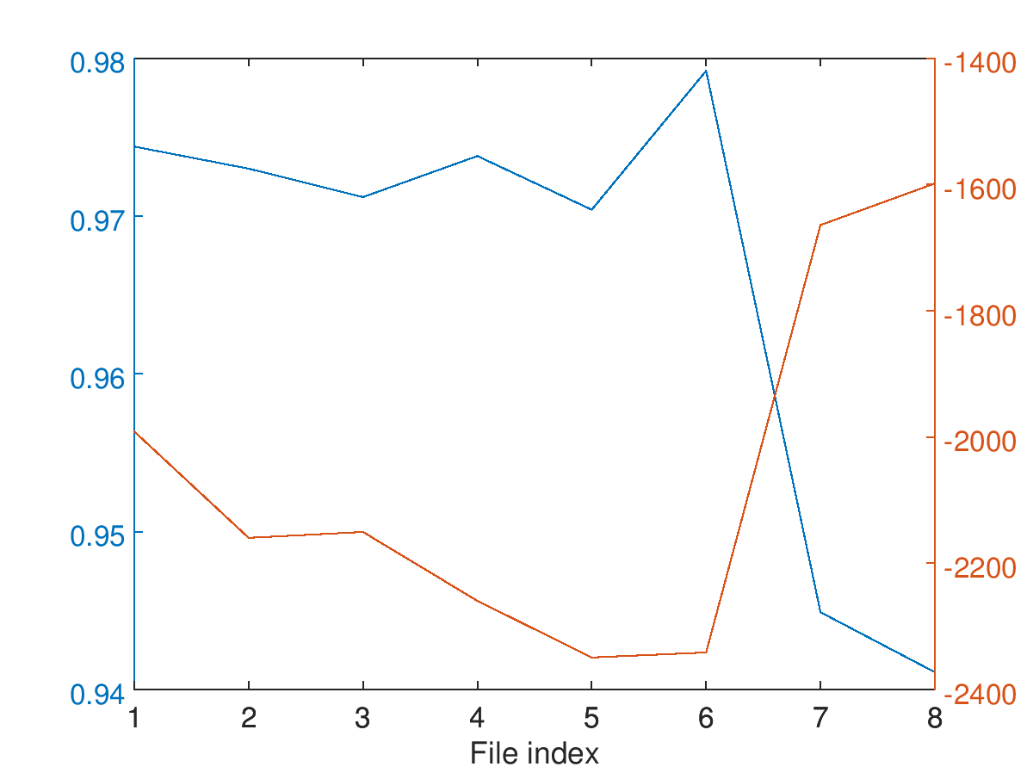
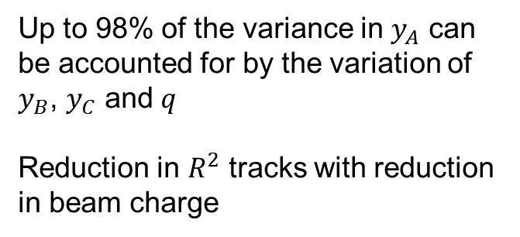


R squared
Up to 98% of the variance in $y_{A}$ can be accounted for by the variation of $y_{B}$, $y_{C}$ and $q$
Reduction in $R^{2}$ tracks with reduction in beam charge
$$R^{2}$$
$$\left\langle q\right\rangle$$

Slide 15
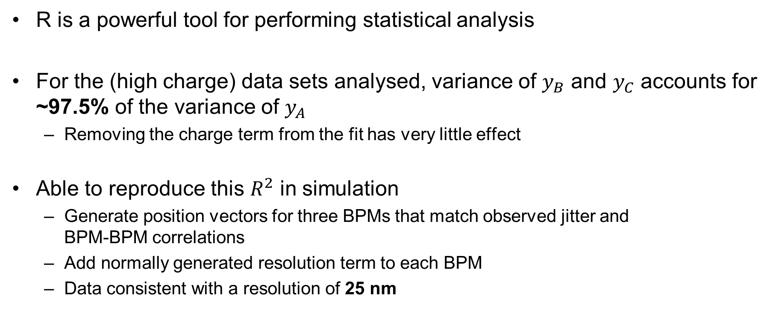
Conclusions
R is a powerful tool for performing statistical analysis
For the (high charge) data sets analysed, variance of $y_{B}$ and $y_{C}$ accounts for ~97.5% of the variance of $y_{A}$
Removing the charge term from the fit has very little effect
Able to reproduce this $R^{2}$ in simulation
Generate position vectors for three BPMs that match observed jitter and BPM-BPM correlations
Add normally generated resolution term to each BPM
Data consistent with a resolution of 25 nm

