Slide 1
FONT Meeting
Friday 12th October 2018
Calibration by iteration
Douglas BETT

Slide 2
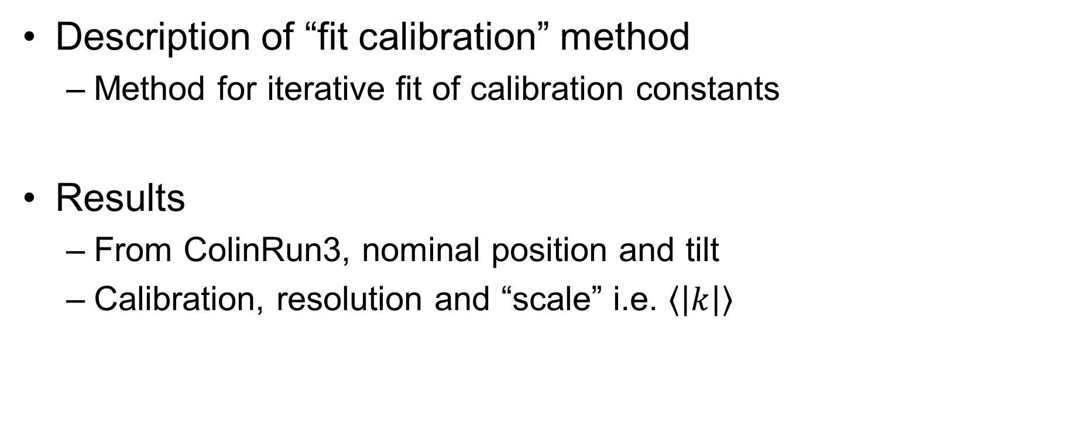
Contents
Description of “fit calibration” method
  Method for iterative fit of calibration constants
Results
  From ColinRun3, nominal position and tilt
  Calibration, resolution and “scale” i.e. $\left\langle \left|k\right|\right\rangle$

Slide 3
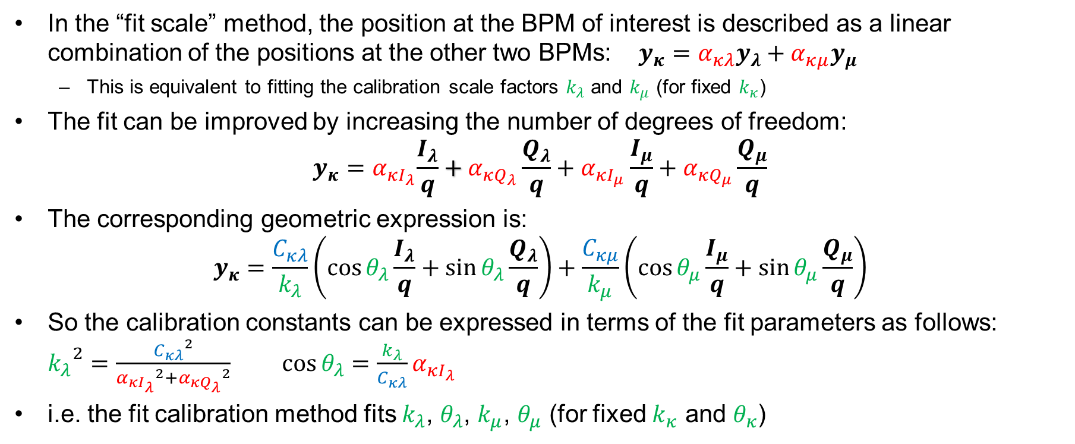
“Fit calibration” method
In the “fit scale” method, the position at the BPM of interest is described as a linear combination of the positions at the other two BPMs: $y_{κ}=α_{κλ}y_{λ}+α_{κμ}y_{μ}$
  This is equivalent to fitting the calibration scale factors $k_{λ}$ and $k_{μ}$ (for fixed $k_{κ}$)
The fit can be improved by increasing the number of degrees of freedom:
$y_{κ}=α_{κI_{λ}}\frac{I_{λ}}{q}+α_{κQ_{λ}}\frac{Q_{λ}}{q}+α_{κI_{μ}}\frac{I_{μ}}{q}+α_{κQ_{μ}}\frac{Q_{μ}}{q}$
The corresponding geometric expression is:
$$y_{κ}=\frac{C_{κλ}}{k_{λ}}\left(\cos{θ_{λ}}\frac{I_{λ}}{q}+\sin{θ_{λ}}\frac{Q_{λ}}{q}\right)+\frac{C_{κμ}}{k_{μ}}\left(\cos{θ_{μ}}\frac{I_{μ}}{q}+\sin{θ_{μ}}\frac{Q_{μ}}{q}\right)$$
So the calibration constants can be expressed in terms of the fit parameters as follows:
${k_{λ}}^{2}=\frac{{C_{κλ}}^{2}}{{α_{κI_{λ}}}^{2}+{α_{κQ_{λ}}}^{2}}$ $\cos{θ_{λ}}=\frac{k_{λ}}{C_{κλ}}α_{κI_{λ}}$
i.e. the fit calibration method fits $k_{λ}$, $θ_{λ}$, $k_{μ}$, $θ_{μ}$ (for fixed $k_{κ}$ and $θ_{κ}$)

Slide 4
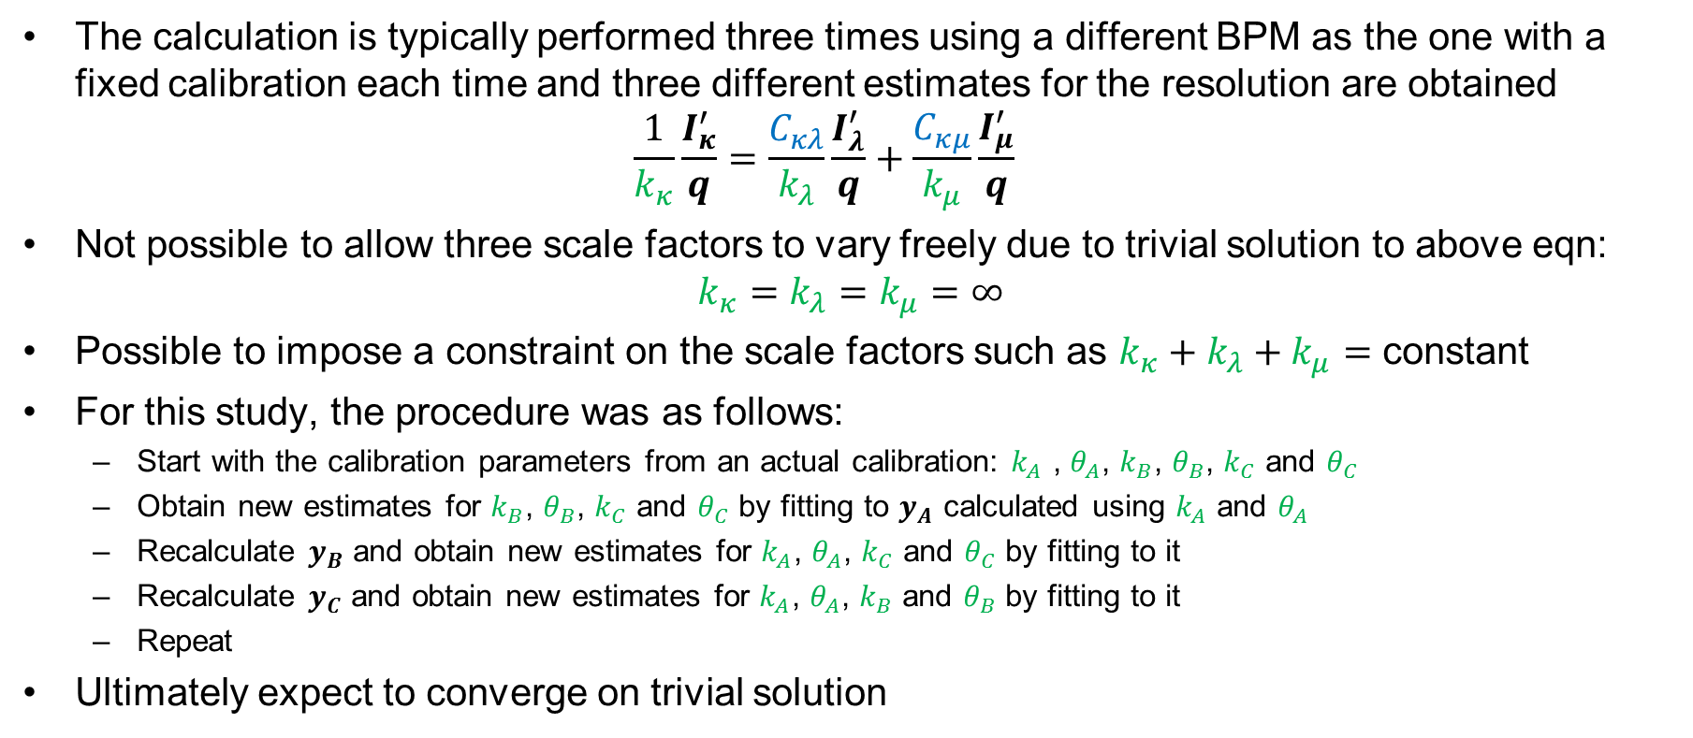
Constraint on calibration
The calculation is typically performed three times using a different BPM as the one with a fixed calibration each time and three different estimates for the resolution are obtained
$\frac{1}{k_{κ}}\frac{I_{κ}^{′}}{q}=\frac{C_{κλ}}{k_{λ}}\frac{I_{λ}^{′}}{q}+\frac{C_{κμ}}{k_{μ}}\frac{I_{μ}^{′}}{q}$
Not possible to allow three scale factors to vary freely due to trivial solution to above eqn:
$k_{κ}=k_{λ}=k_{μ}=∞$
Possible to impose a constraint on the scale factors such as $k_{κ}+k_{λ}+k_{μ}=$ constant
For this study, the procedure was as follows:
  Start with the calibration parameters from an actual calibration: $k_{A}$ , $θ_{A}$, $k_{B}$, $θ_{B}$, $k_{C}$ and $θ_{C}$
  Obtain new estimates for $k_{B}$, $θ_{B}$, $k_{C}$ and $θ_{C}$ by fitting to $y_{A}$ calculated using $k_{A}$ and $θ_{A}$
  Recalculate $y_{B}$ and obtain new estimates for $k_{A}$, $θ_{A}$, $k_{C}$ and $θ_{C}$ by fitting to it
  Recalculate $y_{C}$ and obtain new estimates for $k_{A}$, $θ_{A}$, $k_{B}$ and $θ_{B}$ by fitting to it
  Repeat
Ultimately expect to converge on trivial solution

Slide 5
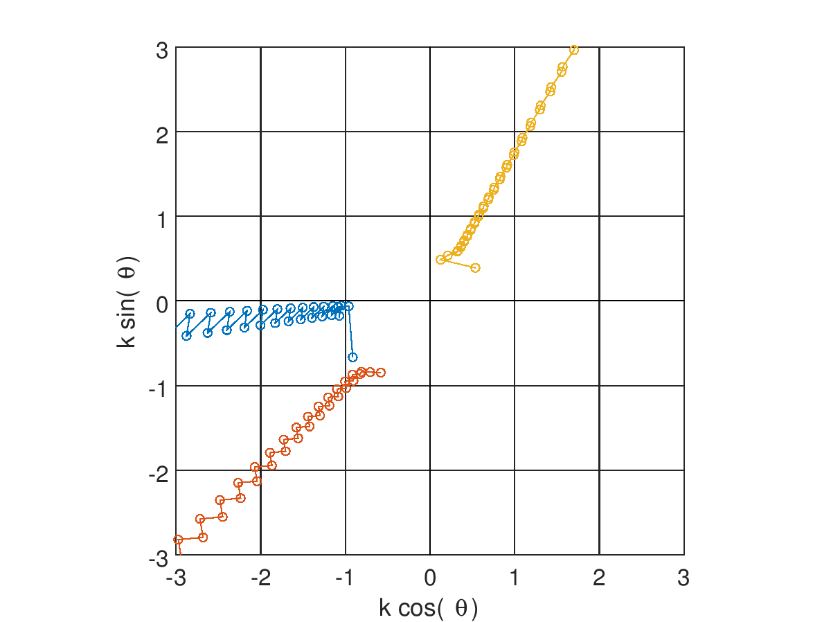
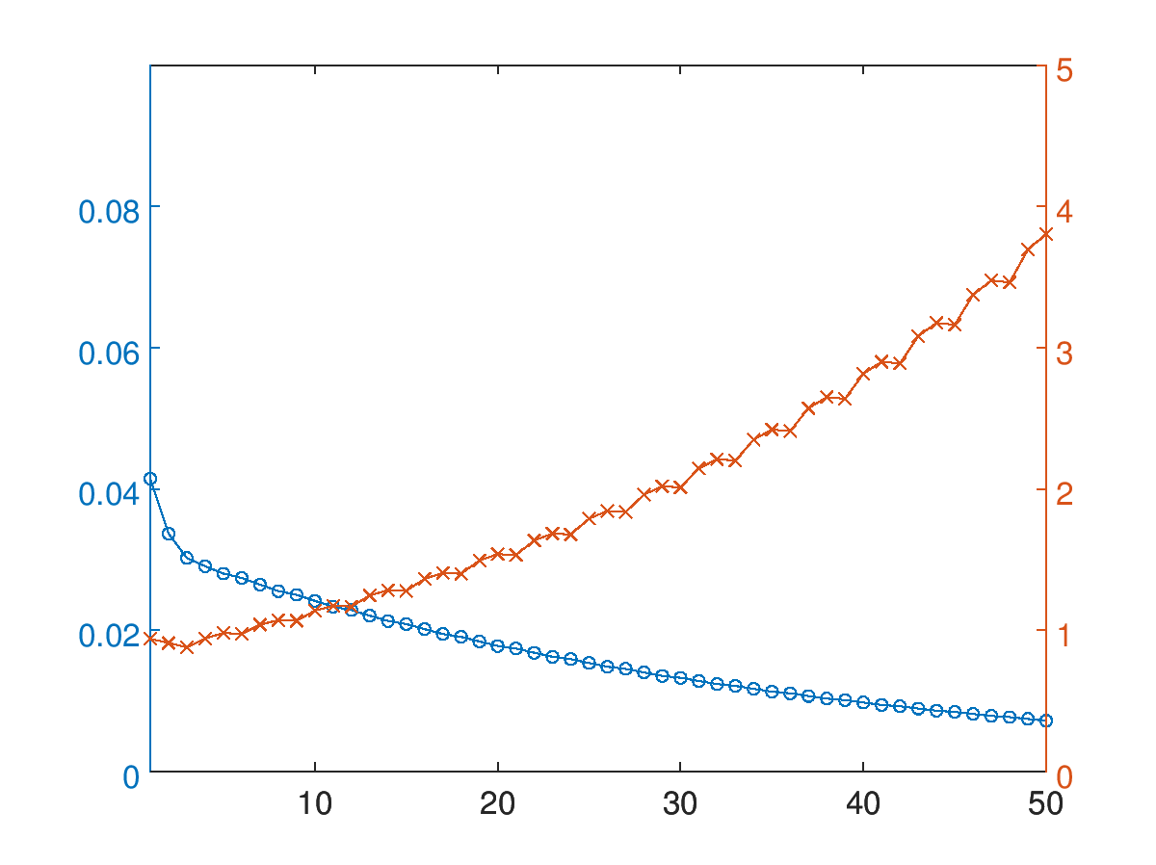
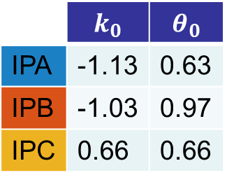
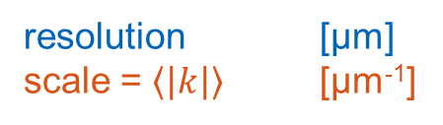


Colin3_posNomTiltNom1
 | $k_{0}$ | $$θ_{0}$$
IPA | -1.13 | 0.63
IPB | -1.03 | 0.97
IPC | 0.66 | 0.66
Calibration parameters
IPA
IPB
IPC
resolution [μm]
scale = $\left\langle \left|k\right|\right\rangle$ [μm⁻¹]
$$θ_{C}$$
$$k_{C}$$

Slide 6
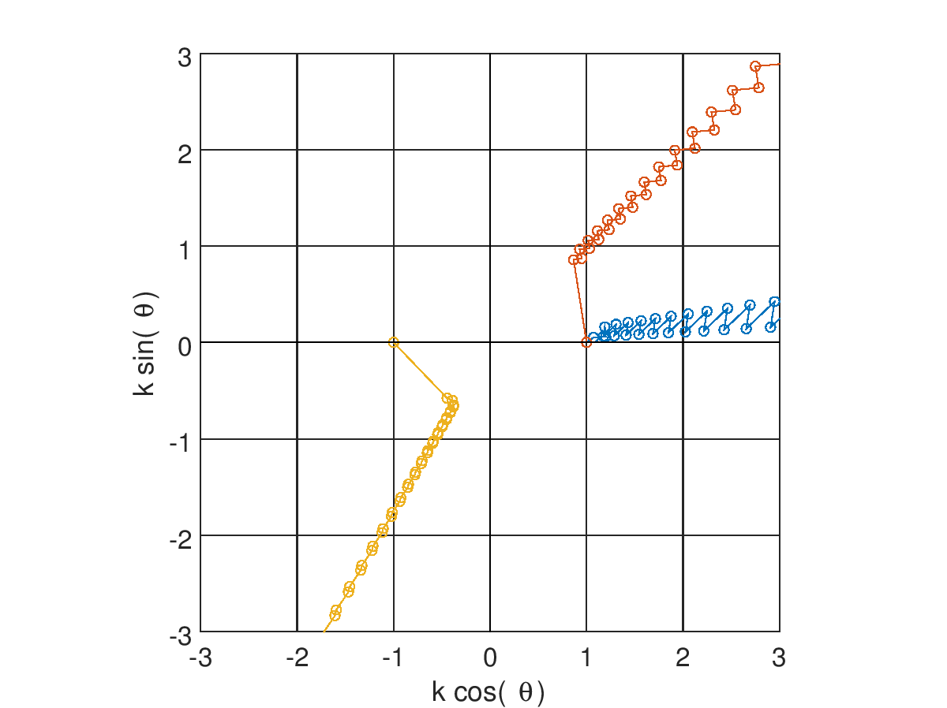
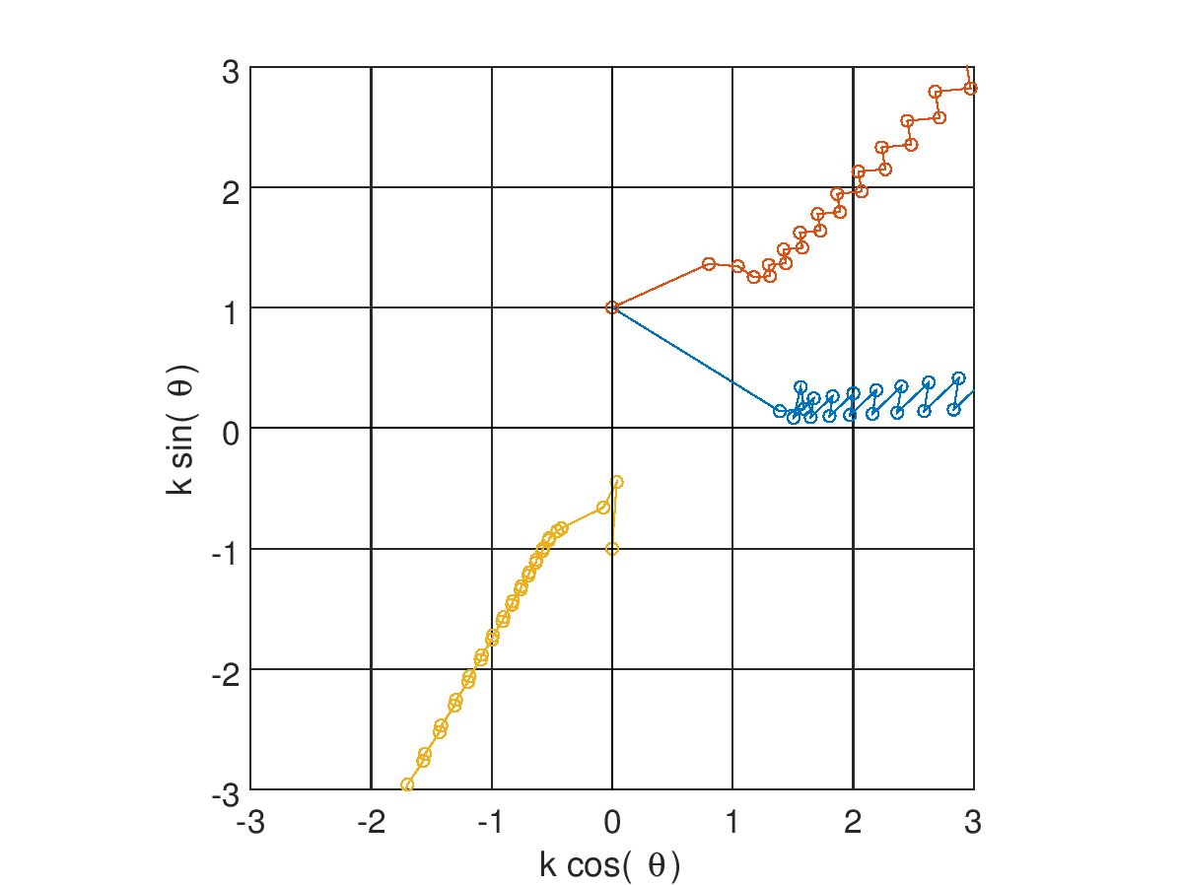
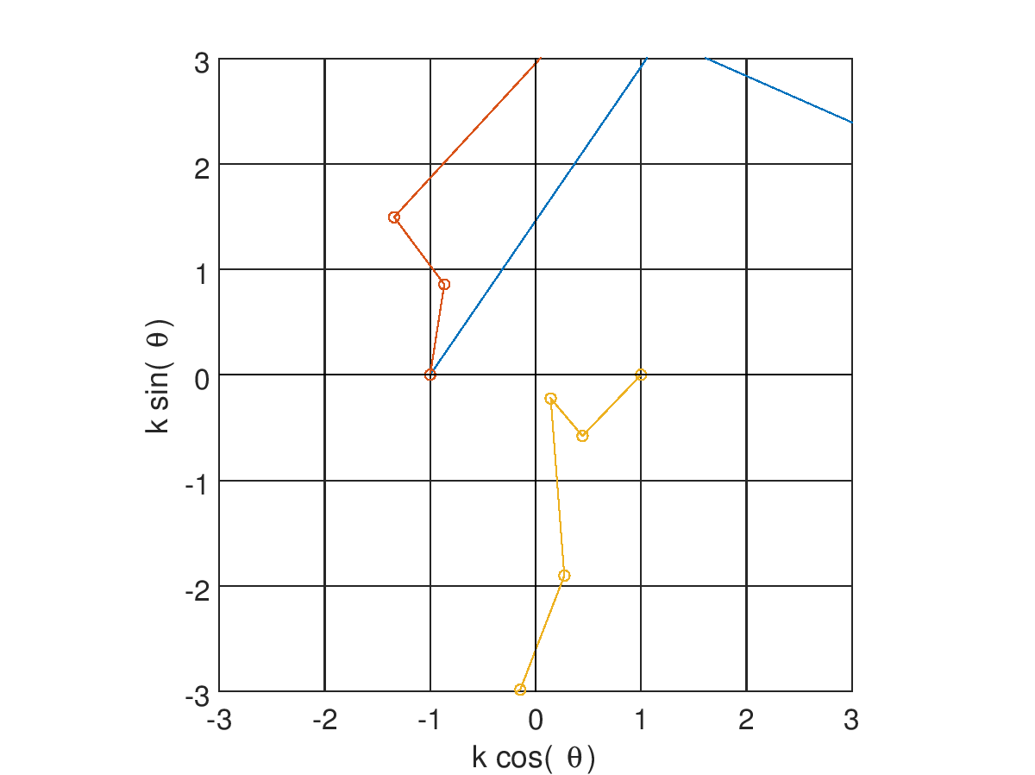
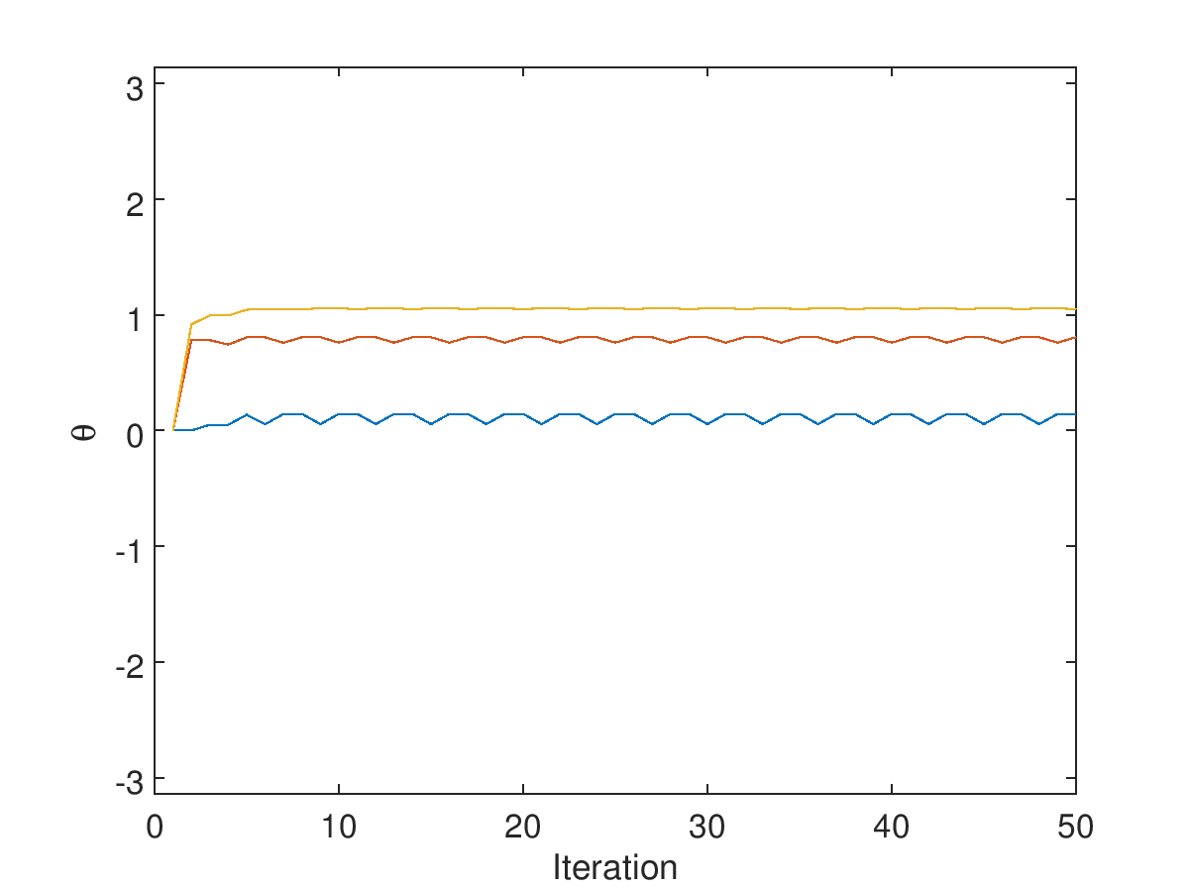
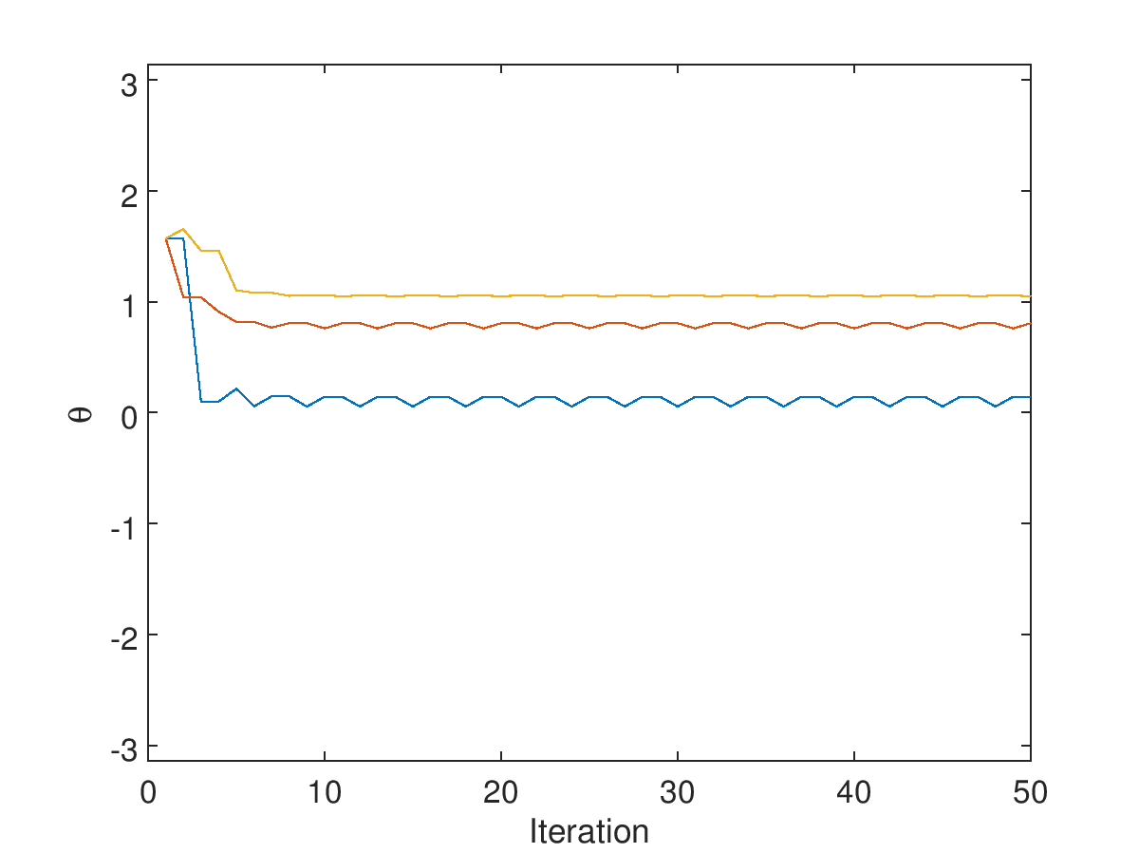
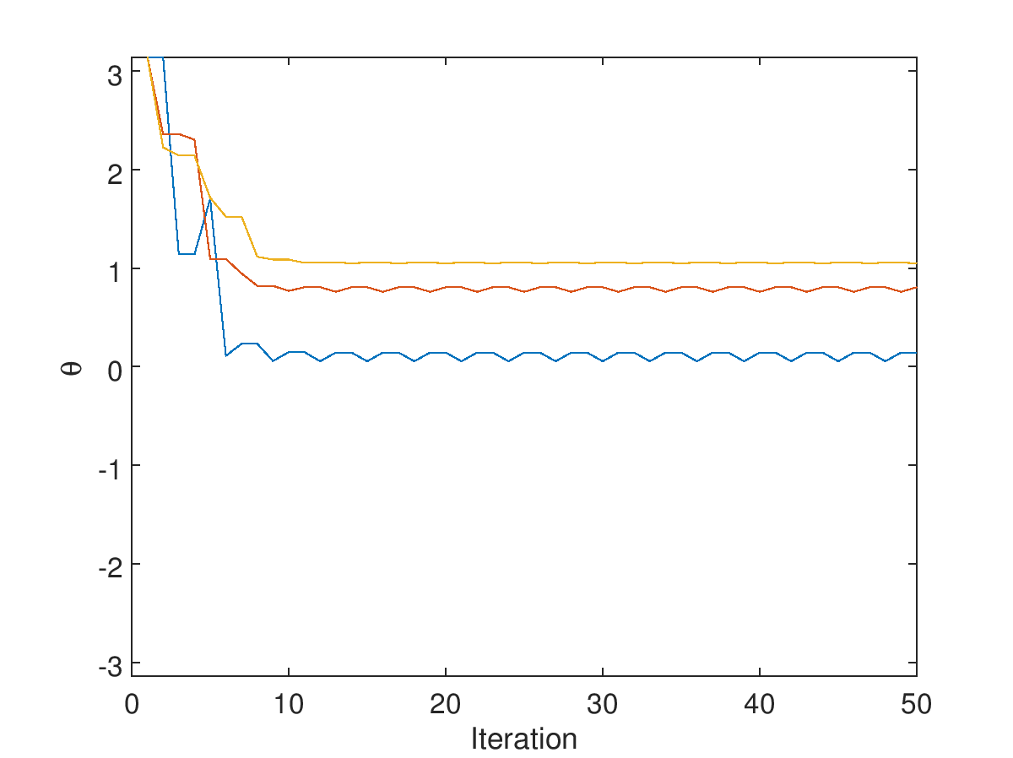





Consistency of $θ$
$$k_{A}=k_{B}=1, k_{C}=−1$$
$$θ_{0}=0$$
$$θ_{0}=π/2$$
$$θ_{0}=π$$

Slide 7
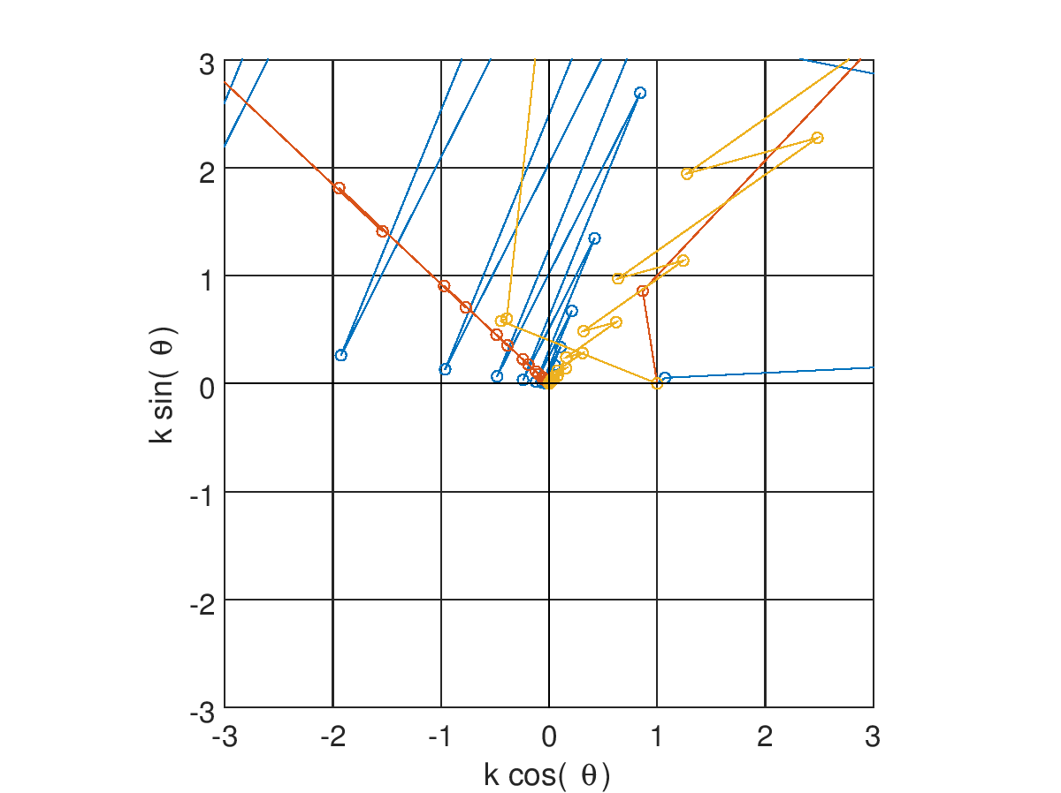
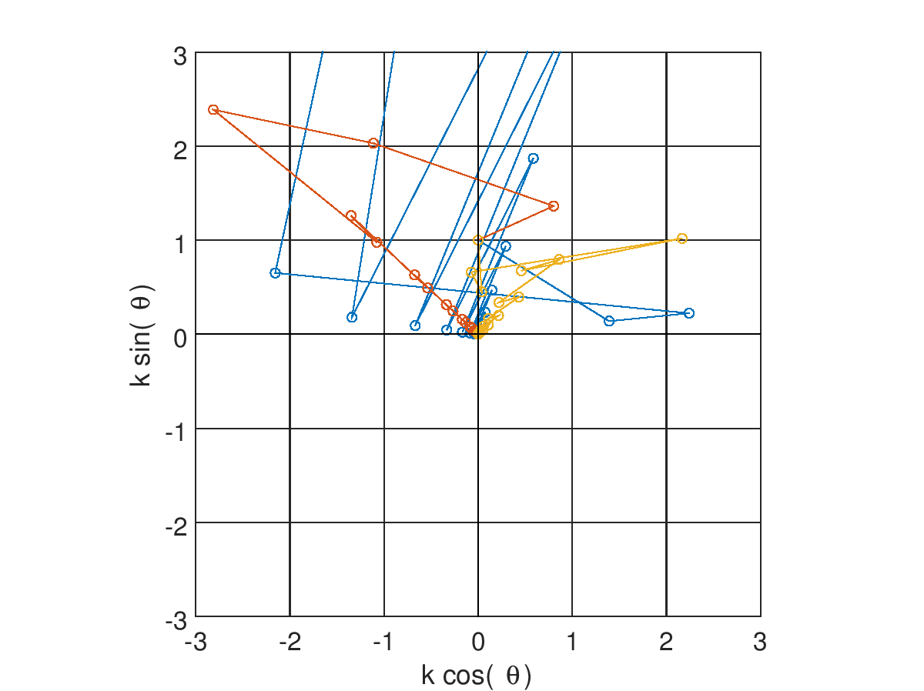
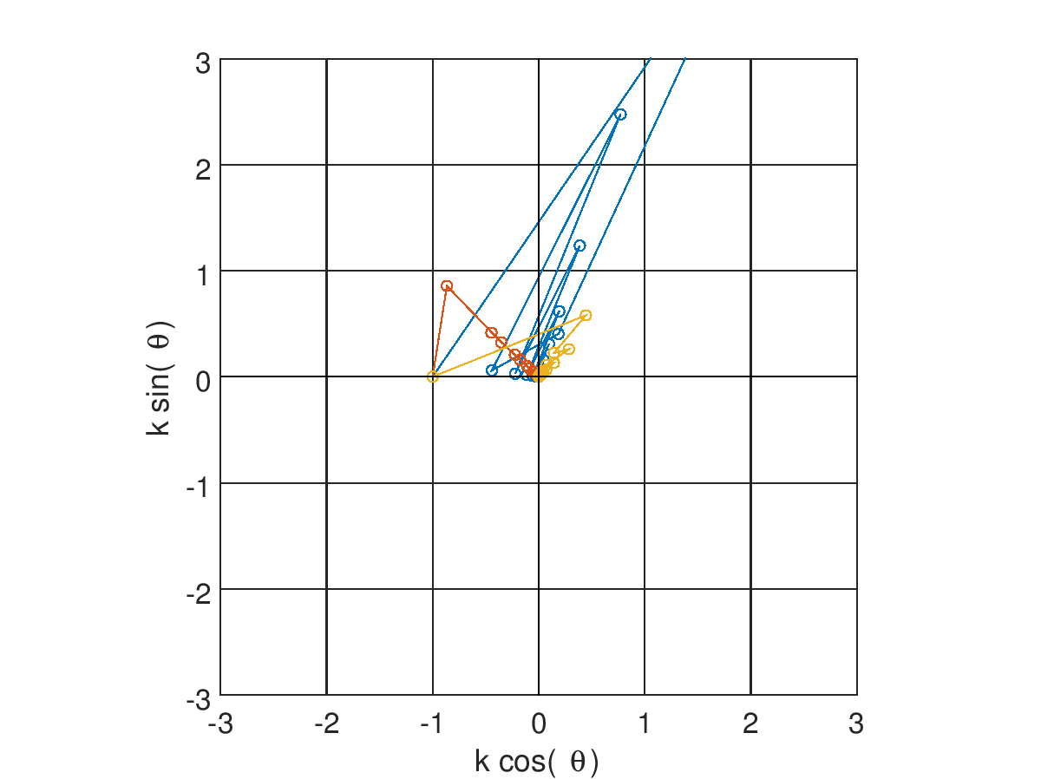
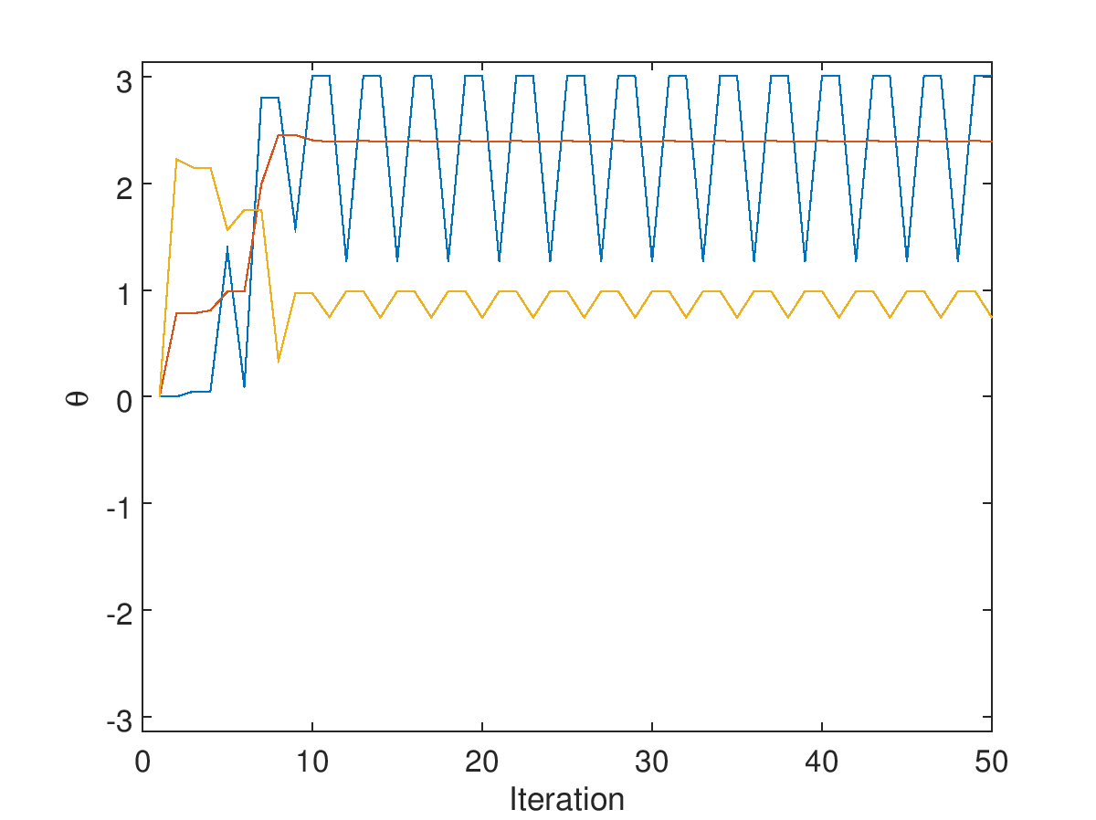
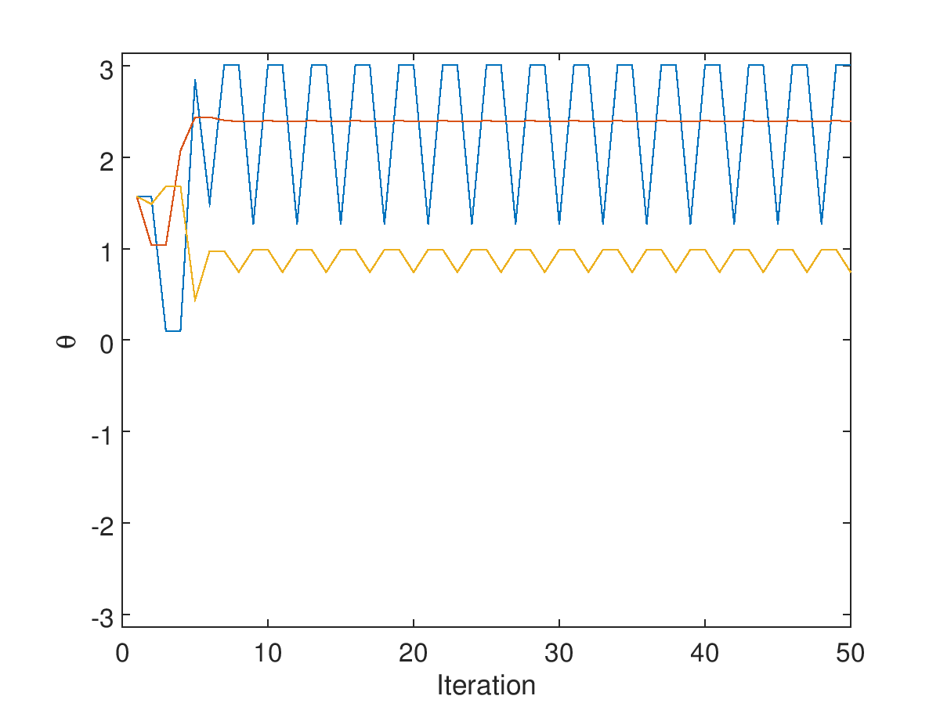
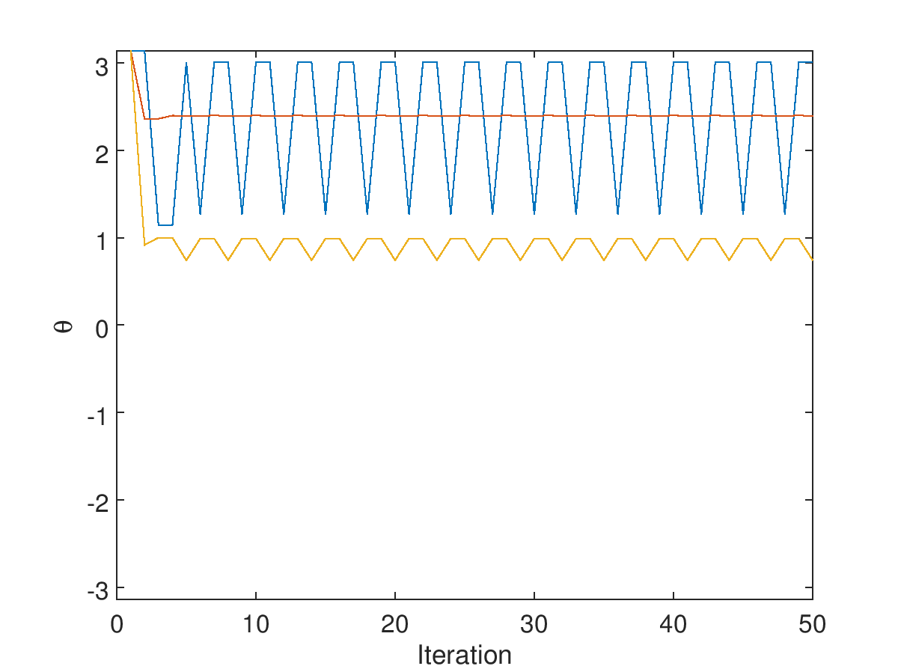




Consistency of $θ$
not consistent with geometry
$$k_{A}=k_{B}=k_{C}=1$$
$$θ_{0}=0$$
$$θ_{0}=π/2$$
$$θ_{0}=π$$

Slide 8
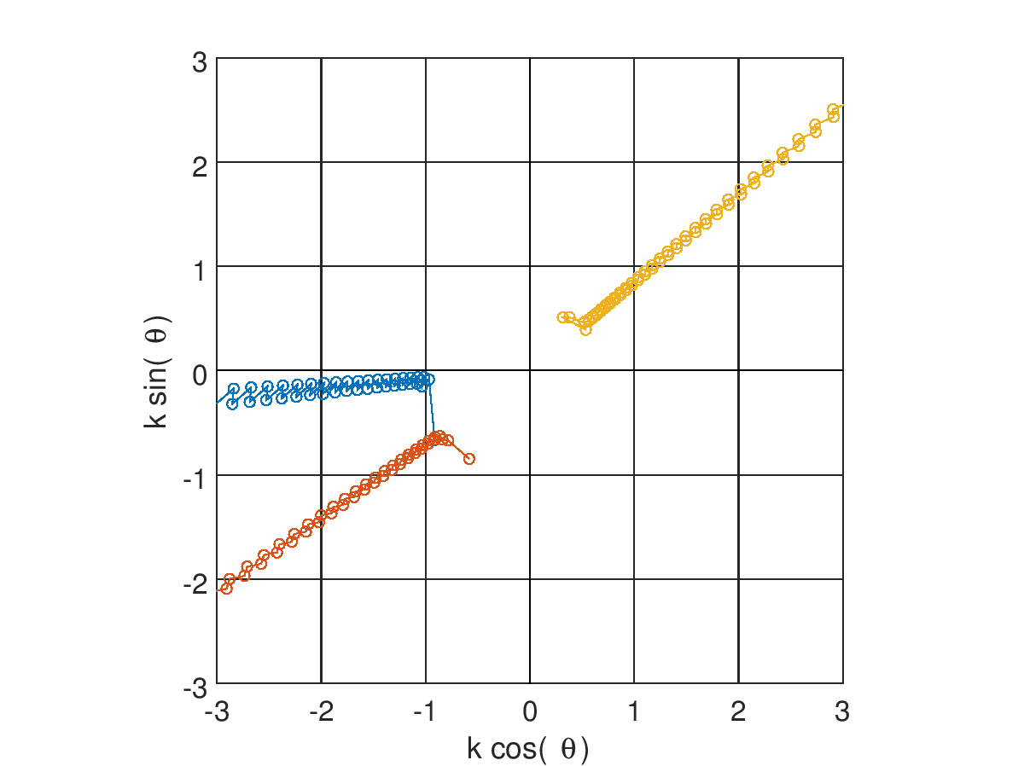
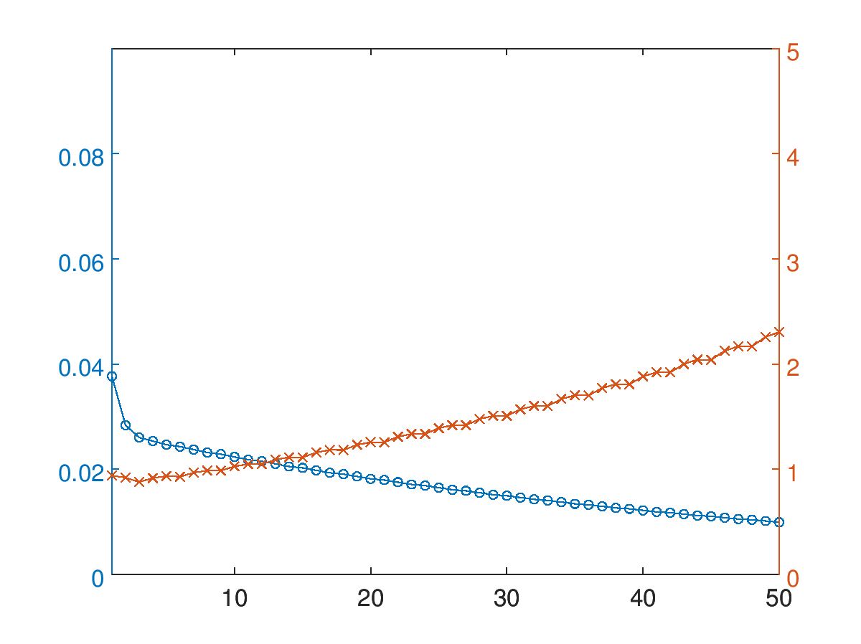
Colin3_posNomTiltNom2
Calibration parameters
IPA
IPB
IPC
resolution [μm]
scale = $\left\langle \left|k\right|\right\rangle$ [μm⁻¹]

Slide 9
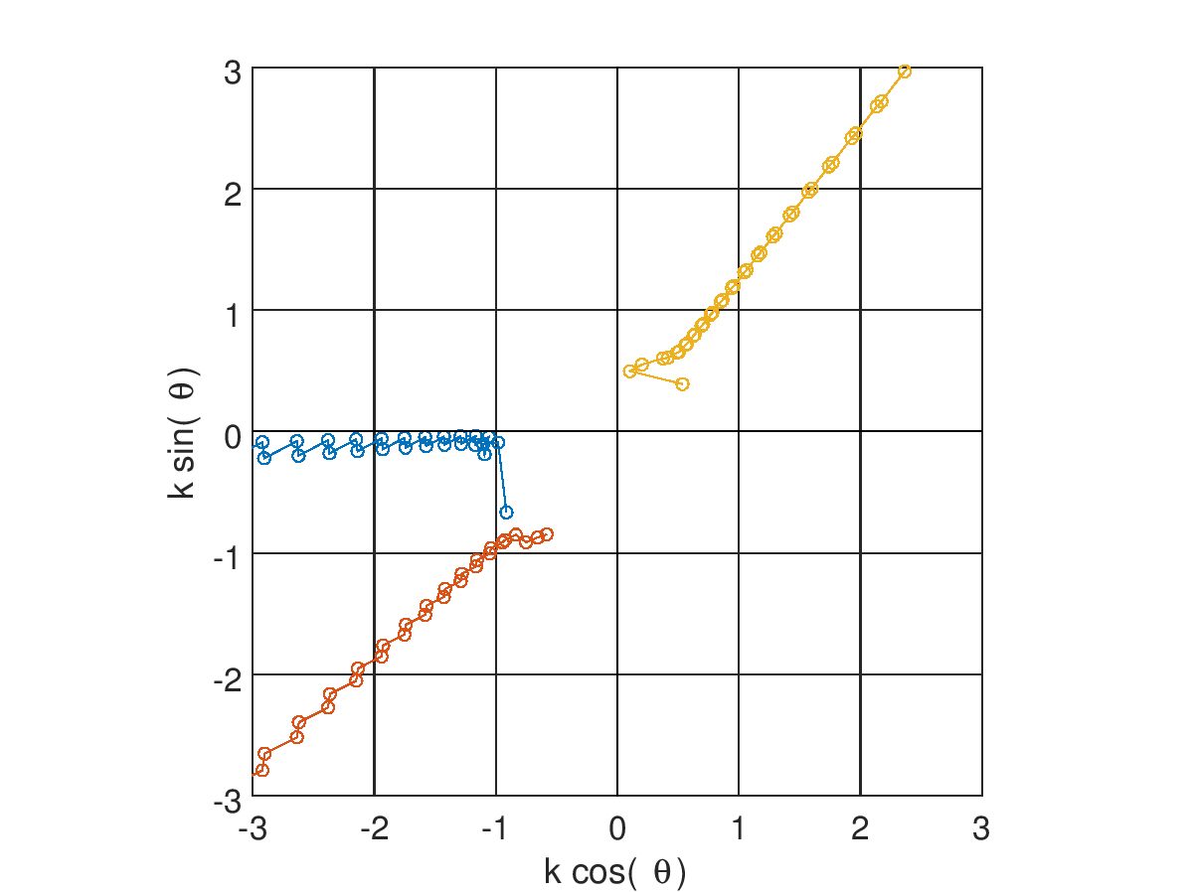
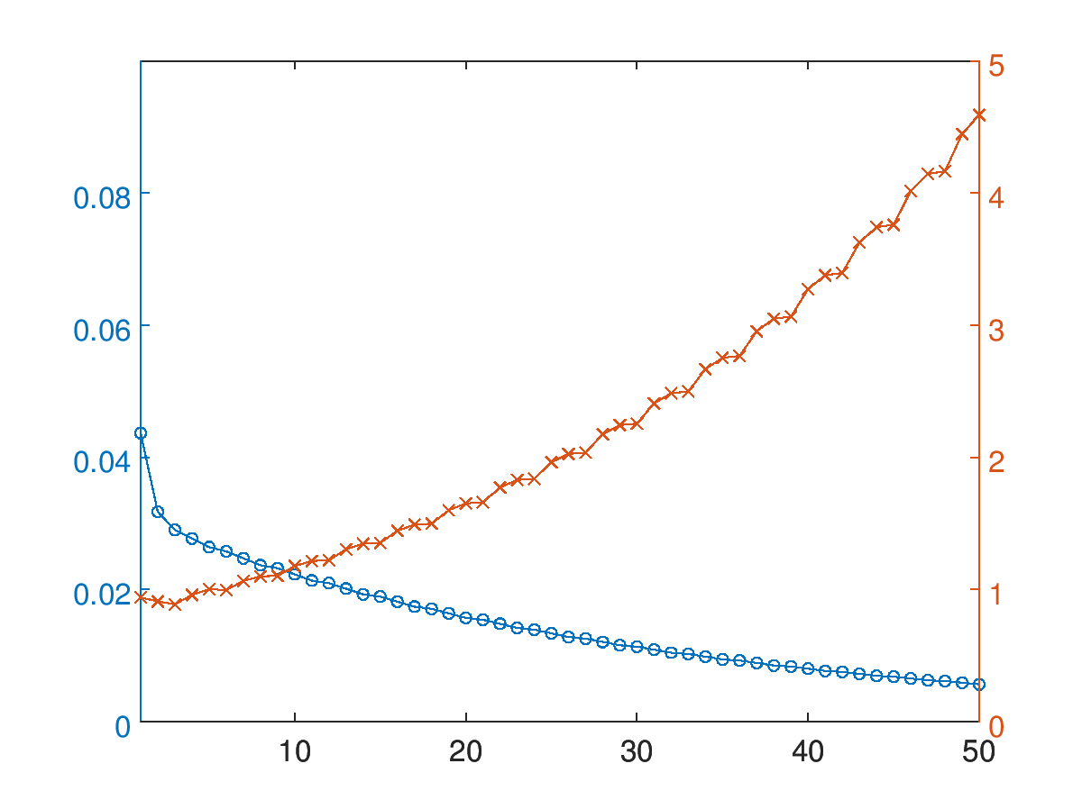
Colin3_posNomTiltNom3
Calibration parameters
IPA
IPB
IPC
resolution [μm]
scale = $\left\langle \left|k\right|\right\rangle$ [μm⁻¹]

Slide 10
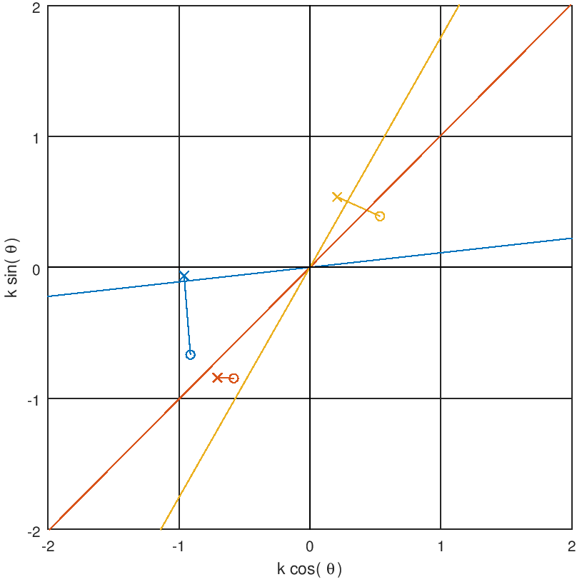
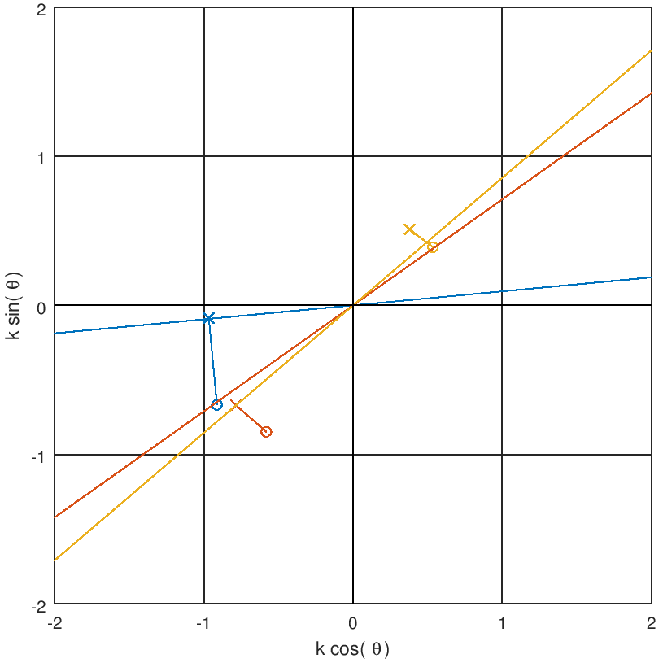
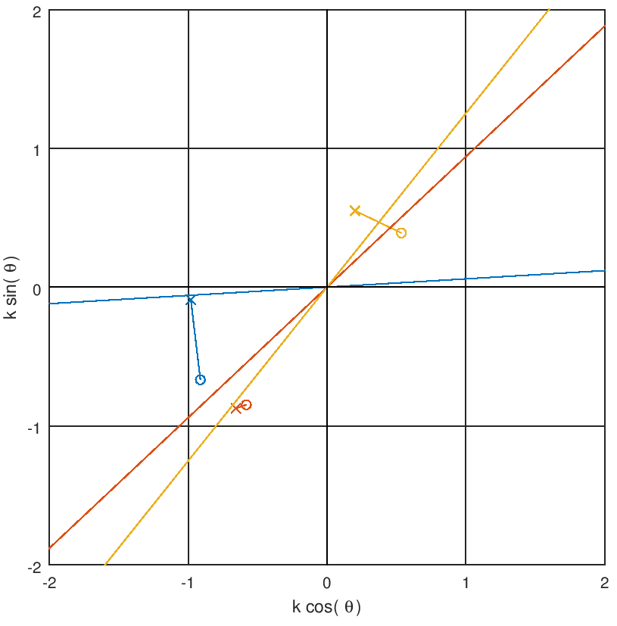

Calibration results
Run 1
Run 2
Run 3
initial calibration
IPA
after two iterations
IPB
converged value of $θ$
IPC

Slide 11
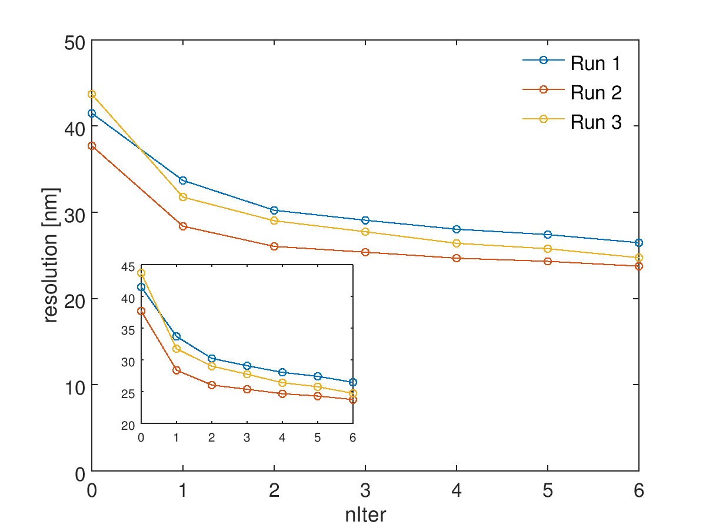
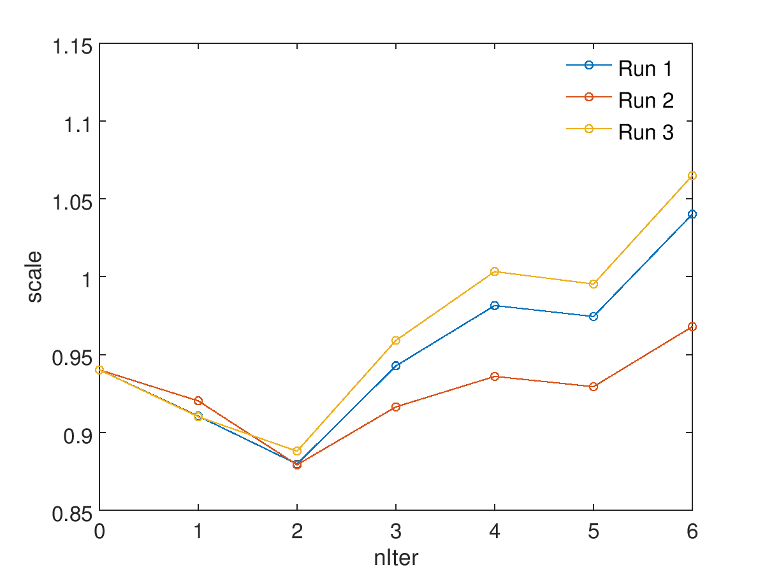
Resolution results

Slide 12
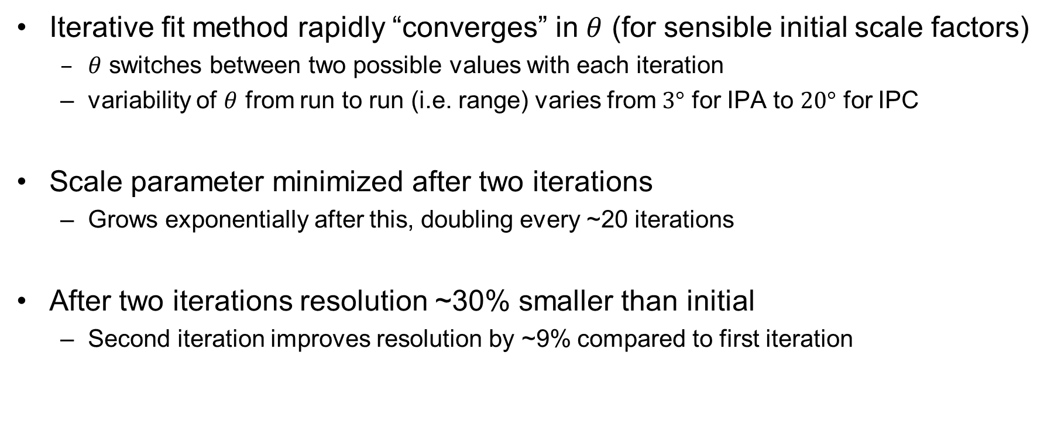
Conclusion
Iterative fit method rapidly “converges” in $θ$ (for sensible initial scale factors)
  $θ$ switches between two possible values with each iteration
  variability of $θ$ from run to run (i.e. range) varies from $3°$ for IPA to $20°$ for IPC
Scale parameter minimized after two iterations
  Grows exponentially after this, doubling every ~20 iterations
After two iterations resolution ~30% smaller than initial
  Second iteration improves resolution by ~9% compared to first iteration

