Slide 1
TPC mechanics
P.C., Julie Elman, Zhihong Sun

Slide 2
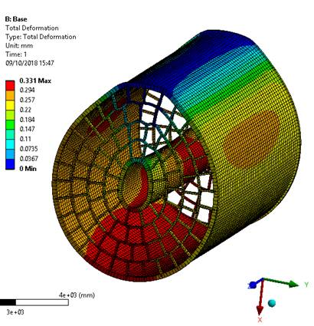
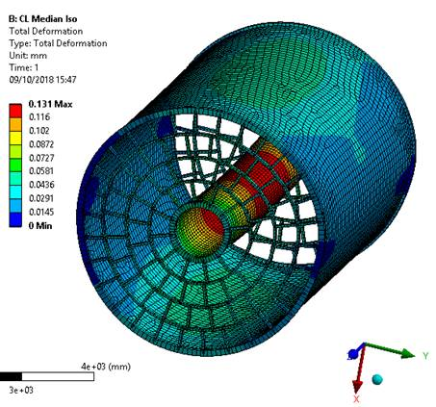
Proposal : support laterally
Gain a factor of 2.5 on the maximal scalar deformation

Slide 3
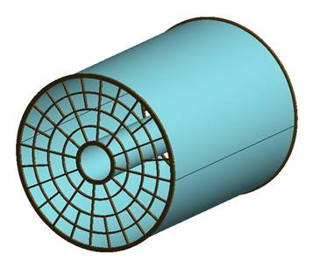
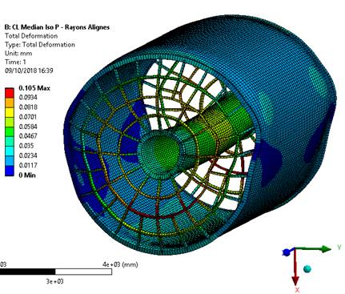
New proposals and recent deformation calculations
Radial enplate support : was not considered so far, because of fear for projective cracks. But maybe cracks can be avoided by staggering at the PCB level.
Gain another 30% on the maximal deformation : 105 µm

Slide 4
Progress on the WBS
Also preparing a mounting scheme. Will require a support tool (stiffeners) to hold the shape of the field cage to include the two endplates.
The modules cannot be mounted horizontally. So jigs have to be placed in place of the modules to stiffen the structure during the endplate mounting, and exchanged one by one with real modules (or supermodules) once the endplates are integrated with the cage.

Slide 5
LC-TPC beam test preparation Nov. 2018
Paul Colas

Slide 6
New Micromegas modules (4 in preparation)
Inverted grounding : mesh at ground and encapsulated resistive anode. Advantages (better shielding, less distortions, better voltage flexibility)
New modules status : 4 manufactured, 3 delivered and tested for connections and HV.
HV stability: one excellent, one medium (250 nA) current, one problematic, to be cleaned up.

