Slide 1
News from the preparation of the MM beam test
P. Colas
With D. Attié, T. Ogawa, M. Riallot, B. Tuchming,…

Slide 2
Status:
4 detectors received and tested for high voltage (all very stable) and connections (almost 100% good)
all backframes received
2 modules fully integrated and tested in cosmics : very low noise ~5.8 ADC / 4096. Charge spreading OK.
Multi-module backend tested
Next week : integrate and test in cosmics 2 more modules
Nov. 12 : pack and put detectors in the car. Serguei arrives in DESY
November 13 : we travel to DESY. Serguei prepares HV connections, triggers, supplies, etc…

Slide 3
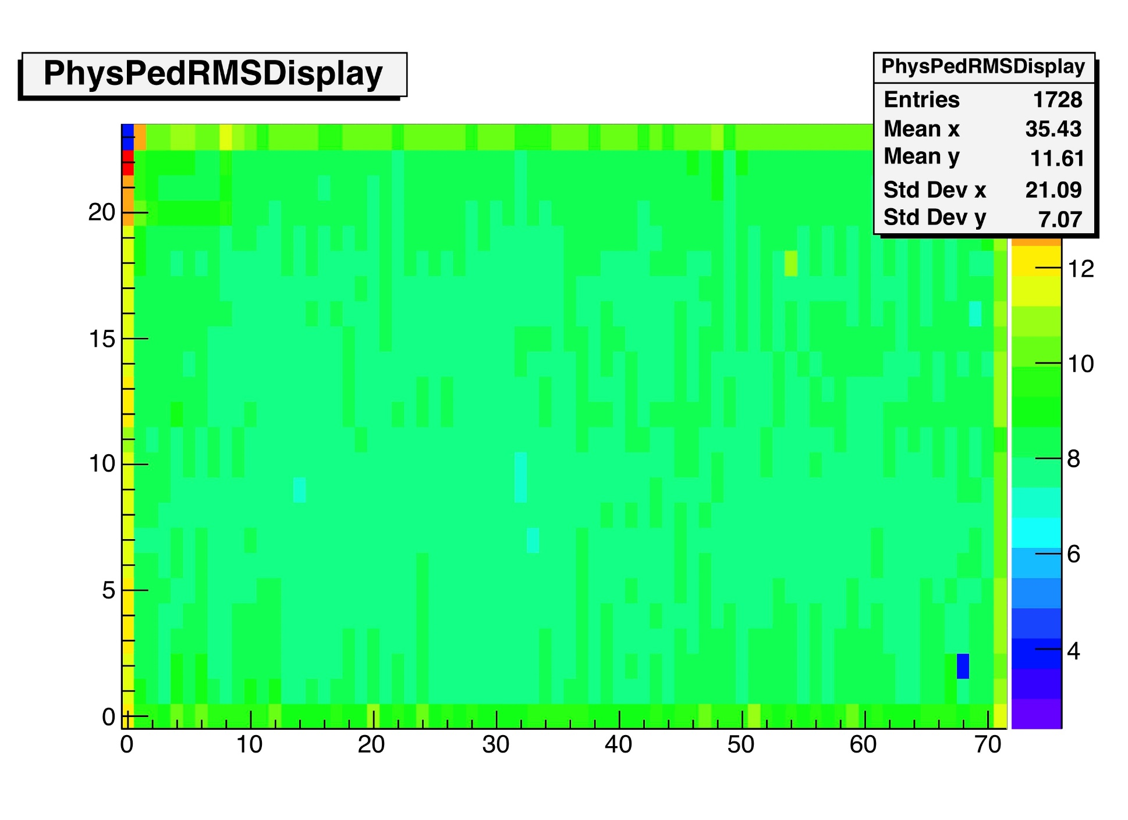

Slide 5
