Slide 1

Two-phase CO₂ cooling
P. Colas
Collaboration Meeting
CO2 has a large latent heat in vaporisation, a large specific heat, and a low viscosity
At 50 bar the two-phase fluid is at almost 10°C, avoiding condensation. At 65 bar it can take out heat at room temperature.
CO2 phase diagram

Slide 2
Thermal simulation of the TPC
Without power pulsing: 32 to 68 degree
With power pulsing: 26 to 29 degree after 7h

Slide 3
2-phase CO2 cooling
Pioneered at Nikhef and CERN, studied at KEK.
KEK bought a compressor (« TRACI ») for ILC and Belle II, installed at DESY Test Beam T24.
Tested in 2014 and 2015 with 7 independent modules with a distribution by a manifold (« clarinette »). 0.8 mm inner diameter pipe
This time (2018) tested with 4 modules in one loop. Very stable operation at 50 bar. 28-31°C on the FECS: continuous operation during 11 days without any incident.

Slide 4
First test in 2014 at Nikhef with a Micromegas module

Slide 5
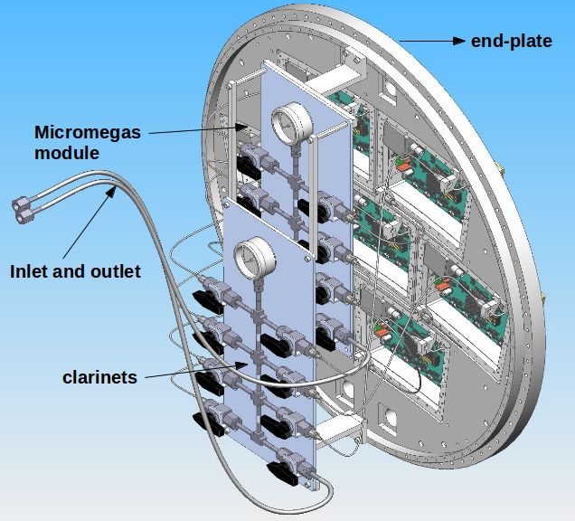
Tests in 2014 and 2015 at DESY Test beam with 7 Micromegas modules

Slide 6
Tests in 2014 and 2015 at DESY Test beam with 7 Micromegas modules

Slide 7
Tests in 2018 at DESY Test beam with 4 Micromegas modules in one loop

Slide 8
3-D printing (=additive manufacturing)
Very easy way to manufacture complicated structures, including shapes like an integrated serpentine where no drilling tool can be used
However every layer must be almost totally supported
Material availability still reduced, but evolving

Slide 9
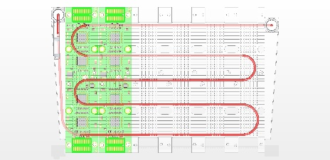

Slide 10
Monolithic cooling plate in 3D printing
Connectors to 2P CO2 loop
Fins for backup air-cooling
Being realized at Saclay within a R&D project on metallic additive manufacturing (COSTARD)
Could be tested in a future beam test
M. Riallot, Y. Jan
Integrated serpentine

Slide 11
Conclusion
2-phase CO2 cooling is a mature technology suited for ILD TPC modules. It has been demonstrated to be very stable and efficient in Micromegas beam tests.
3-D printing might help to optimize the performance and simplify the manufacturing of a cooling plate.
On the longer term, other options are under study (channels in the bulk of the PCB, microchannels, new materials).

