Slide 1


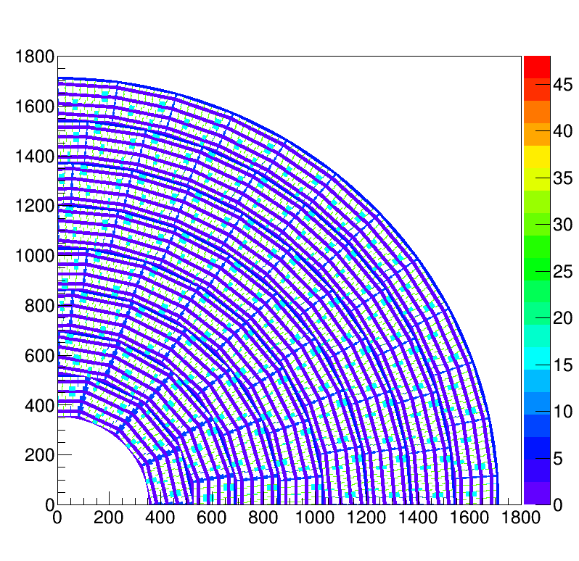
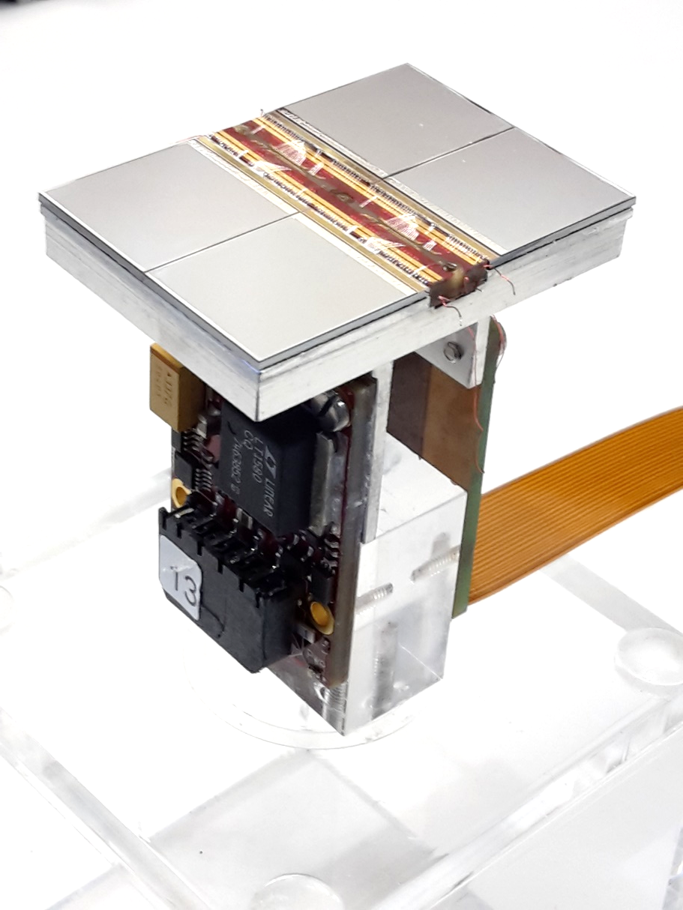
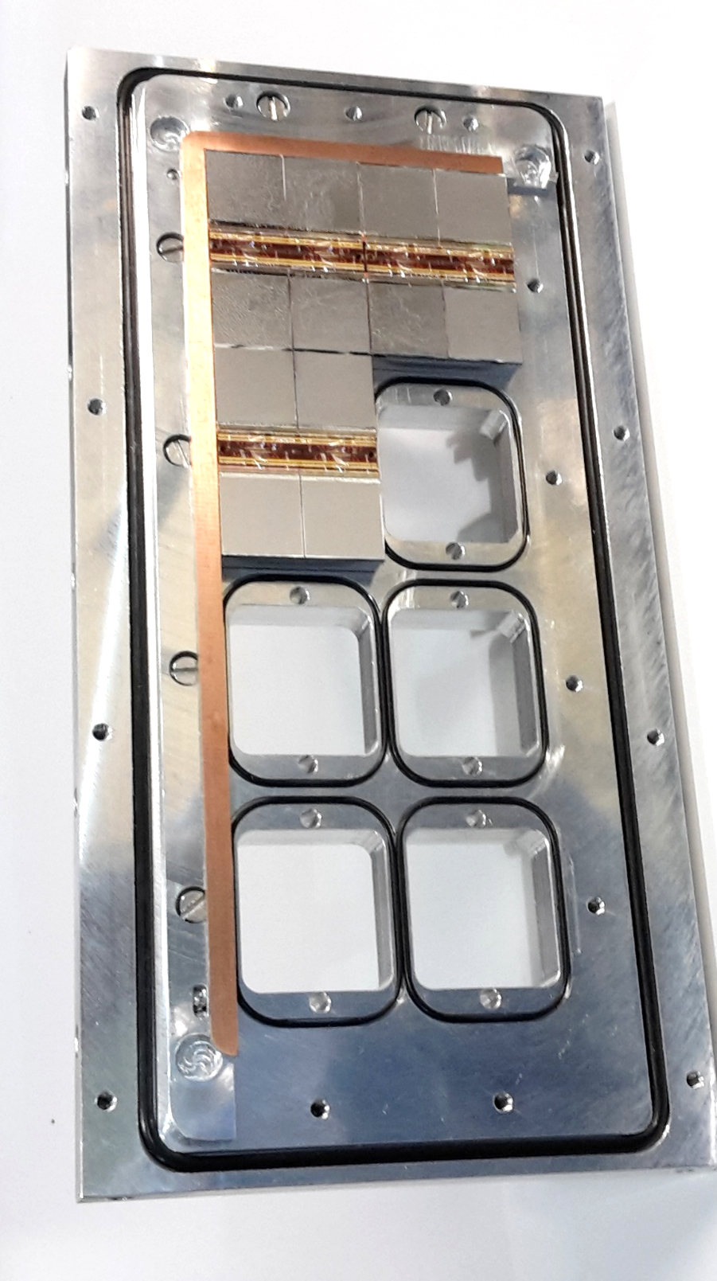
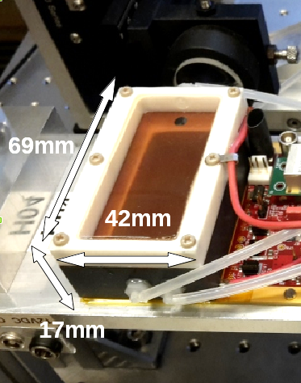


Pixel TPC analysis
Yevgen Bilevych, Klaus Desch, Jean-Paul Fransen, Harry van der Graaf, Markus Gruber, Fred Hartjes, Bas van der Heijden, Kevin Heijhof, Charles Ietswaard, Dimitri John, Jochen Kaminski, Peter Kluit, Naomi van der Kolk, Auke Korporaal, Cornelis Ligtenberg, Oscar van Petten, Gerhard Raven, Joop Rövekamp, Lucian Scharenberg, Tobias Schiffer, Sebastian Schmidt and Jan Timmermans
LCTPC Collaboration meeting @ DESY 9 – 11 january 2019

Slide 2
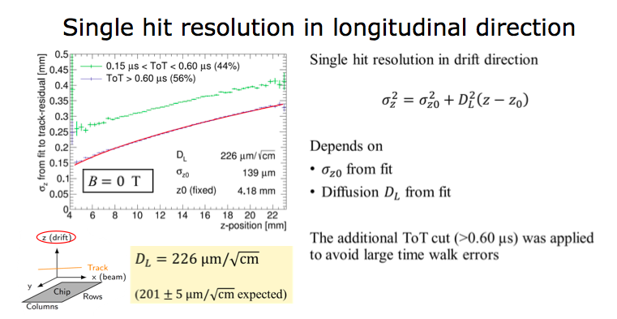
Pixel TPC performance topics
I z and timing resolution in ILD
  Second analysis meeting https://agenda.linearcollider.org/event/7950/ on z resolution and timing
II dEdx using simulation and data
  First analysis meeting https://agenda.linearcollider.org/event/7909/ on dEdx
  III Results for the two track resolution based on the 2019 test beam
z and timing resolution in ILD
Starting point is the test beam result
ILD simulation uses:
σ_{z0} = 168 μm D_{L}=205 μm/√cm

Slide 3
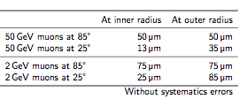
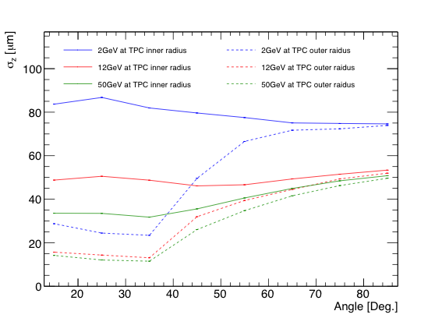
Pixel TPC performance topics: z and timing resolution
z resolution in ILD
The z resolution increases at low momenta due to multiple scattering
The z resolution of the pixel readout
lies between 13 μm and 85 μm
Forward ………………… Barrel…….
Polar angle (deg)

Slide 4
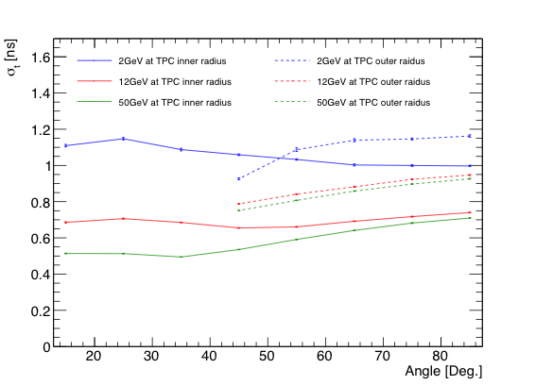
Pixel TPC performance topics: z and timing resolution
time resolution in ILD
The time can measured by comparing the z position of the track, with the position in the SIT or SET.
Assuming uncertainties of 16 μm from the drift velocity, 35 μm from the SIT, and 50 μm from the SET
The Silicon Internal Tracker (SIT) and the Silicon External Tracker (SET) will be build from respectively 2 and 1 layers of the same double strip planes with a σ_{z} = 50 μm resolution. So the SIT and SET resolution is 50/√2 = 35 μm and 50 μm respectively.
The time stamping resolution is estimated to range from 0.65 to 1.2 ns
Polar angle (deg)

Slide 5
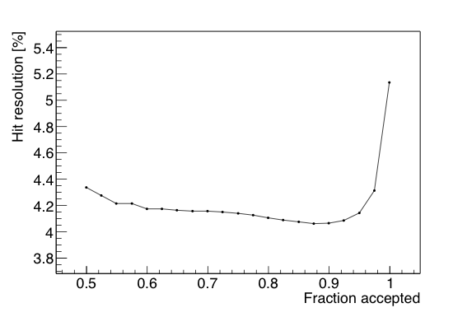
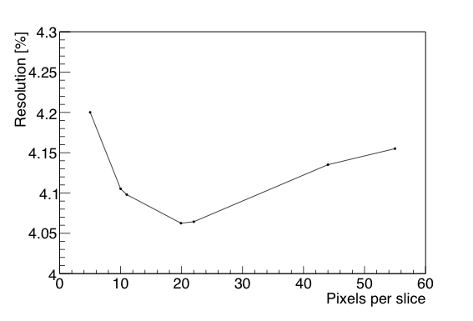
Pixel TPC performance topics: dEdx data and MC
In order to model the test beam data of 2017 (nr of hits), the energy loss model in the Geant4 simulation G4UniversalFluctuation was tuned. Kees Ligtenberg will describe this in his talk on the ILD pixel TPC simulation.
dE/dx with truncated mean for data
  dE/dx is estimated by a truncated sum of electrons for 1 m track (summing over 83 single chips)
  Slices of 20 pixels (∼1.1 mm) as suggested by M. Lupberger. Reject the top 10% of slices with the most electrons. The achieved resolution is 4.1% for 1 m track.

Slide 6
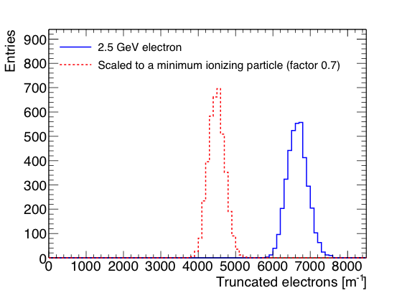
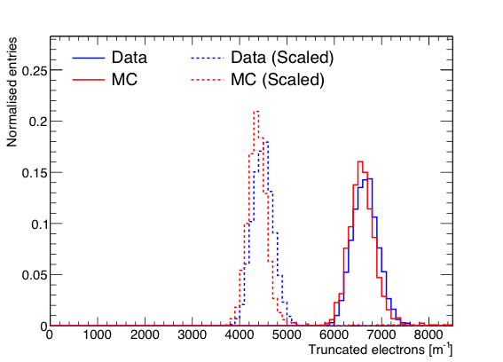
Pixel TPC performance topics: dEdx data and MC
dE/dx with truncated mean for a MIP
  All distances along track are scaled by 1/0.7 to get an estimation for the dEdx of a MIP
  Resolution is 4.1% for a 2.5 GeV electron and 4.9% for a MIP
Separation defined as S = (N_{e} − N_{MIP})/σ_{e}
So we achieve a 8σ MIP-e separation for a 1 meter track (MC 7.1σ)
The data is reasonably well modeled by the tuned G4 MC
Published Data
https://doi.org/10.1016/j.nima.2018.08.012

Slide 7
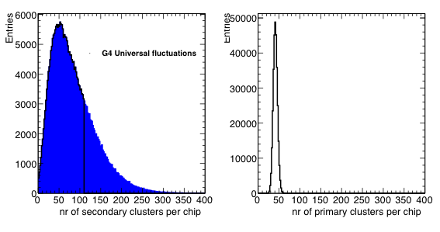
Pixel TPC performance topics: dEdx data and MC
dE/dx with cluster counting
  Cluster counting is possible in a pixel TPC. It is an alternative approach to dE/dx; it reduces the Landau fluctuations by separating primary from secondary clusters
From Fischler measurements in Ar and Geant4 simulation: 3400 clusters/m
Ultimate resolution would be 1.7% or a (2.5 GeV electron)-MIP separation of 17σ

Slide 8
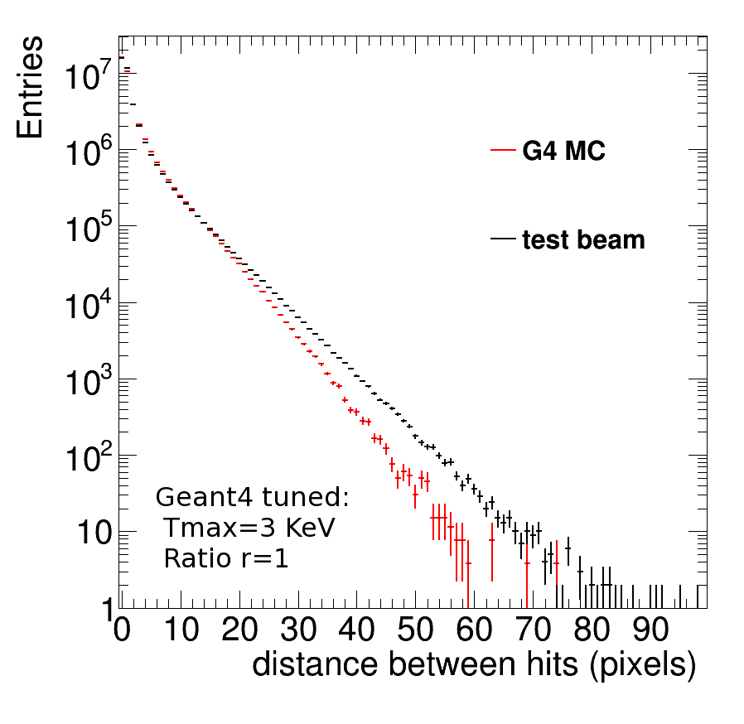
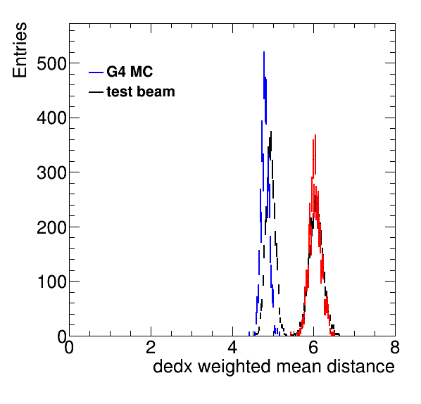
Pixel TPC performance topics: dEdx data and MC
dE/dx from the minimum distance between the hits
  The lowest bins fluctuate more than a Poisson distribution
  Scale factor of fluctuations (wrt √N): (5.79, 2.57, 1.30, 1.08, 1.03, 1, 1, ..)
  Use scale of fluctuations as weights e.g. for distance of 1 pixel, weight is 1/2.57² = 0.15
Resolution 2.7% (MC 2.5%)
Separation (2.5 GeV electron)-MIP is 9.8σ (MC 12.9σ)

Slide 9
Pixel TPC performance topics: dEdx data and MC
dE/dx with truncated mean for a 1 m long track:
  A resolution of 4.1% for a 2.5 GeV electron is found
  A 8σ electron-MIP separation is achieved (MC 7.1σ)
dEdx from the distance between hits for a 1 m long track:
  A resolution of 2.7% (MC 2.5%) for a 2.5 GeV electron id found
A 9.8σ electron-MIP separation is achieved (MC 12.9σ)
Excellent performance for dEdx has been achieved.
In https://agenda.linearcollider.org/event/7909/ more algorithms are discussed

Slide 10
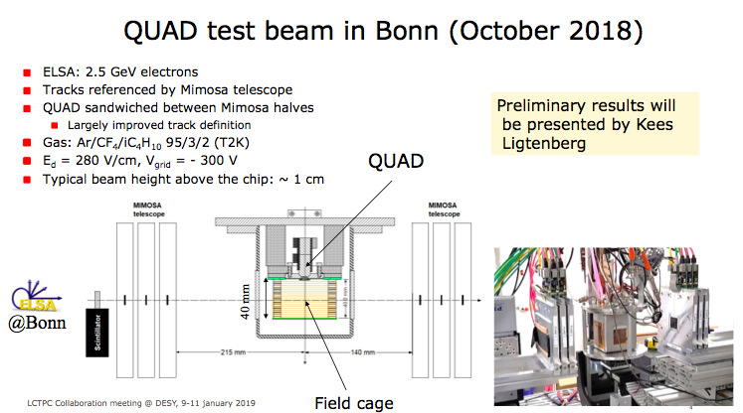
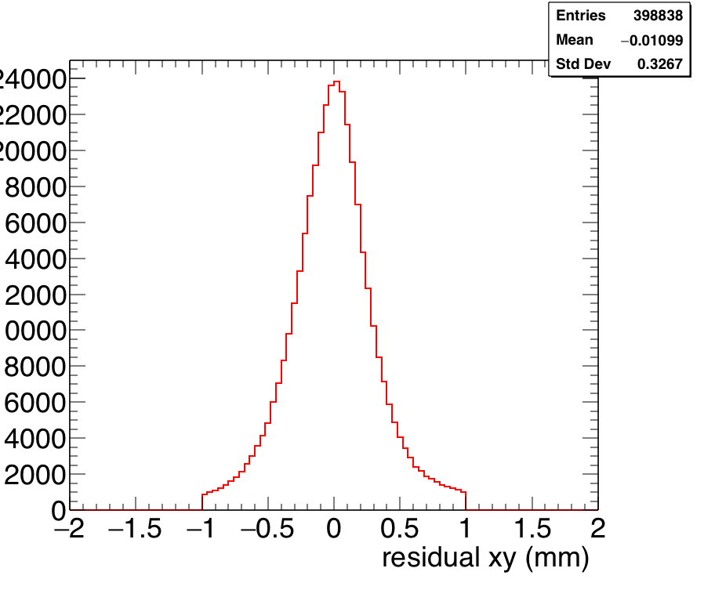
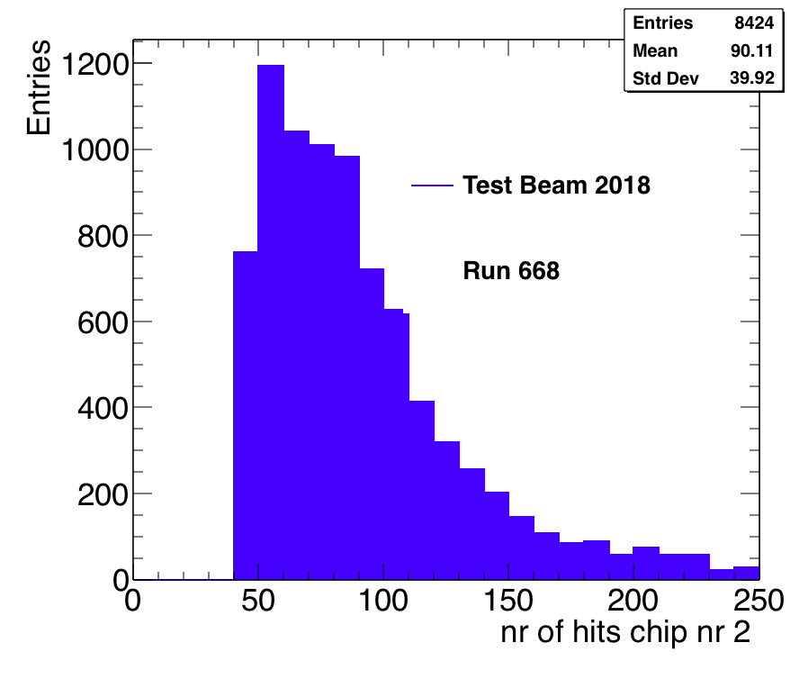
Pixel TPC performance topics: two track resolution
Possible with the 2018 test beam: Need to select well defined clean tracks in the telescope and mix the tracks (superimposing the pixel hits)
Hit resolution xy pixels rms 330 μm in telescope better than 5 μm

Slide 11
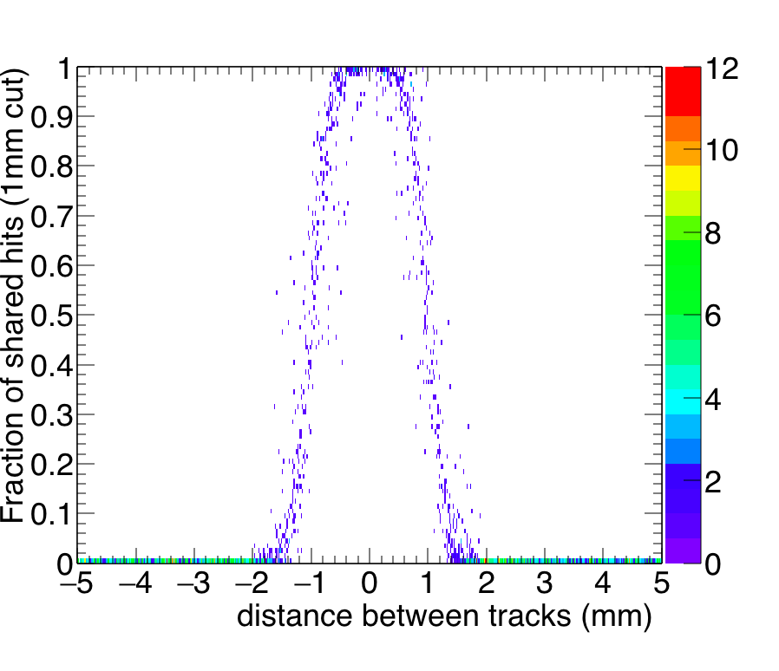
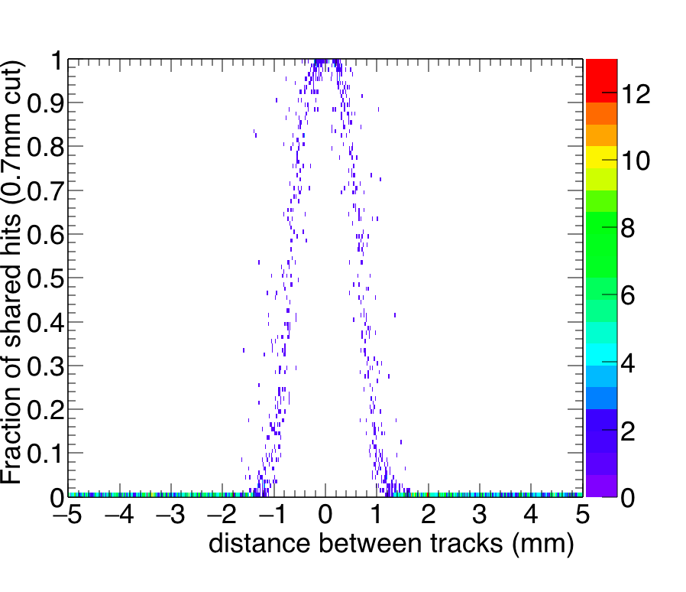
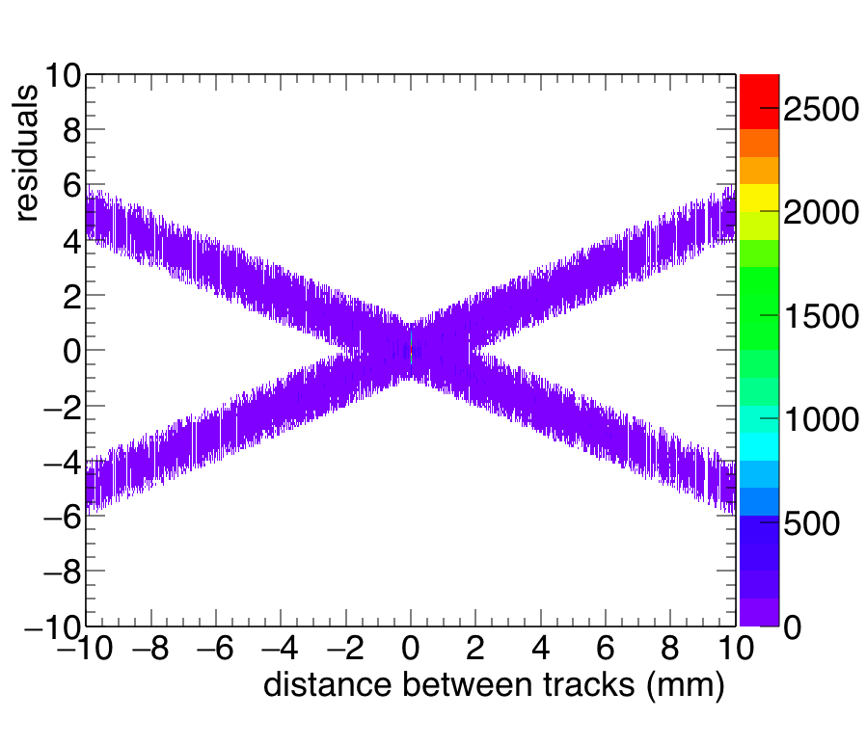
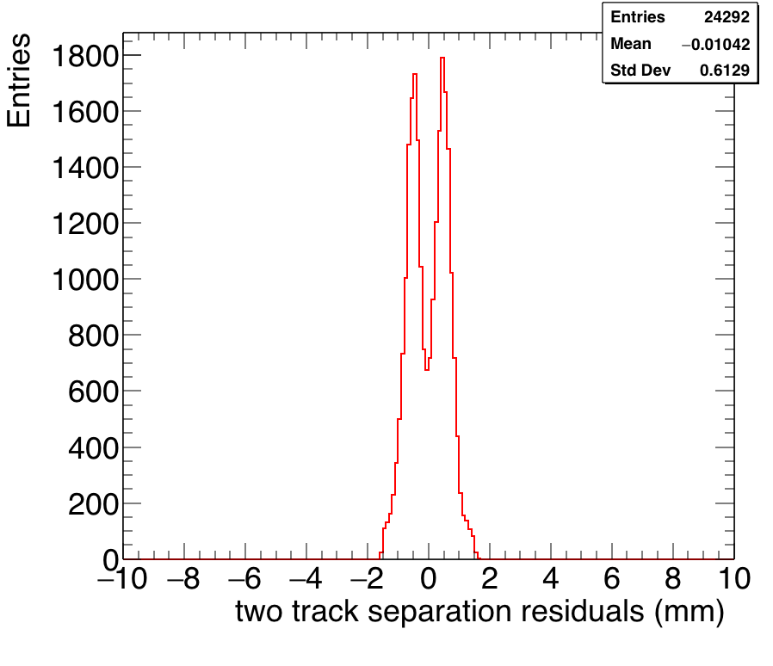
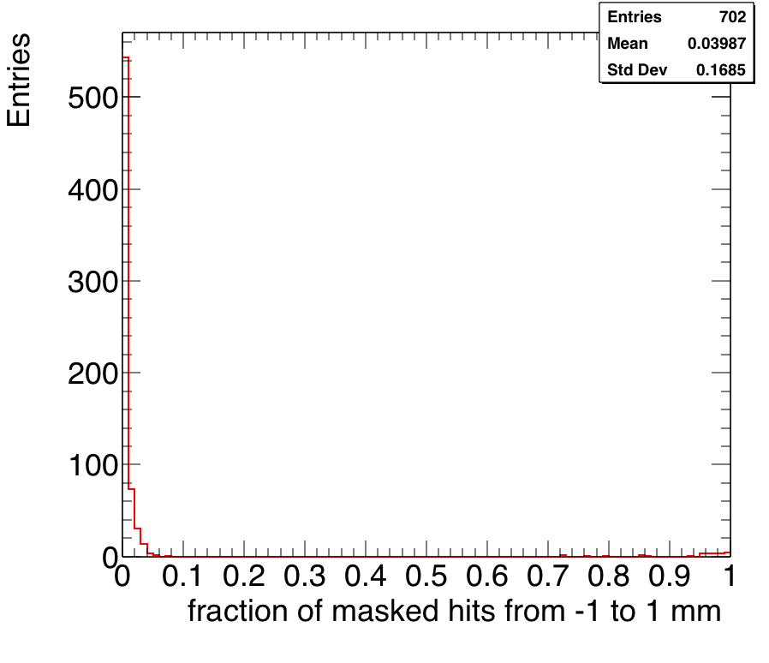
Pixel TPC performance topics: two track resolution
Mixing of two events where the track is fitted through all hits and residuals are recalculated. E.g. at a distance of 1 mm between the residuals look like right below:
One can now calculate the fraction of shared hits within a cut of 1 and 0.7 mm
Masked hits in the core is only 3%

Slide 12
Pixel TPC performance topics: two track resolution
A two track separation of about 0.7 mm can be achieved assuming a 0.33 mm single hit resolution (z = 1 cm).
For a full TPC in ILD with D_{T} = 25 μm/√cm. Assuming 1 m drift distance, one expects 0.5 mm track separation. For a part of the track with drift distances up to a few cm drift one expects to reach 0.15 mm (3 pixels).
There is another possibility for tracks at a distance of less than 0.7 mm. These tracks will have a mean dEdx or number of associated pixel hits of 1.97 times larger (only 3% lost due to the masked hits).
For a full ILD TPC with a (pixel) resolution of dEdx of better than 4% can be achieved. Therefore we know on an track by track basis (by more than 20 σ) that there are two tracks (and not one).
This leaves the possibility to reassign the TPC pixel hits to different tracks, using a more sophisticated track fitting model (such as the gaussian sum filter), e.g. in combination with the ILD pixel detector.

