Slide 1
Micromegas 2018 beam test
LCTPC phone meeting 15/11
Commissioning: D. Attié, P. Colas, S. Ganjour, T. Ogawa, M. Riallot
Data taking: the same, plus:
X. Coppolani, S. Emery, Huirong Qi, J. Timmermans, M. Titov
Strong support from DESY:
R. Diener and O. Schäfer

Slide 2
Goals of the test :
Use LP2 endplate
Use 2PCO2, test 1-loop operation
Test new scheme : encapsulated anode, with grounded mesh. Proved to work already in a cosmic test at Saclay and in a T2K upgrade test at CERN.
Use better mechanics for pad connection : 99.9% of good connections
This time make detailed studies to confirm the expected advantages of this new scheme : less noise, less distortions (mesh at same voltage as frame), better flexibility (gas gain of each module can be tuned independently)

Slide 3
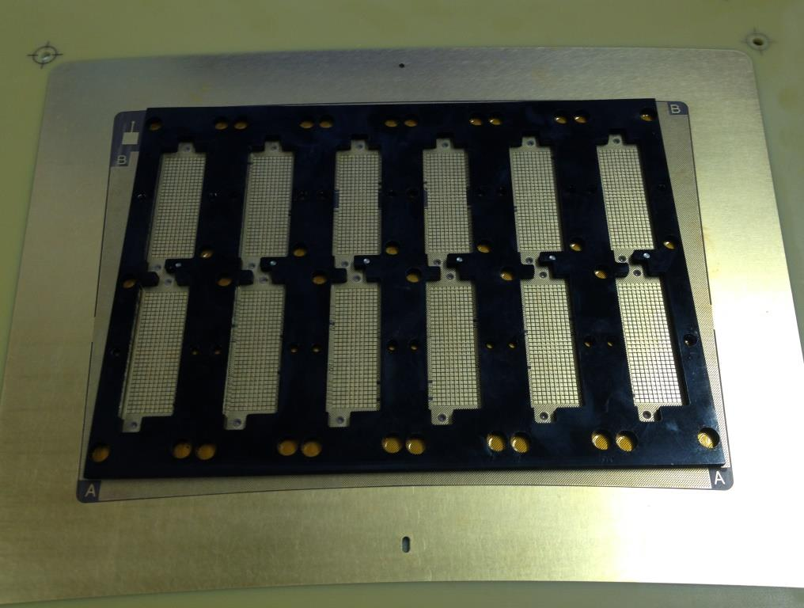

Slide 5
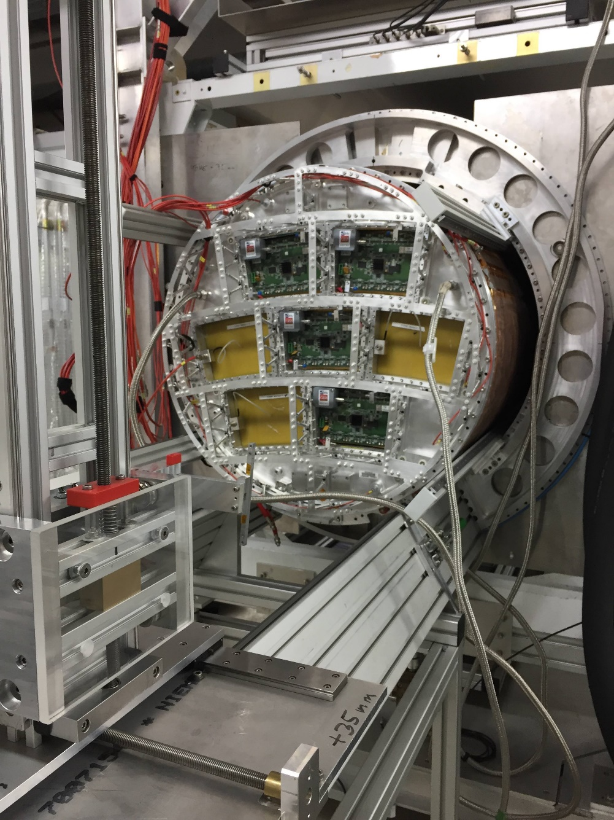
Status
Arrival on November 13th evening
Re-test all modules on the table
Test Field cage HV on November 14
Mount 4 modules on November 14
Leak hunting on the new endplate this morning
Install LV, fibers, etc…
We look forward to take data until Nov. 28 morning
E4 E3
E1
E2

