Slide 1
Mini-workshop on ILC Infrastructure and CFS for Physics & Detectors
2018/12/21
Yasuhiro Sugimoto

Slide 2
History
Series of mini-workshops
  2015/8/31-9/1
  2016/3/15-16
  2016/9/30
  2017/5/16
  2017/9/28-29 (excursion to Kannagawa power plant)
  2018/2/23
  2018/11/29 → today’s report
  2019/2/28
All held at KEK
Supported by E-JADE program

Slide 3
Agenda of WS in 2018 Nov.
News from Japan: Shinichiro Michizono
CFS schedule and risks: Nobuhiro Terunuma
European developments: Karsten Buesser
Update on seismic isolation: Tomoyuki Sanuki
Update on AHCAL earthquake simulation studies: Felix Sefkow
(Fire drill)
Gantry crane considerations: Yasuhiro Sugimoto
Arguments for surface versus underground assembly: Karsten Buesser
ILD utilities: Yasuhiro Sugimoto
Update of coil design: Yasuhiro Makida

Slide 4
News from Japan

Slide 5
CFS schedule and risks
Terunuma-san explained CFS schedule in preparation phase and CFS risks discussed at SCJ committee

Slide 6
CFS schedule and risks
We need a ground water reservoir near the detector hall

Slide 7
European developments
Karsten reported on update on LC activities in Europe
  European strategy
  European preparation plan for ILC
  EU-funded projects
    AIDA2020: extended until 4/2020
    E-JADE under Horizon2020: expires in this year

Slide 8
Update on seismic isolation
Sanuki-san reported on the study of seismic isolation of detectors
Combination of rubber bearing + rigid sliding bearing + oil damper shows good properties

Slide 9
Update on AHCAL earthquake simulation studies
New design of AHCAL structure and its properties were presented by Felix
Rigidity is improved, and the maximum displacement is reduced to <2mm

Slide 10
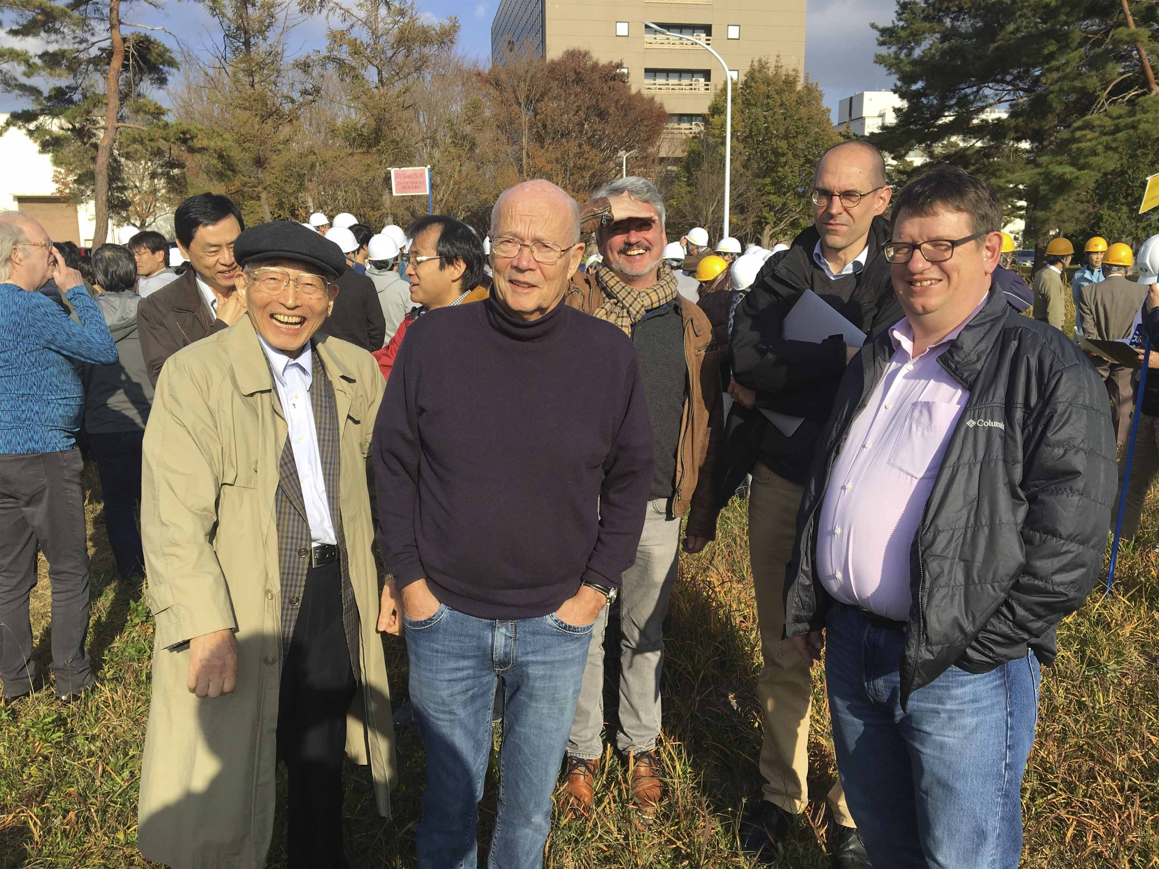
Fire drill

Slide 11
Gantry crane considerations
Some of SCJ sub-committee members expressed doubt about feasibility of the >4000t gantry crane for detector lowering
Y.S. listed up risks of >4000t GC to be addressed

Slide 12
Gantry crane considerations

Slide 13
Arguments for surface versus underground assembly
Karsten discussed pros and cons of surface assembly and underground assembly

Slide 14
Arguments for surface versus underground assembly

Slide 15
ILD utilities
Second round survey of requirements for detector utility has been made
Unfortunately, only a few sub-detector groups has responded so far
Survey of electric power and cooling

Slide 16
ILD utilities
Survey of utility space

Slide 17
Update of coil design
Design study of ILD solenoid with Hitach and Toshiba has been reported by Makida-san

Slide 18
Update of coil design
Maximum stress in the coil ~ 105 MPa < 150 MPa (CMS criteria)

